Slide 1
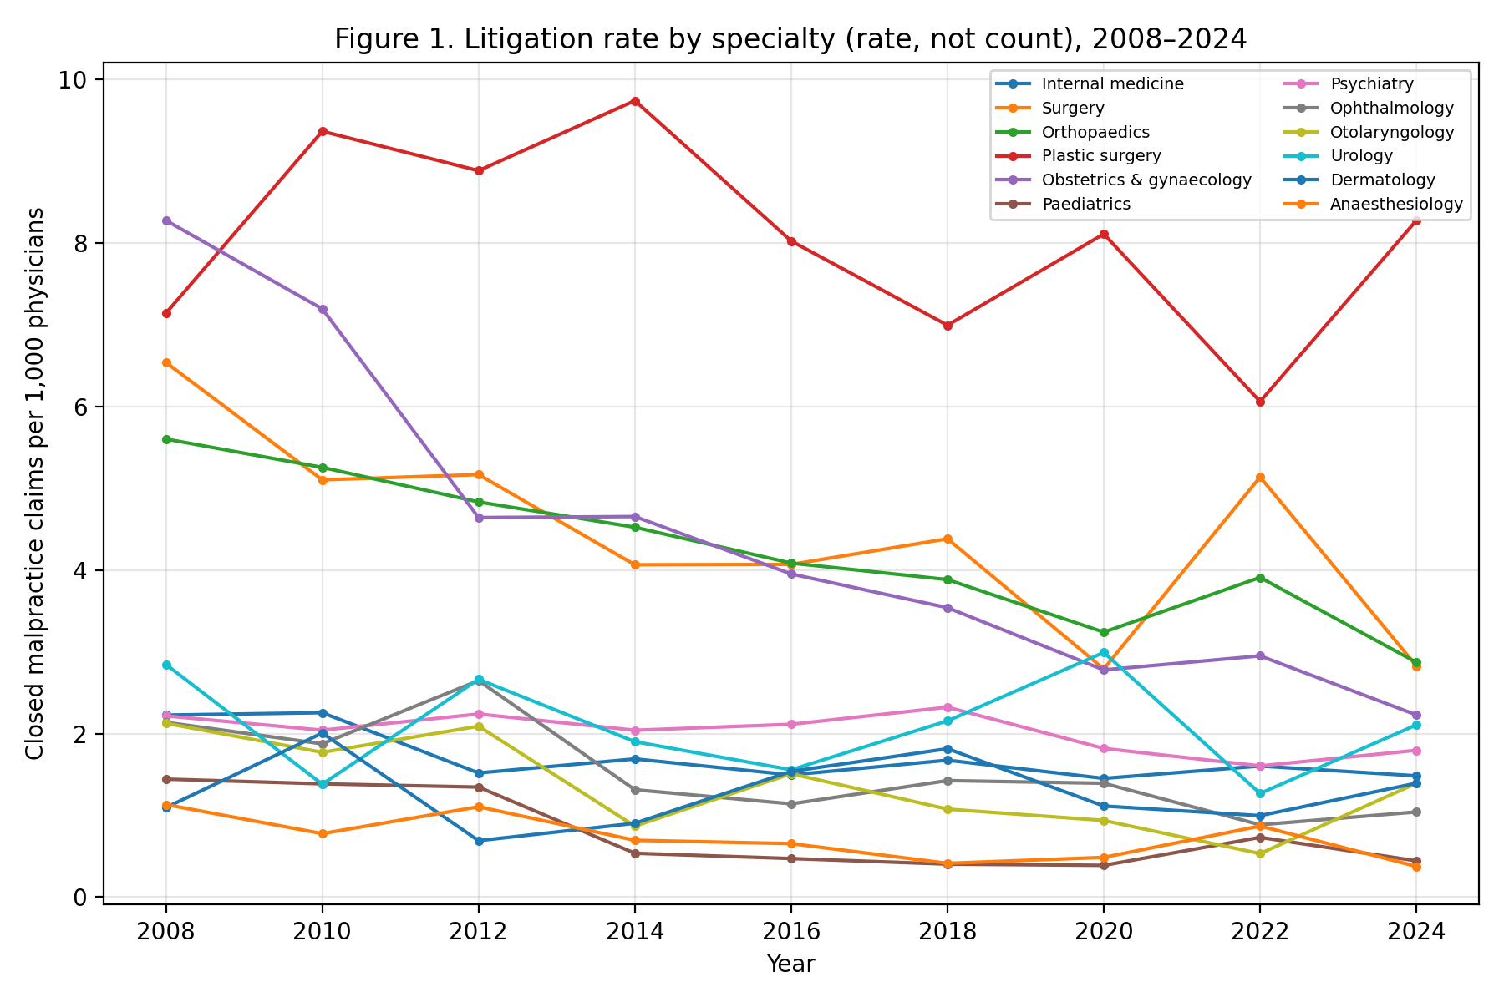
Supplementary Figure 1
Closed malpractice claims per 1,000 physicians by specialty, 2008-2024 (rates, not counts).

Slide 2
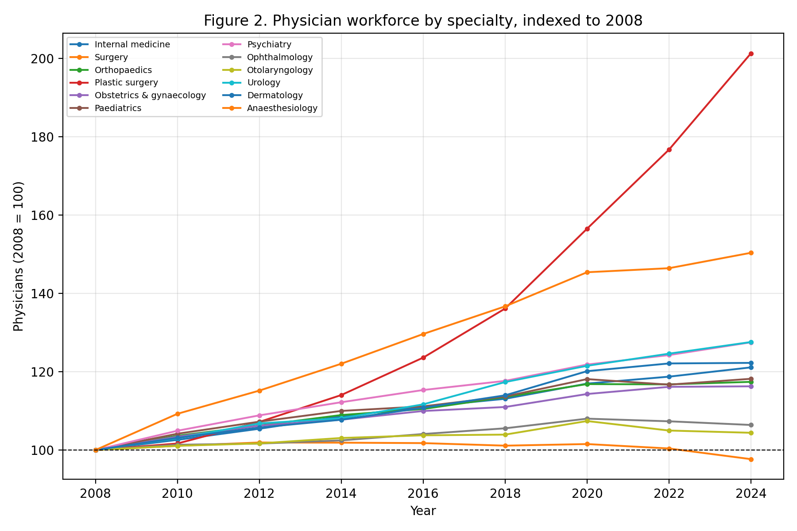
Supplementary Figure 2
Physician workforce by specialty, indexed to 2008 (=100).

