Slide 1
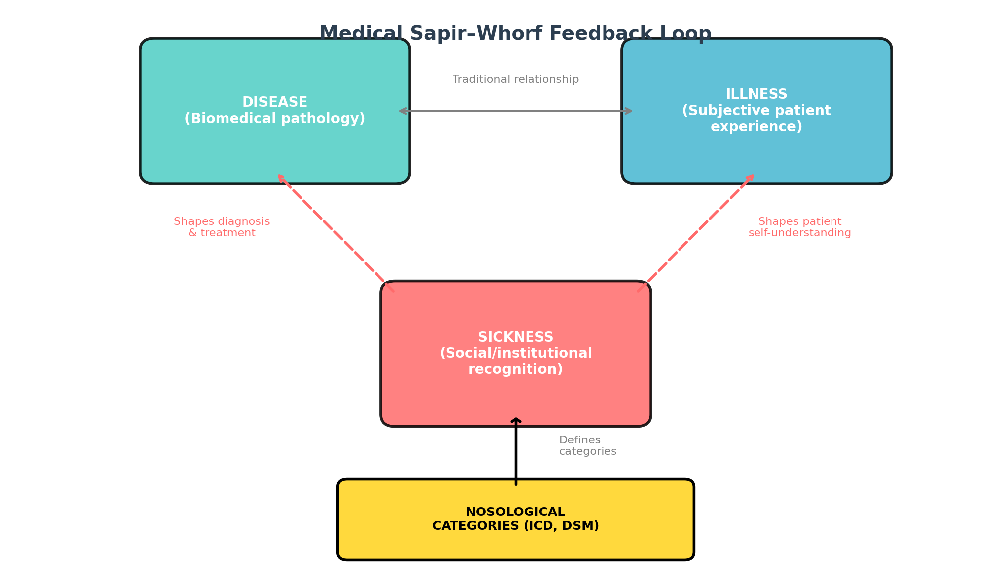
Figure 1. Medical Sapir–Whorf Feedback Loop
Nosological categories operate at the sickness level, shaping institutional responses. These changes feed back to alter disease recognition and illness experience, creating a recursive loop.

Slide 2
Table 1. Clinical Responses to Work-Related CV Events: Japan vs. Countries Without Karoshi
Domain | Japan (karoshi concept present) | Countries without equivalent concept
Diagnostic pathway | Work history systematically assessed; occupational medicine consultation | Standard CVA/MI workup; working conditions rarely documented
Coding | Specific codes link CV event to overwork | Standard ICD CV codes; no work linkage
Compensation | Dedicated workers’ compensation with legal criteria (>80 h/week) | General disability insurance; no work-specific CV pathway
Epidemiological tracking | National karoshi statistics since 1987 | No systematic tracking of work-related CV mortality
Prevention infrastructure | Mandatory overtime limits, annual health checks, karoshi hotline | General OH regulations; no targeted CV prevention
Research funding | Dedicated karoshi research; large epidemiological datasets | Work-related CVD as subtopic of occupational health
Table 1. Comparison illustrating the infrastructure creation mechanism.

Slide 3
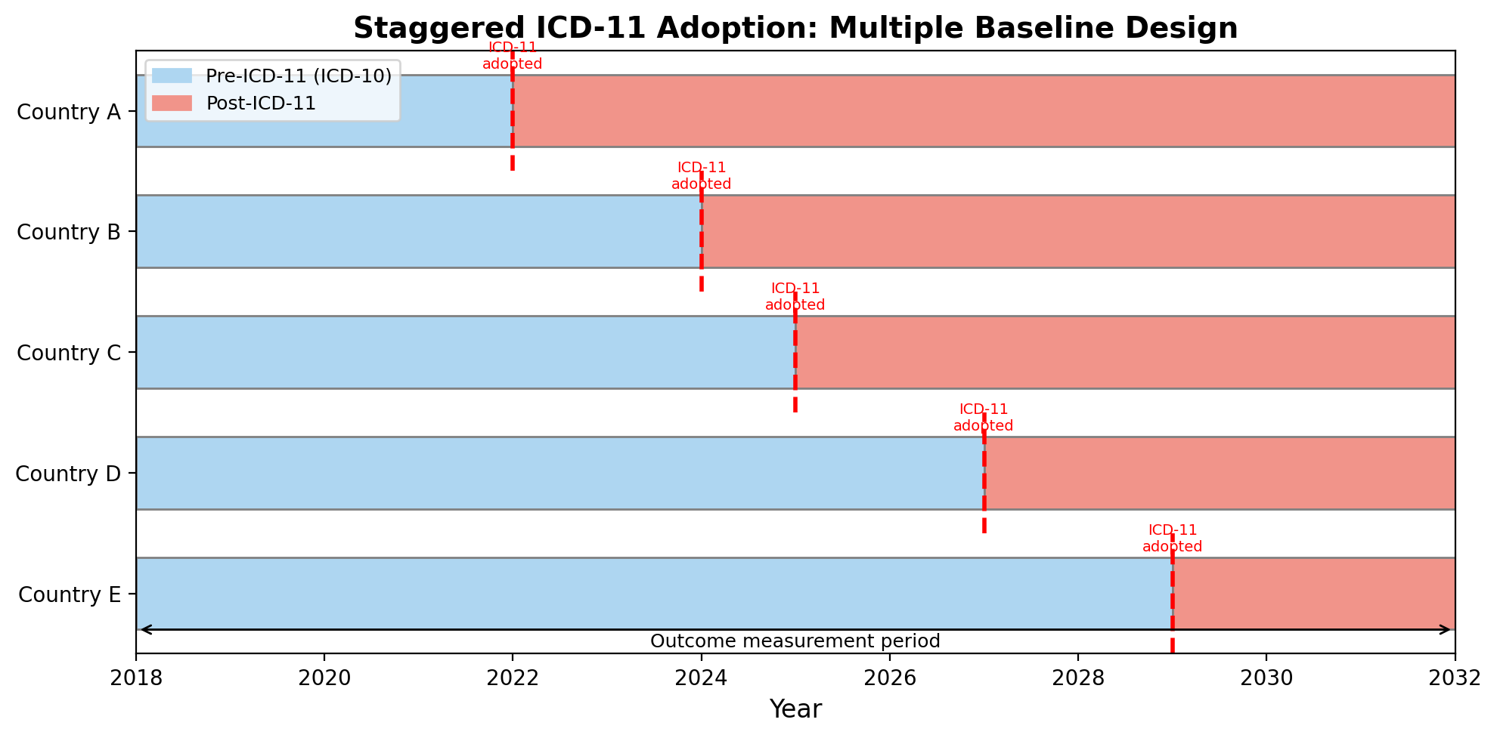
Figure 2. Proposed Interrupted Time-Series Study Design
Staggered ICD-11 adoption across countries enables a multiple baseline design, strengthening causal inference about classification changes on clinical practice.

Slide 4
Table 2. Key ICD-11 Structural Changes for Sapir–Whorf Analysis
ICD-11 change | What can be tested | Expected Sapir–Whorf effect
Chronic pain chapter (MG30) | Referral patterns, specialist utilization, treatment modalities | Pain recognized as disease; increased specialist referrals
Burnout (QD85) | International diffusion of karoshi concepts; sick-leave patterns | Formal classification catalyzes karoshi-like infrastructure
Gaming disorder (6C51) | Incidence trends; treatment-seeking behavior | Classification creates clinical entity (looping effect)
Gender incongruence reclassified | Stigma, treatment access, self-identification | Reclassification alters illness experience without changing biology
Table 2. ICD-11 changes providing natural experimental conditions.

