Slide 1
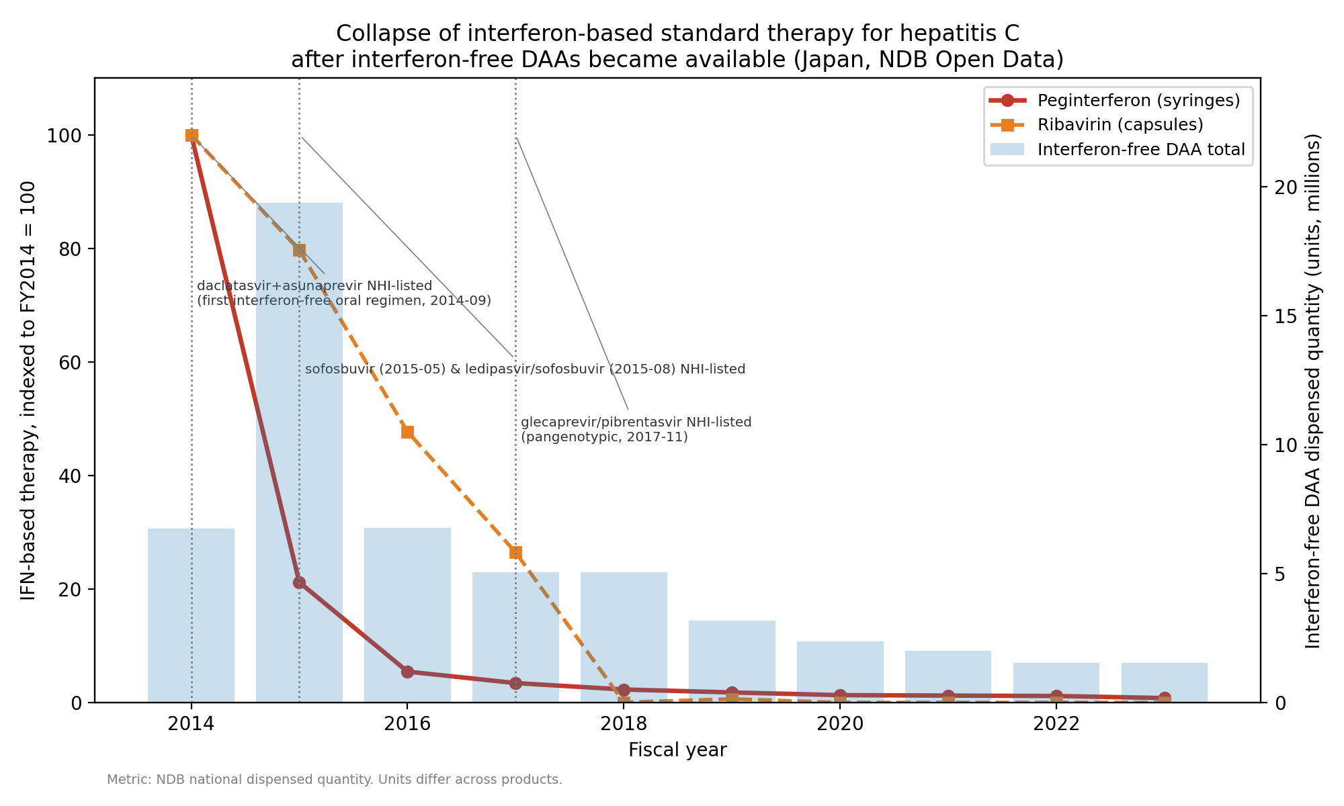
Fig. 1. Collapse of interferon-based standard therapy

Slide 2
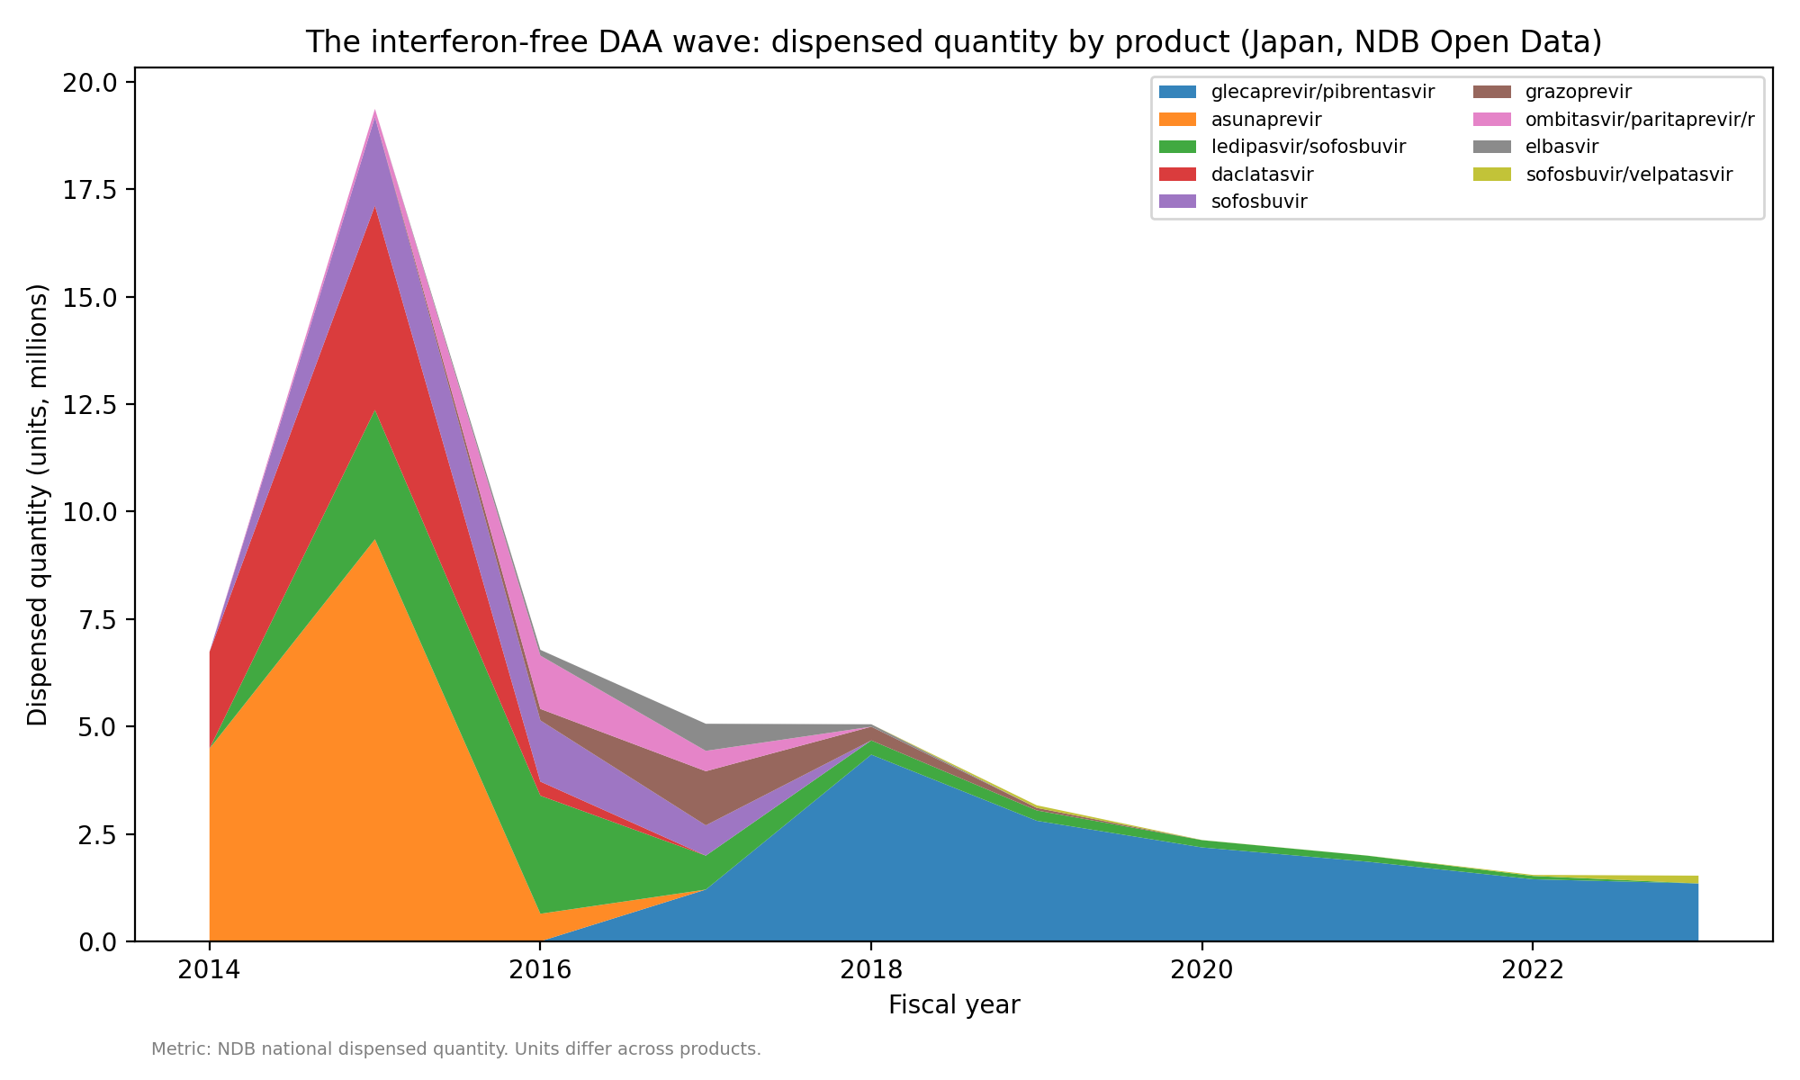
Fig. 2. The DAA wave: dispensed quantity by product

