Slide 1
Quantifying the Point of No Return in Global AI/ML Research Communities
Data-driven manuscript figures and tables

Slide 2
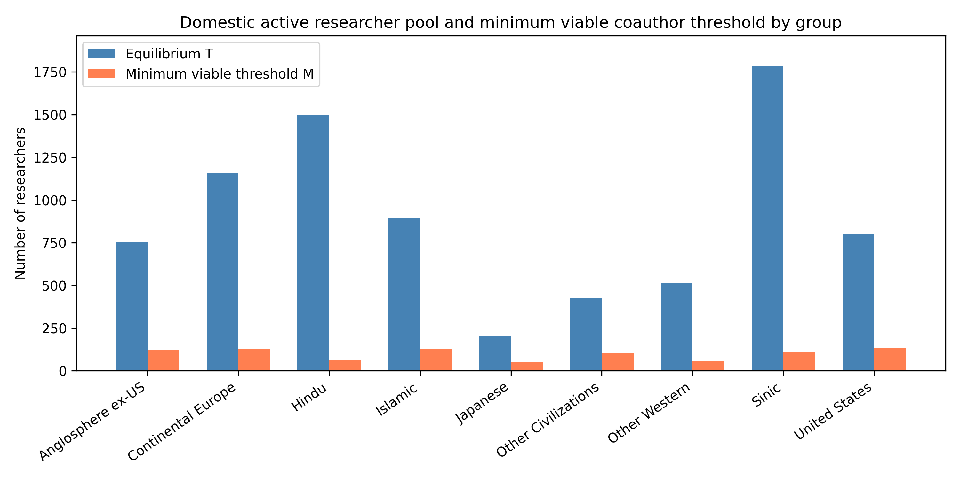
Figure 1: Equilibrium domestic active pool vs minimum viable threshold
Blue bars: equilibrium T; orange bars: threshold M. All groups remain above the threshold, but margins vary widely.

Slide 3
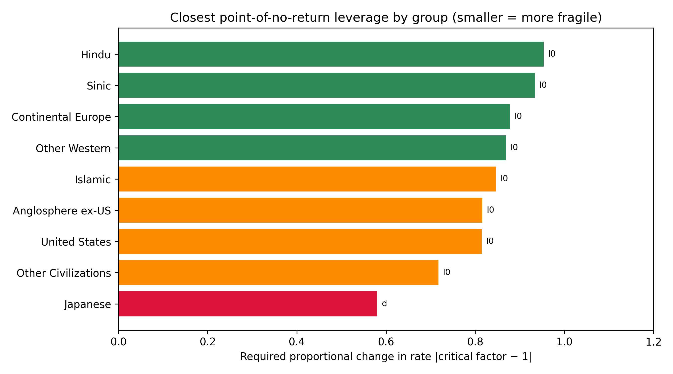
Figure 2: Closest point-of-no-return proximity by group
Smaller values mean a smaller proportional change in the listed rate is required to reach the threshold.

Slide 4
Table 1: Equilibrium, threshold and inflow parameters
Group | T_eq | M | Margin | I0 | r | r_obs | r_crit
Anglosphere ex-US | 752.12 | 119.78 | 632.34 | 1.55 | 0.00239 | 0.11345 | 0.00478
Continental Europe | 1156.27 | 129.07 | 1027.20 | 2.76 | 0.00261 | 0.12276 | 0.00523
Hindu | 1497.37 | 66.04 | 1431.33 | 1.52 | 0.00106 | 0.11765 | 0.00213
Islamic | 892.42 | 126.52 | 765.89 | 1.16 | 0.00141 | 0.13072 | 0.00282
Japanese | 206.81 | 50.48 | 156.33 | 1.42 | 0.00993 | 0.13904 | 0.01985
Other Civilizations | 424.70 | 104.60 | 320.10 | 1.15 | 0.00310 | 0.13072 | 0.00620
Other Western | 513.12 | 57.17 | 455.95 | 0.87 | 0.00200 | 0.17647 | 0.00400
Sinic | 1783.64 | 112.34 | 1671.29 | 2.38 | 0.00140 | 0.12059 | 0.00281
United States | 801.70 | 132.49 | 669.21 | 2.83 | 0.00396 | 0.10504 | 0.00791

Slide 5
Table 2: Top transition-rate elasticities for T
Group | 1st | el1 | 2nd | el2 | 3rd | el3
Anglosphere ex-US | d | -2.162 | p_D | 0.116 | beta | 0.046
Continental Europe | d | -2.100 | p_D | 0.067 | beta | 0.047
Hindu | d | -2.011 | p_D | 0.038 | h_D | 0.013
Islamic | d | -2.051 | p_D | 0.057 | h_D | 0.022
Japanese | d | -2.317 | p_D | 0.233 | h_D | 0.111
Other Civilizations | d | -2.125 | p_D | 0.094 | h_D | 0.047
Other Western | d | -2.123 | p_D | 0.137 | h_D | 0.014
Sinic | d | -2.027 | p_D | 0.035 | h_D | 0.021
United States | d | -2.126 | p_D | 0.087 | h_D | 0.066

Slide 6
Table 3: Closest point of no return
Group | Target | Rate | Current | Crit.factor | Proximity
Japanese | domestic_PIs | d | 0.0134 | 1.580 | 0.580
Other Civilizations | domestic_PIs | I0 | 1.1486 | 0.282 | 0.718
United States | domestic_PIs | I0 | 2.8304 | 0.185 | 0.815
Anglosphere ex-US | domestic_PIs | I0 | 1.5548 | 0.184 | 0.816
Islamic | domestic_PIs | I0 | 1.1638 | 0.153 | 0.847
Other Western | domestic_PIs | I0 | 0.8723 | 0.131 | 0.869
Continental Europe | domestic_PIs | I0 | 2.7634 | 0.122 | 0.878
Sinic | domestic_PIs | I0 | 2.3837 | 0.066 | 0.934
Hindu | domestic_PIs | I0 | 1.5156 | 0.046 | 0.954

Slide 7
Table 4: Saturating inflow extension
Group | Linear T | Saturating T | ε
Anglosphere ex-US | 752.12 | 411.20 | 0.01429
Continental Europe | 1156.27 | 632.67 | 0.00870
Hindu | 1497.37 | 781.23 | 0.01538
Islamic | 892.42 | 469.06 | 0.02222
Japanese | 206.81 | 129.35 | 0.01818
Other Civilizations | 424.70 | 234.34 | 0.02222
Other Western | 513.12 | 270.32 | 0.04000
Sinic | 1783.64 | 940.82 | 0.01000
United States | 801.70 | 462.03 | 0.00714

