Slide 1
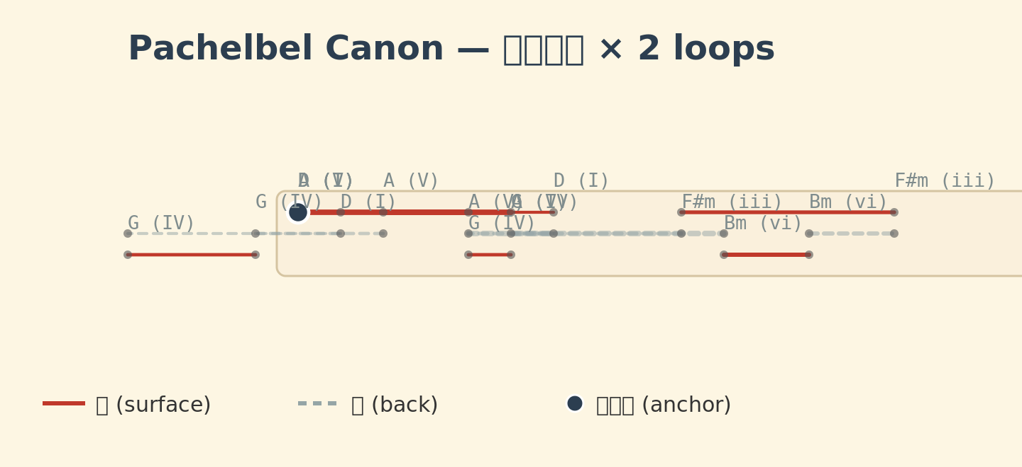
Figure 1
Figure 1. SITS9 Loom Renderer output for Pachelbel's Canon (I-V-vi-iii-IV-I-IV-V, 2 loops). Red solid lines = surface stitches; grey dashed lines = back stitches; filled black circles = anchor points (knots).

Slide 2
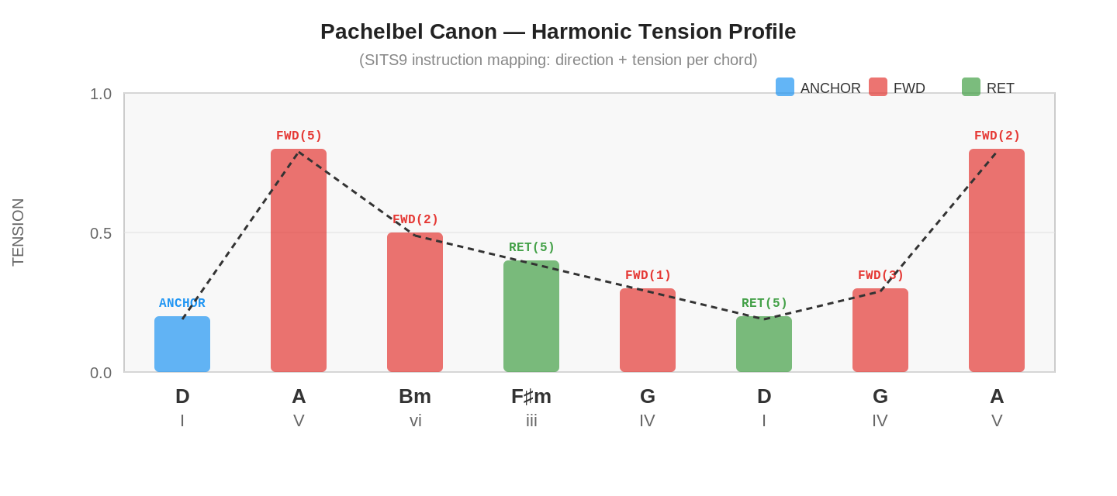
Figure 2
Figure 2. Harmonic tension profile of Pachelbel's Canon encoded as SITS9 instructions. Bar colour = instruction type (blue = ANCHOR, red = FWD, green = RET). Bar height = TENSION. Dashed line traces the tension arc.

Slide 3
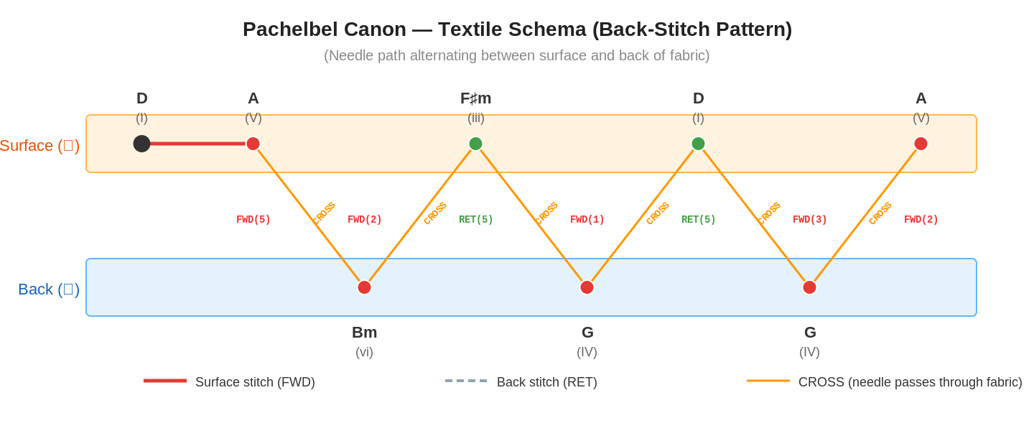
Figure 3
Figure 3. Textile schema (back-stitch pattern) for Pachelbel's Canon. Needle path alternates between surface (orange) and back (blue). Red = FWD on surface; orange diagonals = CROSS; black dot = ANCHOR (knot).

Slide 4
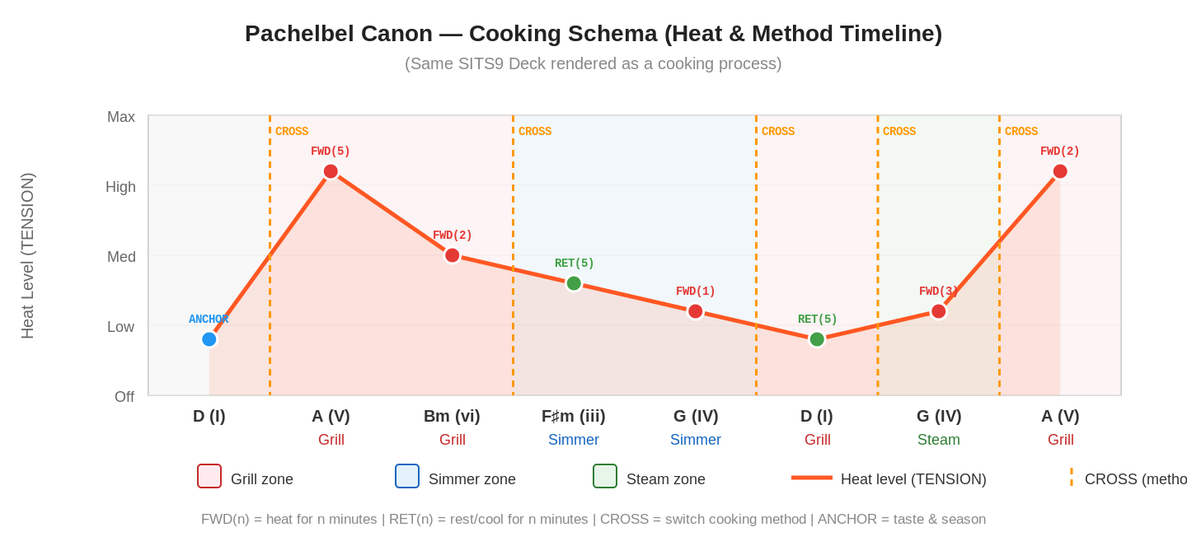
Figure 4
Figure 4. Cooking schema for Pachelbel's Canon. Heat curve (TENSION) follows the harmonic tension profile. Background zones: red = grill, blue = simmer, green = steam. Dashed vertical = CROSS (method switch).

