Slide 1
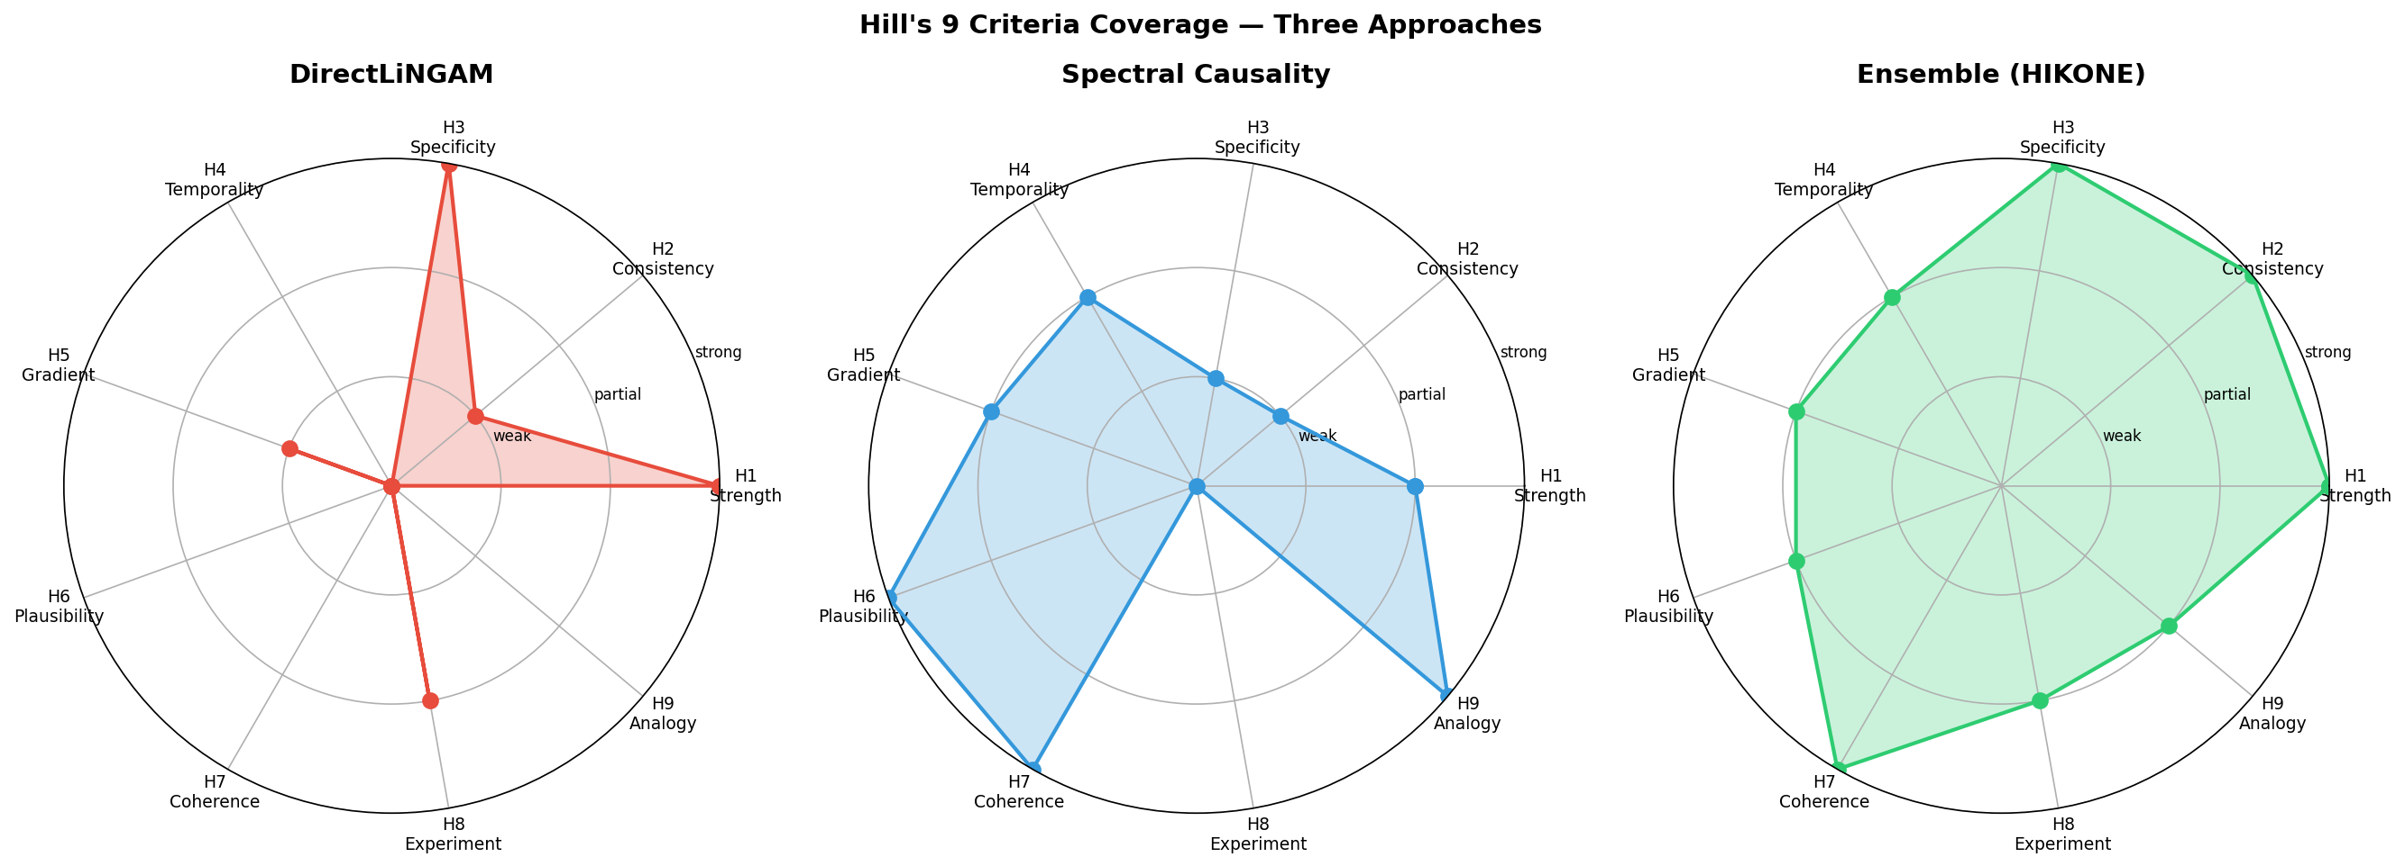
Figure 1: Hill's Nine Criteria Coverage
ECD (purple) achieves broader coverage than any single method.

Slide 2
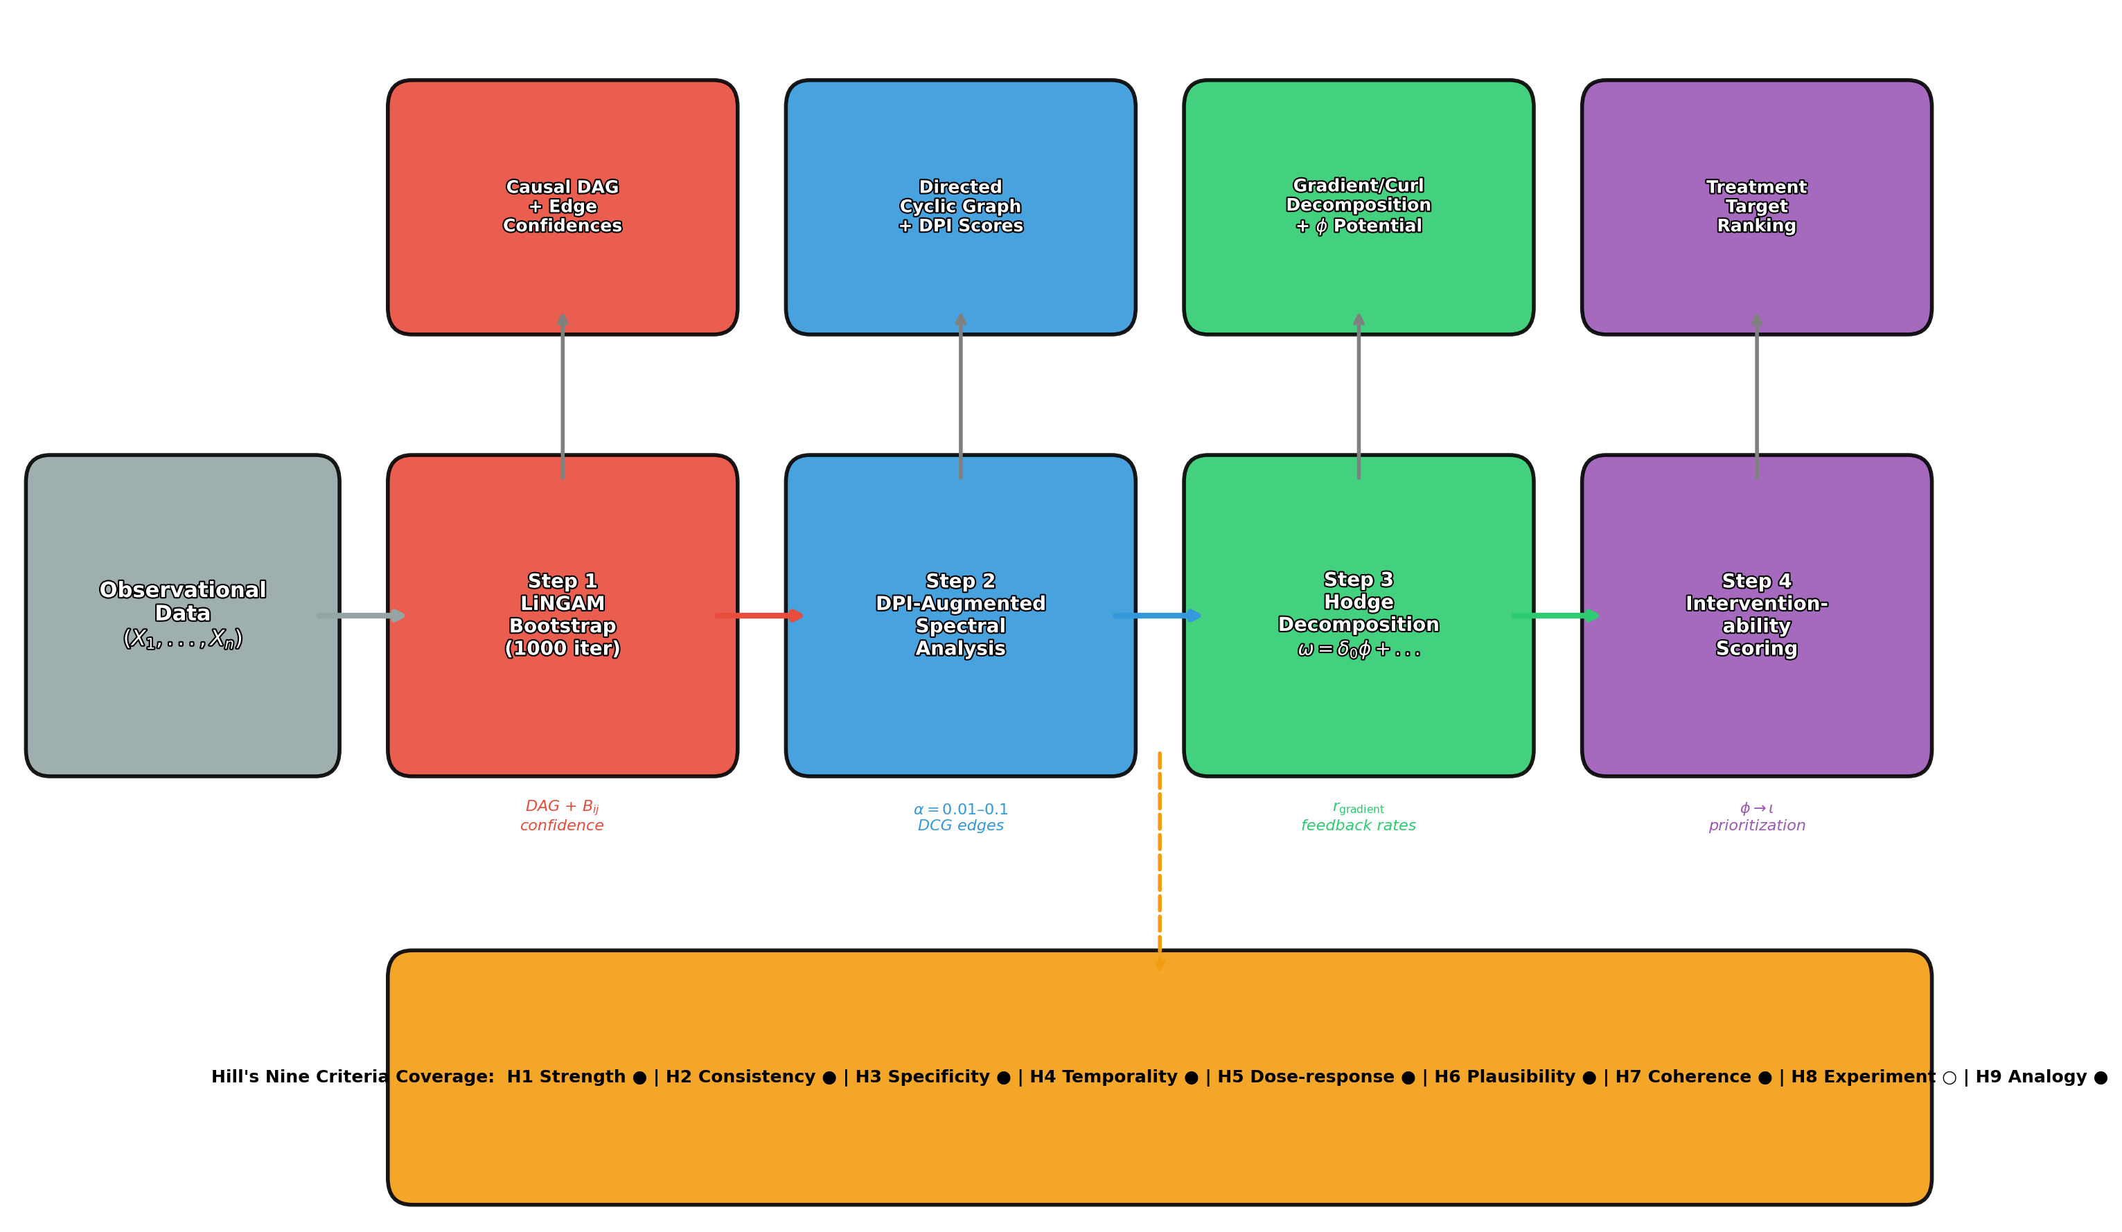
Figure 2: ECD Deployment Pipeline
Four-step pipeline: LiNGAM bootstrap → DPI spectral analysis → Hodge decomposition → Interventionability scoring.

Slide 3
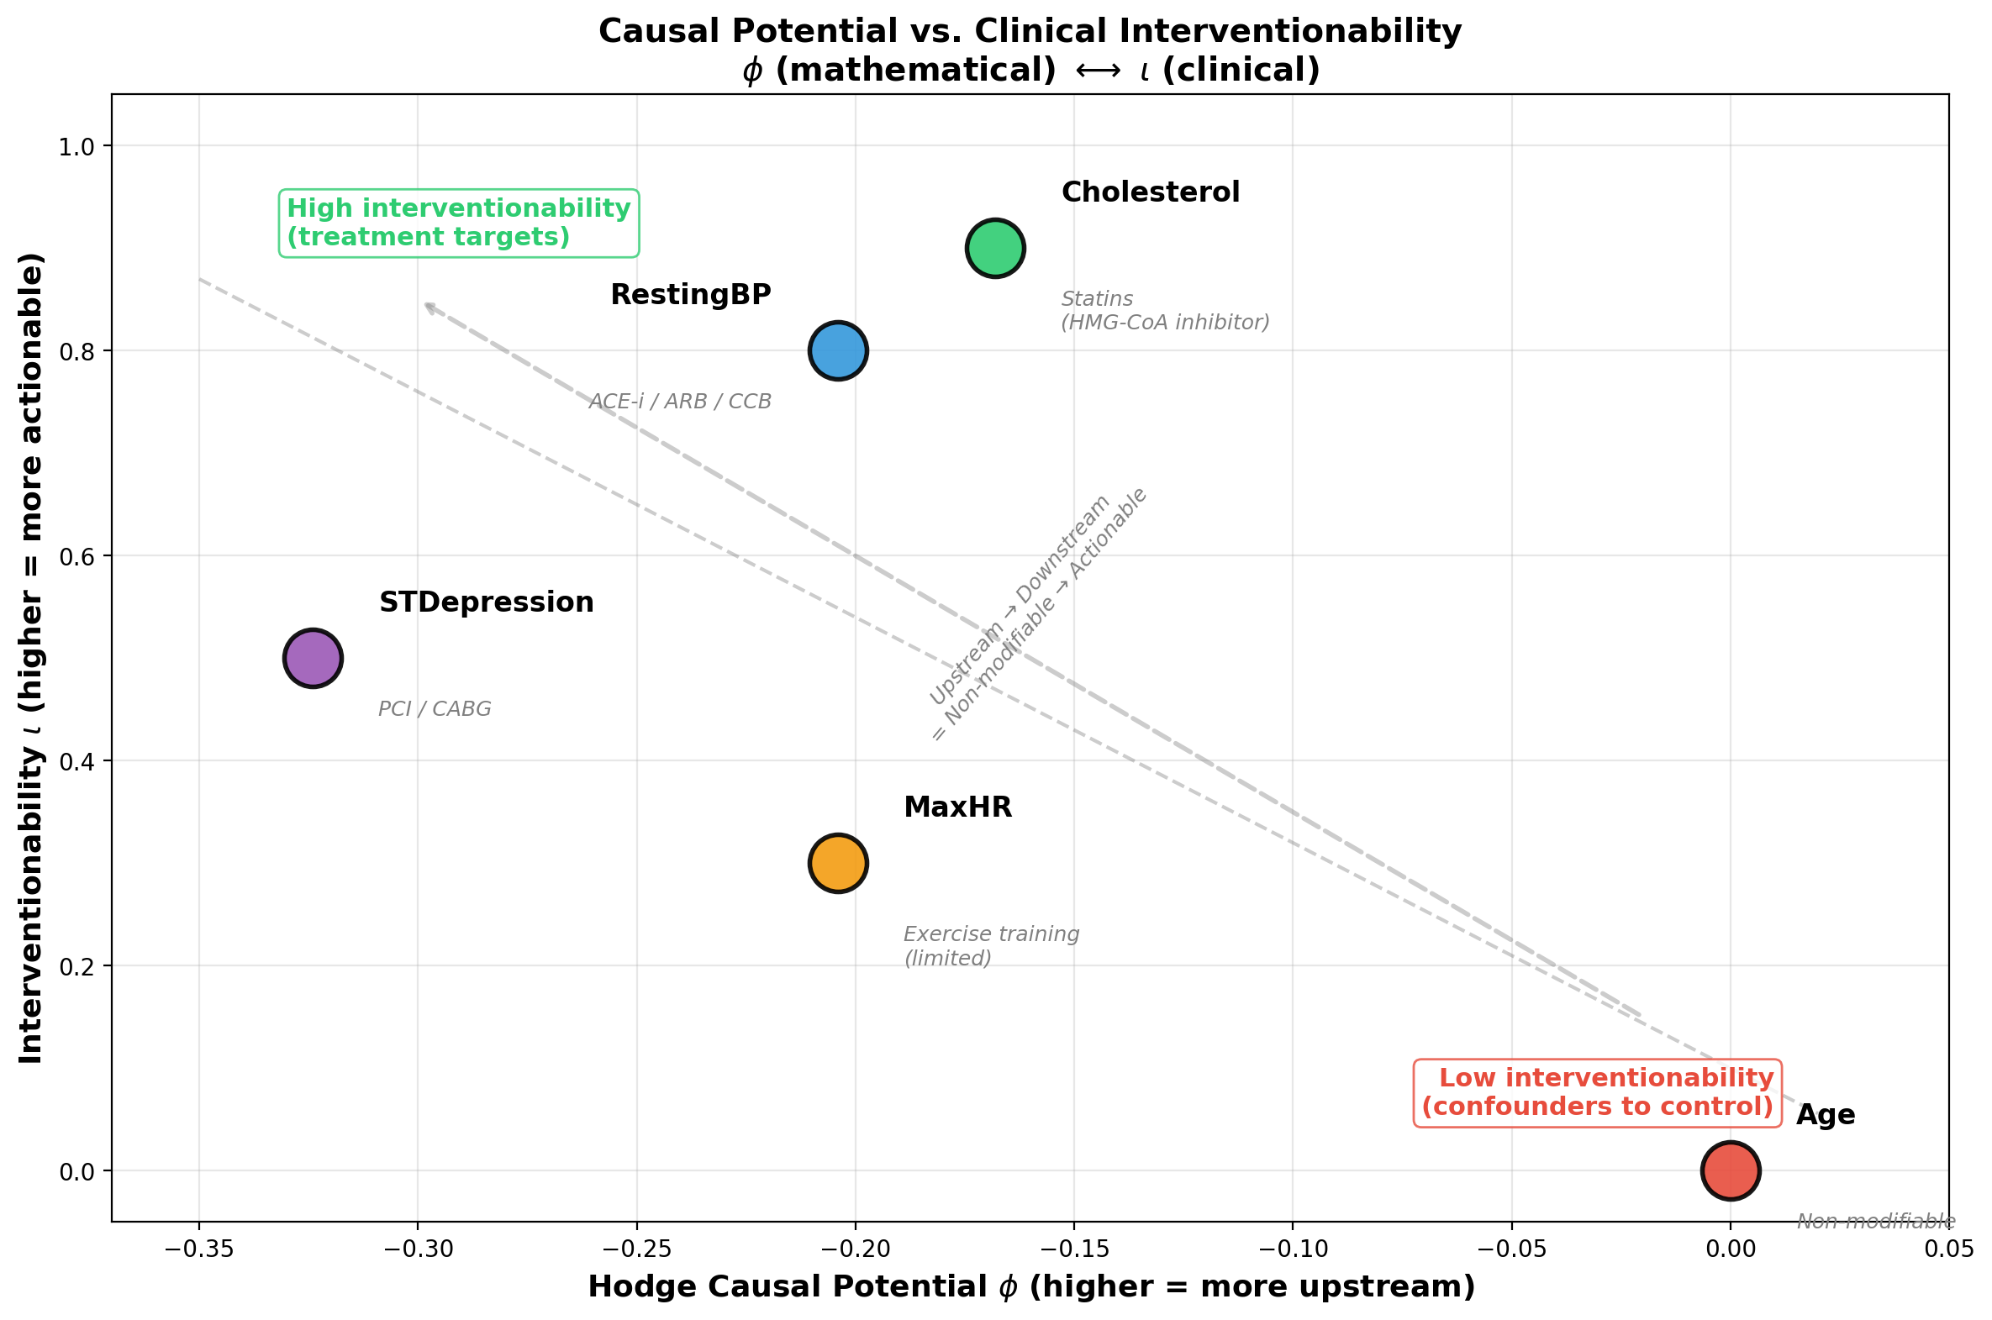
Figure 3: Causal Potential vs. Interventionability
Hodge potential φ vs. clinical interventionability ι. Inverse relationship demonstrates mathematical-clinical correspondence.

Slide 4
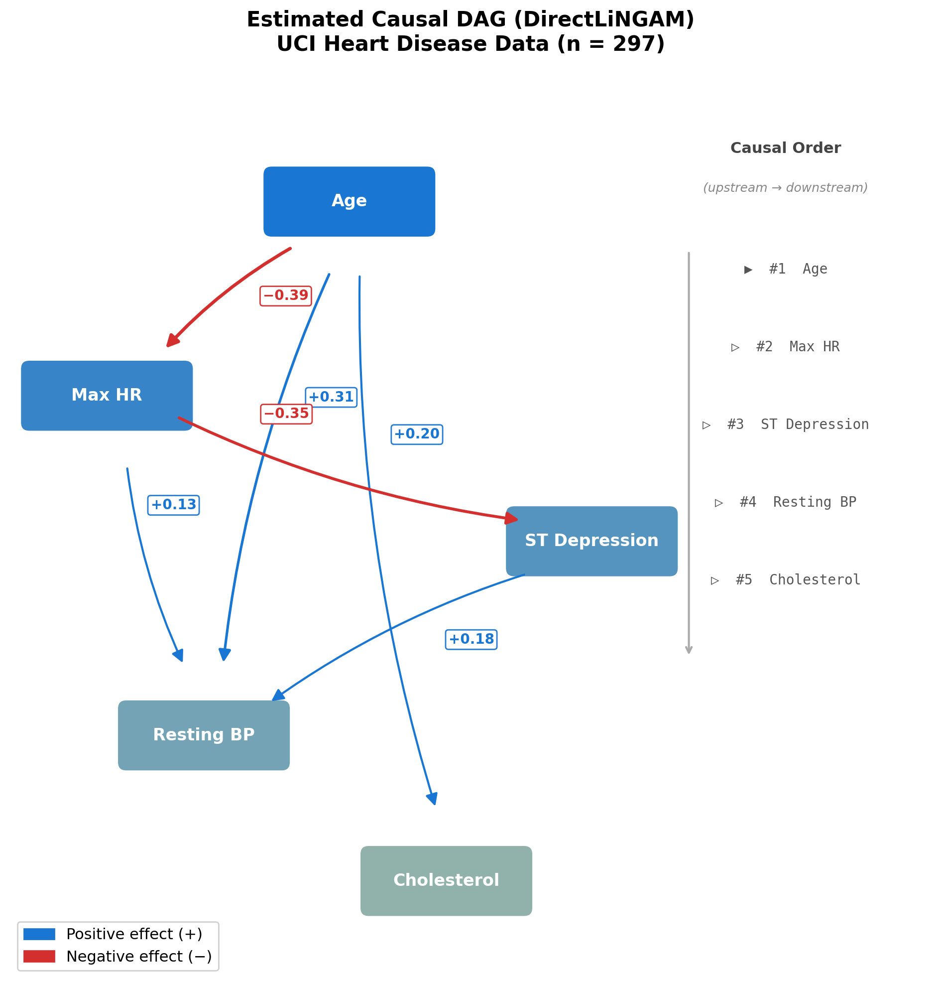
Figure 4: Estimated Causal DAG (DirectLiNGAM)
Arrow weight indicates estimated causal effect size |B_ij|.

Slide 5
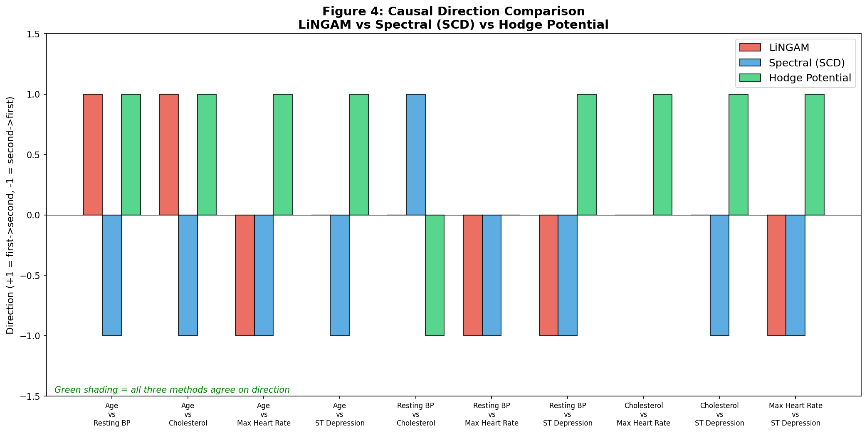
Figure 5: Three-Method Direction Comparison
Green = agreement, Red = disagreement between methods.

Slide 6
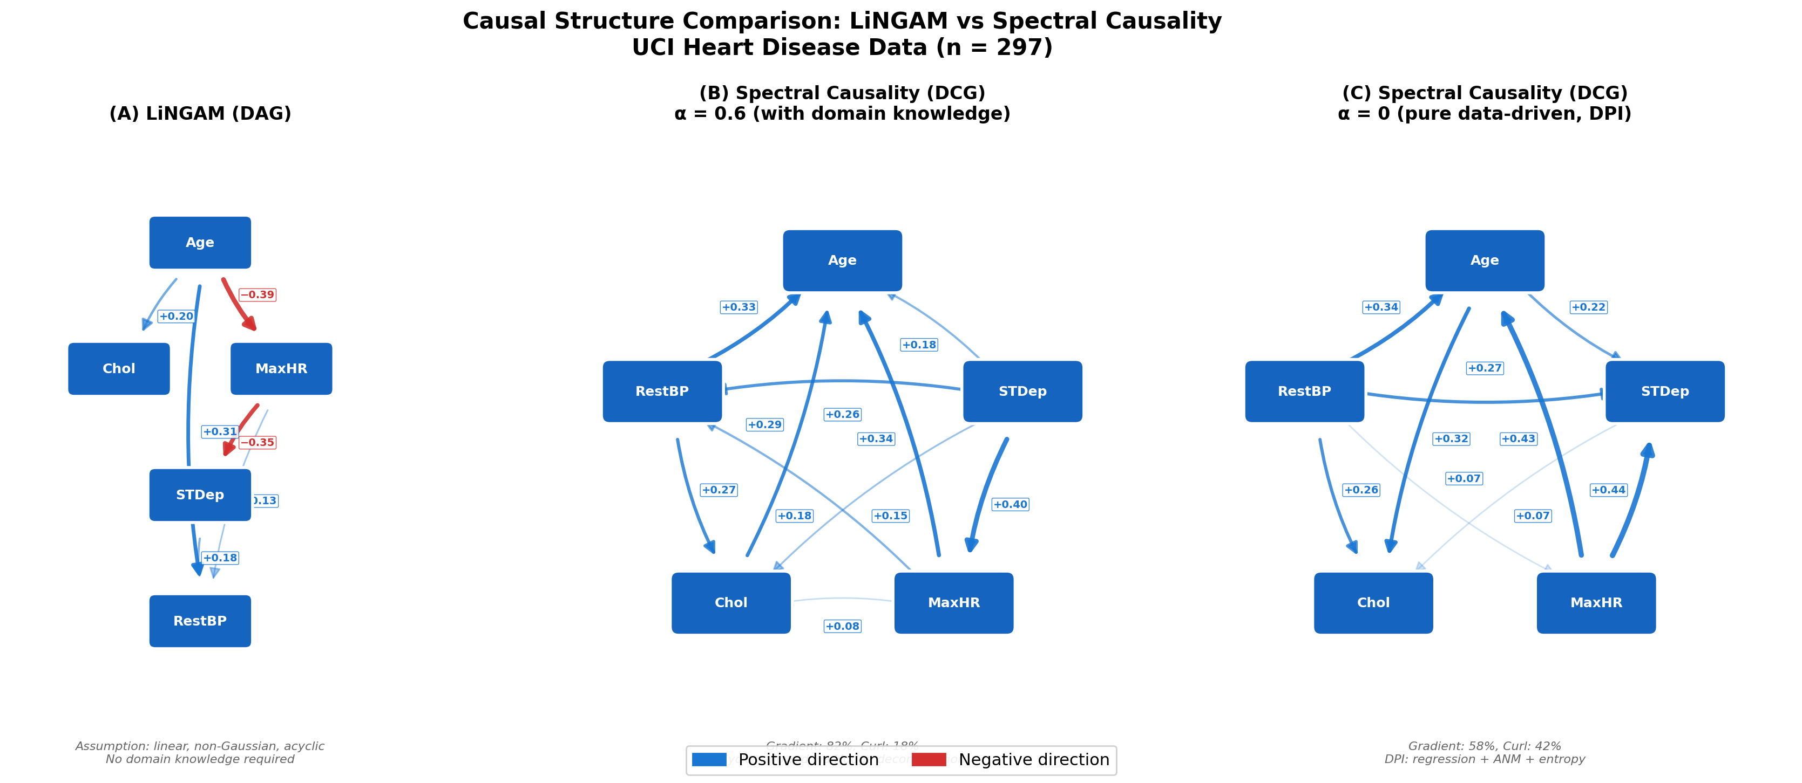
Figure 6: LiNGAM DAG vs. Spectral Causality DCG
Dashed lines indicate feedback edges absent in the DAG.

Slide 7
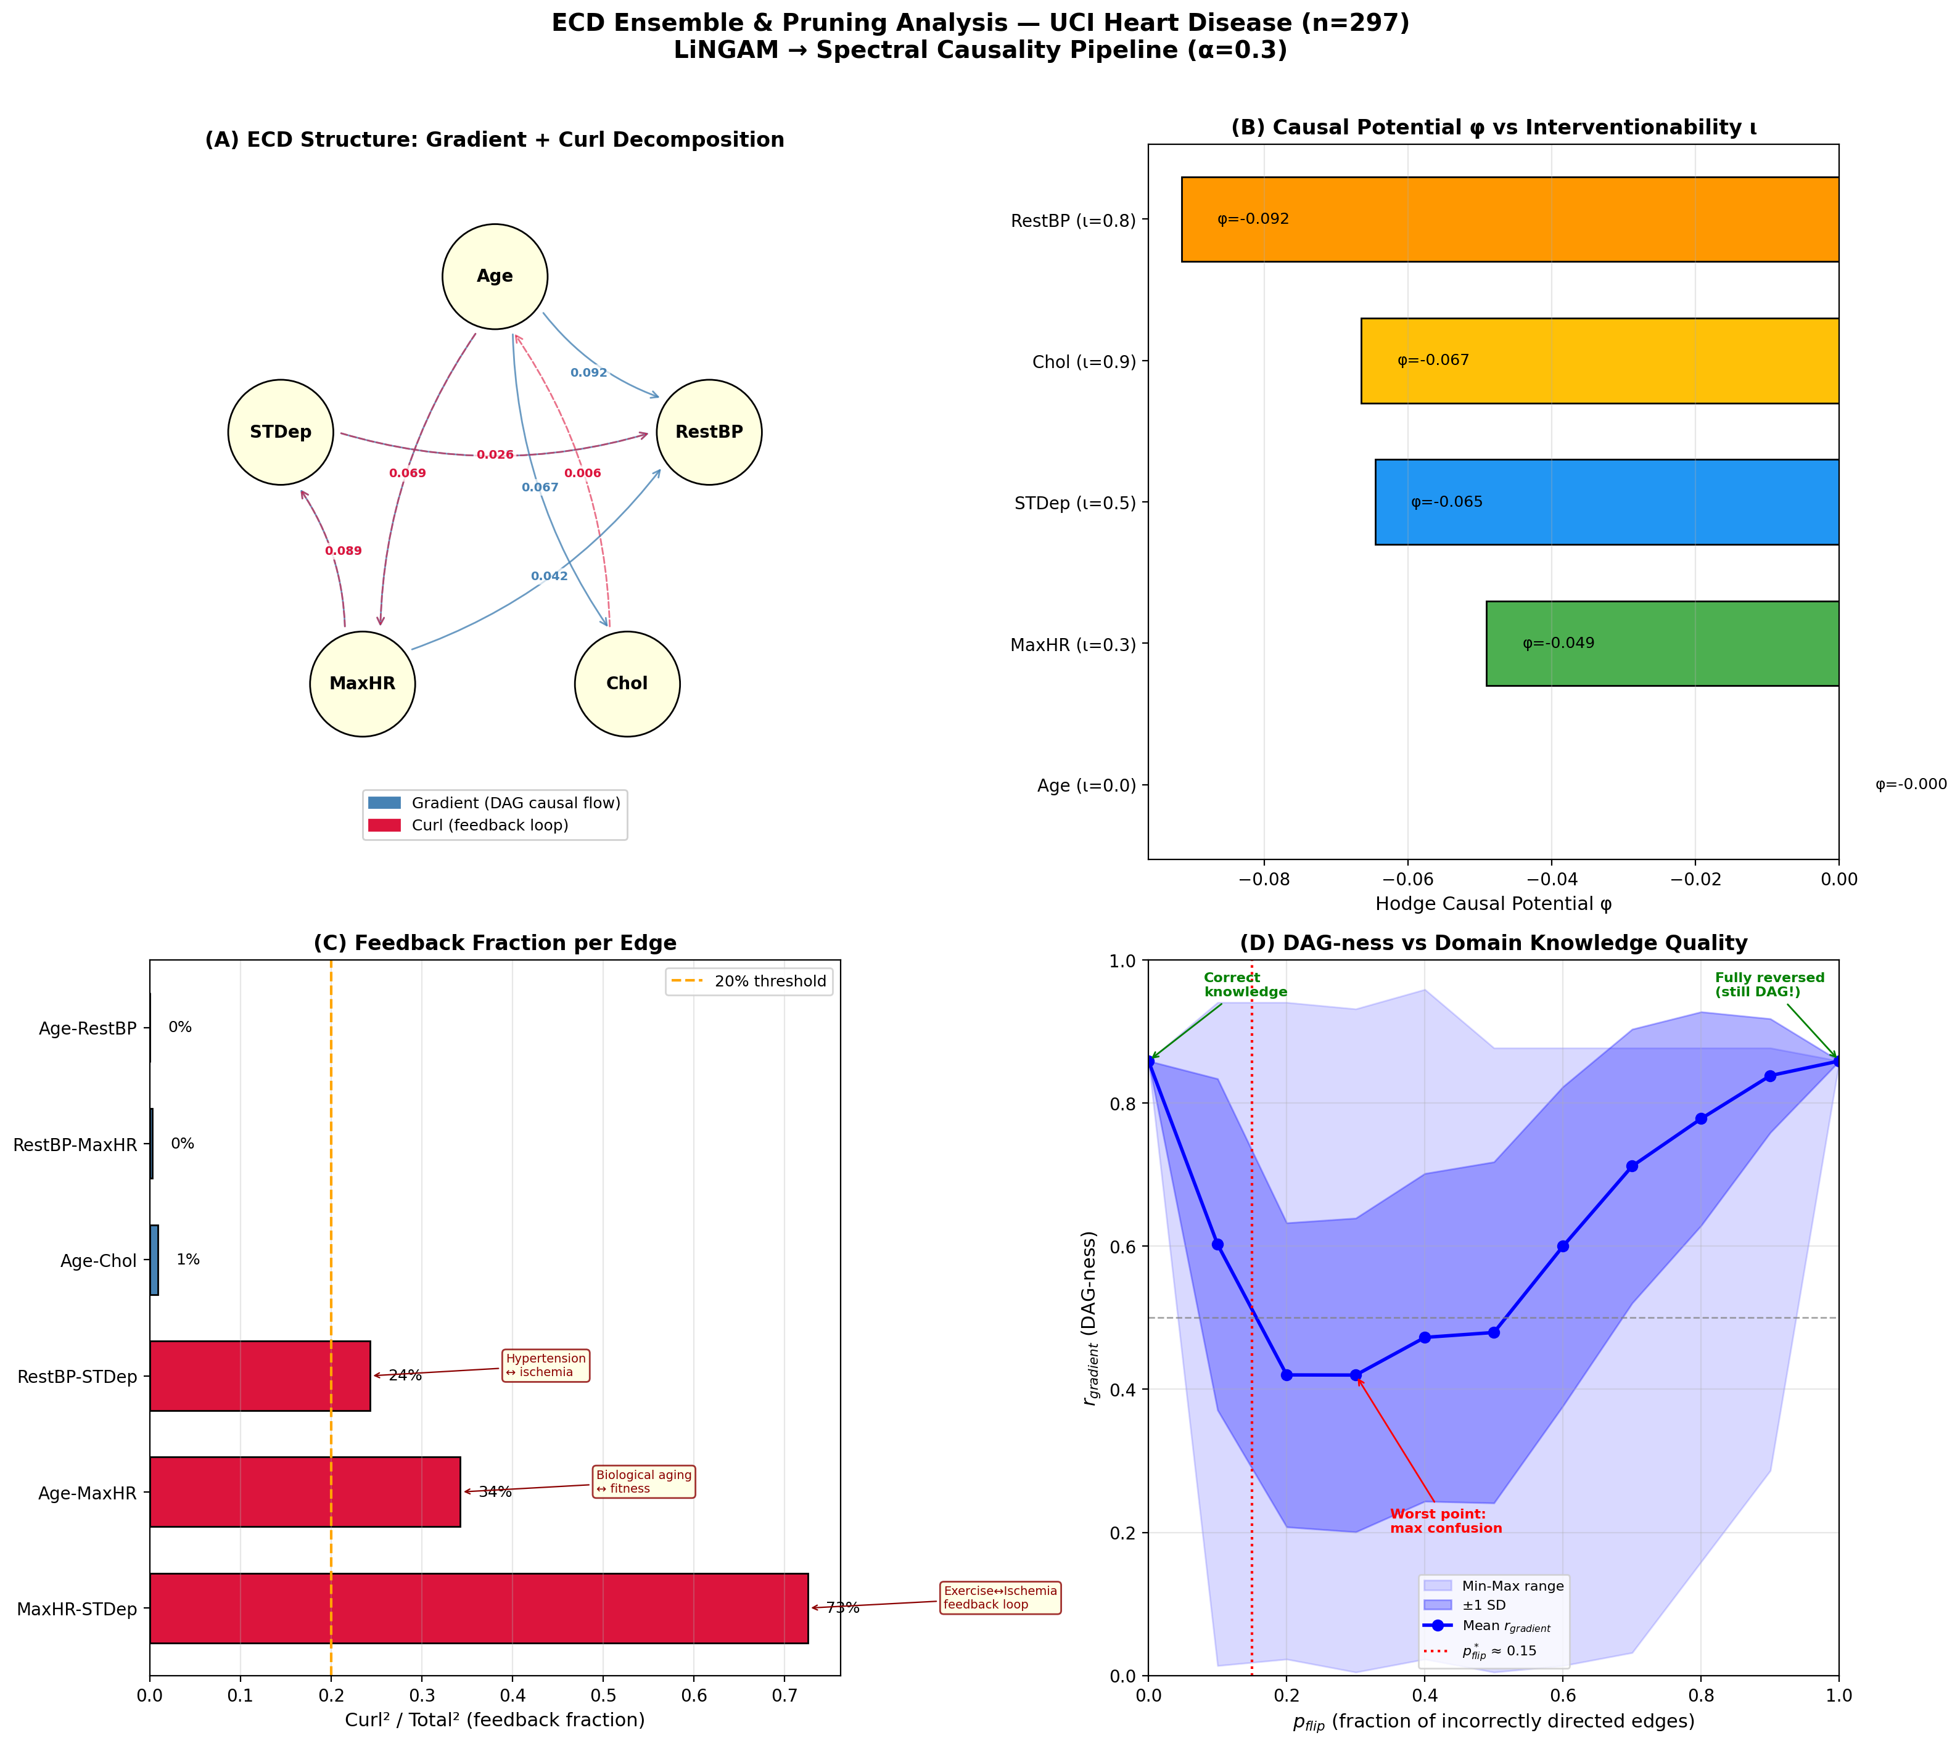
Figure 7: ECD Ensemble & Pruning Analysis
Edge-level feedback rates and bootstrap confidence intervals.

Slide 8
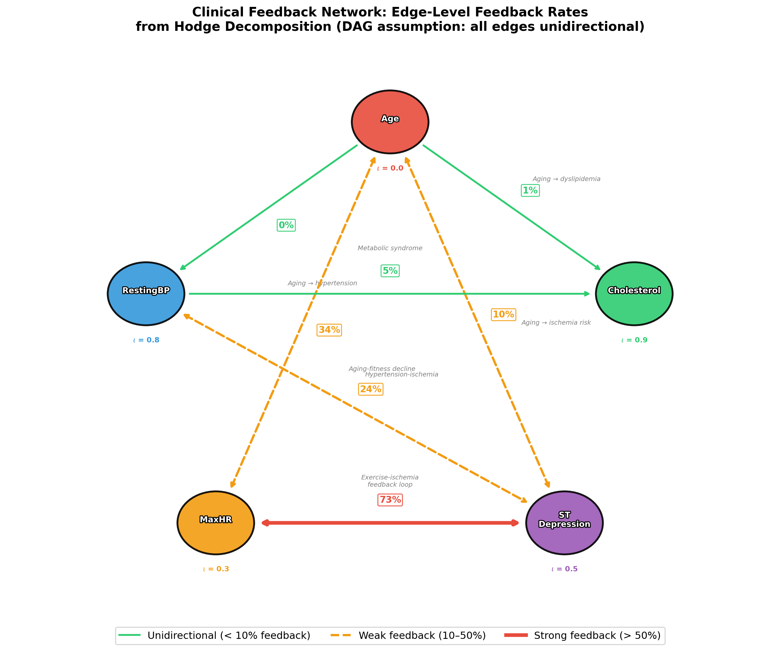
Figure 8: Clinical Feedback Network
Edge colors: green = unidirectional (<10%), orange = weak feedback (10–50%), red = strong feedback (>50%). MaxHR ↔ STDep: 73%.

