Slide 1
Spectral Causality
Finding Causal Relations Through the Science of Sound
UCI Heart Disease Data (n=297) — Real-World Analysis

Slide 2
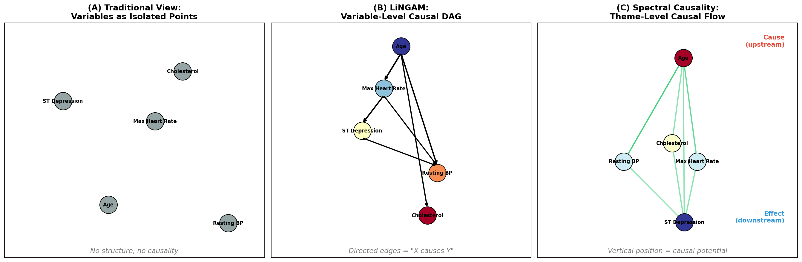
Figure 1: Three Approaches to Causal Inference
Figure 1: (A) Conventional approach — isolated variables. (B) LiNGAM — variable-level causal DAG. (C) Spectral Causality — theme-level causal flow. Vertical position represents causal potential: higher = more upstream (cause), lower = more downstream (effect).

Slide 3
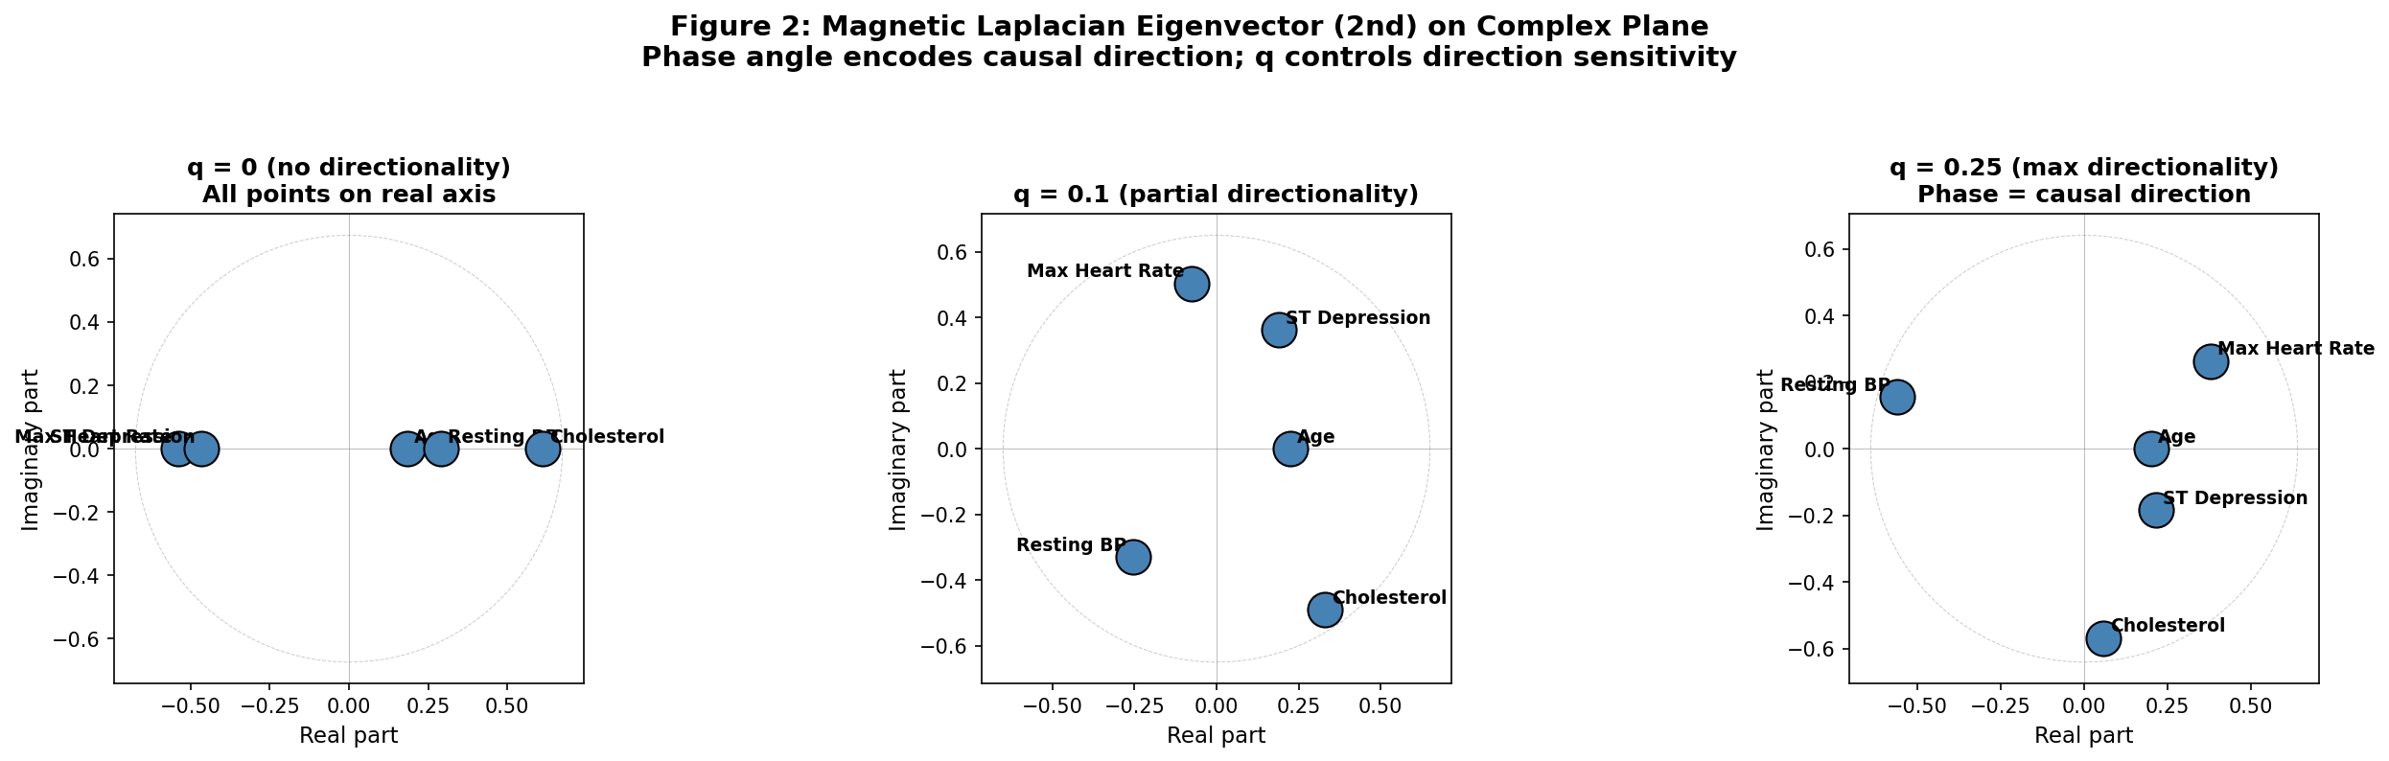
Figure 2: Magnetic Laplacian Eigenvectors in the Complex Plane
Figure 2: Second eigenvector of the magnetic Laplacian plotted on the complex plane. At q=0, all points lie on the real axis (no directionality). At q=0.1 and q=0.25, variables spread into the complex plane, with phase angle ordering encoding causal flow direction.

Slide 4
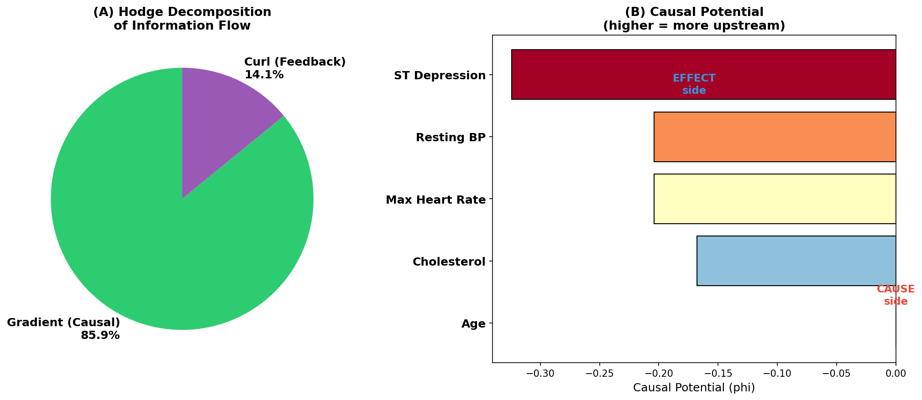
Figure 3: Hodge Decomposition of Information Flow
Figure 3: (A) Hodge decomposition of information flow: 85.9% gradient (causal, one-directional) vs 14.1% curl (feedback loops). (B) Causal potential for each variable. Age is most upstream; ST Depression is most downstream.

Slide 5
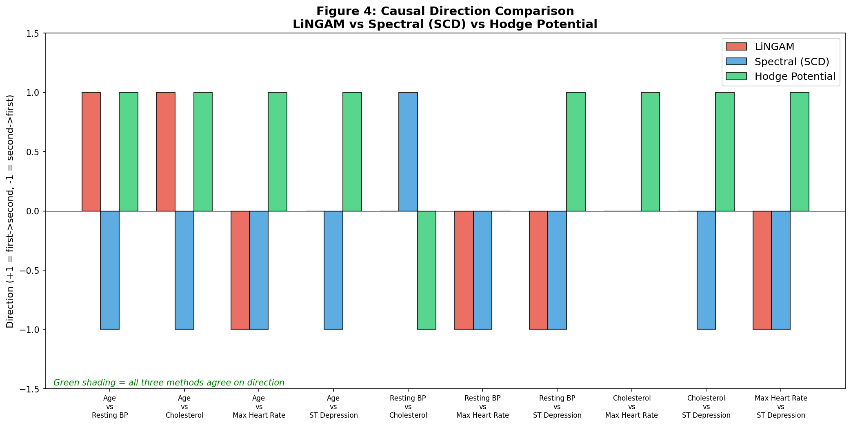
Figure 4: Causal Direction Comparison Across Three Methods
Figure 4: Causal direction for all 10 variable pairs comparing LiNGAM (red), Spectral Causal Direction SCD (blue), and Hodge potential (green). +1 = first variable causes second; -1 = reverse. Green background = all three methods agree.

Slide 6
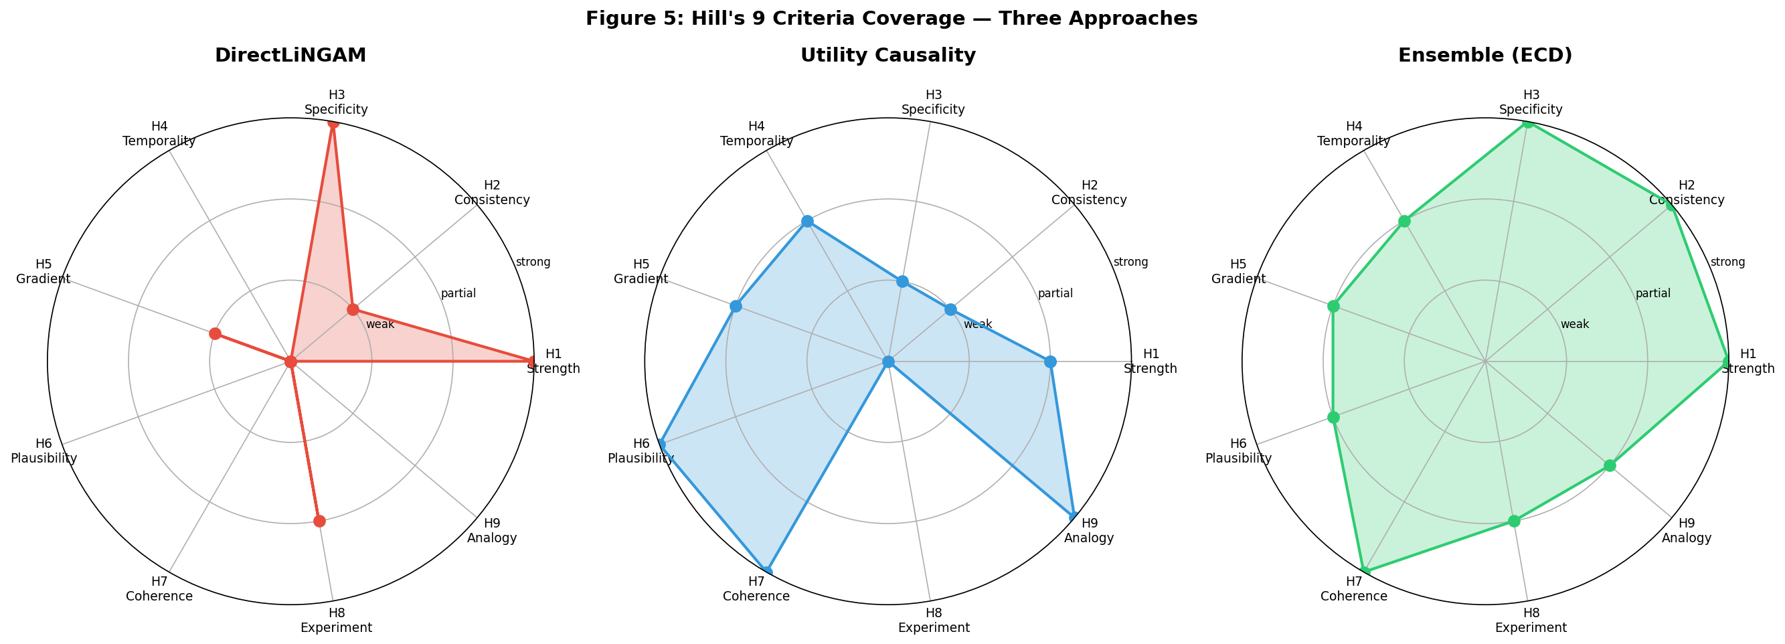
Figure 5: Hill's 9 Criteria Coverage by Method
Figure 5: Radar plots showing coverage of Hill's 9 causal criteria. LiNGAM excels at H1 (strength) and H3 (specificity) but lacks H6/H7/H9. Utility Causality covers H6 (plausibility), H7 (coherence), H9 (analogy). Ensemble (ECD) combines both, covering nearly all criteria.

