Slide 1
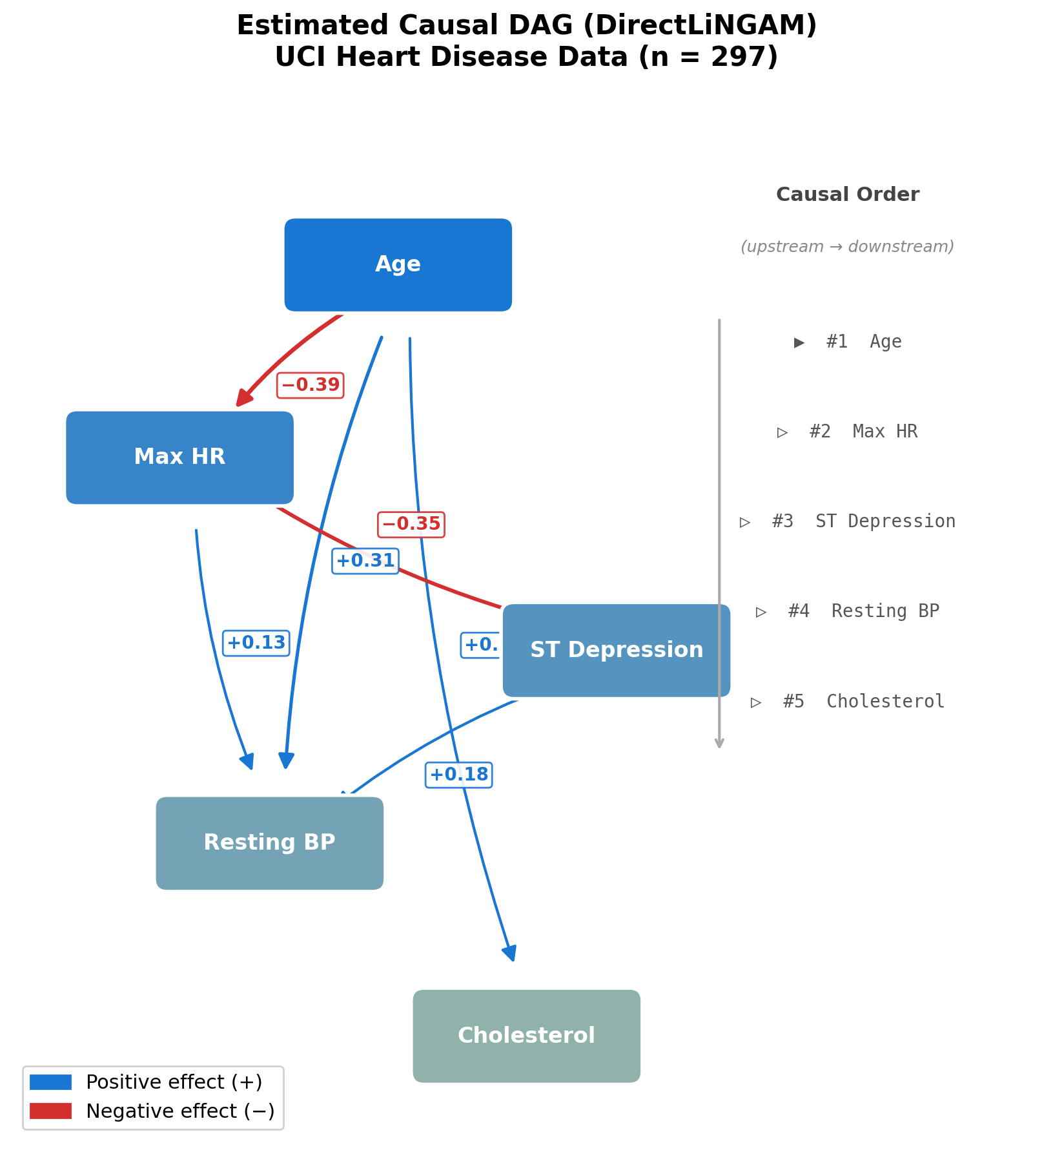
Figure 1: Estimated Causal DAG (DirectLiNGAM)
Causal DAG estimated by DirectLiNGAM on the UCI Heart Disease dataset (Cleveland subset, n = 297). Five clinical variables. Blue = positive effect; red = negative effect. Causal order: Age > MaxHR > STDep > RestBP > Chol.

Slide 2
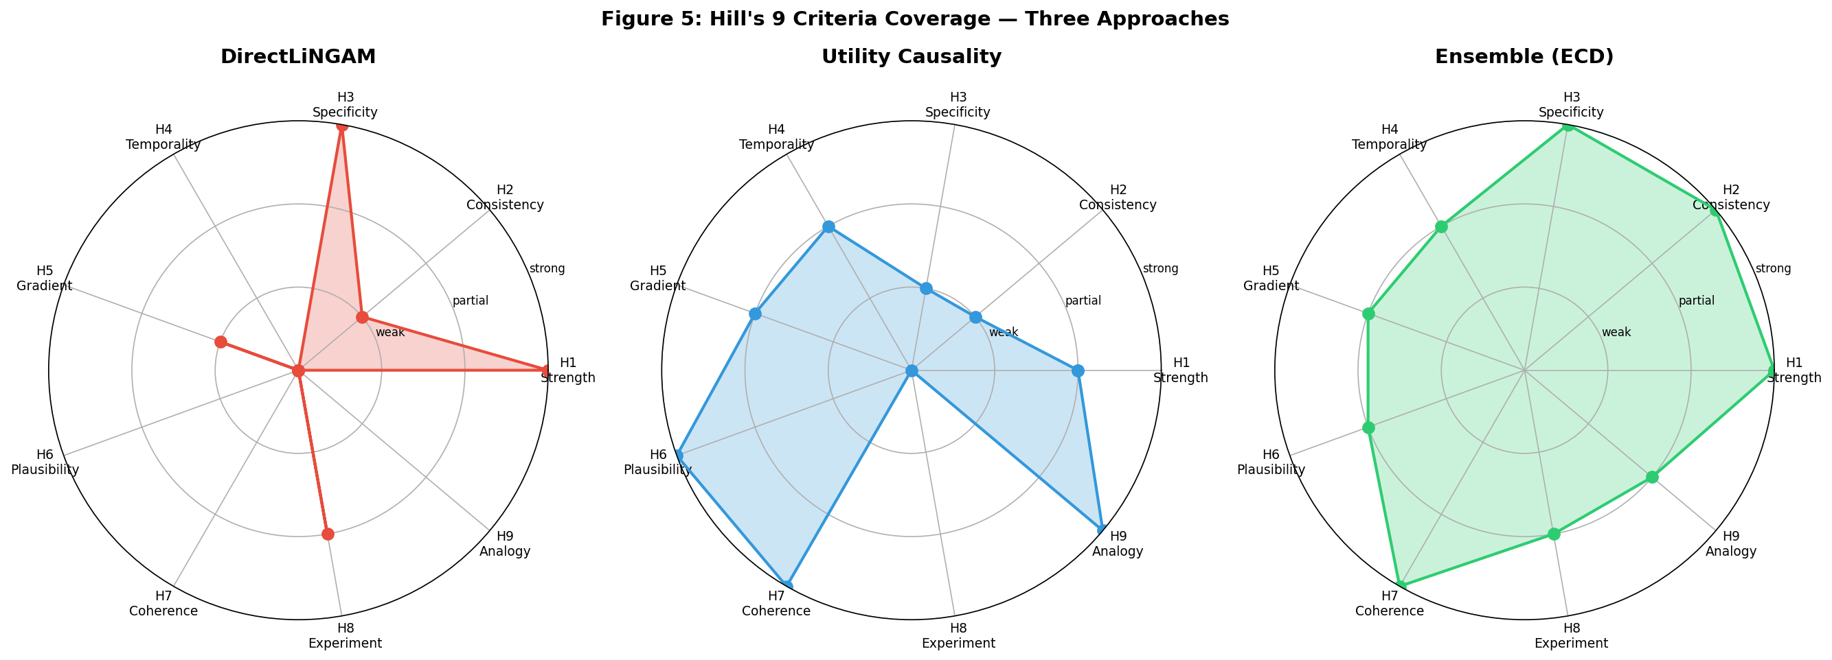
Figure 2: Hill's 9 Criteria Coverage
Radar chart of each method's coverage of Hill's nine criteria. LiNGAM: H1/H3. Utility Causality: H6/H7/H9. ECD Ensemble: nearly all criteria.

Slide 3
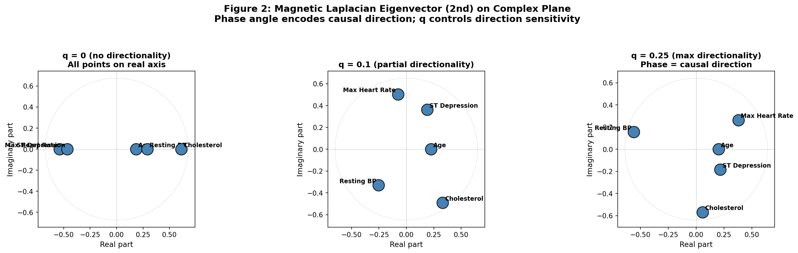
Figure 3: Magnetic Laplacian Eigenvectors
Second eigenvector of the magnetic Laplacian on the complex plane. q=0: all points on real axis. q=0.25: phase angle ordering encodes causal flow.

Slide 4
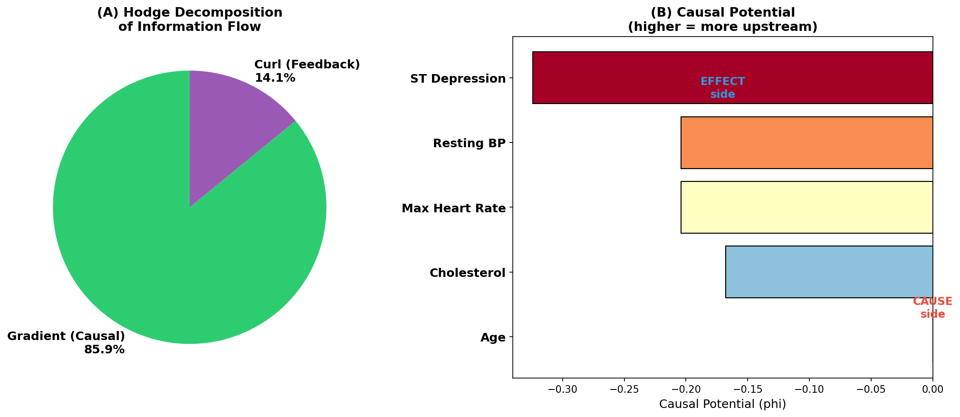
Figure 4: Hodge Decomposition of Causal Flows
Orthogonal decomposition into gradient (DAG-like, 85.9%), curl (feedback, 14.1%), and harmonic components.

Slide 5
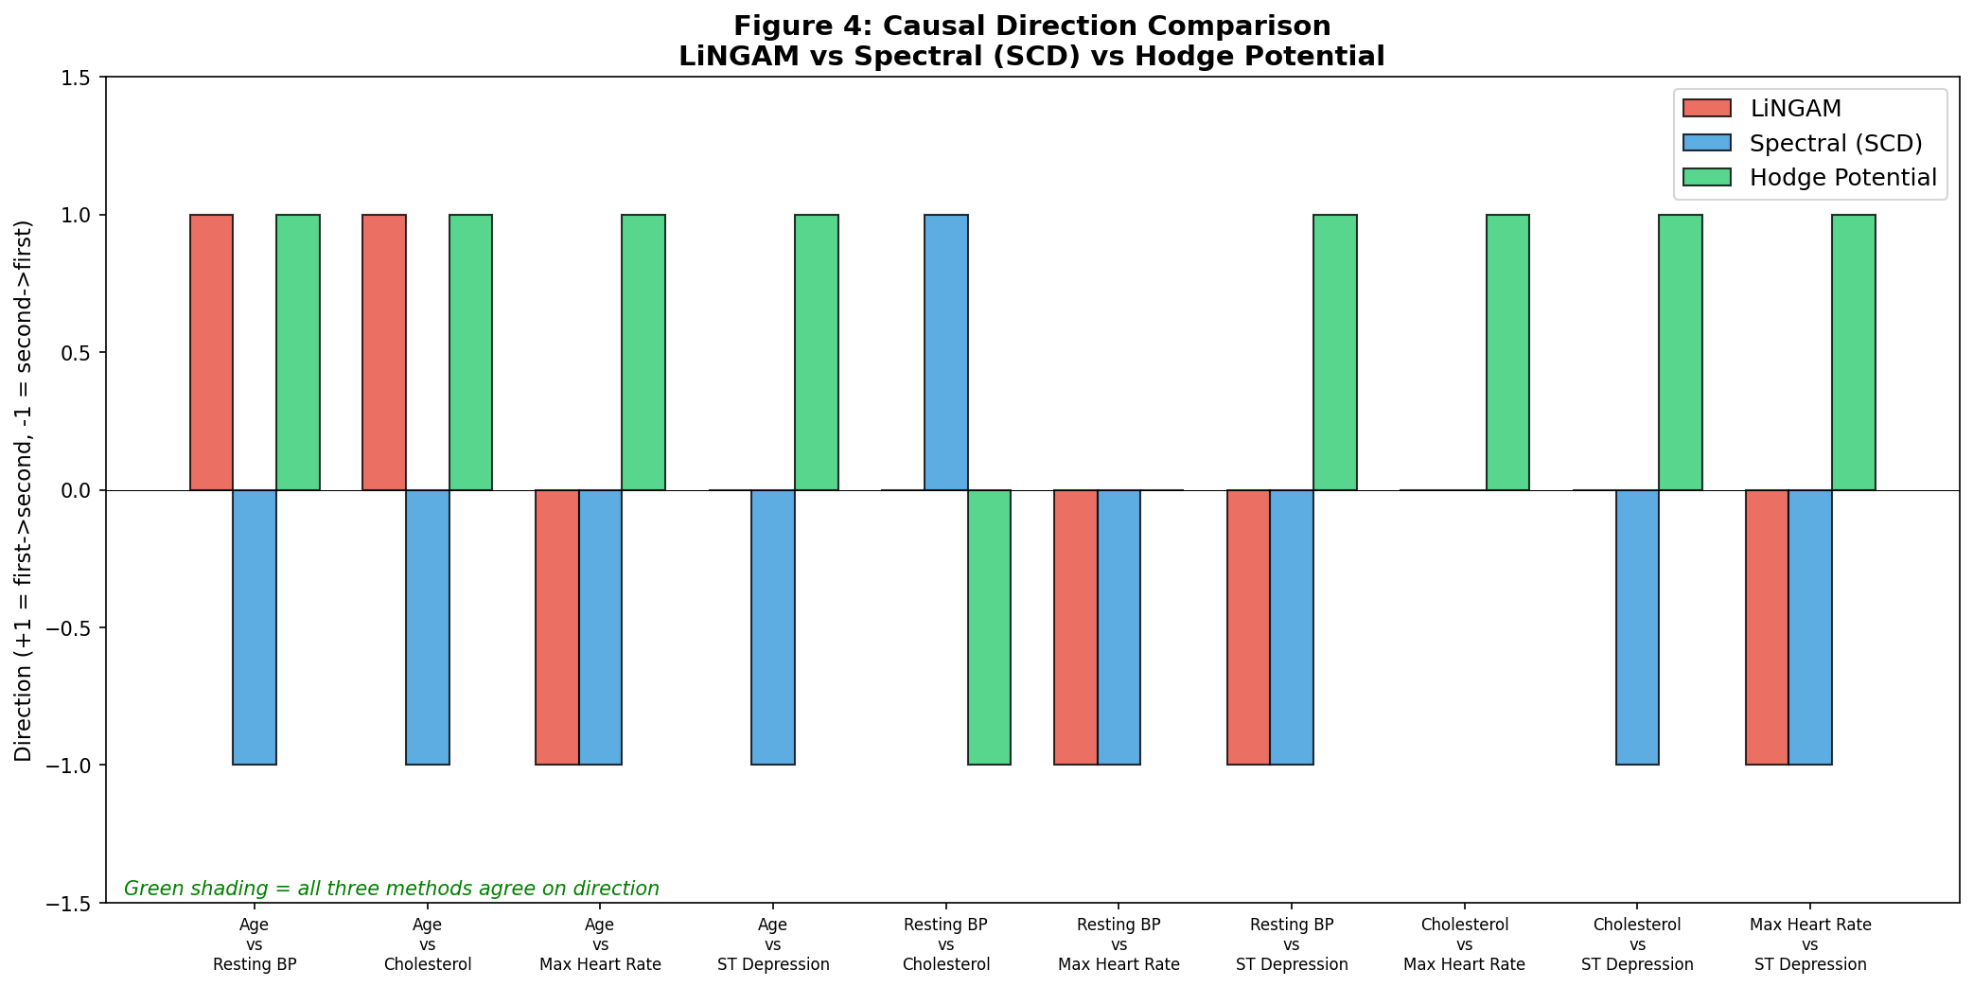
Figure 5: Three-Method Direction Comparison
Causal directions: LiNGAM vs. spectral causality (alpha=0.6) vs. DPI (alpha=0). 5 variables, 10 possible edges. 67% agreement between DPI and LiNGAM.

Slide 6
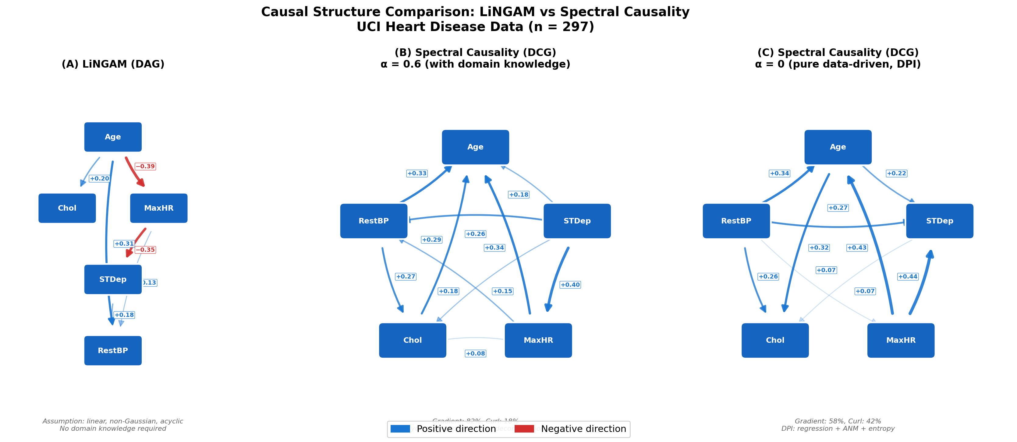
Figure 6: LiNGAM DAG vs. Spectral Causality DCG
LiNGAM enforces DAG (acyclic). Spectral causality permits feedback loops. Edge feedback rates quantified by Hodge decomposition.

Slide 7
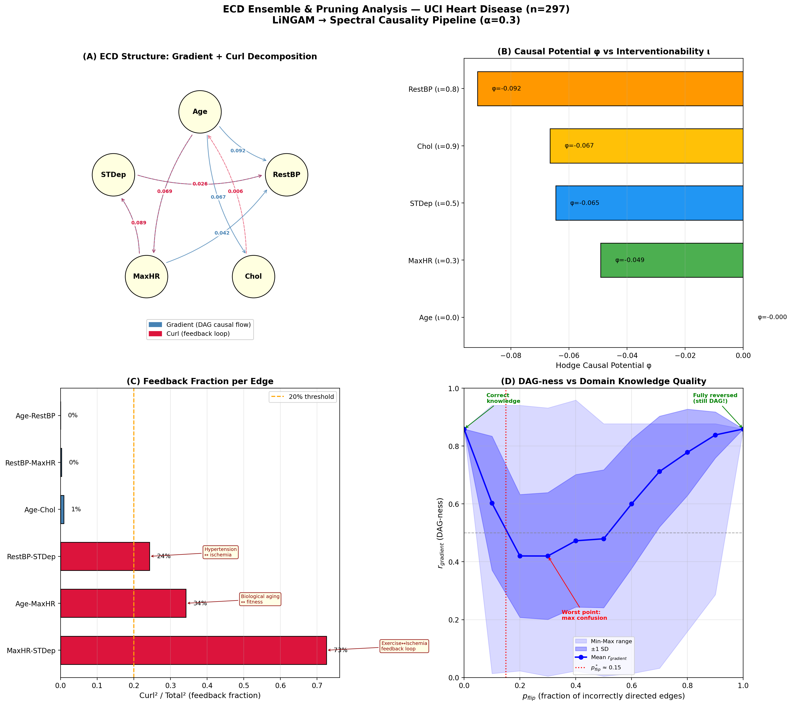
Figure 7: ECD Ensemble & Pruning Analysis
(A) Hodge decomposition. (B) Causal potential vs. interventionability. (C) Edge-level feedback rates. (D) p_flip U-shaped curve.

Slide 8
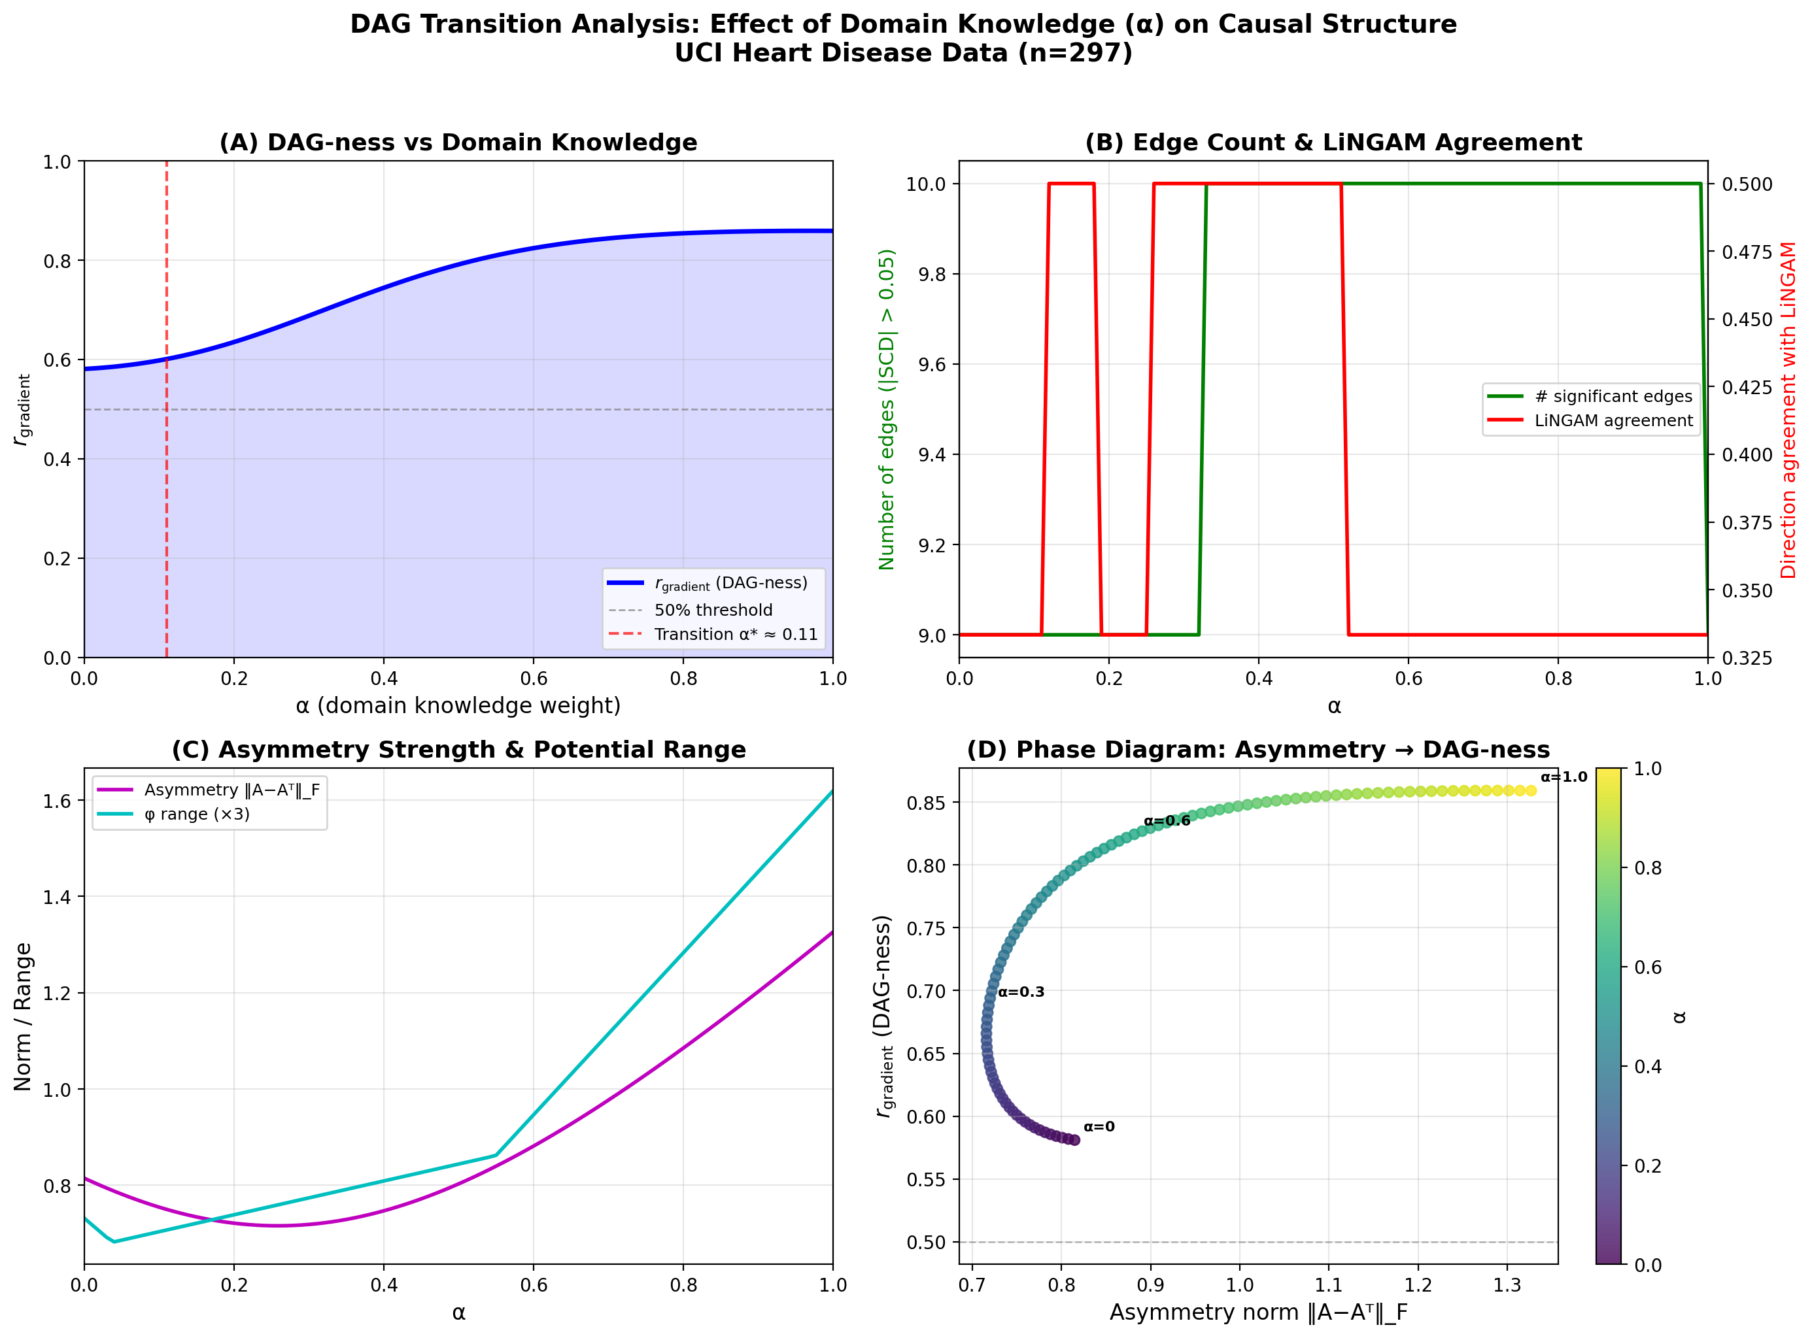
Figure 8: Alpha-Sweep DAG Transition Analysis
(A) r_gradient: 0.581 (alpha=0) to 0.859 (alpha=1.0), smooth transition with DPI. (B) Edge count & LiNGAM agreement. (C) Asymmetric norm. (D) Phase diagram.

