Slide 1
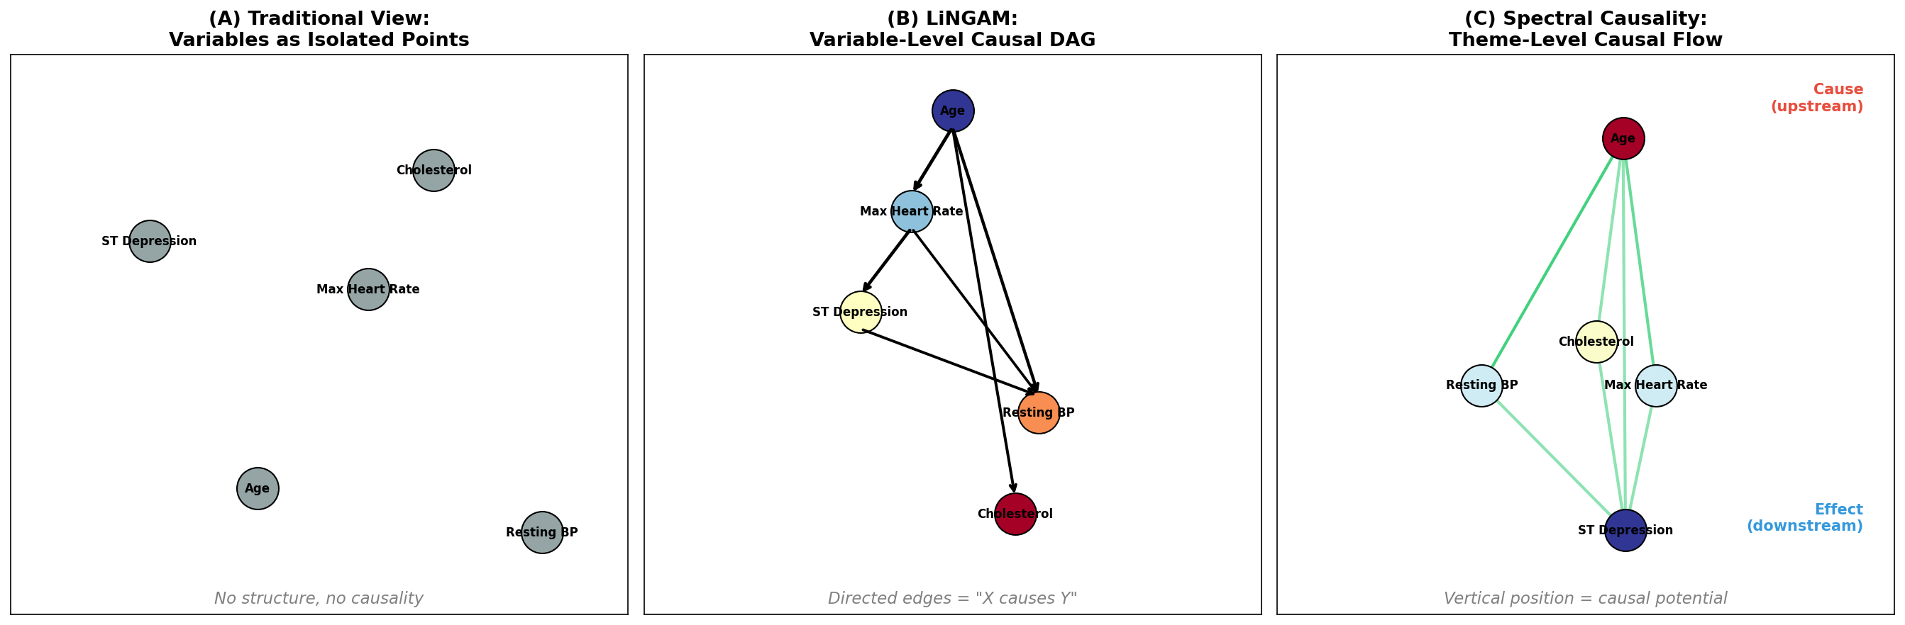
Figure 1: Three Approaches to Causal Inference
Three complementary approaches to causal inference: (1) structural equation models and DAG-based methods (e.g., LiNGAM), (2) spectral graph methods via the magnetic Laplacian, and (3) Hodge-theoretic flow decomposition. Spectral causality unifies (2) and (3).

Slide 2
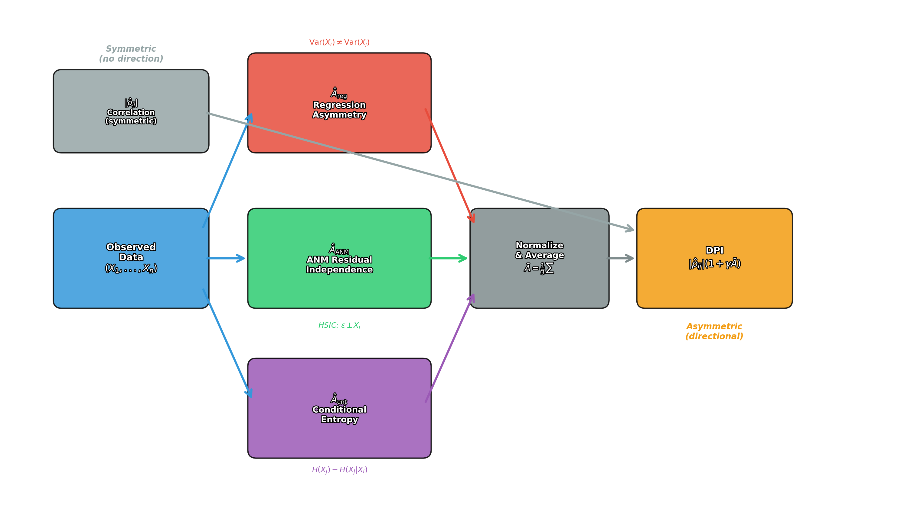
Figure 2: DPI Architecture
Architecture of the Directional Predictability Index (DPI). Three independent asymmetric statistics (regression coefficient asymmetry, ANM residual independence, conditional entropy reduction) are normalized and averaged. The composite asymmetric score modulates the symmetric correlation into the directional DPI.

Slide 3
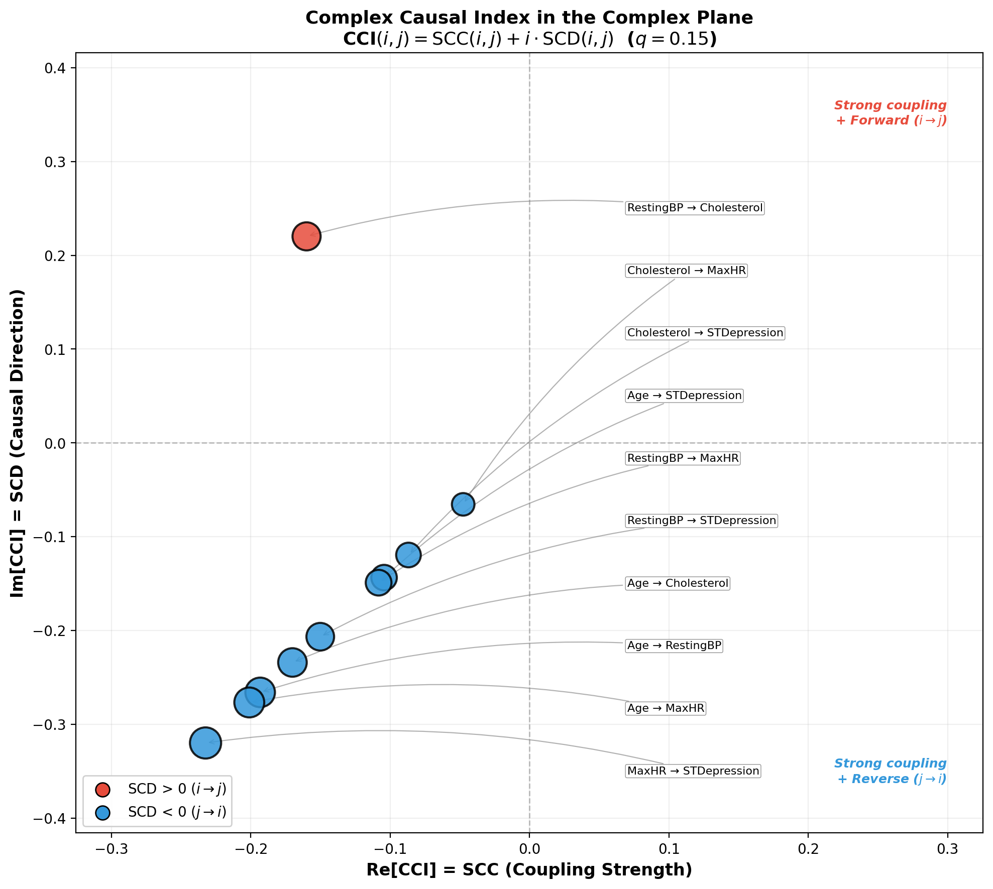
Figure 3: Complex Causal Index in the Complex Plane
CCI(i,j) for all variable pairs plotted in the complex plane. Real axis = SCC (coupling strength); imaginary axis = SCD (causal direction). Red = forward direction (i -> j); blue = reverse. Most pairs cluster in the lower half-plane, reflecting Age's dominance as the upstream root node.

Slide 4
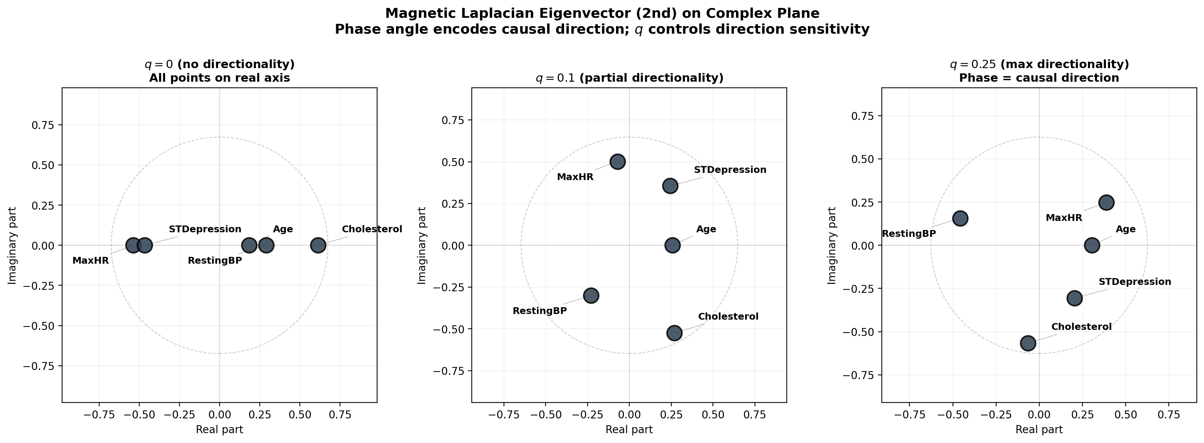
Figure 4: Magnetic Laplacian Eigenvectors in Complex Plane
Fiedler eigenvector of the magnetic Laplacian plotted in the complex plane for q=0, 0.1, and 0.25. At q=0, all points lie on the real axis. As q increases, variables spread into the complex plane, with phase angle ordering reflecting causal flow direction.

Slide 5
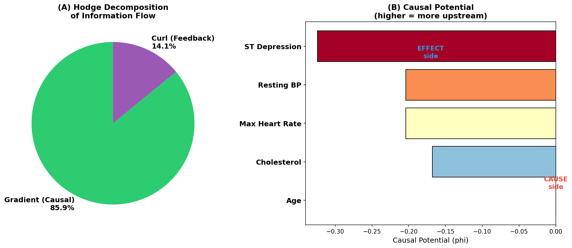
Figure 5: Hodge Decomposition Results
Hodge decomposition results. (A) 85.9% of flow energy is in the gradient (DAG) component; 14.1% is in the curl (feedback) component. (B) Causal potential phi: Age is most upstream; ST Depression is most downstream.

Slide 6
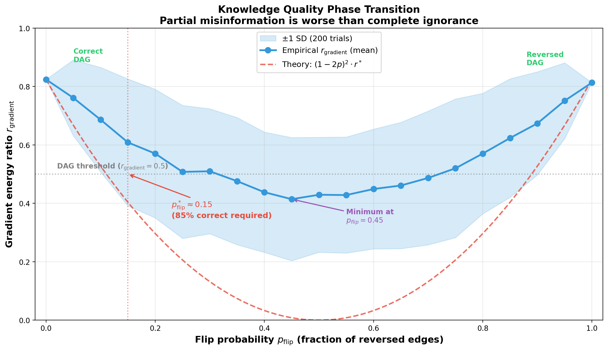
Figure 6: Knowledge Quality Phase Transition
U-shaped quality curve: r_gradient vs p_flip. Empirical results (200 trials, blue) closely match theoretical prediction (1-2p)^2 * r* (red dashed). Critical threshold p*_flip ~ 0.15: at least 85% correct directions needed. Partial misinformation is worse than complete ignorance.

Slide 7
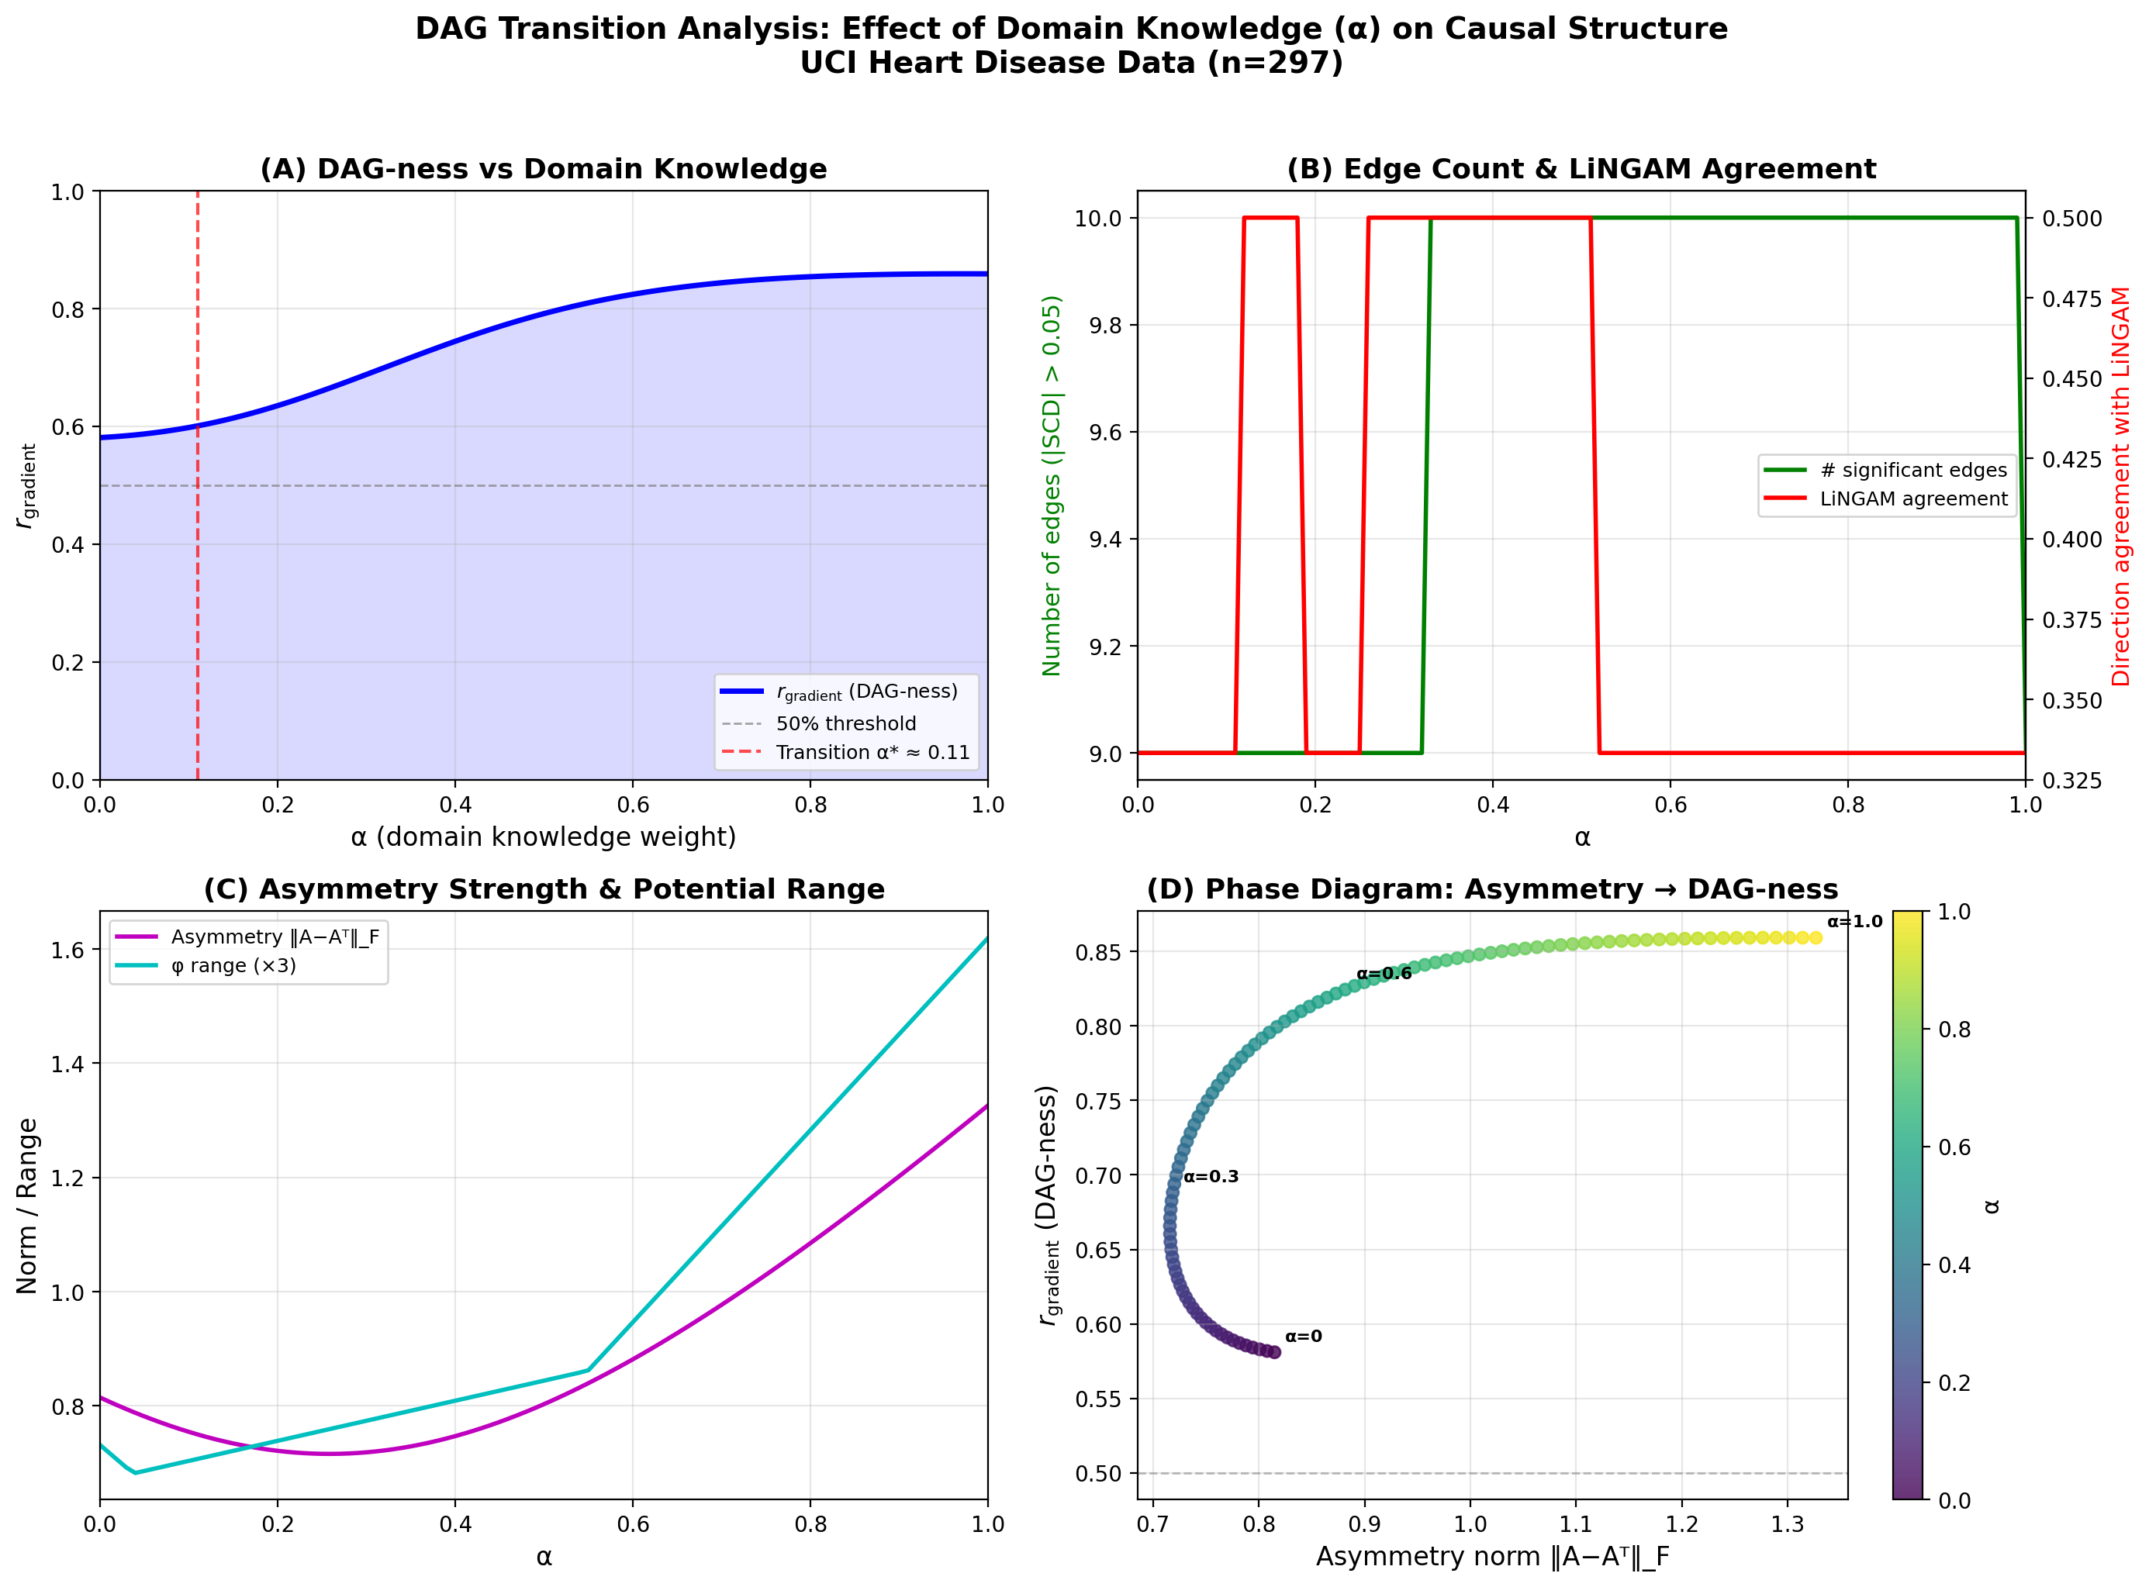
Figure 7: Alpha-Sweep Phase Transition Analysis
Alpha-sweep analysis with DPI. (A) r_gradient increases smoothly from 0.581 (alpha=0) to 0.859 (alpha=1). (B) Number of detected edges and LiNGAM agreement rate. (C) Asymmetric norm. (D) Phase diagram.

