Slide 1
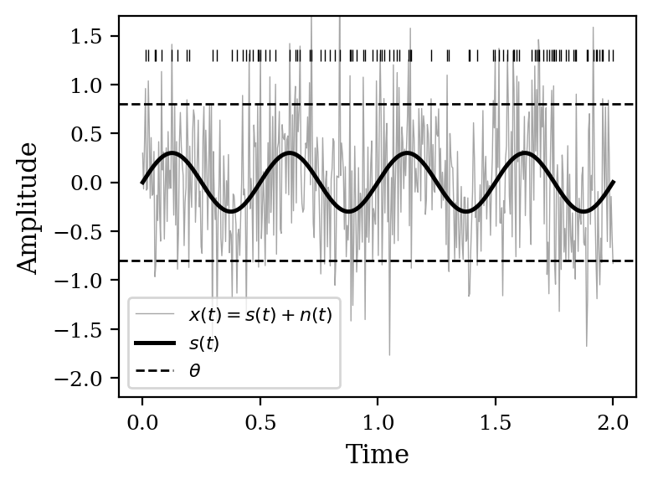
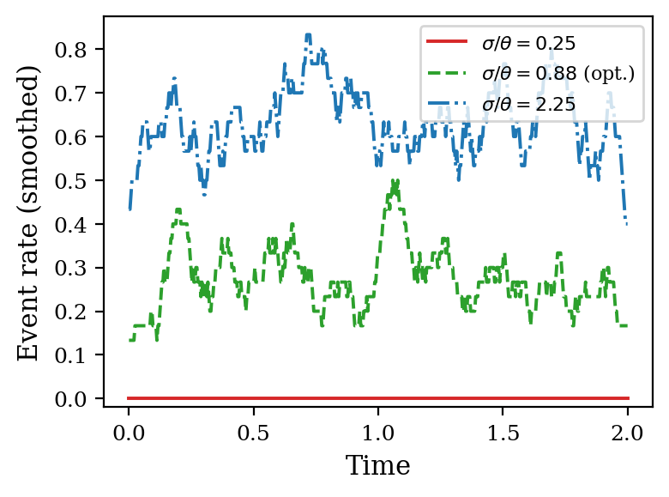
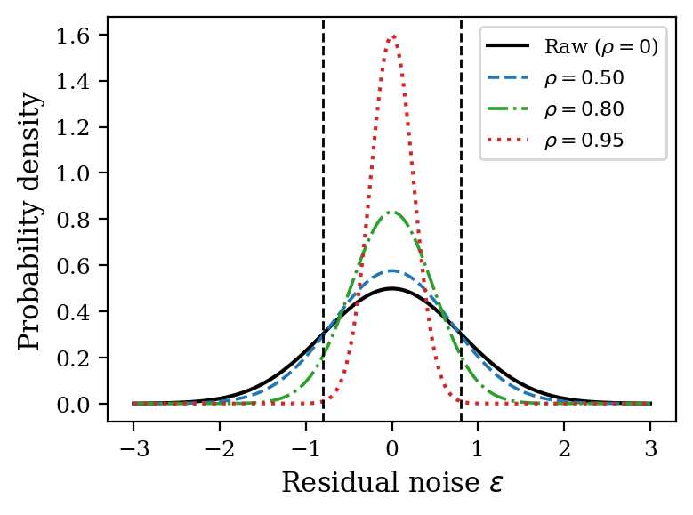
Figure 1: Covariate-adjusted SR framework
(a) Threshold detector
(b) Stochastic resonance
(c) Covariate adjustment
Signal s(t) + noise n(t) → threshold θ → events E(t)
Event-rate modulation peaks at intermediate noise (σ ≈ θ)
Adjustment narrows noise pdf, shifts operating point on SR curve
FIG. 1. Conceptual schematic of covariate-adjusted SR. (a) Threshold detector: subthreshold signal + noise → events. (b) SR: event-rate modulation peaks at σ ≈ θ. (c) Covariate adjustment with correlation ρ narrows the residual, equivalent to leftward shift on the SR curve.

Slide 2
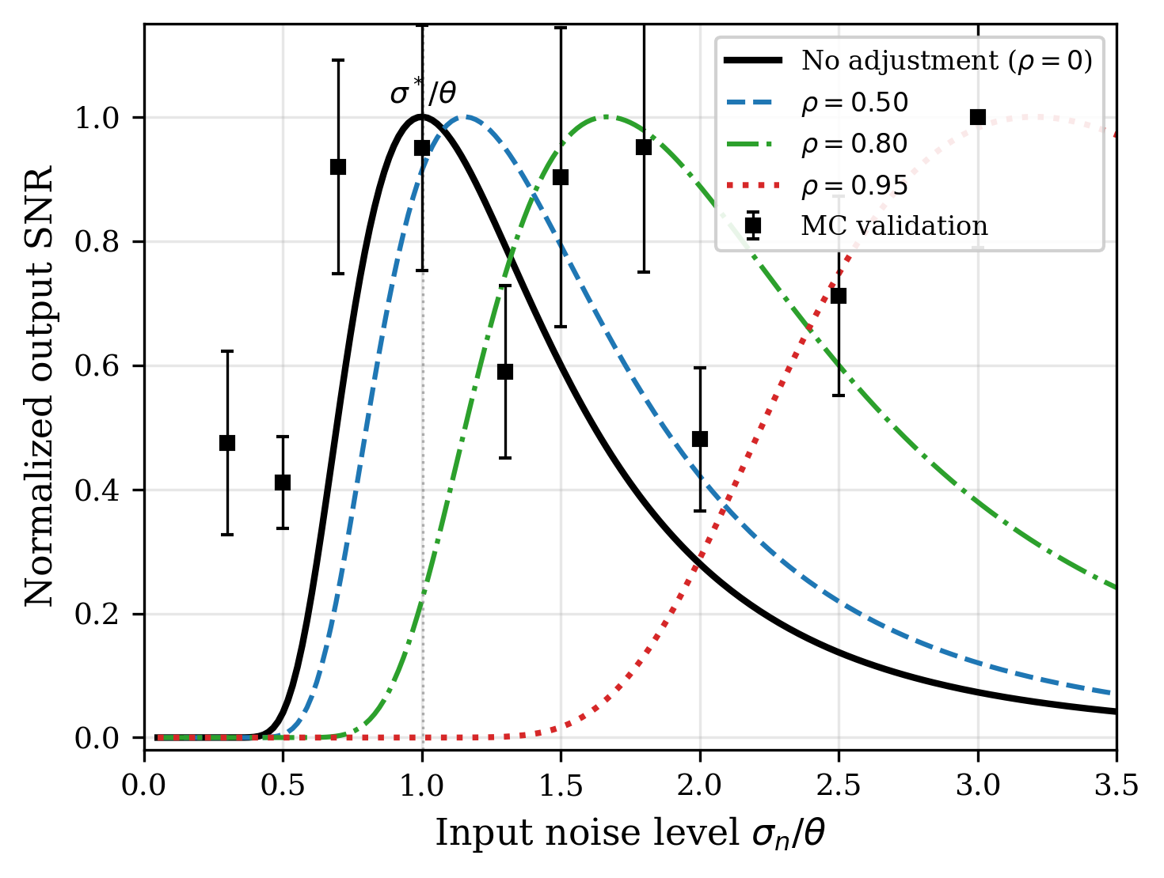
Figure 2
SR curves for a threshold detector (A/θ = 0.3). Solid: analytical SNR. Circles: Monte Carlo (15 trials). Covariate adjustment shifts the peak rightward.

Slide 3
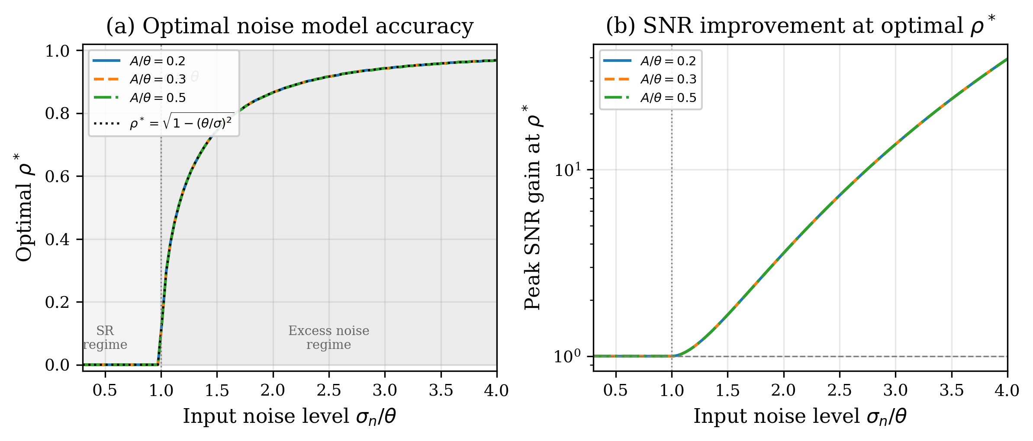
Figure 3
Optimal model accuracy ρ* and SNR improvement. (a) ρ* = 0 in the SR regime (σ < θ); rises steeply for σ > θ. (b) SNR gain at optimal ρ* grows exponentially with input noise.

Slide 4
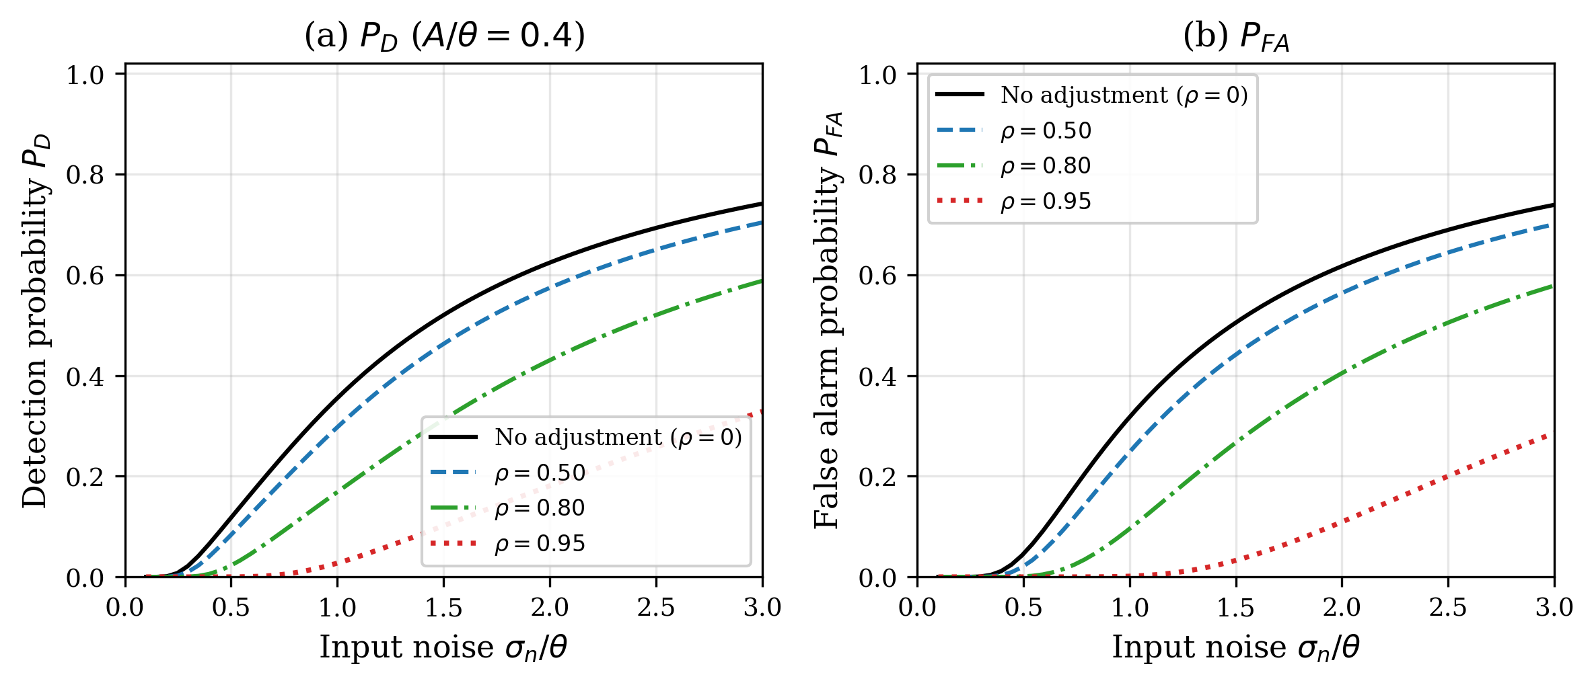
Figure 4
P_D and P_FA vs. input noise for different ρ (A/θ = 0.4). Higher ρ suppresses both by reducing effective noise.

Slide 5
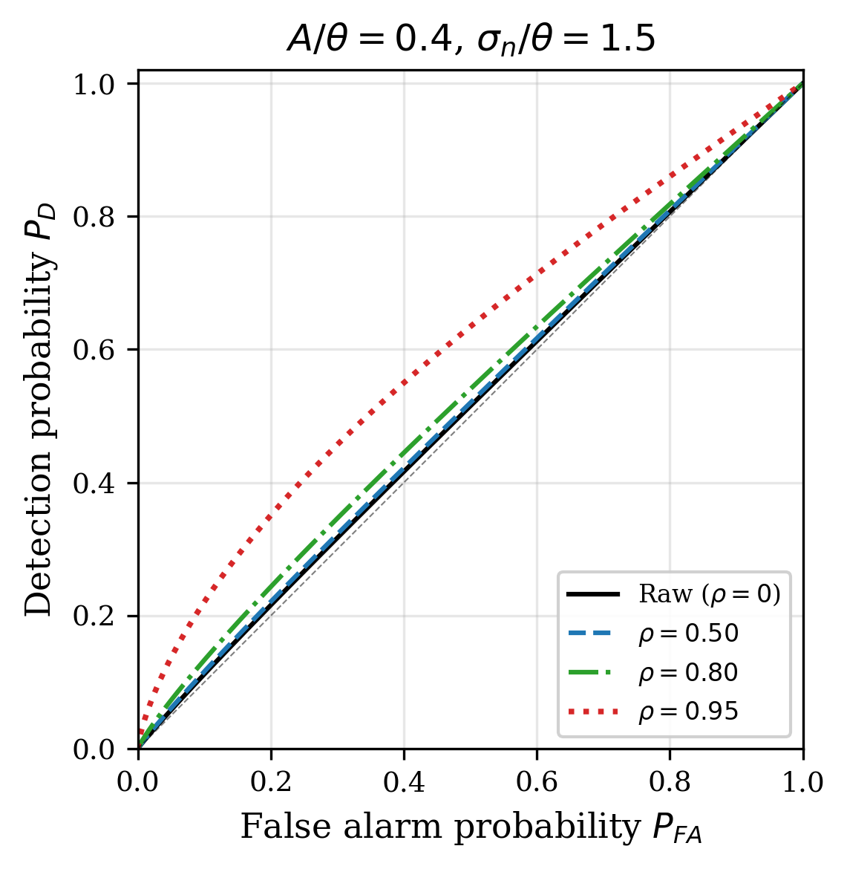
Figure 5
ROC curves at σ/θ = 1.5 (excess noise regime, A/θ = 0.4). Higher ρ improves discrimination.

Slide 6
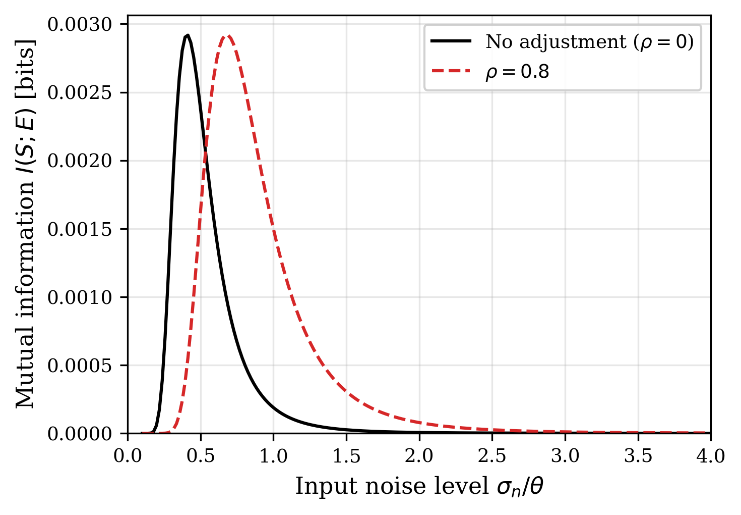
Figure 6
Mutual information I(S; E) vs. input noise. SR peak shifts rightward with covariate adjustment (ρ = 0.8).

Slide 7
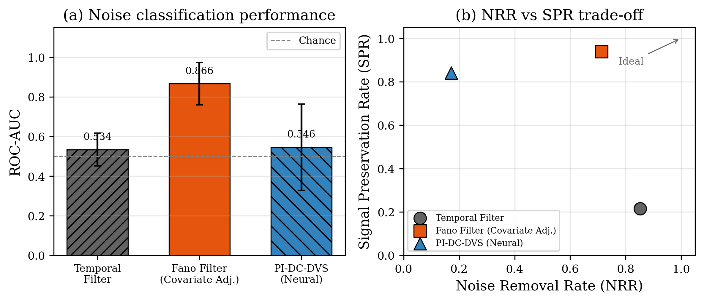
Figure 7
DVS astronomical observation (EBSSA, 20 recordings). (a) ROC-AUC: Fano filter 0.866 vs temporal 0.534. (b) NRR-SPR: 71.3% noise removed, 93.9% signal preserved.

