Slide 1
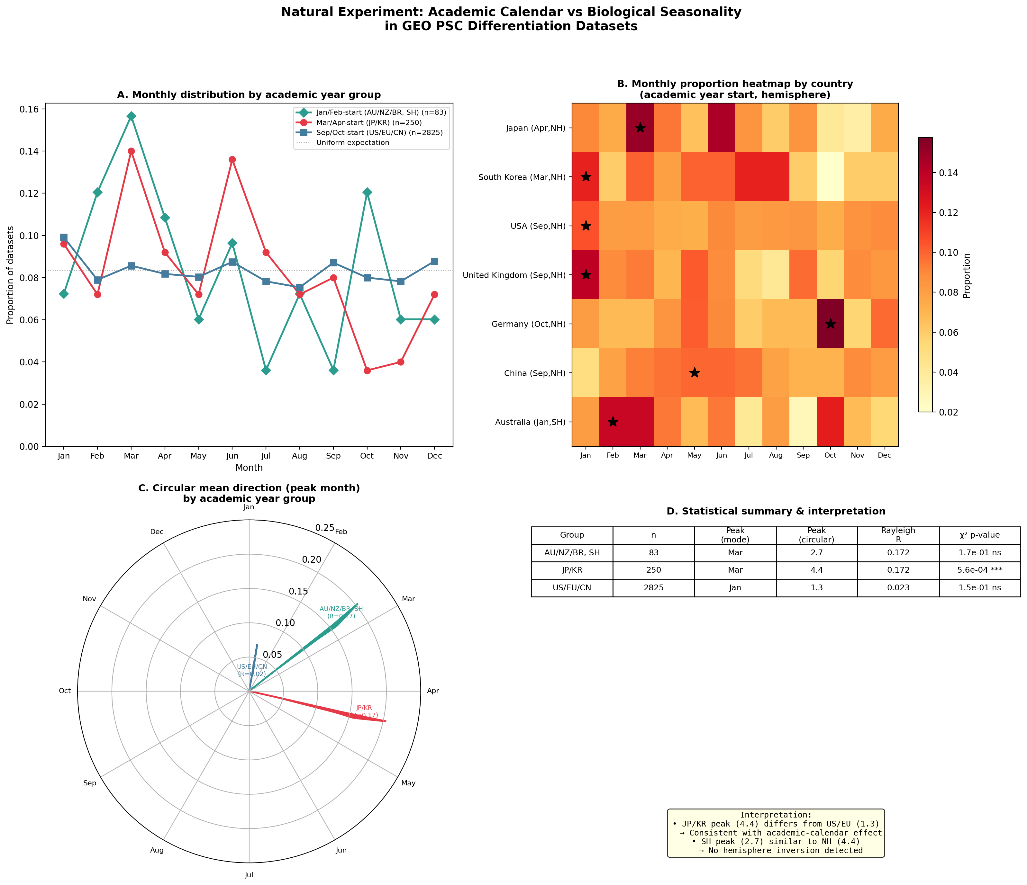
Figure 1. Academic Calendar Variation as a Natural Experiment
(A) Normalized monthly distributions by academic year group. (B) Country-level heatmap. (C) Circular mean directions (Rayleigh vectors). (D) Statistical summary. n=6,101 total; 3,195 with country affiliation.

Slide 2
Figure 2. Research Roadmap for Environmental Profiling
A. Evidence Matrix
• Humidity/Osmolarity: Direct PSC evidence [Inverted]
• VOCs: Direct IVF + PSC evidence [Inverted]
• Photoperiod/Light: Indirect (CRY1, IVF) [Inverted]
• EMF (50/60 Hz): Direct ESC evidence [N/A]
• Barometric pressure: Theoretical [Synchronous]
• Cosmic rays: Indirect (fibroblast) [Synchronous]
B. Three-Phase Strategy
Phase I: Passive Monitoring
→ Multi-parameter IoT sensors
→ 12 months continuous
→ Paired with differentiation outcomes
Phase II: Registry Mining
→ HFEA (UK, 51°N)
→ ANZARD (Australia, 33°S)
→ Hemisphere-inversion test
Phase III: Controlled Intervention
→ Humidity-controlled incubators
→ Light-tight biosafety cabinets
→ EMF shielding

Slide 3
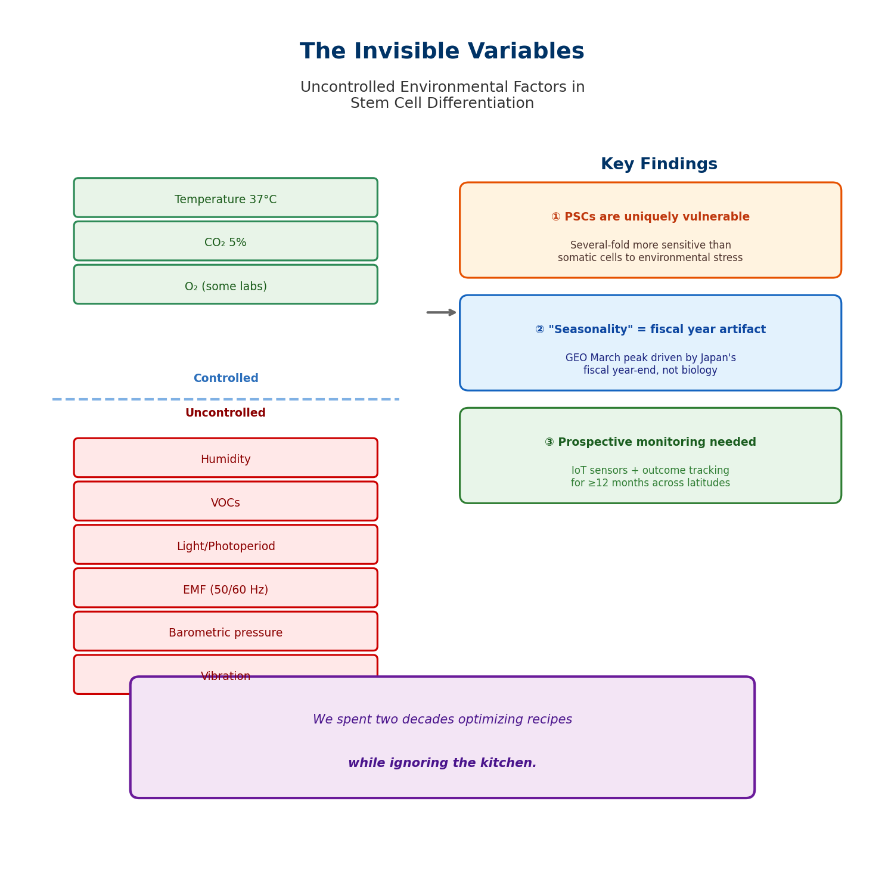
Graphical Abstract

