Slide 1
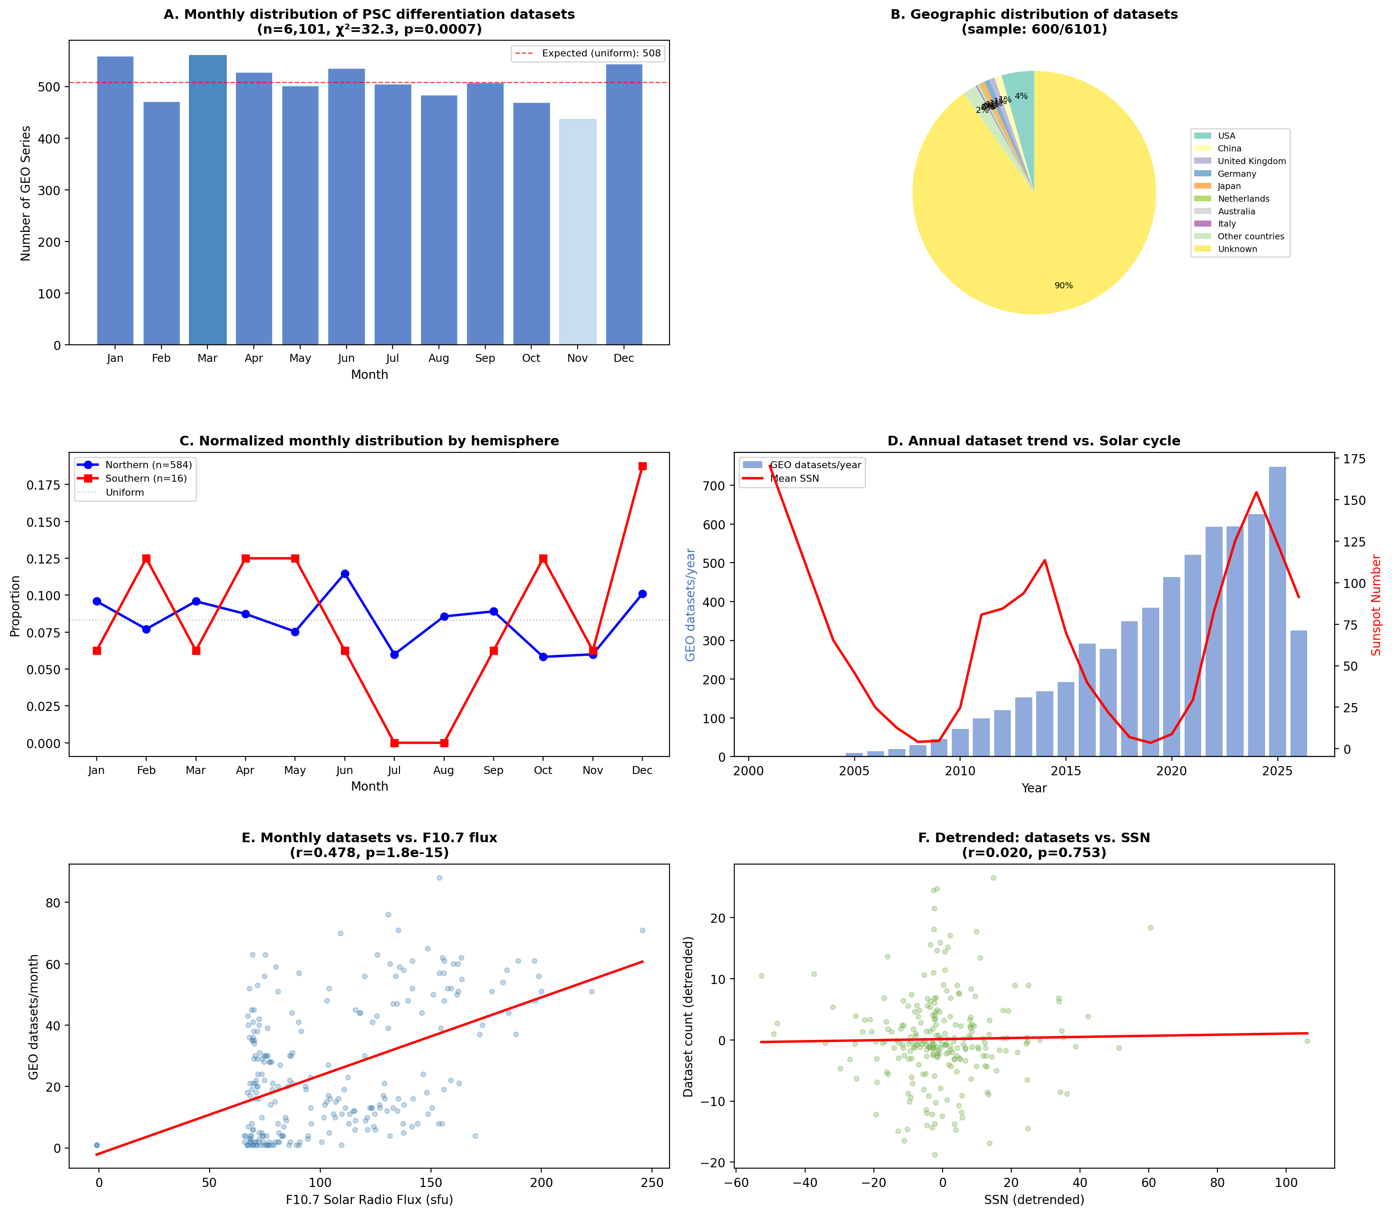
Figure 1. Temporal and Geographic Patterns in GEO PSC Datasets
(A) Monthly distribution with chi-square test. (B) Country distribution. (C) Hemisphere comparison. (D) Annual trend vs solar cycle. (E) F10.7 correlation. (F) Detrended SSN correlation.

Slide 2
Figure 2. Study Design, Limitations, and Proposed Next Steps
A. Data Sources
B. Key Findings
C. Limitations & Next Steps
GEO (NCBI) 6,101 PSC datasets 2001–2026
✓ Seasonal non-uniformity χ²=32.3, p=0.0007
Submission date ≠ Experiment date 6–18 month lag obscures signal
Hemisphere imbalance (97:3) Cannot test photoperiod inversion
NOAA SWPC Solar indices (F10.7, SSN)
✗ Hemisphere comparison 97% NH, only 3% SH
Institutional cycles Academic calendar confound
GEO SOFT Country metadata (n=600 sample)
✗ Solar correlation Detrended r=0.02, p=0.75
↓ Proposed solutions ↓
HFEA Registry (UK) Cycle-level IVF data, 51°N
ANZARD (Australia) Southern Hemisphere, −33°S
Environmental monitoring Humidity, light, EMF in PSC labs
Figure 2. Schematic overview of the study design, key findings, principal limitations, and proposed next steps for hypothesis testing.

