Slide 1
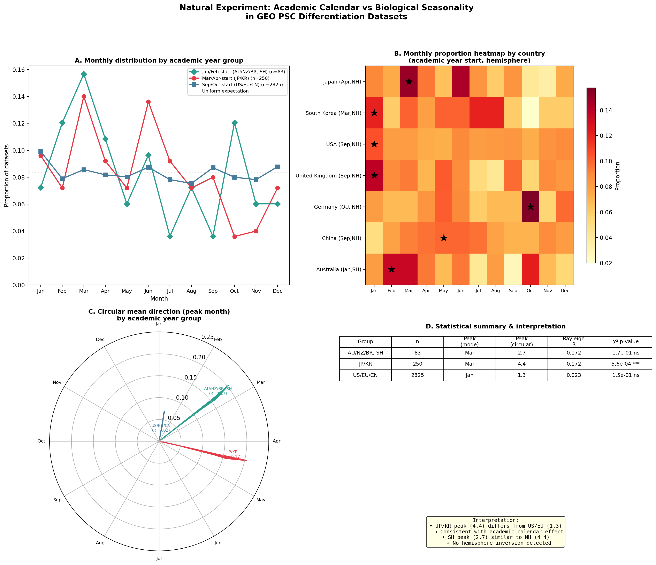
Figure 1. Natural Experiment: Academic Calendar vs Biological Seasonality
Geographic variation in academic year start months used as natural experiment. Japan/Korea (Mar/Apr, n=250): significant March peak (p=0.0006). USA/EU/CN (Sep/Oct, n=2,825): no significant seasonality. Sensitivity: removing Japan eliminates March peak from full dataset.

