Slide 1
Figure 1. TATSUKI Conceptual Overview
Trust-Adjusted Transparent Scoring with Unified Knowledge Integration (襷) — 6-Phase Cycle
Phase 1
Pledge Declaration
w₁, w₂, …, wₖ (Σ=1)
Phase 2
Election
(weighted ballots)
Phase 3
Term in Office
(interim eval: O/P/E)
Next Cycle
Phase 6
Trust Update
τ(S) → next election
Phase 5
Accountability Score
S = Σ wⱼ·fⱼ
Phase 4
Fulfillment Eval
fⱼ ∈ [0,1] per pledge
Core Equations
Accountability Score: Sᶜ = Σ wⱼ · fⱼ where Σwⱼ = 1
Candidate Trust: τᶜ⁽ᵗ⁺¹⁾ = ω(Sᶜ⁽ᵗ⁾) where ω: [0,1] → [τₘᵢₙ, τₘₐₓ]
Effective Vote: V_eff(c) = τᶜ · nᶜ (raw votes for candidate c)
Figure 1. Conceptual overview of the TATSUKI mechanism showing the six phases of each electoral cycle: pledge declaration, election, term in office, fulfillment evaluation, accountability score computation, and trust coefficient update.

Slide 2
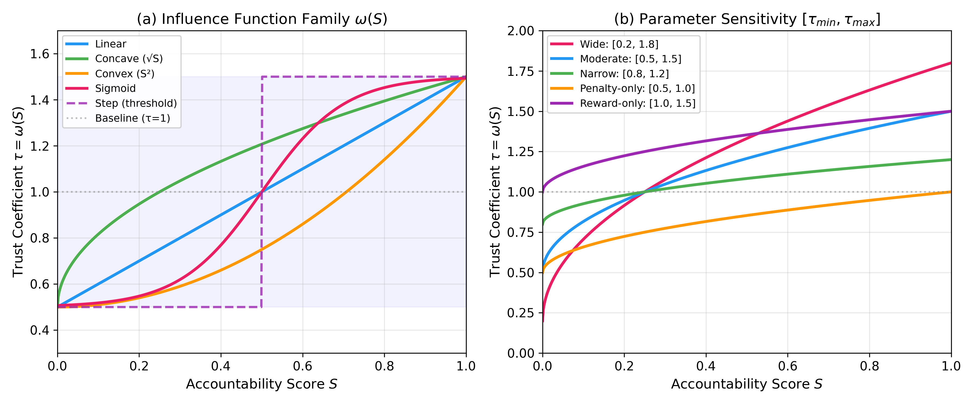
Figure 2. Influence Function Family ω(S)
Figure 2. (a) Different influence function specifications mapping accountability score S to trust coefficient τ. (b) Parameter sensitivity for the concave specification across different [τ_min, τ_max] ranges.

Slide 3
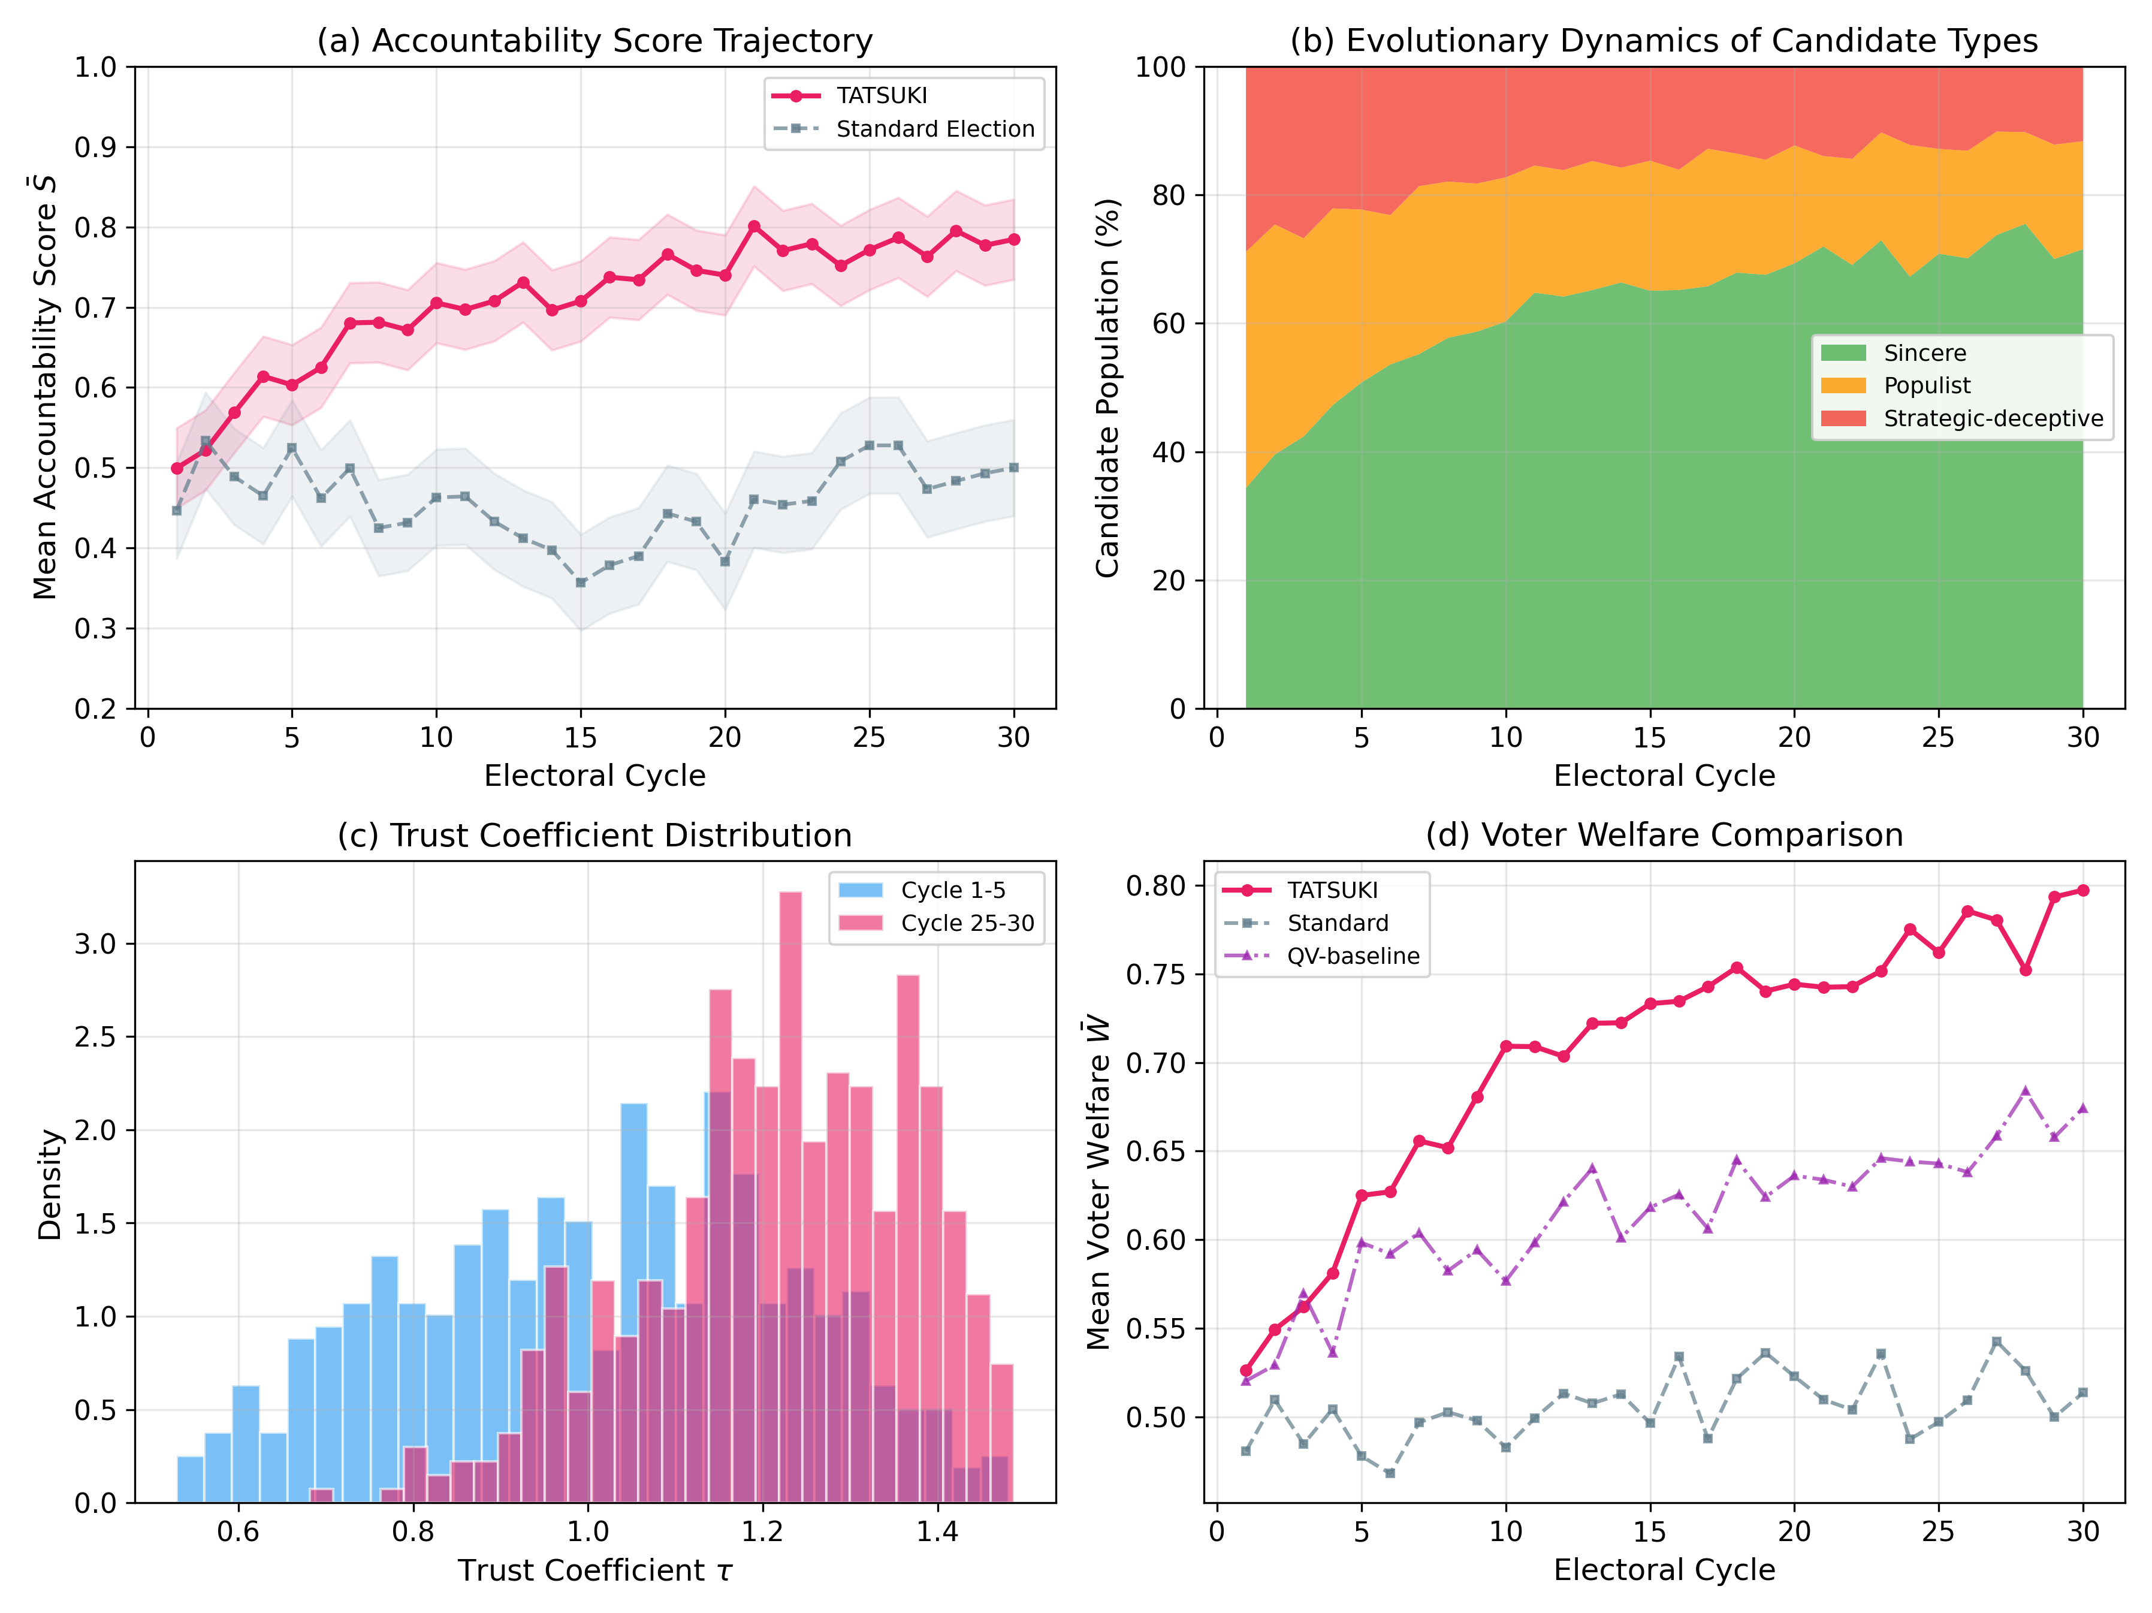
Figure 3. Baseline Simulation Results
Figure 3. (a) Mean accountability score trajectory. (b) Evolutionary dynamics of candidate types. (c) Trust coefficient distribution shift. (d) Voter welfare comparison across systems.

Slide 4
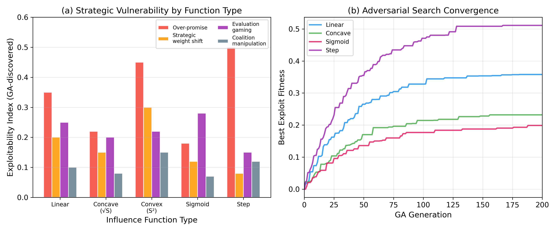
Figure 4. Adversarial Robustness Analysis
Figure 4. (a) Exploitability index by strategy type and influence function. (b) Genetic algorithm convergence for adversarial strategy search.

Slide 5
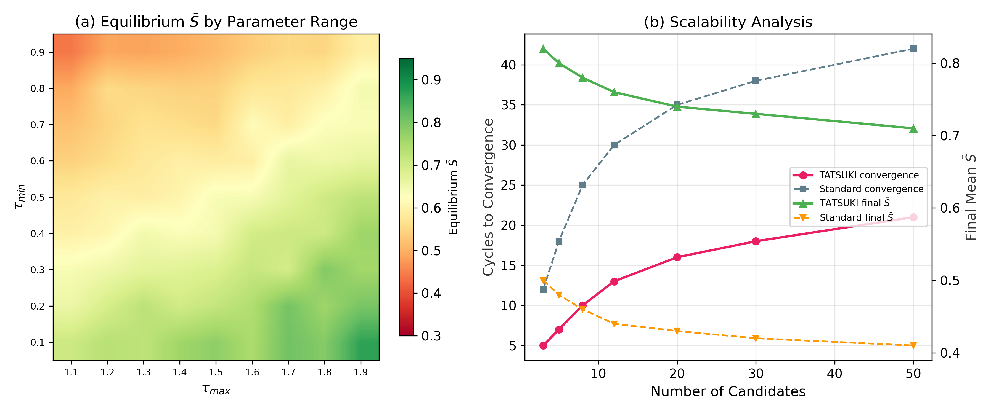
Figure 5. Sensitivity Analysis
Figure 5. (a) Heatmap of equilibrium accountability score as a function of τ_min and τ_max. (b) Scalability analysis across candidate pool sizes.

Slide 6
Figure 6. Theoretical Positioning of TATSUKI
← Retro.
Traditional Democracy
Radical Reform
Futarchy
Standard Election
Liquid Democracy
Weighted Voting
Quadratic Voting
Barro-Ferejohn Model
TATSUKI (This Paper)
Retrospective Voting (Fiorina)
Prosp. →
Accountability Focused
Mechanism Design
Degree of Departure from One-Person-One-Vote →
Figure 6. Positioning of TATSUKI relative to existing electoral reform approaches. Horizontal axis: departure from OPOV. Vertical axis: temporal orientation (retrospective to prospective).

Slide 7
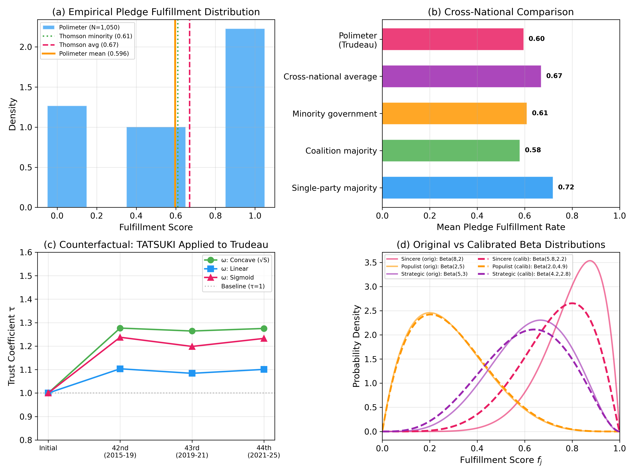
Figure 7. Empirical Calibration & Counterfactual Analysis
Figure 7. (a) Empirical pledge fulfillment distribution from Polimeter (N=1,050). (b) Cross-national comparison of mean fulfillment rates. (c) Counterfactual TATSUKI trust trajectory for Trudeau. (d) Original vs empirically calibrated Beta distributions.

