Slide 1
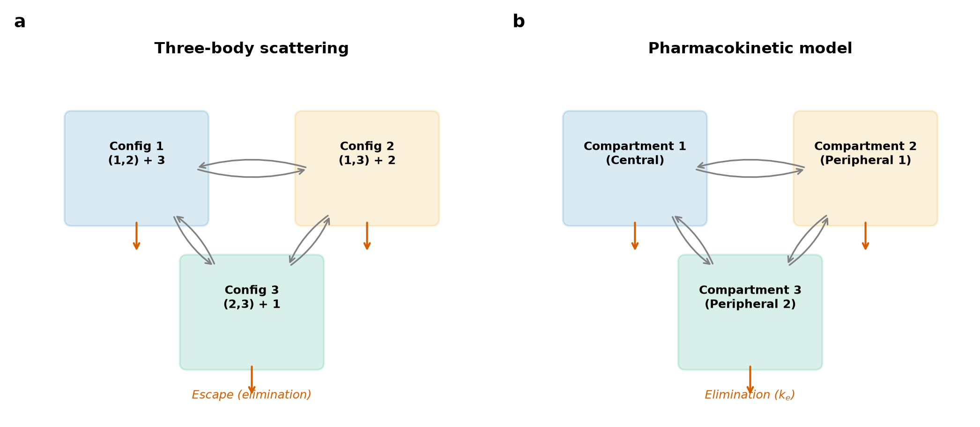
Figure 1
Three-body scattering mapped onto PK compartments

Slide 2
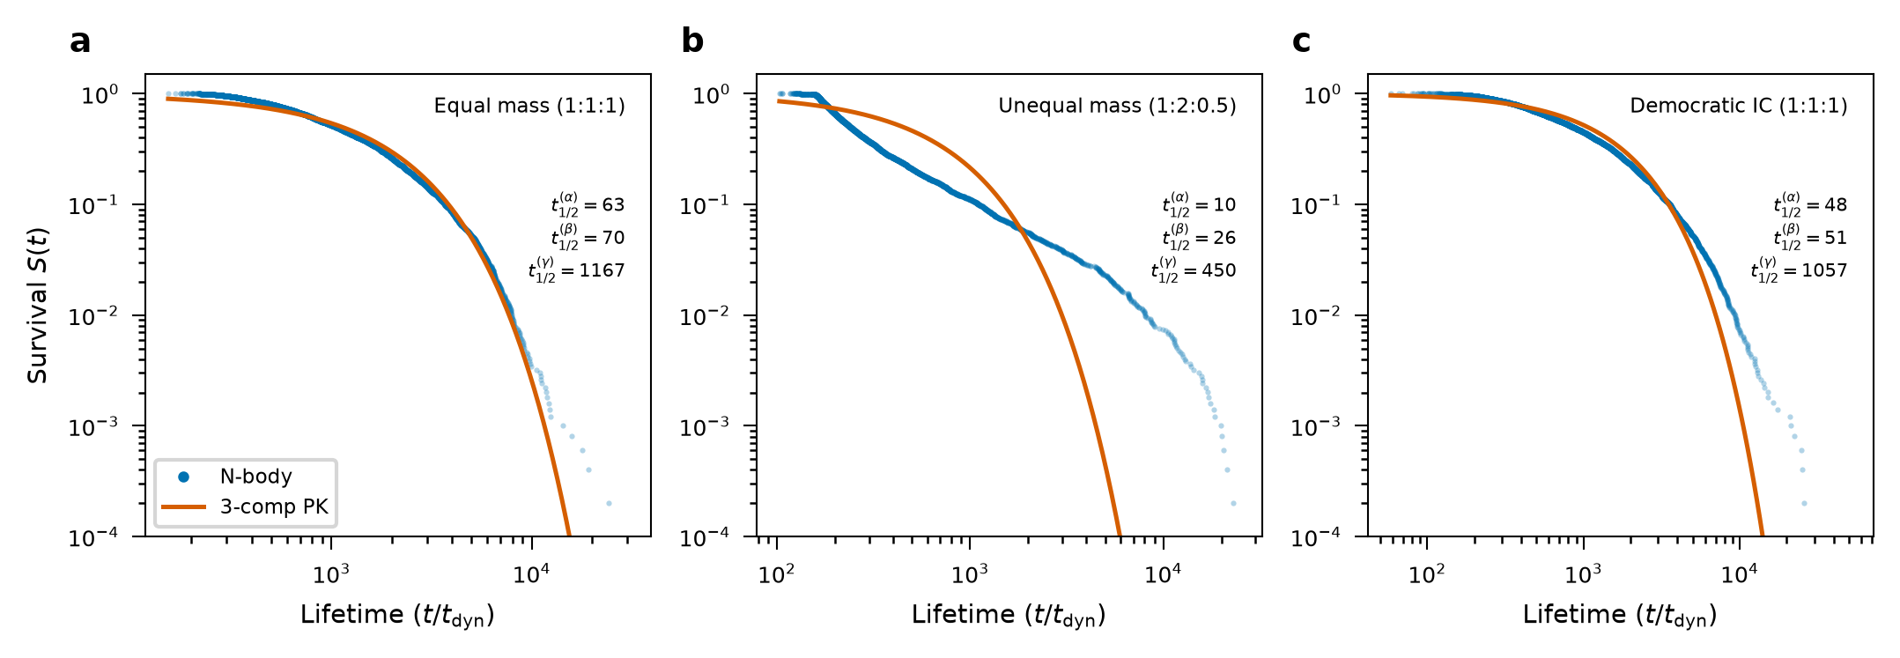
Figure 2
Survival curves: linear PK model fits N-body data

Slide 3
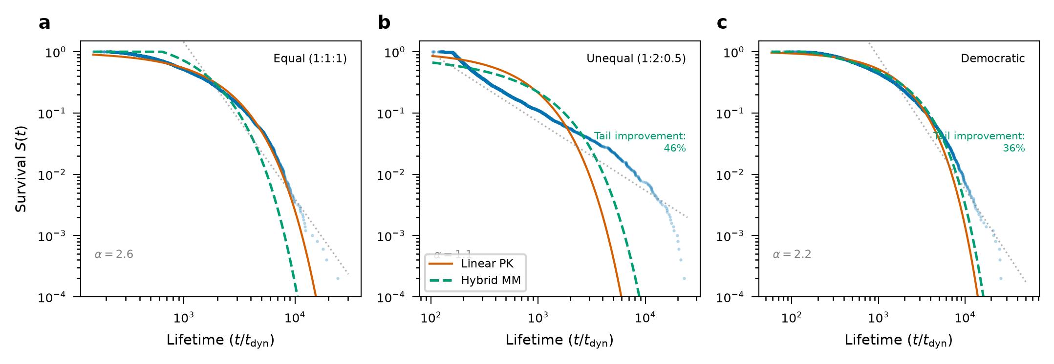
Figure 3
Nonlinear PK captures sticky chaos tail

Slide 4
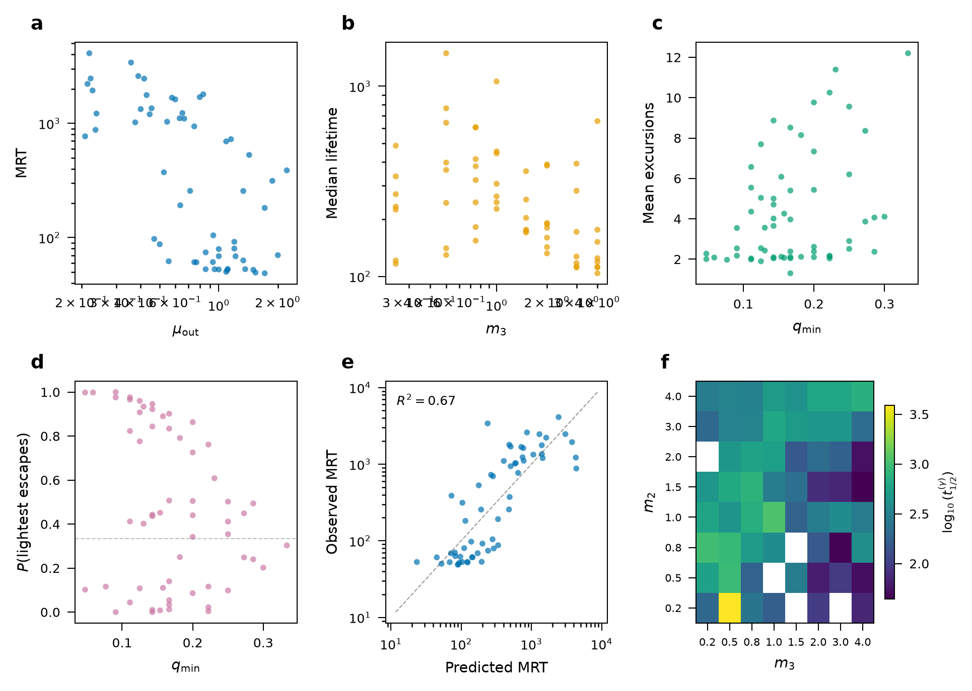
Figure 4
Population PK: mass-ratio dependence (6 panels)

Slide 5
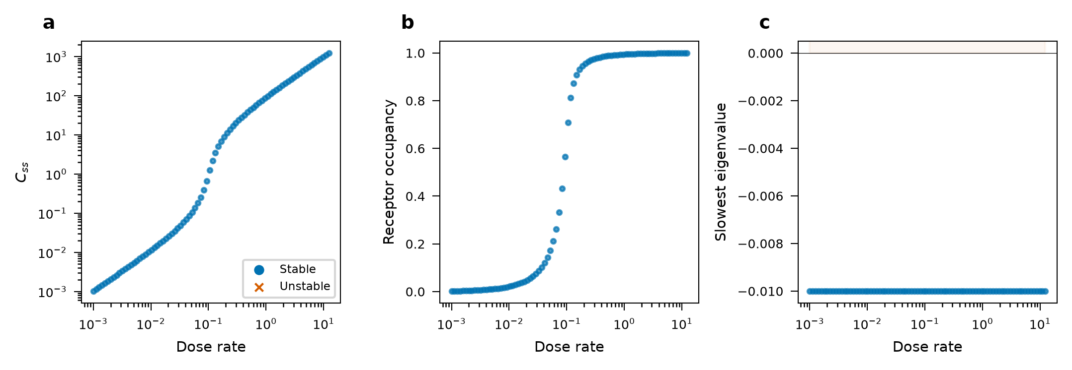
Figure 5
TMDD reverse application: dose-response bifurcation

