Slide 1
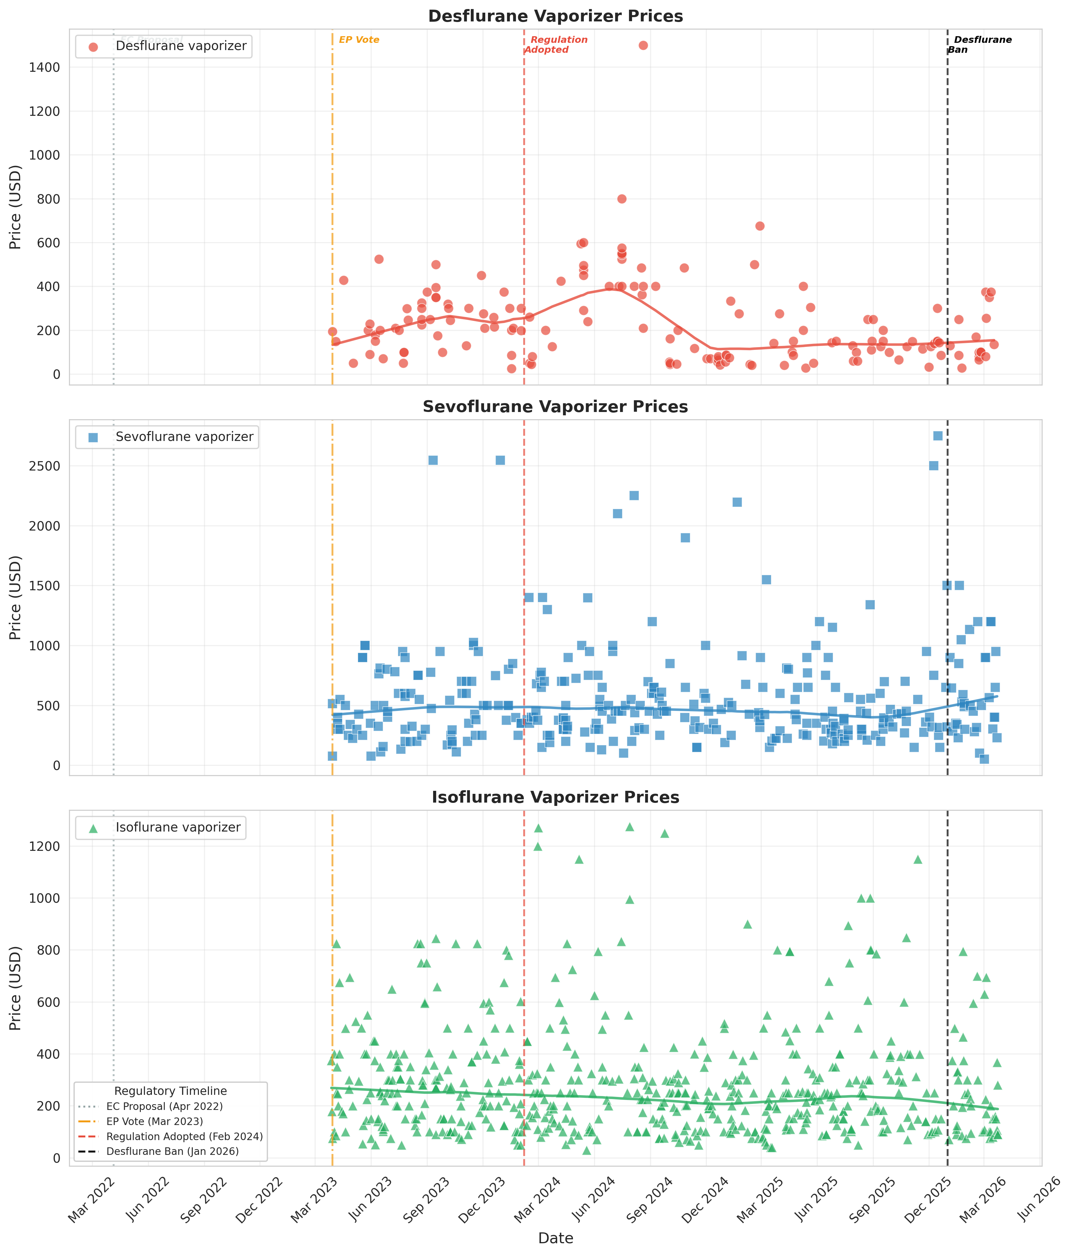
Fig. 1
Fig. 1. Time series of eBay completed sale prices for desflurane (red), sevoflurane (blue) and isoflurane (green) vaporisers over three years (March 2023 to March 2026). Vertical dashed lines indicate key EU regulatory milestones. Curved lines represent LOWESS trend estimates (fraction = 0.3).

Slide 2
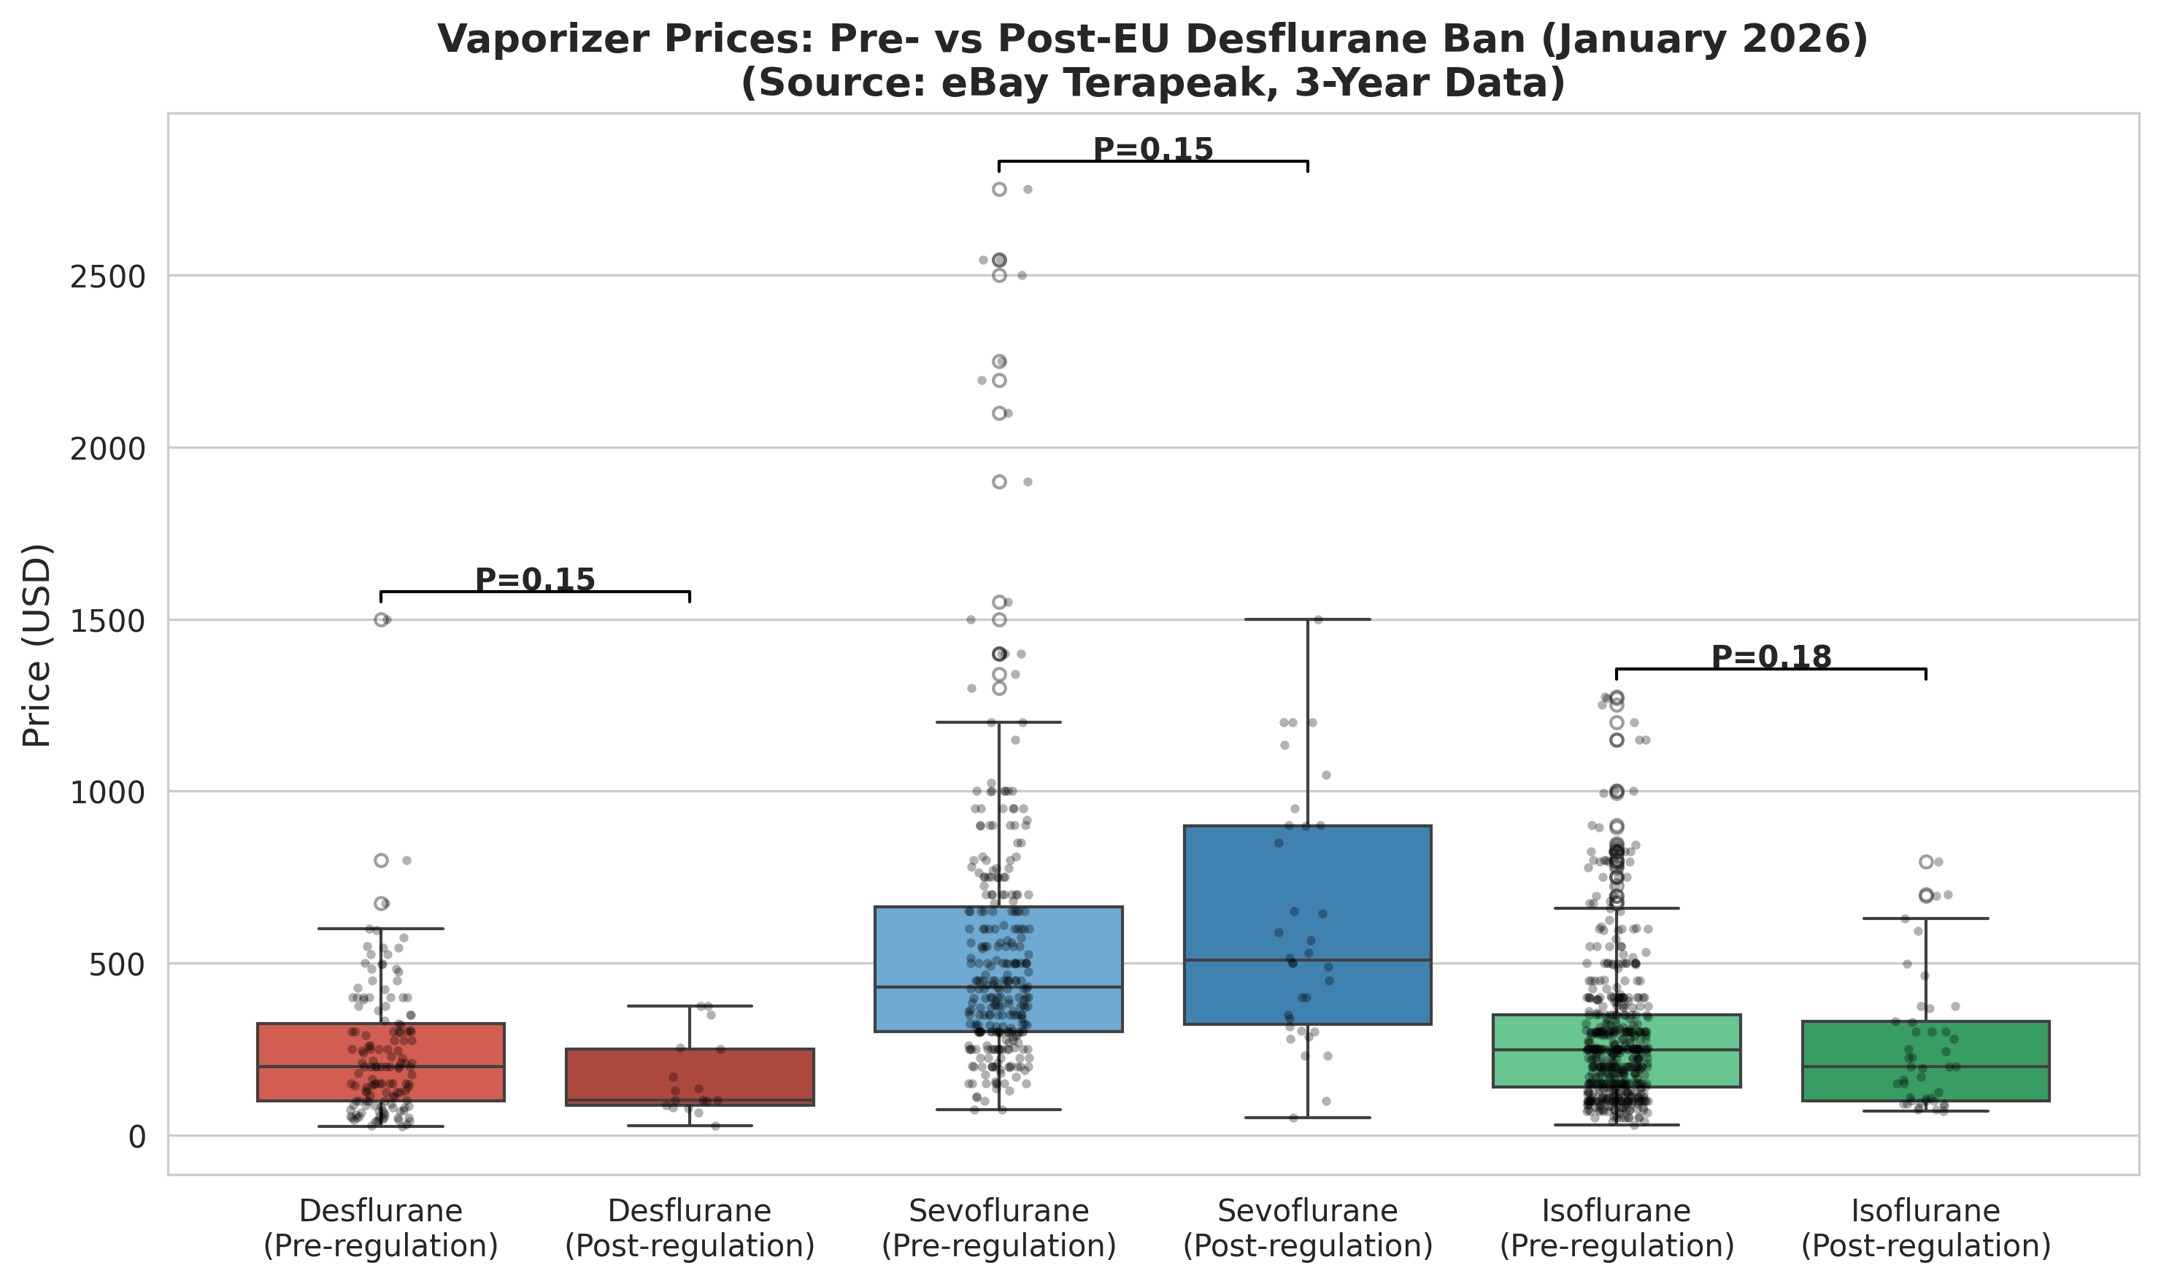
Fig. 2
Fig. 2. Box plot comparison of vaporiser prices before and after the EU desflurane ban (1 January 2026). Individual data points are shown as jittered dots.

Slide 3
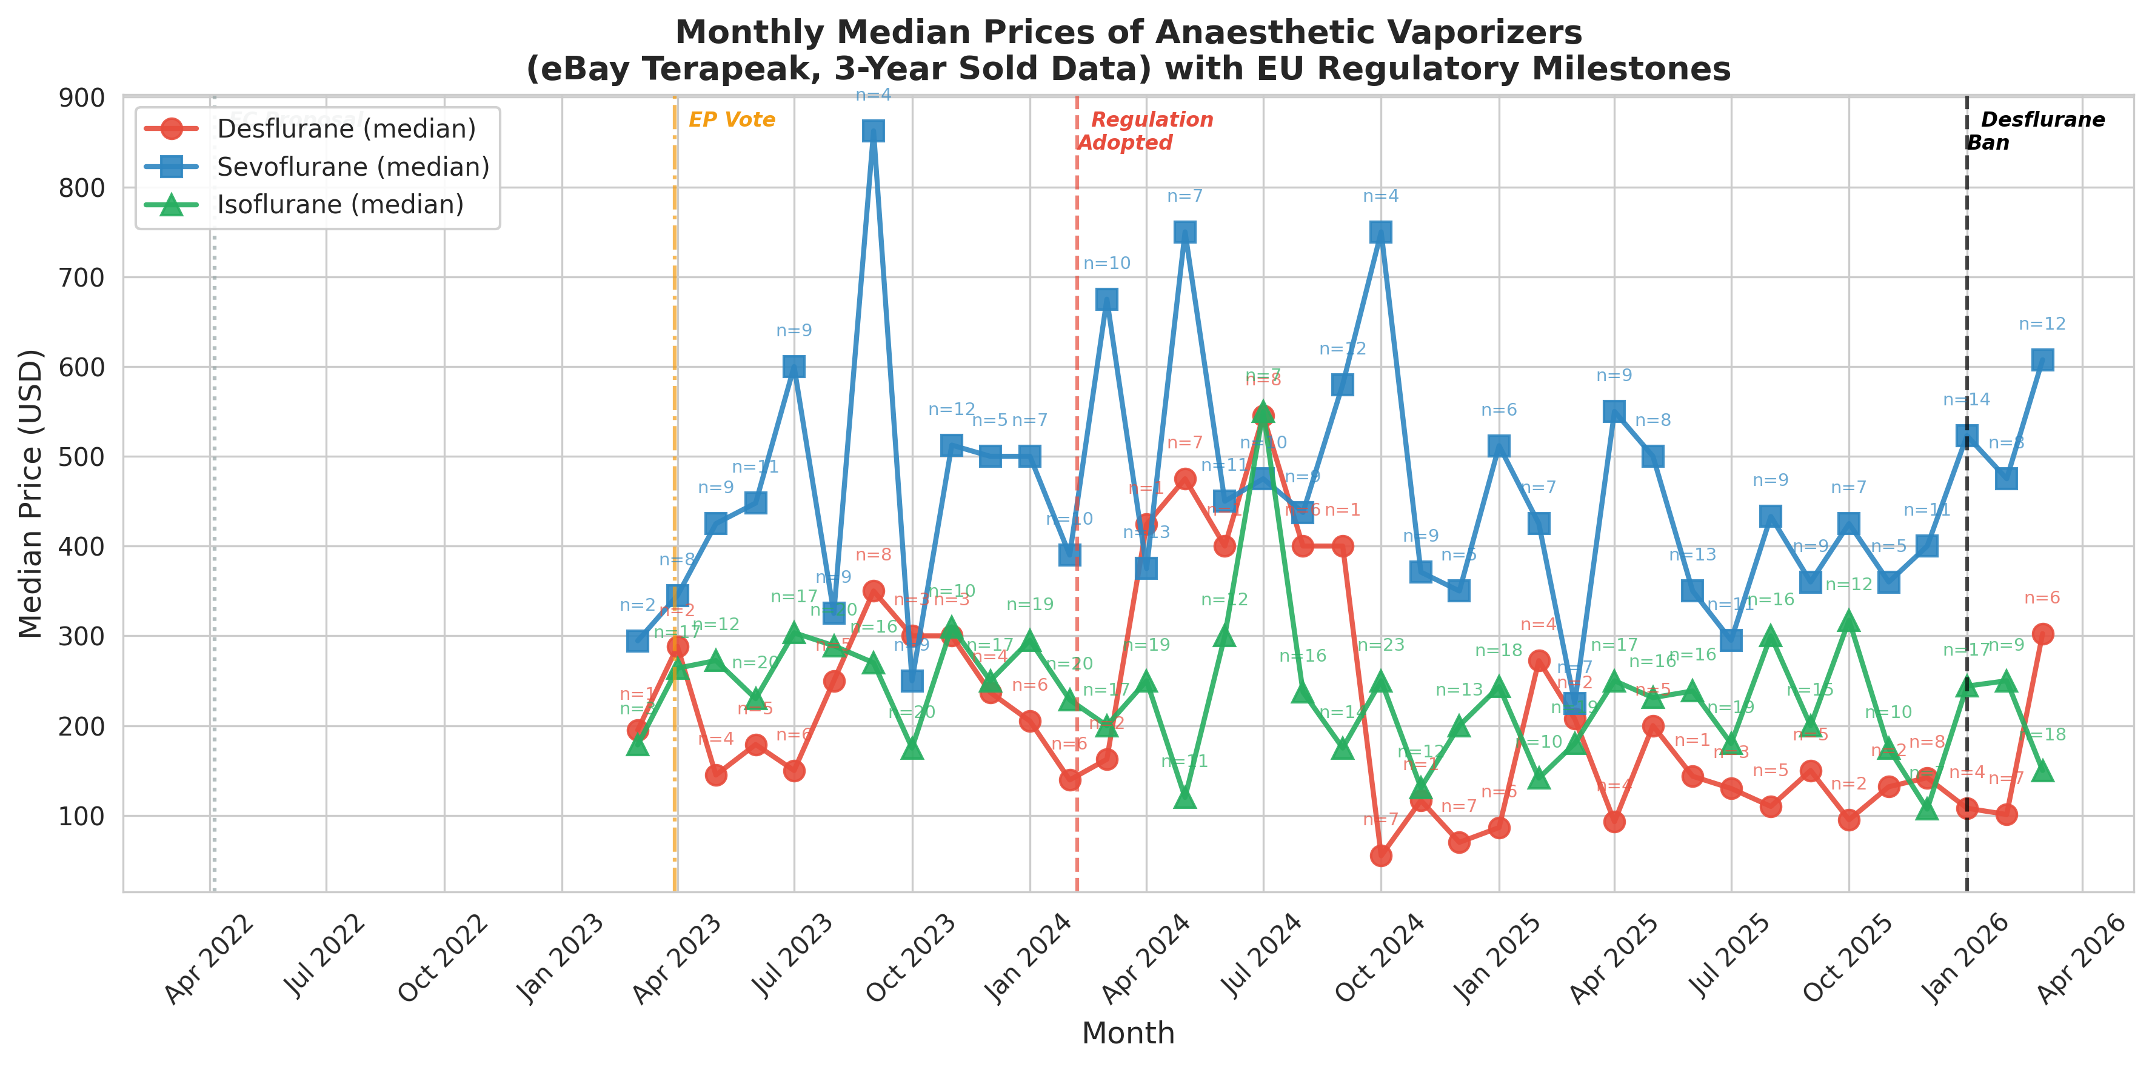
Fig. 3
Fig. 3. Monthly median prices of anaesthetic vaporisers on eBay. Annotations indicate the number of transactions per month (n).

Slide 4
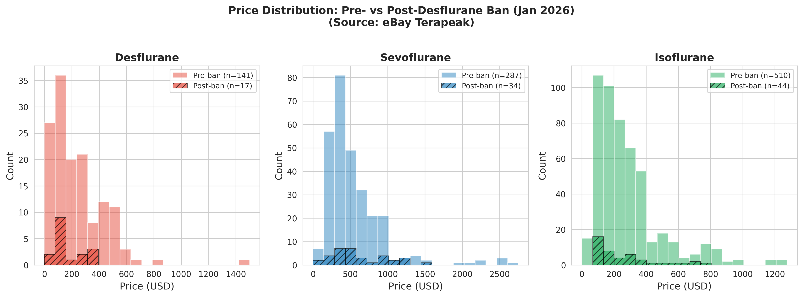
Fig. 4
Fig. 4. Price distribution histograms for each vaporiser type, comparing pre-ban (solid fill) and post-ban (hatched) periods.

Slide 5
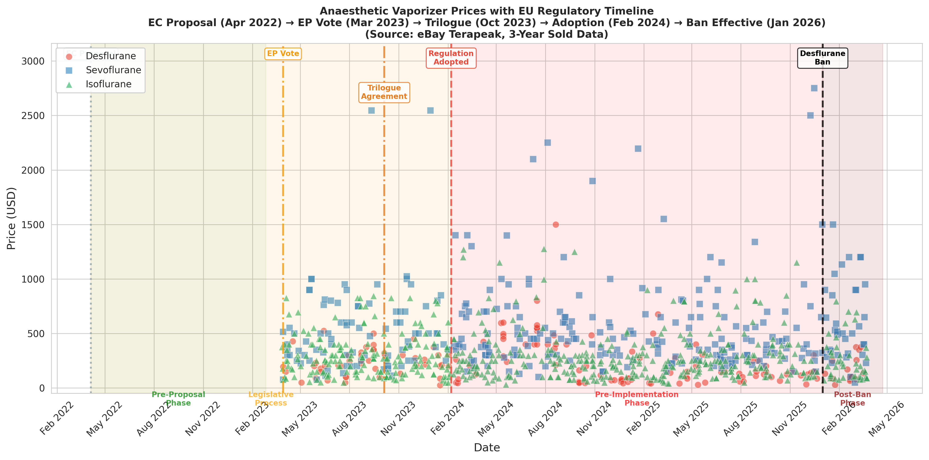
Fig. 5
Fig. 5. Anaesthetic vaporiser prices mapped against the EU regulatory timeline. Shaded regions indicate regulatory phases.

Slide 6
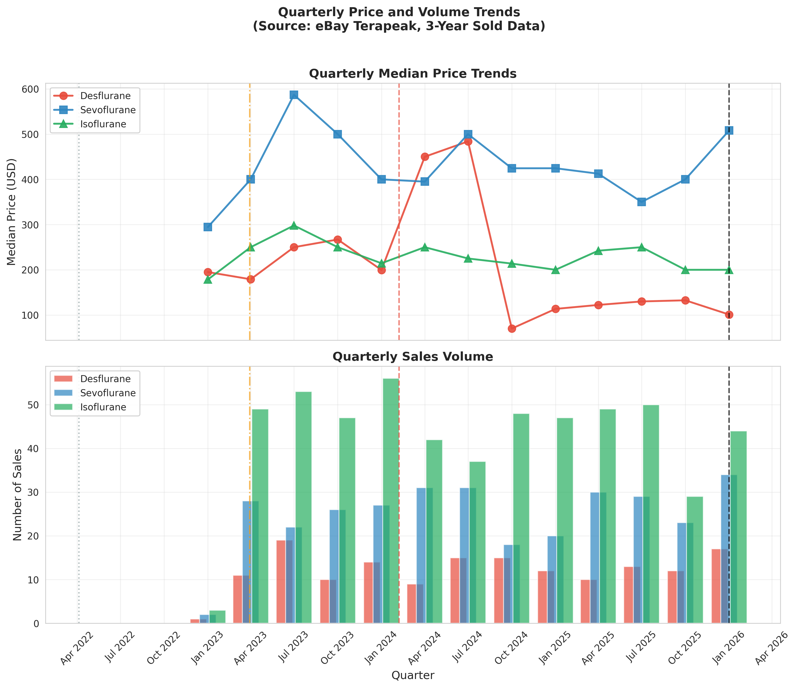
Fig. 6
Fig. 6. Quarterly median price trends (upper panel) and sales volume (lower panel).

