Slide 1
Association between the EU desflurane phase-out and secondary market vaporizer prices: an observational time-series analysis
Figures

Slide 2
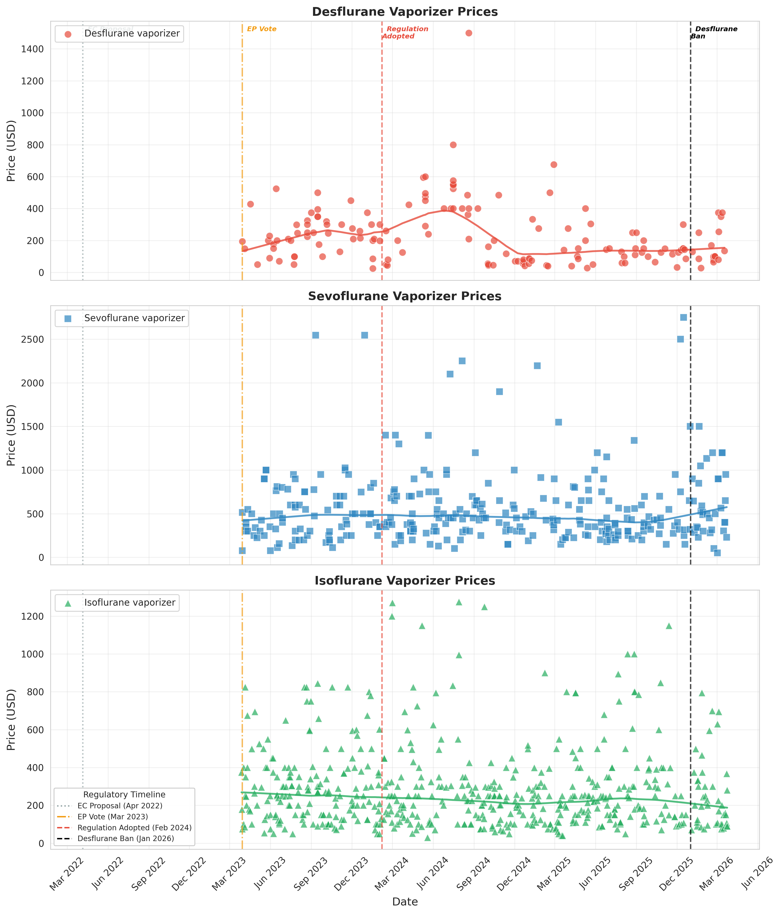
Fig. 1. Time series of eBay completed sale prices for desflurane (red), sevoflurane (blue), and isoflurane (green) vaporizers over three years (March 2023 to March 2026). Vertical dashed lines indicate key EU regulatory milestones. Curved lines represent LOWESS trend estimates (fraction = 0.3). Data source: eBay Terapeak.

Slide 3
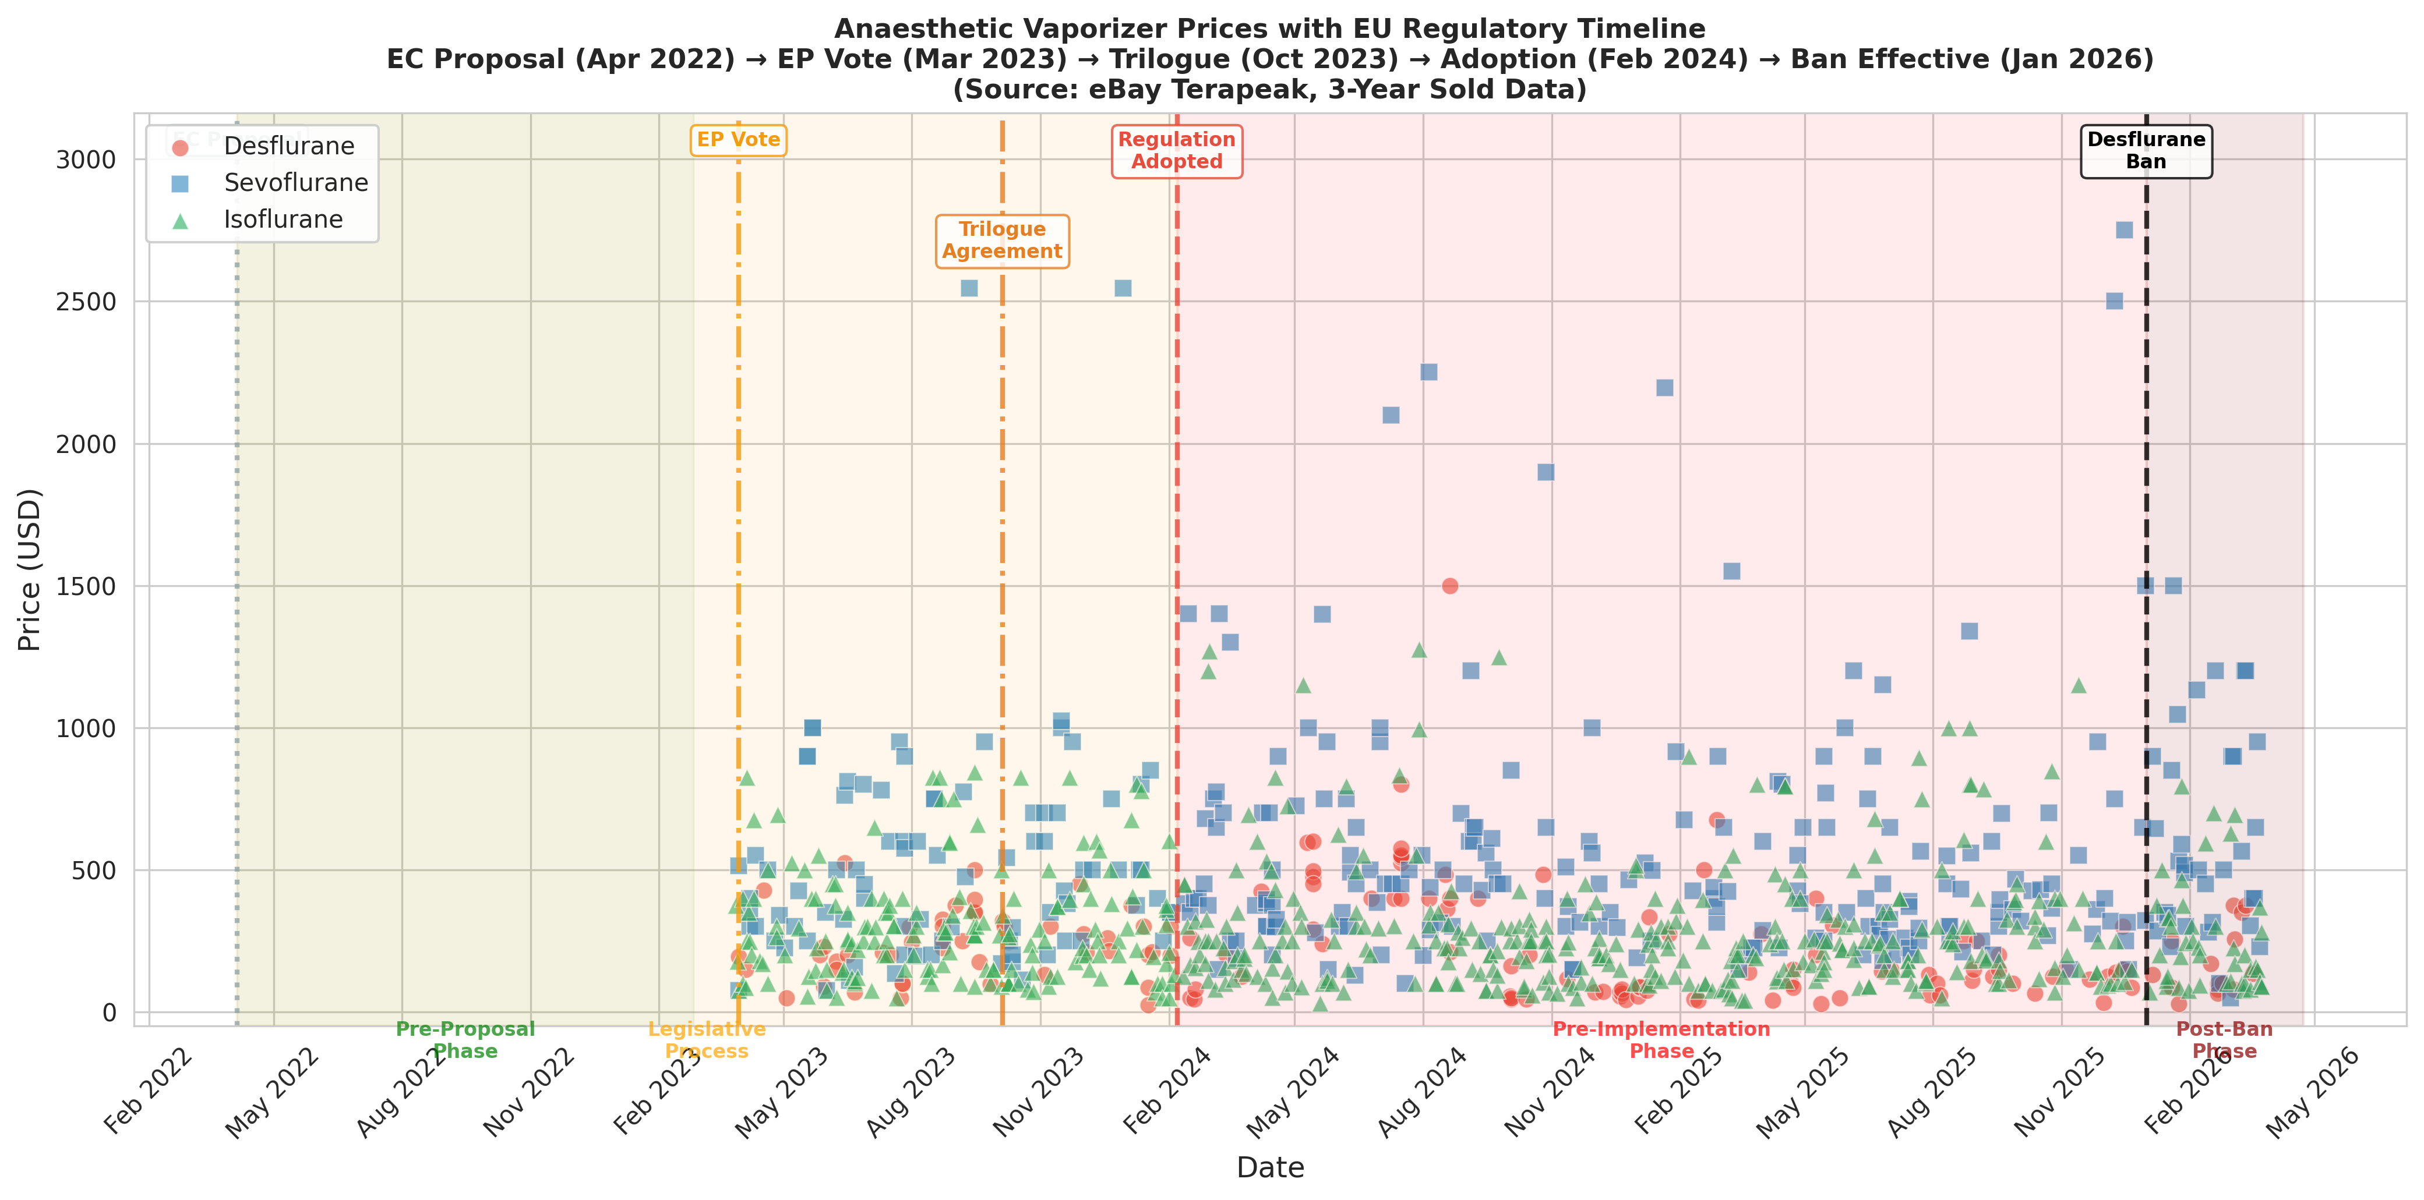
Fig. 2. Anesthetic vaporizer prices mapped against the EU regulatory timeline. Shaded regions indicate regulatory phases. Data source: eBay Terapeak.

Slide 4
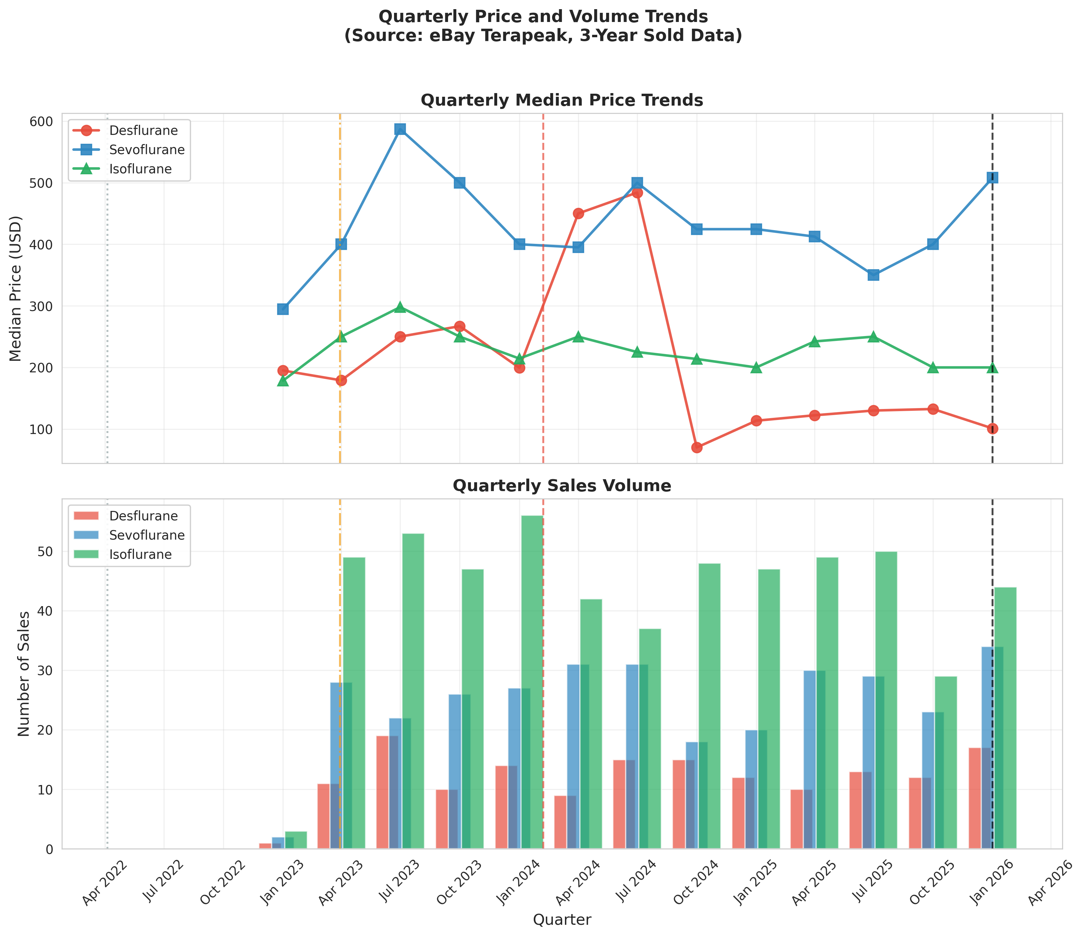
Fig. 3. Quarterly median price trends (upper panel) and sales volume (lower panel). Data source: eBay Terapeak.

Slide 5
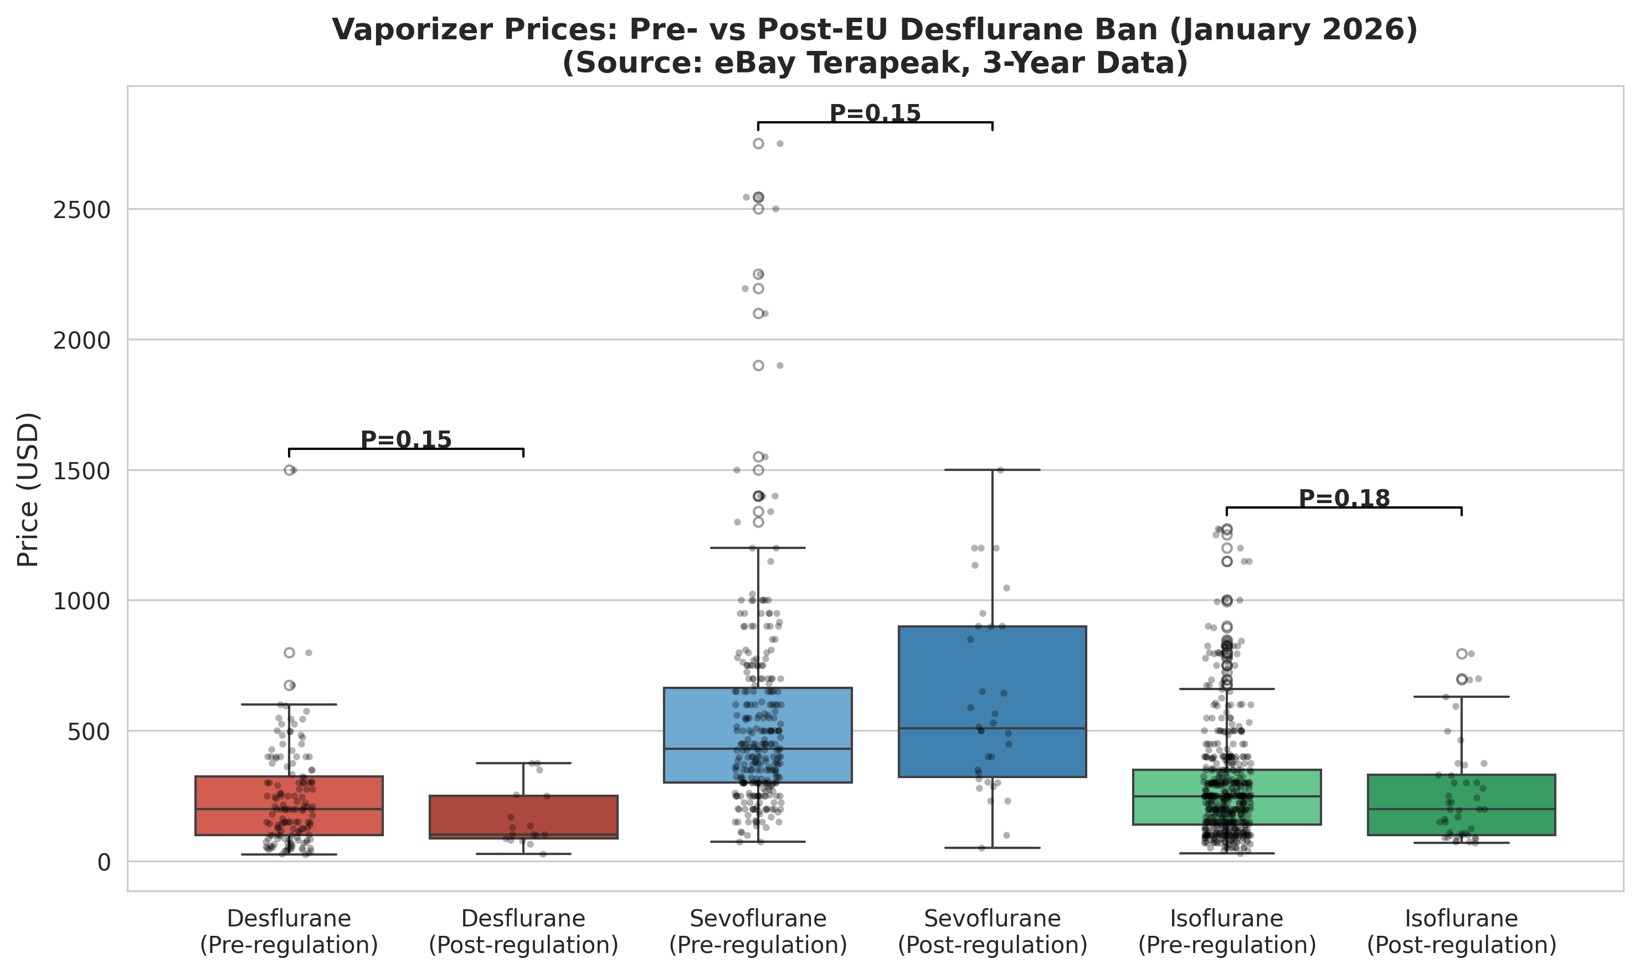
Fig. 4. Box plot comparison of vaporizer prices before and after the EU desflurane ban (1 January 2026). Individual data points are shown as jittered dots. Data source: eBay Terapeak.

Slide 6
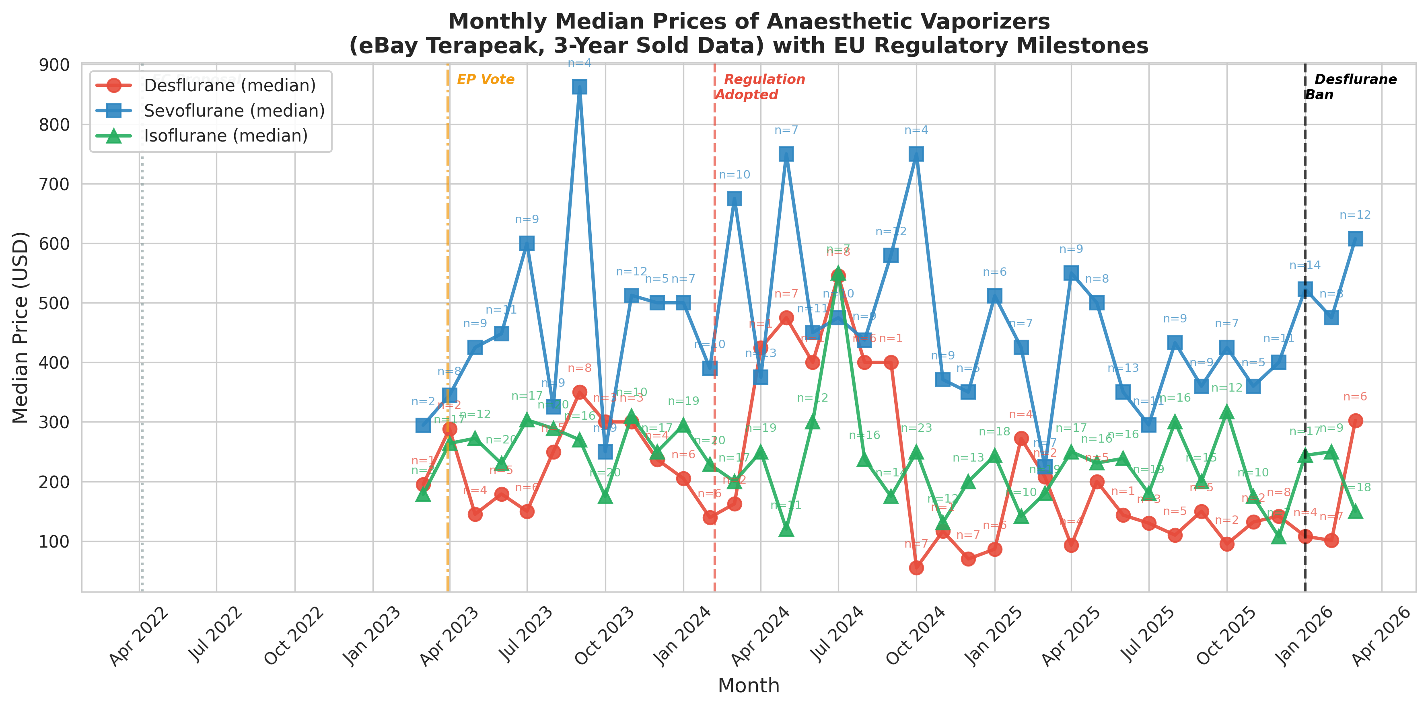
Fig. 5. Monthly median prices of anesthetic vaporizers on eBay. Annotations indicate the number of transactions per month (n). Data source: eBay Terapeak.

Slide 7
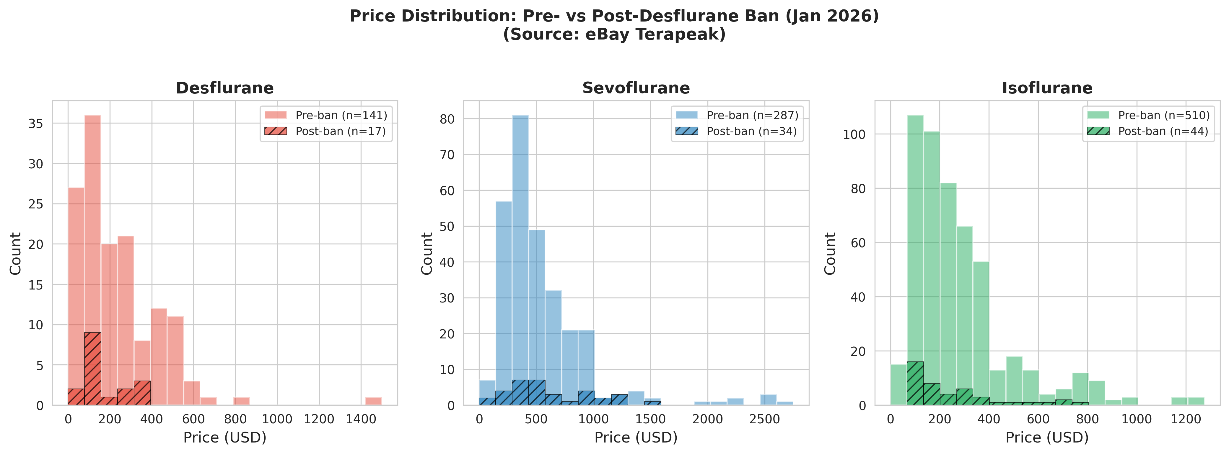
Fig. 6. Price distribution histograms for each vaporizer type, comparing pre-ban (solid fill) and post-ban (hatched) periods. Data source: eBay Terapeak.

