Slide 1
EU Desflurane Regulation and Secondary Market Vaporizer Prices: A Cross-Sectional Time-Series Analysis of eBay Completed Sales
Figures and Tables

Slide 2
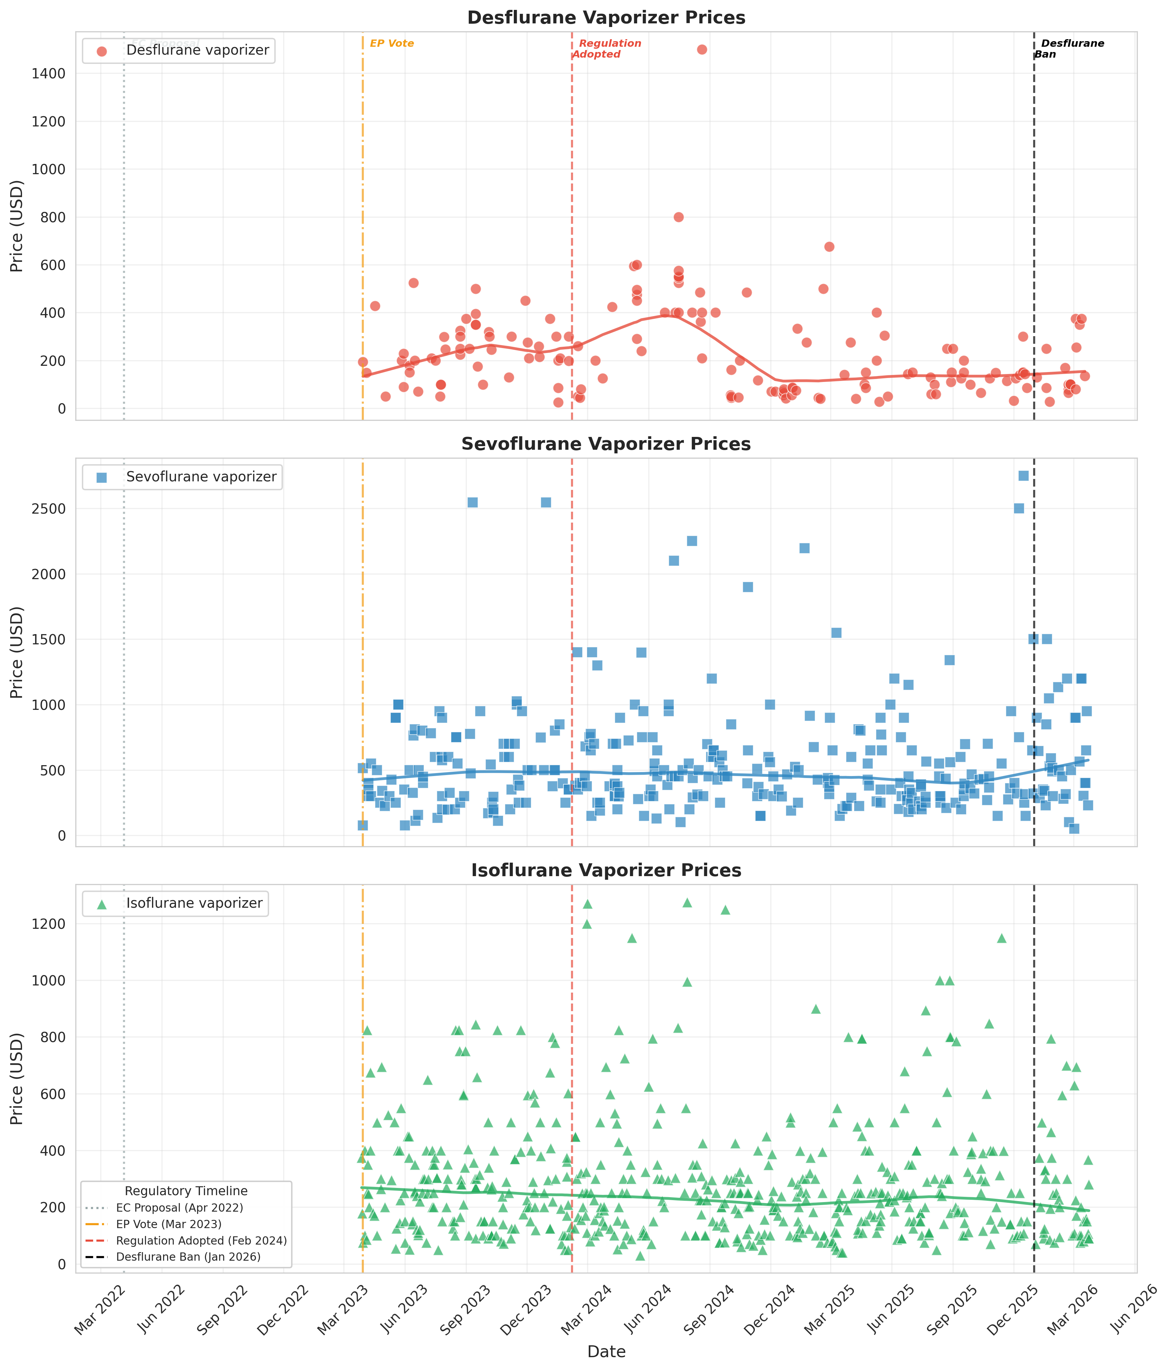
Figure 1. Time-series of eBay sold prices (desflurane=red, sevoflurane=blue, isoflurane=green). Vertical dashed lines indicate EU regulatory milestones. LOWESS trend lines shown. Note the progressive decline in the desflurane LOWESS curve. Data source: eBay Terapeak.

Slide 3
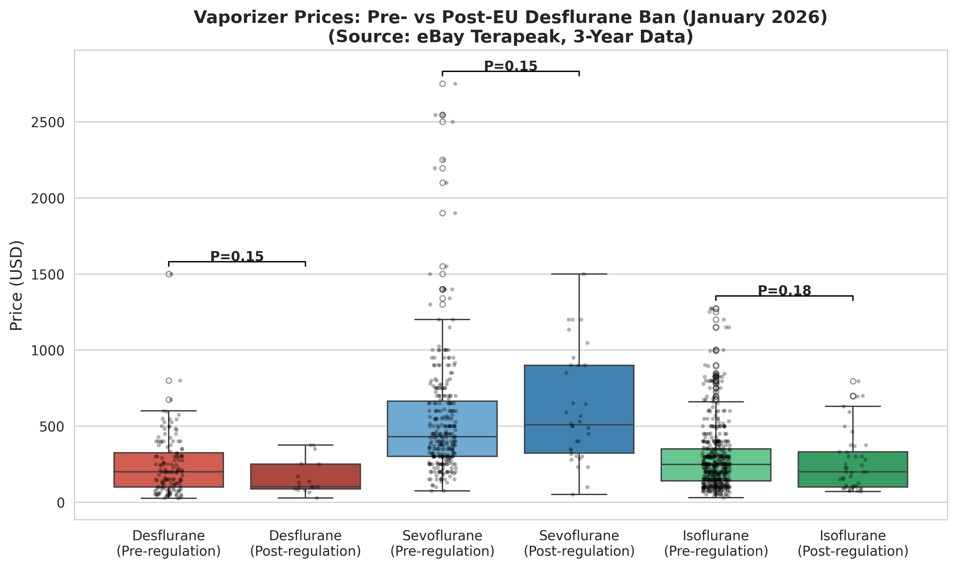
Figure 2. Pre- vs post-regulation price comparison box plots. Note the compressed post-regulation distribution for desflurane toward lower prices. Data source: eBay Terapeak.

Slide 4
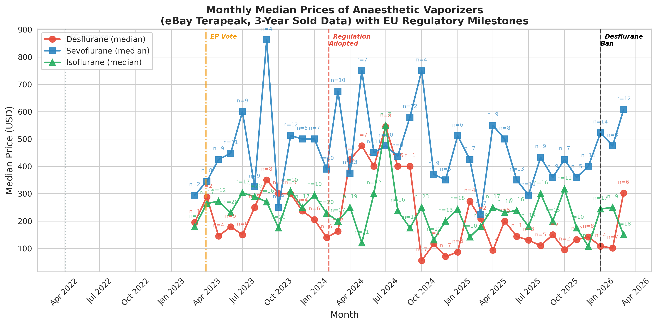
Figure 3. Monthly median price trends. A sustained decline in desflurane prices is visible from mid-2024. Data source: eBay Terapeak.

Slide 5
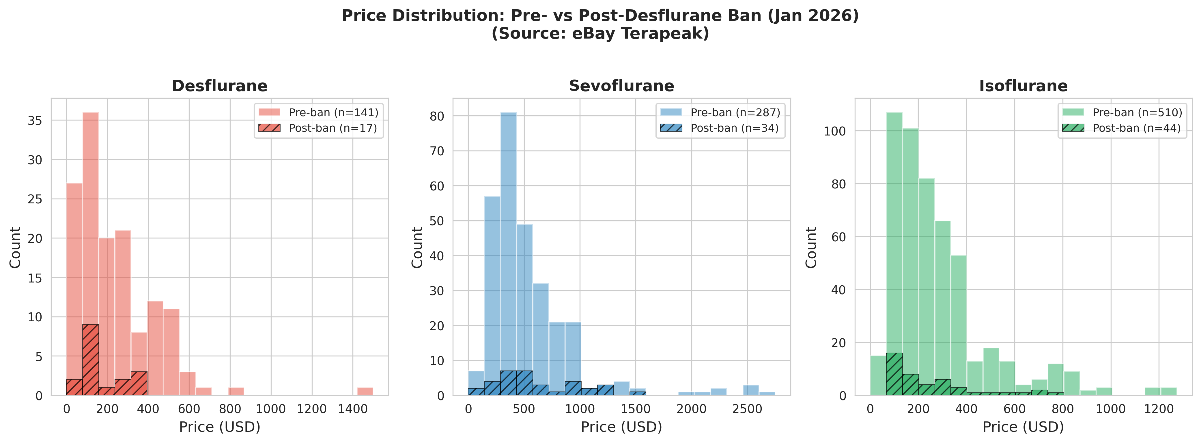
Figure 4. Price distribution histograms. The post-regulation desflurane distribution shifts leftward (toward lower prices). Data source: eBay Terapeak.

Slide 6
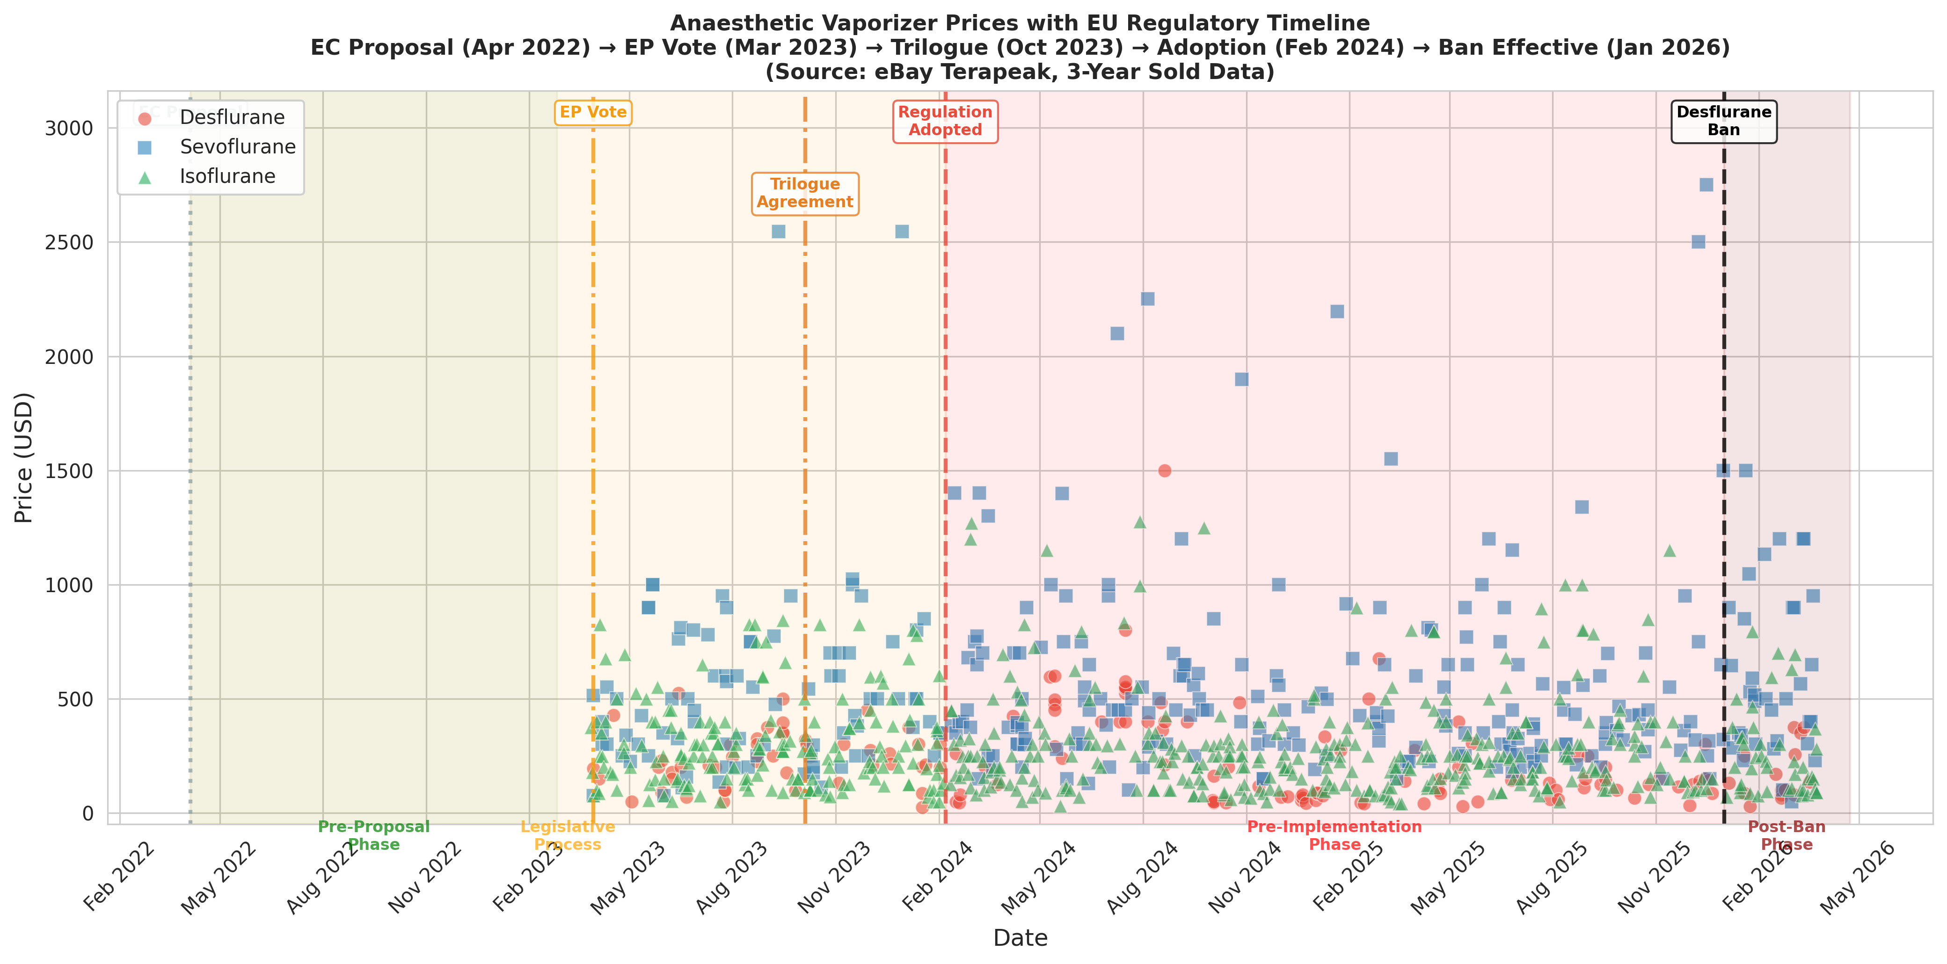
Figure 5. EU regulatory timeline and price trends. Regulatory phases are shaded. The stepwise price decline for desflurane is visually apparent. Data source: eBay Terapeak.

Slide 7
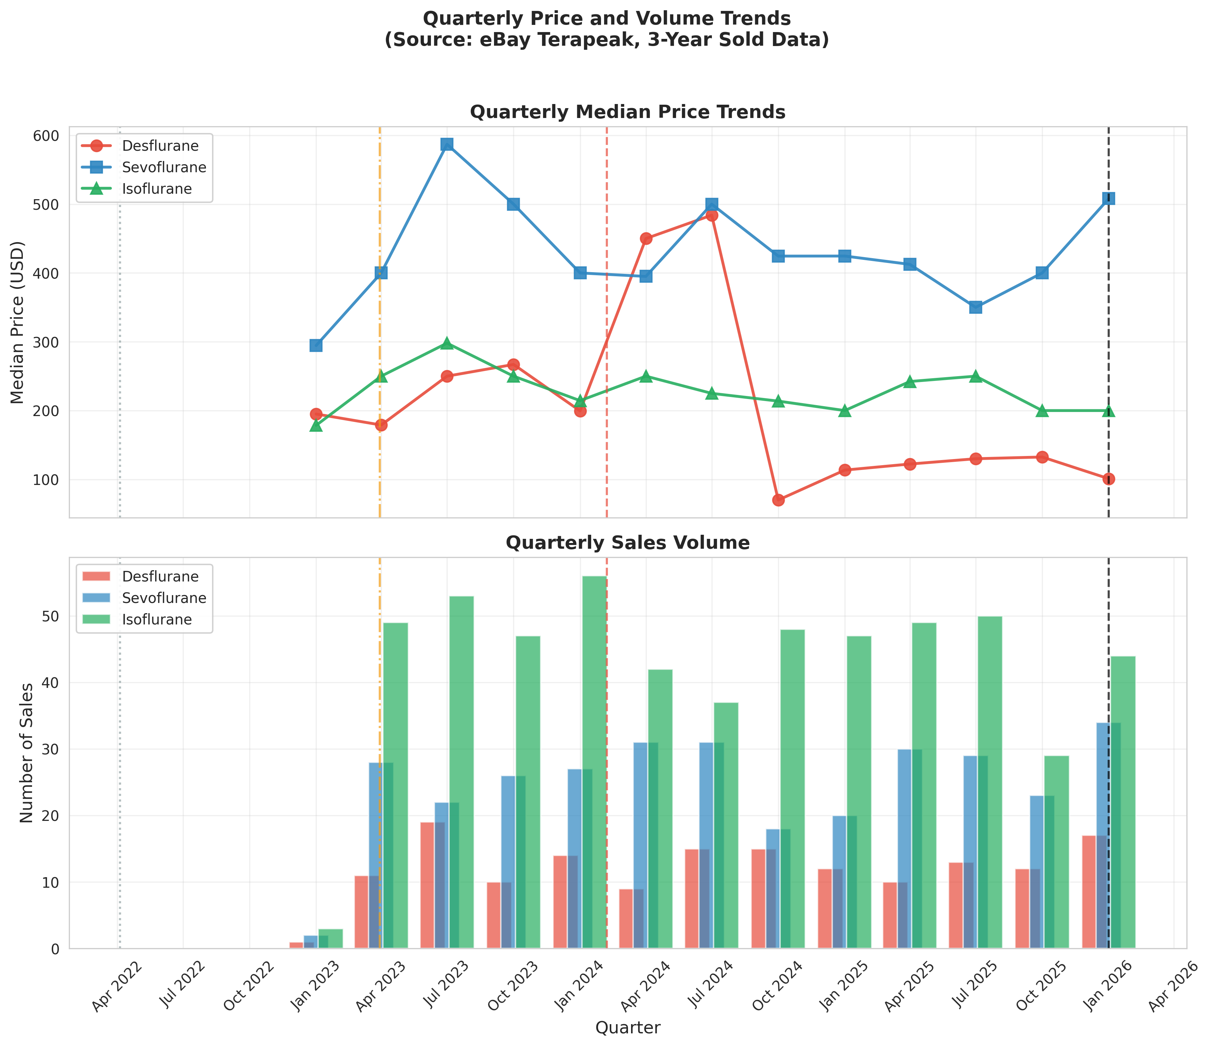
Figure 6. Quarterly median price (top) and transaction volume (bottom) trends. Desflurane quarterly median declined from ~$250 to ~$100. Data source: eBay Terapeak.

