Slide 1
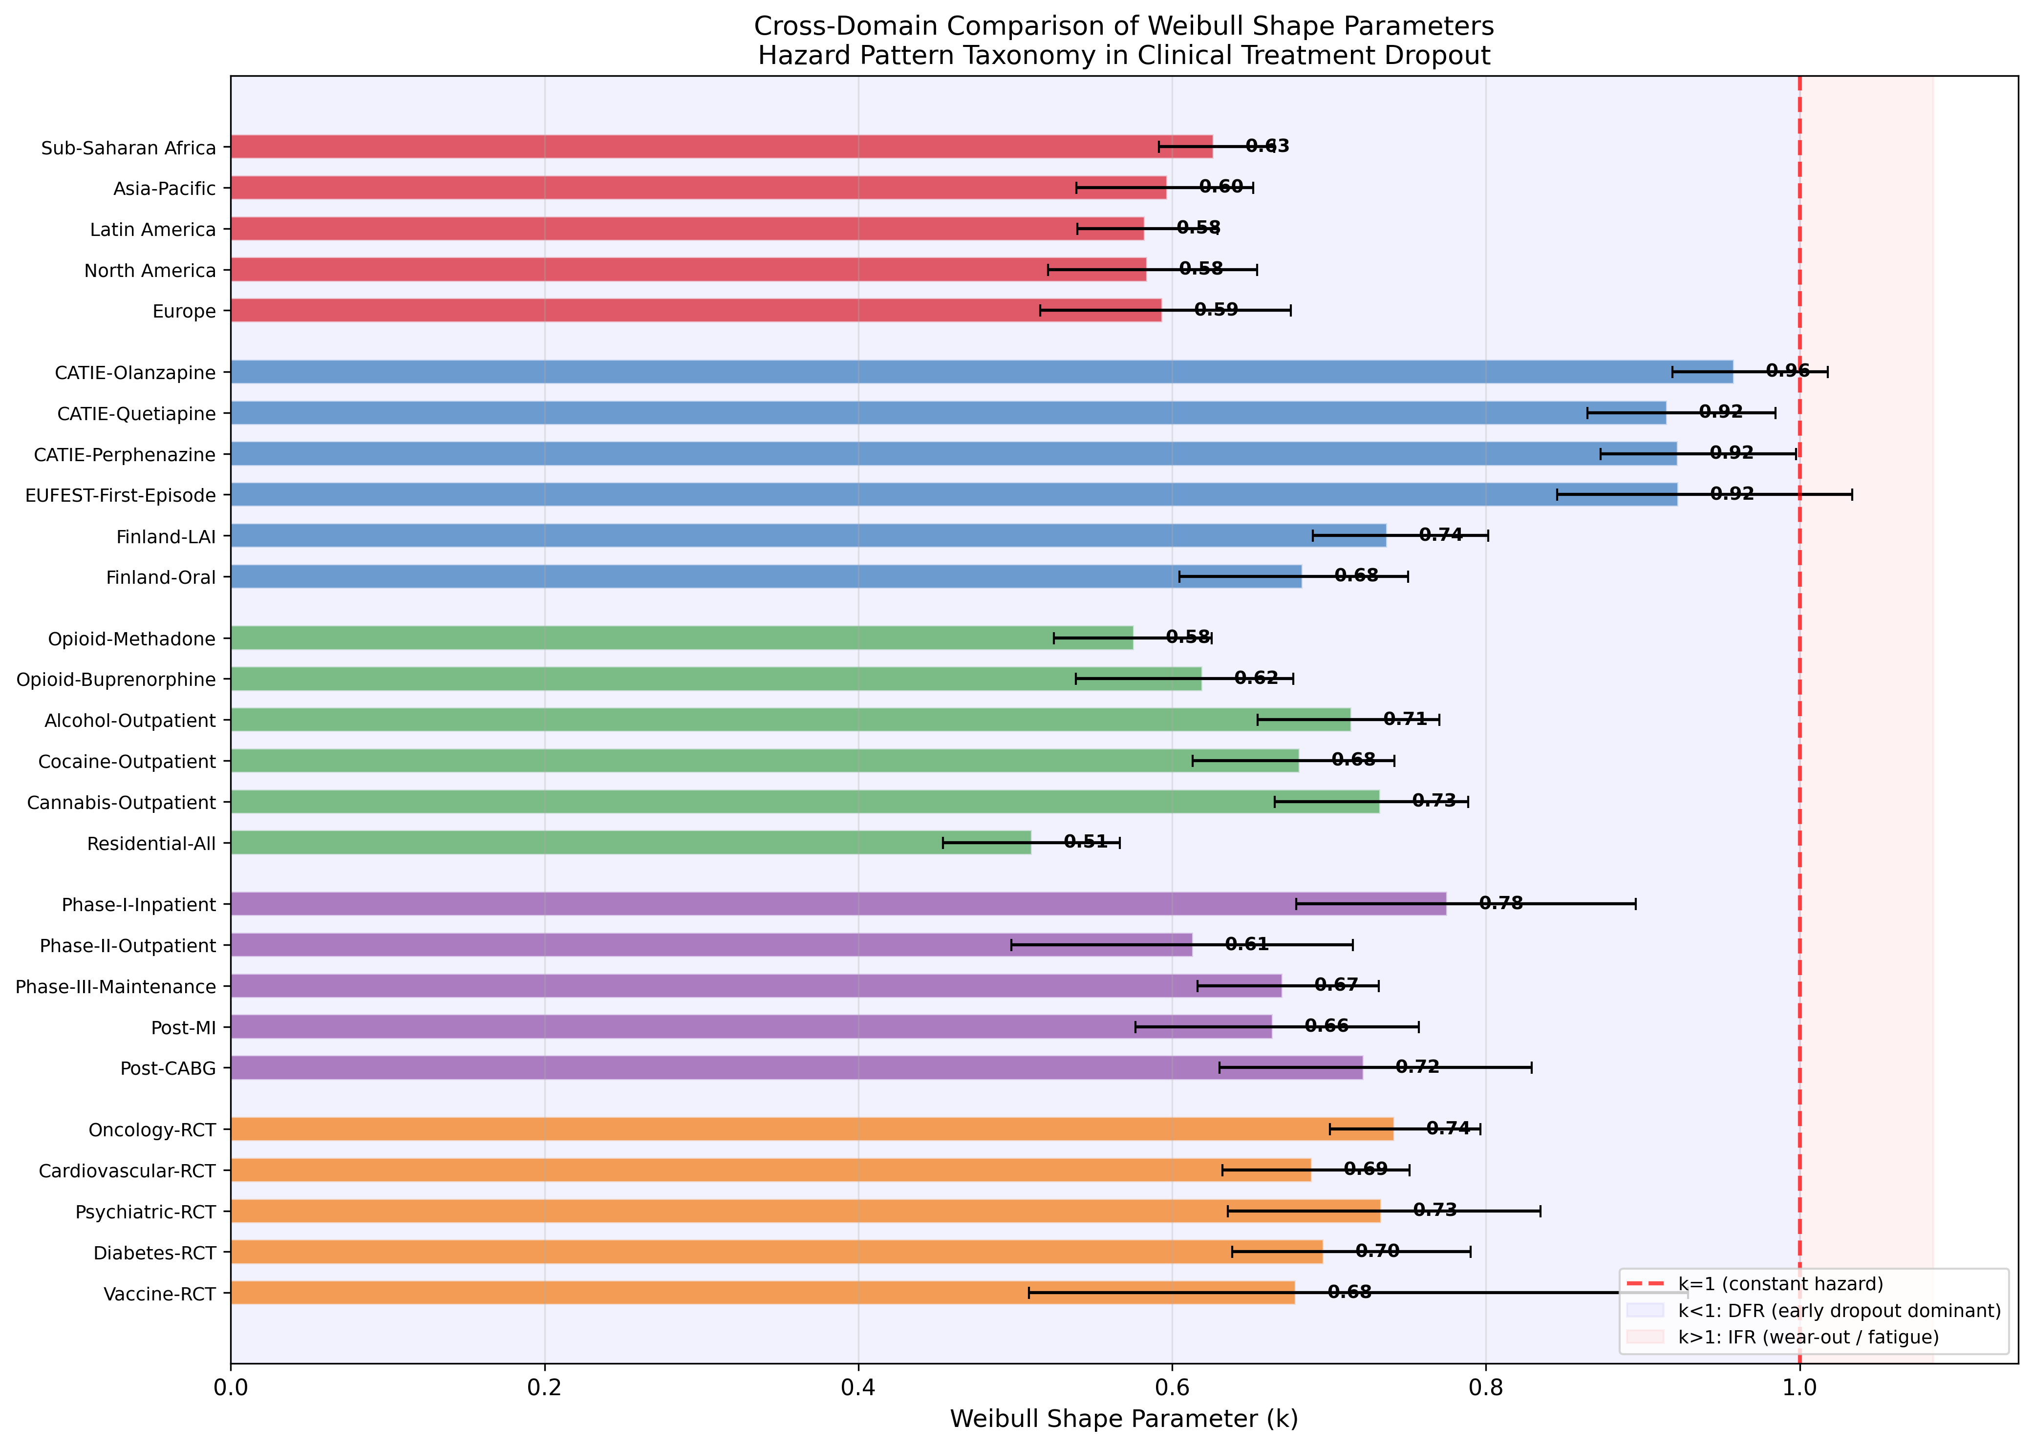
Cross-Domain k Comparison
All 27 datasets across 5 domains show k<1 (universal DFR).

Slide 2
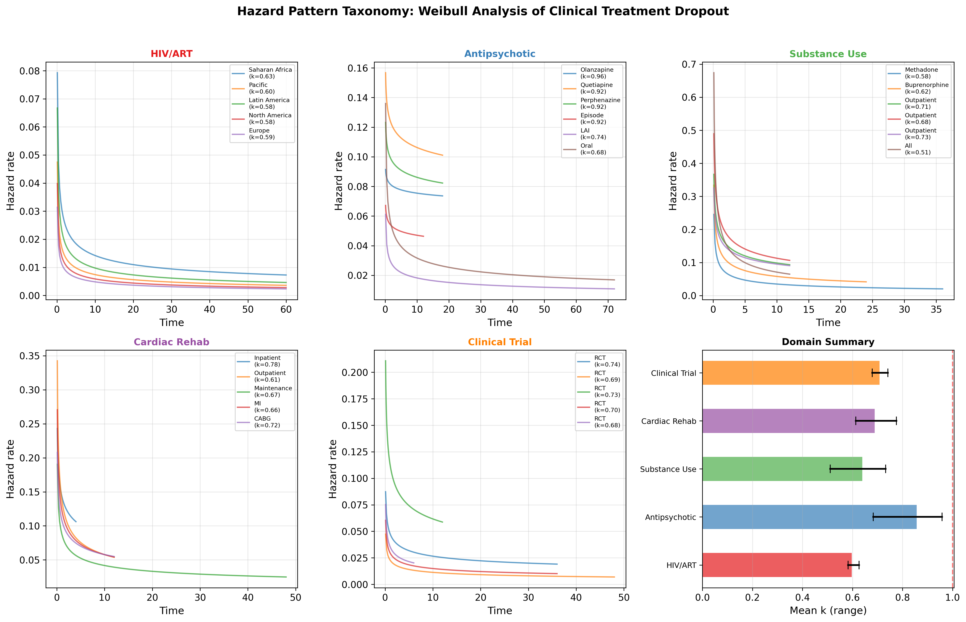
Hazard Pattern Taxonomy
Domain-specific hazard functions showing universal decreasing pattern.

Slide 3
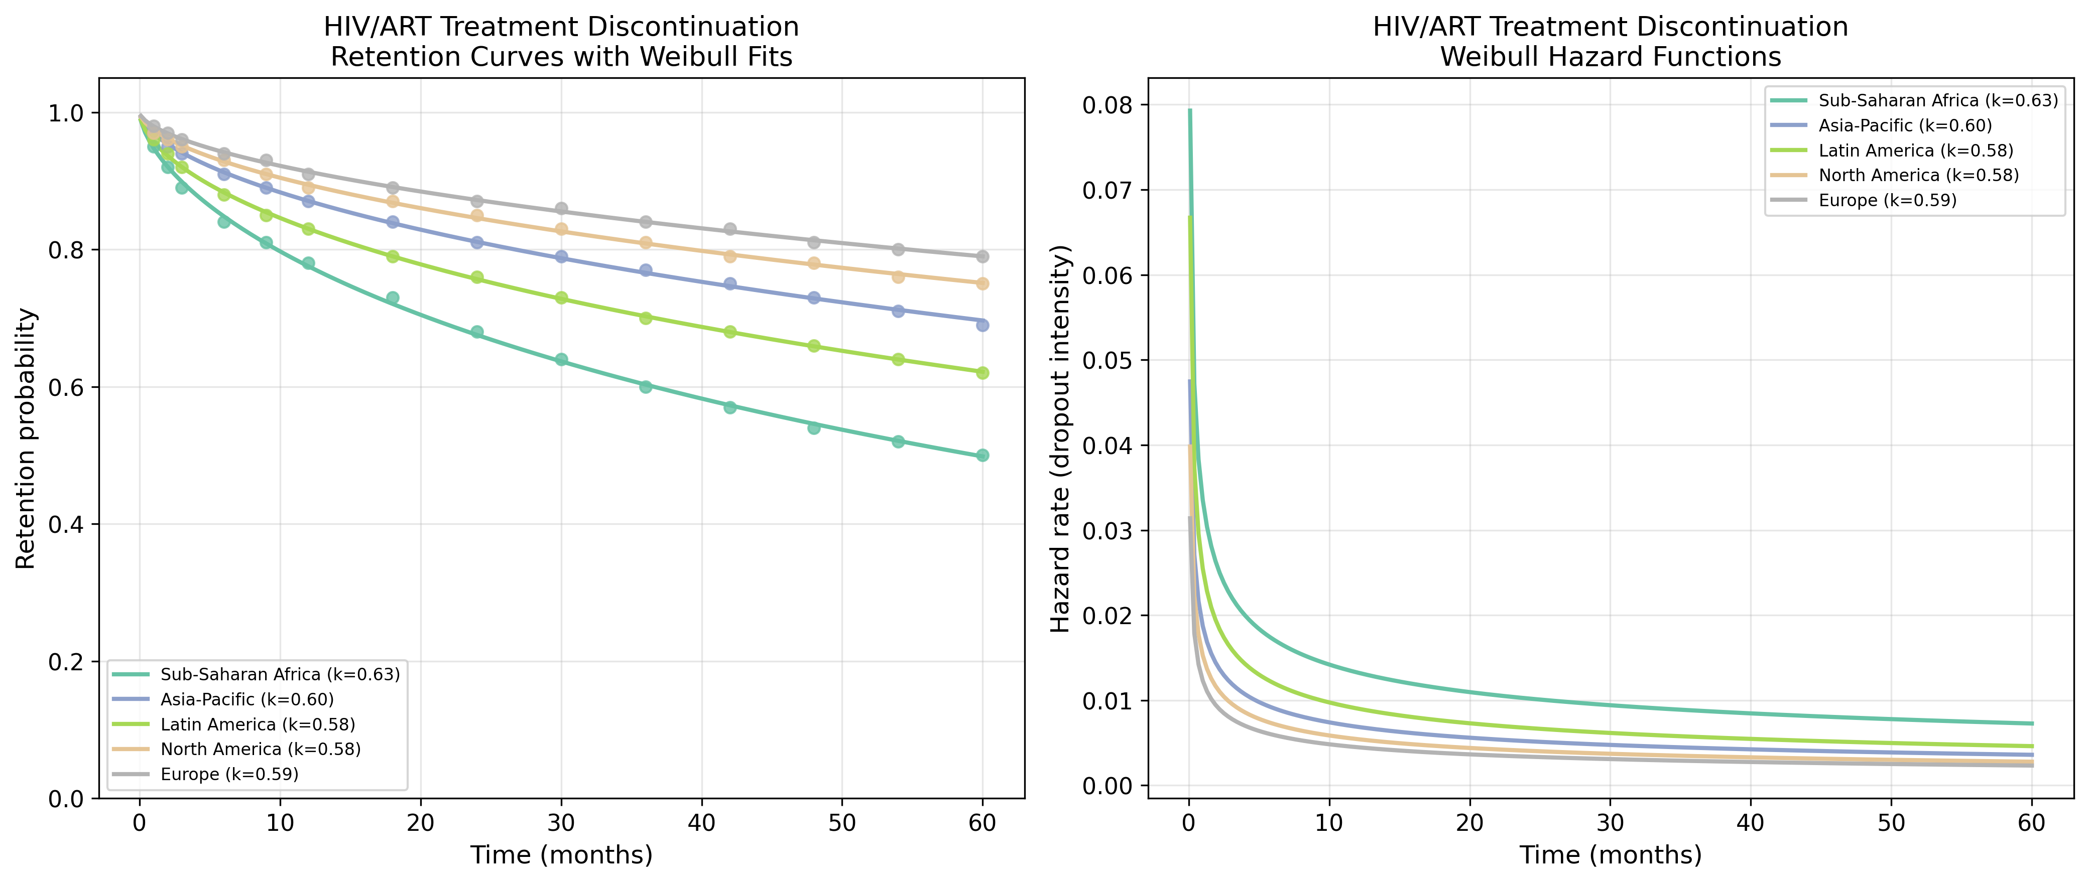
HIV/ART: Retention & Hazard
HIV/ART retention curves with Weibull fits.

Slide 4
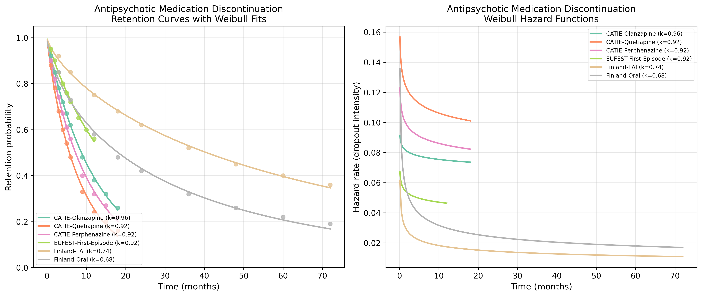
Antipsychotic: Retention & Hazard
Antipsychotic retention curves with Weibull fits.

Slide 5
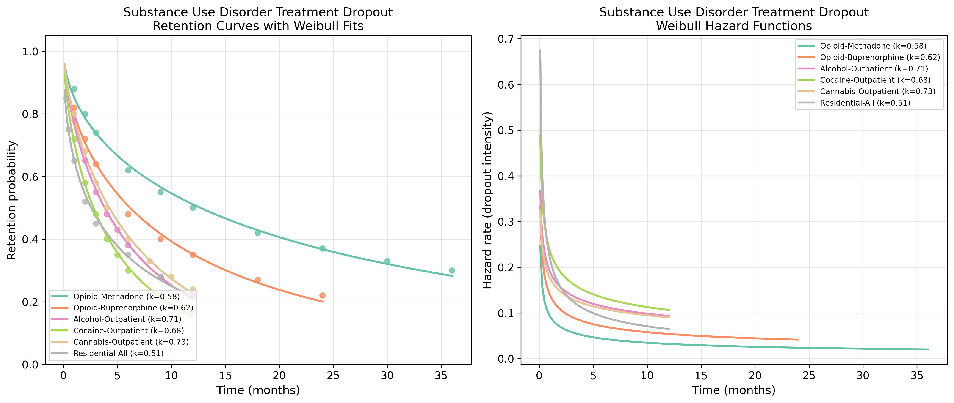
Substance Use: Retention & Hazard
Substance Use retention curves with Weibull fits.

Slide 6
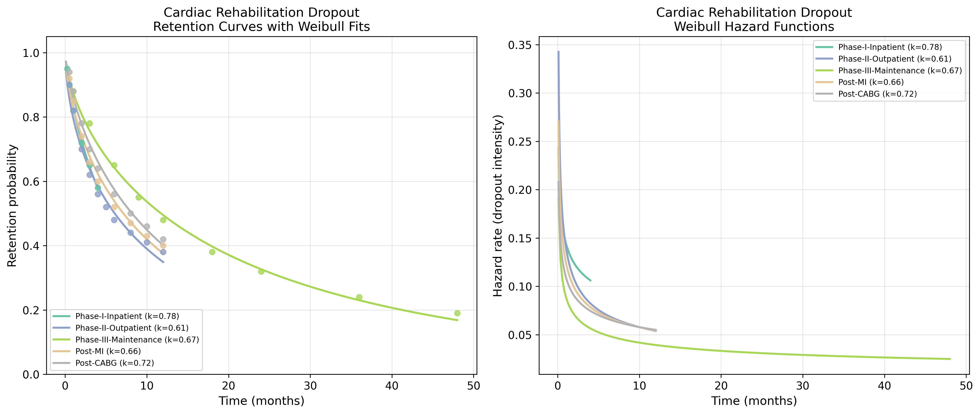
Cardiac Rehab: Retention & Hazard
Cardiac Rehab retention curves with Weibull fits.

Slide 7
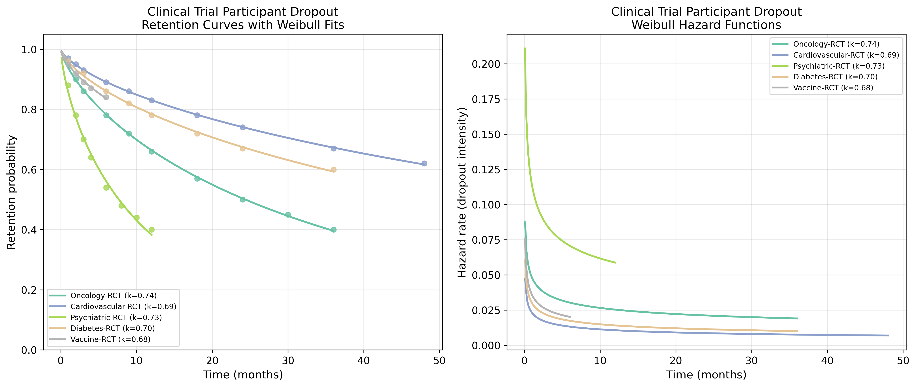
Clinical Trial: Retention & Hazard
Clinical Trial retention curves with Weibull fits.

