Slide 1
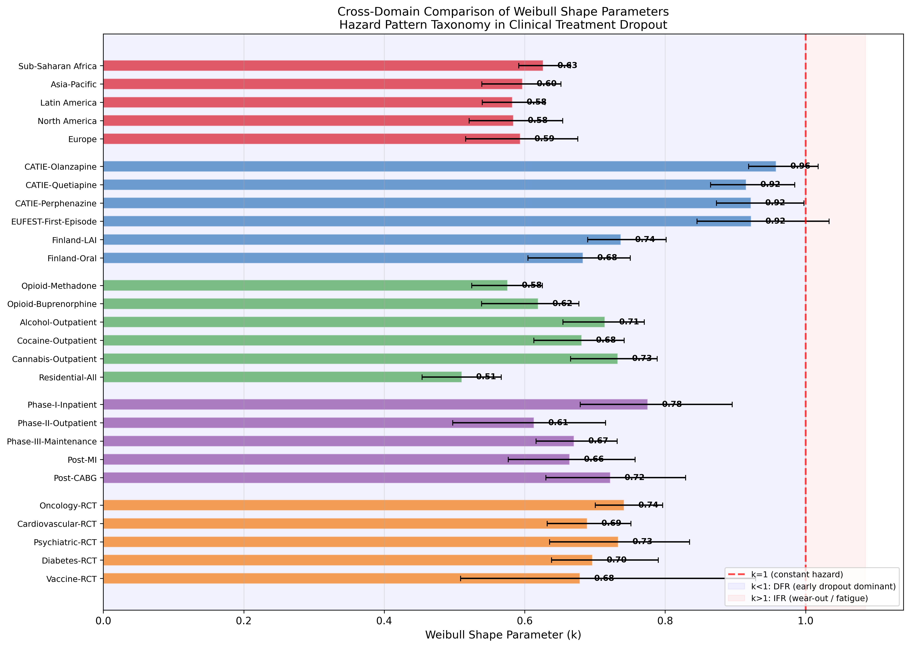
Cross-Domain k Comparison (5 Open-Ended Domains)
TB (k=1.22-1.31, IFR) vs 5 open-ended domains (k<1, DFR). Fixed-duration vs open-ended dichotomy.

Slide 2
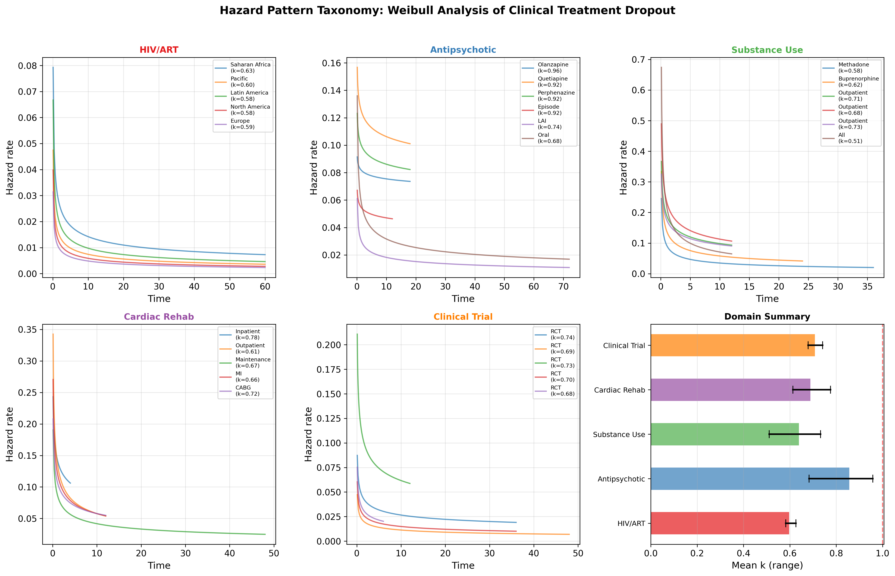
Hazard Pattern Taxonomy
Domain-specific hazard functions showing universal DFR in open-ended treatments.

Slide 3
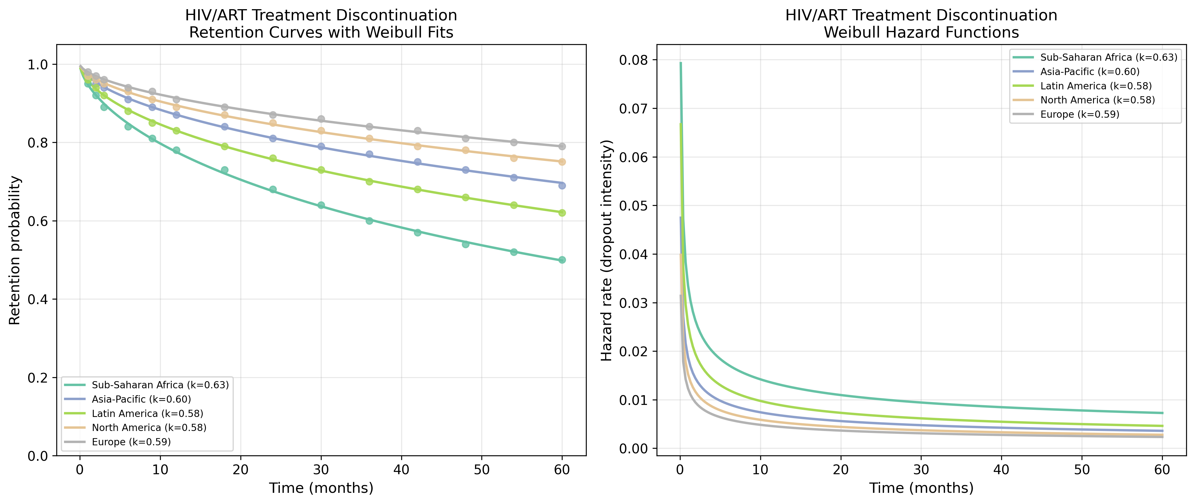
HIV/ART: Retention & Hazard
IeDEA 5-region data.

Slide 4
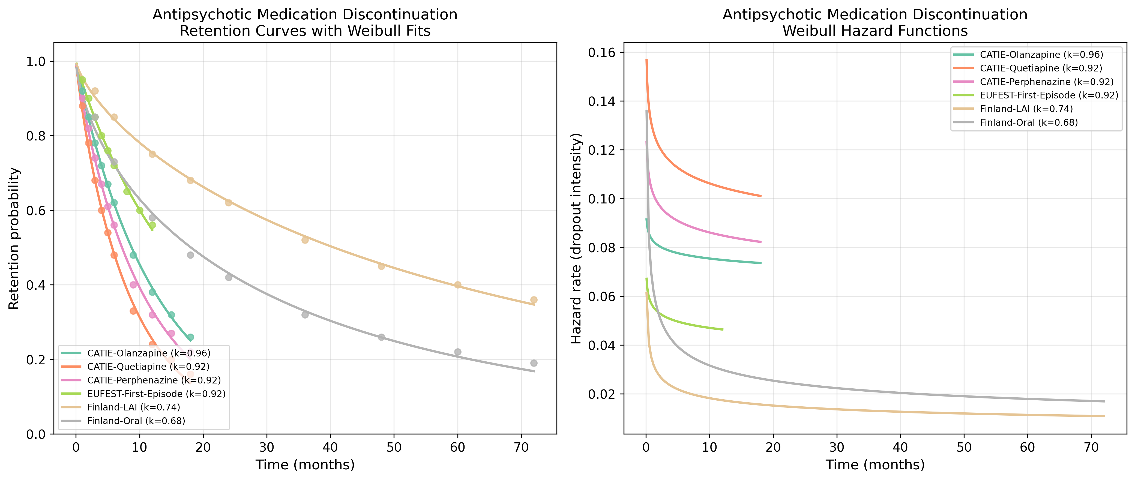
Antipsychotic: Retention & Hazard
CATIE, EUFEST, Finnish data.

Slide 5
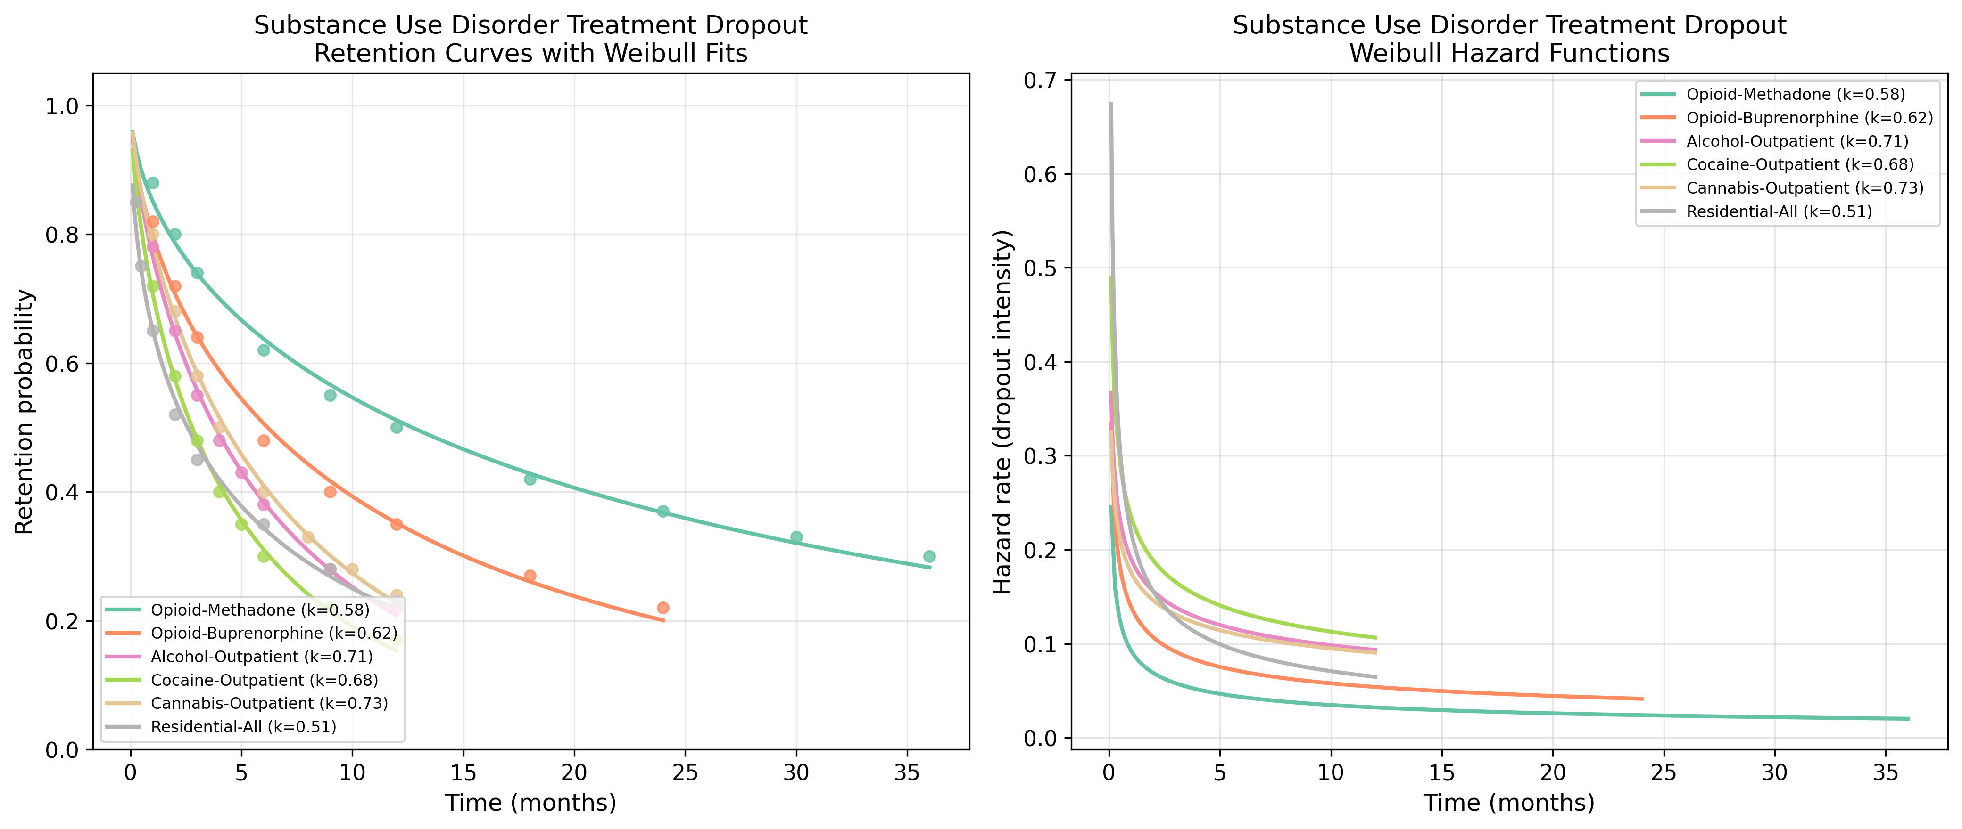
Substance Use: Retention & Hazard
6 modality data.

Slide 6
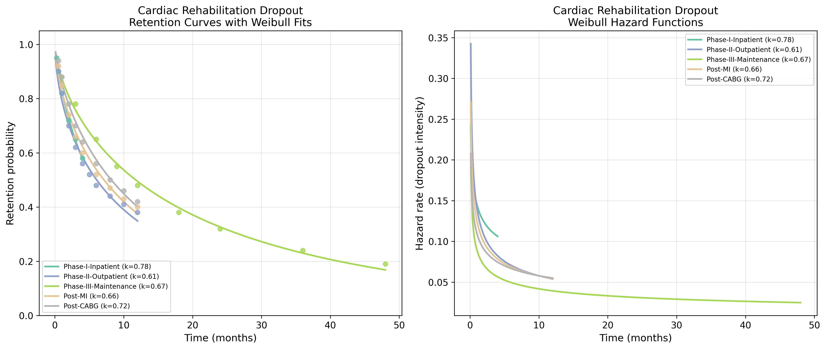
Cardiac Rehab: Retention & Hazard
5 phase/indication data.

Slide 7
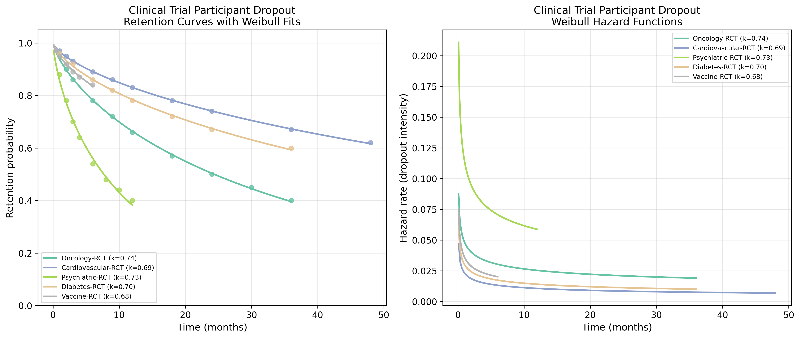
Clinical Trial: Retention & Hazard
5 therapeutic area data.

