Slide 1
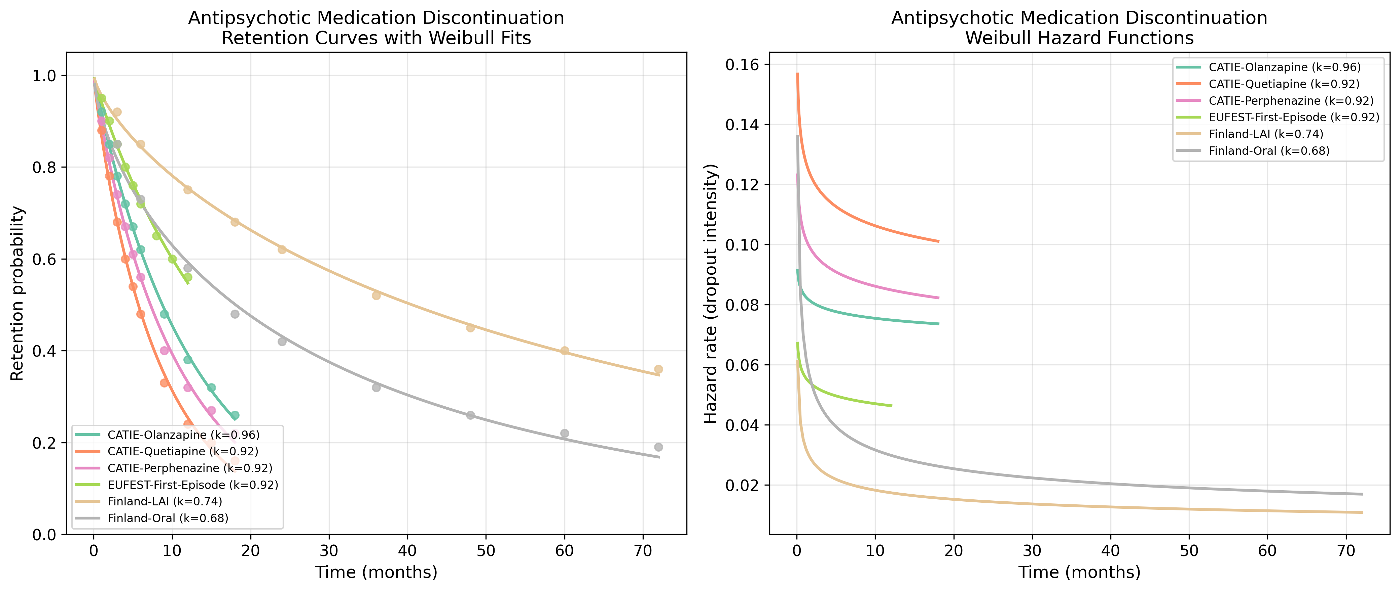
Antipsychotic: Retention & Hazard Functions
Retention curves with Weibull fits and hazard functions for Antipsychotic datasets.

Slide 2
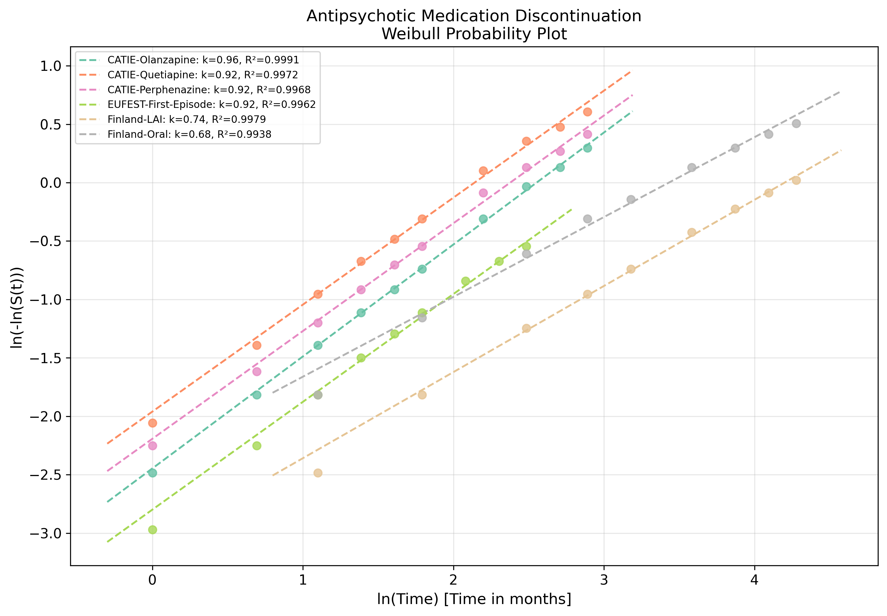
Antipsychotic: Weibull Probability Plot
Linearised goodness-of-fit assessment for Antipsychotic datasets.

