Slide 1
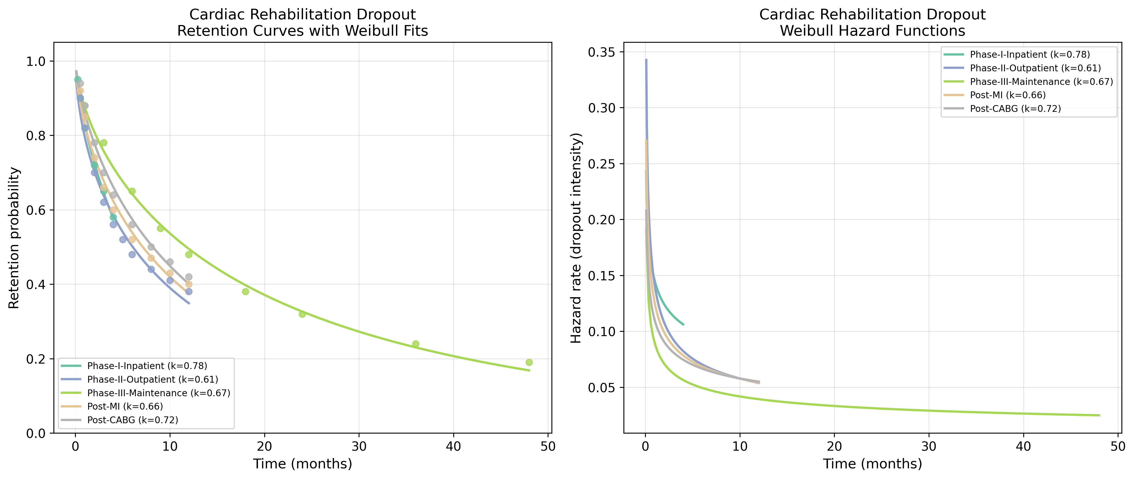
Cardiac Rehab: Retention & Hazard Functions
Retention curves with Weibull fits and hazard functions for Cardiac Rehab datasets.

Slide 2
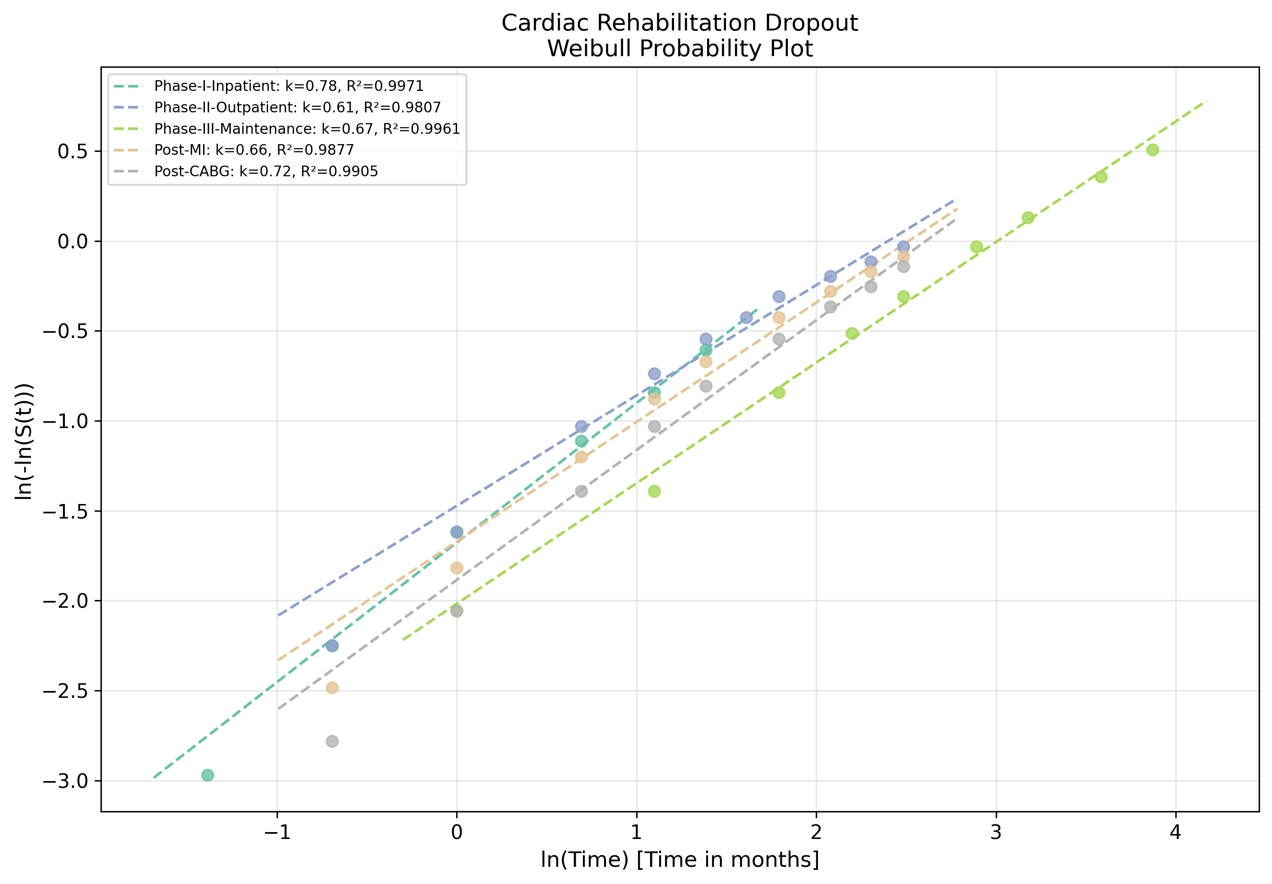
Cardiac Rehab: Weibull Probability Plot
Linearised goodness-of-fit assessment for Cardiac Rehab datasets.

