Slide 1
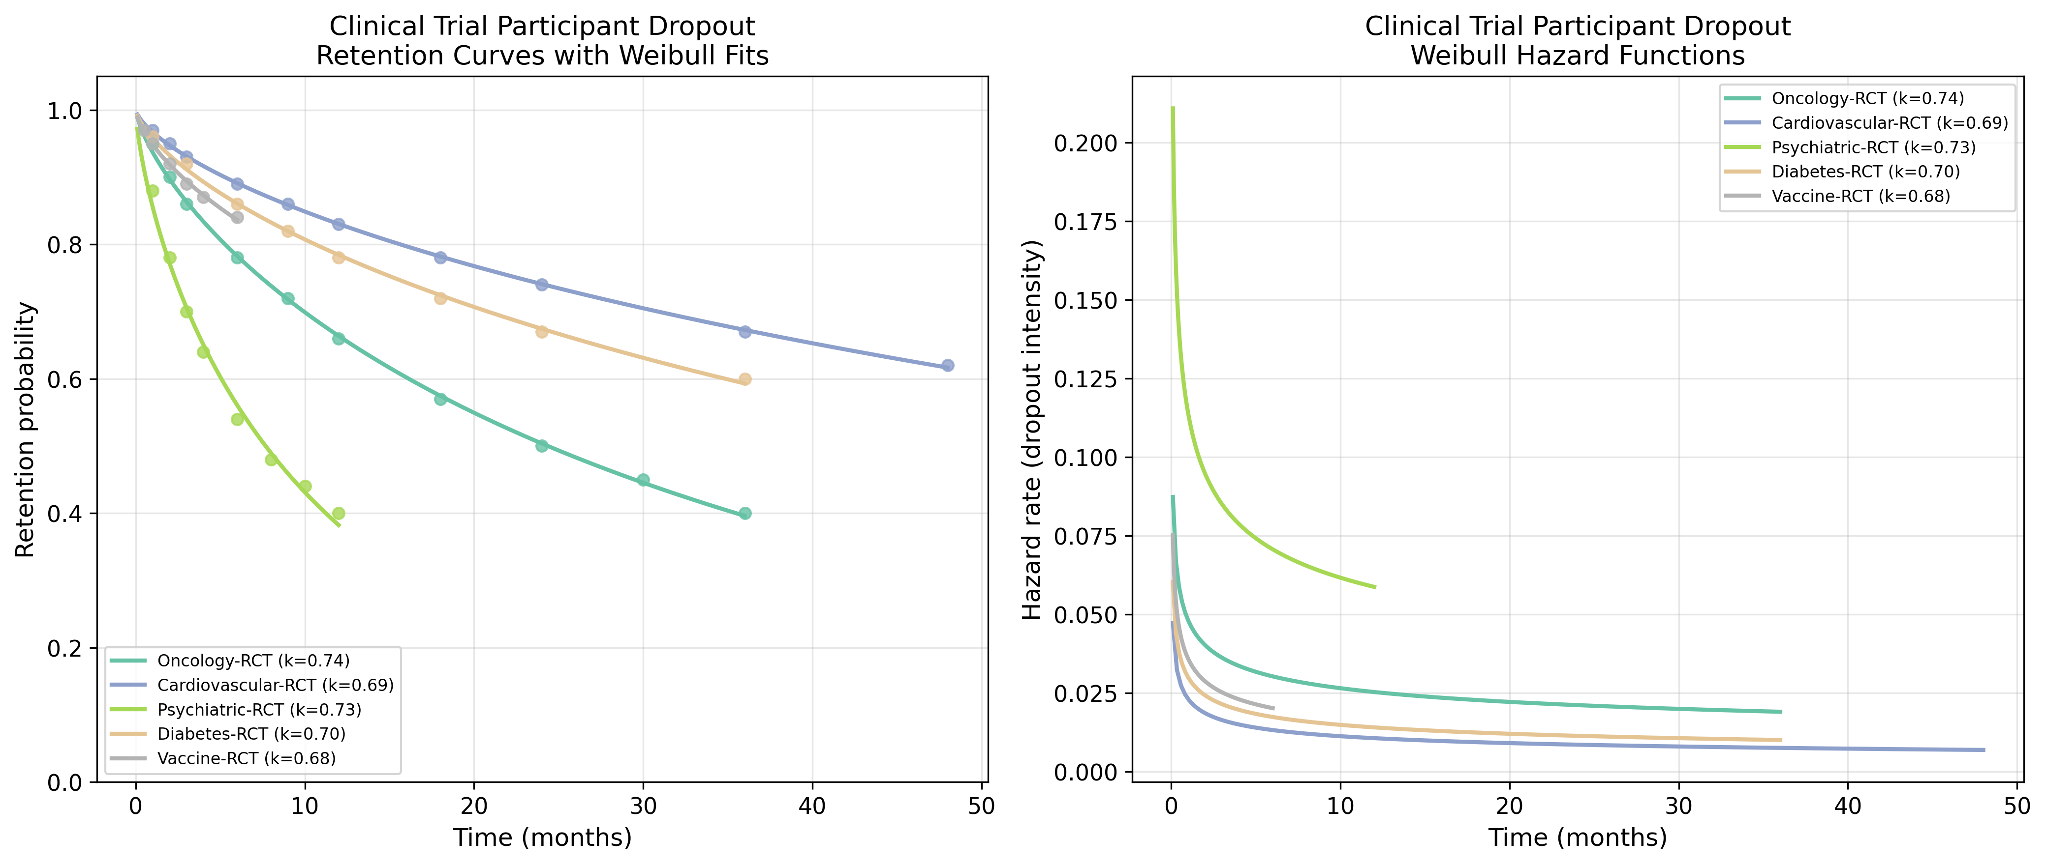
Clinical Trial: Retention & Hazard Functions
Retention curves with Weibull fits and hazard functions for Clinical Trial datasets.

Slide 2
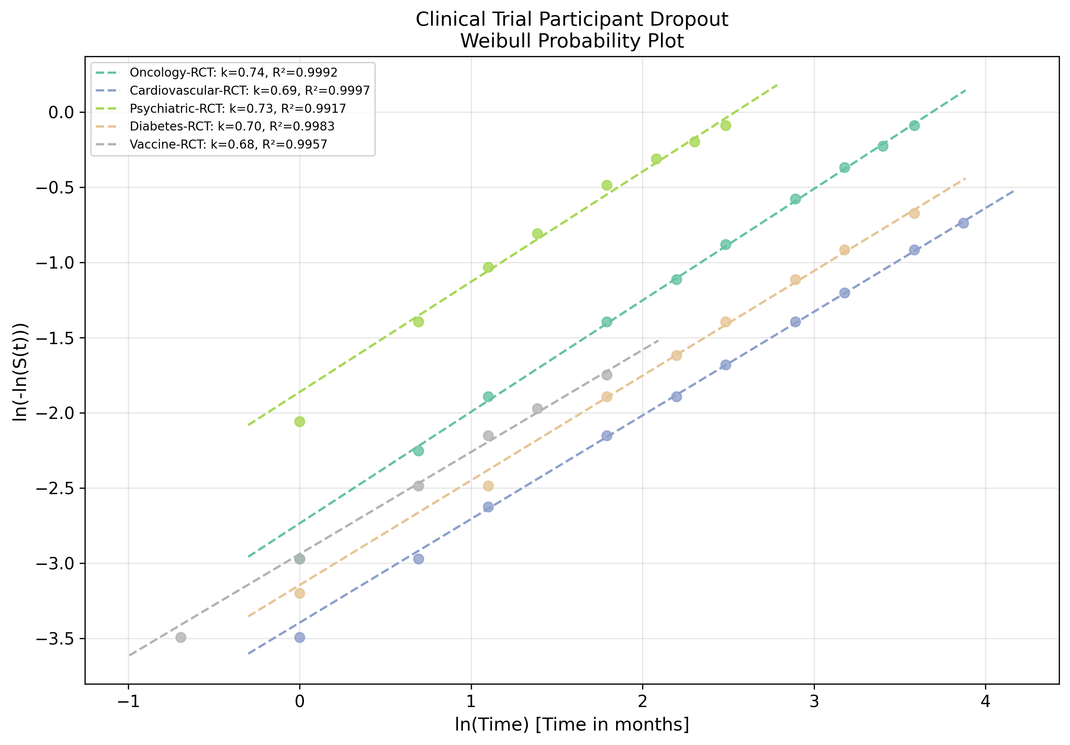
Clinical Trial: Weibull Probability Plot
Linearised goodness-of-fit assessment for Clinical Trial datasets.

