Slide 1
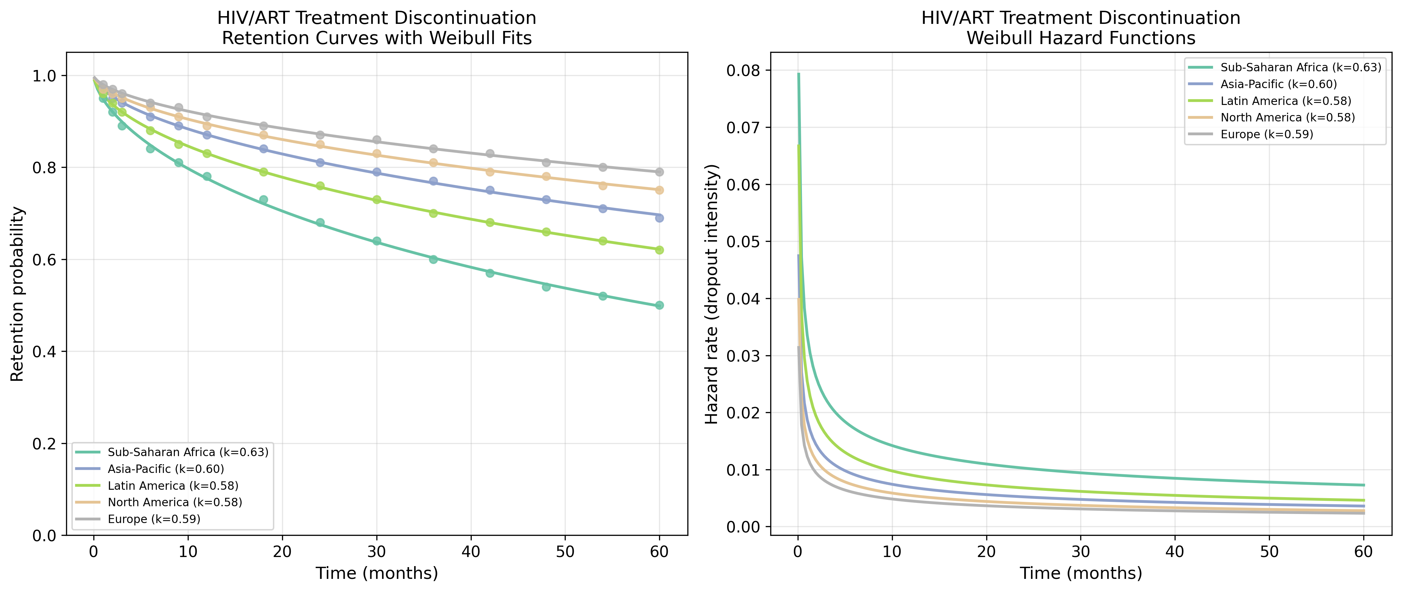
HIV/ART: Retention & Hazard Functions
Retention curves with Weibull fits and hazard functions for HIV/ART datasets.

Slide 2
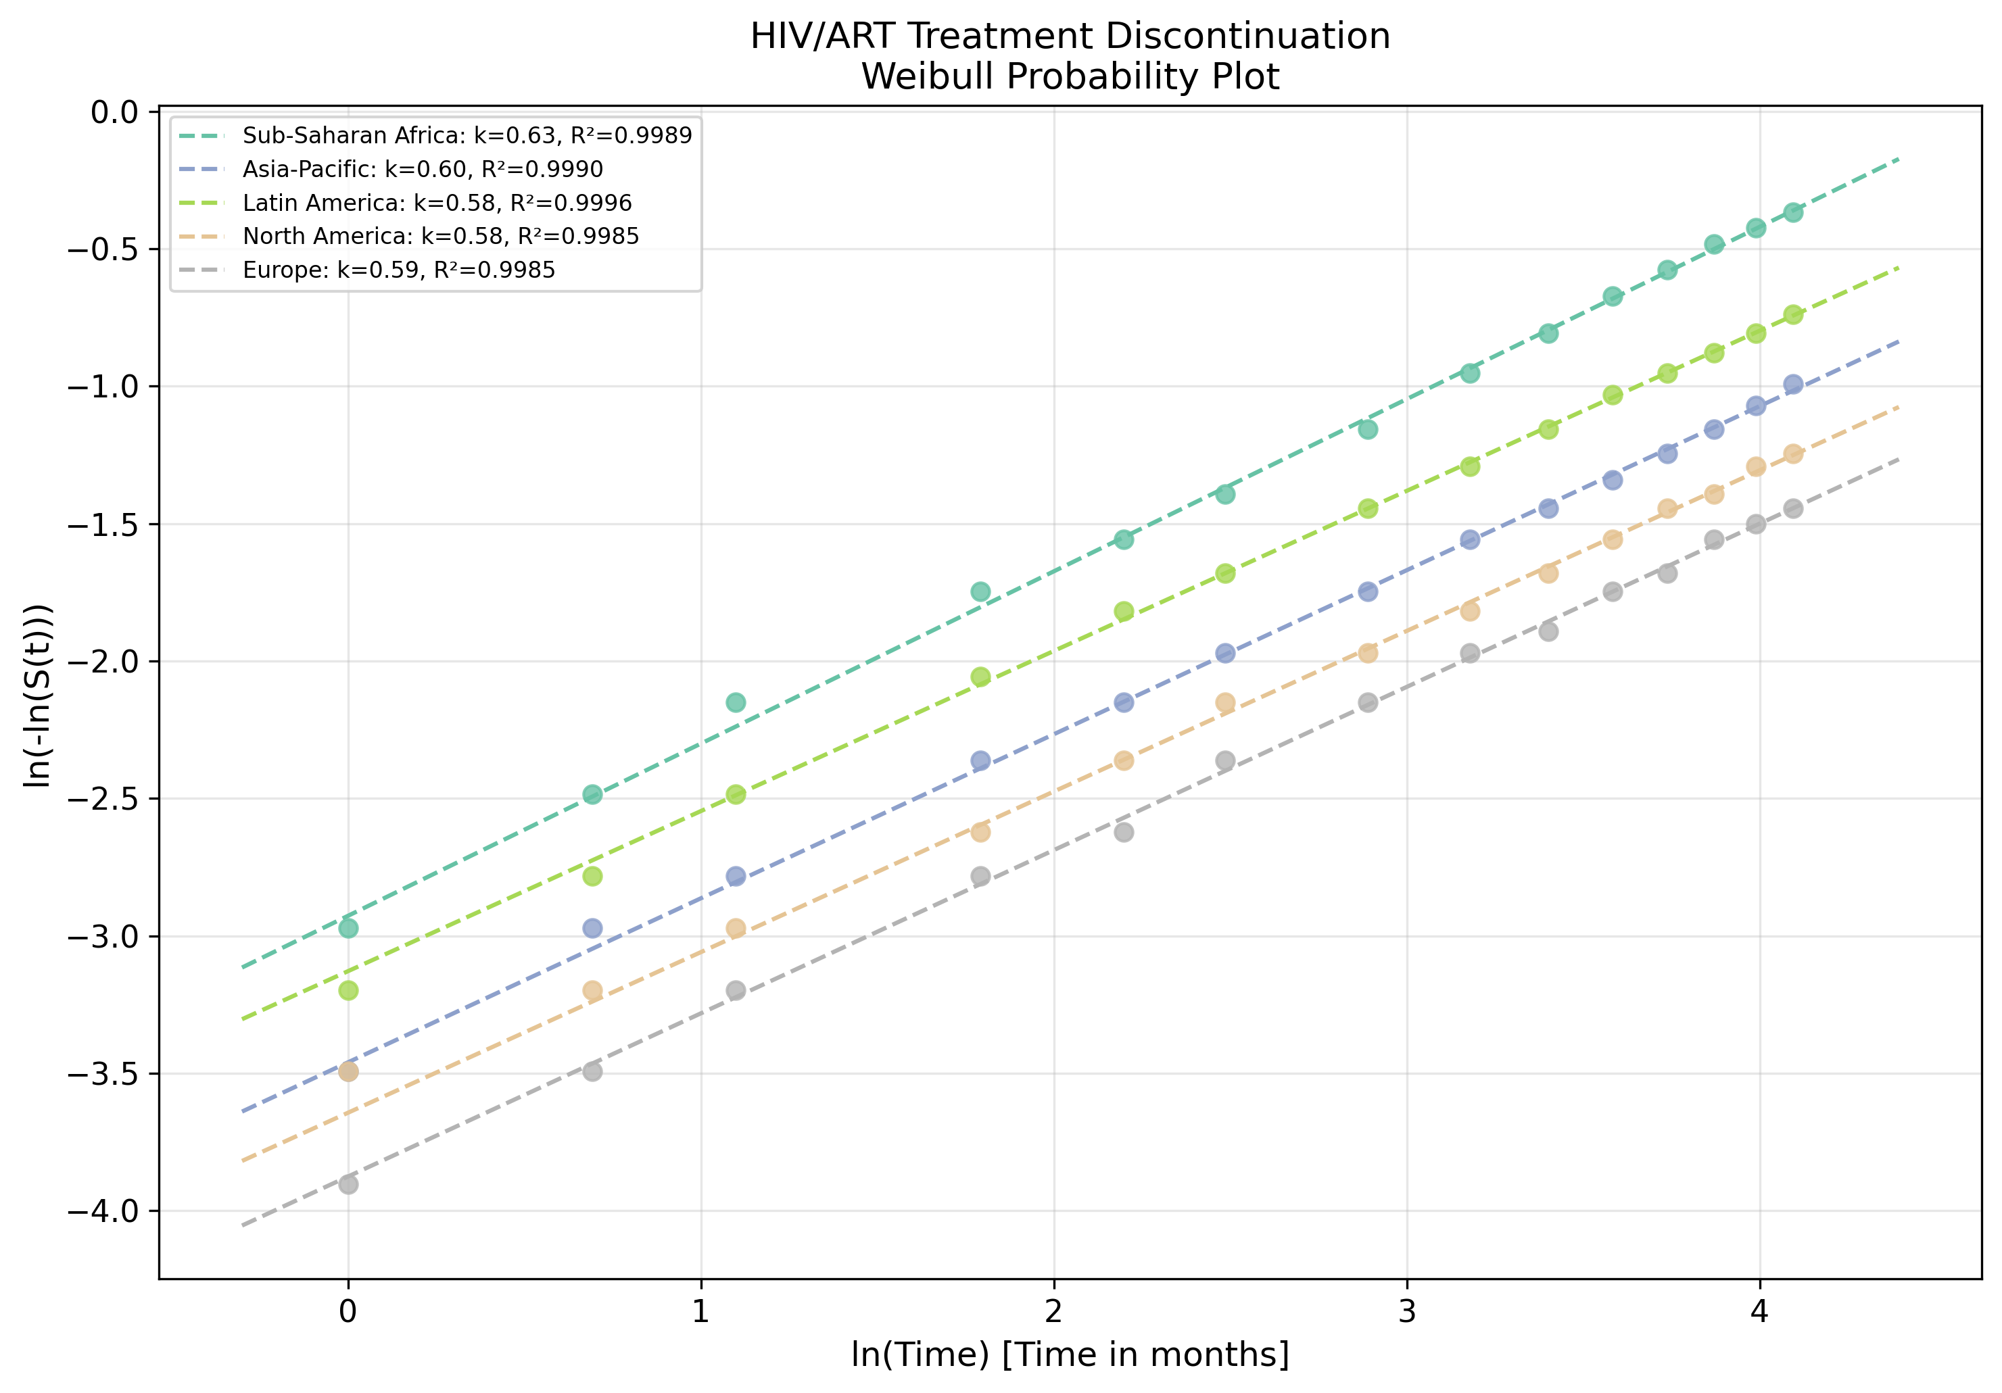
HIV/ART: Weibull Probability Plot
Linearised goodness-of-fit assessment for HIV/ART datasets.

