Slide 1
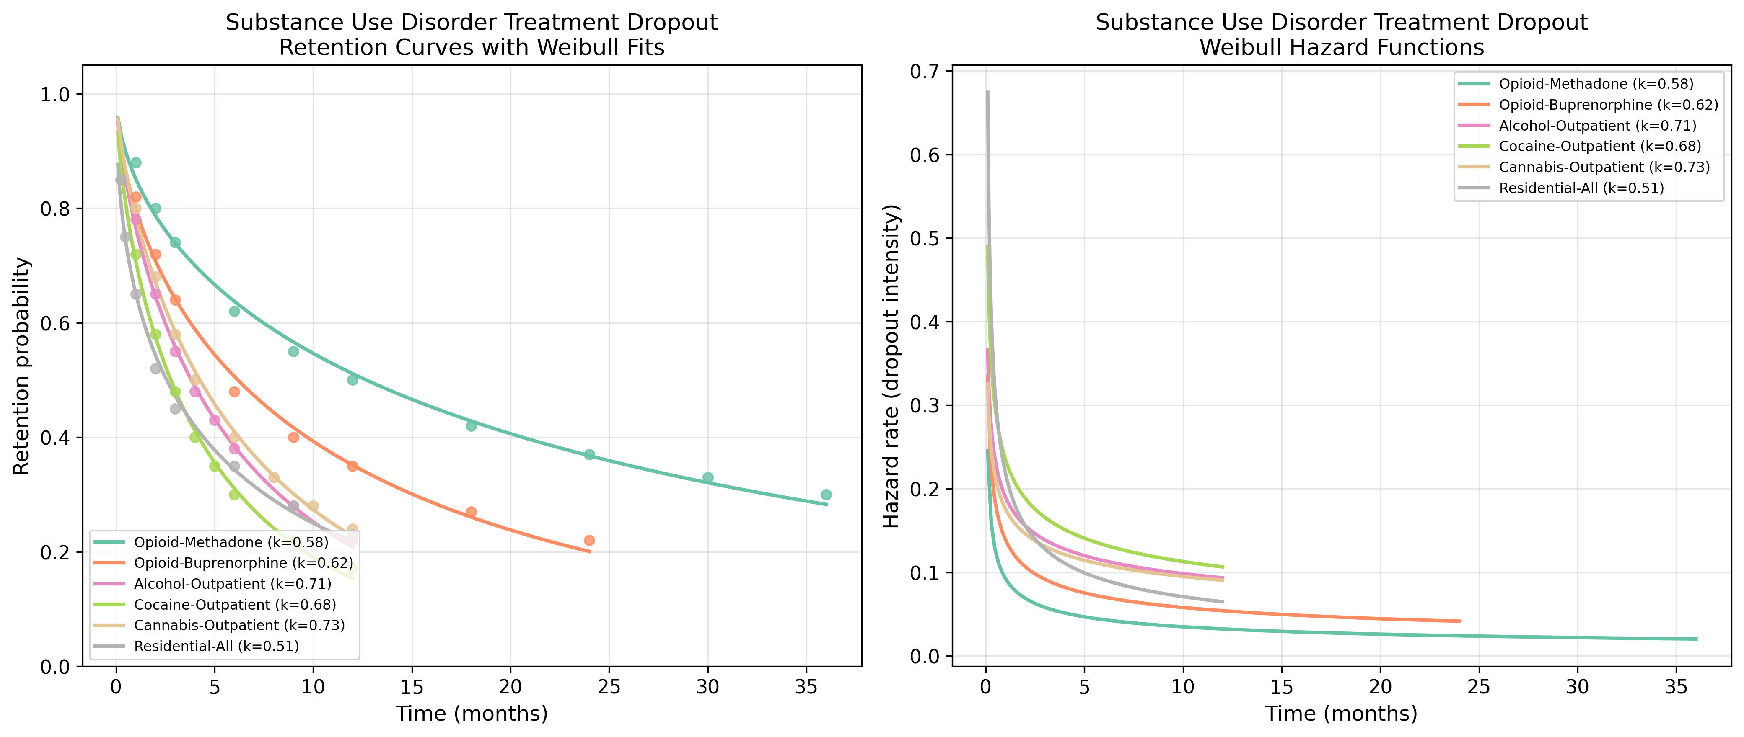
Substance Use: Retention & Hazard Functions
Retention curves with Weibull fits and hazard functions for Substance Use datasets.

Slide 2
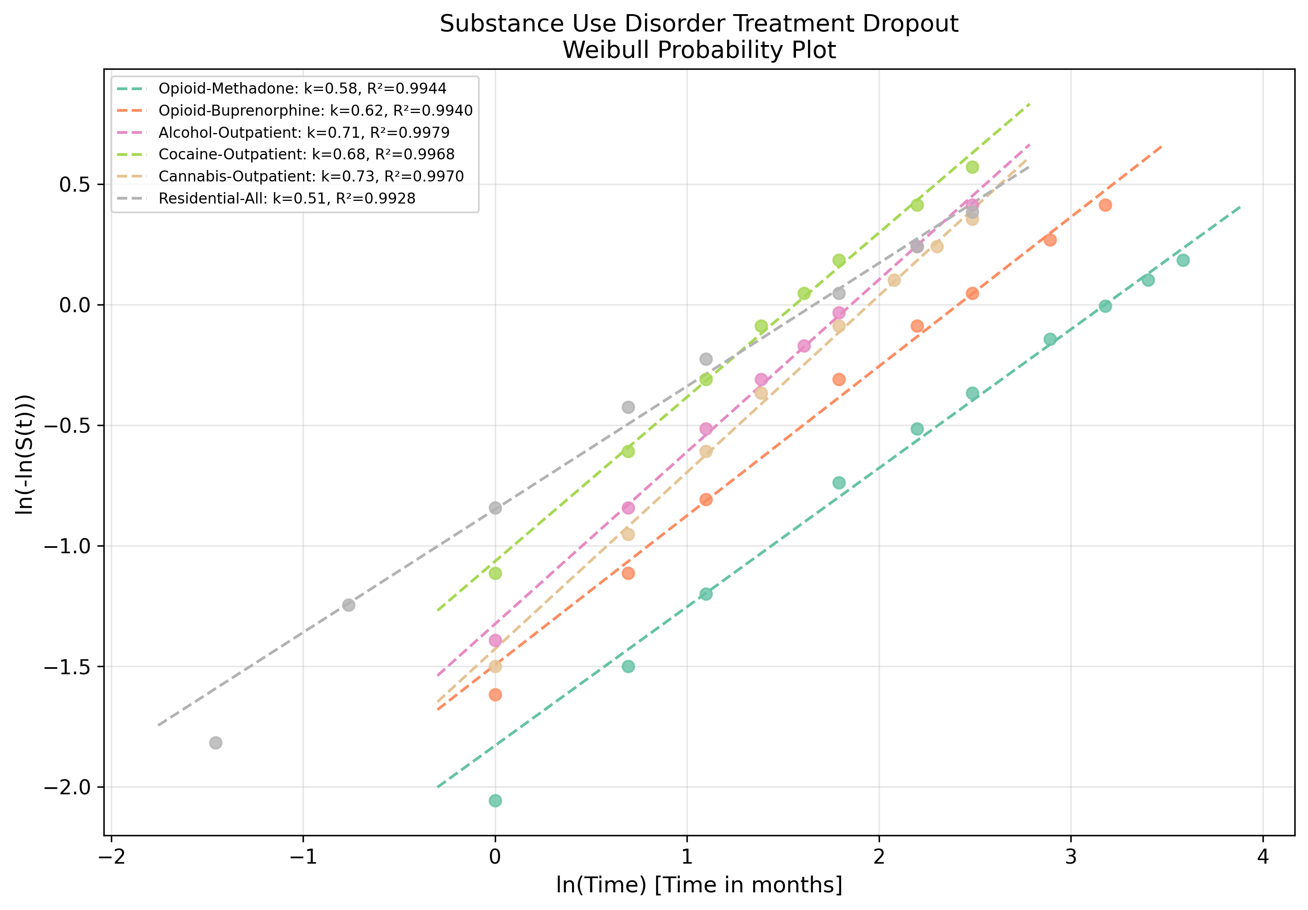
Substance Use: Weibull Probability Plot
Linearised goodness-of-fit assessment for Substance Use datasets.

