Slide 1
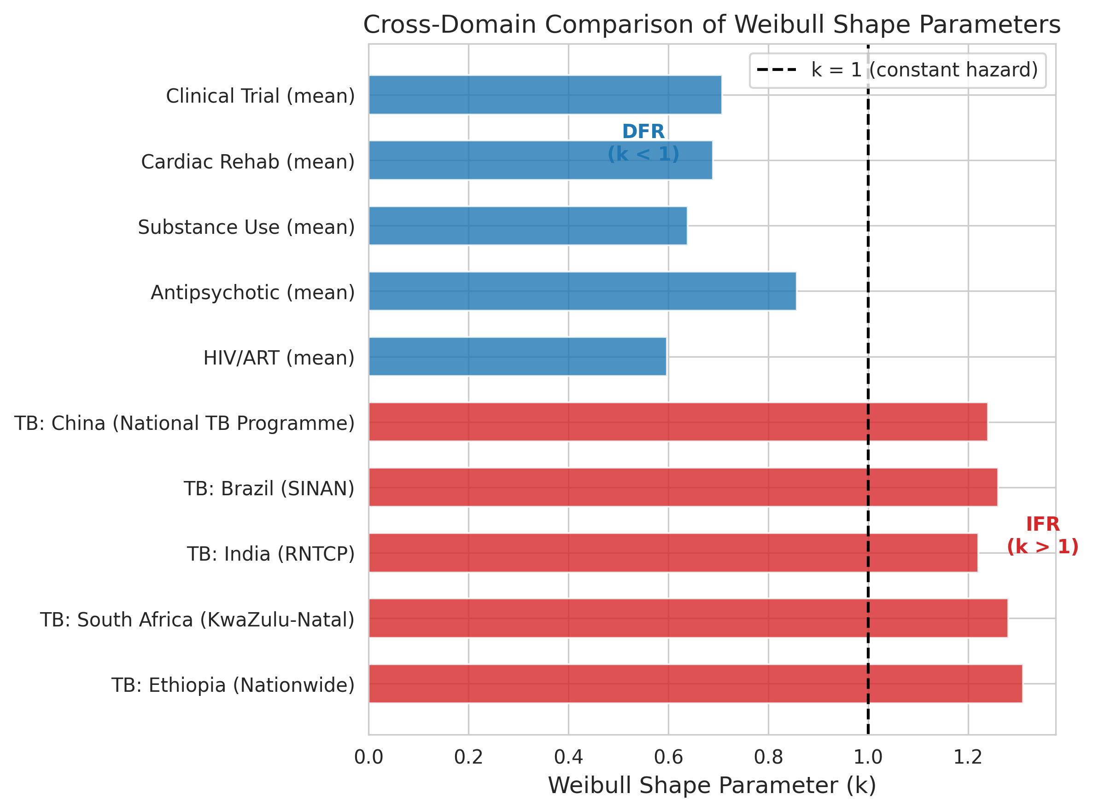
Figure 1
Cross-domain comparison of Weibull shape parameters (k)

Slide 2
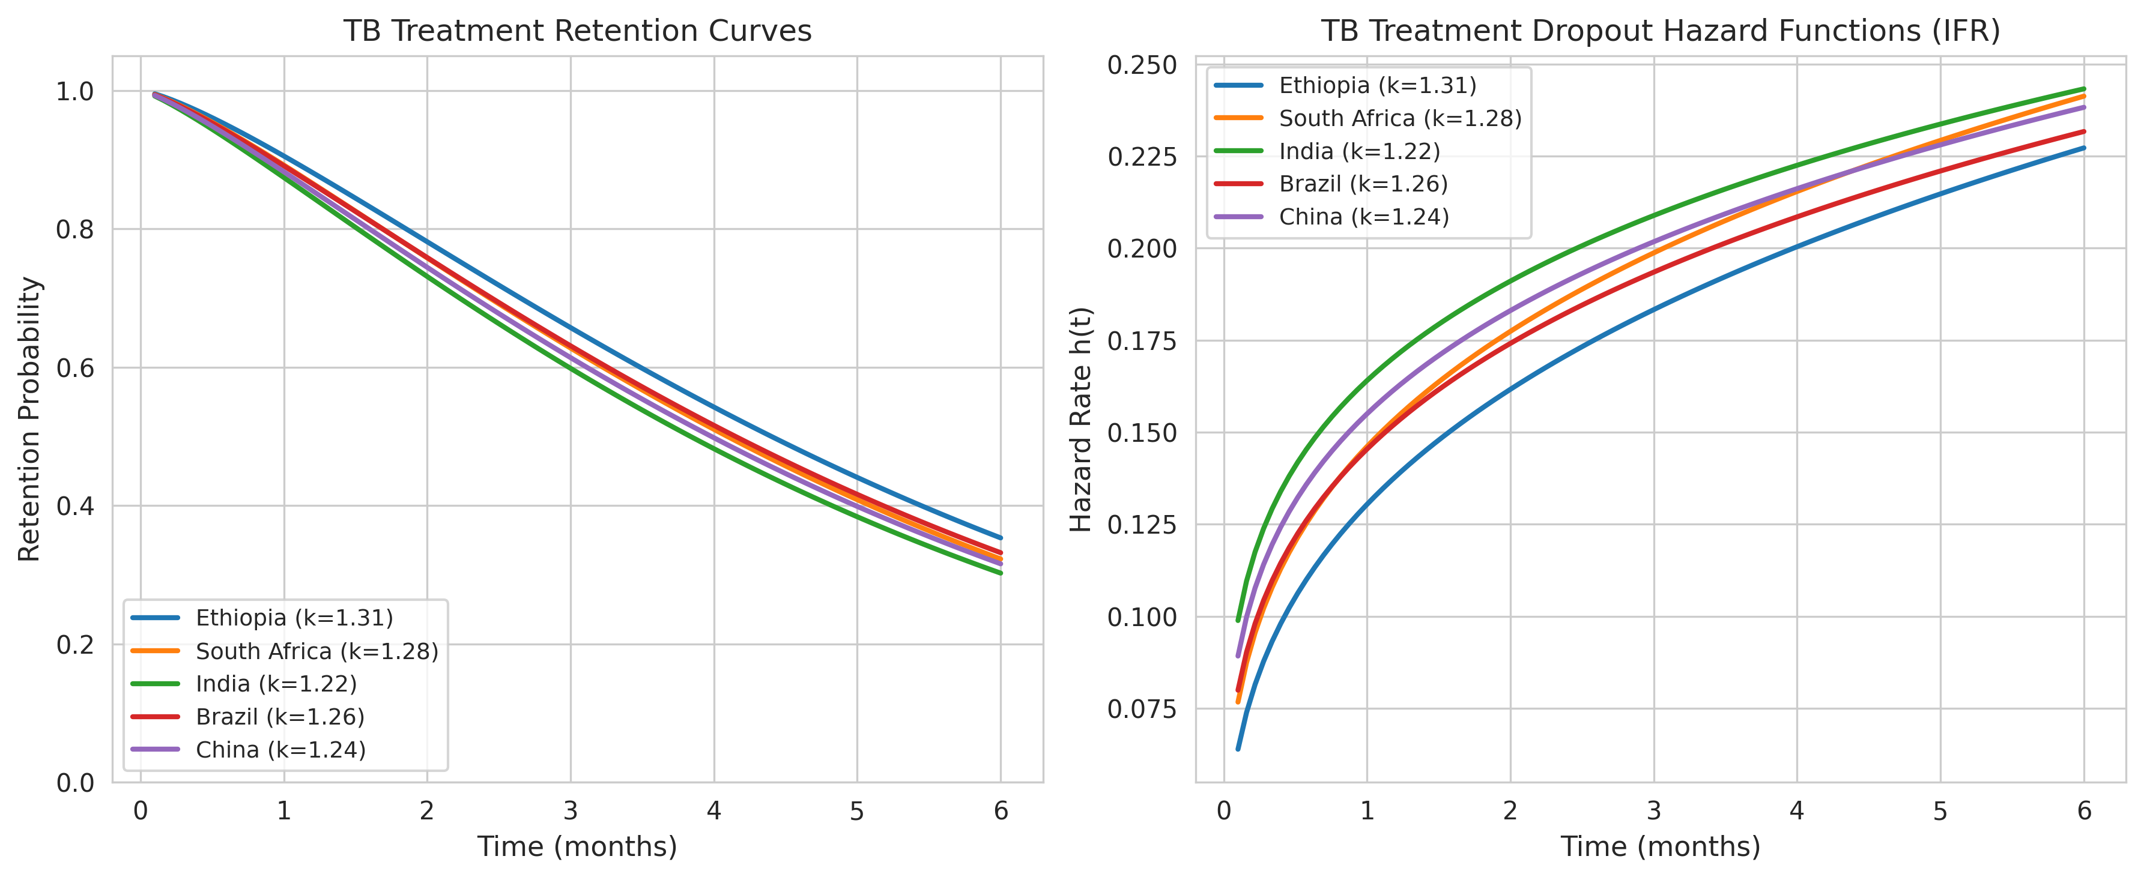
Figure 2
TB treatment retention curves and hazard functions

Slide 3
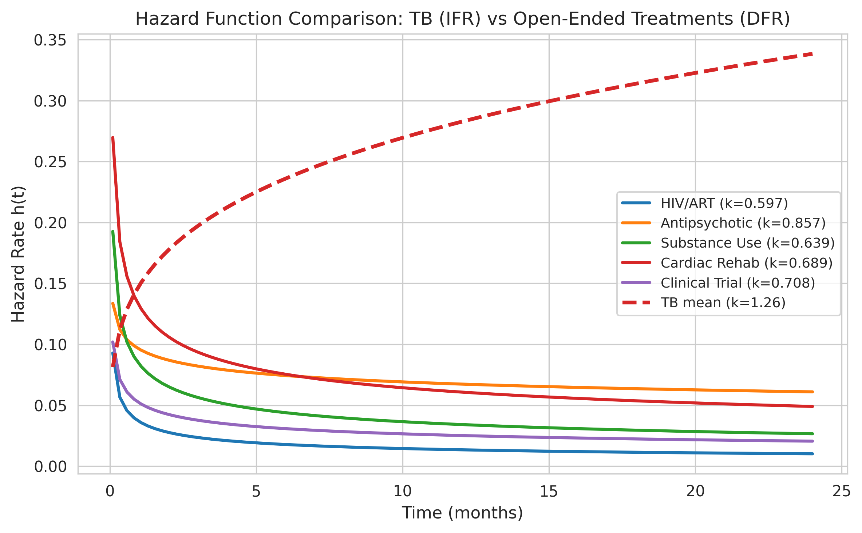
Figure 3
Hazard function comparison: TB (IFR) vs open-ended treatments (DFR)

