Slide 1
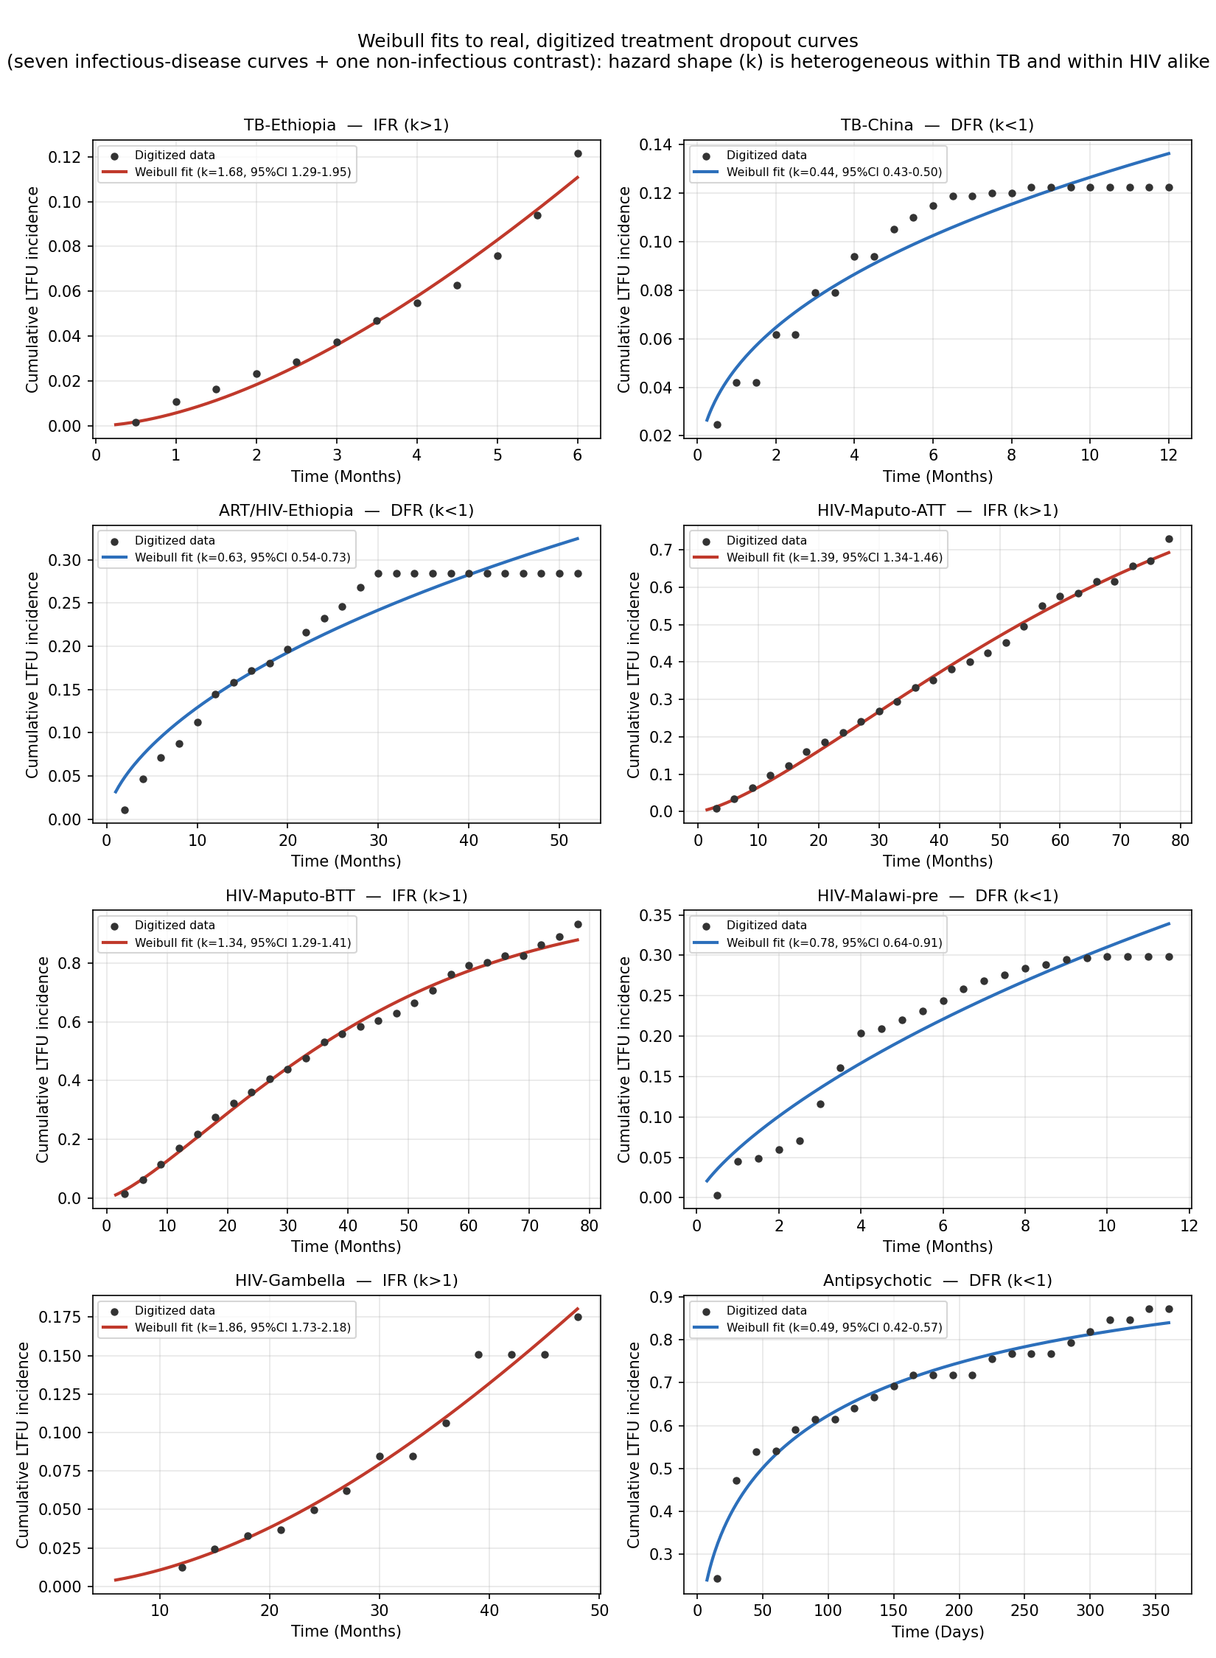
Figure 1. Weibull fits to digitized treatment-dropout curves (TB and HIV cohorts)
Hazard shape (k) is heterogeneous within TB and within HIV alike (both IFR and DFR appear in each). Values: results/weibull_fits.csv.

