Slide 1
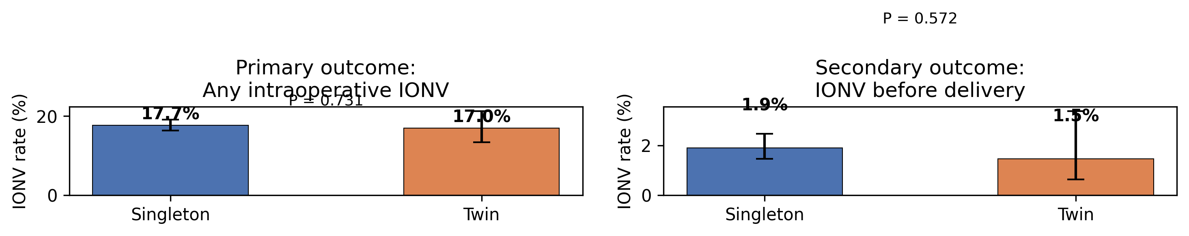
Figure 1: IONV Rates by Group

Slide 2
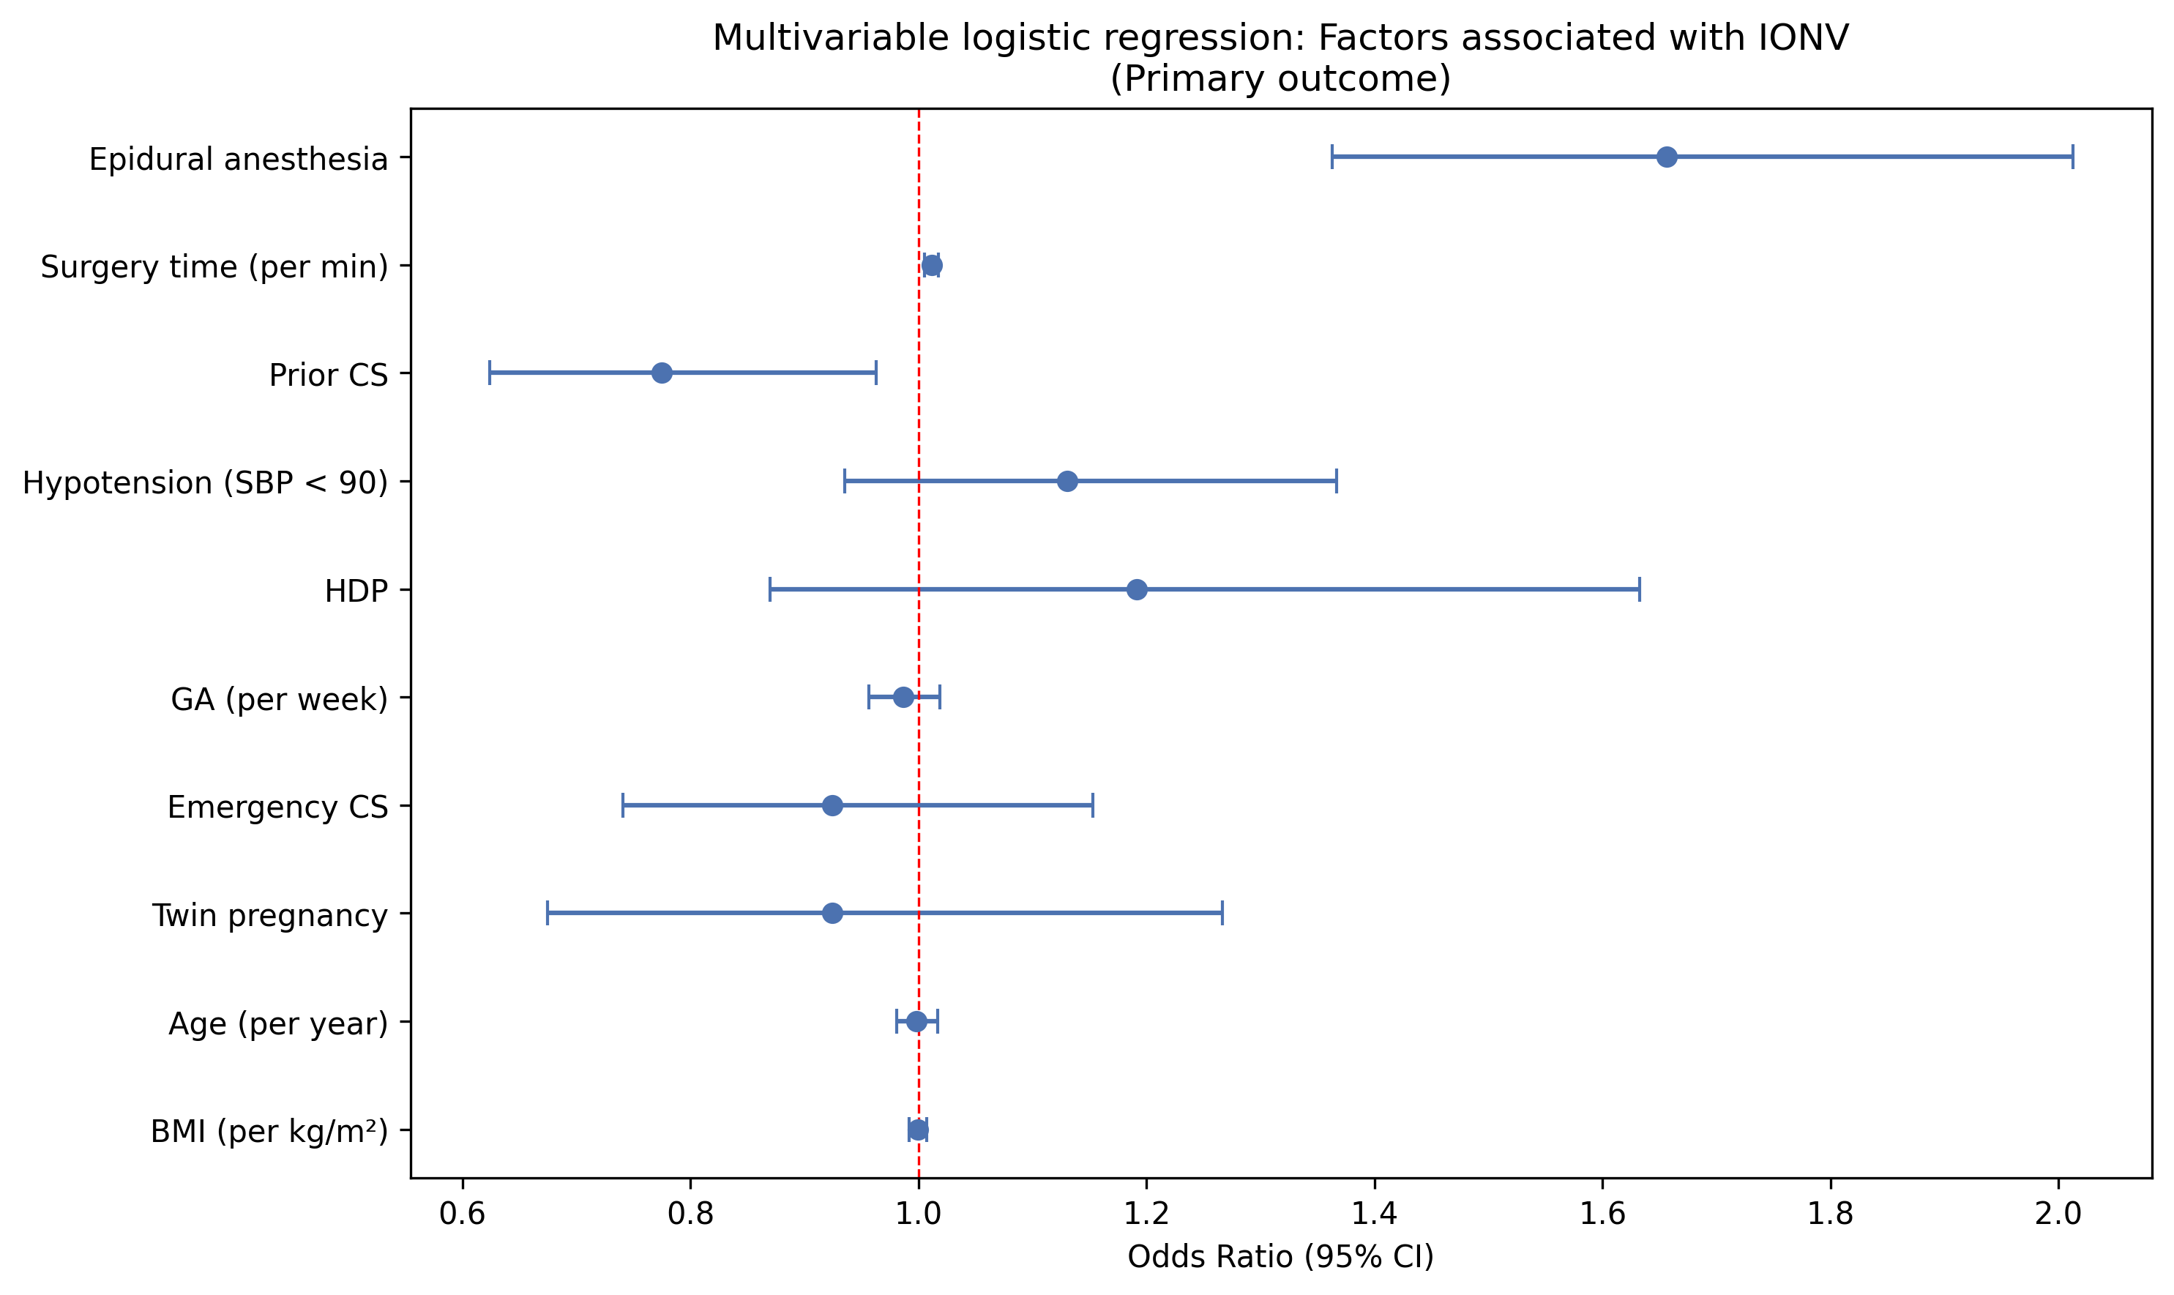
Figure 2: Forest Plot — Primary Outcome

Slide 3
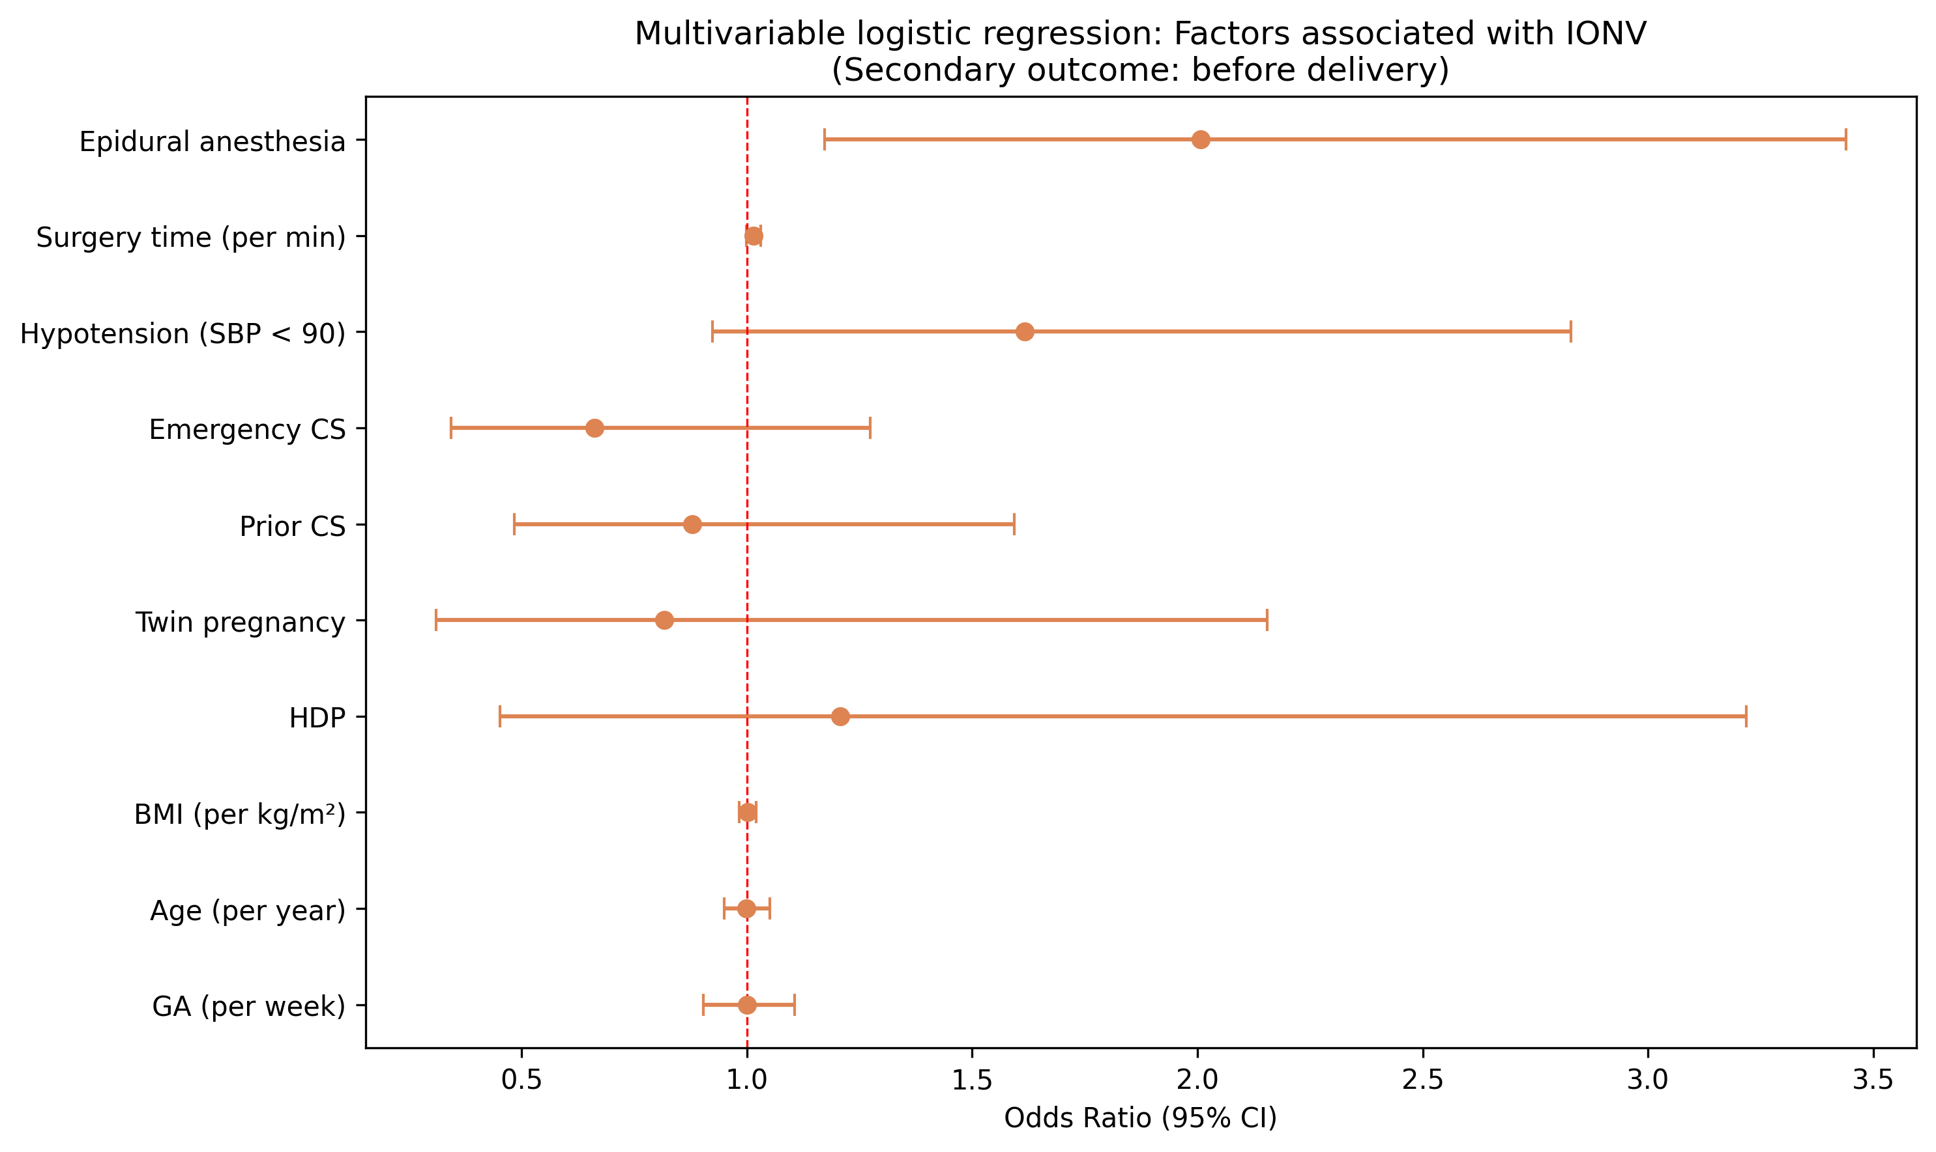
Figure 3: Forest Plot — Secondary Outcome

Slide 4
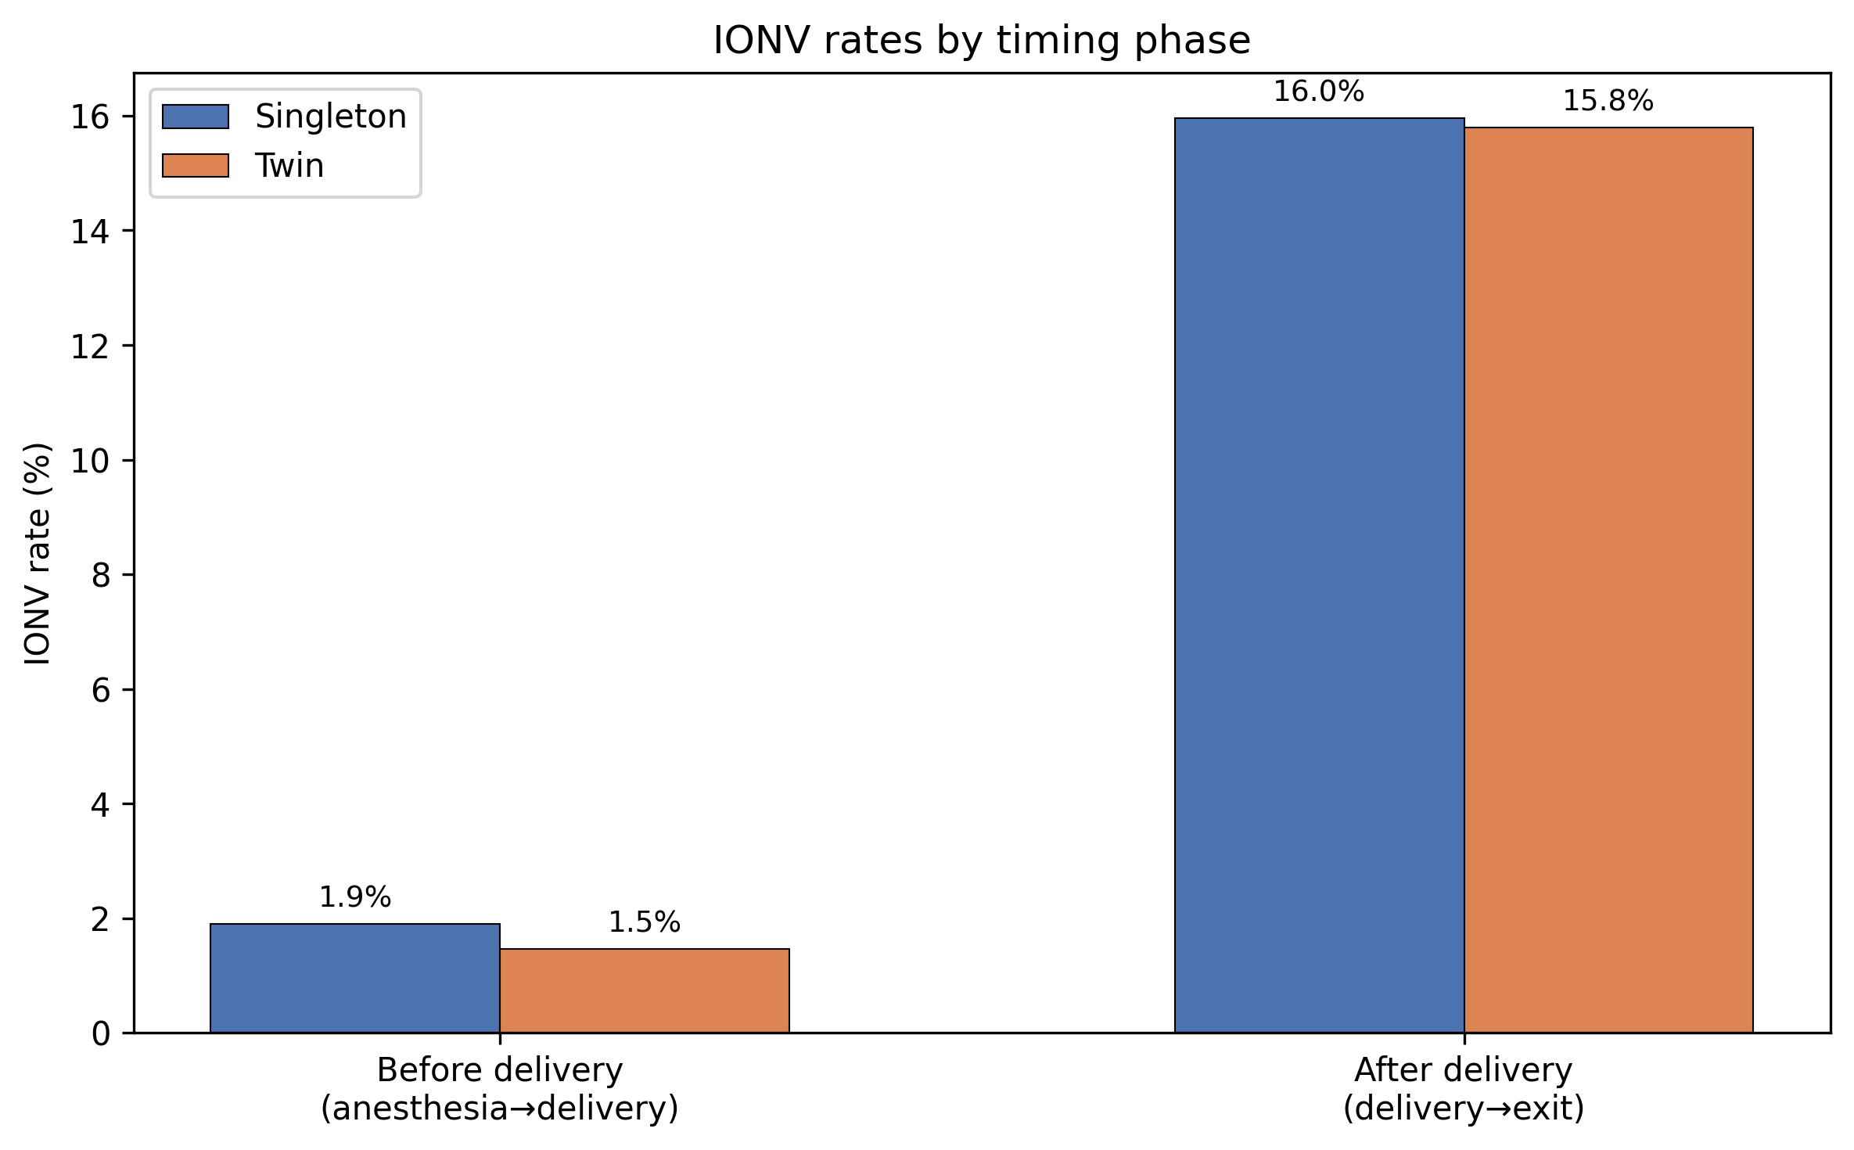
Figure 4: IONV Rates by Timing Phase

Slide 5
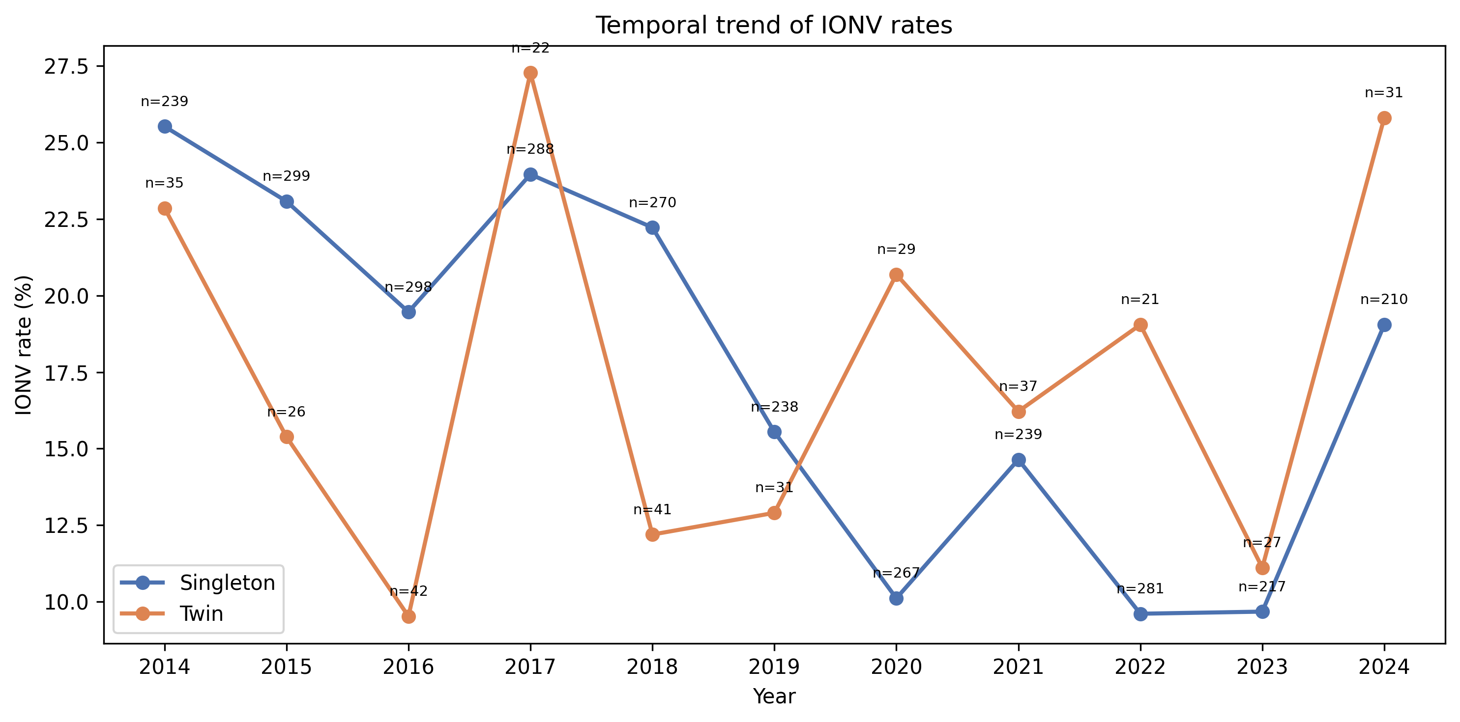
Figure 5: Temporal Trend of IONV Rates

Slide 6
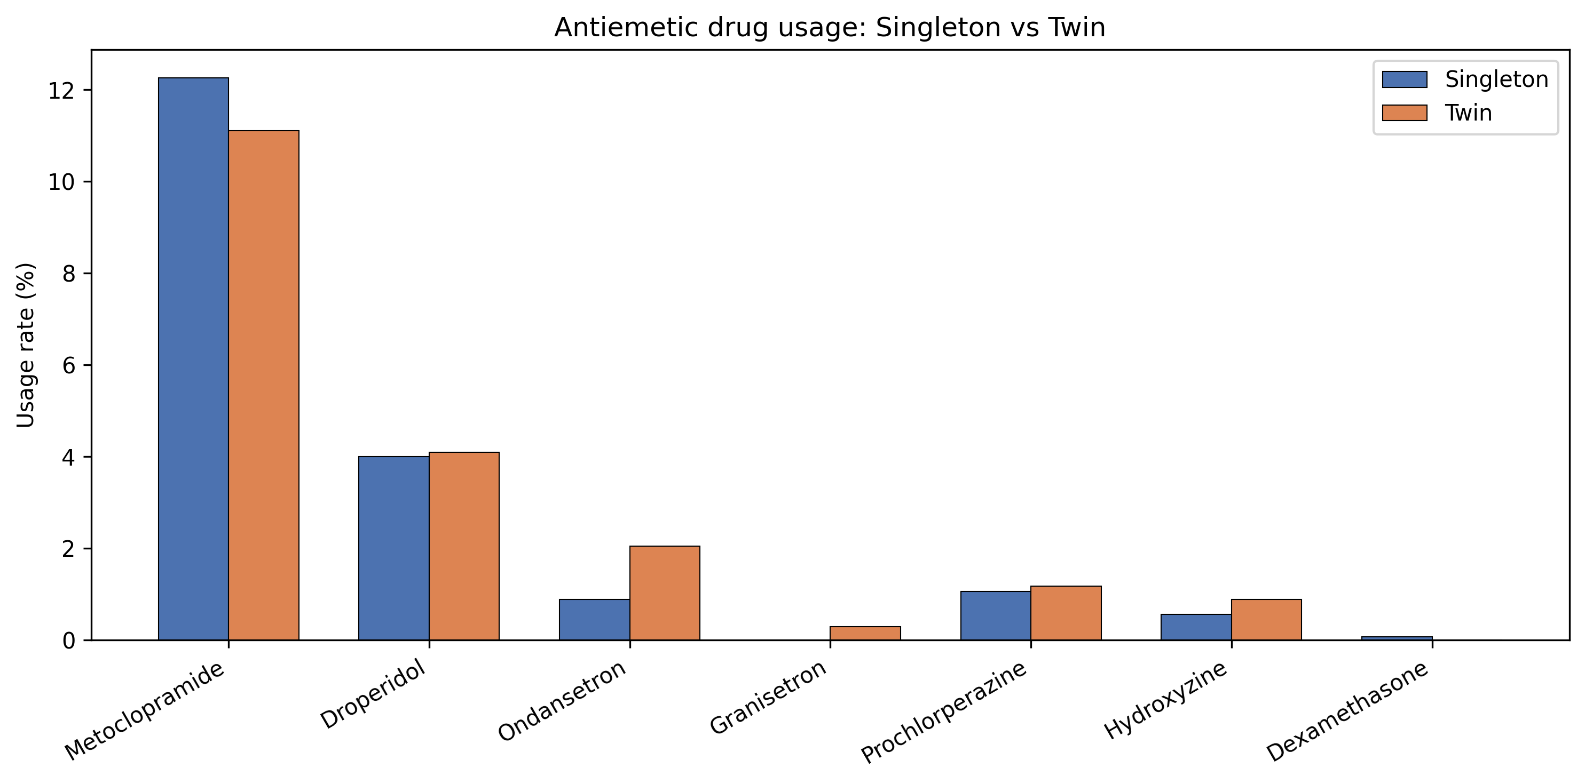
Figure 6: Antiemetic Drug Usage Comparison

Slide 7
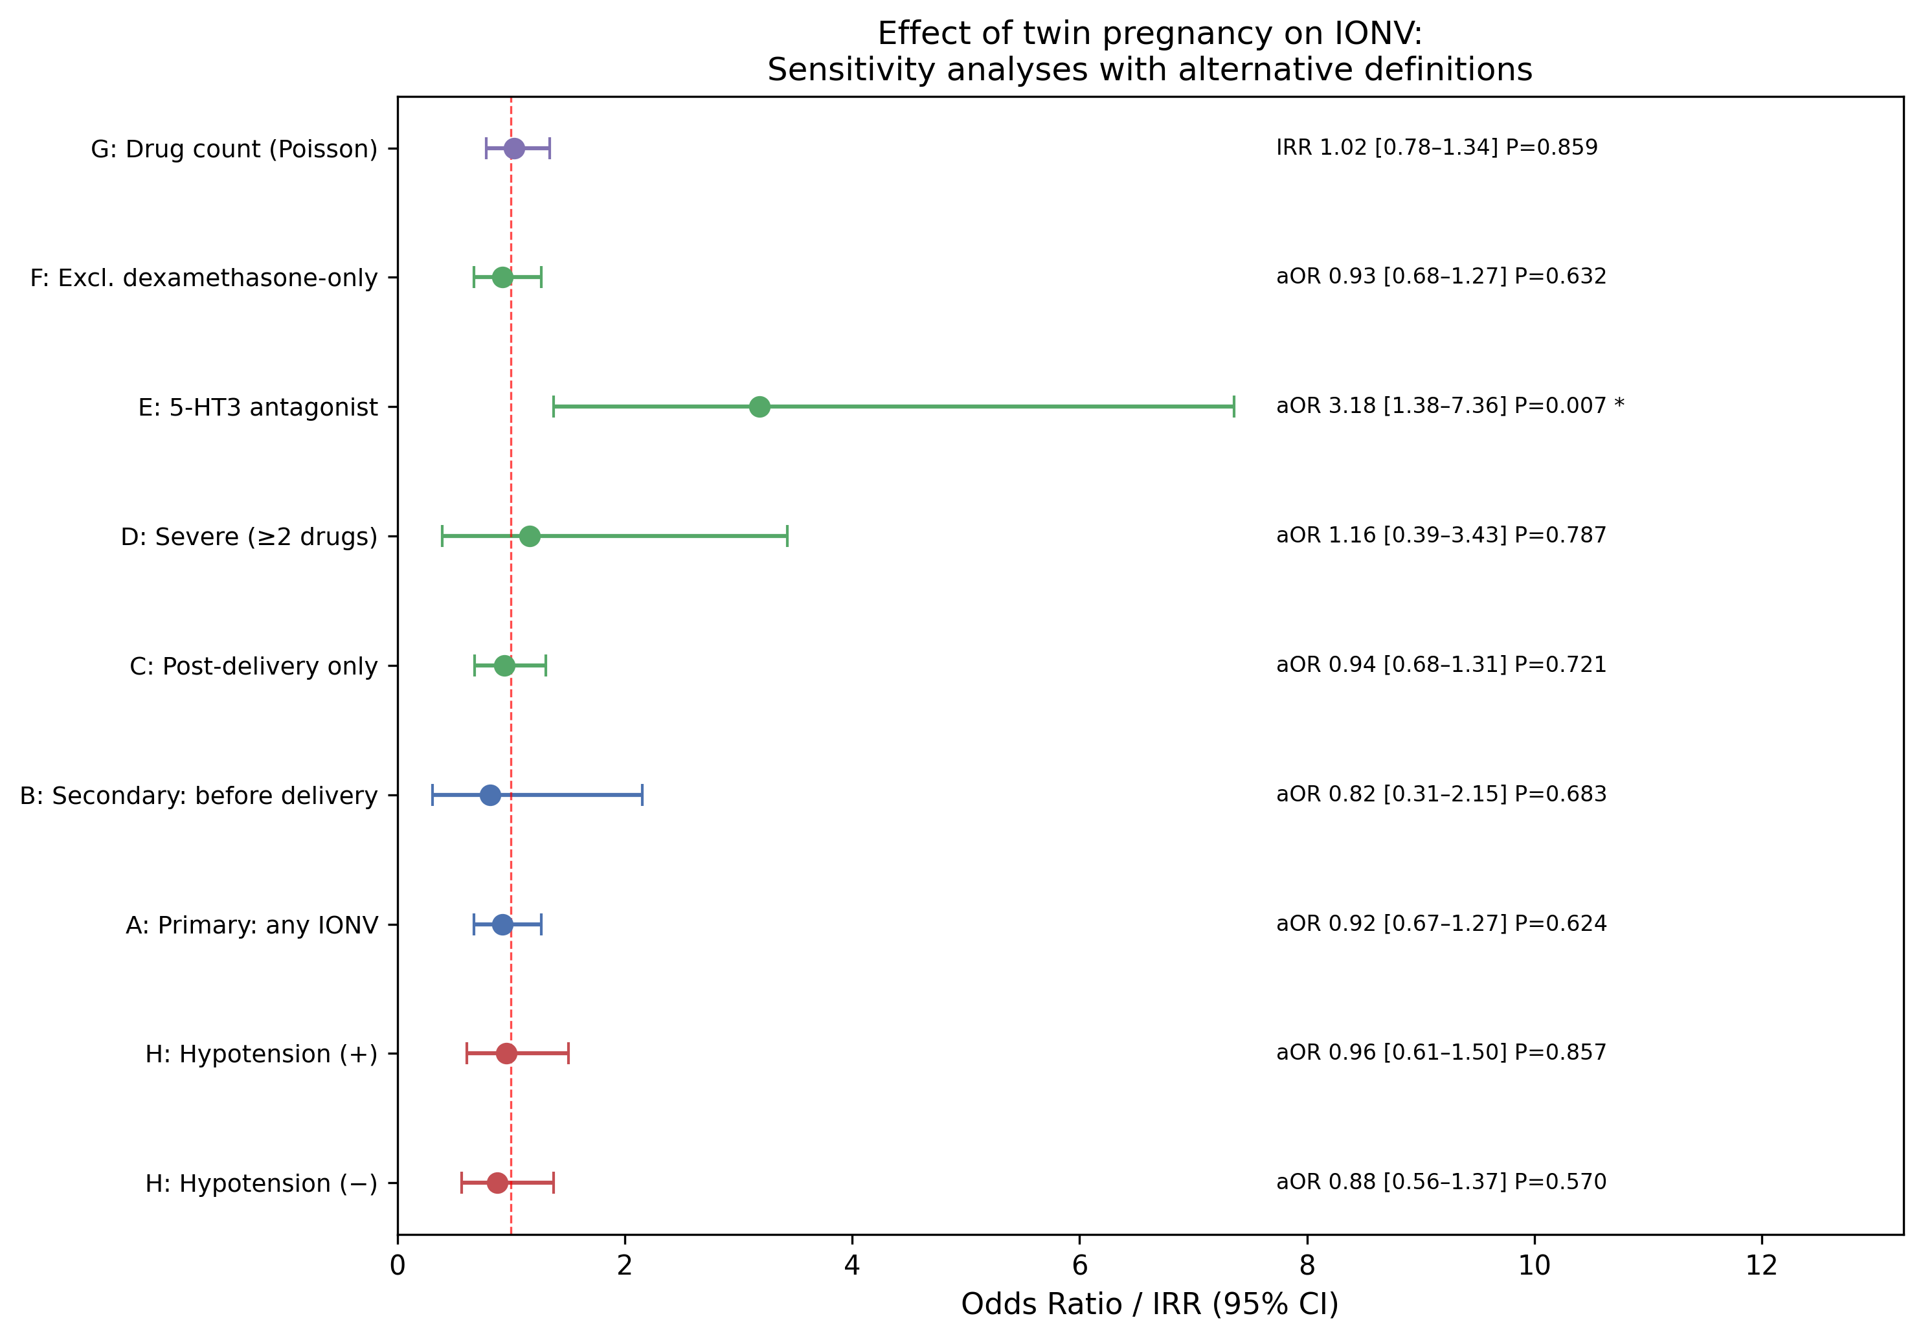
Figure 7: Sensitivity — Twin aOR Across Definitions

Slide 8
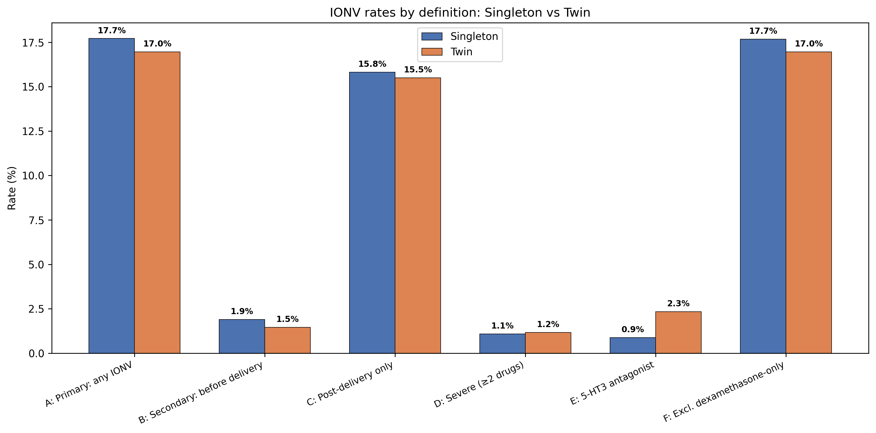
Figure 8: Sensitivity — IONV Rates by Definition

Slide 9
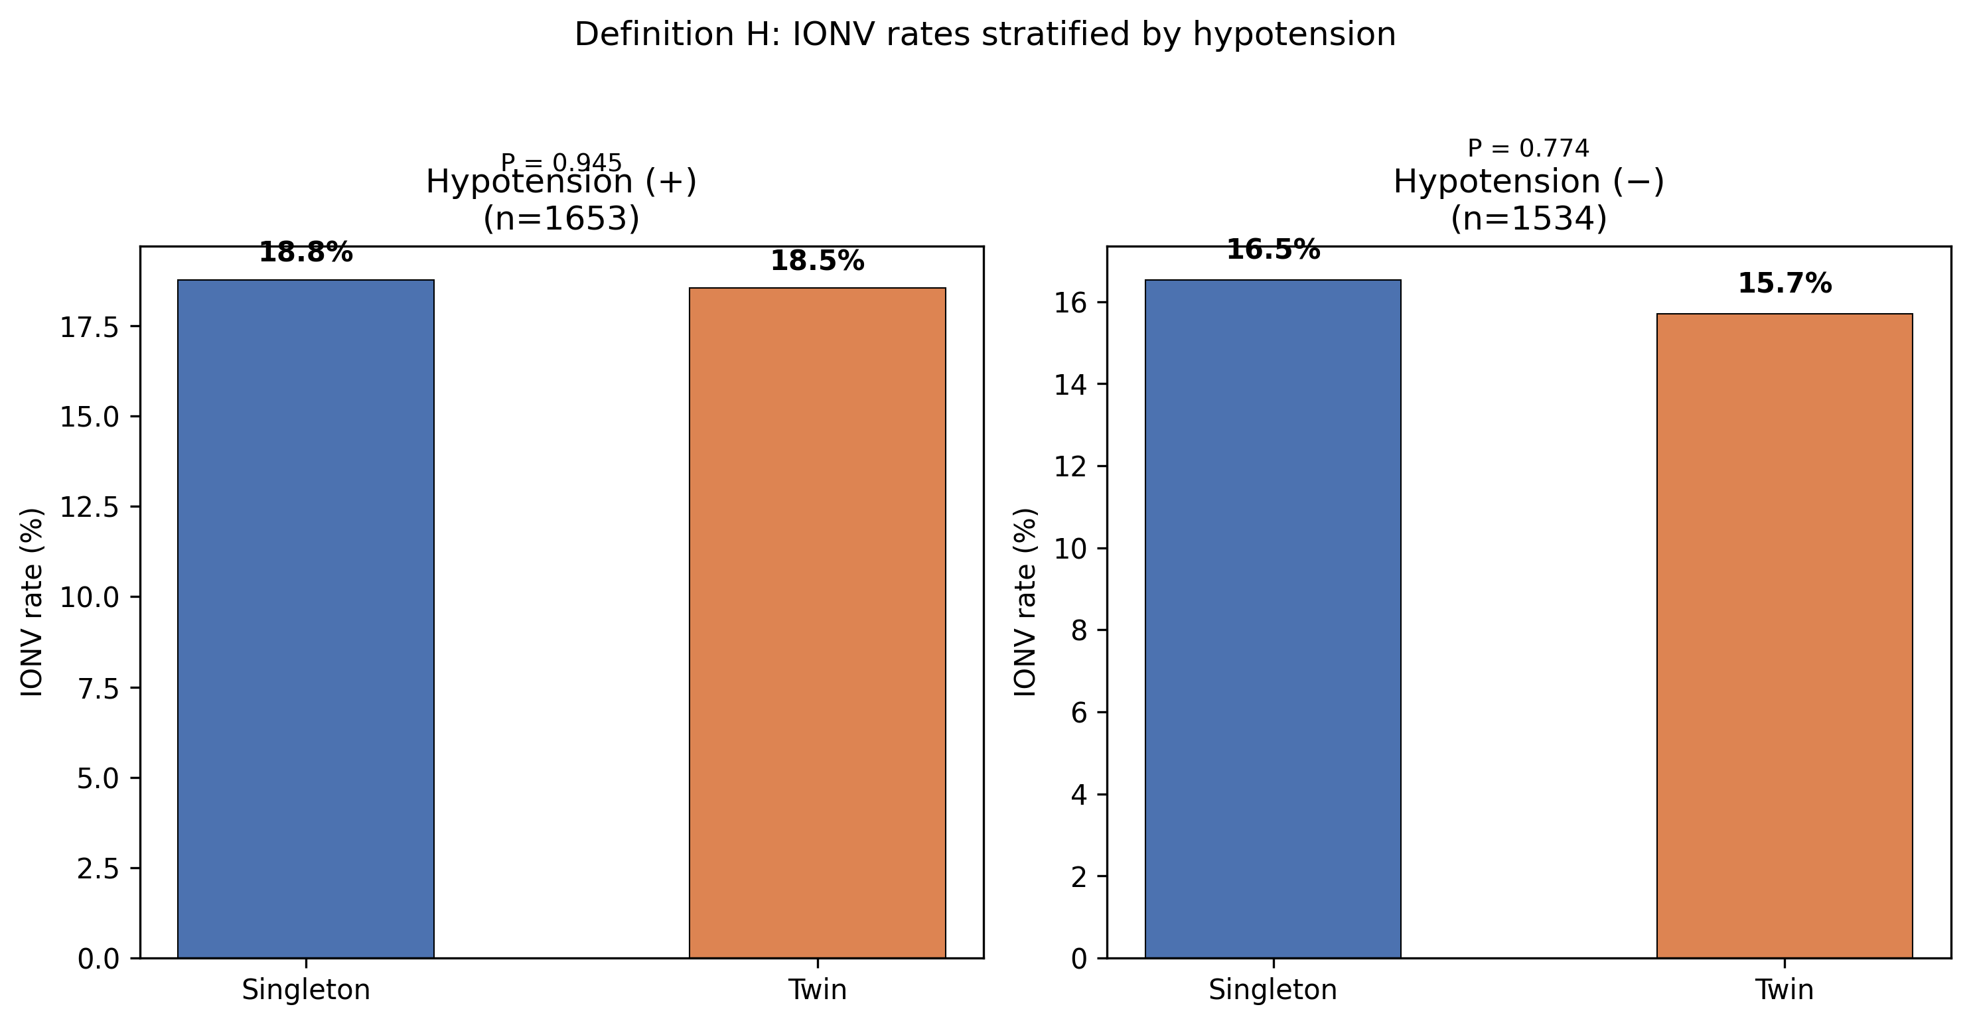
Figure 9: Definition H — Hypotension-Stratified IONV

