Slide 1
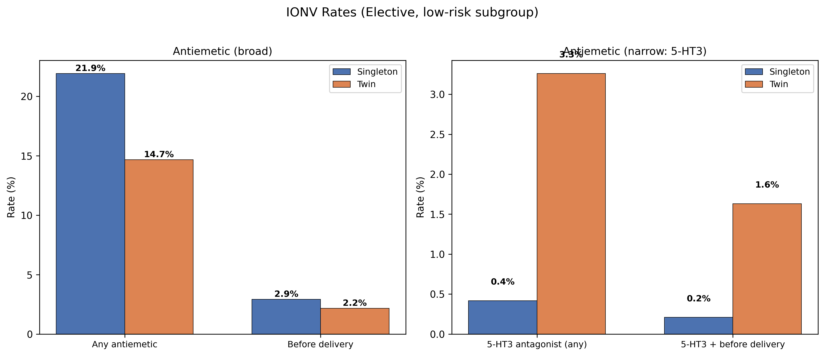
Fig. 1: IONV Rates — Elective Low-Risk Subgroup

Slide 2
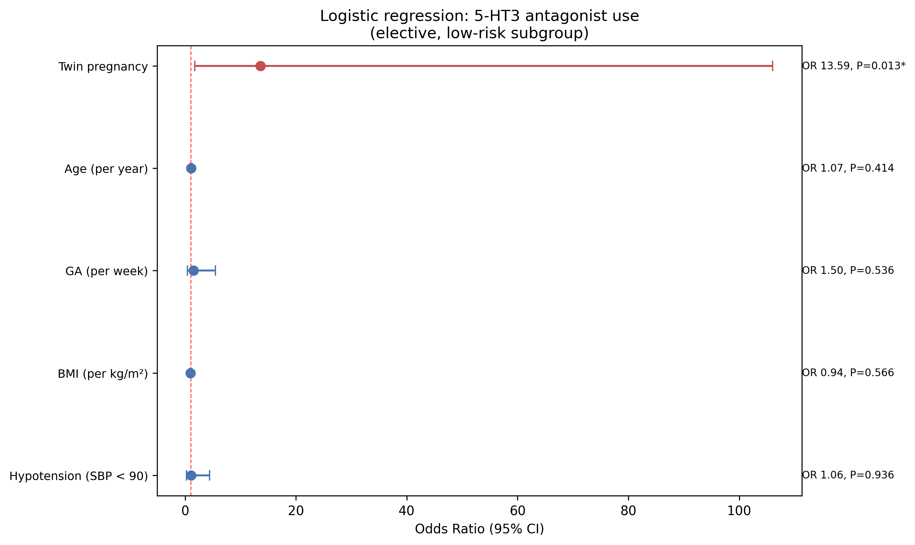
Fig. 2: Logistic Regression — 5-HT3 Antagonist Use (Elective Low-Risk)

Slide 3
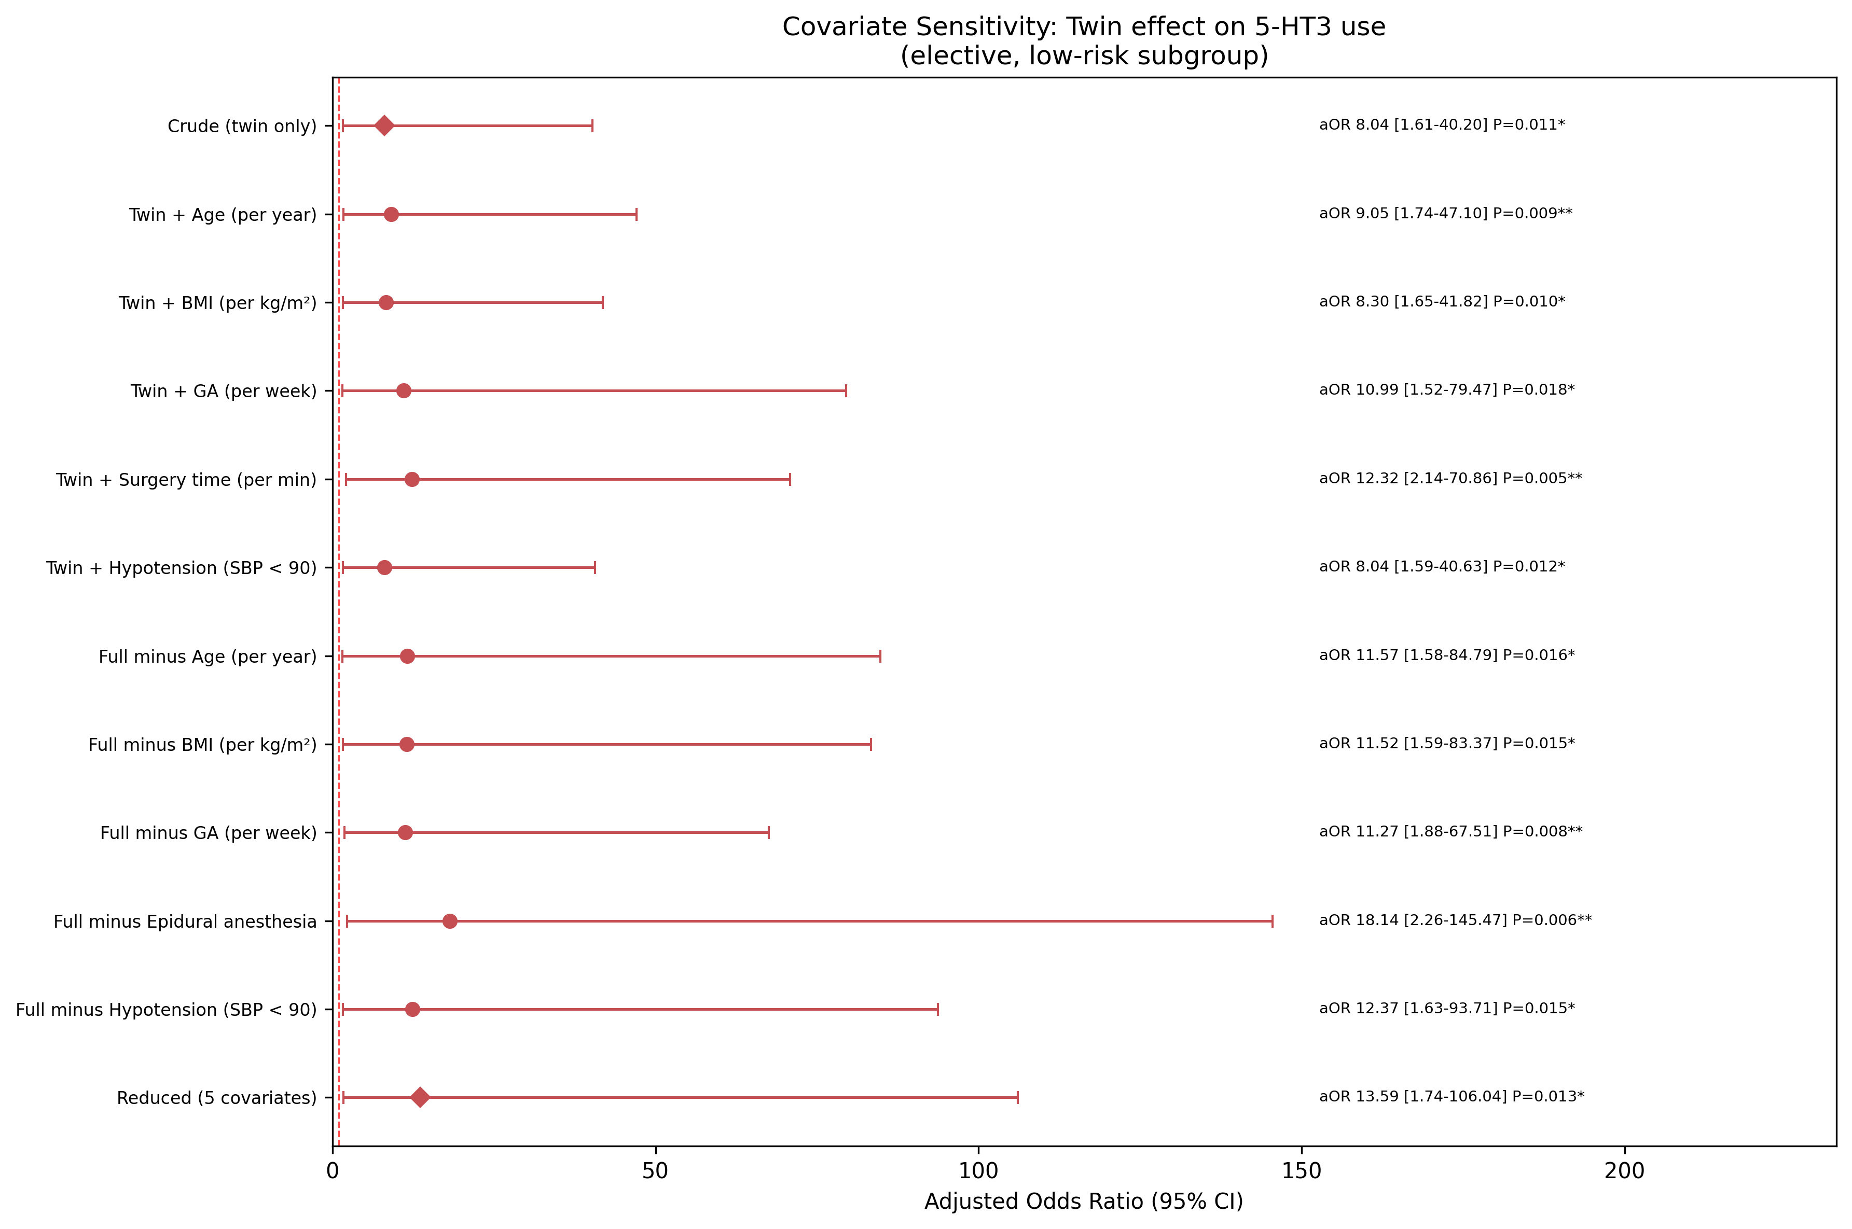
Fig. 3: Covariate Sensitivity Analysis (Elective Low-Risk)

Slide 4
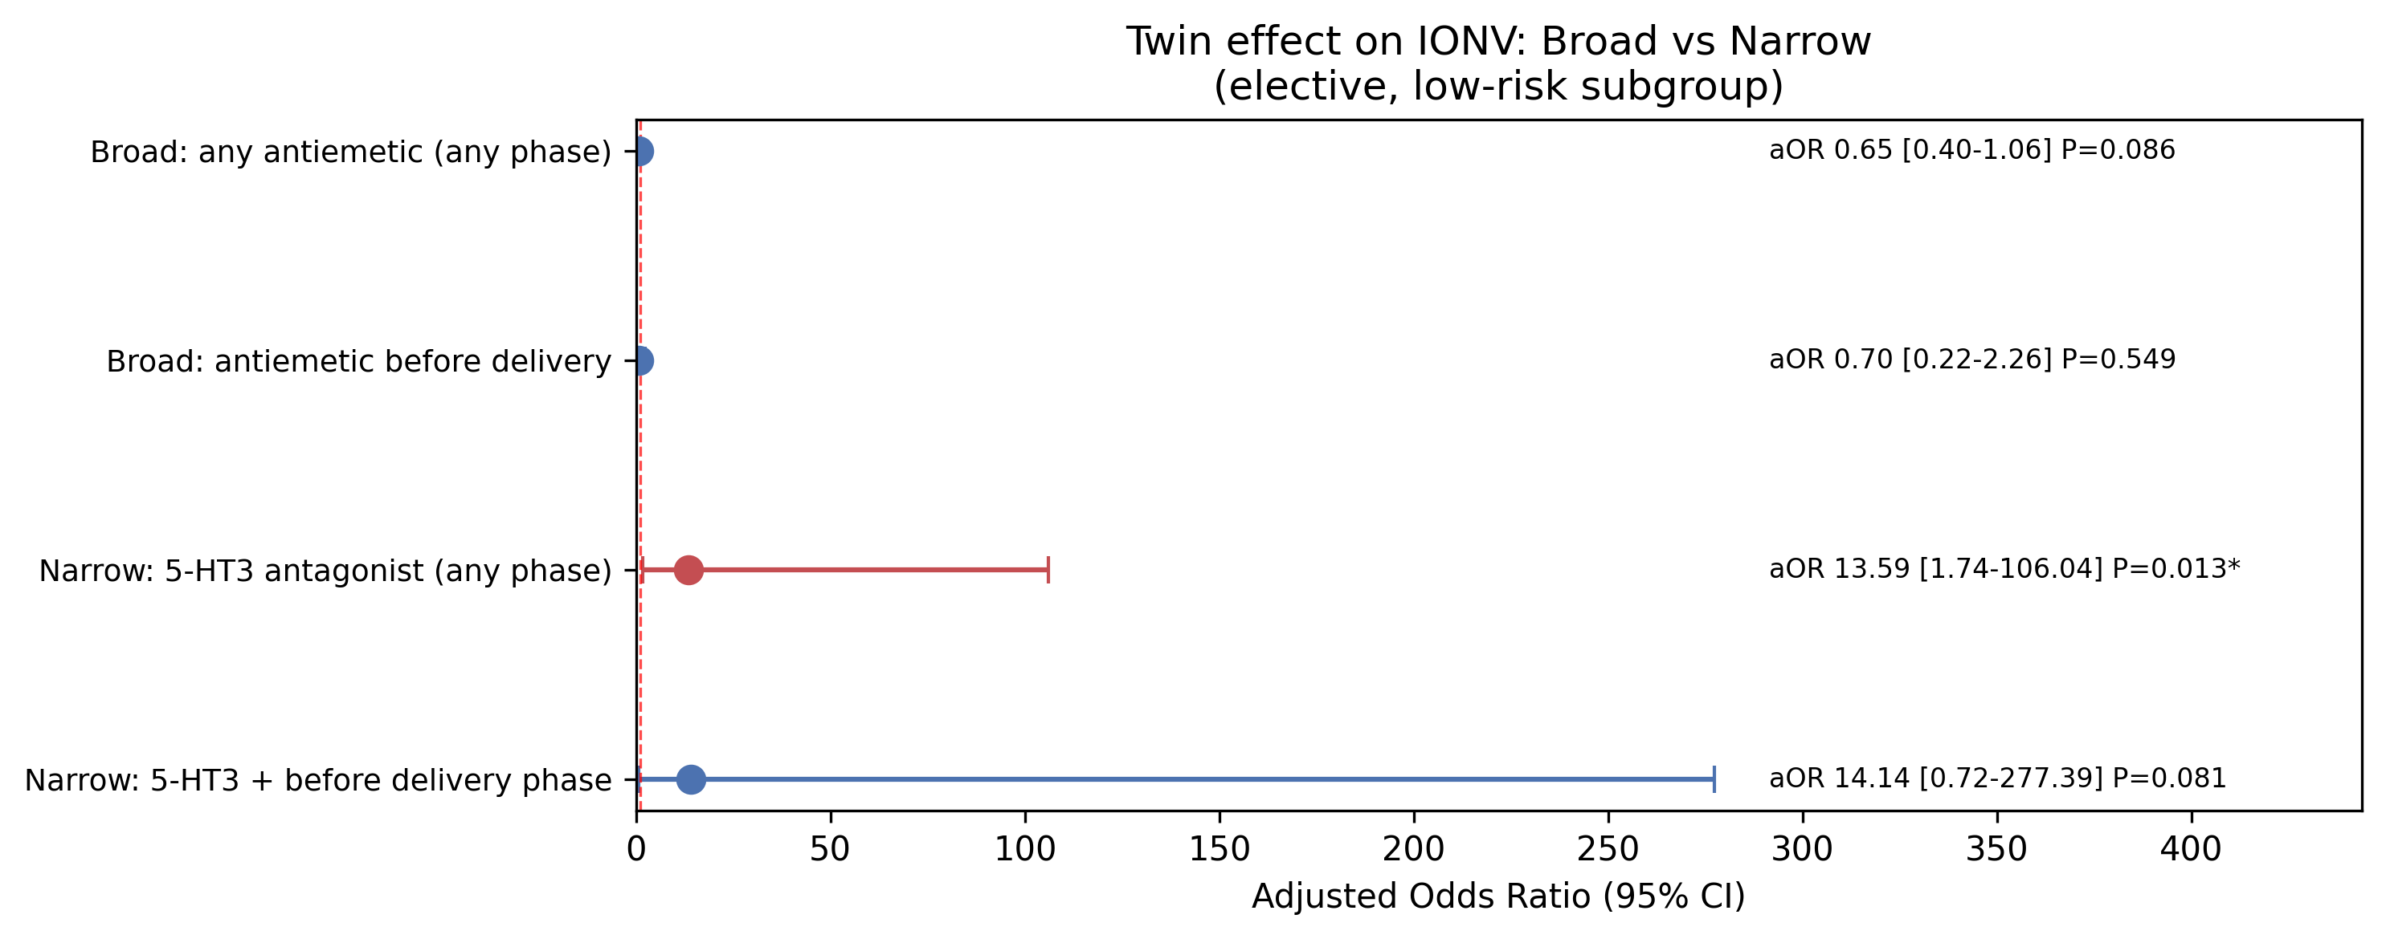
Fig. 4: Twin Effect — Broad vs Narrow Definition (Elective Low-Risk)

