Slide 1
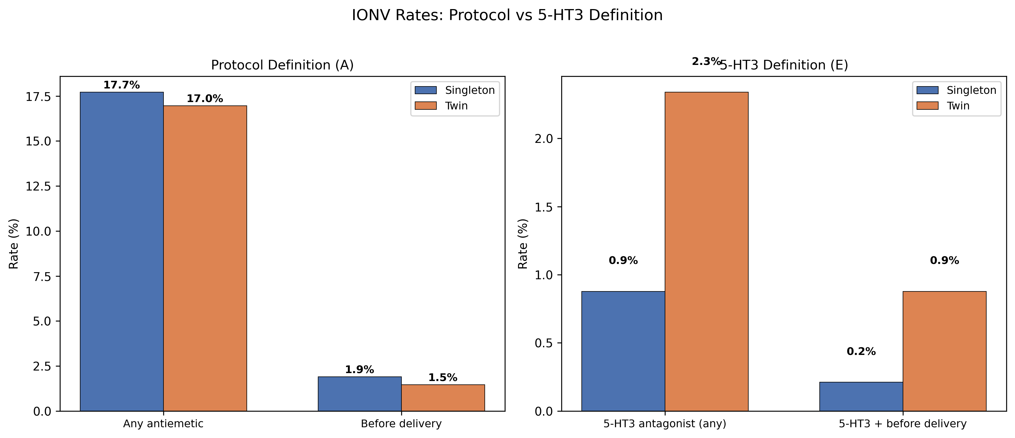
Fig. 1: IONV Rates — Protocol (A) vs 5-HT3 (E)

Slide 2
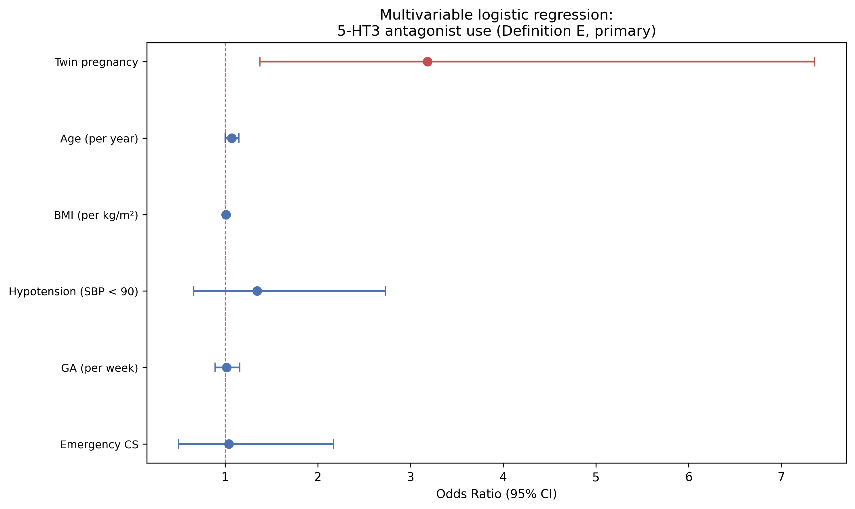
Fig. 2: Logistic Regression — 5-HT3 Use (Def E Primary)

Slide 3
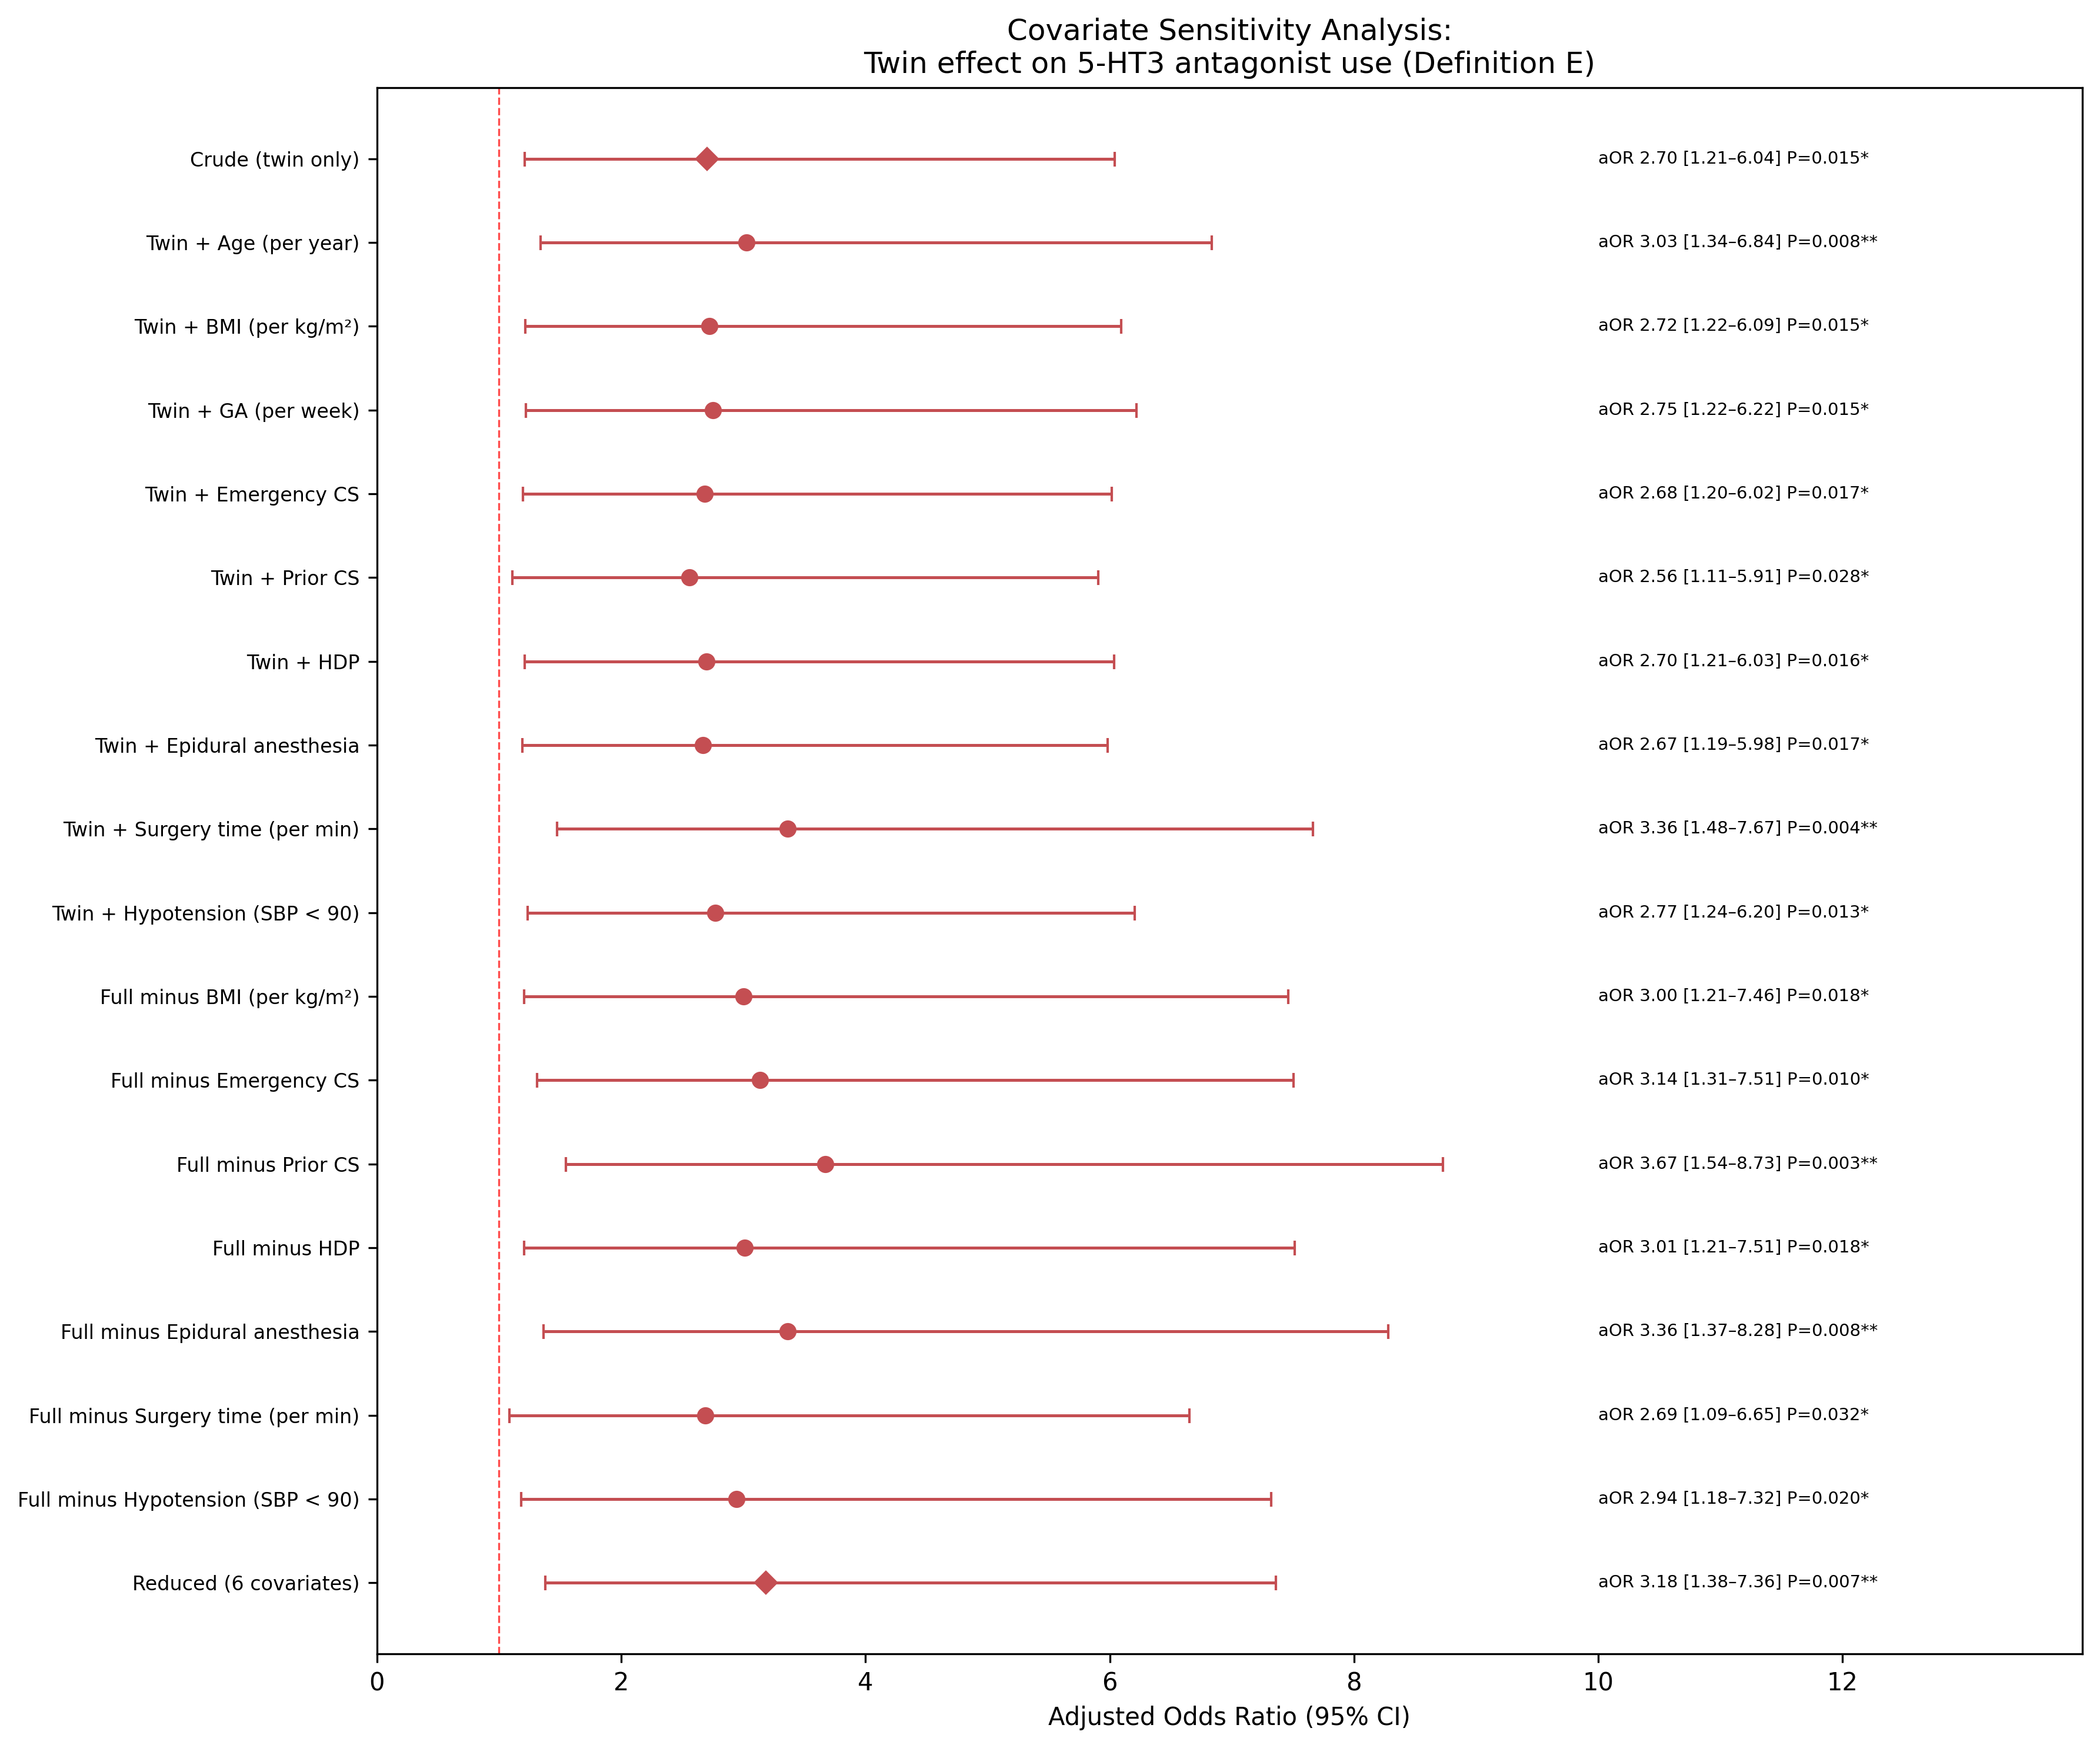
Fig. 3: Covariate Sensitivity Analysis (Def E Primary)

Slide 4
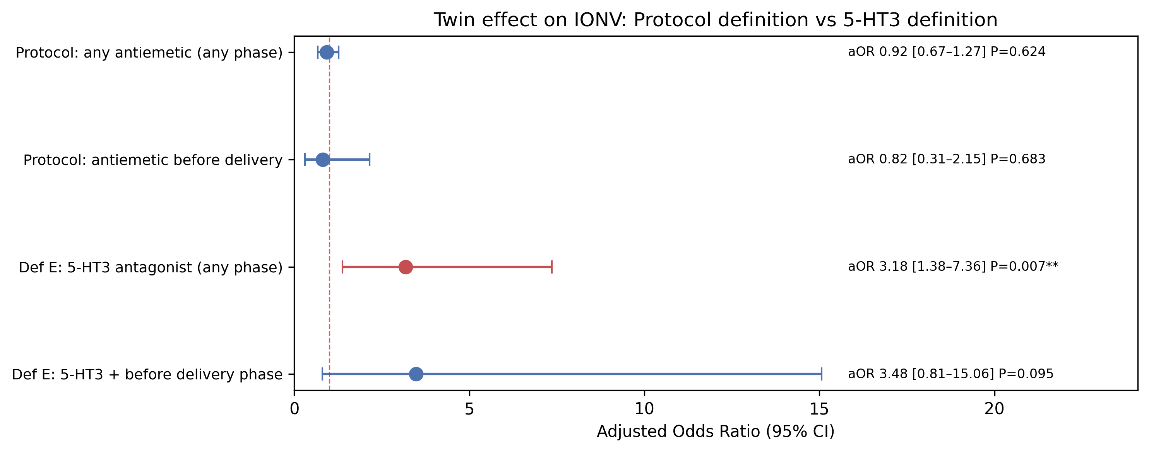
Fig. 4: Twin Effect — Protocol vs 5-HT3 Definition

