Slide 1
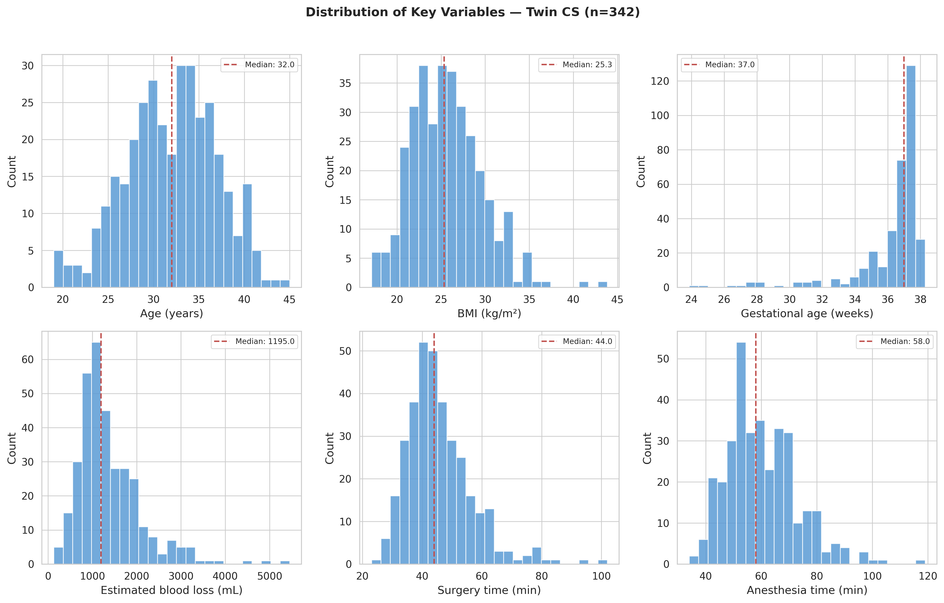
Figure 1
Distribution of key variables — Twin CS (n=342)

Slide 2
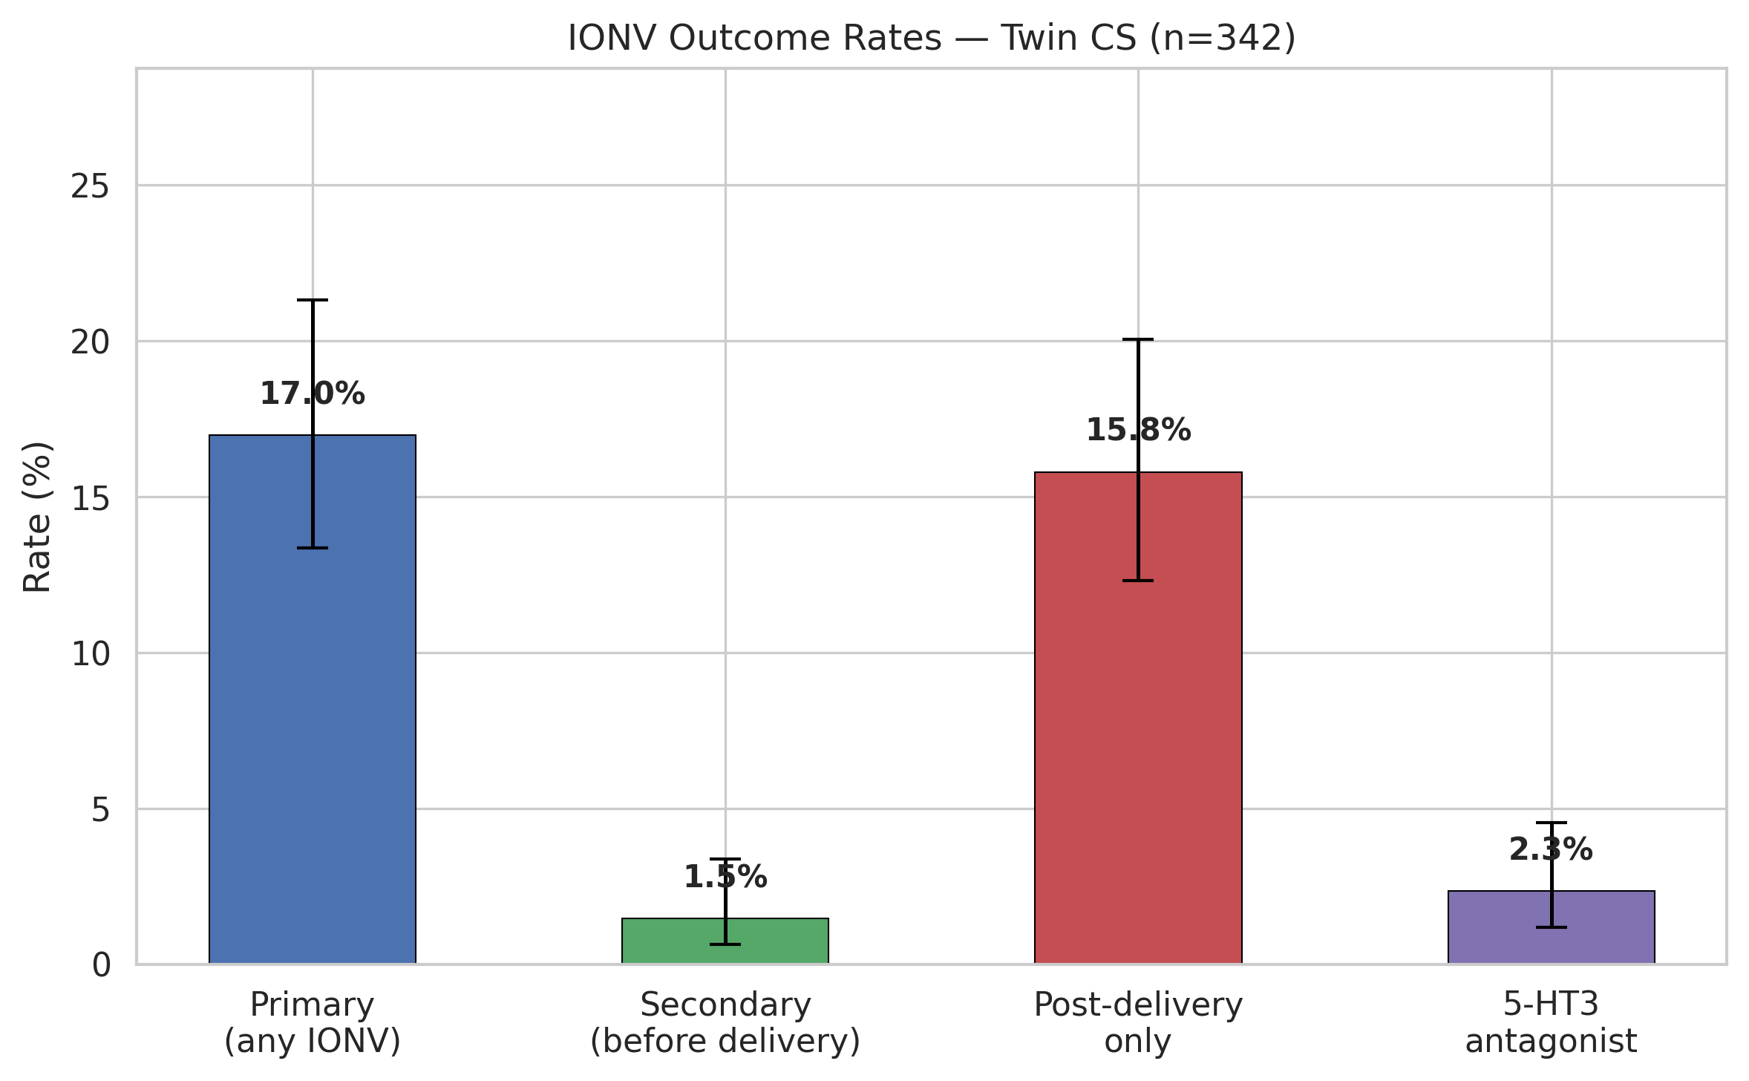
Figure 2
IONV outcome rates with 95% CI — Twin CS (n=342)

Slide 3
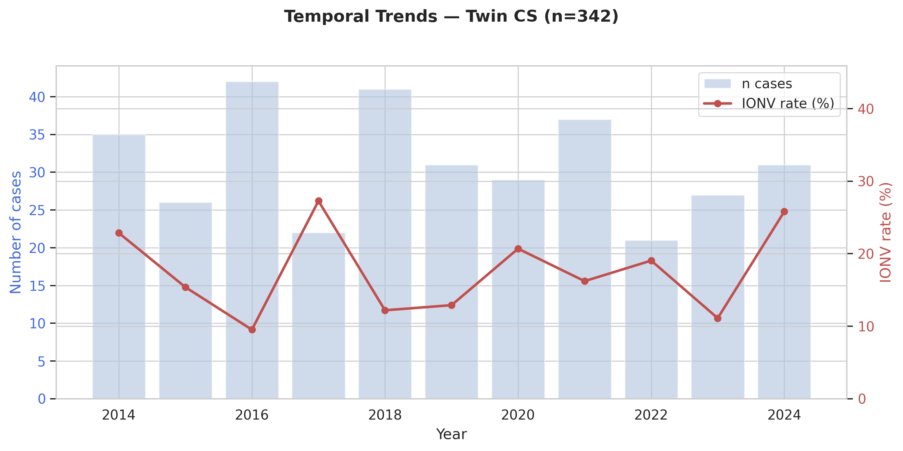
Figure 3
Temporal trends — Twin CS (n=342)

Slide 4
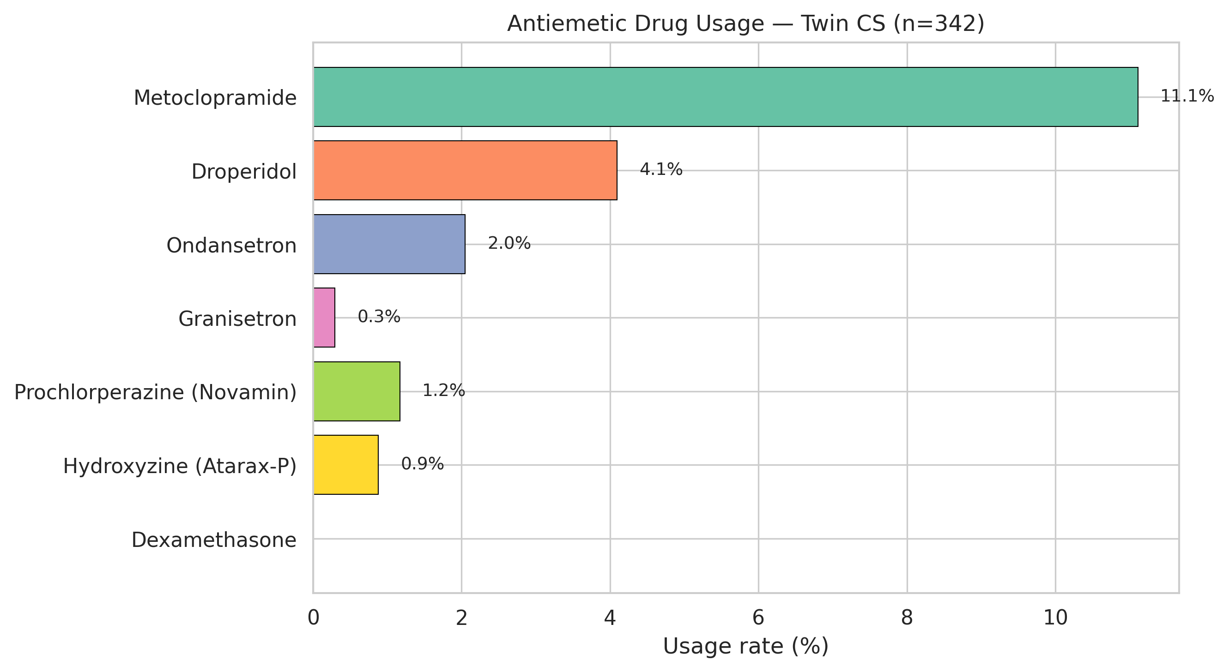
Figure 4
Antiemetic drug usage — Twin CS (n=342)

Slide 5
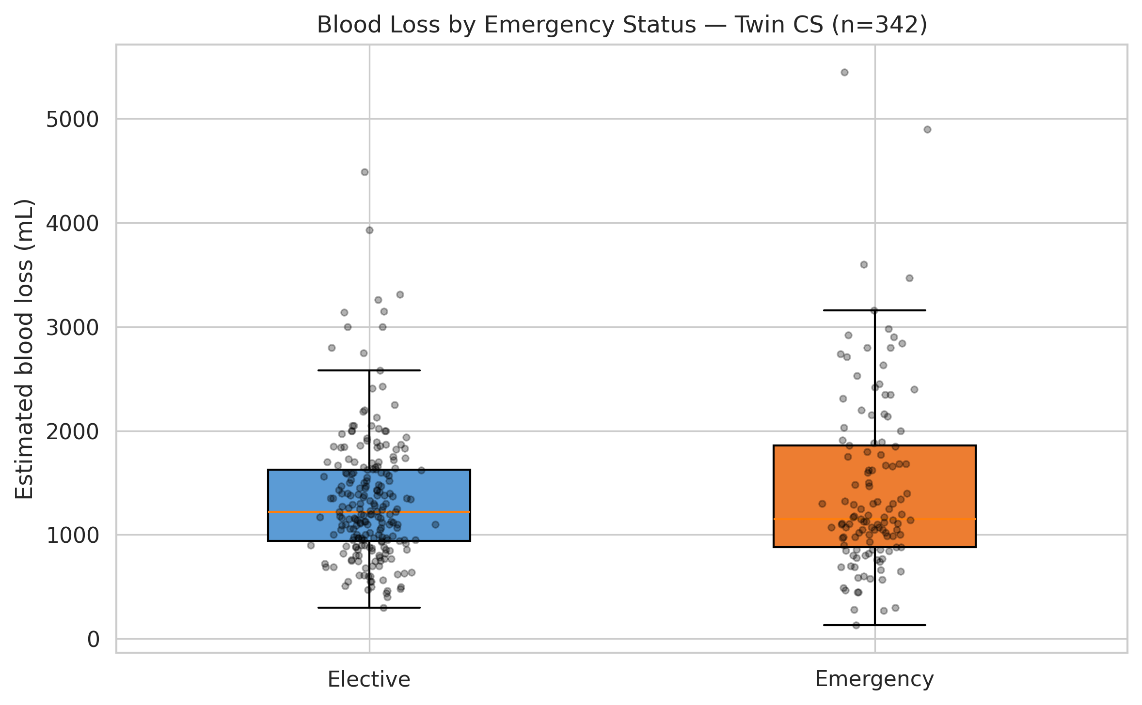
Figure 5
Blood loss by emergency status — Twin CS (n=342)

