Slide 1
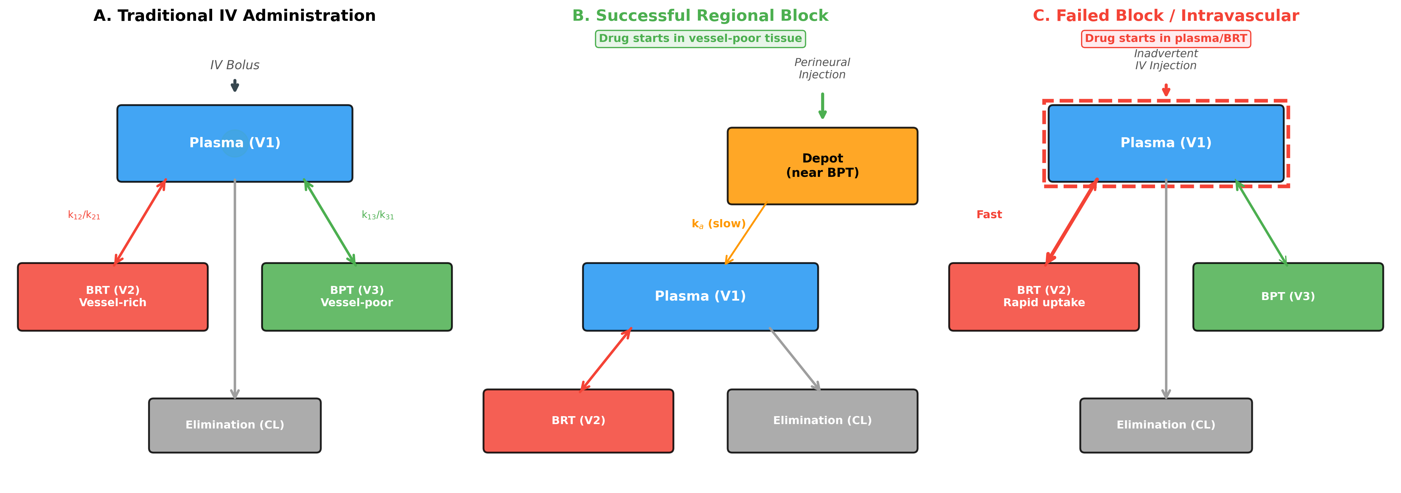
Figure 1. Comparison of Compartment Models for Three Clinical Scenarios
(A) Traditional IV model | (B) Successful regional block (BPT start) | (C) Failed block / Intravascular (Plasma/BRT start)

Slide 2
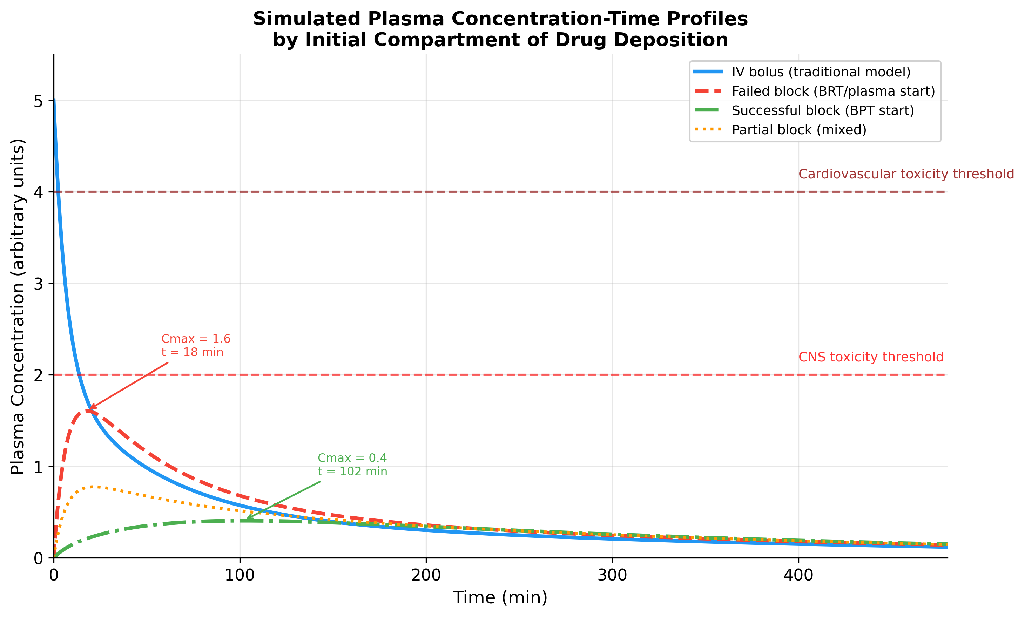
Figure 2. Simulated Plasma Concentration-Time Profiles by Initial Compartment of Drug Deposition

Slide 3
Figure 3. Proposed PBPK-Based Workflow for Maximum Dose Reassessment in Regional Anaesthesia
Step 1
Clinical Assessment
Step 2
Initial Compartment Selection
Step 3
PBPK Simulation
(PK-Sim / MoBi)
Block type, site, success probability, patient factors
Successful Block
BPT Start
Lower Cmax
Higher safe dose
Partial Block
Mixed Start
Intermediate Cmax
Failed Block
Plasma/BRT Start
Higher Cmax
Lower safe dose
Simulation results
Step 4: Context-Sensitive Maximum Dose Recommendation
Individualised, scenario-dependent maximum dose based on predicted plasma concentration profile

Slide 4
Figure 4. Route-Adaptive PKPD Simulation in AIMS
Anaesthesia Information Management System (AIMS)
Drug Administration Record
Route: IV / Regional (block type)
Drug: Bupivacaine 150 mg
Route Detection
IF route = IV:
-> Standard 3-compartment
IF route = Regional:
-> Depot-augmented model
IV
Regional
IV Model
3-Compartment (Plasma start)
V1 -> V2 (BRT) + V3 (BPT)
Standard Marsh / Schnider / Eleveld
Regional Model (Route-Adaptive)
Depot + 3-Compartment (BPT start)
Depot(ka, F) -> V1 -> V2 + V3
Block-type-specific ka values
(TAP, ESP, FNB, Epidural, etc.)
Block Success
Feedback
Adjust ka in real time
Real-Time AIMS Display
Predicted Plasma Concentration --- IV model: rapid peak, fast decline --- Regional model: low, delayed Cmax --- Toxicity threshold line
Dose Guidance Panel Current dose: 150 mg bupivacaine Route: TAP block (bilateral) Predicted Cmax: 0.8 ug/mL (safe) Remaining margin: 68% below threshold

Slide 5
Table 1. Proposed Context-Sensitive Maximum Dose Framework for Local Anaesthetics in Regional Anaesthesia
Scenario | Initial Compartment | Expected Cmax | Dose Adjustment
Successful block (perineural / fascial) | BPT (V3) Vessel-poor tissue | Low, delayed | Higher dose may be safe
Partial block | Mixed (BPT + BRT / Plasma) | Intermediate | Standard dose limit applies
Failed block (vessel-rich deposition) | BRT (V2) Vessel-rich tissue | Moderate-high, early | Lower dose may be needed
Intravascular injection | Plasma (V1) | Very high, immediate | Traditional IV limits apply
Epidural administration | Depot (multi-pathway) Fat + dural transfer + vascular | Intermediate, delayed | Adequately approximated by depot model
Note: Spinal (intrathecal) anaesthesia was excluded from this framework due to unique CSF pharmacokinetics, small doses employed, and predominantly single-shot nature of the technique.

