Slide 1
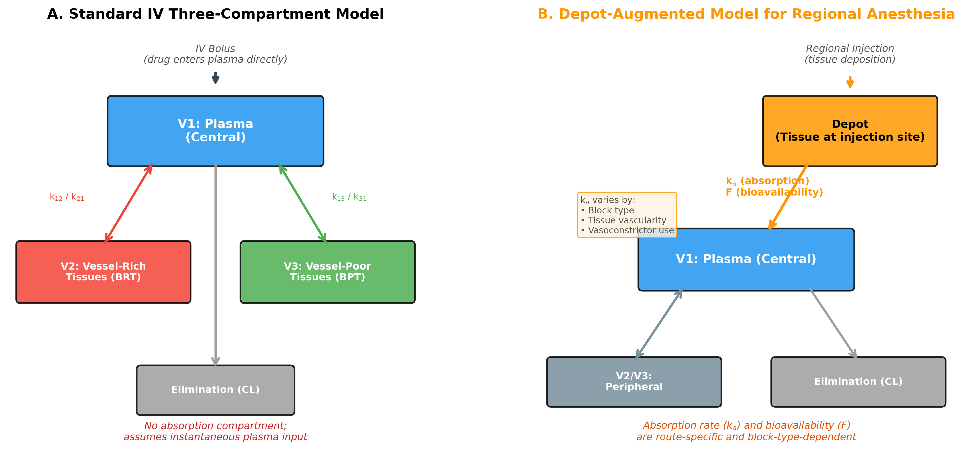
Figure 1. Comparison of Pharmacokinetic Model Structures
Comparison of pharmacokinetic model structures for intravenous and regional administration. (A) Standard three-compartment intravenous model with drug entering the central plasma compartment (V1) directly. (B) Depot-augmented model for regional anesthesia with drug deposited into a tissue depot compartment, from which first-order absorption (rate constant ka) governs entry into the central compartment. V1, central compartment (plasma); V2, rapidly equilibrating peripheral compartment (vessel-rich tissues); V3, slowly equilibrating peripheral compartment (vessel-poor tissues); CL, clearance; ka, absorption rate constant; F, bioavailability.

Slide 2
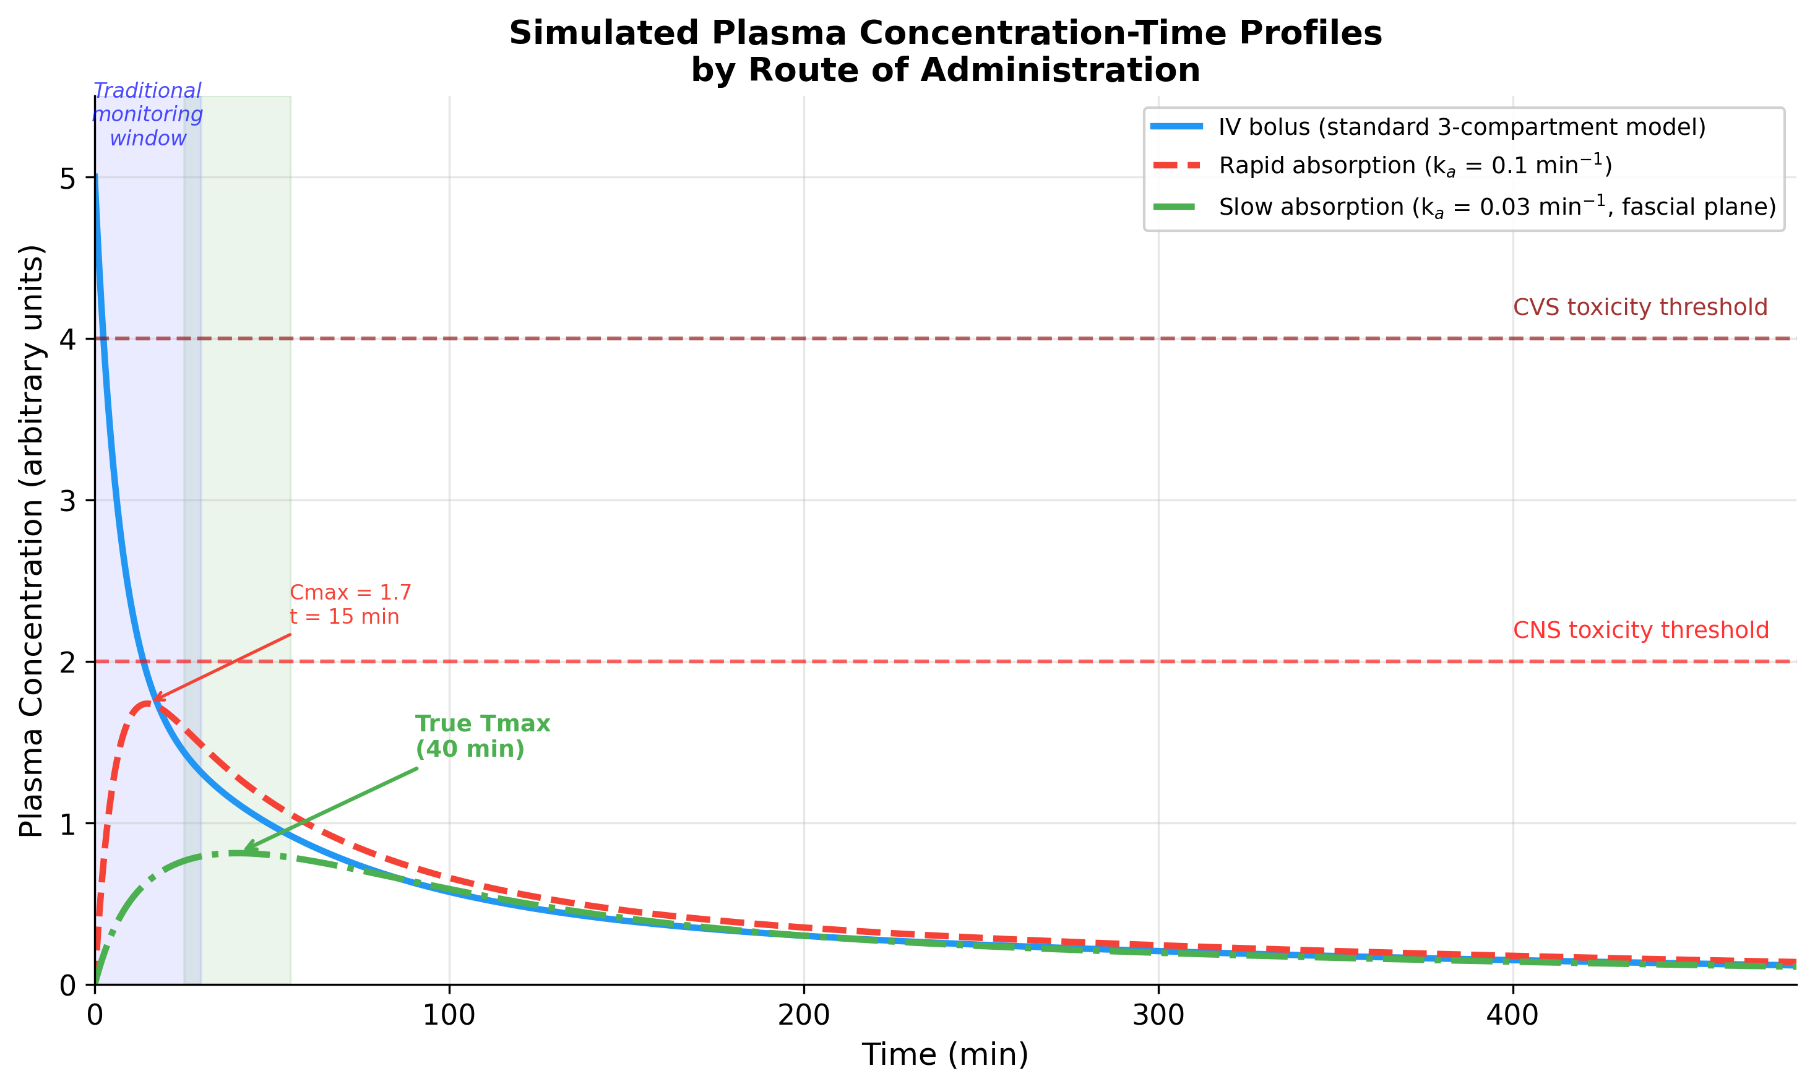
Figure 2. Simulated Plasma Concentration–Time Profiles
Simulated plasma concentration–time profiles demonstrating the effect of route of administration on local anesthetic pharmacokinetics. Blue solid line: intravenous bolus (standard three-compartment model). Red dashed line: rapid absorption (ka = 0.1 min⁻¹, representing highly vascular injection site). Green dash-dot line: slow absorption (ka = 0.03 min⁻¹, representing fascial plane deposition). Shaded regions indicate traditional monitoring window (blue, 0–30 min) and true Tmax window for slow absorption (green). Note the marked differences in Cmax and Tmax depending on the absorption rate.

Slide 3
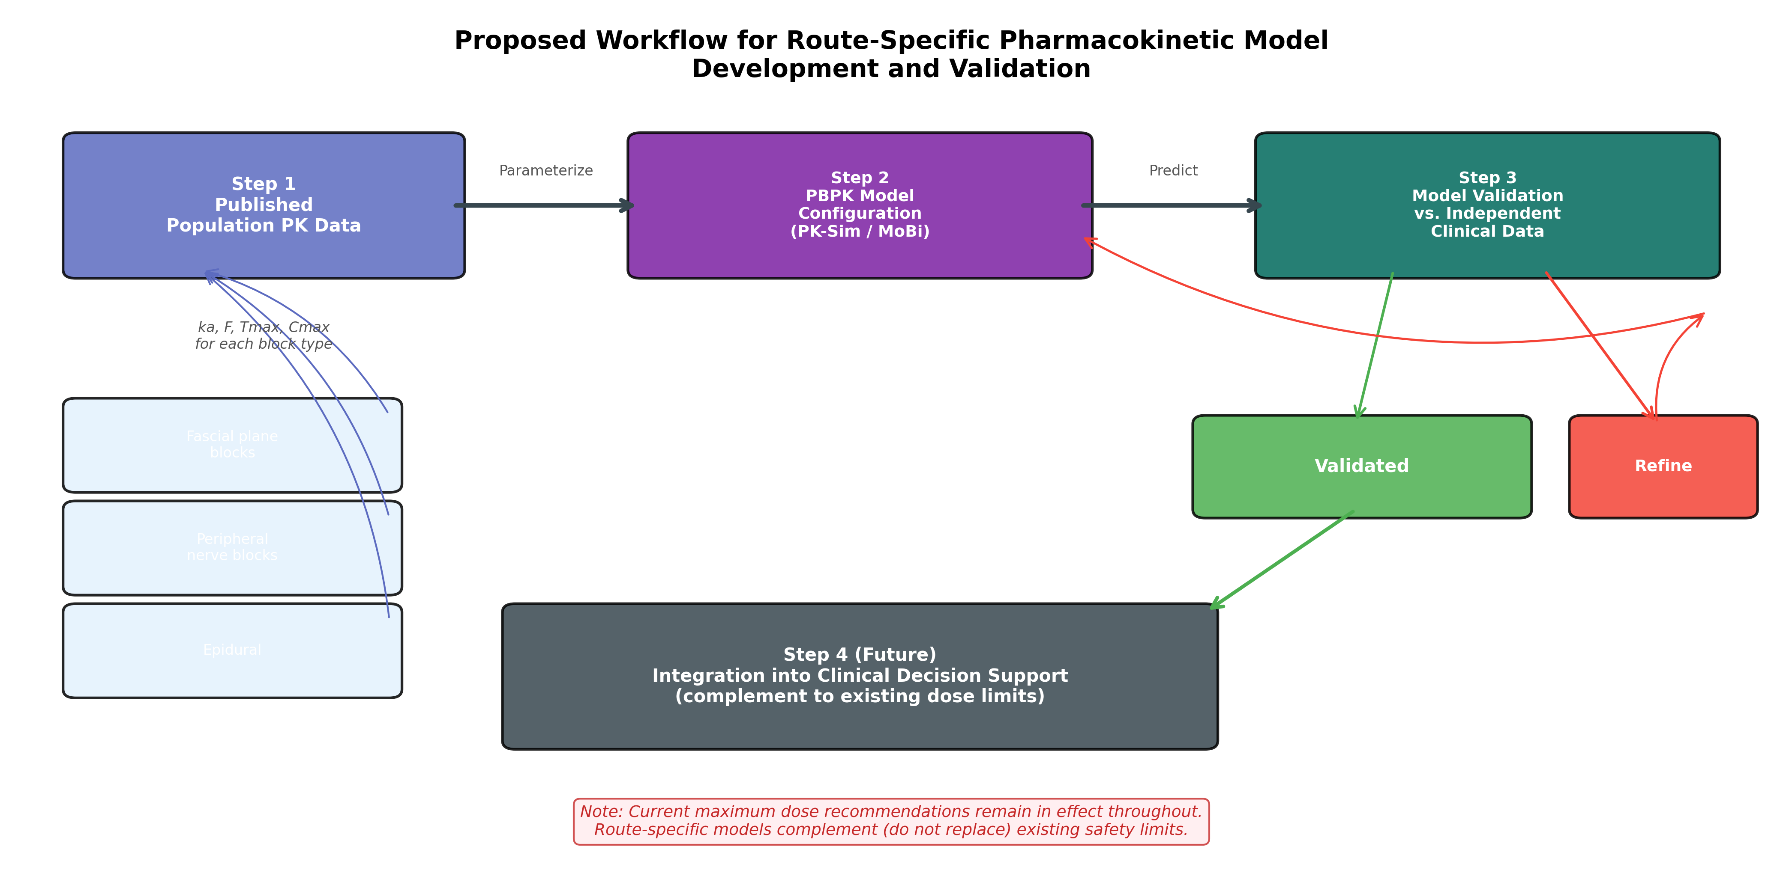
Figure 3. Route-Specific PBPK Model Development Workflow
Proposed workflow for development and validation of route-specific pharmacokinetic models for regional anesthesia. Step 1: Published population pharmacokinetic data provide block-type-specific absorption parameters. Step 2: PBPK model configuration using PK-Sim/MoBi with route-specific initial conditions. Step 3: Model validation against independent clinical pharmacokinetic datasets. Step 4: If validated, potential integration into clinical decision support tools as a complement to existing dose limits.

