Slide 1
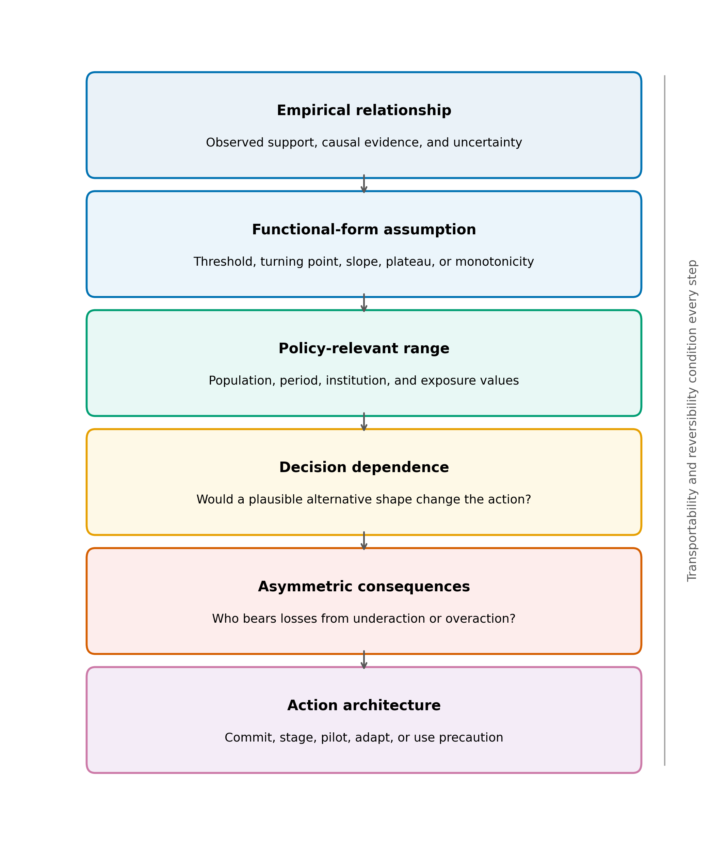
Figure 1
Figure 1. Evidence-to-policy appraisal sequence for functional-form dependence. The same analytical sequence is applied to both applications: the empirical relationship, the assumed functional form, the policy-relevant range, decision dependence, asymmetric consequences, and the action architecture. Transportability and reversibility condition every step.

Slide 2
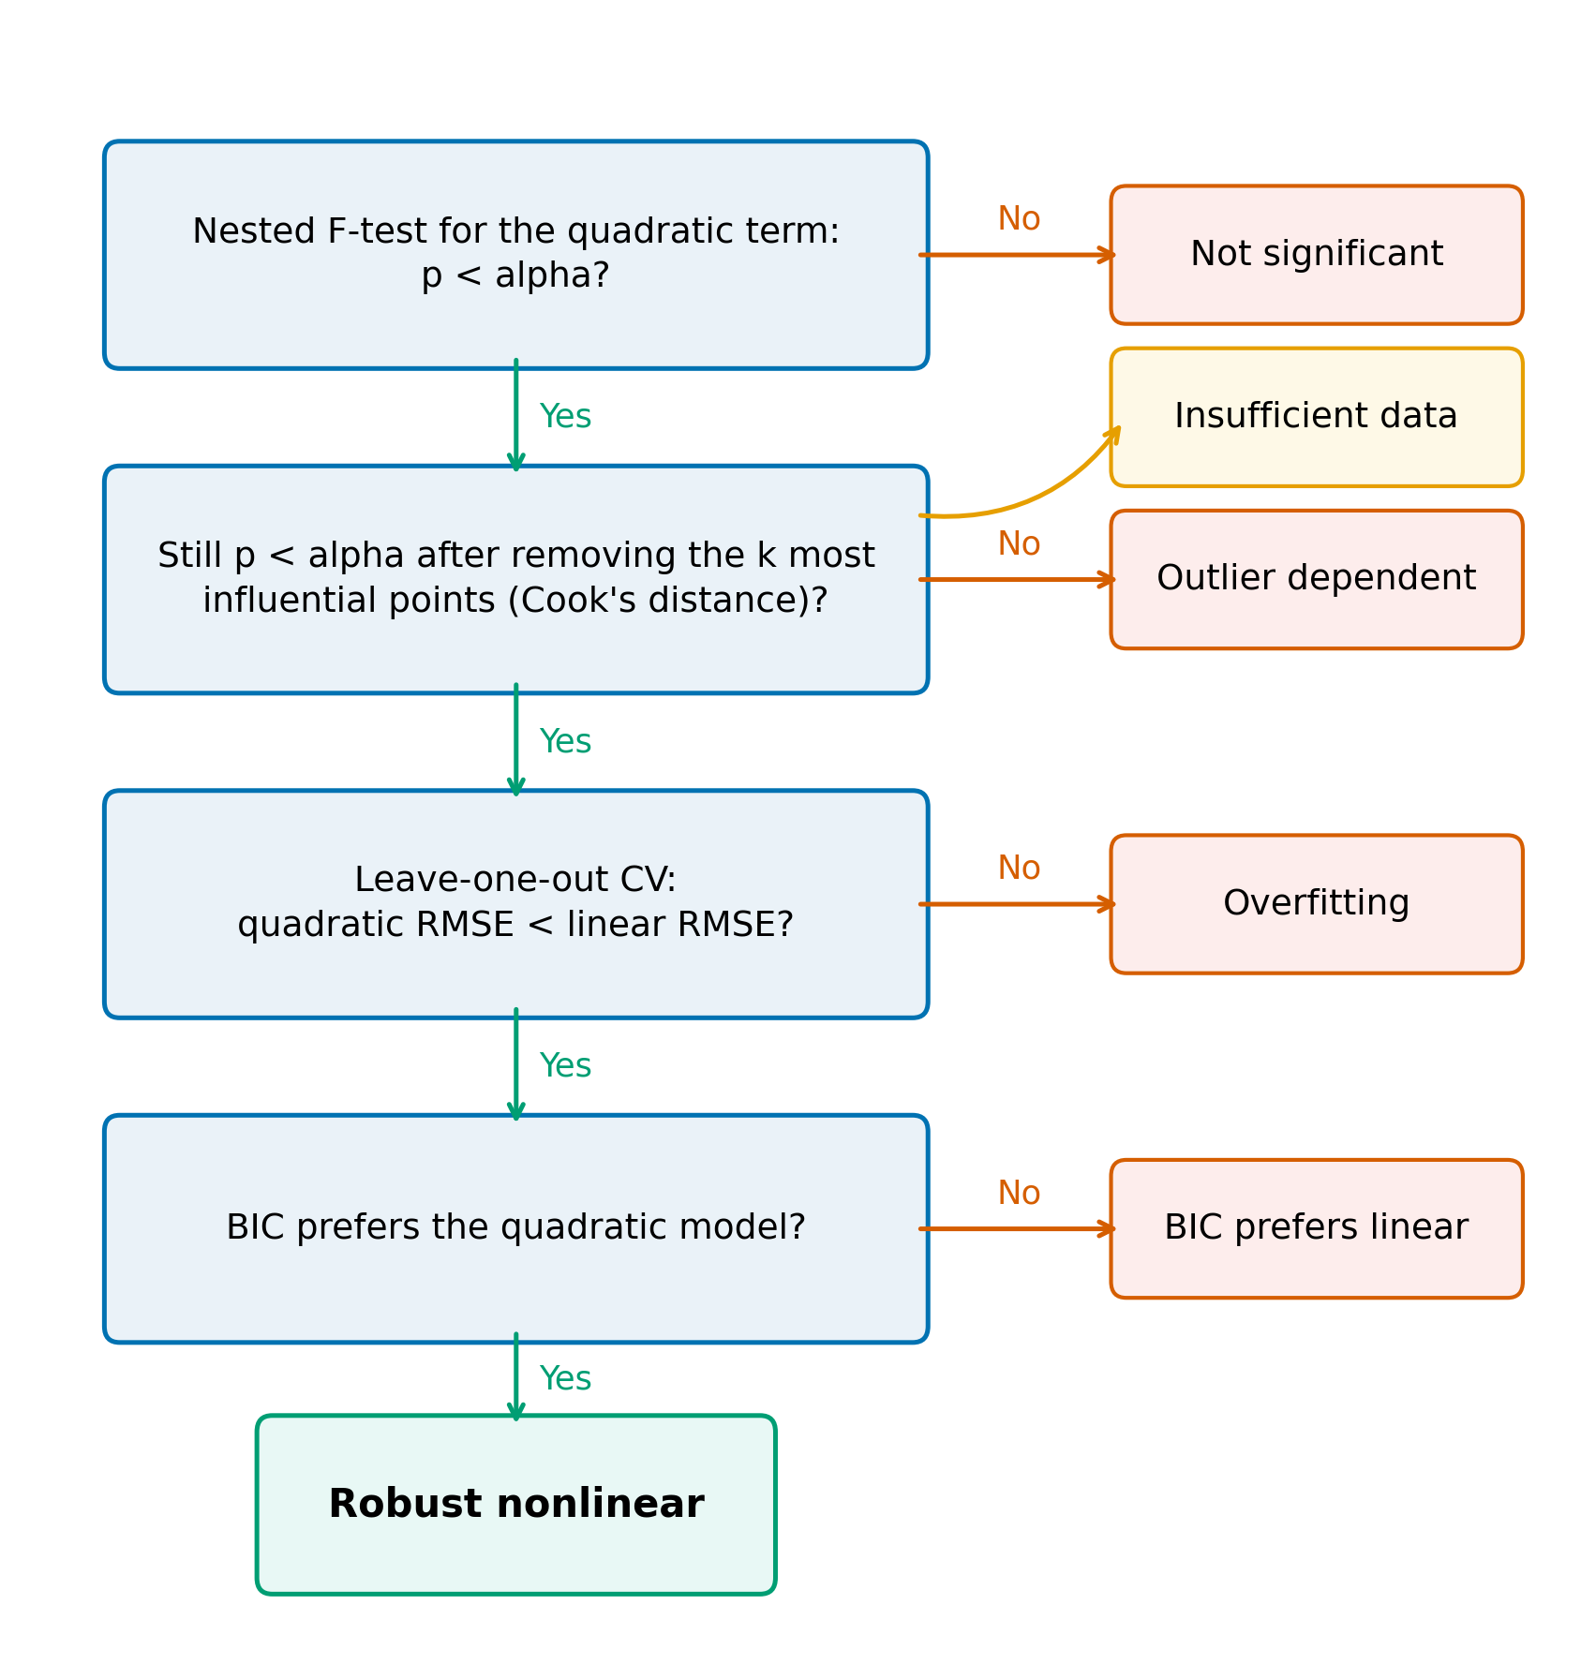
Supplement Figure S1
Supplement Figure S1. Diagnostic used in the cross-domain mapping exercise. Green paths continue toward robust nonlinear classification; orange paths indicate the first unmet criterion. Insufficient data is assigned when influence removal leaves too few observations for the nested comparison.

Slide 3
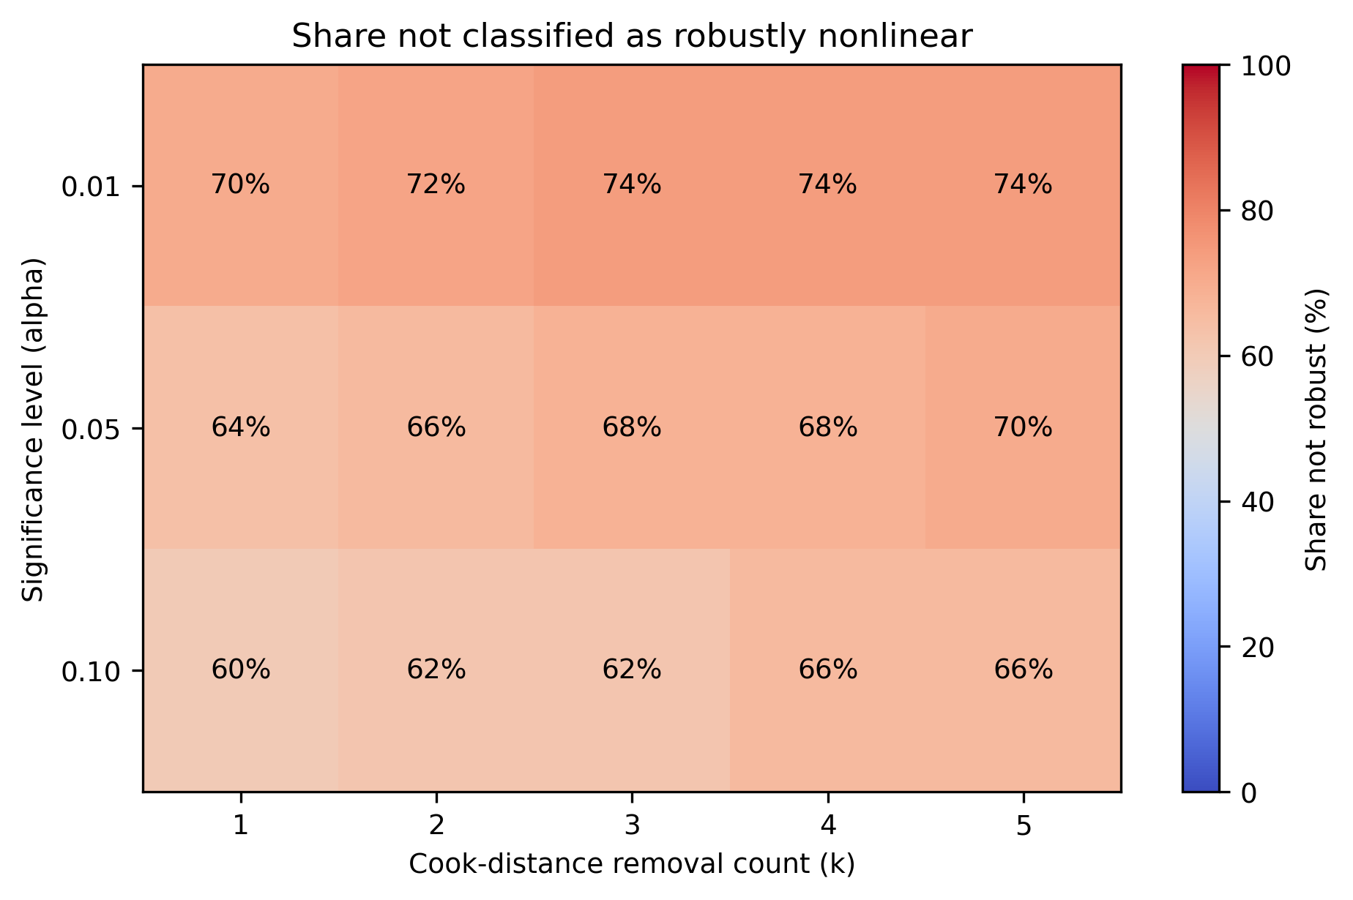
Figure 2
Figure 2. Share of 50 relationship-dataset pairs not classified as robustly nonlinear across significance levels and Cook-distance removal counts. Cell labels report percentages; the colour scale spans 0-100%.

Slide 4
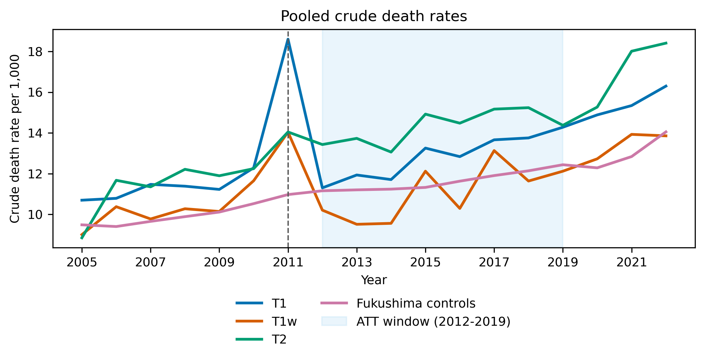
Figure 3
Figure 3. Pooled crude death rates in Fukushima treatment and control groups. T1 contains 10 mandatory-evacuation municipalities; T1w is the restricted complete-evacuation group; T2 contains comparison municipalities subject to other evacuation-related classifications. The shaded region is the 2012-2019 average-treatment-effect window.

Slide 5
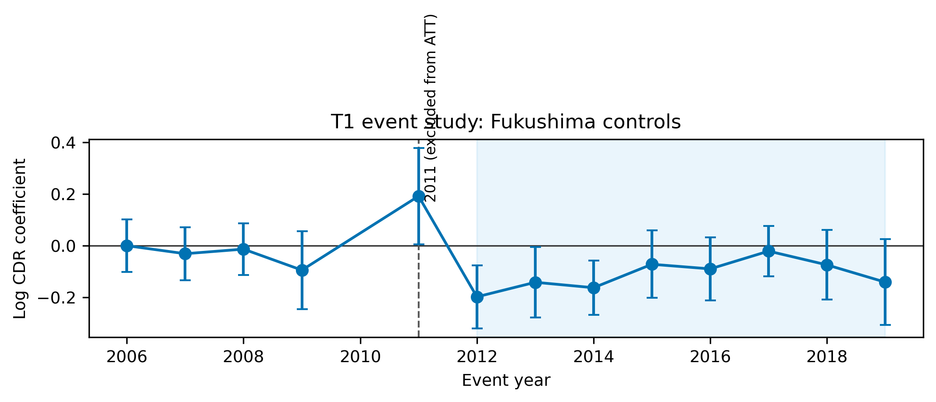
Supplement Figure S3
Supplement Figure S3. Preferred T1 event-study estimates using unweighted Fukushima municipal controls. Points are year-specific coefficients relative to the omitted reference year; bars are 95% confidence intervals. The acute disaster year 2011 is shown but excluded from the 2012-2019 average-treatment-effect window.

Slide 6
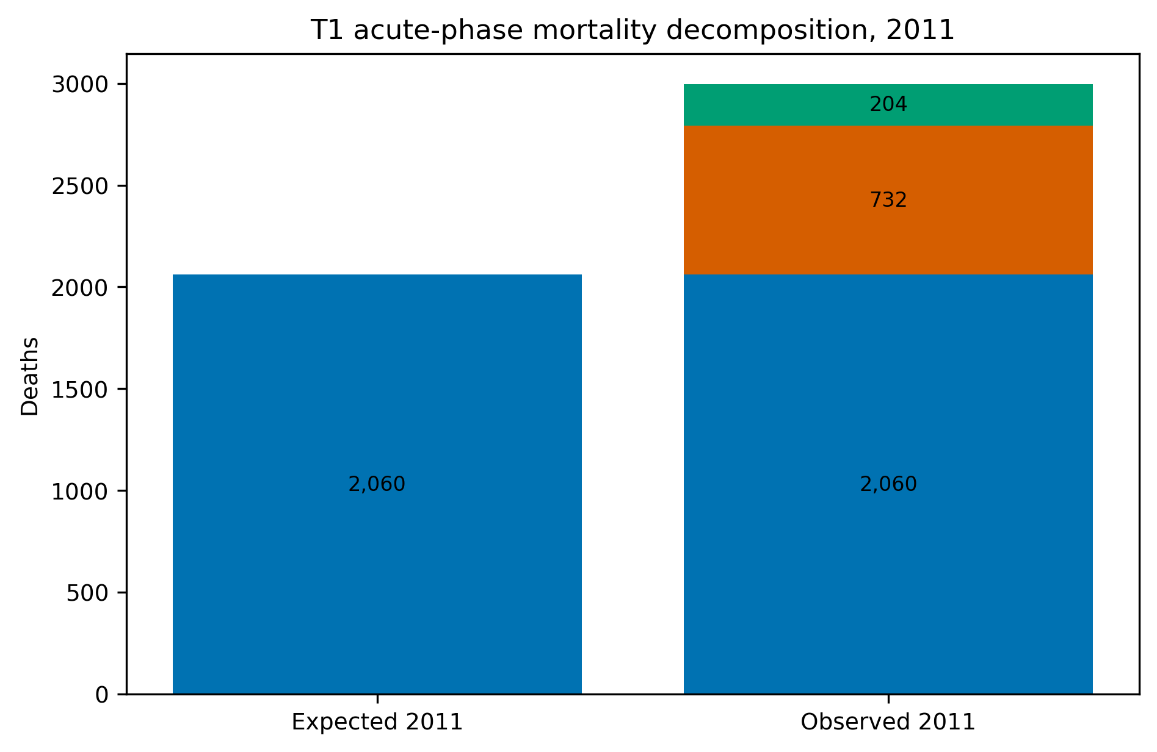
Supplement Figure S4
Supplement Figure S4. T1 acute-phase mortality decomposition for 2011. Expected deaths are projected from the pre-disaster municipal trend; direct disaster deaths are reported by Fukushima Prefecture; residual excess is the arithmetic difference and is not assigned to a single cause.

Slide 7
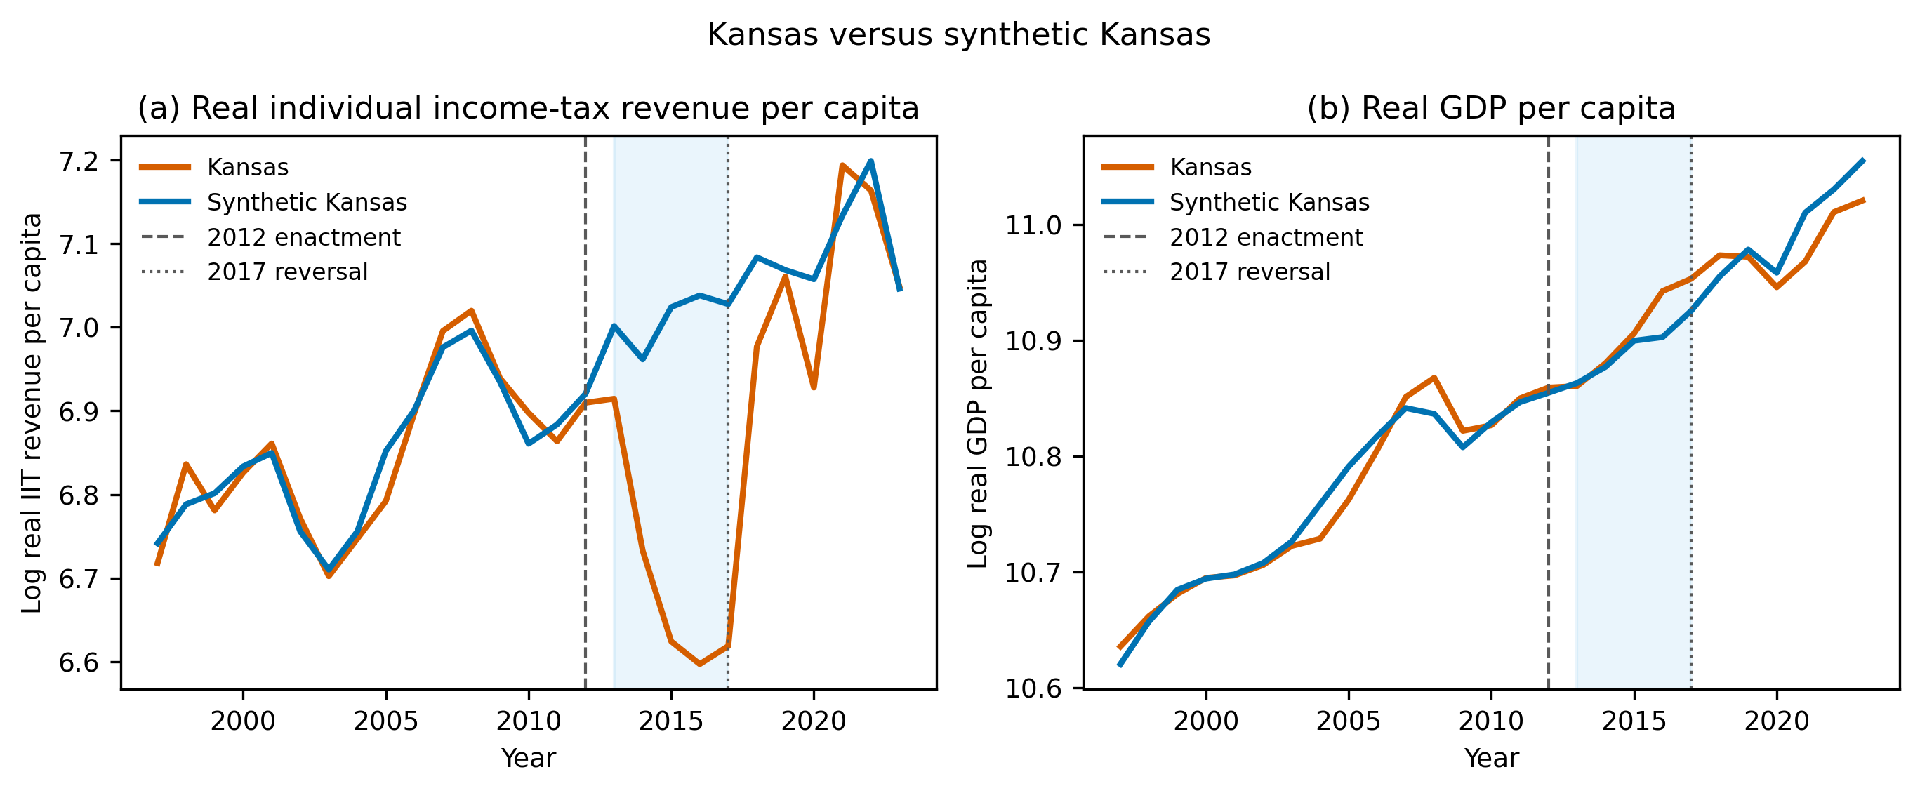
Figure 4
Figure 4. Kansas and synthetic Kansas, 1997-2019. Panel (a) reports log real individual income-tax revenue per capita; panel (b) reports log GDP per capita. Synthetic controls use the main 33-state donor pool. Shading marks 2013-2017, between implementation and legislative reversal.

Slide 8
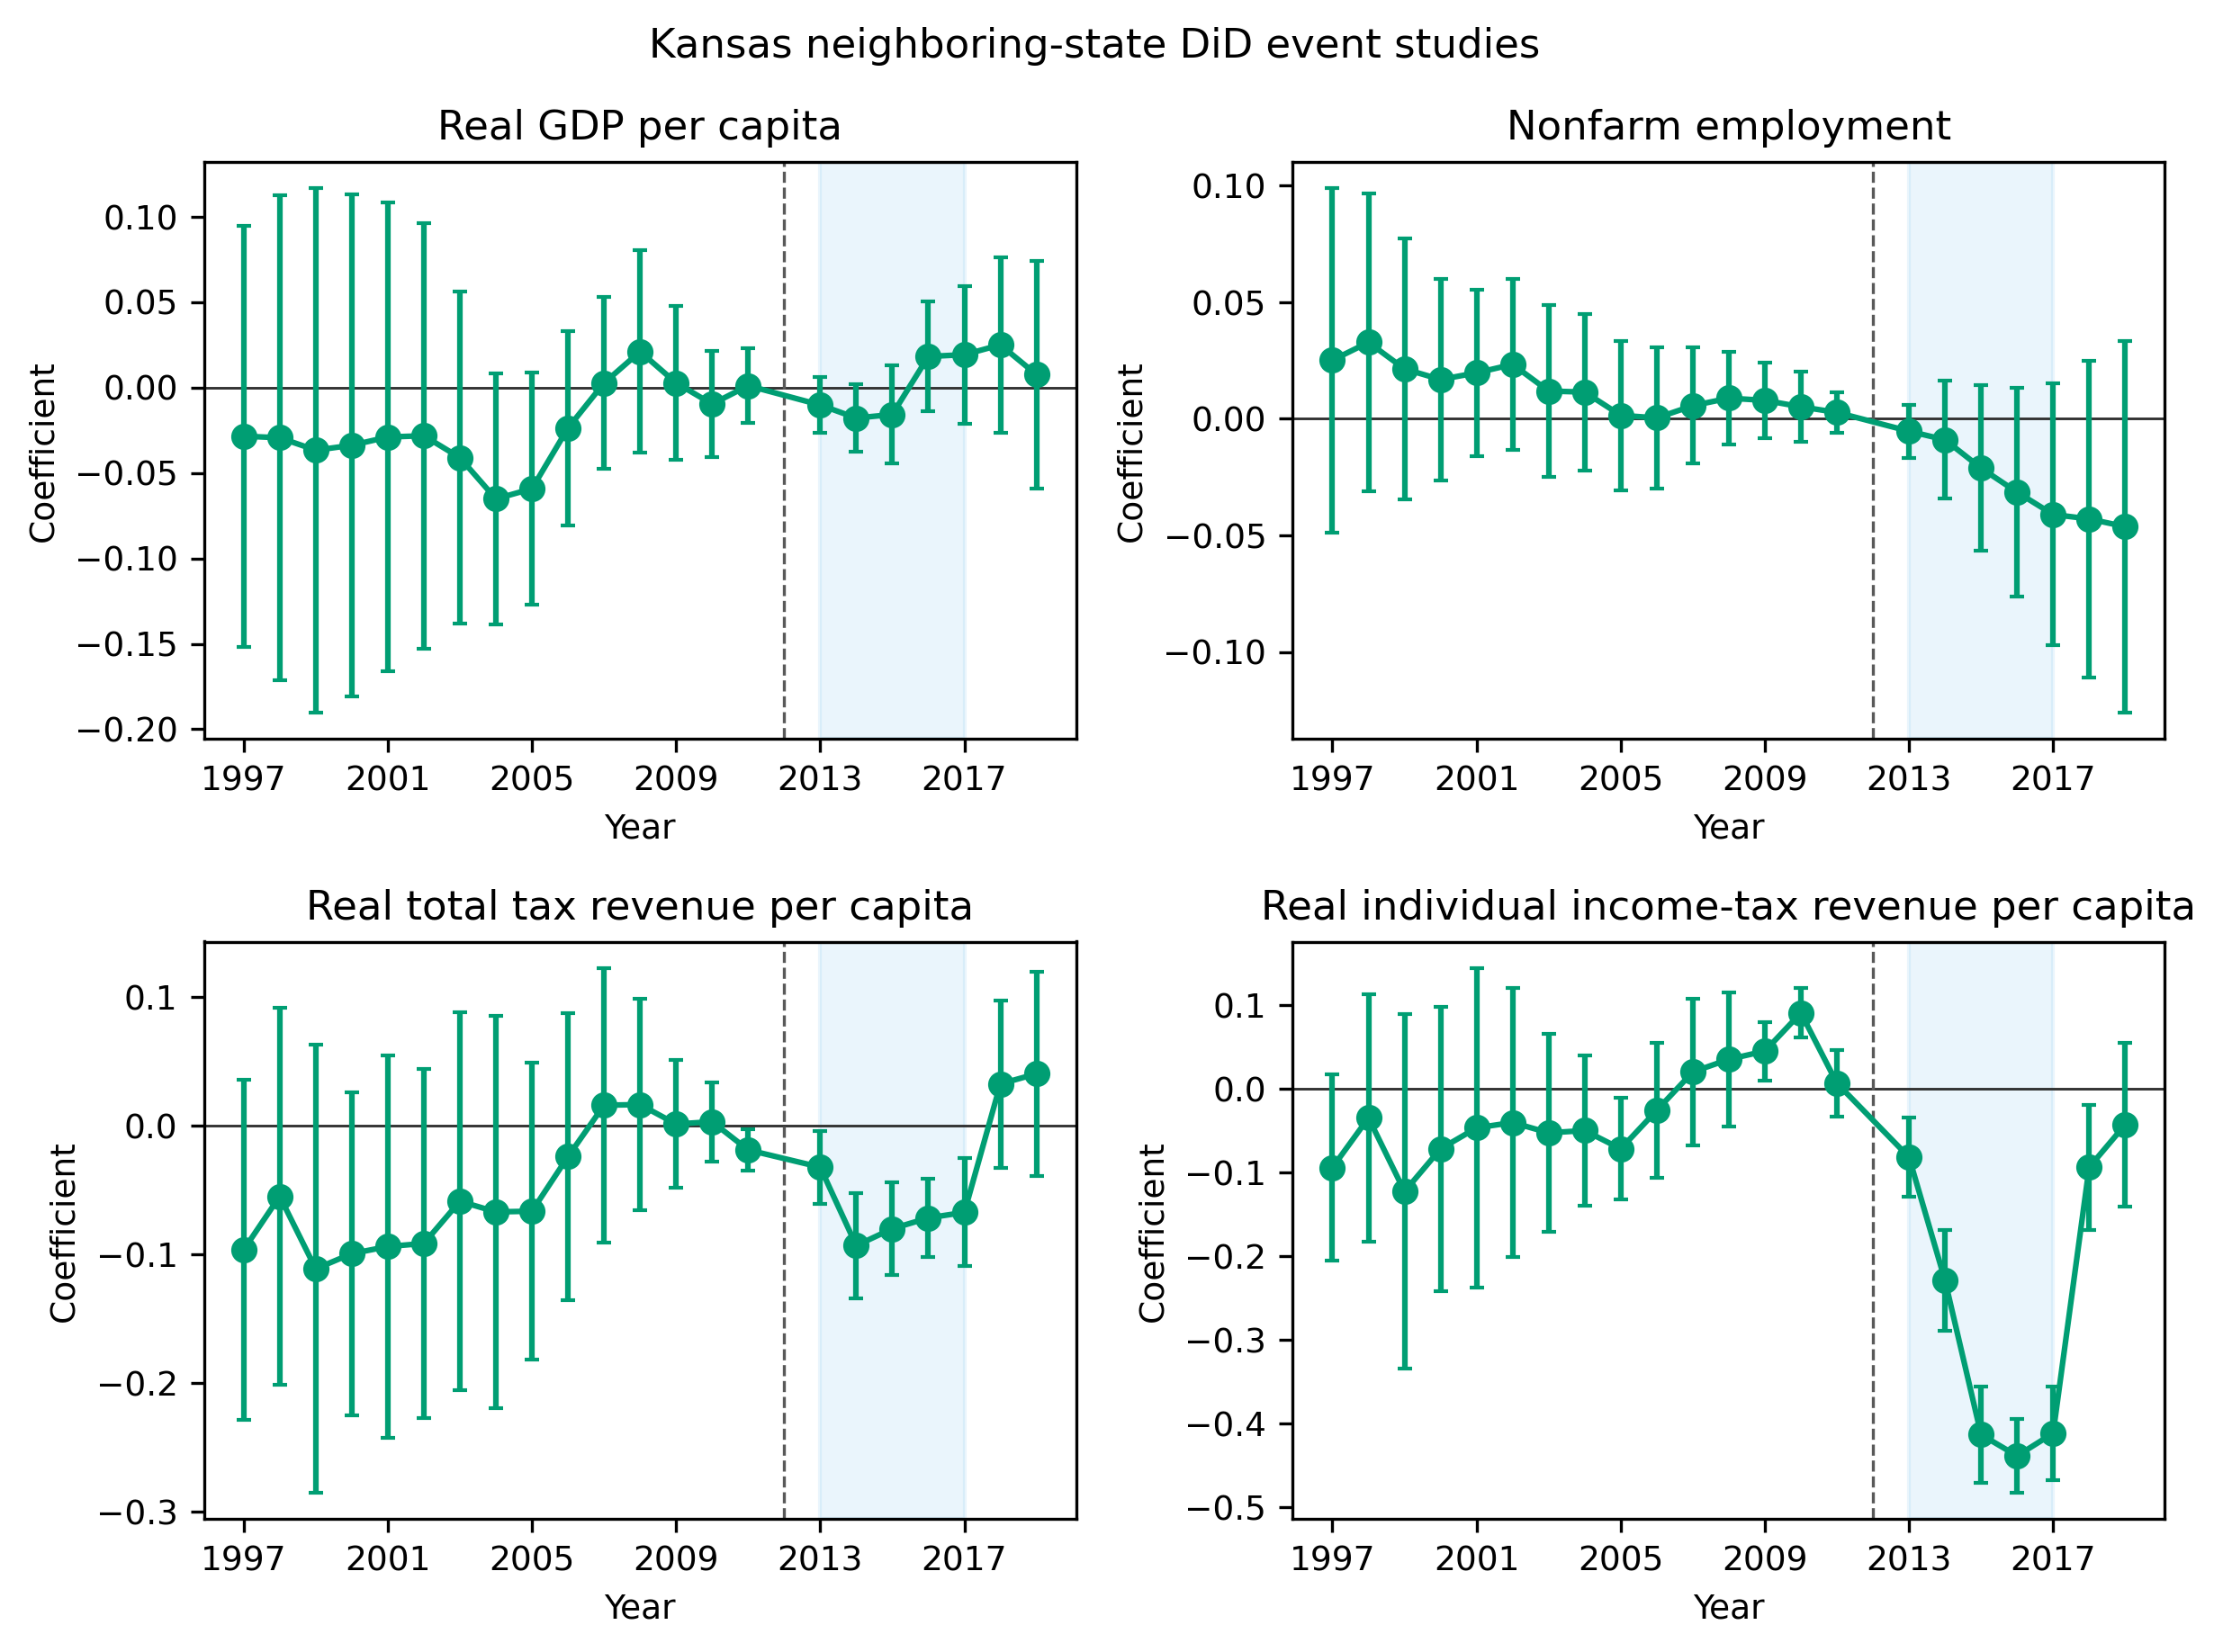
Supplement Figure S2
Supplement Figure S2. Kansas neighbouring-state difference-in-differences event studies for real GDP per capita, employment, total tax revenue, and individual income-tax revenue. Coefficients are relative to 2012; bars are 95% confidence intervals.

Slide 9
Table 1. Cross-domain mapping classifications by category
Category | Robust nonlinear | Not significant | Outlier dependent | Overfitting | Insufficient data | Total
Agriculture | 2 | 1 | 0 | 0 | 1 | 4
Demography | 2 | 3 | 0 | 0 | 1 | 6
Economics | 3 | 8 | 1 | 0 | 0 | 12
Environmental Science | 2 | 3 | 1 | 0 | 0 | 6
Physics | 1 | 2 | 1 | 0 | 0 | 4
Political Science | 2 | 2 | 1 | 0 | 0 | 5
Psychology | 1 | 2 | 0 | 0 | 0 | 3
Public Health | 3 | 6 | 0 | 1 | 0 | 10
Total | 16 | 27 | 4 | 1 | 2 | 50
Table 1. Cross-domain mapping classifications by category. Counts describe the purposive relationship-dataset inventory and are not prevalence estimates for scientific theories or literatures.

Slide 10
Supplement Table S3. Fukushima difference-in-differences estimates
Group | Controls | Weighting | Age control | ATT (log points) | Permutation p | Pre-trend p | Implied deaths 2012-2019
T1 | All prefectures | Weighted | No | -0.057 | 0.002 | 0.268 | -877
T1 | All prefectures | Weighted | Yes | -0.066 | < 0.001 | 0.335 | -1,018
T1 | All prefectures | Unweighted | No | -0.072 | 0.002 | 0.039 | -1,123
T1 | All prefectures | Unweighted | Yes | -0.072 | < 0.001 | 0.035 | -1,109
T1 | Fukushima only | Weighted | No | -0.085 | < 0.001 | 0.847 | -1,333
T1 | Fukushima only | Weighted | Yes | -0.083 | < 0.001 | 0.863 | -1,291
T1 | Fukushima only | Unweighted | No | -0.085 | 0.001 | 0.314 | -1,322
T1 | Fukushima only | Unweighted | Yes | -0.079 | 0.005 | 0.275 | -1,224
T1w | All prefectures | Unweighted | No | -0.116 | 0.003 | 0.170 | -405
T1w | Fukushima only | Unweighted | No | -0.129 | < 0.001 | 0.498 | -451
T2 | All prefectures | Unweighted | No | -0.022 | 0.581 | 0.829 | -93
T2 | Fukushima only | Unweighted | No | -0.034 | 0.421 | 0.932 | -146
Supplement Table S3. Fukushima difference-in-differences estimates. ATT is the 2012-2019 average difference in log crude death rates; 2011 is excluded. Permutation p values use 1000 assignments. Implied deaths are descriptive transformations of recorded municipal deaths and are not causal death counts.

Slide 11
Supplement Table S4. Fukushima measured mortality quantities and published radiological-risk projections
Quantity | Value | Scope | Type | Source
T1 observed deaths 2011 | 2,996 | T1 municipalities | Measured | This study
T1 expected deaths 2011 | 2,060 | T1 municipalities | Measured | This study
T1 excess deaths 2011 | 936 | T1 municipalities | Measured | This study
Of which direct disaster deaths | 732 | T1 municipalities | Measured | Fukushima Prefecture, 2014
T1 residual excess deaths 2011 | 204 | T1 municipalities | Measured | This study
T1 implied difference 2012-2019 (recorded) | -1,322 | T1 municipalities | Measured | This study
Certified disaster-related deaths, Fukushima Prefecture | 2,350 | Fukushima prefecture | Measured | Reconstruction Agency, 2026
Projected worldwide cancer deaths from the release | 130 (15-1,100) | Worldwide | Projected (LNT-based) | ten Hoeve & Jacobson, 2012
Evacuation-avoided radiological mortalities | 28 (3-245) | Worldwide | Projected (LNT-based) | ten Hoeve & Jacobson, 2012
Lifetime-risk relative increases in the most affected areas | leukaemia up to 7%; breast up to 6%; all solid cancers up to 4%; thyroid up to 70% | Most affected areas | Projected (LNT-based) | WHO, 2013
WHO conclusion outside Japan | no discernible increase | Outside Japan | Projected (LNT-based) | WHO, 2013
Collective effective dose | 18 / 36 / 48 thousand man-Sv (first year / ten years / lifetime) | Japanese population | Projected (LNT-based) | UNSCEAR, 2014
UNSCEAR conclusion | no discernible increase expected | Exposed population | Projected (LNT-based) | UNSCEAR, 2014
Supplement Table S4. Fukushima measured mortality quantities and published radiological-risk projections. Rows differ in population, geography, time horizon, measurement, and model basis and must not be added or interpreted as commensurate estimands.

Slide 12
Supplement Table S5. Kansas synthetic-control estimates by outcome and donor pool
Outcome | Pool | Mean gap | Gap (%) | Permutation p | Pre-RMSPE | donors | in-time placebo | LOO range
Real GDP per capita | Main | 0.015 | +1.5% | 0.71 | 0.015 | 33 | 0.056 | 0.009 to 0.029
Real GDP per capita | All states | -0.004 | -0.4% | 0.49 | 0.007 | 50 | 0.056 | -
Nonfarm employment | Main | -0.013 | -1.3% | 0.47 | 0.004 | 33 | 0.006 | -0.014 to -0.001
Nonfarm employment | All states | -0.001 | -0.1% | 0.96 | 0.003 | 50 | 0.006 | -
Real total tax revenue per capita | Main | -0.031 | -3.0% | 0.18 | 0.013 | 32 | 0.075 | -0.039 to -0.028
Real total tax revenue per capita | All states | 0.030 | +3.1% | 0.12 | 0.010 | 49 | 0.075 | -
Real individual income-tax revenue per capita | Main | -0.313 | -26.9% | 0.03 | 0.025 | 32 | 0.103 | -0.322 to -0.291
Real individual income-tax revenue per capita | All states | -0.301 | -26.0% | 0.02 | 0.019 | 42 | 0.103 | -
Supplement Table S5. Kansas synthetic-control estimates by outcome and donor pool. Mean gaps cover 2013-2017. Permutation p values compare Kansas with donor-state placebo gaps; LOO denotes leave-one-donor-out sensitivity.

Slide 13
Table 2. Cross-case synthesis of the two applications across the evidence-to-policy dimensions
Dimension | Fukushima | Kansas
Policy domain | Health and radiation protection | Fiscal policy
Canonical relationship | Dose-response | Tax rate-revenue
Decision-relevant feature | Low-dose slope and extrapolation | Local slope and turning point
Central uncertainty | Extrapolation below the observed range | Unknown position and behavioral response
Principal downside of error | Health and displacement harms | Revenue and growth effects
Reversibility | Relatively limited | Comparatively greater
Functional-form dependence | High if action changes under alternative plausible shapes | High if expected fiscal response depends on local curve geometry
Table 2. Cross-case synthesis of the two applications across the evidence-to-policy dimensions. The applications are not statistically comparable.

Slide 14
Supplement Table S1. Municipalities excluded from the Fukushima panel because of missing mortality or population observations
Prefecture | Municipality | Reason | Years missing
Iwate | Hachimantai | Population missing in at least one year 2005-2019 | 2005
Iwate | Oshu | Unit not observed under a single code 2005-2019 | 2005
Iwate | Takizawa | Unit not observed under a single code 2005-2019 | 2005,2006,2007,2008,2009,2010,2011,2012,2013
Iwate | Nishiwaga | Population missing in at least one year 2005-2019 | 2005
Iwate | Hirono | Unit not observed under a single code 2005-2019 | 2005
Miyagi | Aoba Ward, Sendai | Population missing in at least one year 2005-2019 | 2006,2007,2008,2009,2010
Miyagi | Miyagino Ward, Sendai | Population missing in at least one year 2005-2019 | 2005,2006,2007,2008,2009,2010
Miyagi | Wakabayashi Ward, Sendai | Population missing in at least one year 2005-2019 | 2005,2006,2007,2008,2009,2010
Miyagi | Taihaku Ward, Sendai | Population missing in at least one year 2005-2019 | 2005,2006,2007,2008,2009,2010
Miyagi | Izumi Ward, Sendai | Population missing in at least one year 2005-2019 | 2005,2006,2007,2008,2009,2010
Miyagi | Shiogama | Population missing in at least one year 2005-2019 | 2006,2007
Miyagi | Tome | Population missing in at least one year 2005-2019 | 2005
Miyagi | Kurihara | Population missing in at least one year 2005-2019 | 2005
Miyagi | Higashimatsushima | Population missing in at least one year 2005-2019 | 2005
Miyagi | Osaki | Unit not observed under a single code 2005-2019 | 2005
Miyagi | Tomiya | Unit not observed under a single code 2005-2019 | 2005,2006,2007,2008,2009,2010,2011,2012,2013,2014,2015,2016
Miyagi | Shichikashuku | Population missing in at least one year 2005-2019 | 2007,2008,2009,2010,2011,2012,2013,2014,2015,2016,2017
Miyagi | Shichigahama | Population missing in at least one year 2005-2019 | 2007,2008,2009,2010,2011,2012,2013,2014,2015,2016,2017
Miyagi | Misato | Unit not observed under a single code 2005-2019 | 2005
Miyagi | Minamisanriku | Population missing in at least one year 2005-2019 | 2005
Yamagata | Shonai | Population missing in at least one year 2005-2019 | 2005
Fukushima | Motomiya | Population missing in at least one year 2005-2019 | 2006
Ibaraki | Kasumigaura | Population missing in at least one year 2005-2019 | 2006
Ibaraki | Sakuragawa | Population missing in at least one year 2005-2019 | 2005
Ibaraki | Kamisu | Population missing in at least one year 2005-2019 | 2005
Ibaraki | Namegata | Population missing in at least one year 2005-2019 | 2005
Ibaraki | Hokota | Population missing in at least one year 2005-2019 | 2005
Supplement Table S1. Municipalities excluded from the Fukushima panel because of missing mortality or population observations. Exclusions are determined before outcome estimation.

Slide 15
Supplement Table S2. Unit-level Fukushima synthetic-control results for T1 municipalities
Municipality | Donors | Pre-RMSPE | Post-RMSPE | Mean gap 2012-2019 | Permutation p
Minamisoma | 7 | 0.029 | 0.184 | -0.011 | 0.25
Kawamata | 23 | 0.01 | 0.082 | 0.055 | 0.333
Naraha | 20 | 0.088 | 0.204 | -0.128 | 0.714
Tomioka | 13 | 0.059 | 0.164 | -0.152 | 0.5
Kawauchi | 13 | 0.044 | 0.148 | 0.083 | 0.5
Okuma | 15 | 0.144 | 0.304 | -0.268 | 0.562
Futaba | 20 | 0.049 | 0.257 | -0.191 | 0.286
Namie | 18 | 0.004 | 0.18 | -0.098 | 0.263
Katsurao | 5 | 0.183 | 0.249 | -0.137 | 0.833
Iitate | 22 | 0.017 | 0.118 | -0.027 | 0.304
Supplement Table S2. Unit-level Fukushima synthetic-control results for T1 municipalities. Mean gaps cover 2012-2019; permutation p values compare treated and placebo-unit gaps.

