Slide 1
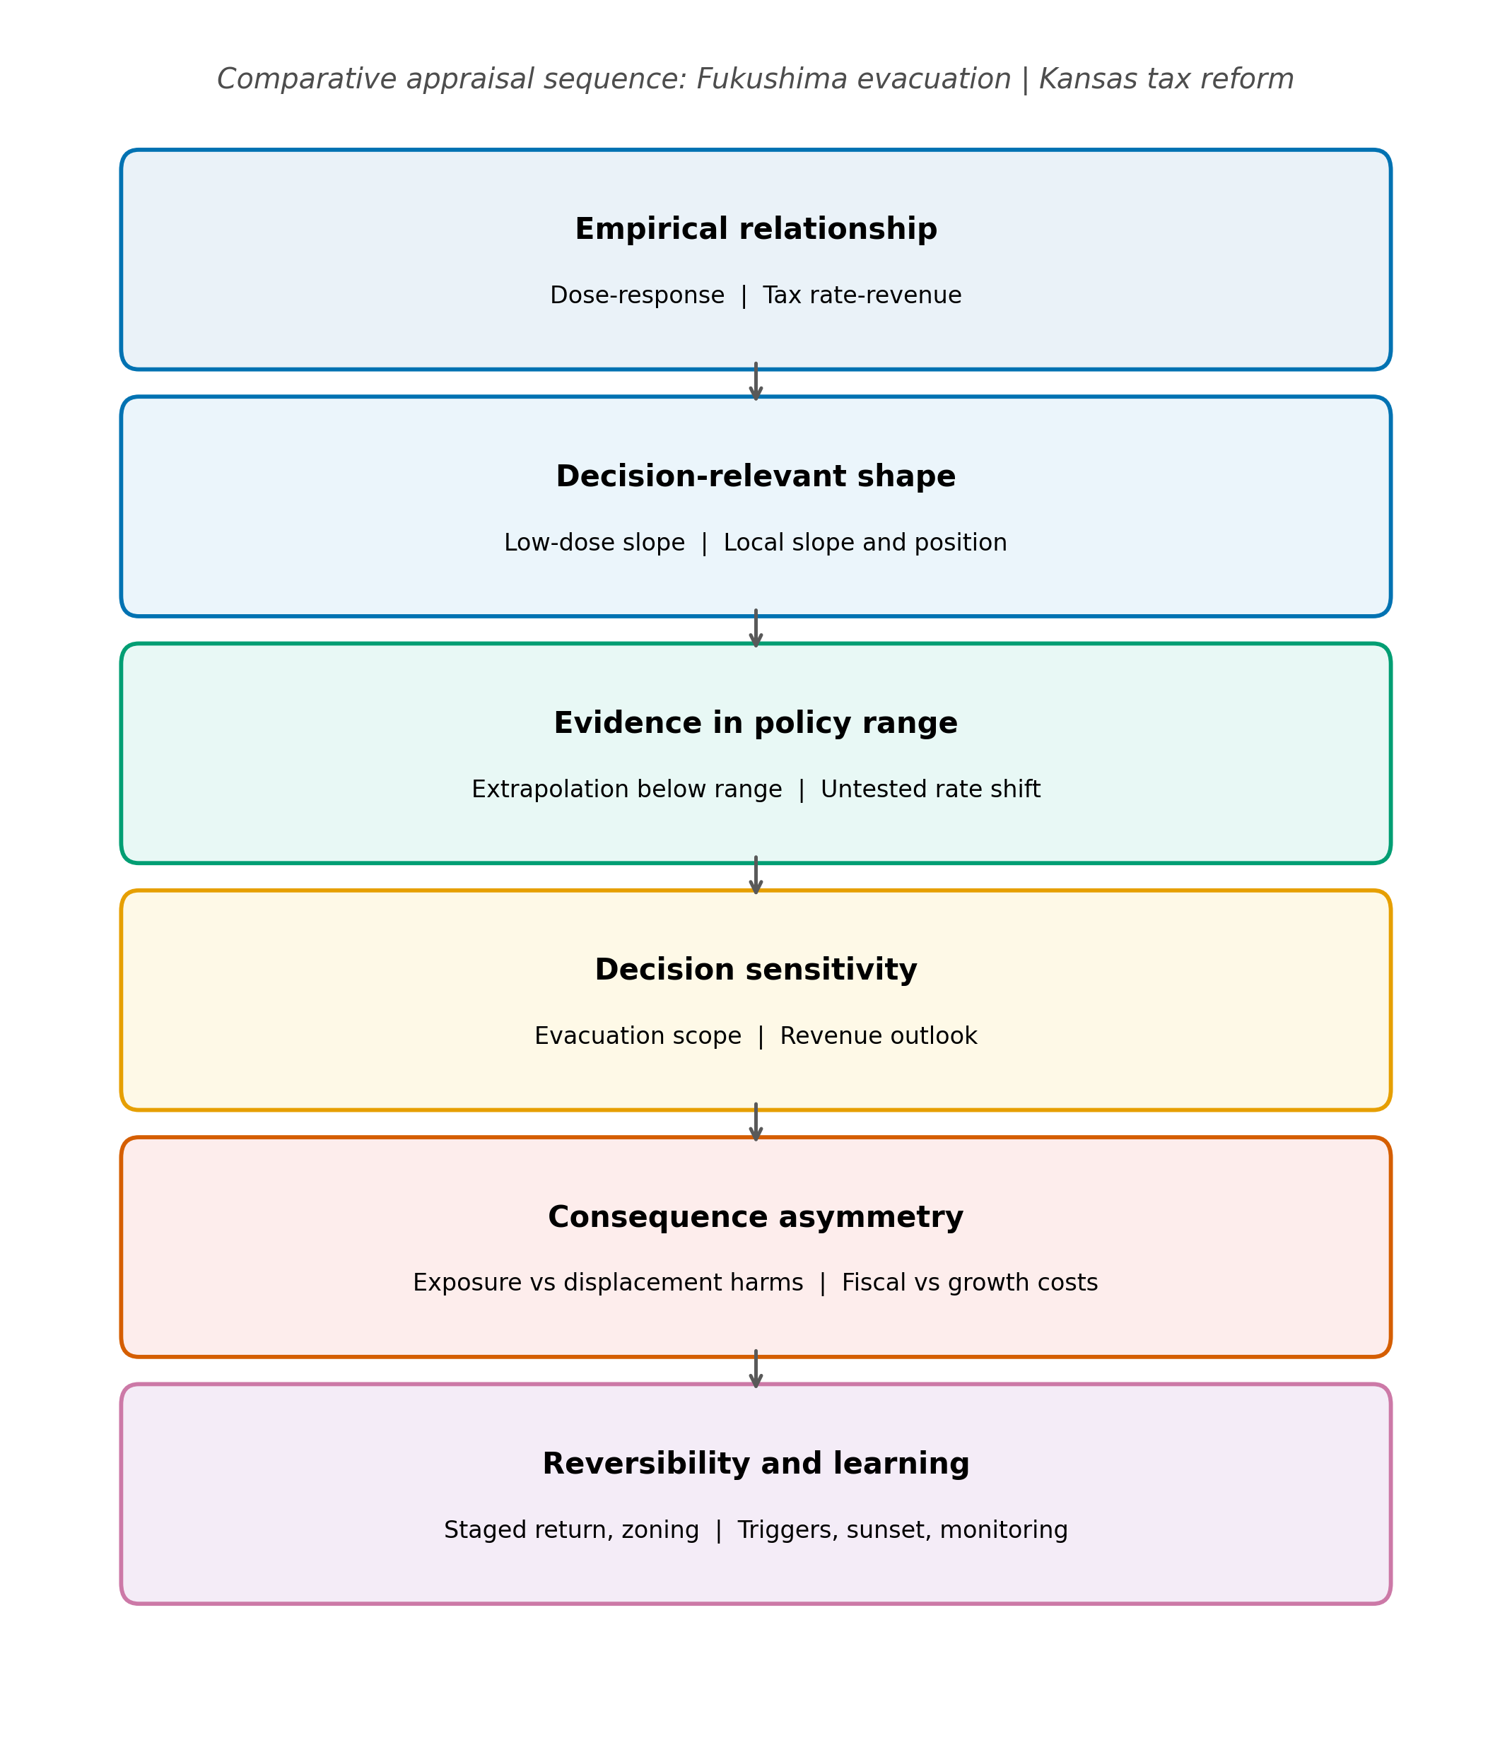
Figure 1
Figure 1. Comparative appraisal sequence for functional-form dependence. The same analytical sequence is applied to both cases: the empirical relationship, the decision-relevant shape, evidence in the policy range, decision sensitivity, consequence asymmetry, and reversibility and learning. Fukushima entries appear before the vertical bar; Kansas entries after it.

Slide 2
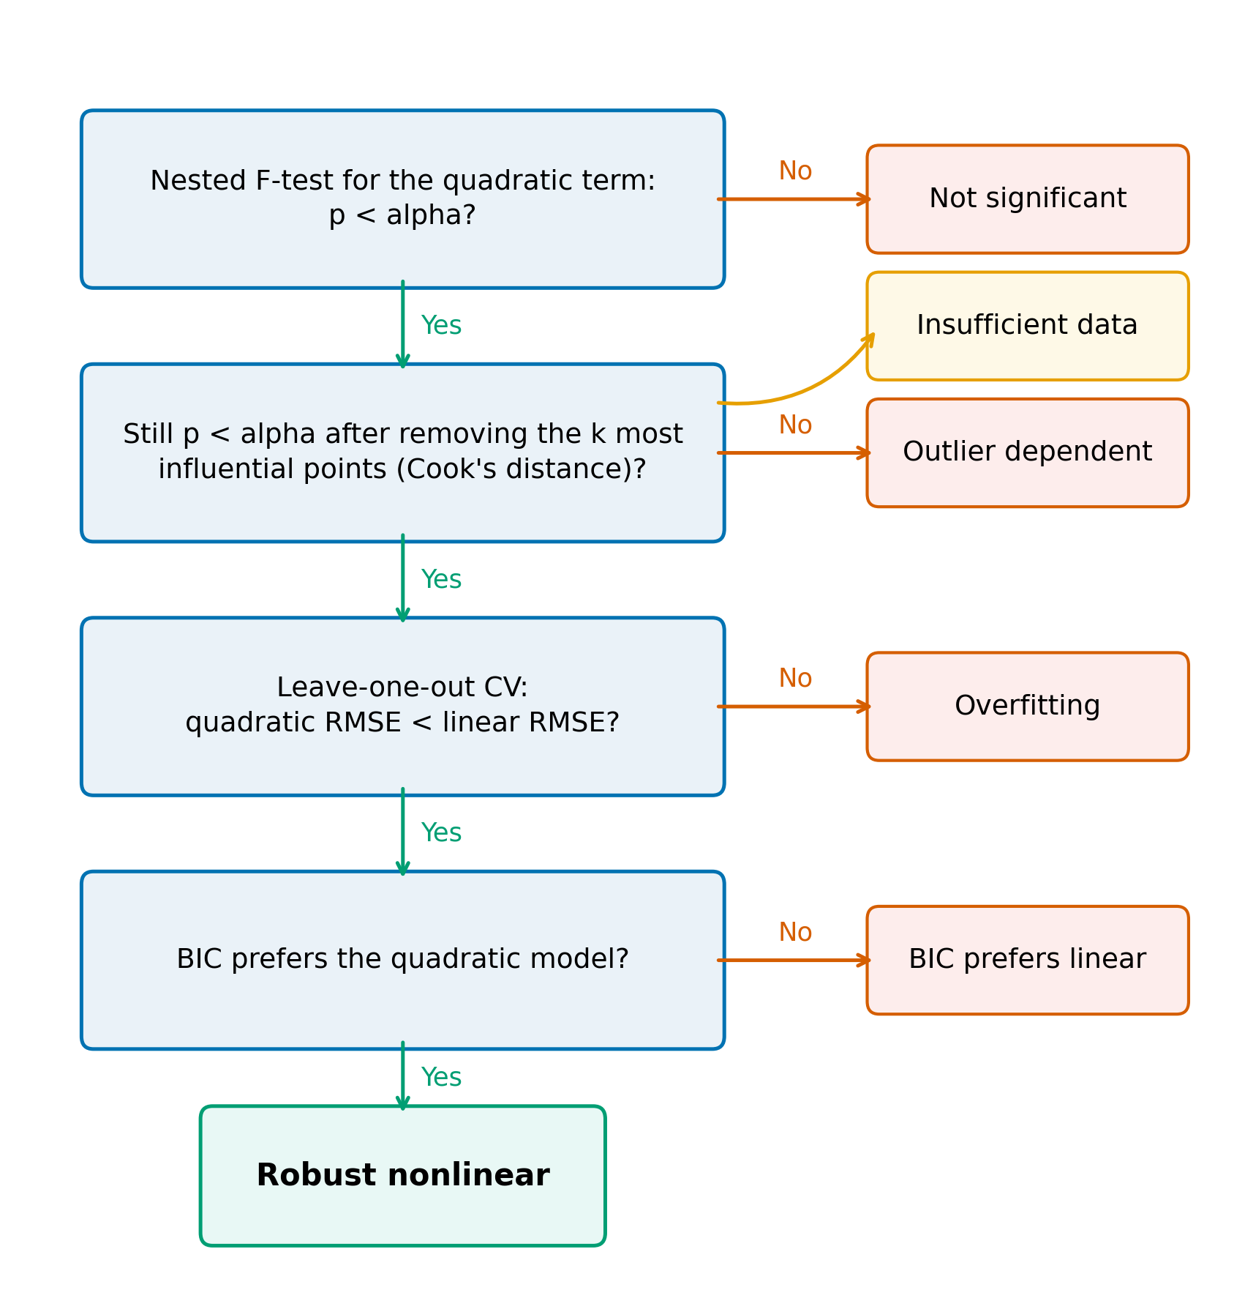
Figure 2
Figure 2. Diagnostic used in the cross-domain mapping exercise. Green paths continue toward robust nonlinear classification; orange paths indicate the first unmet criterion. Insufficient data is assigned when influence removal leaves too few observations for the nested comparison.

Slide 3
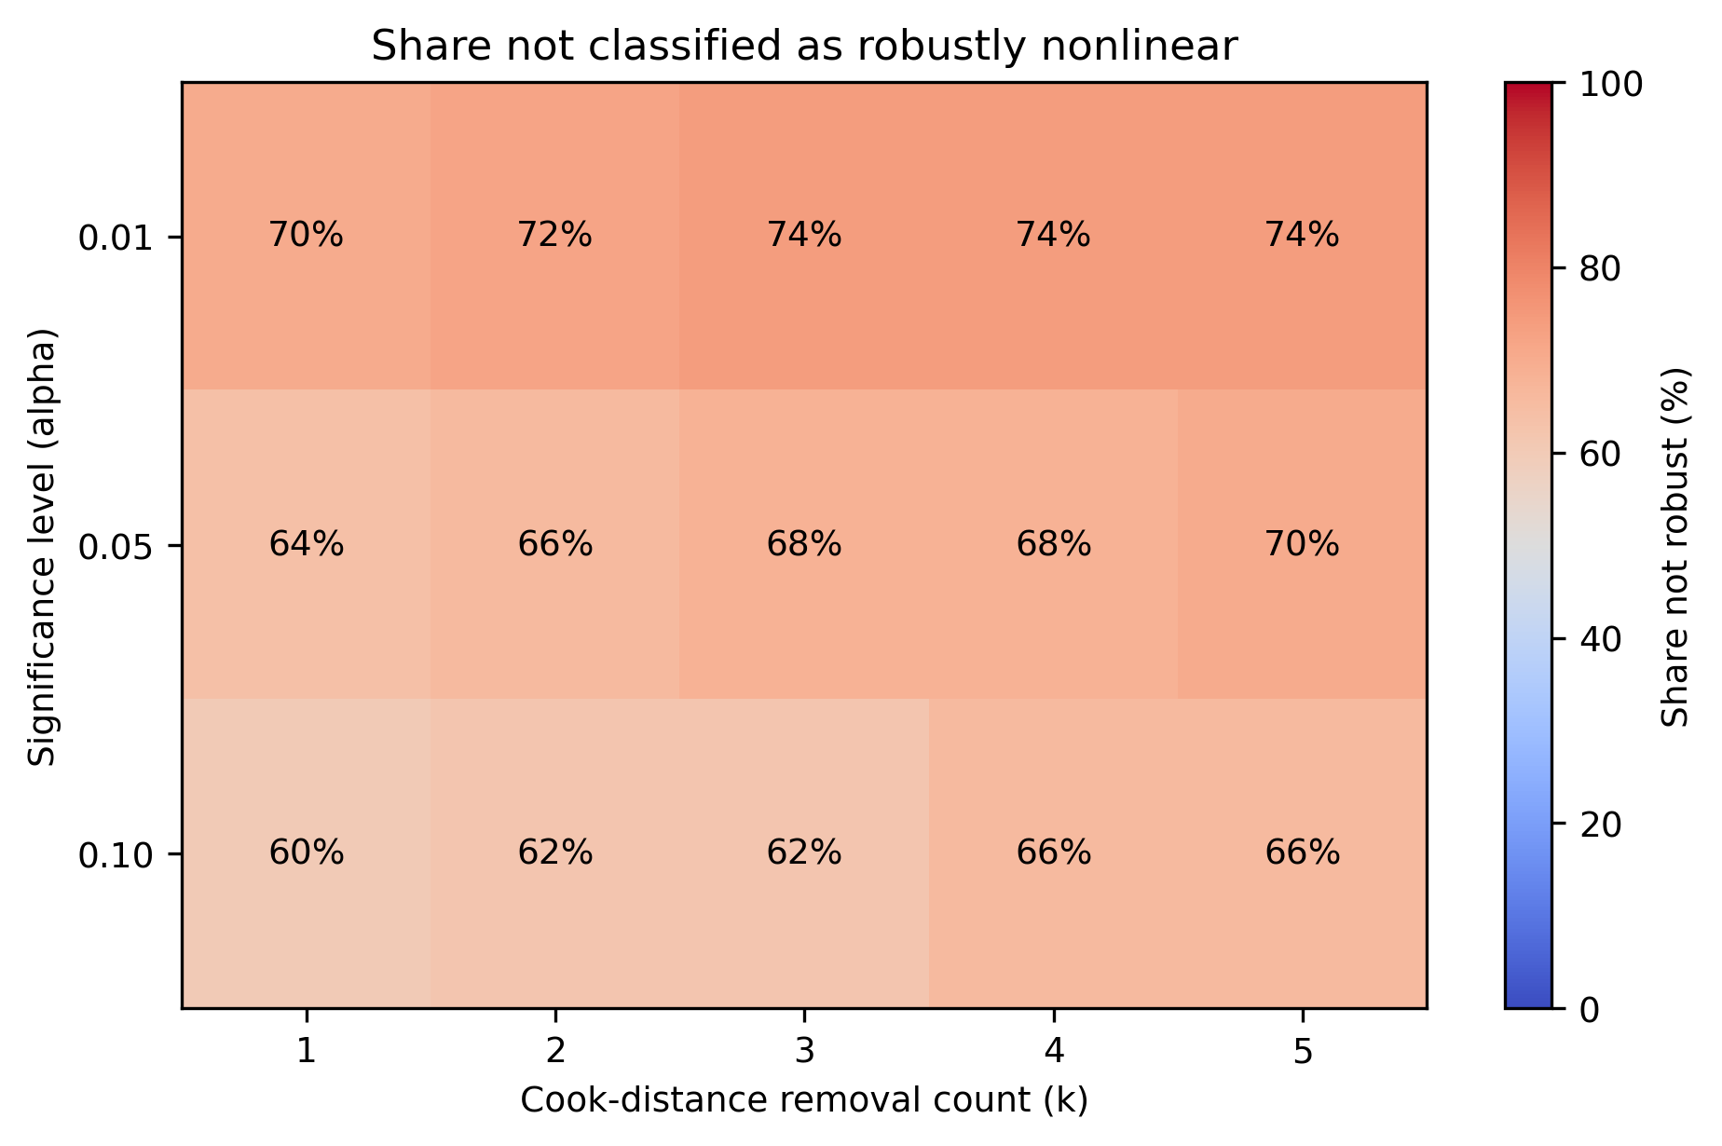
Figure 3
Figure 3. Share of 50 relationship-dataset pairs not classified as robustly nonlinear across significance levels and Cook-distance removal counts. Cell labels report percentages; the color scale spans 0-100%.

Slide 4
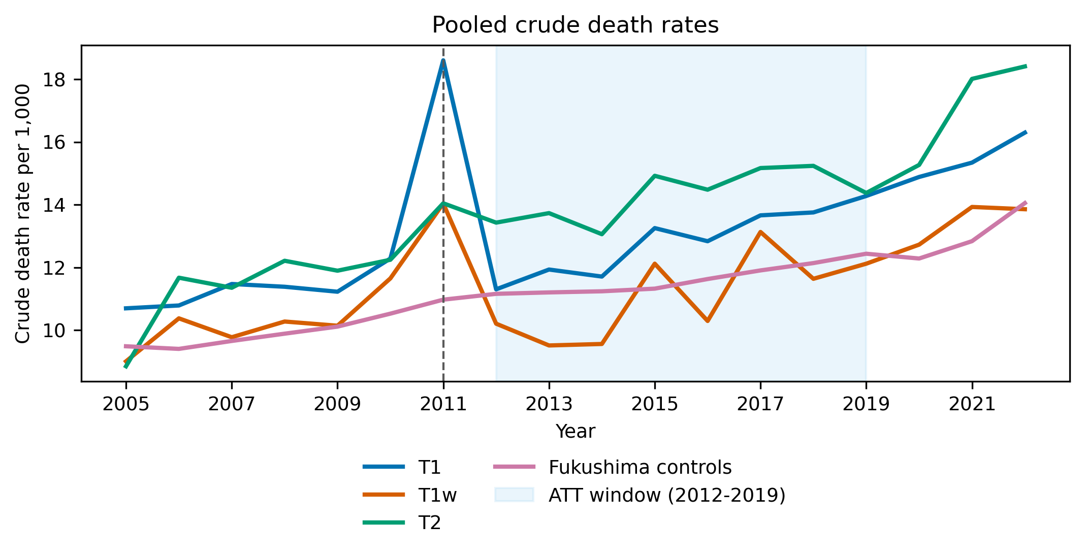
Figure 4
Figure 4. Pooled crude death rates in Fukushima treatment and control groups. T1 contains 10 mandatory-evacuation municipalities; T1w is the restricted complete-evacuation group; T2 contains comparison municipalities subject to other evacuation-related classifications. The shaded region is the 2012-2019 average-treatment-effect window.

Slide 5
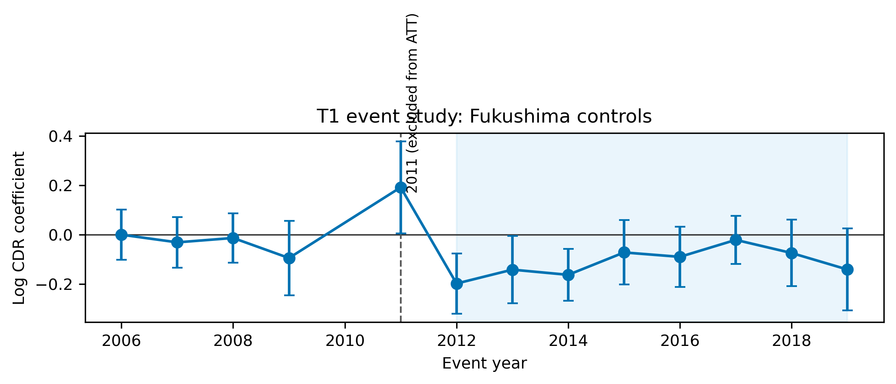
Figure 5
Figure 5. Preferred T1 event-study estimates using unweighted Fukushima municipal controls. Points are year-specific coefficients relative to the omitted reference year; bars are 95% confidence intervals. The acute disaster year 2011 is shown but excluded from the 2012-2019 average-treatment-effect window.

Slide 6
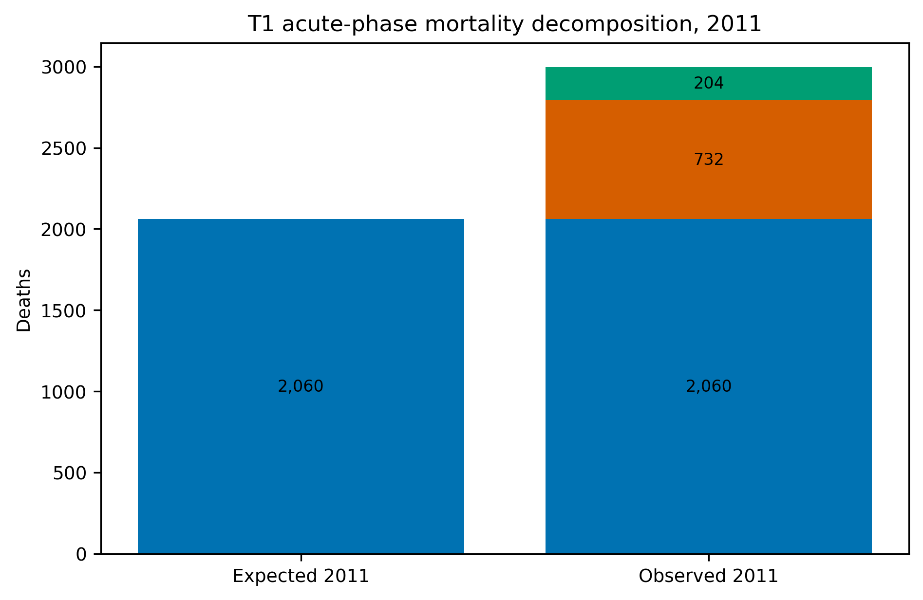
Figure 6
Figure 6. T1 acute-phase mortality decomposition for 2011. Expected deaths are projected from the pre-disaster municipal trend; direct disaster deaths are reported by Fukushima Prefecture; residual excess is the arithmetic difference and is not assigned to a single cause.

Slide 7
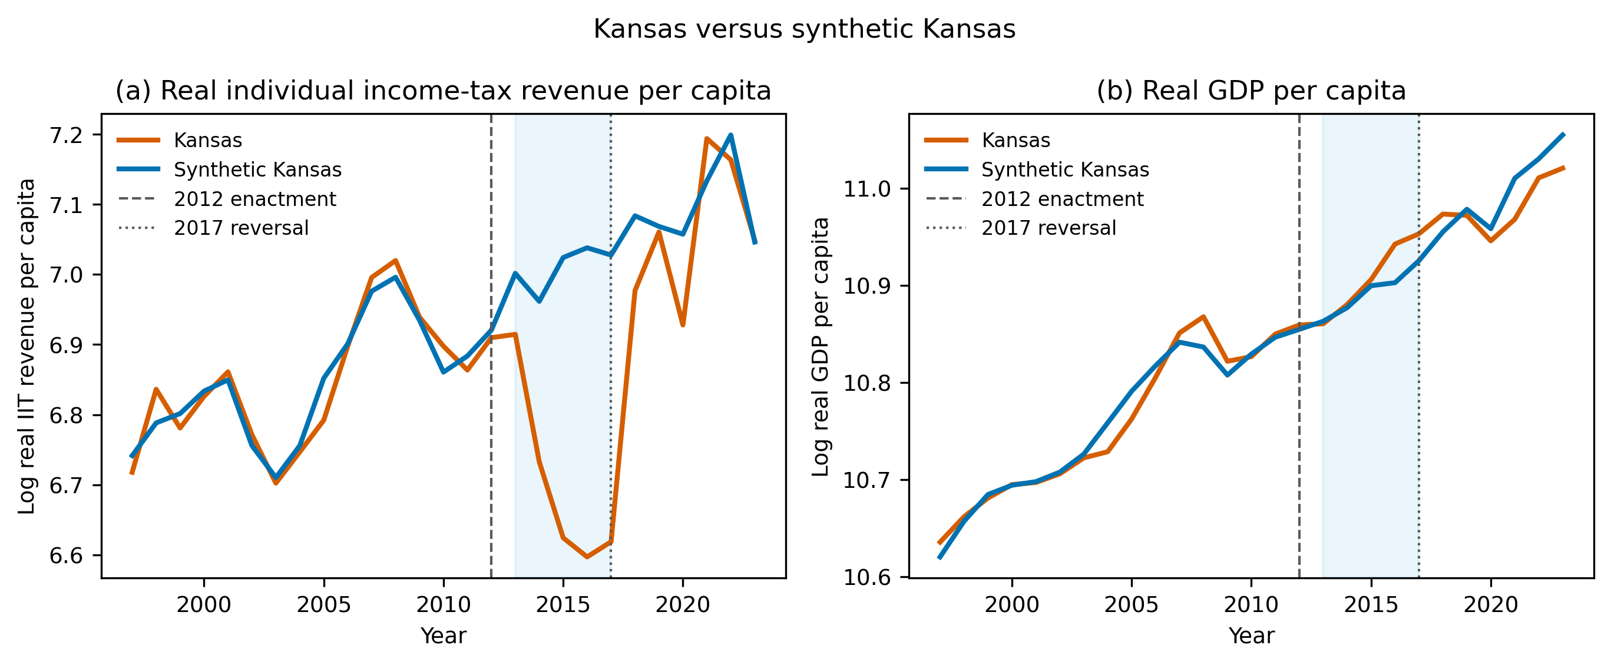
Figure 7
Figure 7. Kansas and synthetic Kansas, 1997-2019. Panel (a) reports log real individual income-tax revenue per capita; panel (b) reports log GDP per capita. Synthetic controls use the main 33-state donor pool. Shading marks 2013-2017, between implementation and legislative reversal.

Slide 8
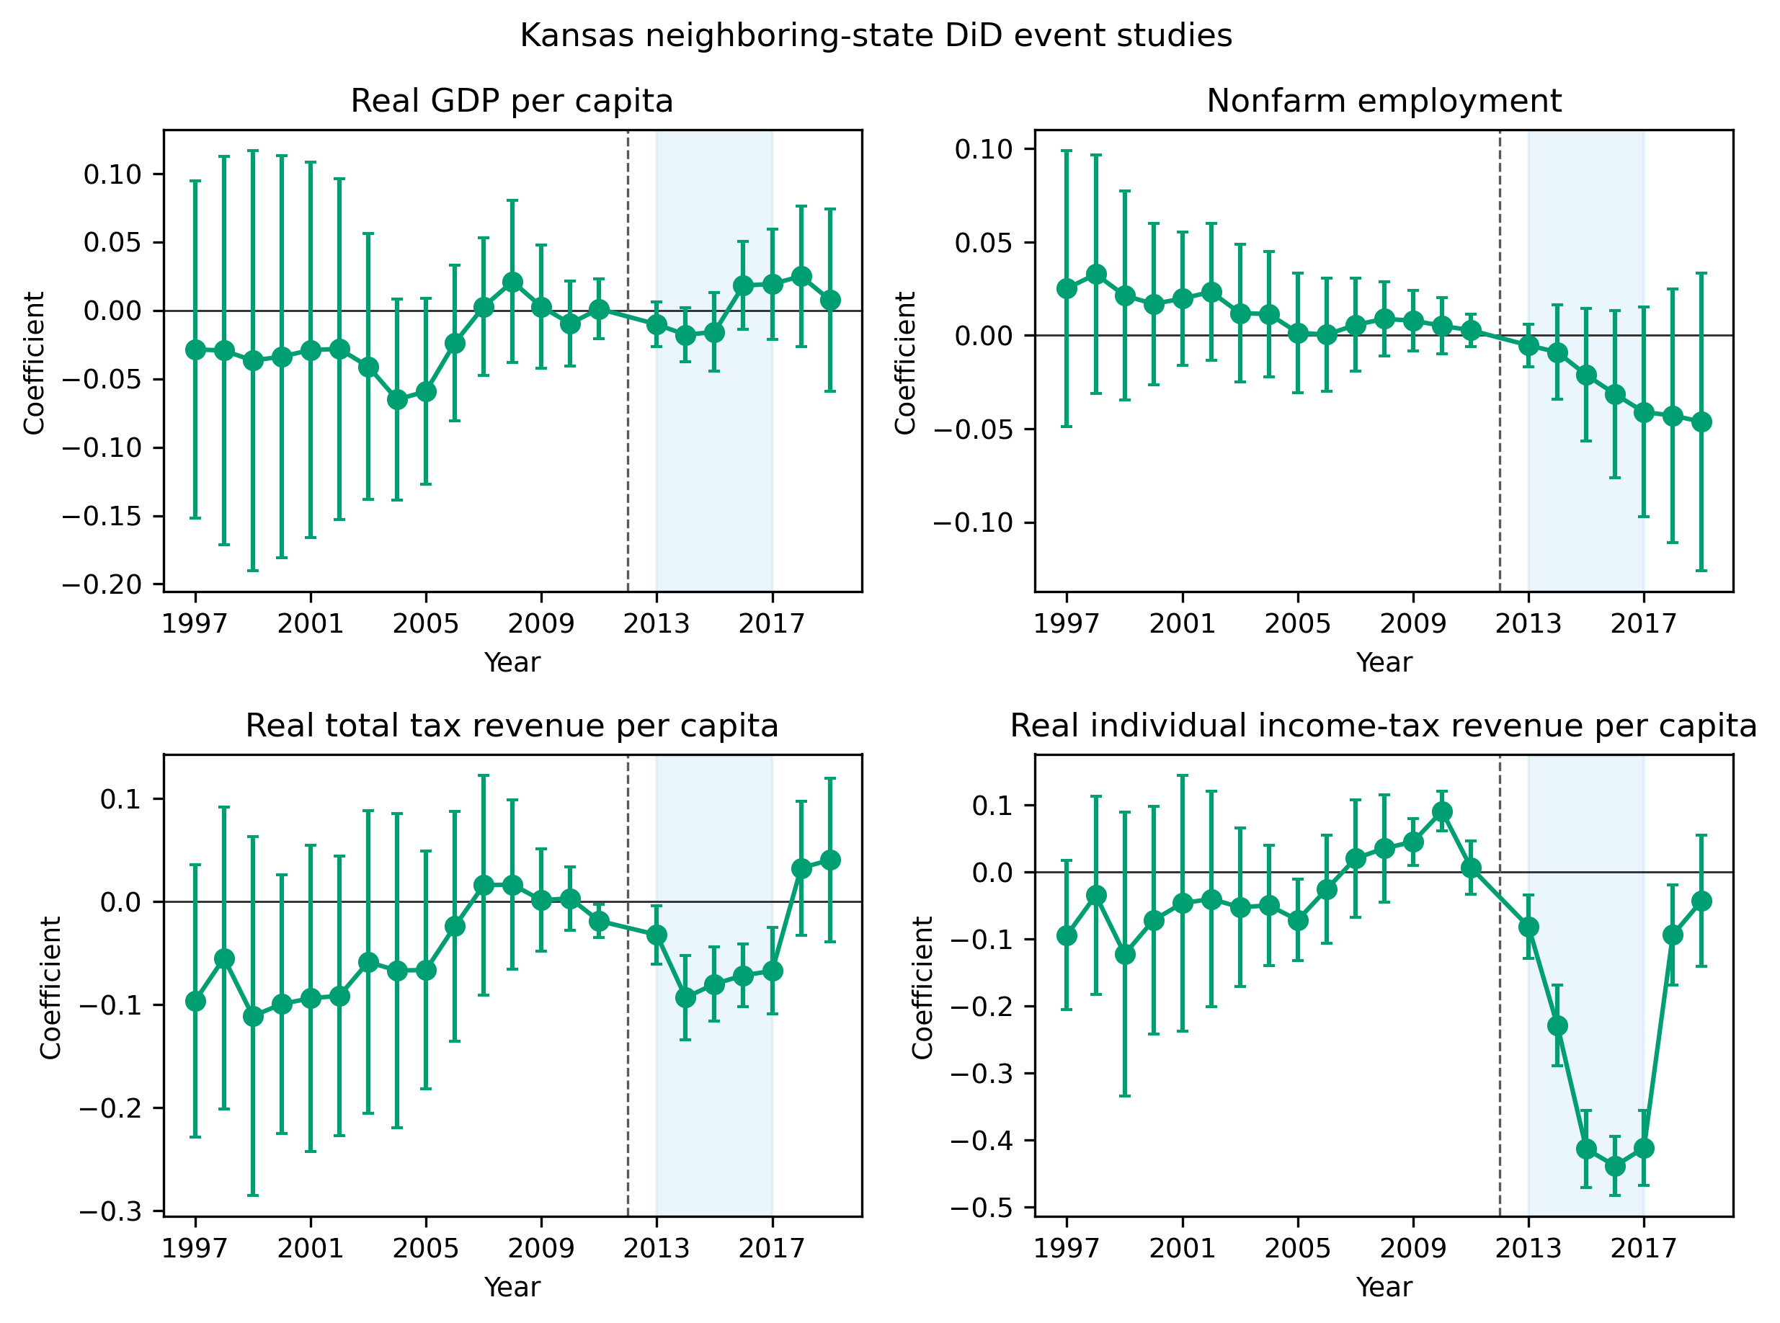
Appendix Figure A1
Appendix Figure A1. Kansas neighboring-state difference-in-differences event studies for real GDP per capita, employment, total tax revenue, and individual income-tax revenue. Coefficients are relative to 2012; bars are 95% confidence intervals.

Slide 9
Table 1. Cross-domain mapping classifications by category
Category | Robust nonlinear | Not significant | Outlier dependent | Overfitting | Insufficient data | Total
Agriculture | 2 | 1 | 0 | 0 | 1 | 4
Demography | 2 | 3 | 0 | 0 | 1 | 6
Economics | 3 | 8 | 1 | 0 | 0 | 12
Environmental Science | 2 | 3 | 1 | 0 | 0 | 6
Physics | 1 | 2 | 1 | 0 | 0 | 4
Political Science | 2 | 2 | 1 | 0 | 0 | 5
Psychology | 1 | 2 | 0 | 0 | 0 | 3
Public Health | 3 | 6 | 0 | 1 | 0 | 10
Total | 16 | 27 | 4 | 1 | 2 | 50
Table 1. Cross-domain mapping classifications by category. Counts describe the purposive relationship-dataset inventory and are not prevalence estimates for scientific theories or literatures.

Slide 10
Table 2. Fukushima difference-in-differences estimates
Group | Controls | Weighting | Age control | ATT (log points) | Permutation p | Pre-trend p | Implied deaths 2012-2019
T1 | All prefectures | Weighted | No | -0.057 | 0.002 | 0.268 | -877
T1 | All prefectures | Weighted | Yes | -0.066 | < 0.001 | 0.335 | -1,018
T1 | All prefectures | Unweighted | No | -0.072 | 0.002 | 0.039 | -1,123
T1 | All prefectures | Unweighted | Yes | -0.072 | < 0.001 | 0.035 | -1,109
T1 | Fukushima only | Weighted | No | -0.085 | < 0.001 | 0.847 | -1,333
T1 | Fukushima only | Weighted | Yes | -0.083 | < 0.001 | 0.863 | -1,291
T1 | Fukushima only | Unweighted | No | -0.085 | 0.001 | 0.314 | -1,322
T1 | Fukushima only | Unweighted | Yes | -0.079 | 0.005 | 0.275 | -1,224
T1w | All prefectures | Unweighted | No | -0.116 | 0.003 | 0.170 | -405
T1w | Fukushima only | Unweighted | No | -0.129 | < 0.001 | 0.498 | -451
T2 | All prefectures | Unweighted | No | -0.022 | 0.581 | 0.829 | -93
T2 | Fukushima only | Unweighted | No | -0.034 | 0.421 | 0.932 | -146
Table 2. Fukushima difference-in-differences estimates. ATT is the 2012-2019 average difference in log crude death rates; 2011 is excluded. Permutation p values use 1000 assignments. Implied deaths are descriptive transformations of recorded municipal deaths and are not causal death counts.

Slide 11
Table 3. Fukushima measured mortality quantities and published radiological-risk projections
Quantity | Value | Scope | Type | Source
T1 observed deaths 2011 | 2,996 | T1 municipalities | Measured | This study
T1 expected deaths 2011 | 2,060 | T1 municipalities | Measured | This study
T1 excess deaths 2011 | 936 | T1 municipalities | Measured | This study
Of which direct disaster deaths | 732 | T1 municipalities | Measured | Fukushima Prefecture, 2014
T1 residual excess deaths 2011 | 204 | T1 municipalities | Measured | This study
T1 implied difference 2012-2019 (recorded) | -1,322 | T1 municipalities | Measured | This study
Certified disaster-related deaths, Fukushima Prefecture | 2,350 | Fukushima prefecture | Measured | Reconstruction Agency, 2026
Projected worldwide cancer deaths from the release | 130 (15-1,100) | Worldwide | Projected (LNT-based) | ten Hoeve & Jacobson, 2012
Evacuation-avoided radiological mortalities | 28 (3-245) | Worldwide | Projected (LNT-based) | ten Hoeve & Jacobson, 2012
Lifetime-risk relative increases in the most affected areas | leukaemia up to 7%; breast up to 6%; all solid cancers up to 4%; thyroid up to 70% | Most affected areas | Projected (LNT-based) | WHO, 2013
WHO conclusion outside Japan | no discernible increase | Outside Japan | Projected (LNT-based) | WHO, 2013
Collective effective dose | 18 / 36 / 48 thousand man-Sv (first year / ten years / lifetime) | Japanese population | Projected (LNT-based) | UNSCEAR, 2014
UNSCEAR conclusion | no discernible increase expected | Exposed population | Projected (LNT-based) | UNSCEAR, 2014
Table 3. Fukushima measured mortality quantities and published radiological-risk projections. Rows differ in population, geography, time horizon, measurement, and model basis and must not be added or interpreted as commensurate estimands.

Slide 12
Table 4. Kansas synthetic-control estimates by outcome and donor pool
Outcome | Pool | Mean gap | Gap (%) | Permutation p | Pre-RMSPE | donors | in-time placebo | LOO range
Real GDP per capita | Main | 0.015 | +1.5% | 0.71 | 0.015 | 33 | 0.056 | 0.009 to 0.029
Real GDP per capita | All states | -0.004 | -0.4% | 0.49 | 0.007 | 50 | 0.056 | -
Nonfarm employment | Main | -0.013 | -1.3% | 0.47 | 0.004 | 33 | 0.006 | -0.013 to -0.001
Nonfarm employment | All states | -0.001 | -0.1% | 0.96 | 0.003 | 50 | 0.006 | -
Real total tax revenue per capita | Main | -0.031 | -3.0% | 0.18 | 0.013 | 32 | 0.075 | -0.039 to -0.028
Real total tax revenue per capita | All states | 0.030 | +3.1% | 0.12 | 0.010 | 49 | 0.075 | -
Real individual income-tax revenue per capita | Main | -0.313 | -26.9% | 0.03 | 0.025 | 32 | 0.103 | -0.322 to -0.291
Real individual income-tax revenue per capita | All states | -0.301 | -26.0% | 0.02 | 0.019 | 42 | 0.103 | -
Table 4. Kansas synthetic-control estimates by outcome and donor pool. Mean gaps cover 2013-2017. Permutation p values compare Kansas with donor-state placebo gaps; LOO denotes leave-one-donor-out sensitivity.

Slide 13
Table 5. Comparative summary of the two cases across the common dimensions
Comparative dimension | Fukushima evacuation | Kansas tax reform | Comparative lesson
Policy domain | Radiation protection; emergency public health | Fiscal and economic policy | The mechanism is domain-general: a named curve can carry a decision in any sector.
Policy objective | Reduce population radiation exposure | Raise growth while recovering revenue | Both objectives required a specific shape, not just an association.
Canonical relationship | Low-dose radiation dose-response | Tax rate-revenue and growth response | Named curves compress multi-step arguments into portable pictures.
Decision-relevant feature | Low-dose slope below observed doses | Local position, slope, and dynamic response | Each decision needed one feature of the curve, not the curve as a whole.
Type of uncertainty | Extrapolation below the observed range | Local-position and response-geometry uncertainty | Different uncertainty locations produce different appraisal priorities.
Extrapolation burden | High; few observations below 0.1 Gy | Moderate; within-state history but untested rate cut | Extrapolation burden predicts how far evidence can carry a decision.
Transportability | Atomic-bomb and occupational evidence to municipal exposure | Cross-state and theoretical evidence to one state's response | Transport gaps differ in kind; decompose them by population, period, and institution.
Decision sensitivity | Evacuation scope and duration change under plausible dose-response shapes | Revenue outlook changes under plausible local slopes and growth paths | In both, plausible alternative shapes imply materially different policies.
Cost of wrong action | Displacement, mortality risk, care disruption | Revenue loss and service compression | Error costs fall on identifiable groups, not on the model.
Cost of inaction | Residual radiation exposure | Foregone growth stimulus claim | Asymmetry must be weighed in both directions, not one.
Consequence asymmetry | Severe on both sides; competing harms | Primarily fiscal; distribution across budgets | Higher asymmetry raises the decision value of shape certainty.
Reversibility | Limited; displacement and health effects partly irreversible | Comparatively greater; statutes revised in 2017 | Reversible settings can substitute adaptive design for ex ante certainty.
Time to observe outcomes | Years; health endpoints partly latent | Years; fiscal outcomes observable quickly | Observability on policy timescales enables learning architectures.
Learning opportunity | Zoning, staged return, exemptions possible but hard mid-crisis | Staged cuts, triggers, sunset clauses readily available | Where learning is feasible, adaptive implementation hedges shape uncertainty.
Preferred decision architecture | Staged, revisable protection with asymmetric-harm safeguards | Staged implementation with triggers and monitoring | Architecture should match the joint uncertainty-consequence-reversibility configuration.
Table 5. Comparative summary of the two cases across the common dimensions. The cases are not statistically comparable; the final column states the comparative lesson each contrast supports.

Slide 14
Appendix Table A1. Municipalities excluded from the Fukushima panel because of missing mortality or population observations
Prefecture | Municipality | Reason | Years missing
Iwate | Hachimantai | Population missing in at least one year 2005-2019 | 2005
Iwate | Oshu | Unit not observed under a single code 2005-2019 | 2005
Iwate | Takizawa | Unit not observed under a single code 2005-2019 | 2005,2006,2007,2008,2009,2010,2011,2012,2013
Iwate | Nishiwaga | Population missing in at least one year 2005-2019 | 2005
Iwate | Hirono | Unit not observed under a single code 2005-2019 | 2005
Miyagi | Aoba Ward, Sendai | Population missing in at least one year 2005-2019 | 2006,2007,2008,2009,2010
Miyagi | Miyagino Ward, Sendai | Population missing in at least one year 2005-2019 | 2005,2006,2007,2008,2009,2010
Miyagi | Wakabayashi Ward, Sendai | Population missing in at least one year 2005-2019 | 2005,2006,2007,2008,2009,2010
Miyagi | Taihaku Ward, Sendai | Population missing in at least one year 2005-2019 | 2005,2006,2007,2008,2009,2010
Miyagi | Izumi Ward, Sendai | Population missing in at least one year 2005-2019 | 2005,2006,2007,2008,2009,2010
Miyagi | Shiogama | Population missing in at least one year 2005-2019 | 2006,2007
Miyagi | Tome | Population missing in at least one year 2005-2019 | 2005
Miyagi | Kurihara | Population missing in at least one year 2005-2019 | 2005
Miyagi | Higashimatsushima | Population missing in at least one year 2005-2019 | 2005
Miyagi | Osaki | Unit not observed under a single code 2005-2019 | 2005
Miyagi | Tomiya | Unit not observed under a single code 2005-2019 | 2005,2006,2007,2008,2009,2010,2011,2012,2013,2014,2015,2016
Miyagi | Shichikashuku | Population missing in at least one year 2005-2019 | 2007,2008,2009,2010,2011,2012,2013,2014,2015,2016,2017
Miyagi | Shichigahama | Population missing in at least one year 2005-2019 | 2007,2008,2009,2010,2011,2012,2013,2014,2015,2016,2017
Miyagi | Misato | Unit not observed under a single code 2005-2019 | 2005
Miyagi | Minamisanriku | Population missing in at least one year 2005-2019 | 2005
Yamagata | Shonai | Population missing in at least one year 2005-2019 | 2005
Fukushima | Motomiya | Population missing in at least one year 2005-2019 | 2006
Ibaraki | Kasumigaura | Population missing in at least one year 2005-2019 | 2006
Ibaraki | Sakuragawa | Population missing in at least one year 2005-2019 | 2005
Ibaraki | Kamisu | Population missing in at least one year 2005-2019 | 2005
Ibaraki | Namegata | Population missing in at least one year 2005-2019 | 2005
Ibaraki | Hokota | Population missing in at least one year 2005-2019 | 2005
Appendix Table A1. Municipalities excluded from the Fukushima panel because of missing mortality or population observations. Exclusions are determined before outcome estimation.

Slide 15
Appendix Table A2. Unit-level Fukushima synthetic-control results for T1 municipalities
Municipality | Donors | Pre-RMSPE | Post-RMSPE | Mean gap 2012-2019 | Permutation p
Minamisoma | 7 | 0.029300435978957 | 0.1839369039357427 | -0.0106632246883388 | 0.25
Kawamata | 23 | 0.0097976486916118 | 0.0816468772883595 | 0.0551197205542313 | 0.3333333333333333
Naraha | 20 | 0.0884818531209874 | 0.2043825464261744 | -0.1279506017217466 | 0.7142857142857143
Tomioka | 13 | 0.0593407198567986 | 0.164491604408235 | -0.1516691457422756 | 0.5
Kawauchi | 13 | 0.0444060903046035 | 0.1480735301319032 | 0.0831437221720144 | 0.5
Okuma | 15 | 0.1444174894492097 | 0.3036512375095741 | -0.2680256930368754 | 0.5625
Futaba | 20 | 0.0489068465462905 | 0.2571351516004428 | -0.1909625167259772 | 0.2857142857142857
Namie | 18 | 0.0043825333785589 | 0.1800522918063515 | -0.0984116620871223 | 0.2631578947368421
Katsurao | 5 | 0.1826943753700612 | 0.2488059137391605 | -0.1367370322694726 | 0.8333333333333334
Iitate | 22 | 0.0168998085544814 | 0.1182144357751331 | -0.0265778278315405 | 0.3043478260869565
Appendix Table A2. Unit-level Fukushima synthetic-control results for T1 municipalities. Mean gaps cover 2012-2019; permutation p values compare treated and placebo-unit gaps.

