Slide 1
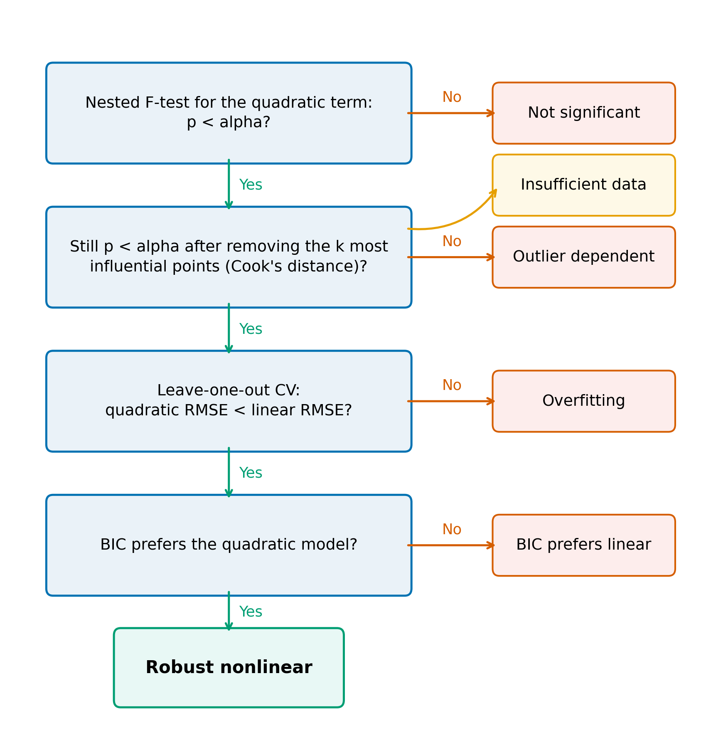
Figure 1
Figure 1. Decision tree used to classify each canonical curve. Each curve is fitted with linear and quadratic models; the verdict depends on the nested F-test at level alpha, the same test after removing the k most influential observations by Cook's distance, leave-one-out cross-validated prediction error, and the Bayesian information criterion. Default alpha = 0.05, k = 3.

Slide 2
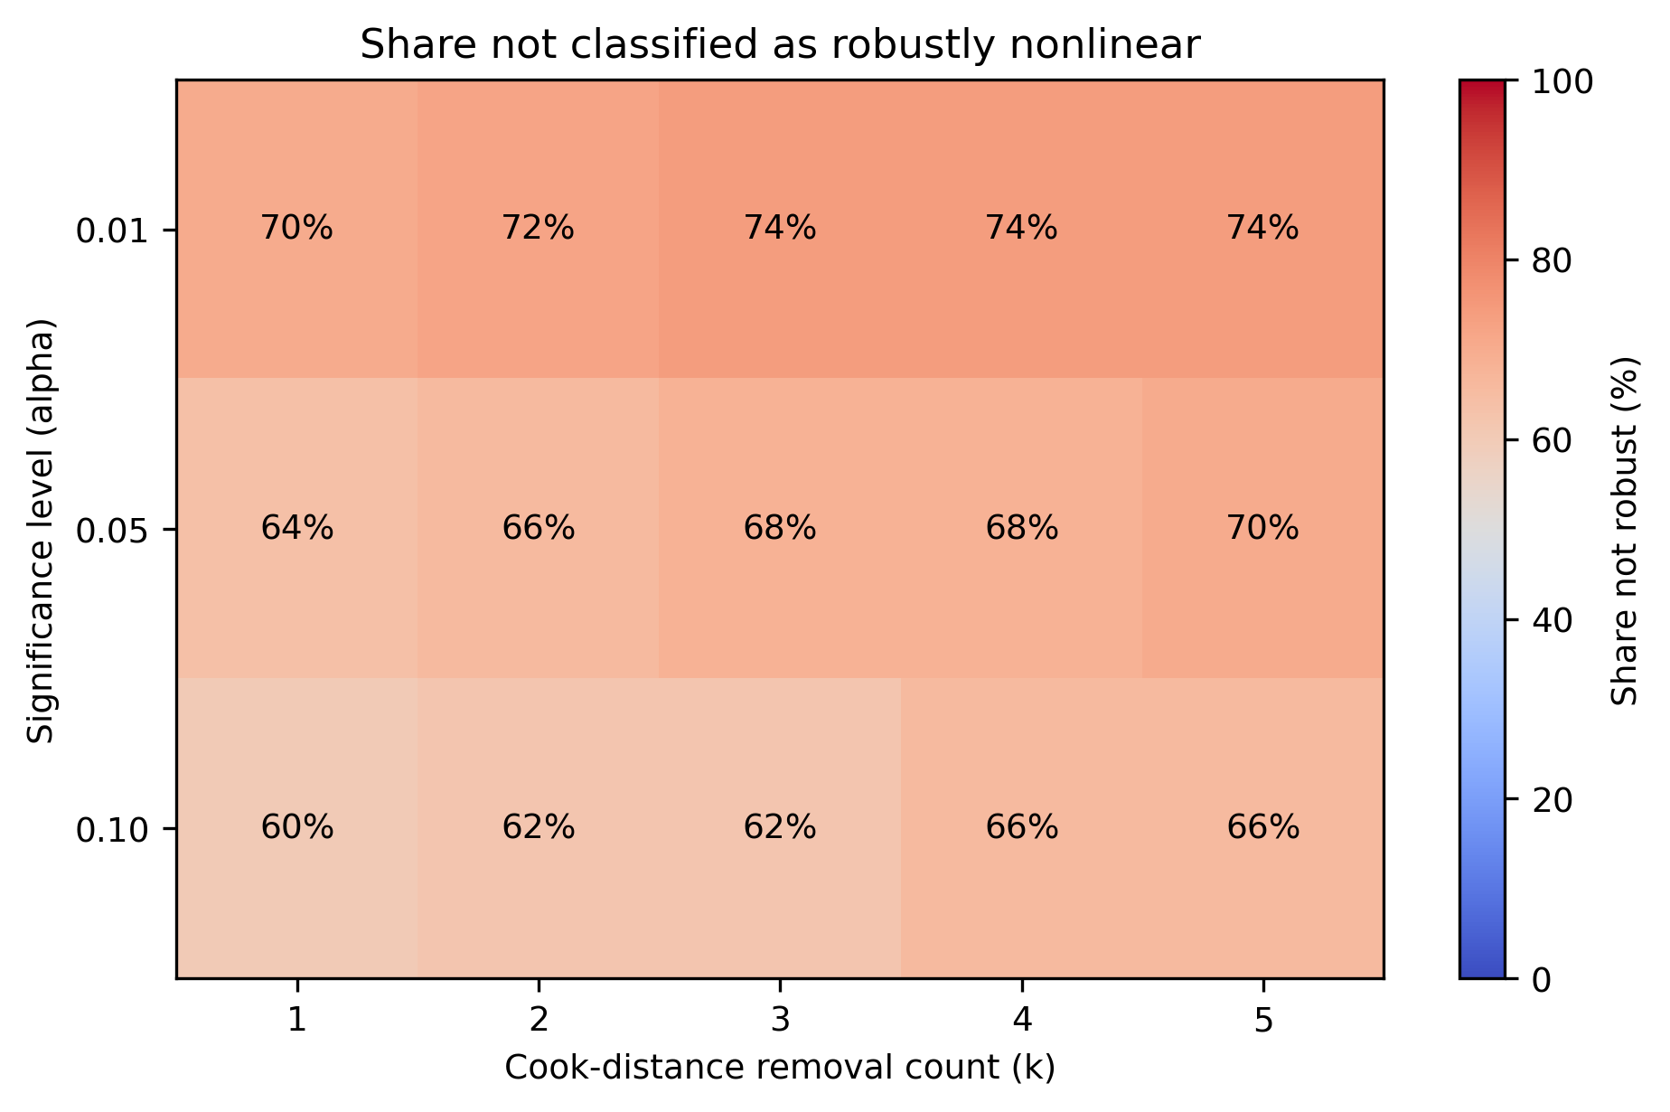
Figure 2
Figure 2. Share of the 50 canonical curves not classified as robustly nonlinear, by significance level alpha and number of influential observations removed k. The default cell (alpha = 0.05, k = 3) gives 68%.

Slide 3
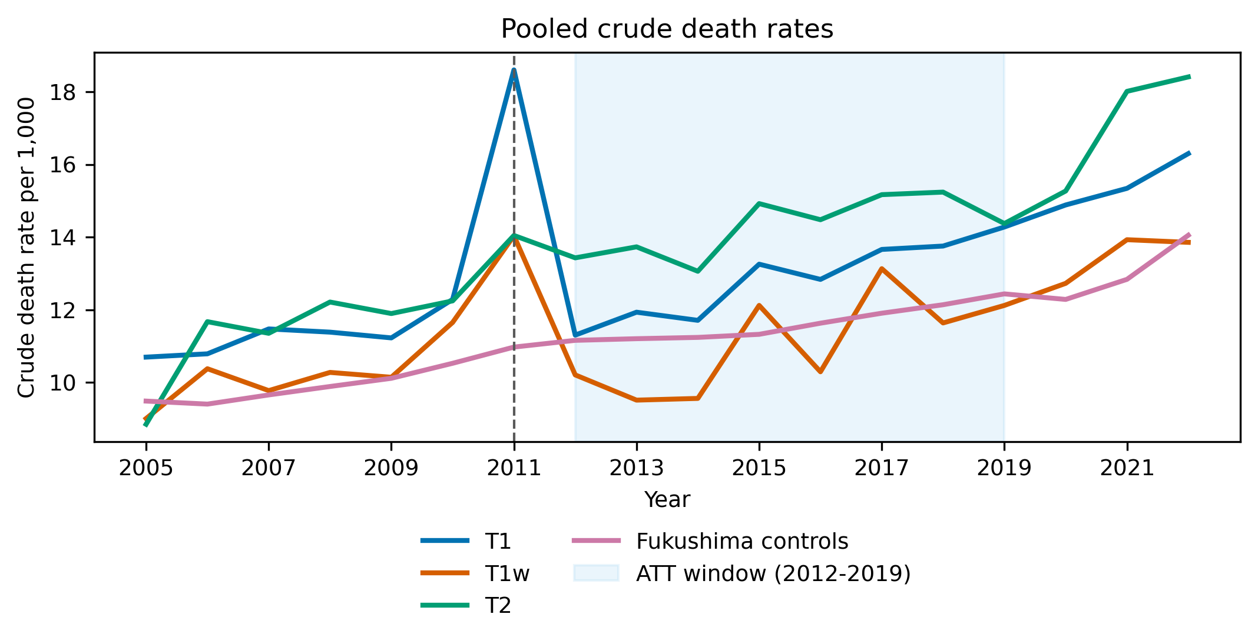
Figure 3
Figure 3. Crude death rate per 1,000 registered residents, 2005-2022, for municipalities in the restricted or deliberate evacuation areas (T1), the subset evacuated in full (T1w), the emergency evacuation preparation area (T2), and Fukushima control municipalities. Deaths from Vital Statistics; population from the Basic Resident Register. Shaded years (2020-2022) are outside the estimation sample.

Slide 4
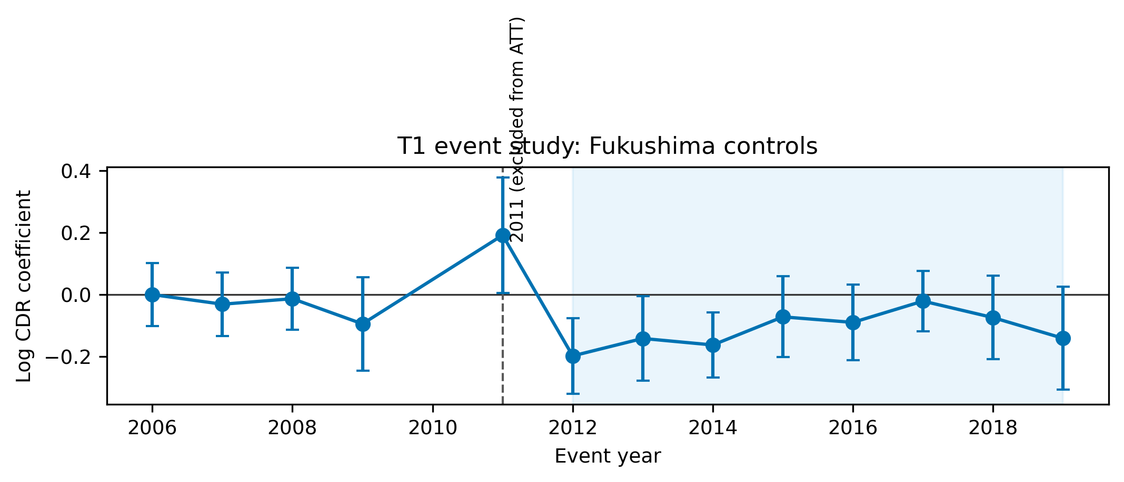
Figure 4
Figure 4. Event-study estimates of the effect of evacuation orders on log crude death rate, T1 municipalities versus Fukushima controls, unweighted, reference year 2010. Points are coefficients; bars are 95% confidence intervals from municipality-clustered standard errors, shown for reference only; inference in the text uses permutation.

Slide 5
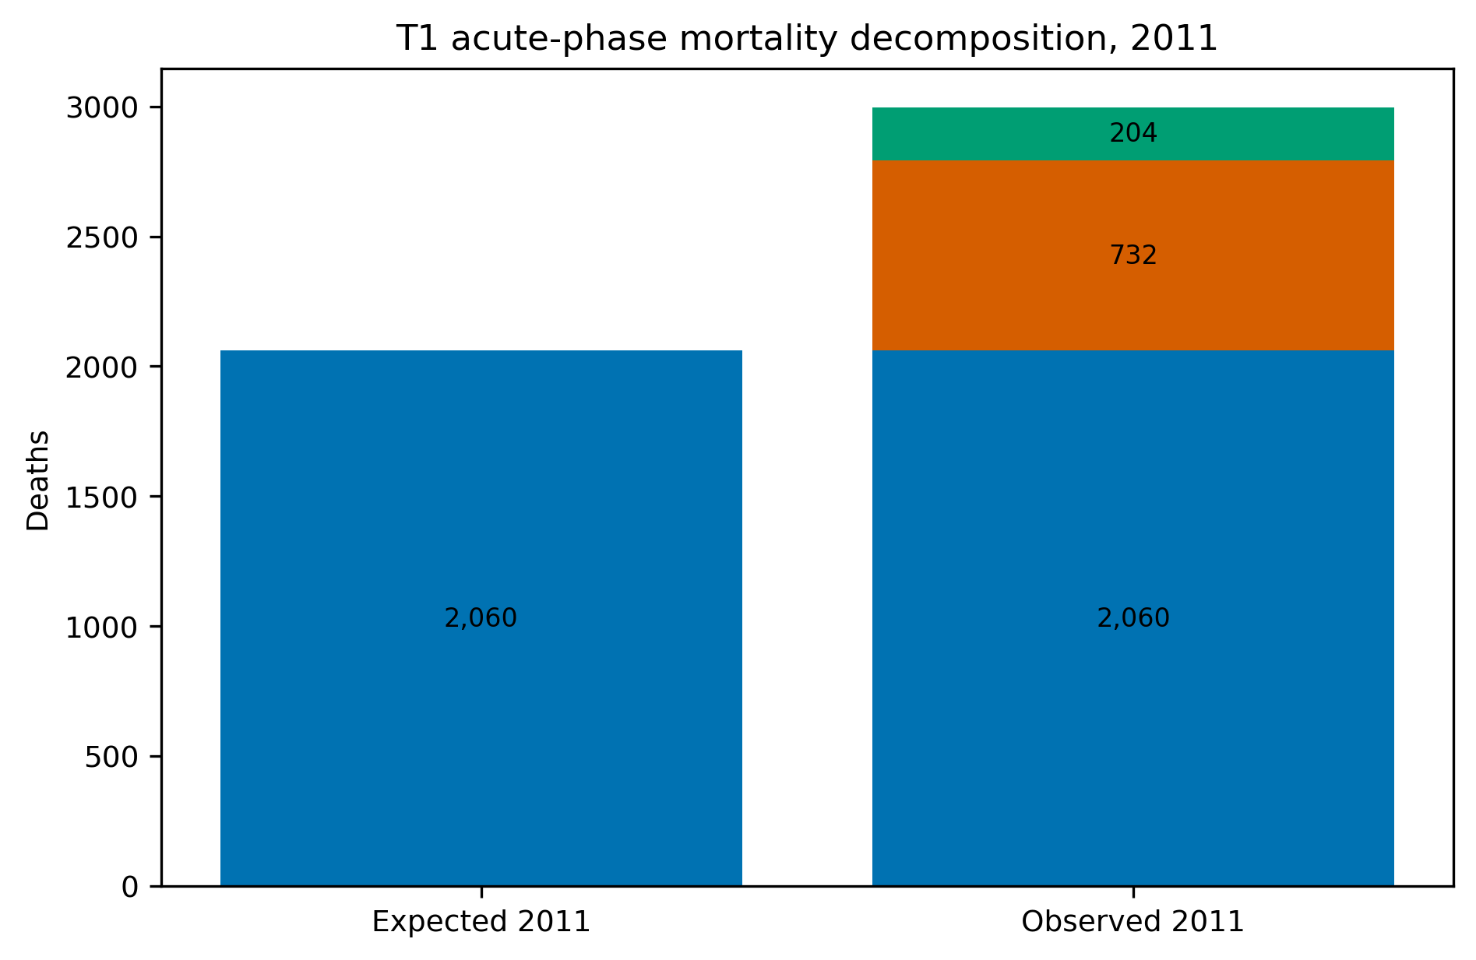
Figure 5
Figure 5. Decomposition of 2011 deaths in evacuated municipalities into expected deaths, direct disaster deaths, and residual excess. Expected deaths are 2011 population times the 2010 death rate, scaled by the change in the pooled control death rate. Direct deaths from the Fukushima Prefecture damage report.

Slide 6
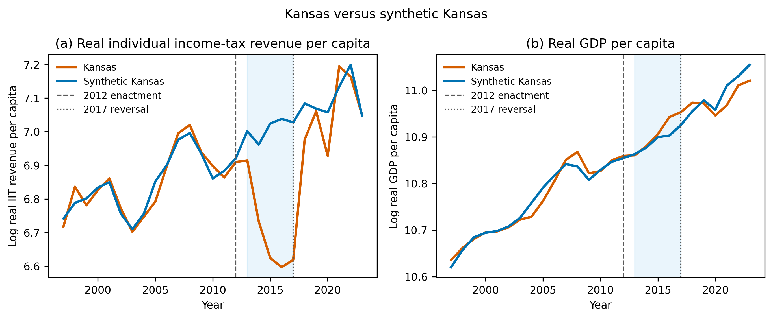
Figure 6
Figure 6. Kansas versus synthetic Kansas, main donor pool: log real individual income-tax revenue per capita (left) and log real GDP per capita (right), 1997-2019. Vertical lines mark the 2012 enactment and the 2017 reversal. Synthetic series are convex combinations of 33 donor states fitted on 1997-2012.

Slide 7
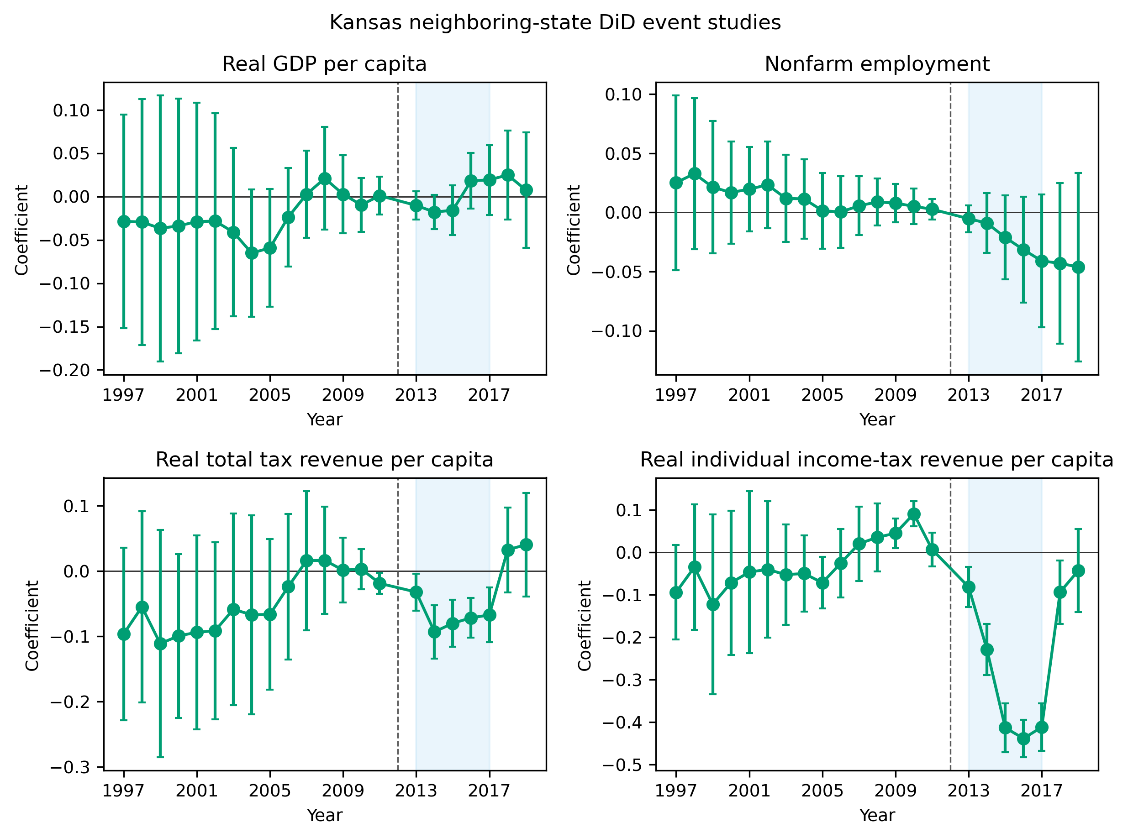
Figure A1
Figure A1. Difference-in-differences event studies for Kansas versus the four neighbouring states, reference year 2012, for the four outcomes.

Slide 8
Table 1. Verdicts for 50 canonical curves at the default thresholds (alpha = 0.05, k = 3), by field.
Category | Robust nonlinear | Not significant | Outlier dependent | Overfitting | Insufficient data | Total
Agriculture | 2 | 1 | 0 | 0 | 1 | 4
Demography | 2 | 3 | 0 | 0 | 1 | 6
Economics | 3 | 8 | 1 | 0 | 0 | 12
Environmental Science | 2 | 3 | 1 | 0 | 0 | 6
Physics | 1 | 2 | 1 | 0 | 0 | 4
Political Science | 2 | 2 | 1 | 0 | 0 | 5
Psychology | 1 | 2 | 0 | 0 | 0 | 3
Public Health | 3 | 6 | 0 | 1 | 0 | 10
Total | 16 | 27 | 4 | 1 | 2 | 50

Slide 9
Table 2. Difference-in-differences estimates of the effect of evacuation orders on log crude death rate, 2012-2019 versus 2006-2010, 2011 excluded. Permutation p-values from 1000 random re-assignments of treatment among control municipalities; pre-trend p from the same distribution of the sum of squared 2006-2009 event-study coefficients. Excess deaths are implied by the estimate applied to observed deaths.
Group | Controls | Weighting | Age control | ATT (log points) | Permutation p | Pre-trend p | Implied deaths 2012-2019
T1 | All prefectures | Weighted | No | -0.057 | 0.002 | 0.268 | -877
T1 | All prefectures | Weighted | Yes | -0.066 | < 0.001 | 0.335 | -1,018
T1 | All prefectures | Unweighted | No | -0.072 | 0.002 | 0.039 | -1,123
T1 | All prefectures | Unweighted | Yes | -0.072 | < 0.001 | 0.035 | -1,109
T1 | Fukushima only | Weighted | No | -0.085 | < 0.001 | 0.847 | -1,333
T1 | Fukushima only | Weighted | Yes | -0.083 | < 0.001 | 0.863 | -1,291
T1 | Fukushima only | Unweighted | No | -0.085 | 0.001 | 0.314 | -1,322
T1 | Fukushima only | Unweighted | Yes | -0.079 | 0.005 | 0.275 | -1,224
T1w | All prefectures | Unweighted | No | -0.116 | 0.003 | 0.170 | -405
T1w | Fukushima only | Unweighted | No | -0.129 | < 0.001 | 0.498 | -451
T2 | All prefectures | Unweighted | No | -0.022 | 0.581 | 0.829 | -93
T2 | Fukushima only | Unweighted | No | -0.034 | 0.421 | 0.932 | -146

Slide 10
Table 3. Measured and projected mortality associated with the Fukushima Daiichi accident. Measured quantities are from this paper's estimates or official counts; projected quantities are LNT-based assessments, quoted from the cited source.
Quantity | Value | Scope | Type | Source
T1 observed deaths 2011 | 2,996 | T1 municipalities | Measured | This study
T1 expected deaths 2011 | 2,060 | T1 municipalities | Measured | This study
T1 excess deaths 2011 | 936 | T1 municipalities | Measured | This study
Of which direct disaster deaths | 732 | T1 municipalities | Measured | Fukushima Prefecture, 2014
T1 residual excess deaths 2011 | 204 | T1 municipalities | Measured | This study
T1 implied difference 2012-2019 (recorded) | -1,322 | T1 municipalities | Measured | This study
Certified disaster-related deaths, Fukushima Prefecture | 2,350 | Fukushima prefecture | Measured | Reconstruction Agency, 2026
Projected worldwide cancer deaths from the release | 130 (15-1,100) | Worldwide | Projected (LNT-based) | ten Hoeve & Jacobson, 2012
Evacuation-avoided radiological mortalities | 28 (3-245) | Worldwide | Projected (LNT-based) | ten Hoeve & Jacobson, 2012
Lifetime-risk relative increases in the most affected areas | leukaemia up to 7%; breast up to 6%; all solid cancers up to 4%; thyroid up to 70% | Most affected areas | Projected (LNT-based) | WHO, 2013
WHO conclusion outside Japan | no discernible increase | Outside Japan | Projected (LNT-based) | WHO, 2013
Collective effective dose | 18 / 36 / 48 thousand man-Sv (first year / ten years / lifetime) | Japanese population | Projected (LNT-based) | UNSCEAR, 2014
UNSCEAR conclusion | no discernible increase expected | Exposed population | Projected (LNT-based) | UNSCEAR, 2014

Slide 11
Table 4. Synthetic-control estimates for Kansas, 2013-2017 mean gap relative to synthetic Kansas. Permutation p is the rank of the Kansas post/pre RMSPE ratio among all donors. In-time placebo assigns a pseudo-treatment in 2005 and reports the 2005-2012 mean gap.
Outcome | Pool | Mean gap | Gap (%) | Permutation p | Pre-RMSPE | donors | in-time placebo | LOO range
Real GDP per capita | Main | 0.015 | +1.5% | 0.71 | 0.015 | 33 | 0.056 | 0.009 to 0.029
Real GDP per capita | All states | -0.004 | -0.4% | 0.49 | 0.007 | 50 | 0.056 | -
Nonfarm employment | Main | -0.013 | -1.3% | 0.47 | 0.004 | 33 | 0.006 | -0.014 to -0.001
Nonfarm employment | All states | -0.001 | -0.1% | 0.96 | 0.003 | 50 | 0.006 | -
Real total tax revenue per capita | Main | -0.031 | -3.0% | 0.18 | 0.013 | 32 | 0.075 | -0.039 to -0.028
Real total tax revenue per capita | All states | 0.030 | +3.1% | 0.12 | 0.010 | 49 | 0.075 | -
Real individual income-tax revenue per capita | Main | -0.313 | -26.9% | 0.03 | 0.025 | 32 | 0.103 | -0.322 to -0.291
Real individual income-tax revenue per capita | All states | -0.301 | -26.0% | 0.02 | 0.019 | 42 | 0.103 | -

Slide 12
Table A1. Municipalities excluded from the estimation sample, by prefecture and reason.
Prefecture | Municipality | Reason | Years missing
Iwate | Hachimantai | Population missing in at least one year 2005-2019 | 2005
Iwate | Oshu | Unit not observed under a single code 2005-2019 | 2005
Iwate | Takizawa | Unit not observed under a single code 2005-2019 | 2005,2006,2007,2008,2009,2010,2011,2012,2013
Iwate | Nishiwaga | Population missing in at least one year 2005-2019 | 2005
Iwate | Hirono | Unit not observed under a single code 2005-2019 | 2005
Miyagi | Aoba Ward, Sendai | Population missing in at least one year 2005-2019 | 2006,2007,2008,2009,2010
Miyagi | Miyagino Ward, Sendai | Population missing in at least one year 2005-2019 | 2005,2006,2007,2008,2009,2010
Miyagi | Wakabayashi Ward, Sendai | Population missing in at least one year 2005-2019 | 2005,2006,2007,2008,2009,2010
Miyagi | Taihaku Ward, Sendai | Population missing in at least one year 2005-2019 | 2005,2006,2007,2008,2009,2010
Miyagi | Izumi Ward, Sendai | Population missing in at least one year 2005-2019 | 2005,2006,2007,2008,2009,2010
Miyagi | Shiogama | Population missing in at least one year 2005-2019 | 2006,2007
Miyagi | Tome | Population missing in at least one year 2005-2019 | 2005
Miyagi | Kurihara | Population missing in at least one year 2005-2019 | 2005
Miyagi | Higashimatsushima | Population missing in at least one year 2005-2019 | 2005
Miyagi | Osaki | Unit not observed under a single code 2005-2019 | 2005
Miyagi | Tomiya | Unit not observed under a single code 2005-2019 | 2005,2006,2007,2008,2009,2010,2011,2012,2013,2014,2015,2016
Miyagi | Shichikashuku | Population missing in at least one year 2005-2019 | 2007,2008,2009,2010,2011,2012,2013,2014,2015,2016,2017
Miyagi | Shichigahama | Population missing in at least one year 2005-2019 | 2007,2008,2009,2010,2011,2012,2013,2014,2015,2016,2017
Miyagi | Misato | Unit not observed under a single code 2005-2019 | 2005
Miyagi | Minamisanriku | Population missing in at least one year 2005-2019 | 2005
Yamagata | Shonai | Population missing in at least one year 2005-2019 | 2005
Fukushima | Motomiya | Population missing in at least one year 2005-2019 | 2006
Ibaraki | Kasumigaura | Population missing in at least one year 2005-2019 | 2006
Ibaraki | Sakuragawa | Population missing in at least one year 2005-2019 | 2005
Ibaraki | Kamisu | Population missing in at least one year 2005-2019 | 2005
Ibaraki | Namegata | Population missing in at least one year 2005-2019 | 2005
Ibaraki | Hokota | Population missing in at least one year 2005-2019 | 2005

Slide 13
Table A2. Municipality-level synthetic controls for the ten T1 municipalities: donors, pre- and post-period RMSPE, 2012-2019 mean gap, and permutation p.
Municipality | Donors | Pre-RMSPE | Post-RMSPE | Mean gap 2012-2019 | Permutation p
Minamisoma | 7 | 0.0293004359789378 | 0.1839369029359153 | -0.0106632202853943 | 0.25
Kawamata | 23 | 0.0097976486915868 | 0.0816468760361608 | 0.0551197222469218 | 0.3333333333333333
Naraha | 20 | 0.0884818531208004 | 0.2043826907729224 | -0.1279509738692234 | 0.7142857142857143
Tomioka | 13 | 0.0593407198568021 | 0.1644916020423305 | -0.1516691449521056 | 0.5
Kawauchi | 13 | 0.0444060903046119 | 0.148073524583365 | 0.0831437141637636 | 0.5
Okuma | 15 | 0.1444174894492124 | 0.3036511289006508 | -0.2680255705173741 | 0.5625
Futaba | 20 | 0.0489068465462831 | 0.2571351506549926 | -0.1909625137928648 | 0.2857142857142857
Namie | 18 | 0.004382533378559 | 0.1800522917924872 | -0.098411662199711 | 0.2631578947368421
Katsurao | 5 | 0.1826943753700668 | 0.2488059139201824 | -0.1367370317019828 | 0.8333333333333334
Iitate | 22 | 0.0168998085544957 | 0.1182144350993184 | -0.0265778280351051 | 0.3043478260869565

