Slide 1
Quantitative Analysis of Encoding Structures in Cetacean Acoustic Communication
Verification of CDMA-like Code Division and Beat Frequency Hypotheses

Slide 2
Conceptual Diagram of Hypotheses Under Test
Hypothesis 1: CDMA-like Code Division
Hypothesis 2: Beat Frequency Effect
Sender A
Unique spectral code A
Ocean Channel
Signal f₁
Interference (nonlinear interaction)
Receiver
Sender B
Unique spectral code B
Signal f₂ (time delay Δt)
Sender C
Unique spectral code C
Beat component f₁ - f₂
Result: Within > Between correlation (p = 3.37 × 10⁻³) → Supported
Result: Bicoherence > 0 in all species Sperm whale highest → Partial support
Note: All elements are editable

Slide 3
Acoustic Characteristics of 6 Target Species
Species
Vocalization Type
Centroid Freq.
Entropy
Sperm whale
Click trains (codas)
2,323 Hz
7.43 bits
Humpback whale
Songs (Zipf distribution)
593 Hz
4.47 bits
Killer whale
Calls & whistles
1,788 Hz
6.65 bits
Fin whale
Infrasonic pulses
37 Hz
2.28 bits
Bottlenose dolphin
Whistles & clicks
3,791 Hz
5.77 bits
Beluga whale
Diverse vocalizations
1,218 Hz
6.17 bits
Note: All elements are editable

Slide 4
Analysis Pipeline Overview
1
2
3
4
5
Data Acquisition
Preprocessing
Feature Extraction
Comparative Analysis
Output
Watkins WMMS 1,357 recordings, 32 species
Audio decode Stereo→Mono Resample (16kHz)
Spectrogram ICI detection Bispectrum Entropy Temporal
Cross-species CDMA orthogonality Mann-Whitney U test
Paper report Visualizations (58 figs) Statistical validation
Note: All elements are editable

Slide 5
Seven Analytical Methods
1
2
3
4
Spectrogram
ICI Analysis
Bispectrum
Entropy
STFT → frequency structure centroid, bandwidth
Click interval distribution identity code detection
Nonlinear phase coupling beat effect detection
Shannon information Zipf's law fit
5
6
7
Temporal
Cross-species
CDMA Orthogonality
Auto/cross-correlation spectral flatness
Box plots interspecific differences
Spectral correlation matrix Mann-Whitney U test
Note: All elements are editable

Slide 6
Cross-Species Spectral Feature Comparison
Species | Centroid (Hz) | Bandwidth (Hz) | Dominant (Hz) | Entropy (bits) | Bicoherence
Sperm Whale | 2,323 | 1,849 | 1,049 | 7.43 | 0.000751
Humpback Whale | 593 | 389 | 508 | 4.47 | 0.000285
Killer Whale | 1,788 | 1,276 | 1,547 | 6.65 | 0.000131
Fin Whale | 37 | 29 | 29 | 2.28 | 0.000124
Bottlenose Dolphin | 3,791 | 2,444 | 1,362 | 5.77 | 0.000340
Beluga Whale | 1,218 | 1,610 | 128 | 6.17 | 0.000387
Table 1. Comparison of acoustic spectral features across six marine mammal species

Slide 7
CDMA-like Orthogonality Test Results
Metric | Value
Within-species correlation (mean) | 0.3991 ± 0.2940
Between-species correlation (mean) | 0.2970 ± 0.2755
Mann-Whitney U statistic | 13,700.0
p-value | 3.37 × 10⁻³
Null hypothesis | Rejected (α = 0.05)
Conclusion | Species-specific spectral codes exist
Table 2. CDMA-like orthogonality test results

Slide 8
Inter-Click Interval (ICI) Analysis Results
Species | Median ICI range (ms) | No. clicks/recording
Sperm Whale | 21.2–117.1 | 18–290
Killer Whale | 2.6–129.4 | 10–41
Bottlenose Dolphin | 9.7–11.5 | 9–14
Table 3. Summary of inter-click interval (ICI) analysis

Slide 9
1. Spectrogram Analysis Results

Slide 10
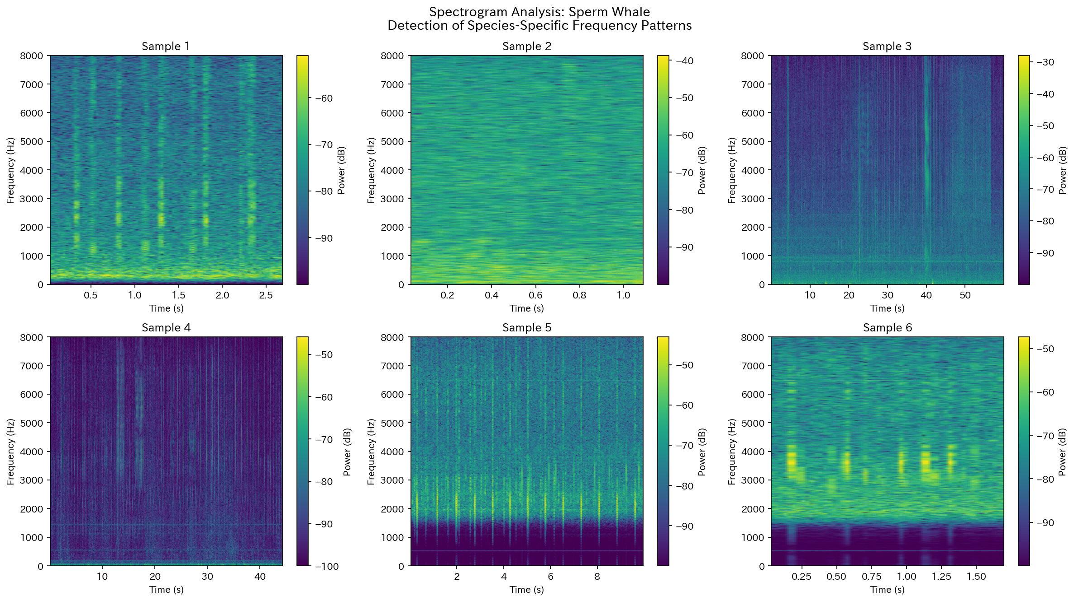
Spectrogram: Sperm Whale
Figure. Spectrogram and frequency structure of Sperm Whale

Slide 11
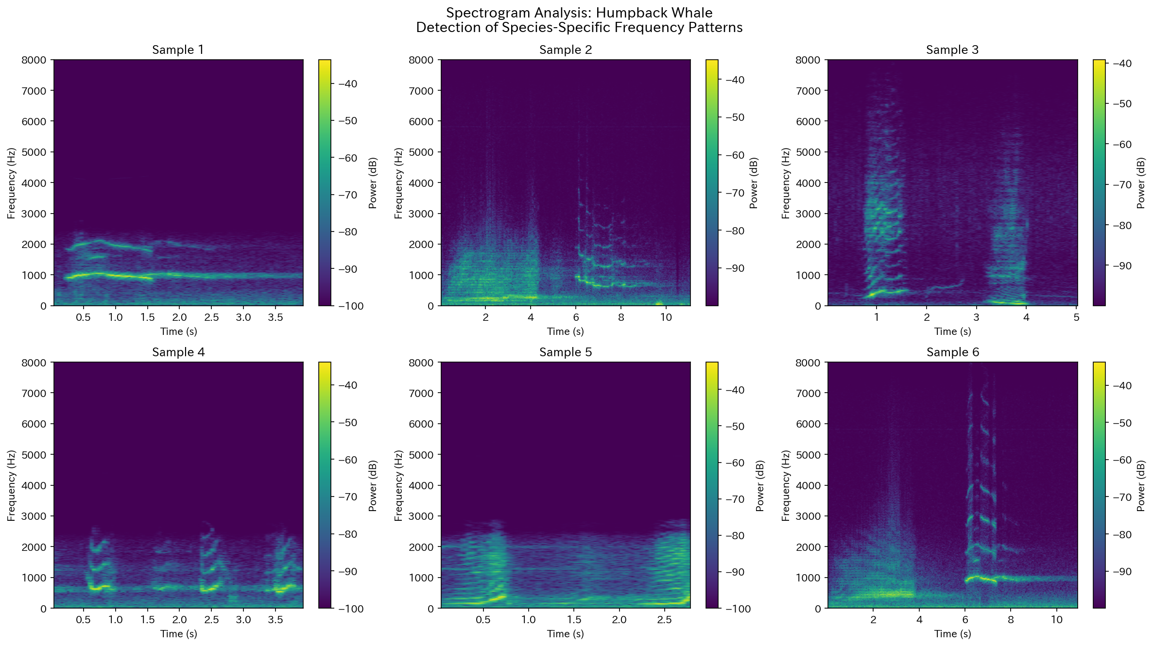
Spectrogram: Humpback Whale
Figure. Spectrogram and frequency structure of Humpback Whale

Slide 12
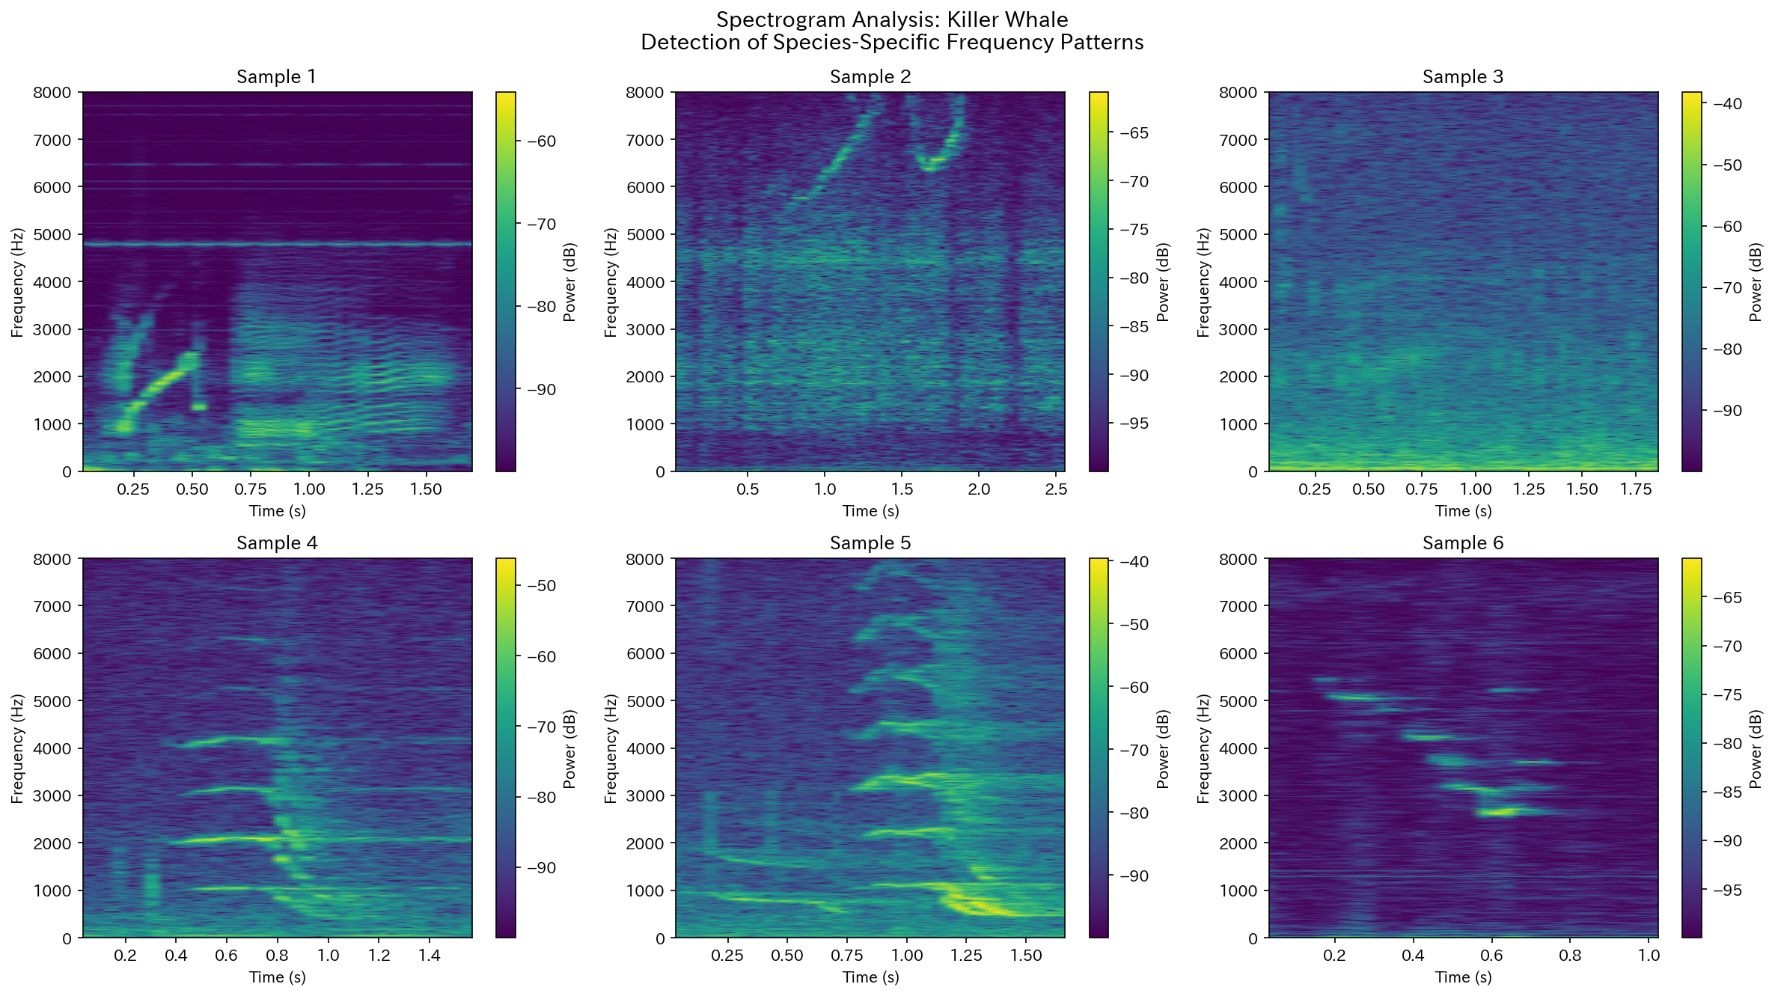
Spectrogram: Killer Whale
Figure. Spectrogram and frequency structure of Killer Whale

Slide 13
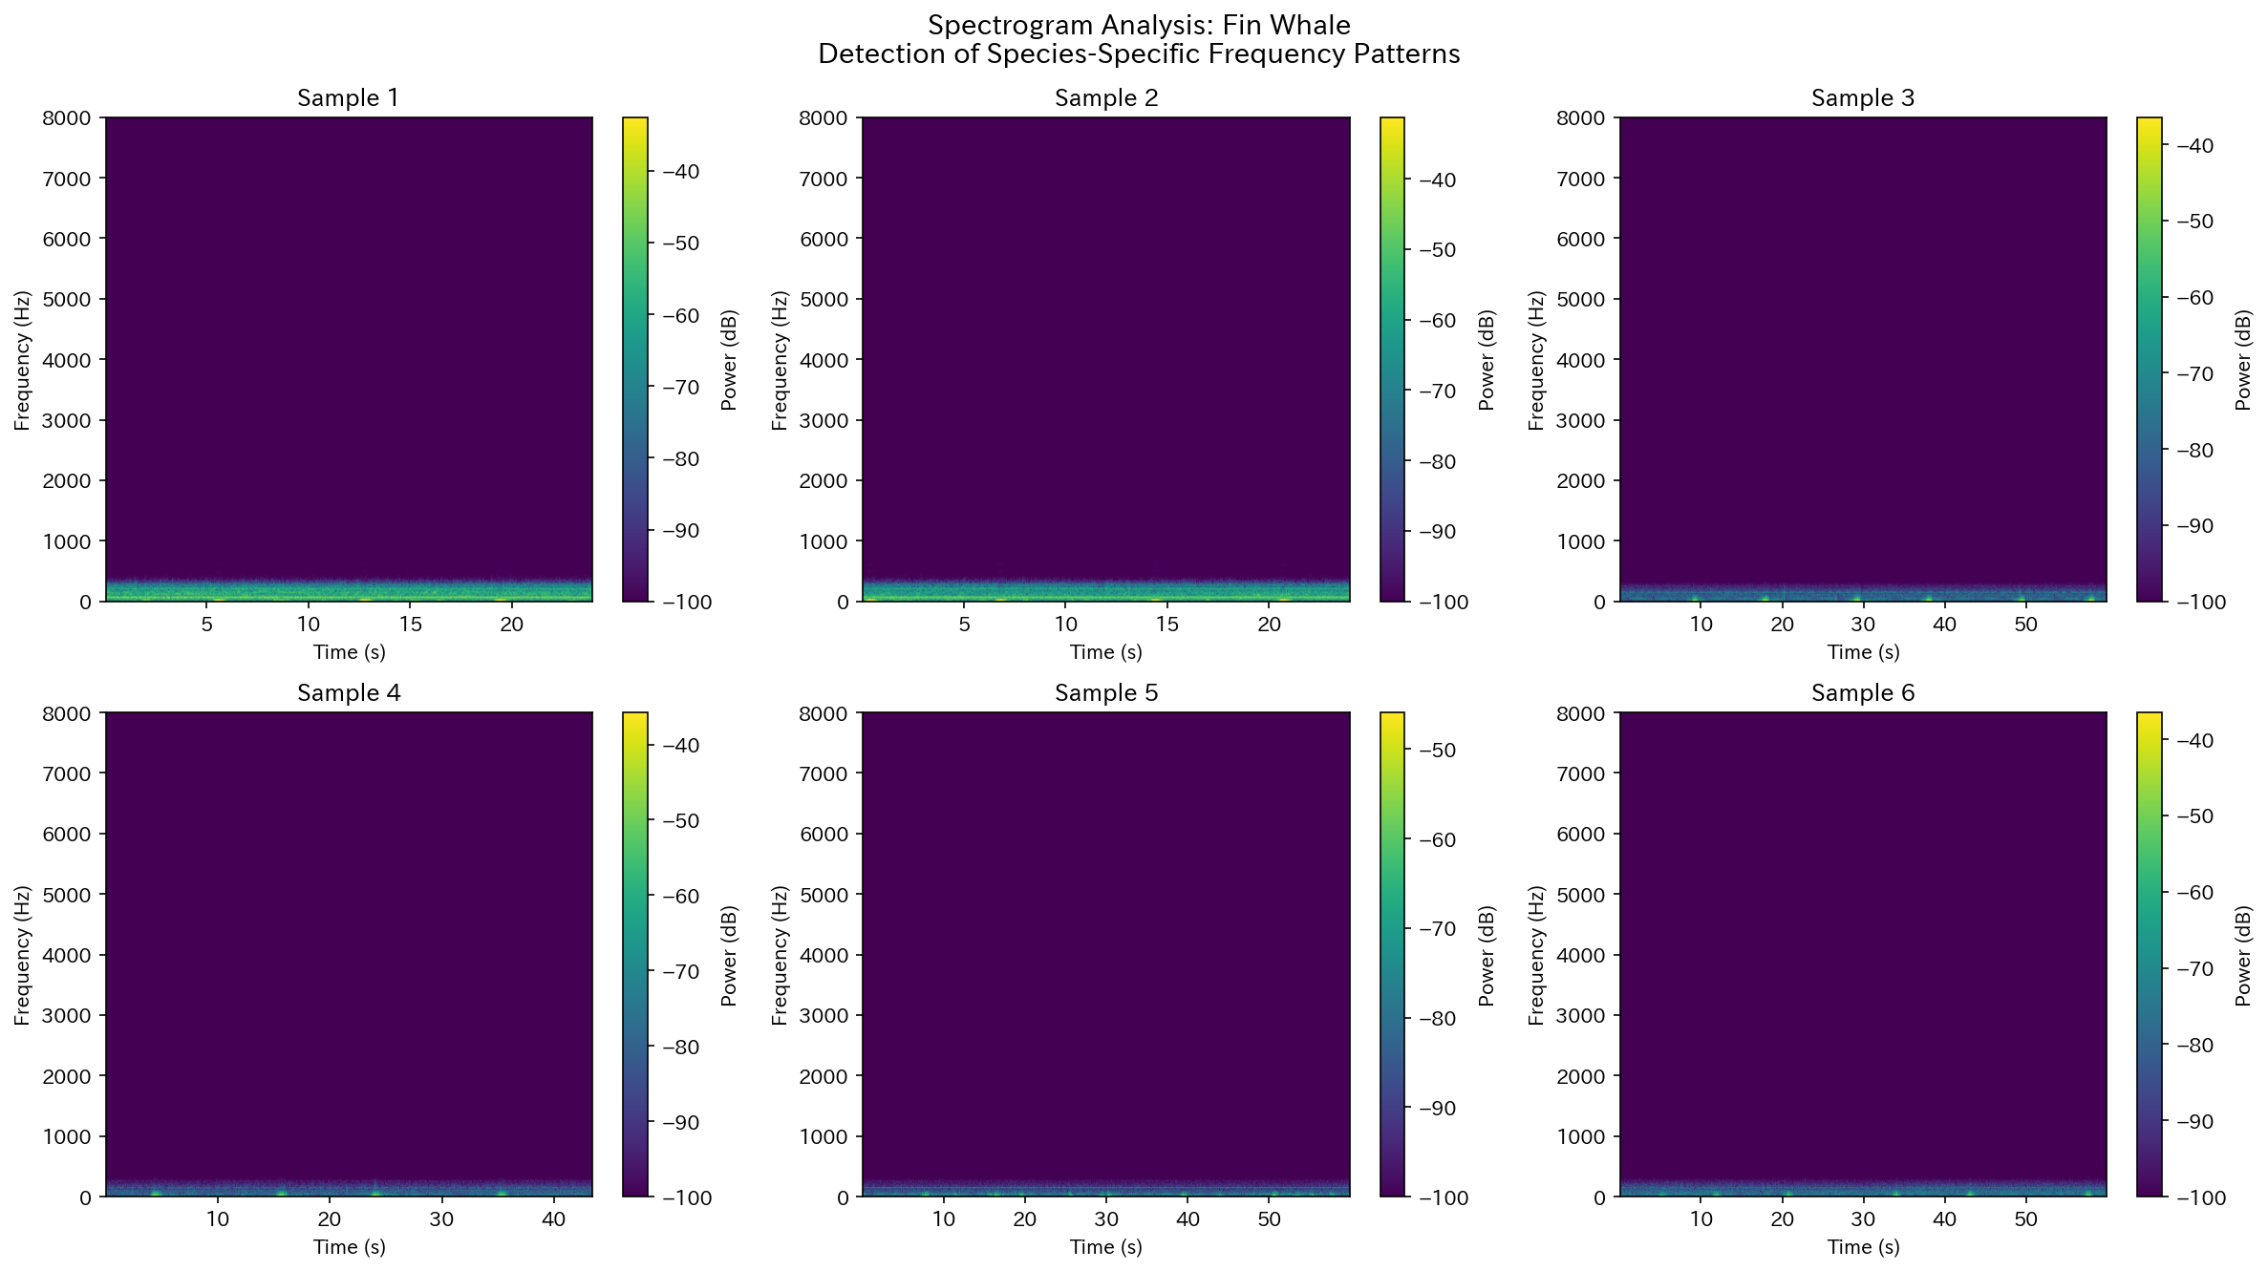
Spectrogram: Fin Whale
Figure. Spectrogram and frequency structure of Fin Whale

Slide 14
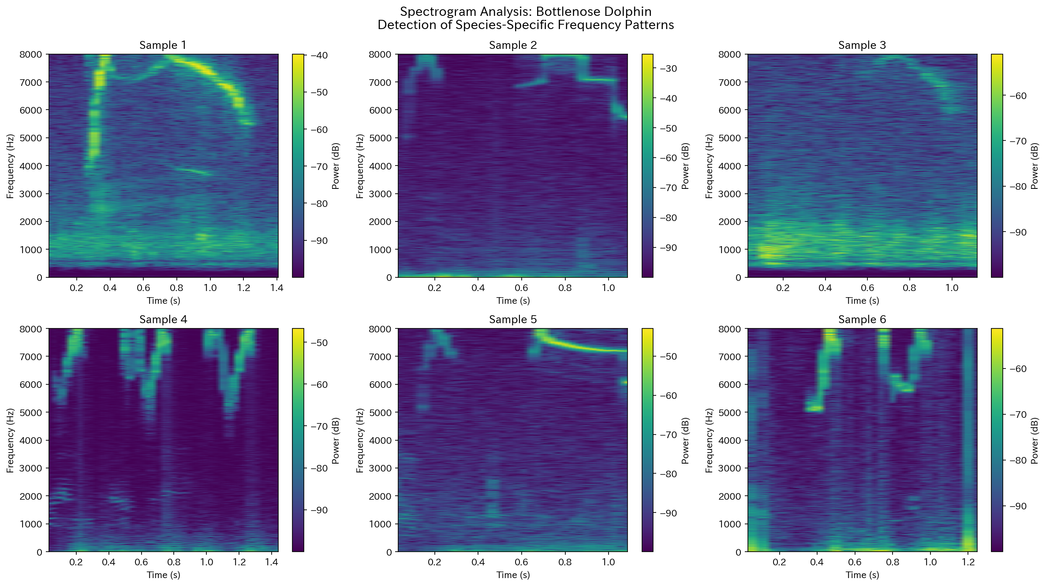
Spectrogram: Bottlenose Dolphin
Figure. Spectrogram and frequency structure of Bottlenose Dolphin

Slide 15
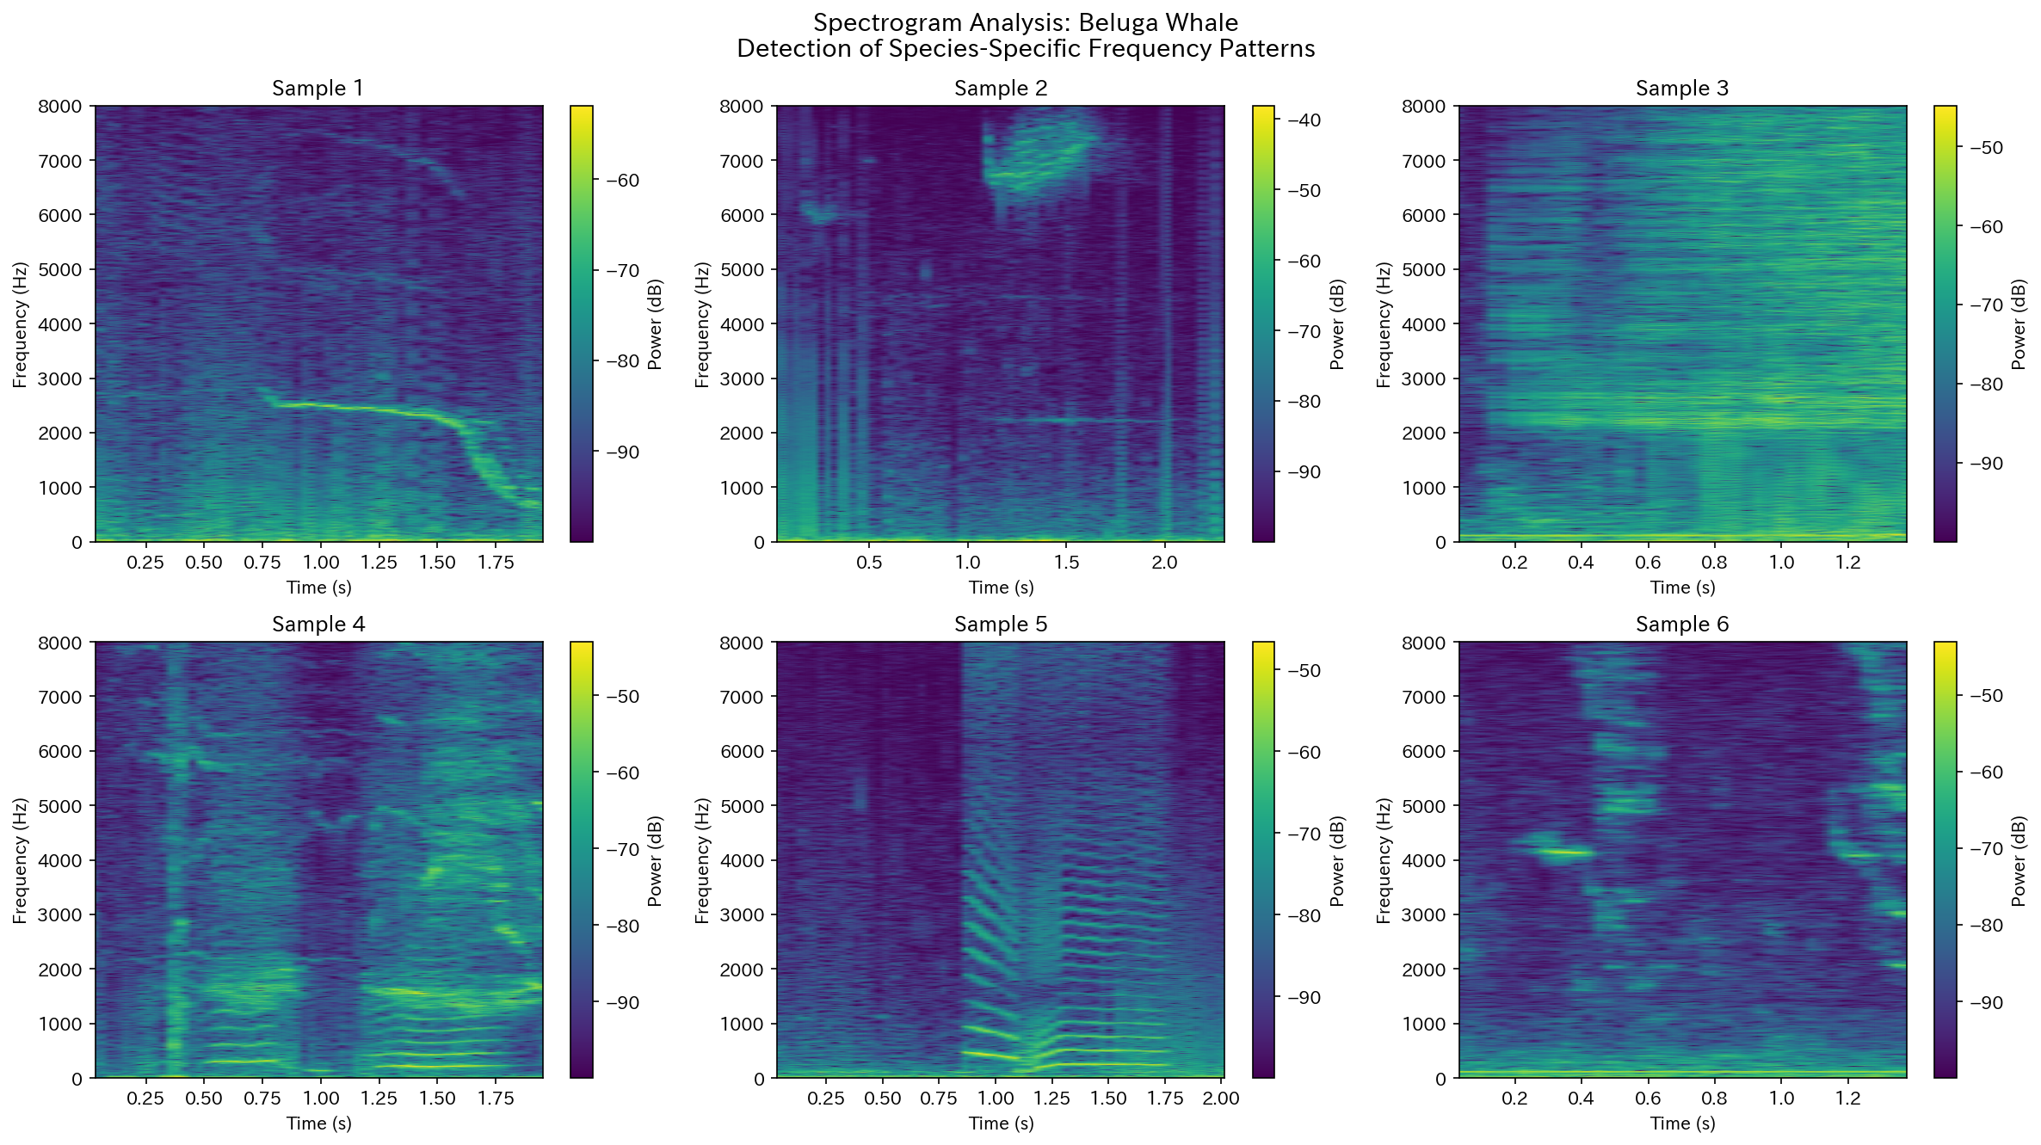
Spectrogram: Beluga Whale
Figure. Spectrogram and frequency structure of Beluga Whale

Slide 16
2. Inter-Click Interval (ICI) Results

Slide 17
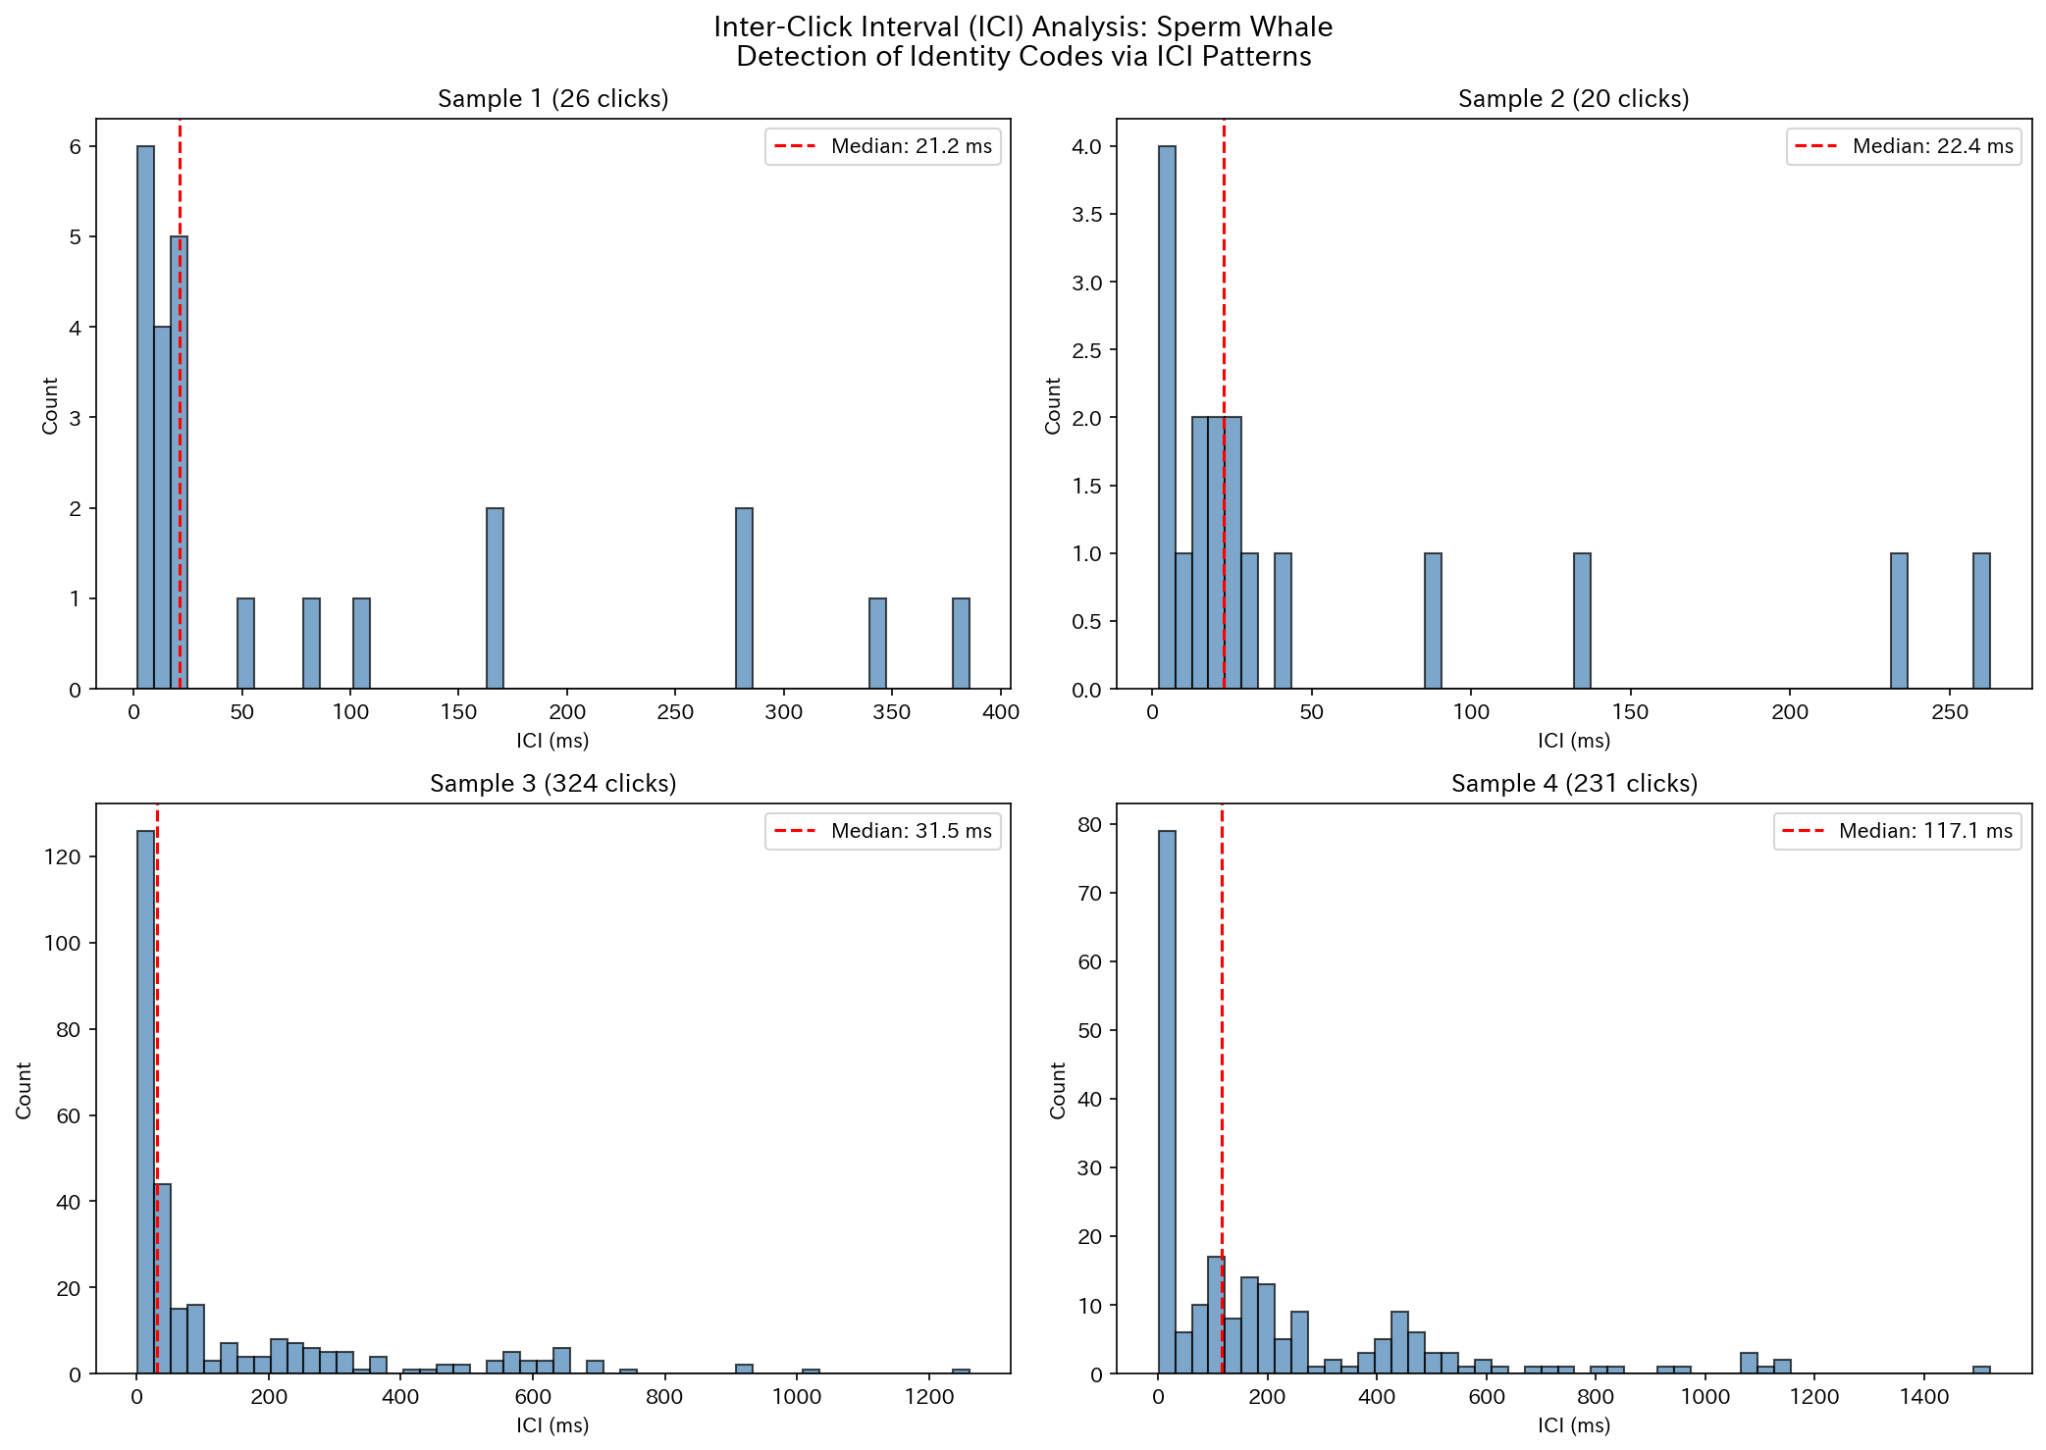
ICI Distribution: Sperm Whale
Figure. Inter-click interval distribution of Sperm Whale

Slide 18
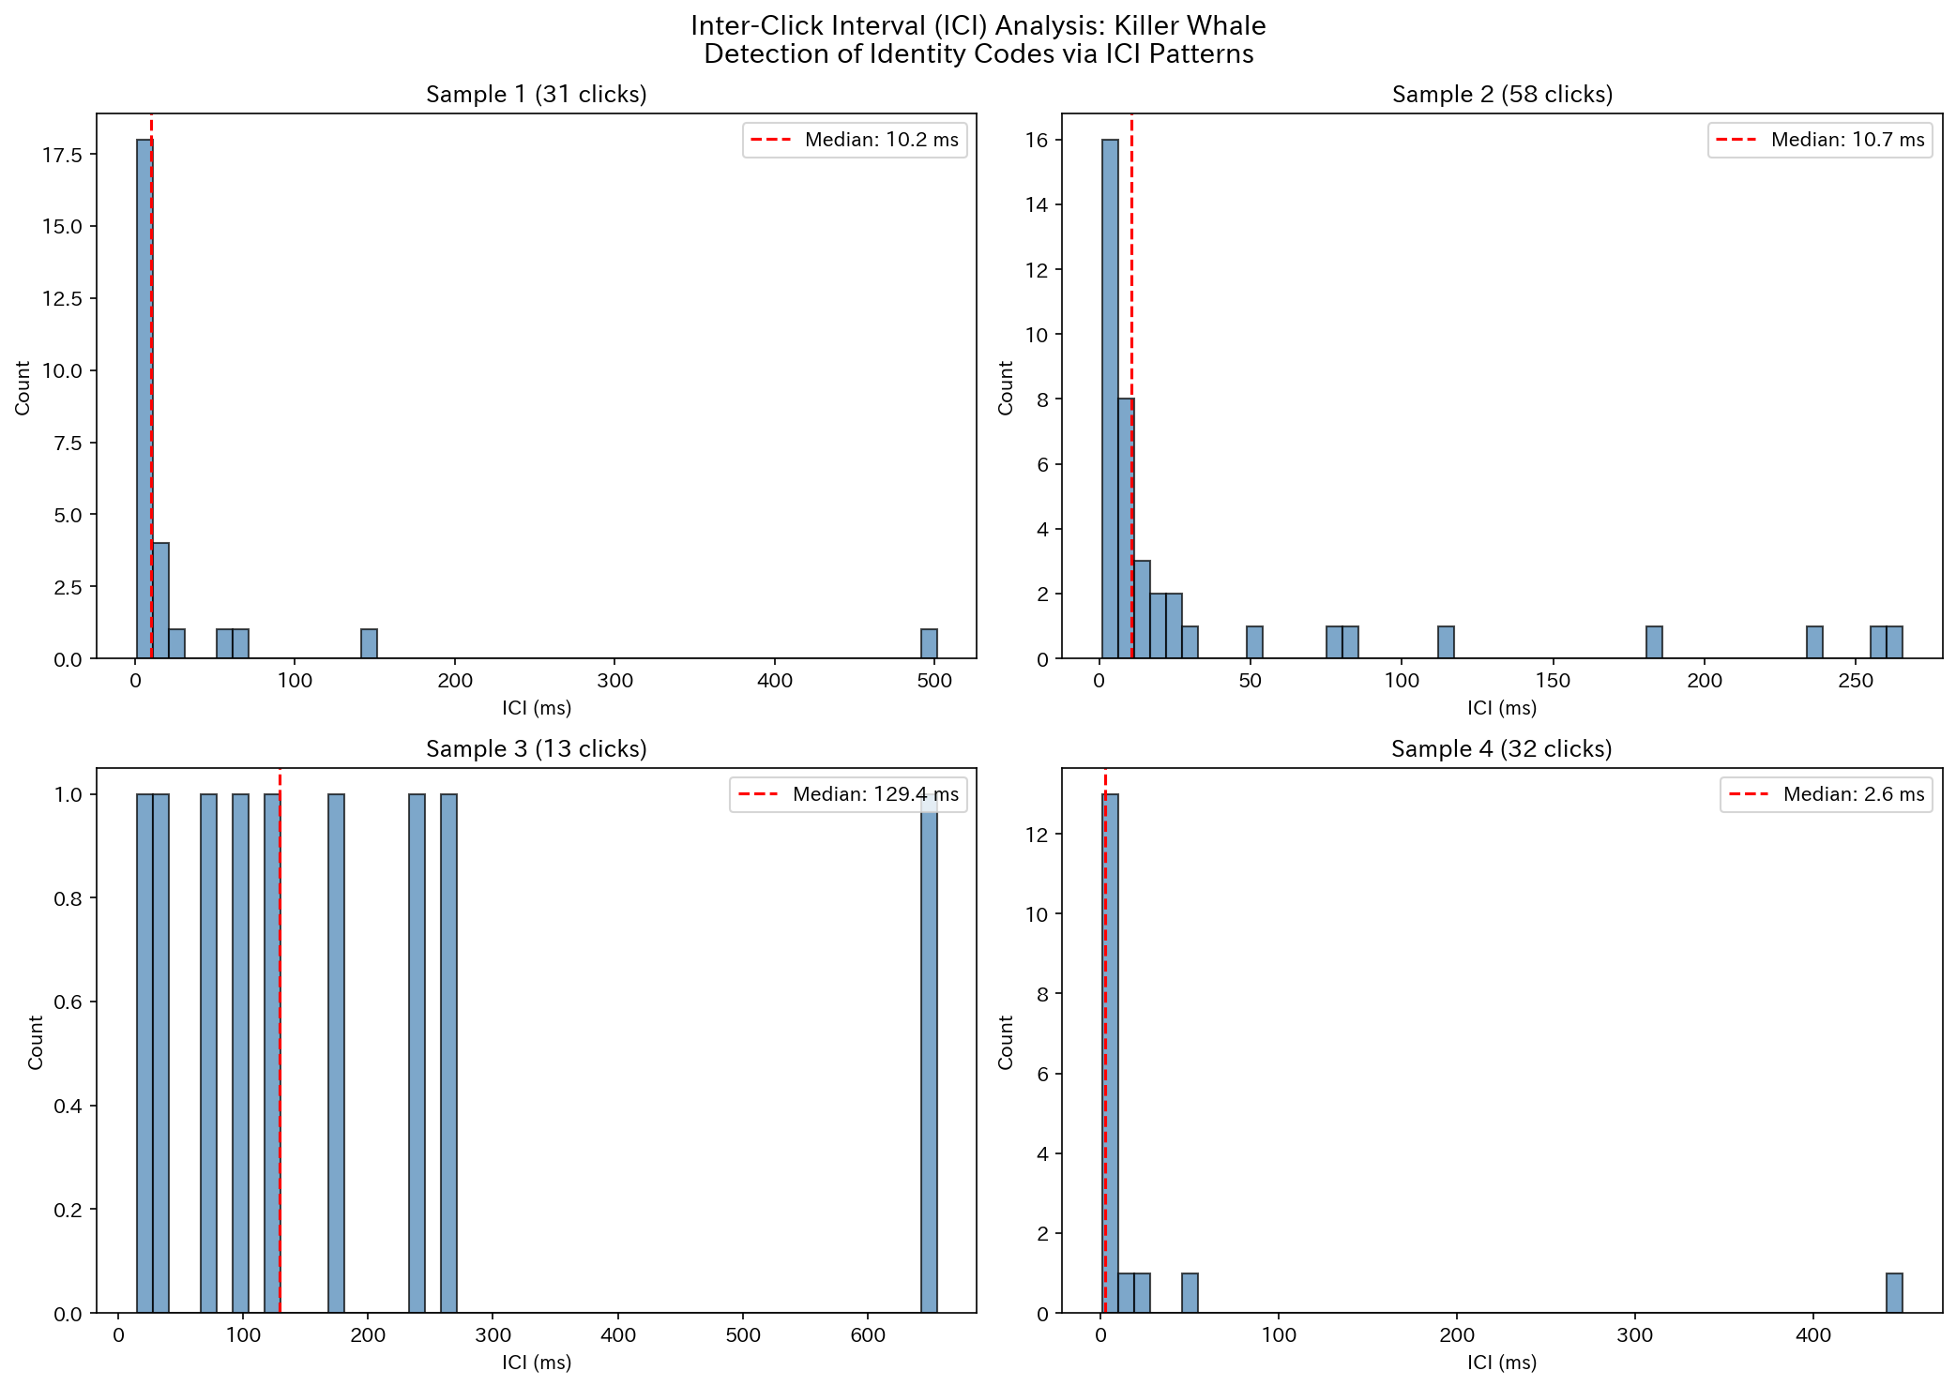
ICI Distribution: Killer Whale
Figure. Inter-click interval distribution of Killer Whale

Slide 19
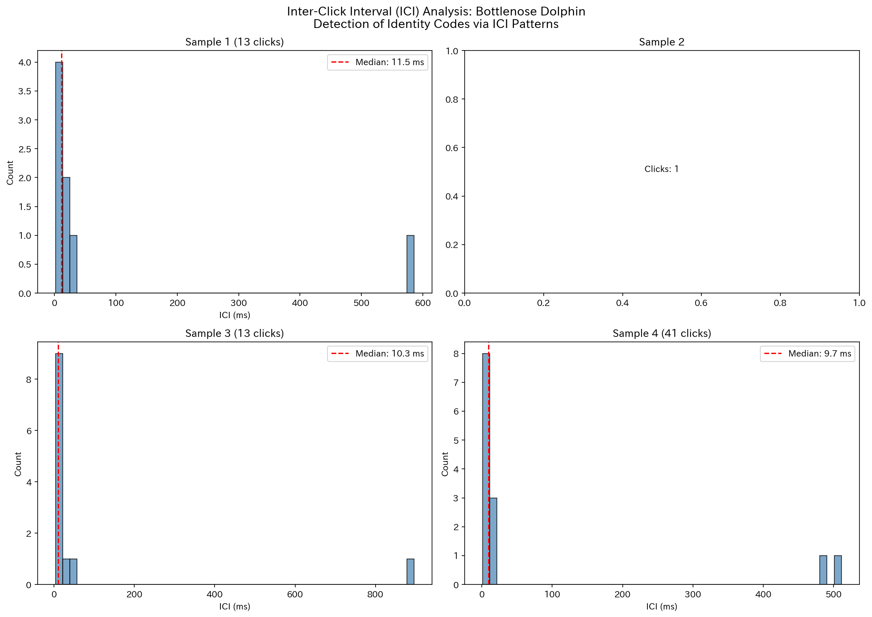
ICI Distribution: Bottlenose Dolphin
Figure. Inter-click interval distribution of Bottlenose Dolphin

Slide 20
3. Bispectral Analysis Results

Slide 21
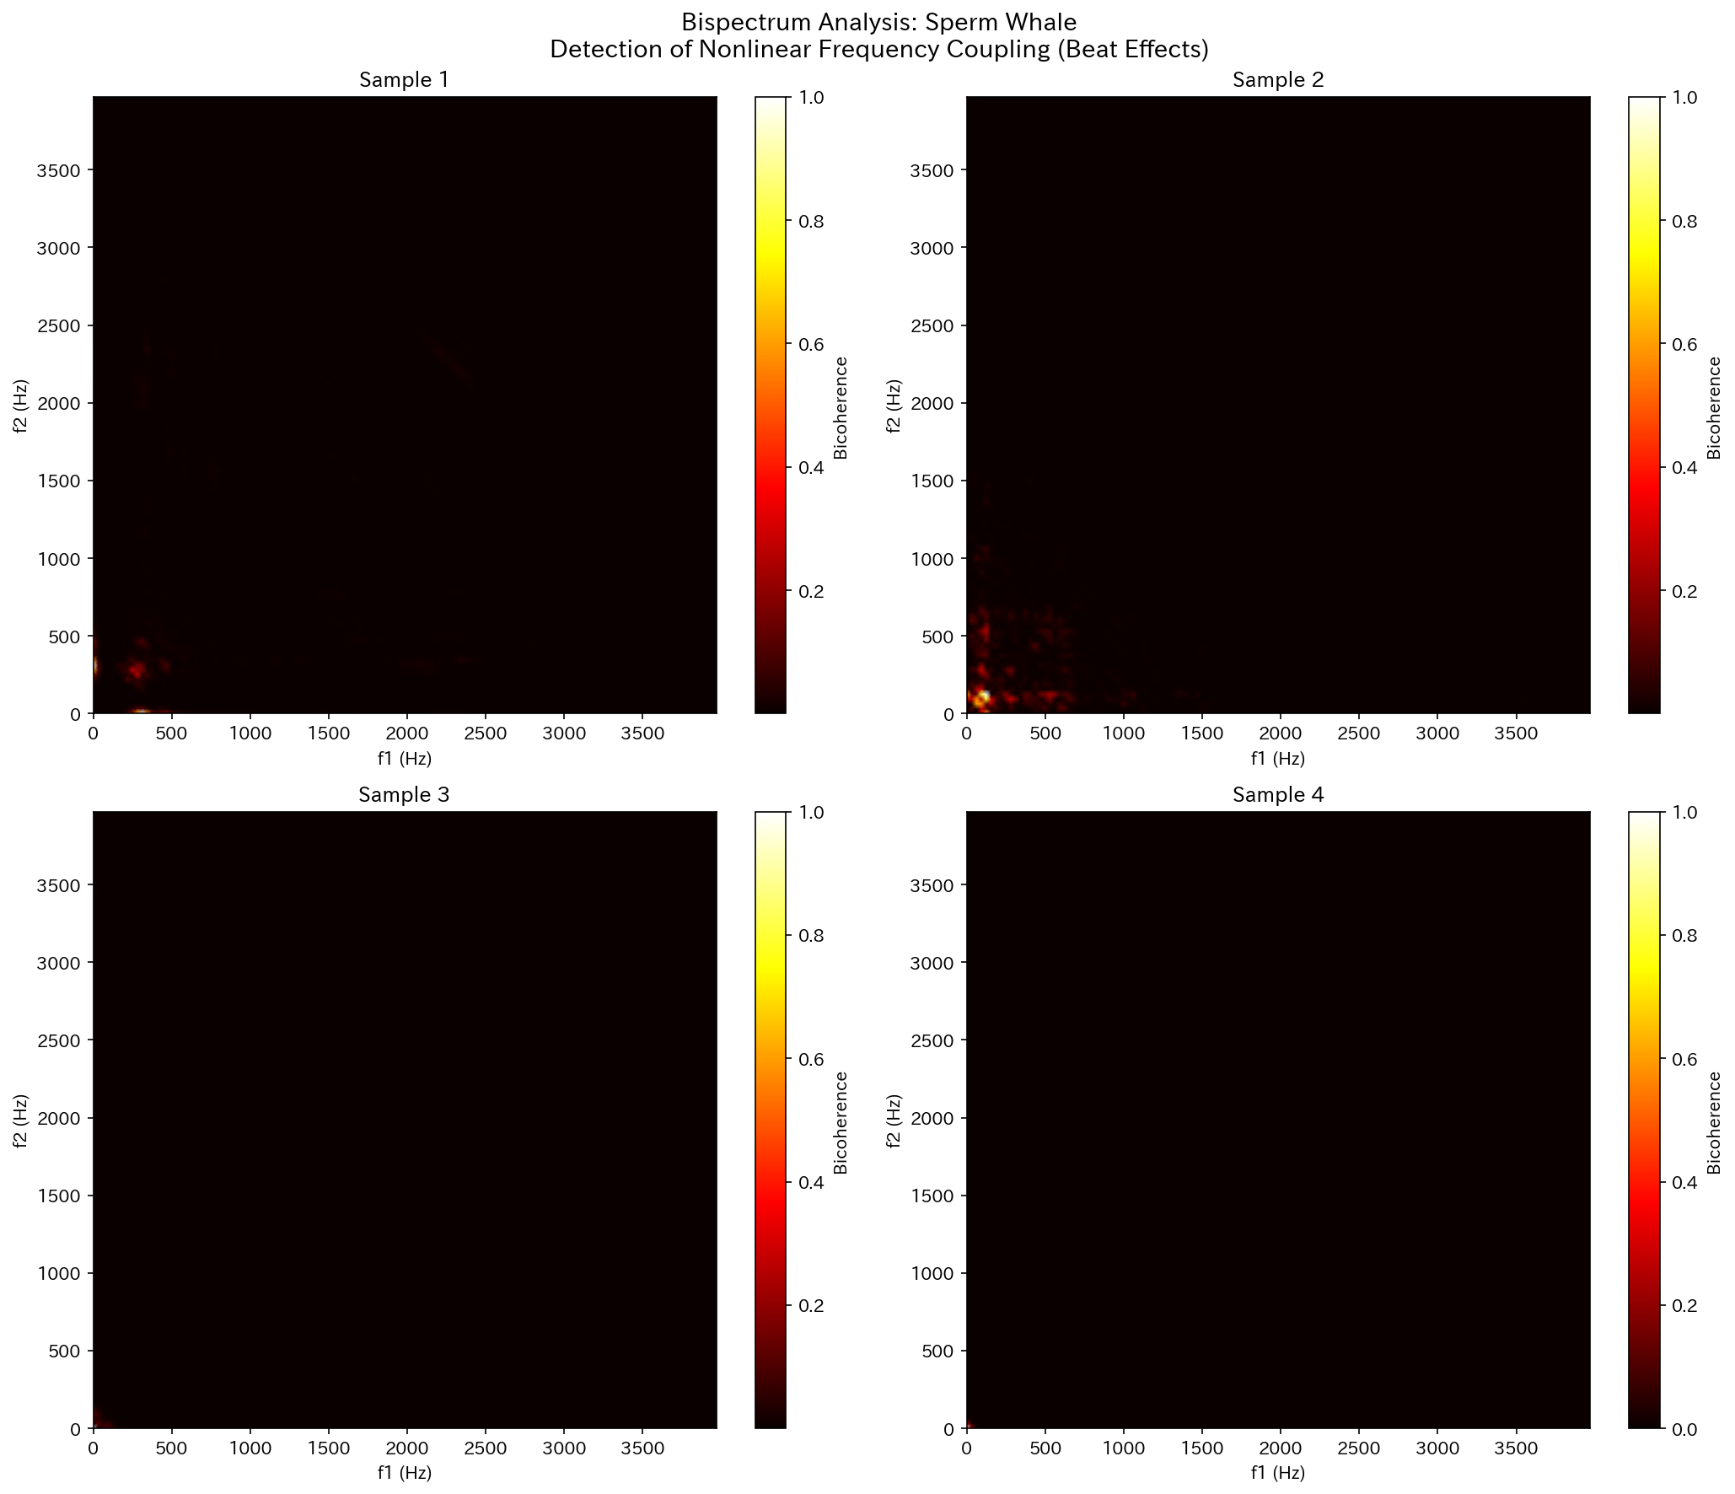
Bispectrum: Sperm Whale
Figure. Bicoherence map (nonlinear coupling) of Sperm Whale

Slide 22
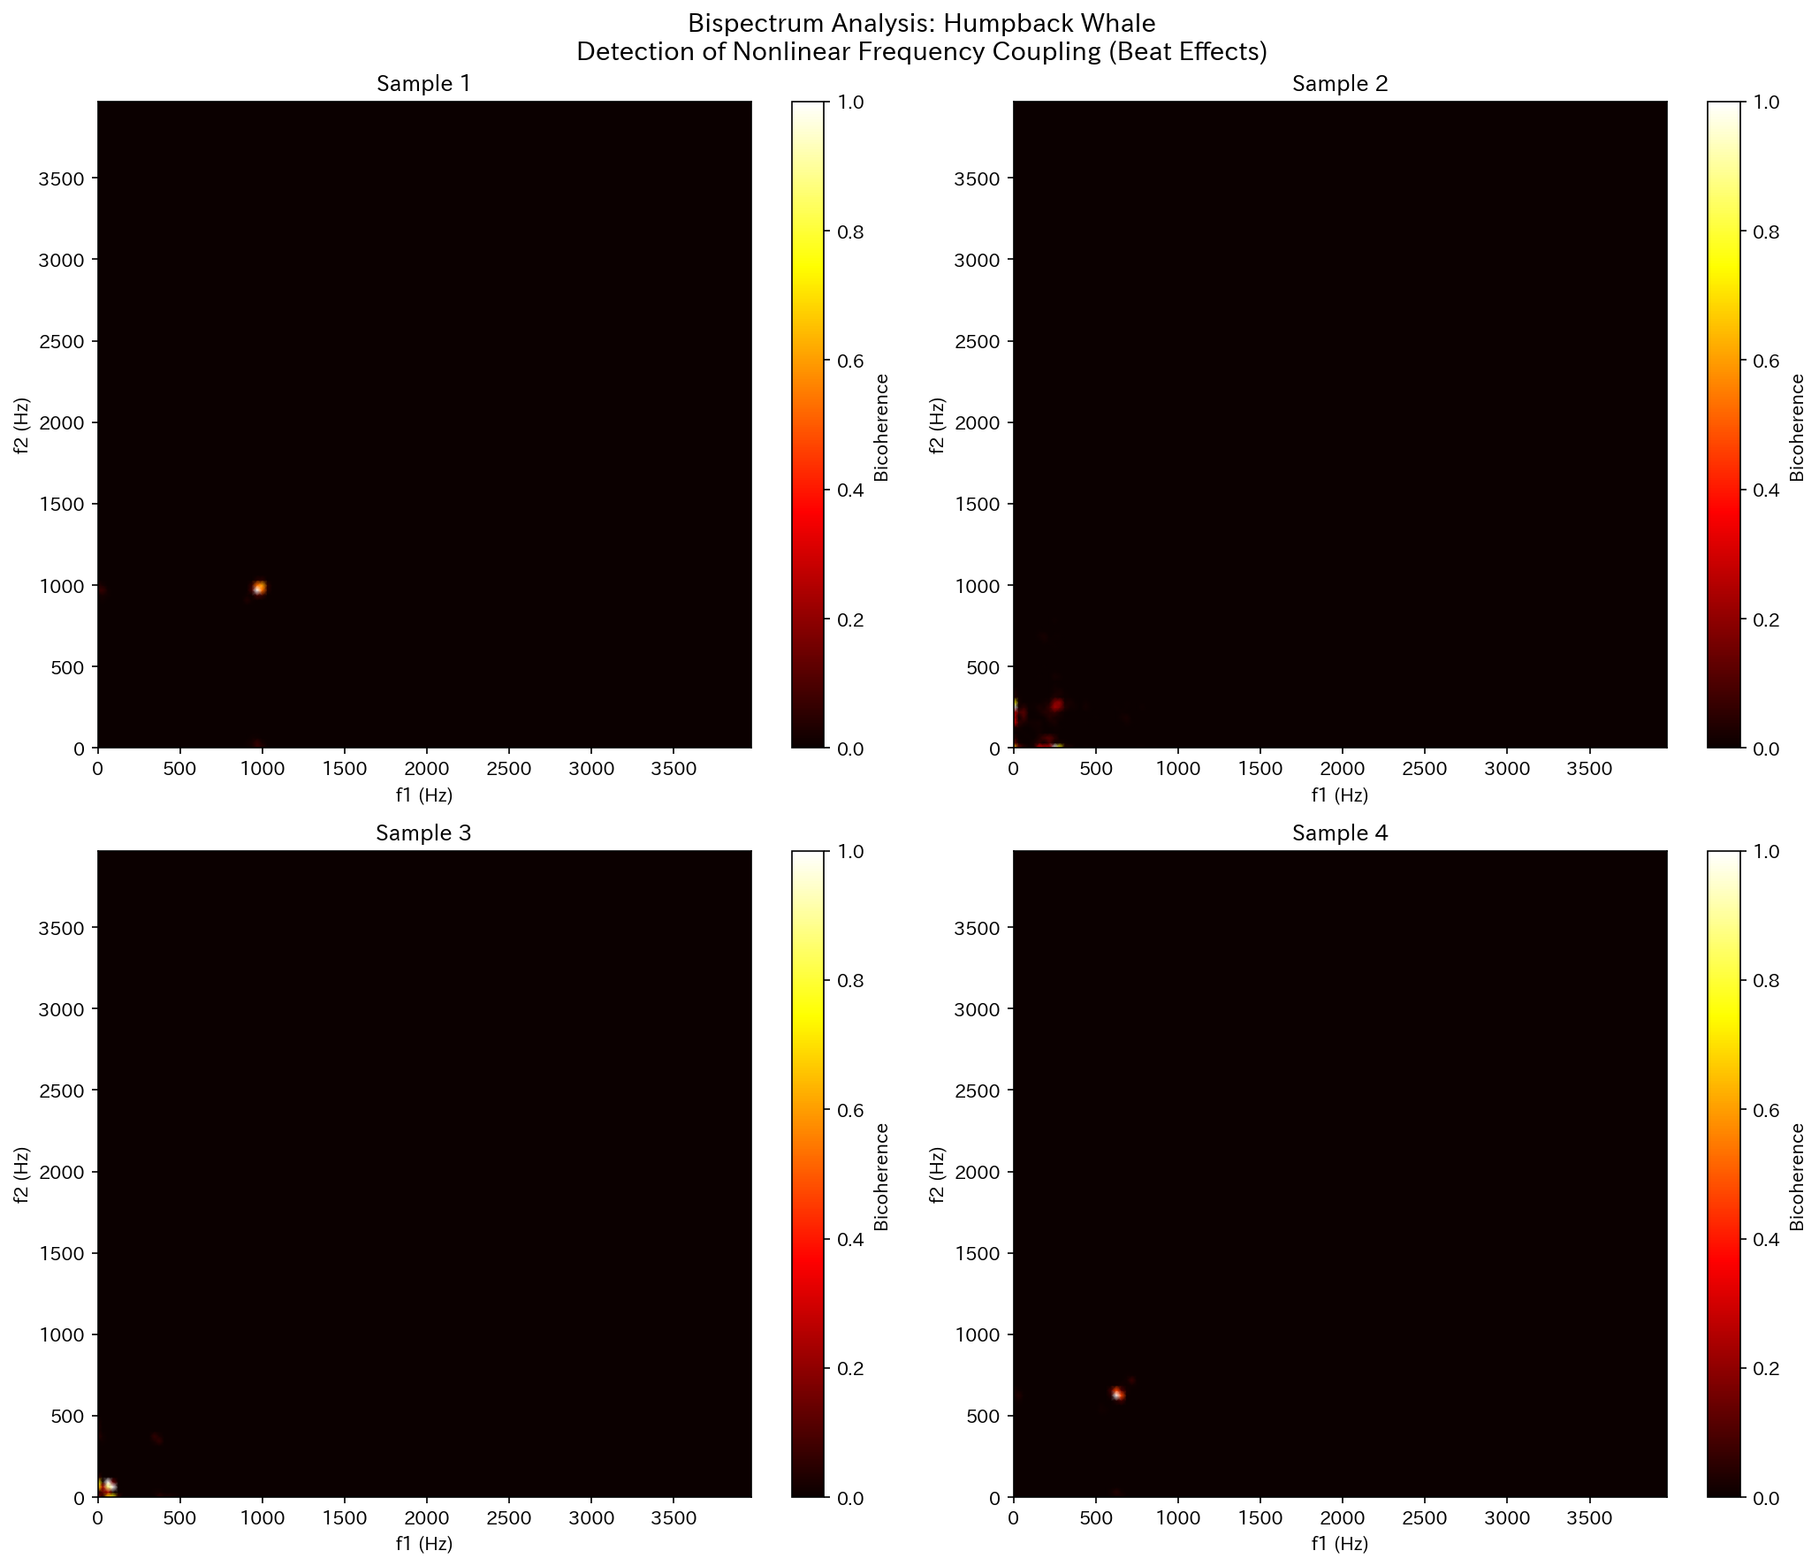
Bispectrum: Humpback Whale
Figure. Bicoherence map (nonlinear coupling) of Humpback Whale

Slide 23

Bispectrum: Killer Whale
Figure. Bicoherence map (nonlinear coupling) of Killer Whale

Slide 24

Bispectrum: Fin Whale
Figure. Bicoherence map (nonlinear coupling) of Fin Whale

Slide 25
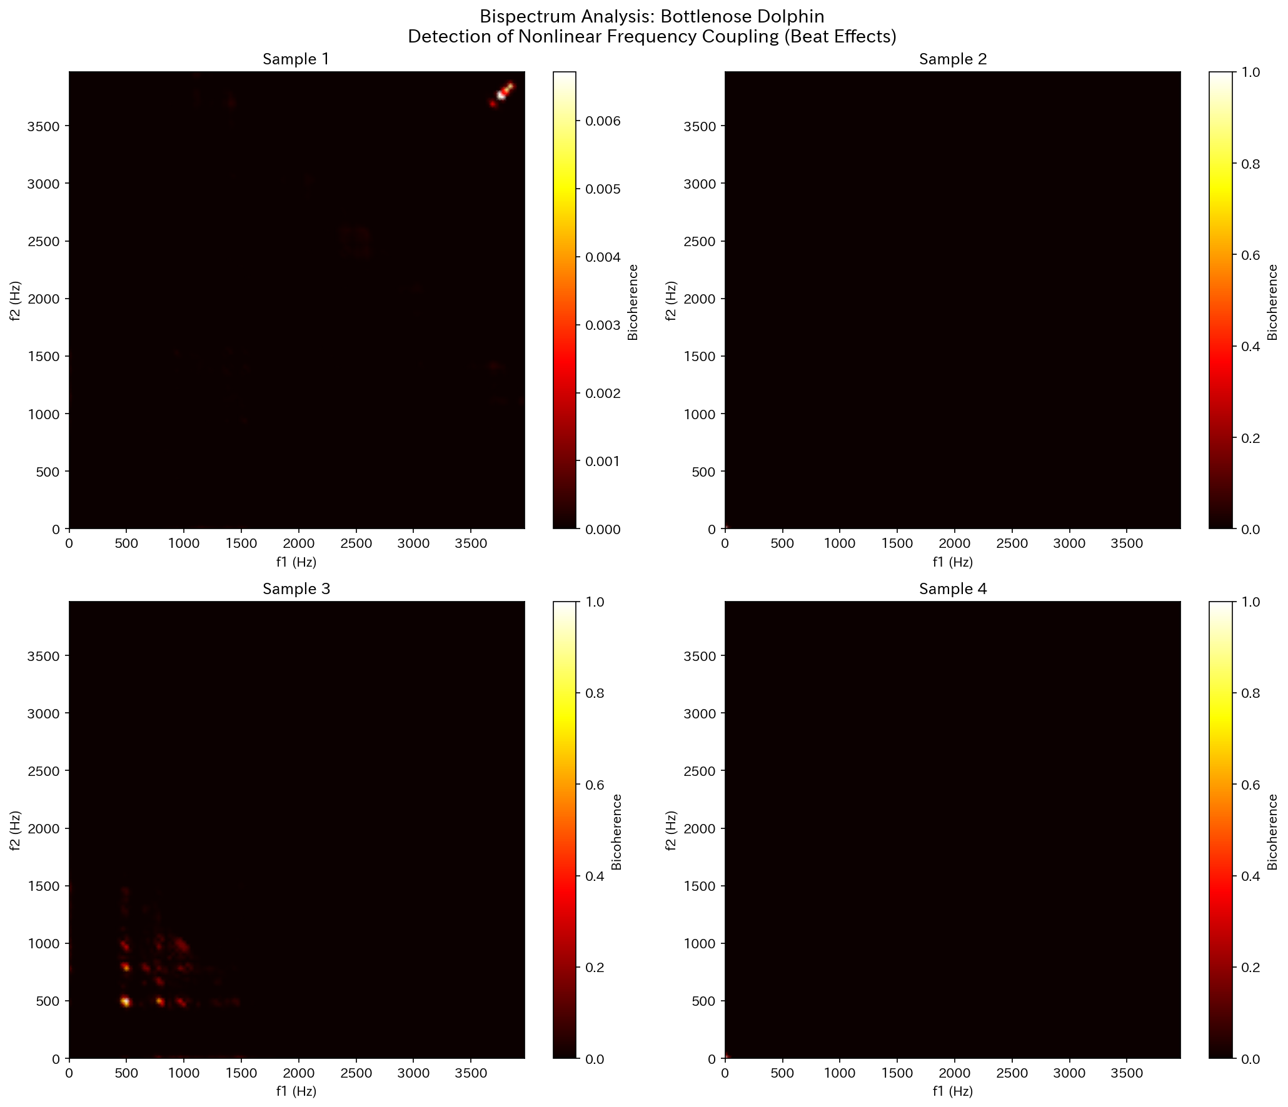
Bispectrum: Bottlenose Dolphin
Figure. Bicoherence map (nonlinear coupling) of Bottlenose Dolphin

Slide 26

Bispectrum: Beluga Whale
Figure. Bicoherence map (nonlinear coupling) of Beluga Whale

Slide 27
4. Information Entropy Results

Slide 28
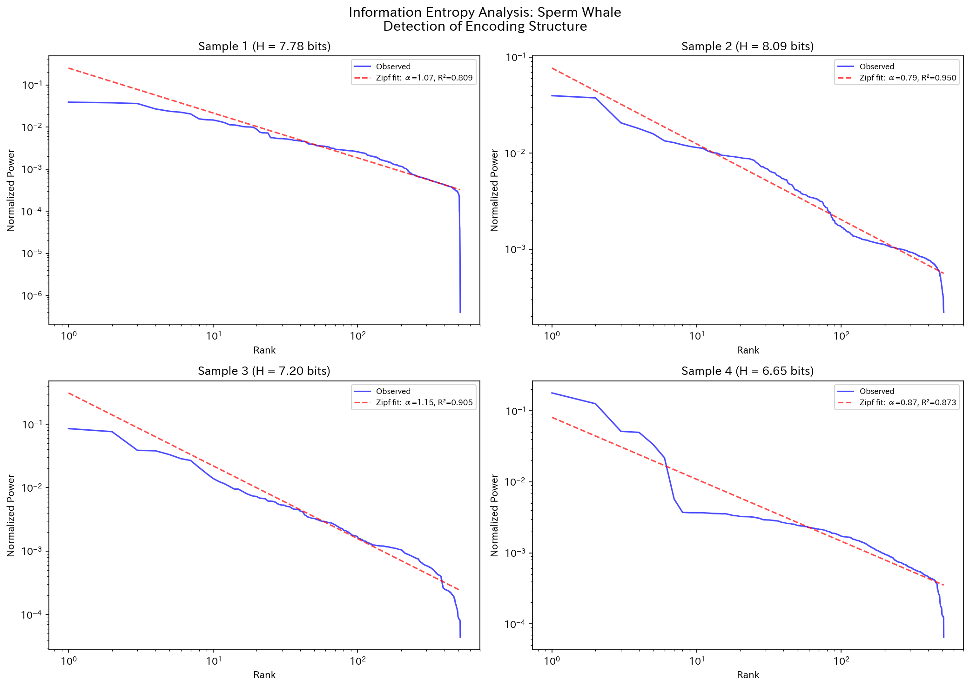
Entropy & Zipf Distribution: Sperm Whale
Figure. Information entropy and Zipf's law fit of Sperm Whale

Slide 29
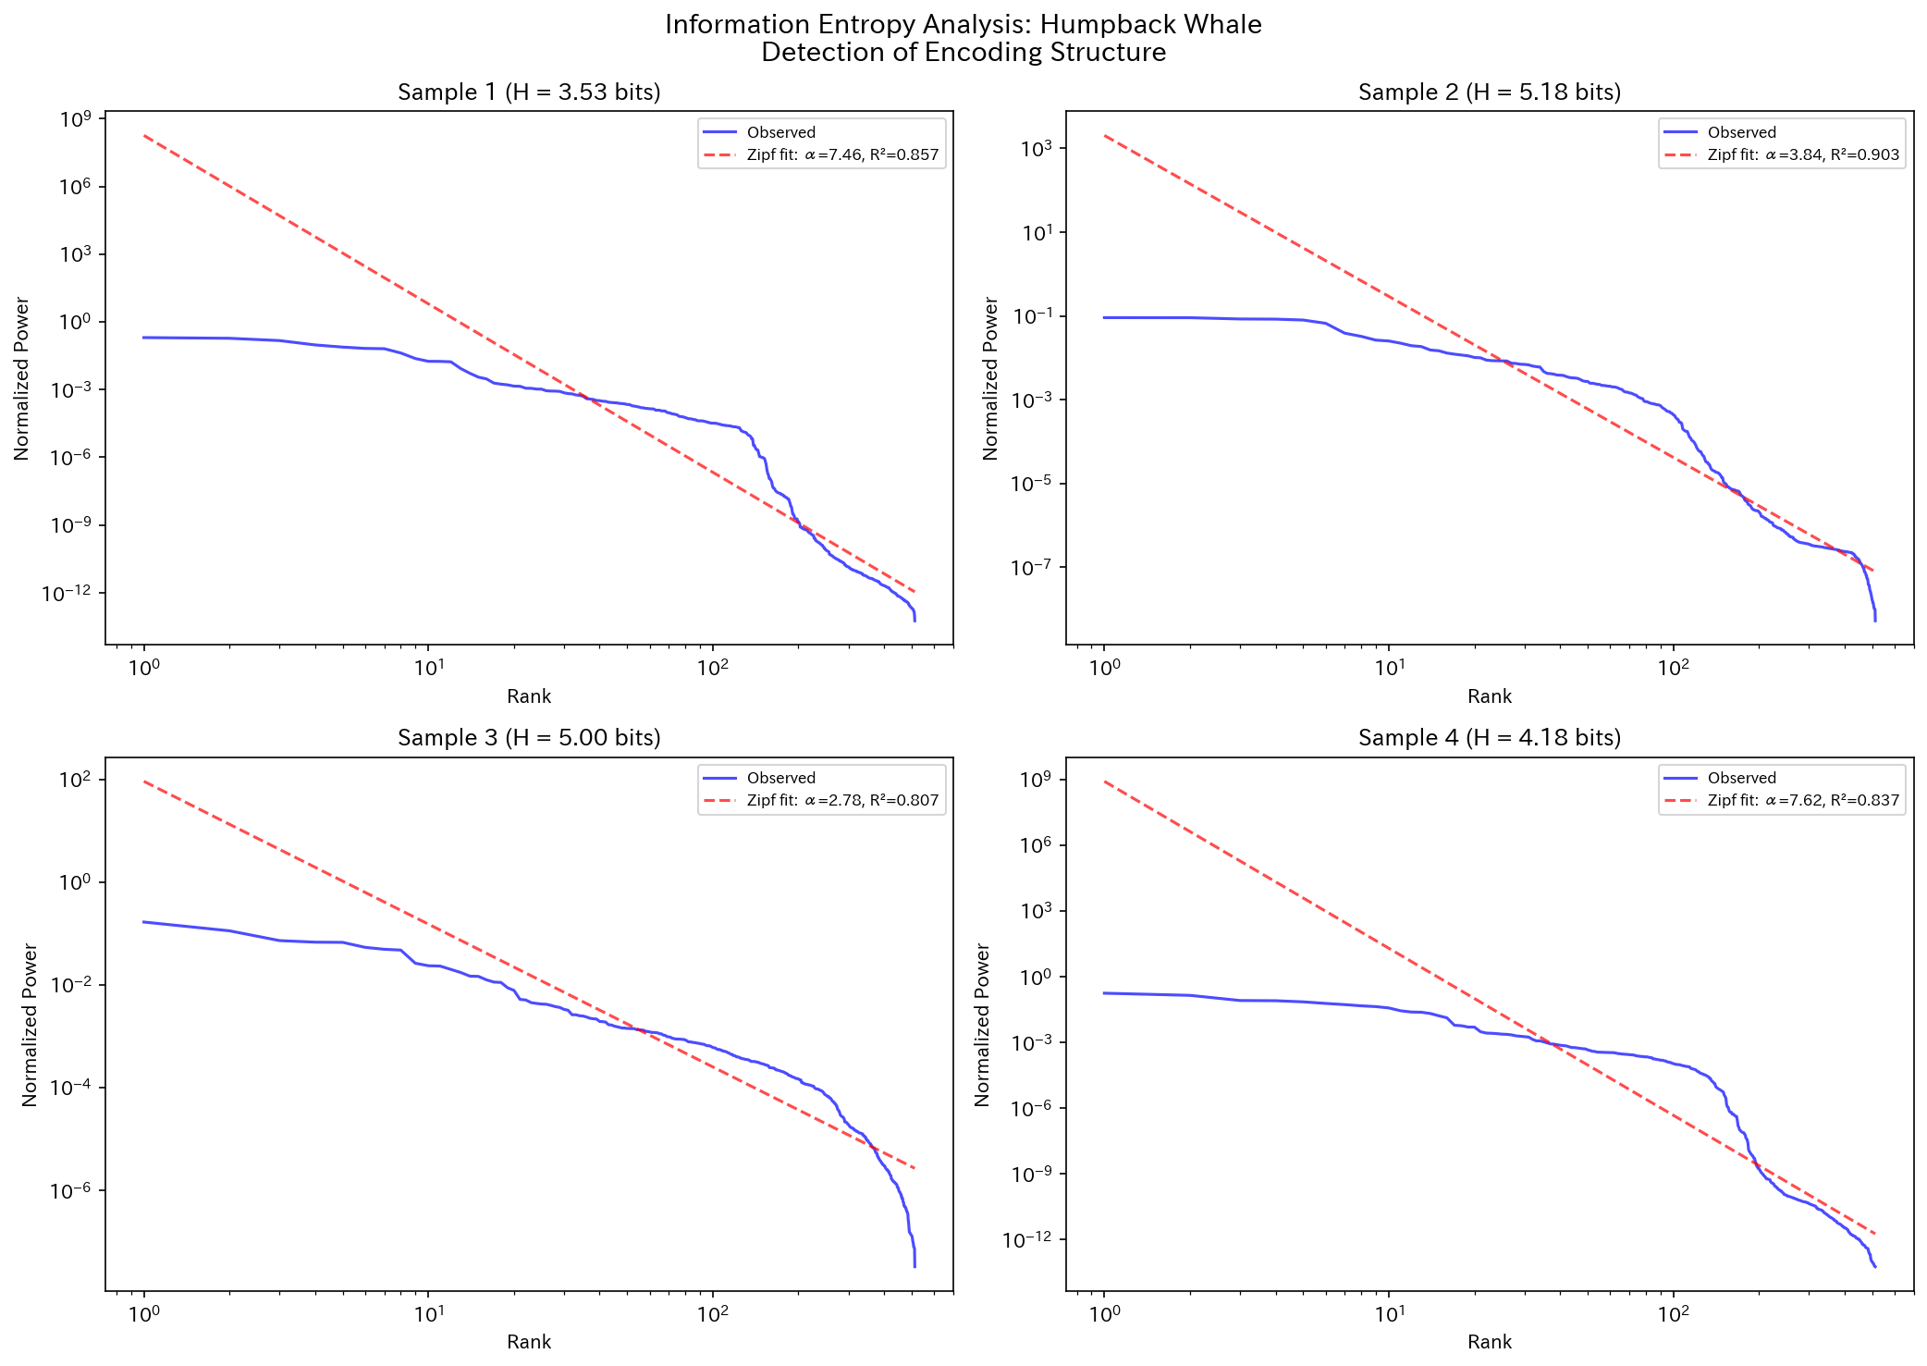
Entropy & Zipf Distribution: Humpback Whale
Figure. Information entropy and Zipf's law fit of Humpback Whale

Slide 30
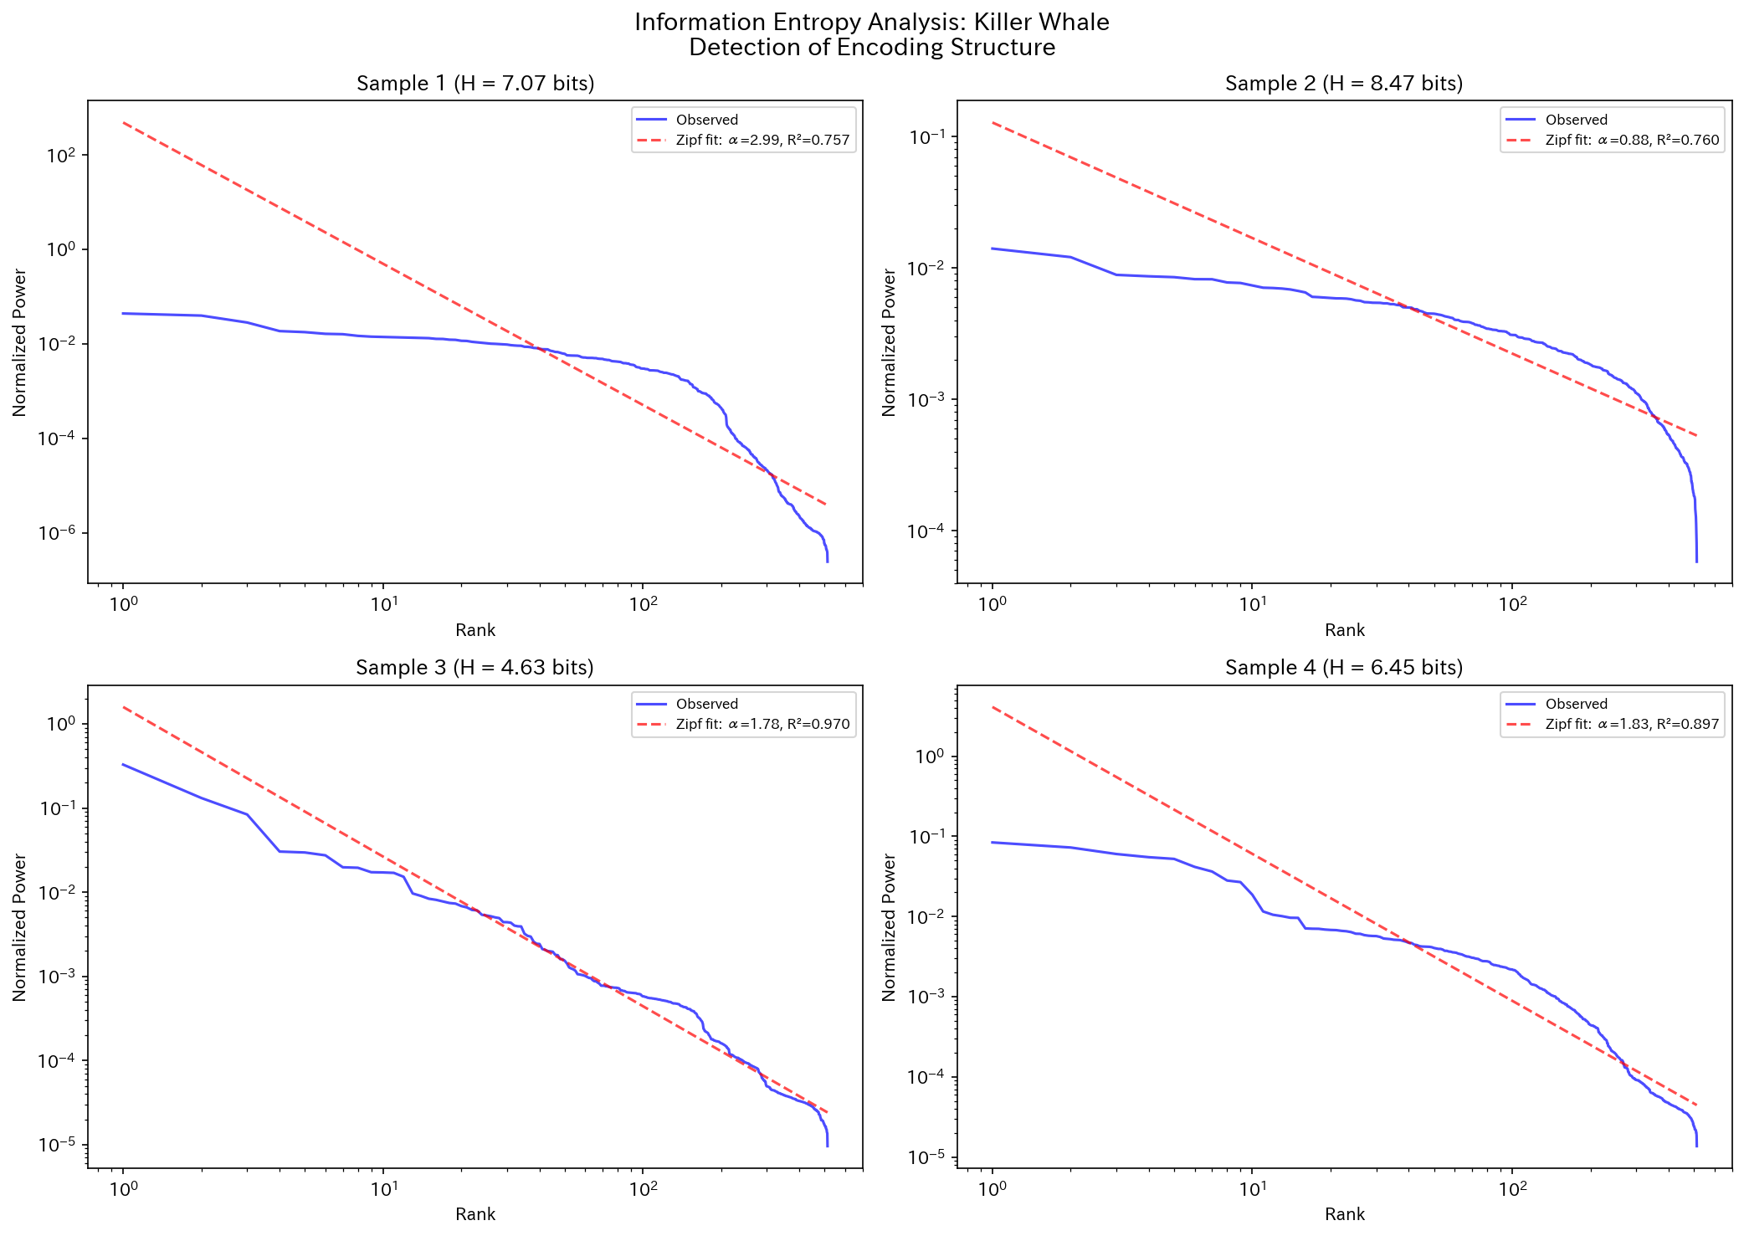
Entropy & Zipf Distribution: Killer Whale
Figure. Information entropy and Zipf's law fit of Killer Whale

Slide 31
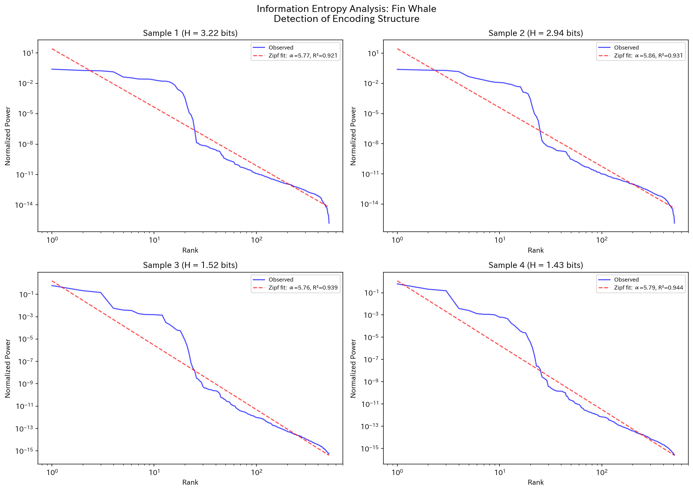
Entropy & Zipf Distribution: Fin Whale
Figure. Information entropy and Zipf's law fit of Fin Whale

Slide 32
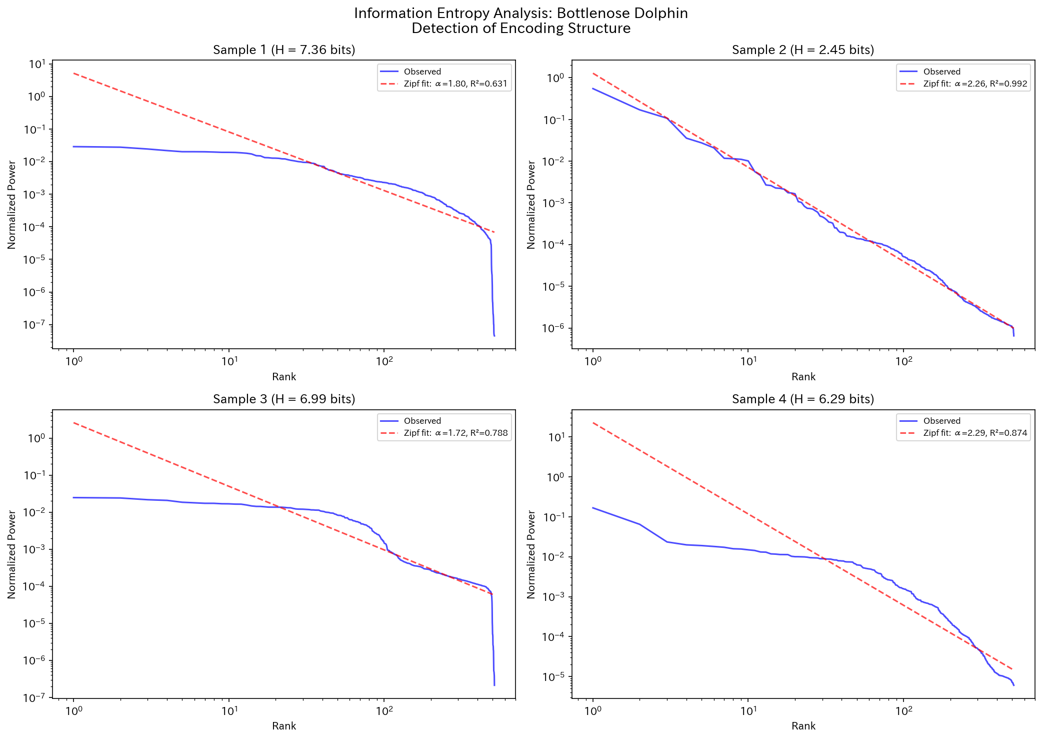
Entropy & Zipf Distribution: Bottlenose Dolphin
Figure. Information entropy and Zipf's law fit of Bottlenose Dolphin

Slide 33
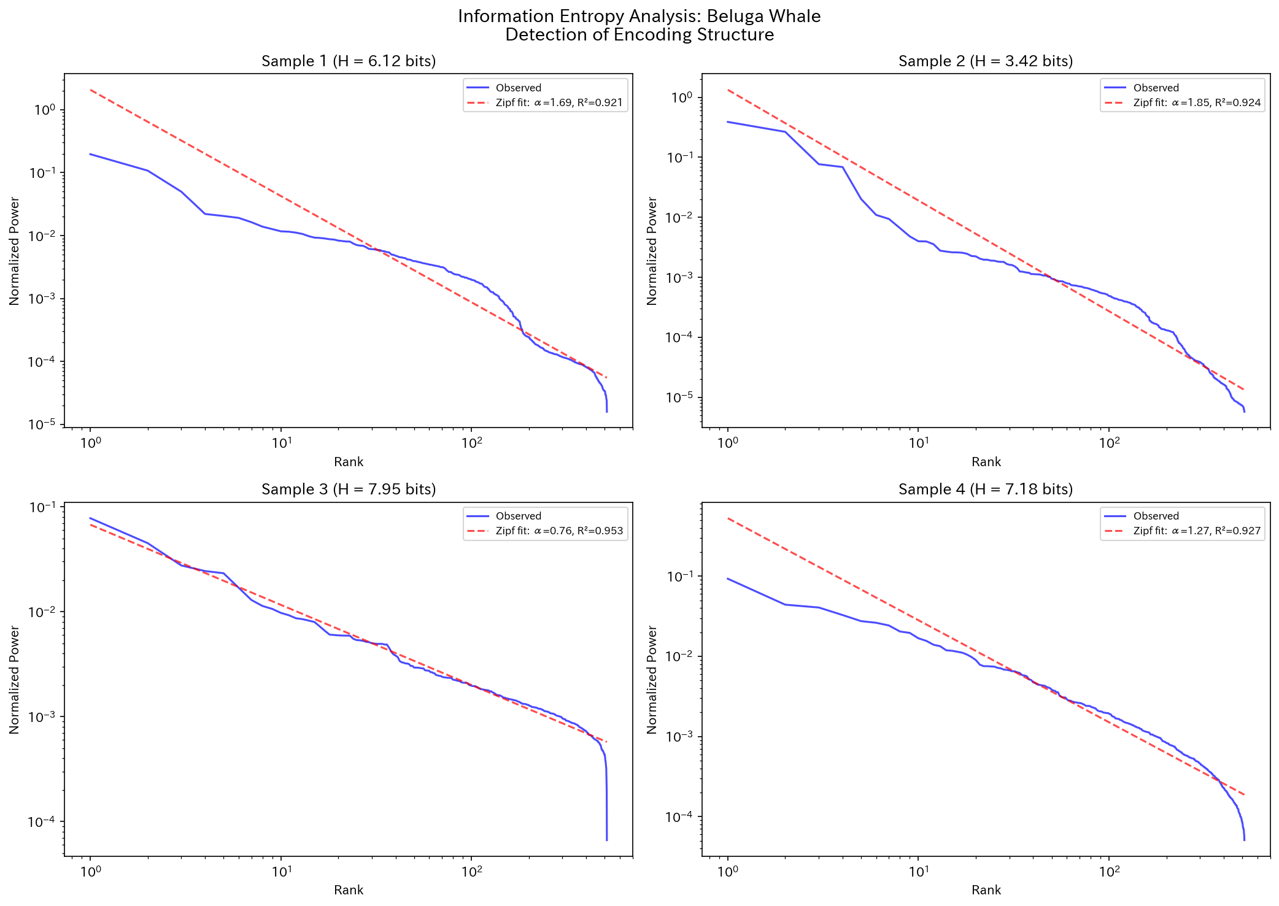
Entropy & Zipf Distribution: Beluga Whale
Figure. Information entropy and Zipf's law fit of Beluga Whale

Slide 34
5. Temporal Structure Results

Slide 35
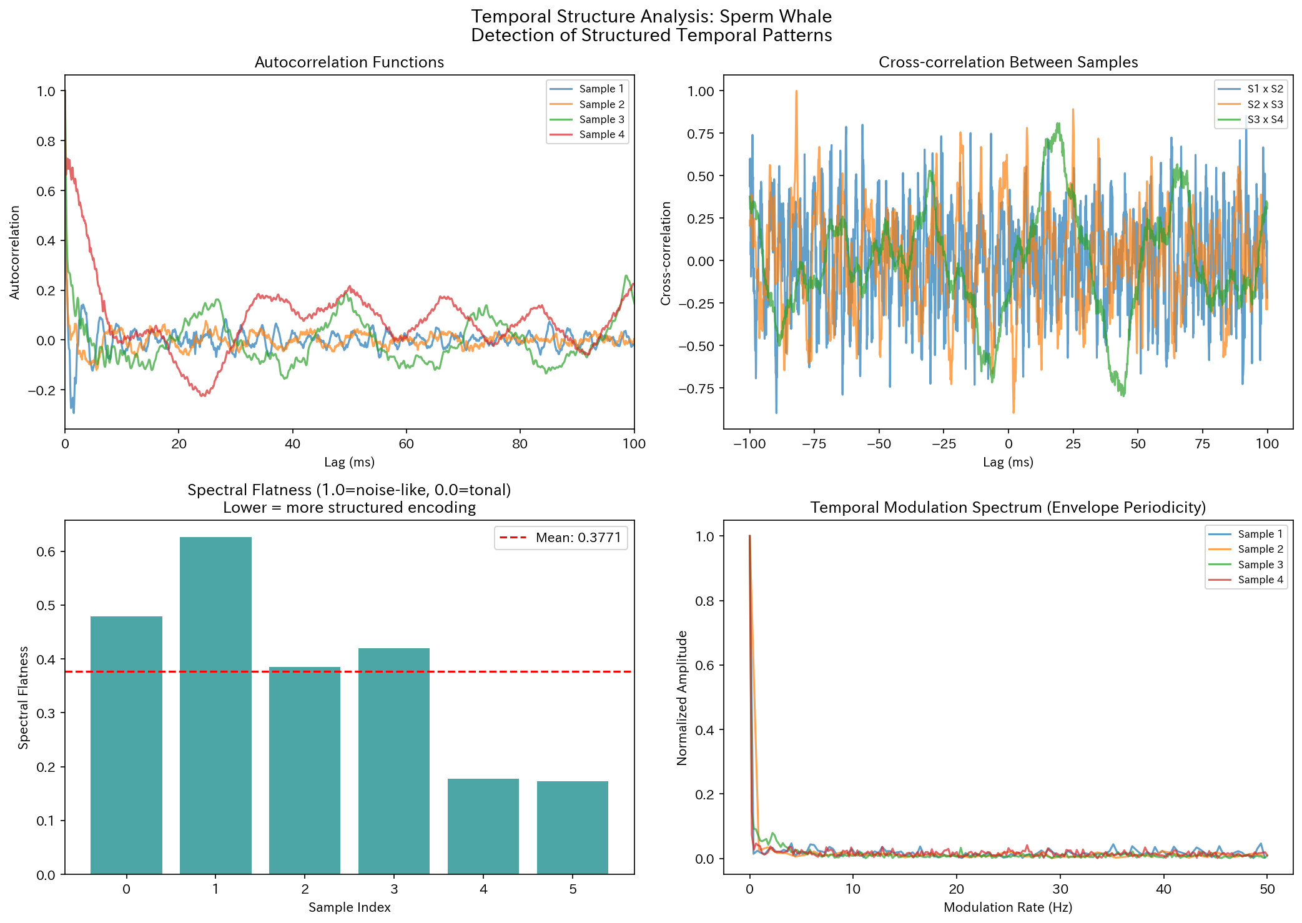
Temporal Structure: Sperm Whale
Figure. Temporal structure analysis of Sperm Whale

Slide 36
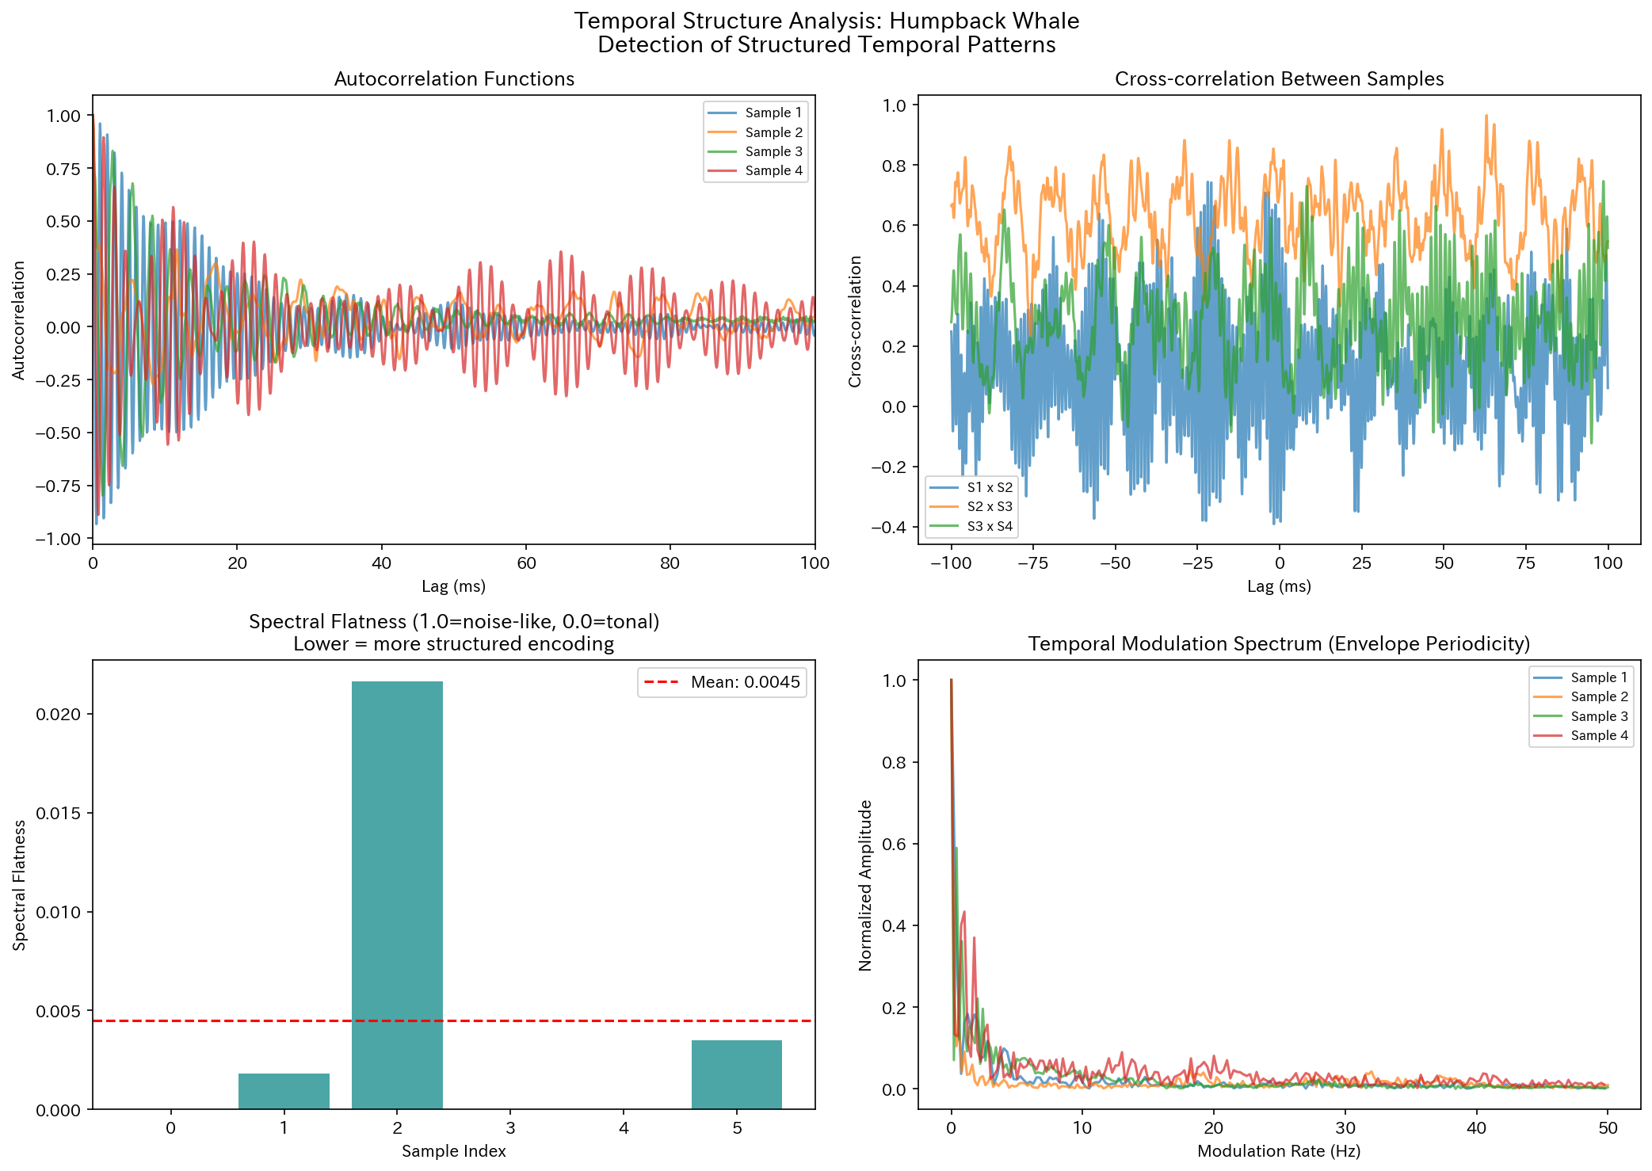
Temporal Structure: Humpback Whale
Figure. Temporal structure analysis of Humpback Whale

Slide 37
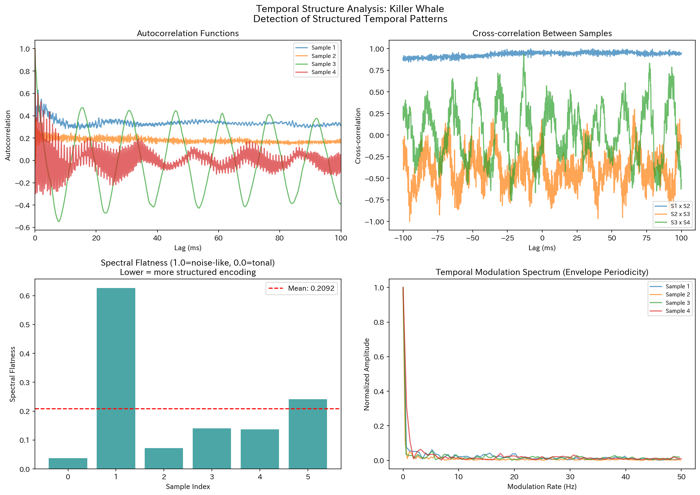
Temporal Structure: Killer Whale
Figure. Temporal structure analysis of Killer Whale

Slide 38
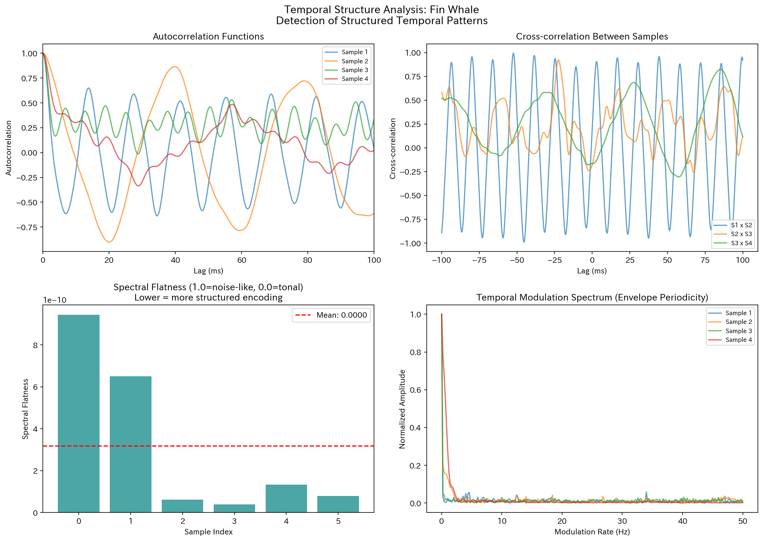
Temporal Structure: Fin Whale
Figure. Temporal structure analysis of Fin Whale

Slide 39
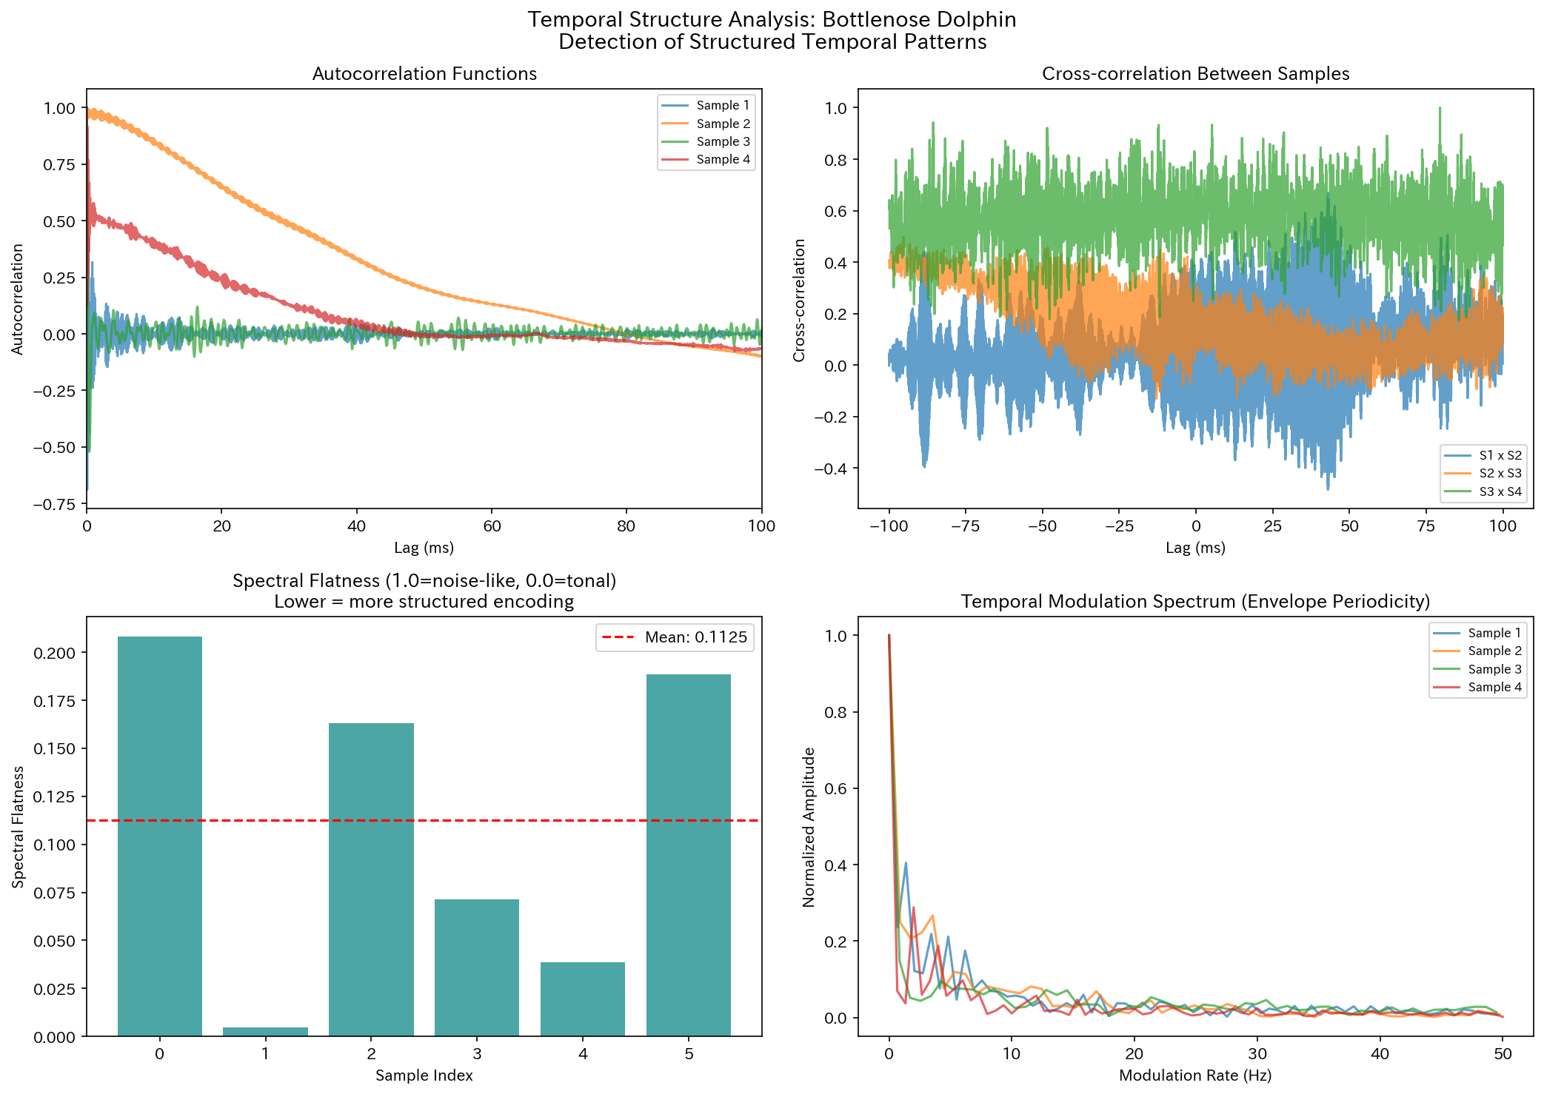
Temporal Structure: Bottlenose Dolphin
Figure. Temporal structure analysis of Bottlenose Dolphin

Slide 40
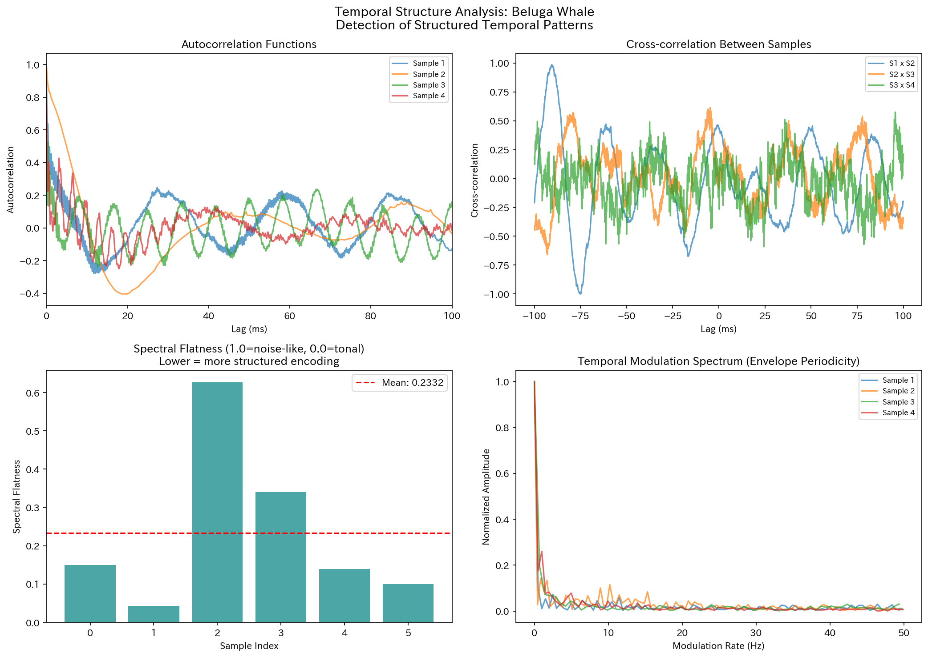
Temporal Structure: Beluga Whale
Figure. Temporal structure analysis of Beluga Whale

Slide 41
6. Cross-Species Comparison

Slide 42
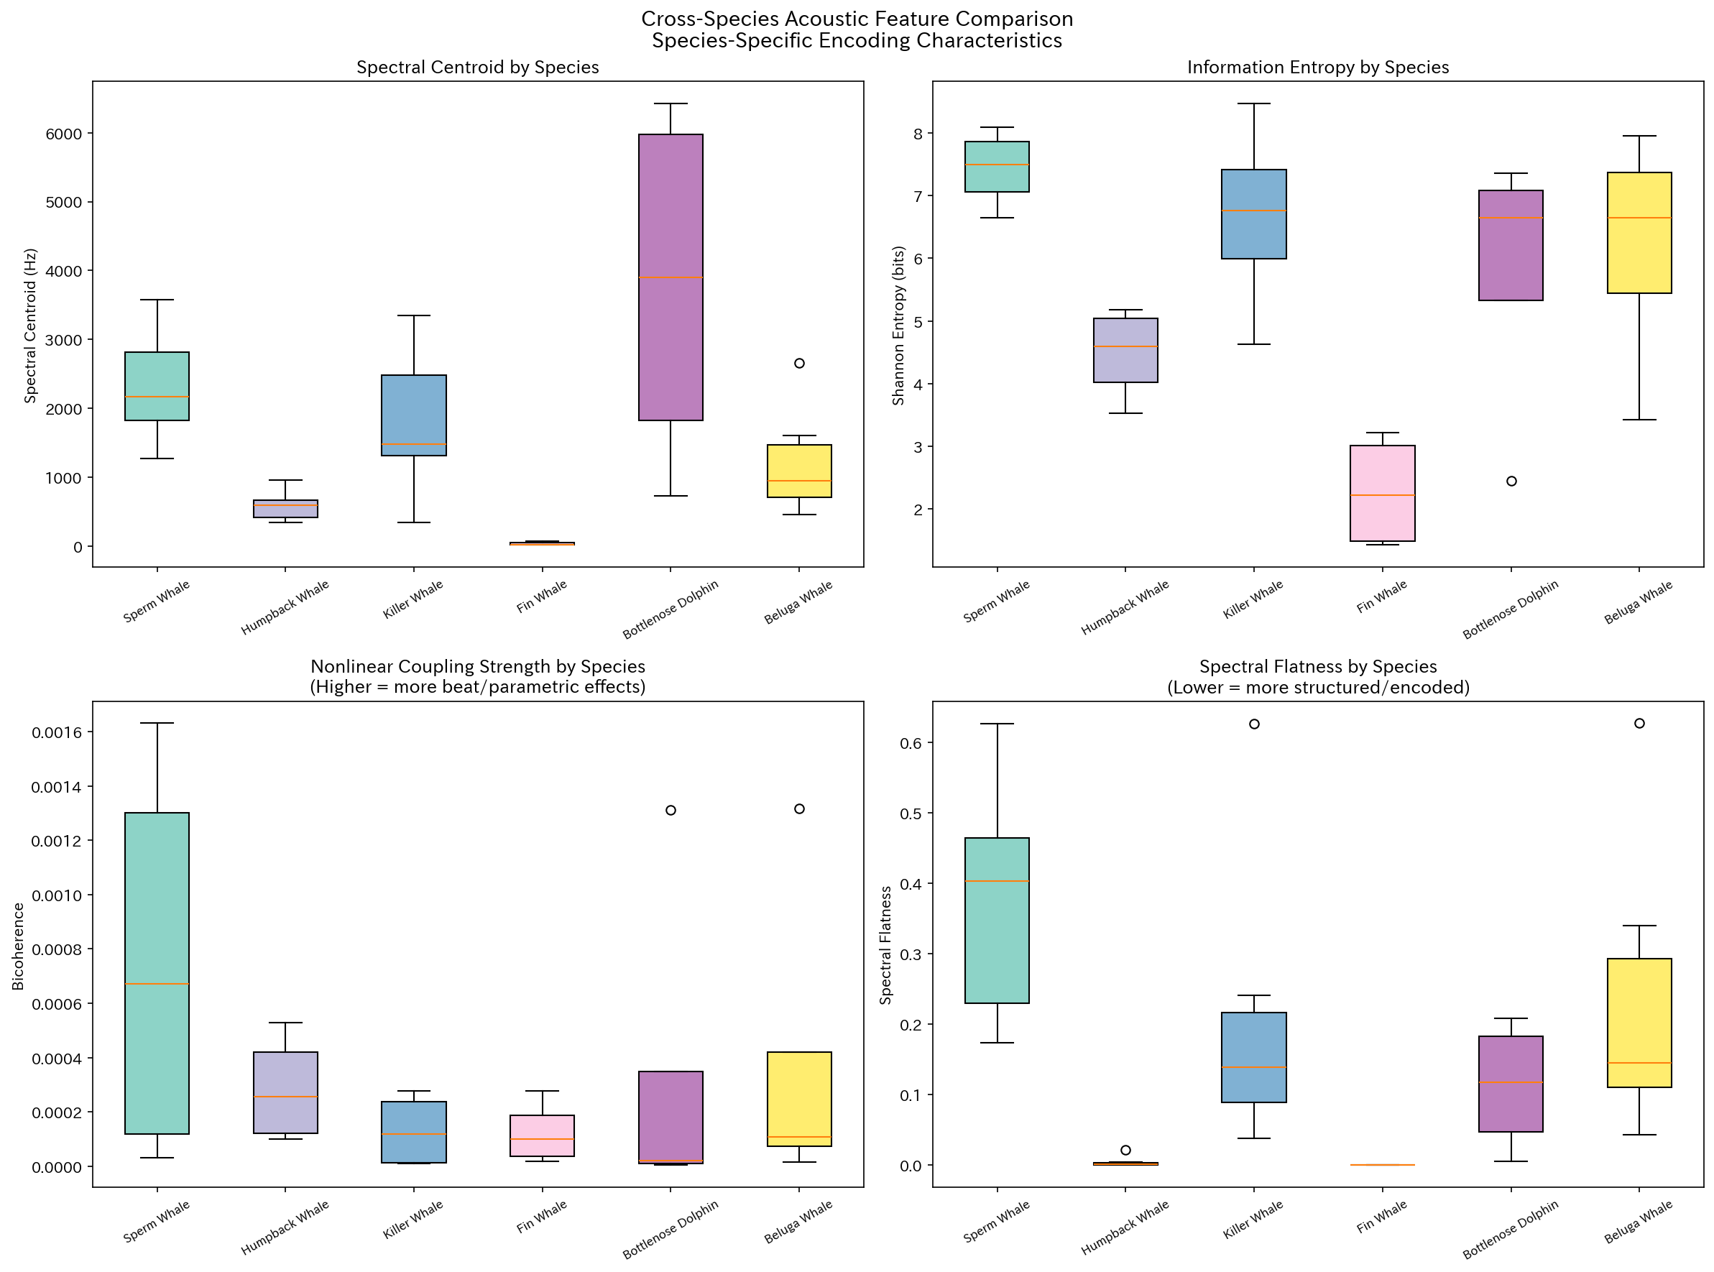
Cross-Species Acoustic Feature Comparison
Figure. Box-plot comparison of acoustic features across six species

Slide 43
7. CDMA-like Orthogonality Analysis

Slide 44
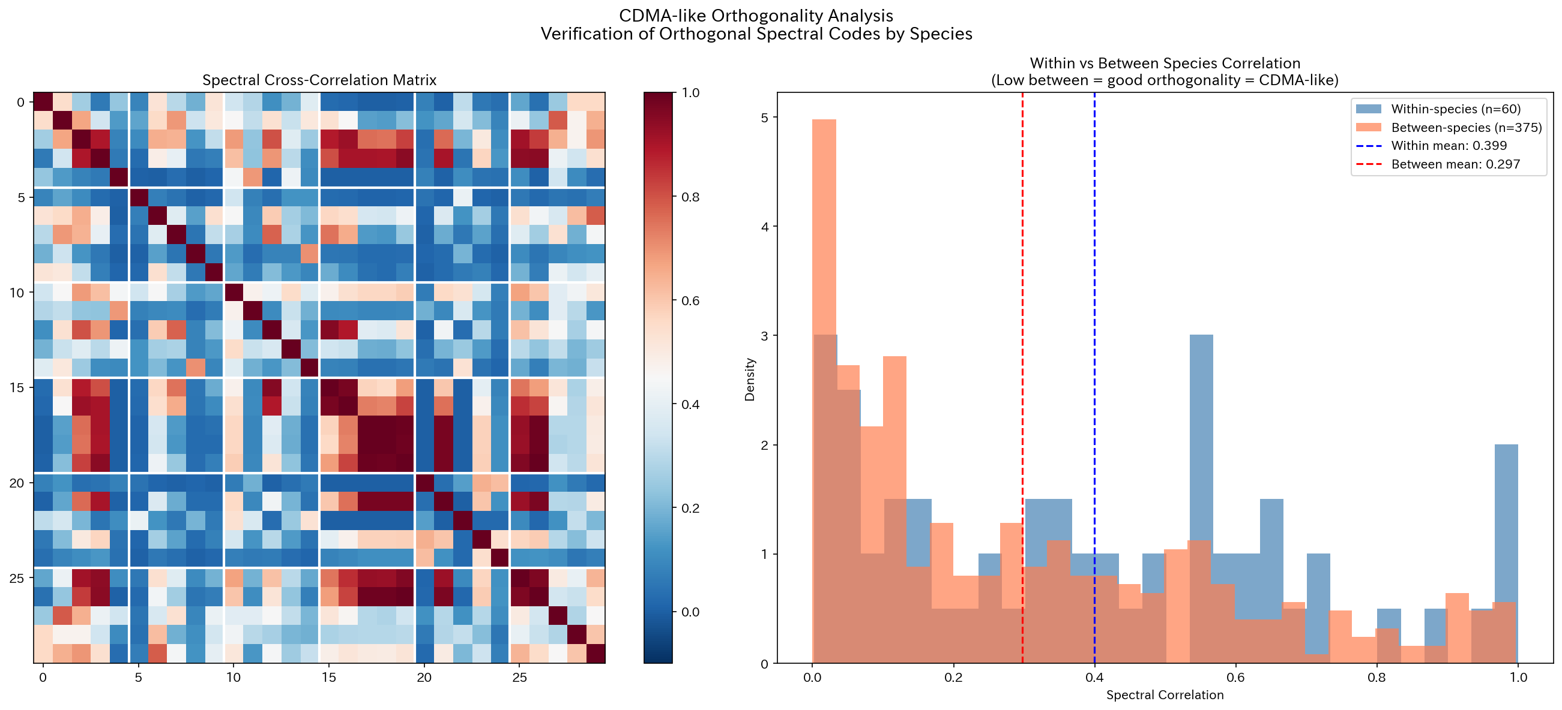
CDMA Orthogonality: Spectral Correlation Matrix
Figure. Within vs between species spectral correlation (Mann-Whitney U, p=3.37 × 10⁻³)

Slide 45
Conclusions and Future Directions
Species-specific codes
CDMA orthogonality
Nonlinear coupling
Information structure
6 species clearly distinguishable by frequency features
Within > Between correlation p = 3.37 × 10⁻³
Bicoherence > 0 detected in all species
Entropy 2.28-7.43 bits interspecific variation
Supported
Supported
Partial
Supported
Future Directions
1
2
3
4
Multi-hydrophone synchronized recordings
Individual-level code separation
Longitudinal code variation tracking
Deep learning feature extraction
Note: All elements are editable

