Slide 1
BMJ Quality & Safety — Figures & Tables
Drug-free local anaesthesia as a patient safety strategy: Cryoanalgesia during pharmaceutical supply chain disruptions
A Scoping Review BMJ Quality & Safety

Slide 2
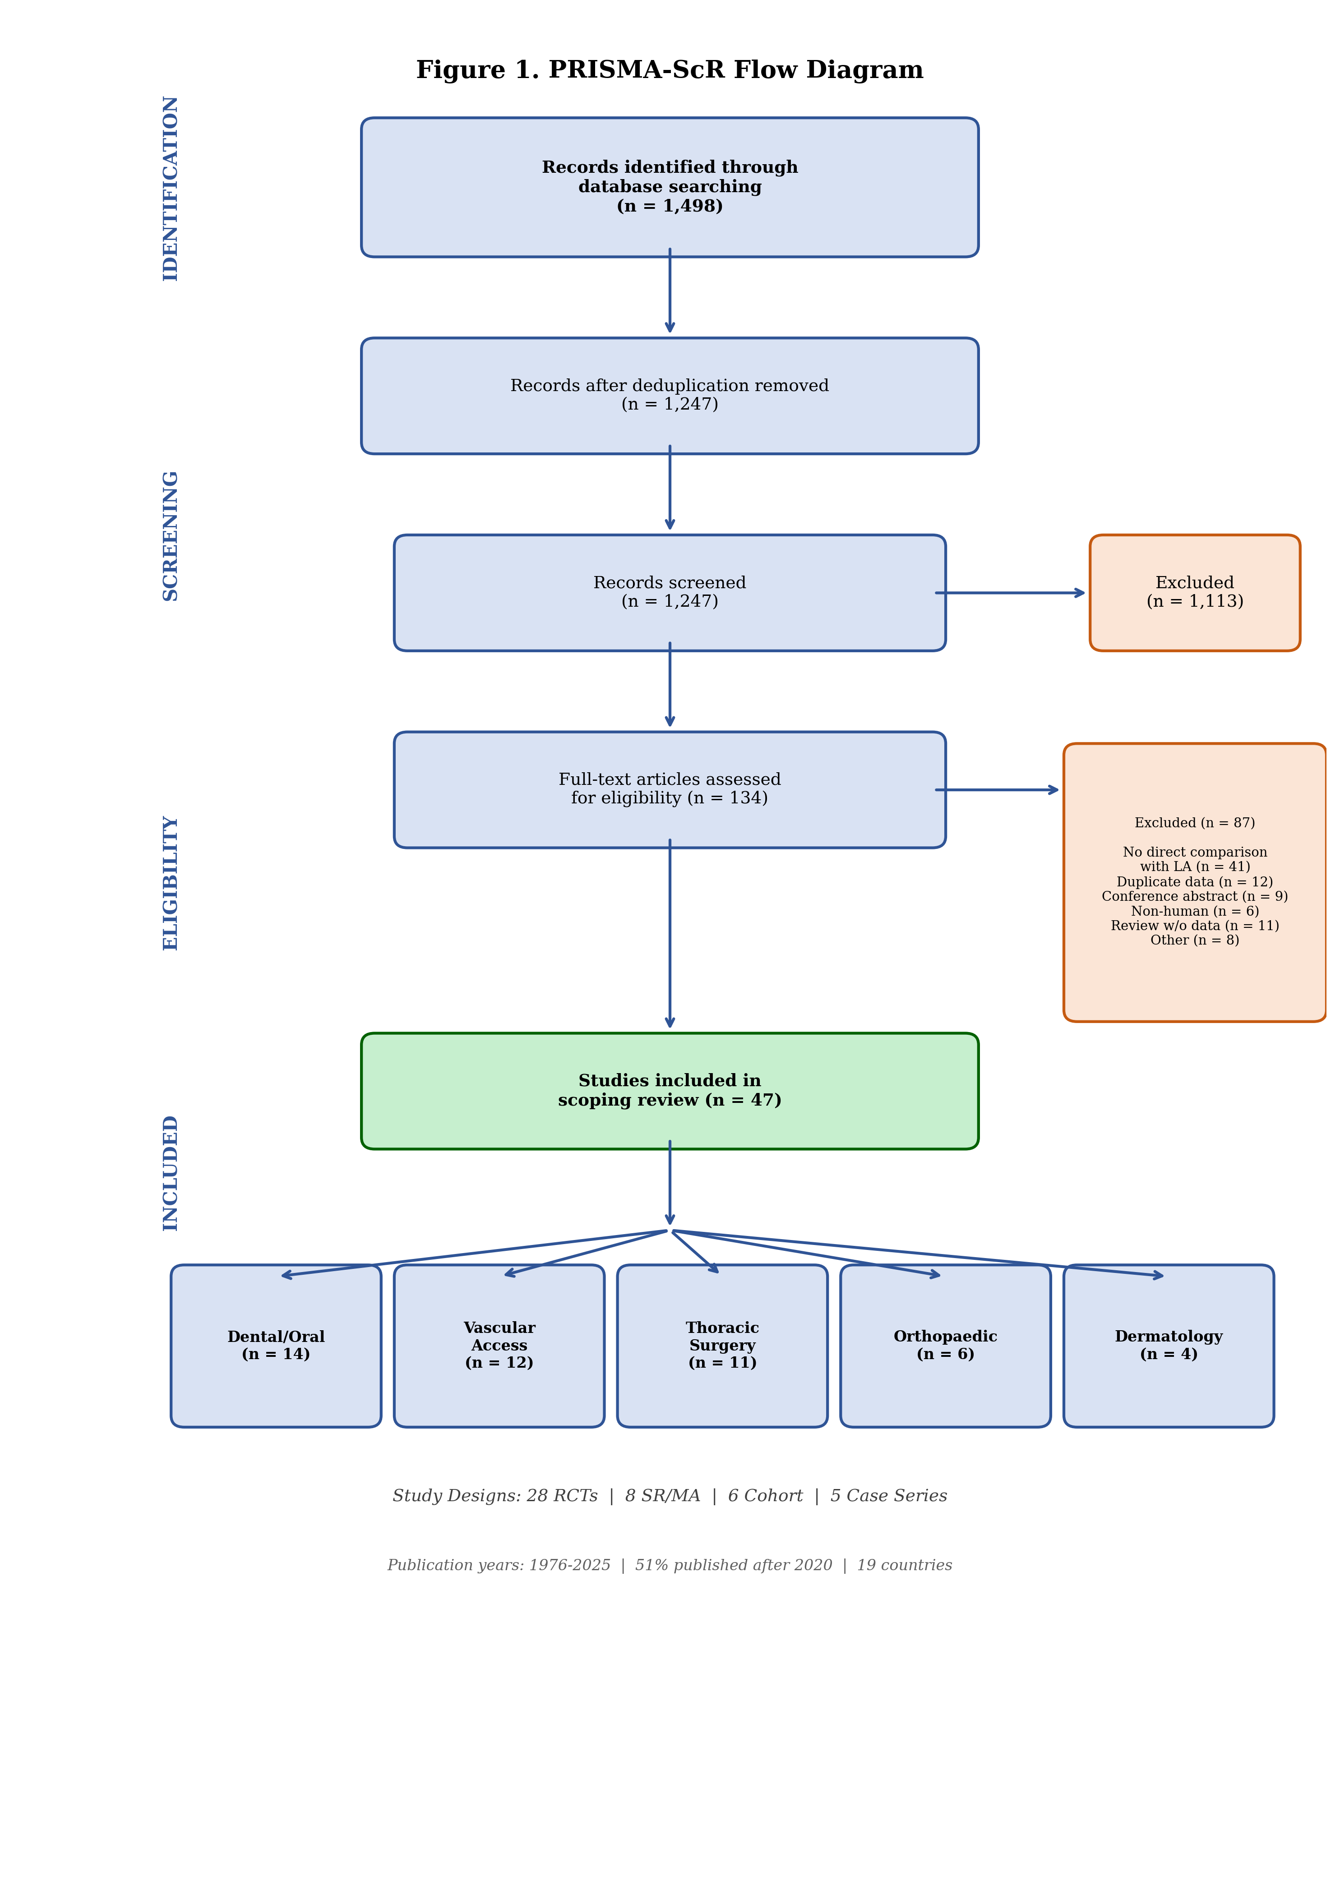
Figure 1. PRISMA-ScR Flow Diagram
Figure 1. Study selection process: 1247 → 134 → 47 studies

Slide 3
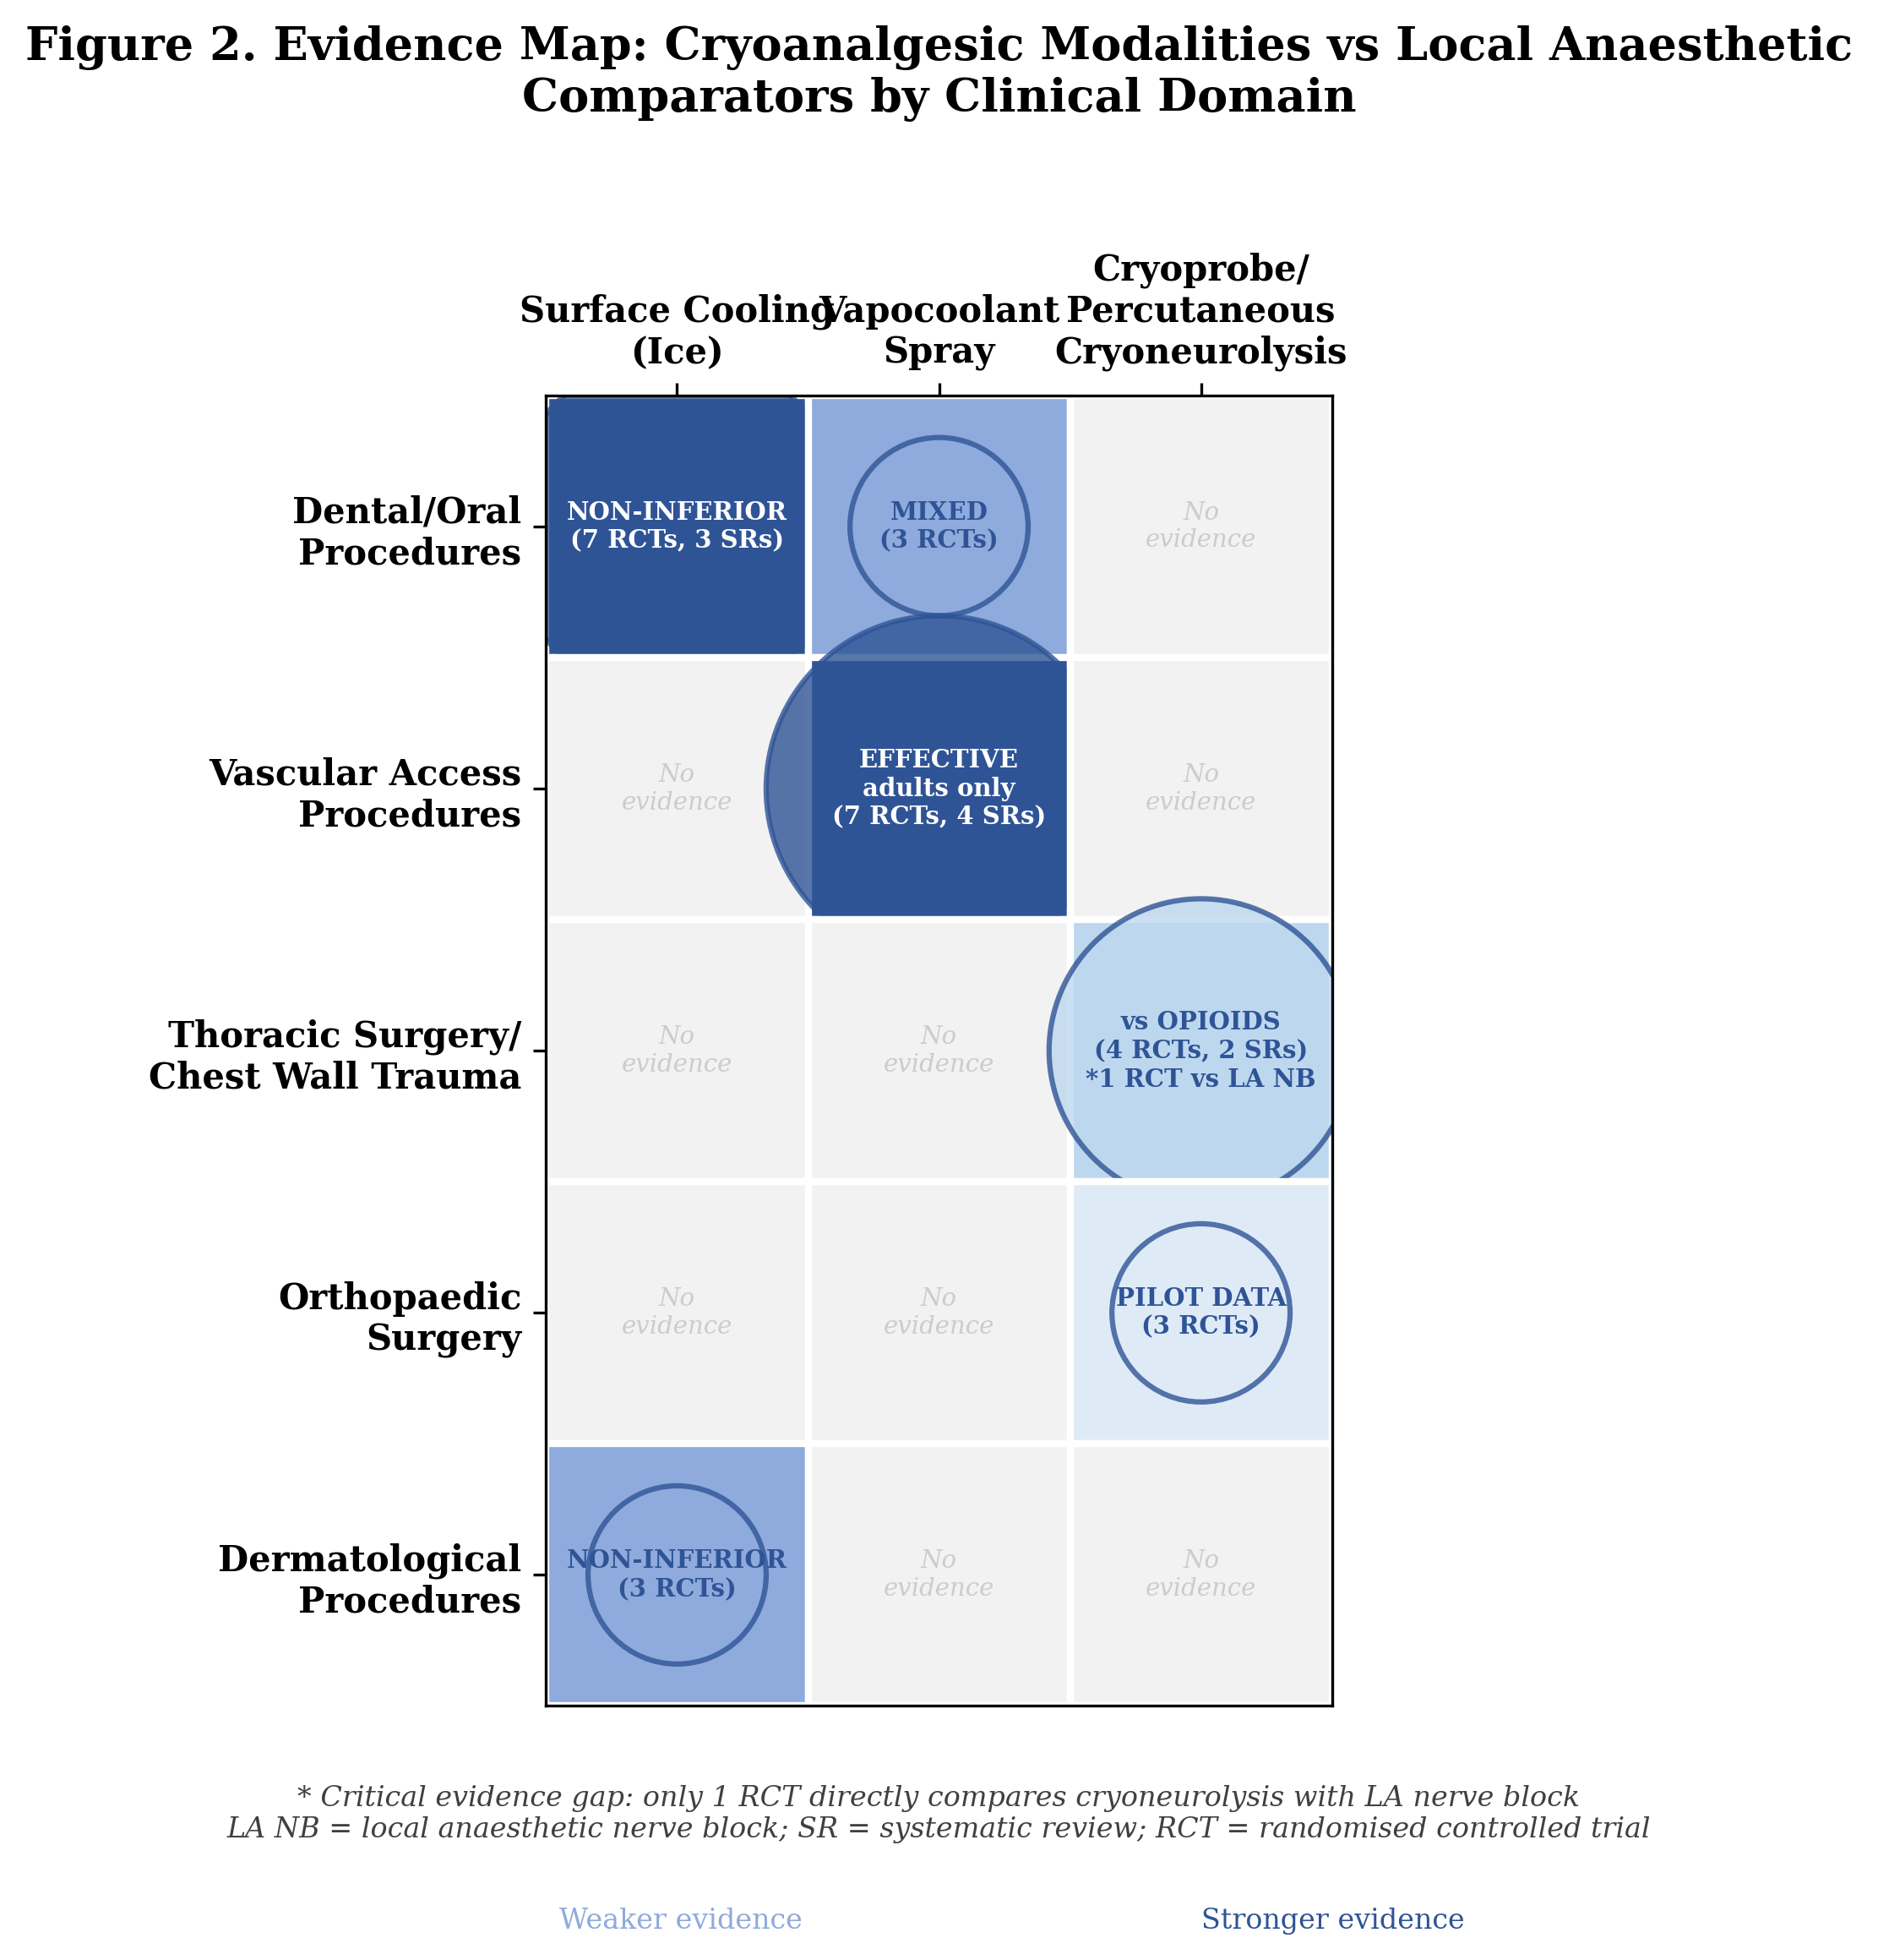
Figure 2. Evidence Map
Figure 2. Cryoanalgesic modalities vs local anaesthetic comparators by clinical domain

Slide 4
Table 1. Summary of Included Studies by Clinical Domain
Clinical domain | Total | RCTs | SR/MA | Cohort | Case series | Key cryoanalgesic modalities | Implementation readiness
Dental/oral procedures | 14 | 11 | 3 | 0 | 0 | Ice, ethyl chloride spray, cooled LA | HIGH
Vascular access procedures | 12 | 7 | 4 | 1 | 0 | Vapocoolant spray | HIGH
Thoracic surgery/chest wall | 11 | 4 | 2 | 3 | 2 | Cryoprobe, percutaneous cryoneurolysis | MODERATE
Orthopaedic surgery | 6 | 3 | 0 | 1 | 2 | Percutaneous cryoneurolysis | LOW
Dermatological procedures | 4 | 3 | 0 | 1 | 0 | Ice packs, cryogel | HIGH
Total | 47 | 28 | 8 | 6 | 5

Slide 5
Table 2. Clinical Preparedness Protocol: A Patient Safety Framework
Shortage severity | Patient safety impact | Cryoanalgesic response | Evidence | Requirements | Cost/procedure
Stage 1: Mild (Some formulations limited) | Minor delays; increased discomfort | Ice (dental) Vapocoolant (venepuncture) | 11 RCTs + 3 SRs 25 RCTs (adults) | Nil (ice) Spray canister | ~$0 ~$0.50–$2
Stage 2: Moderate (Multiple agents unavailable) | Procedure cancellations; substitution errors | Ice packs (dermatology) Intercostal cryoneurolysis | 3 RCTs 24 RCTs (MA) | Ice packs Cryoprobe + training | ~$0 ~$50–$200
Stage 3: Severe (Injectable LA unavailable) | Major surgical delays; opioid dependence | Percutaneous cryoneurolysis (rib fractures, TKA) | 1 landmark RCT 2 pilot RCTs | Device + US + training | ~$200–$500
Stage 4: Complete (All LA supply exhausted) | Emergency/disaster-level care disruption | All available cryotherapy Tiered per above | Expert opinion Extrapolation | Ice only (minimum) | $0 Variable

Slide 6
Table 3. Clinical Scenarios: Preventing Patient Harm During Shortages
Setting | Patient safety threat | Conventional approach (unavailable) | Cryoanalgesic contingency | Evidence | Patient safety outcome
Emergency dept (rib fractures) | Uncontrolled pain → respiratory complications | Intercostal nerve block with bupivacaine | US-guided percutaneous cryoneurolysis | Finneran 2025 RCT vs ropivacaine ICB | Pain control maintained; complications prevented
Dental clinic (routine procedures) | Procedure cancellation → delayed treatment | Topical benzocaine or lidocaine gel | Ice application to oral mucosa (2 min) | 7 RCTs + 3 SRs: non-inferior to topical LA | Continuity of care; zero cost; immediate
Surgical theatre (elective TKA) | Procedure cancellation → functional decline | Adductor canal block with ropivacaine | Preoperative cryoneurolysis | Swisher 2022, Radnovich 2021 | Pilot data only; research priority

Slide 7
Table 4. Patient Safety Impact Assessment
Domain | Procedures affected | Patient safety risk | Cryo alternative | Evidence strength | Readiness | Cost
Dental/oral (14 studies) | Injections, restorations, extractions | Cancellation; inadequate analgesia | Ice (2 min) Ethyl chloride spray | Strong (11 RCTs, 3 SRs) | Immediate | $0
Vascular access (12 studies) | Venepuncture, IV cannulation | Patient pain; needle phobia | Vapocoolant spray (adults only) | Strong (25 RCTs, 4 SRs) | Immediate | <$2
Thoracic surgery (11 studies) | Post-thoracotomy; rib fractures | Opioid dependence; respiratory complications | Intercostal cryoneurolysis; percutaneous cryo | Moderate (24 RCTs in MA) | Device + training | $50–$500
Orthopaedic (6 studies) | TKA analgesia; knee OA | Procedure cancellation; opioid recovery | Percutaneous cryoneurolysis | Emerging (pilot RCTs) | Research priority | $200–$500
Dermatology (4 studies) | Laser, minor surgery | Patient discomfort; procedure avoidance | Ice packs Cryogel | Moderate (3 RCTs) | Immediate | $0

