Slide 1
Are we prepared for local anaesthetic shortages?
Cryoanalgesia as a drug-free contingency: a scoping review Regional Anesthesia & Pain Medicine

Slide 2
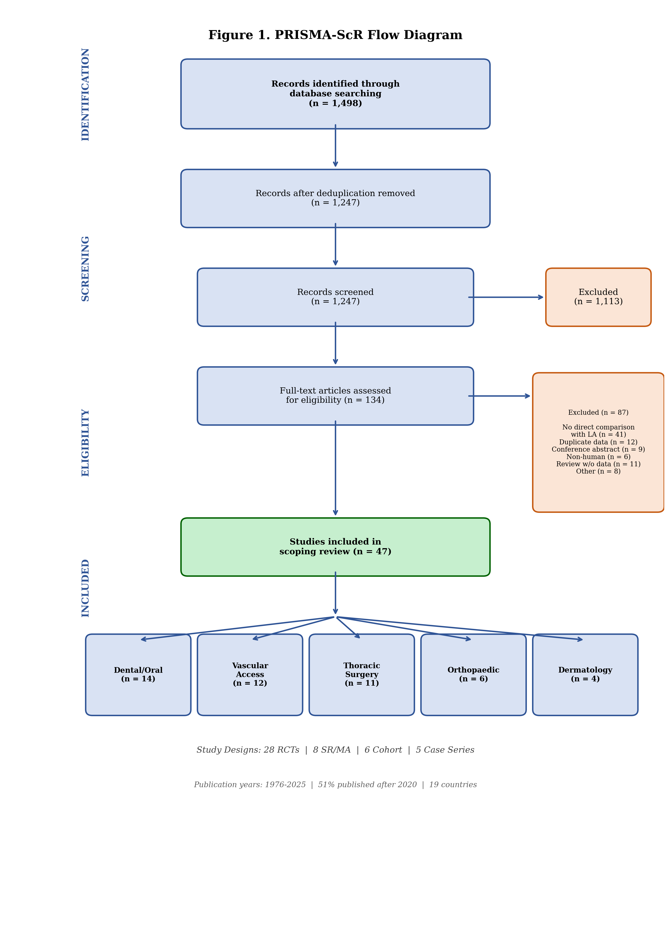
Figure 1. PRISMA-ScR Flow Diagram

Slide 3
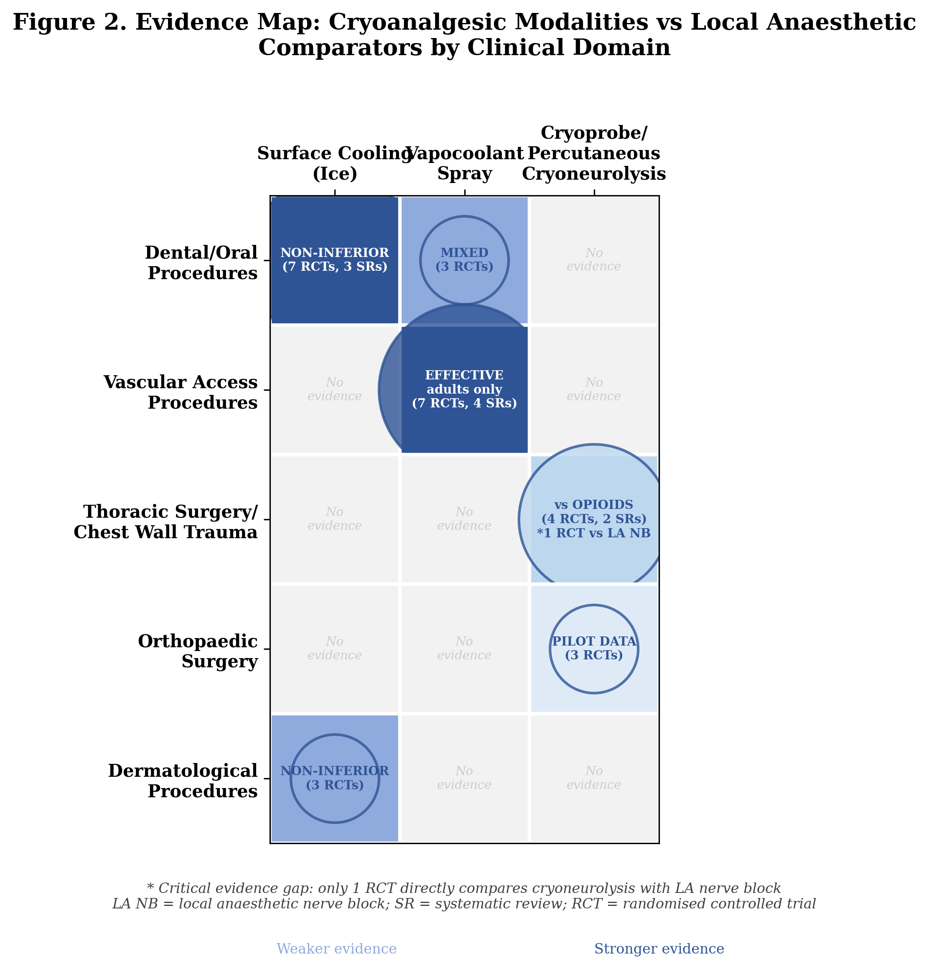
Figure 2. Evidence Map

Slide 4
Table 1. Summary of Included Studies by Clinical Domain
Clinical Domain | Total | RCTs | SR/MA | Cohort | Case Series | Key Modalities
Dental/oral procedures | 14 | 11 | 3 | 0 | 0 | Ice, ethyl chloride spray, cooled LA
Vascular access procedures | 12 | 7 | 4 | 1 | 0 | Vapocoolant spray
Thoracic surgery/chest wall | 11 | 4 | 2 | 3 | 2 | Cryoprobe, percutaneous cryoneurolysis
Orthopaedic surgery | 6 | 3 | 0 | 1 | 2 | Percutaneous cryoneurolysis
Dermatological procedures | 4 | 3 | 0 | 1 | 0 | Ice packs, cryogel
TOTAL | 47 | 28 | 8 | 6 | 5

Slide 5
Table 2. Clinical Preparedness Protocol
Shortage Stage | Clinical Application | Modality | Evidence | Equipment | Cost/procedure
Stage 1: Mild (some formulations limited) | Dental pre-injection Adult venepuncture | Ice (2 min) Vapocoolant spray | 11 RCTs + 3 SRs 25 RCTs (adults) | Ice Spray canister | ~$0 ~$0.50–$2
Stage 2: Moderate (multiple agents unavailable) | Dermatological procedures Post-thoracotomy analgesia | Ice packs Intercostal cryoneurolysis | 3 RCTs 24 RCTs (MA) | Ice packs Cryoprobe device | ~$0 ~$50–$200
Stage 3: Severe (injectable LA unavailable) | Rib fracture analgesia Post-TKA analgesia | Percutaneous cryoneurolysis Percutaneous cryoneurolysis | 1 RCT vs ropivacaine ICB 2 pilot RCTs | Cryo device + US Cryo device + US | ~$200–$500 ~$200–$500
Stage 4: Complete (all LA supply exhausted) | Emergency protocol All amenable procedures | Ice + available cryo Tiered per above | Expert opinion As above | Ice only (minimum) All available | $0 Variable

Slide 6
Table 3. Clinical Scenarios
Scenario | Situation | Conventional Approach | Cryo Alternative | Evidence | Considerations
Emergency Dept | Rib fractures Bupivacaine unavailable | Intercostal nerve block ESP block | US-guided percutaneous cryoneurolysis | Finneran 2025 RCT | Weeks of analgesia vs hours Requires cryo device + US
Orthopaedic Theatre | Elective TKA Ropivacaine unavailable | Adductor canal block Femoral nerve block | Preop cryoneurolysis (IBSN) | Swisher 2022 Radnovich 2021 | Pilot data only No ACB comparison Research priority
Dental Clinic | Routine restoration Lidocaine rationed | Topical benzocaine or lidocaine gel | Ice application (2 min to mucosa) | 7 RCTs + 3 SRs Non-inferior | Immediate implementation Zero cost High acceptance

Slide 7
Table 4. Key Cryoneurolysis vs LA Regional Techniques
Study | Design | n | Domain | Cryo Modality | Comparator | Key Finding
Finneran 2025 | RCT | ~60 | Rib fractures | US-guided cryoneurolysis | Ropivacaine ICB | DIRECT comparison with LA block
ICE trial (protocol) | RCT | Planned | Pectus (Nuss) | Intercostal cryoablation | Thoracic epidural | Rare LA neuraxial comparison
Park 2021 | SR/MA (24 RCTs) | ~2000 | Thoracotomy | Intercostal cryoanalgesia | Opioids only | No LA block comparator
Swisher 2022 | Pilot RCT | 16 | TKA | US cryoneurolysis (IBSN) | Sham | No nerve block comparator
Radnovich 2021 | RCT | ~100 | TKA | Preop cryoneurolysis | Sham | No ACB comparator

