Slide 1
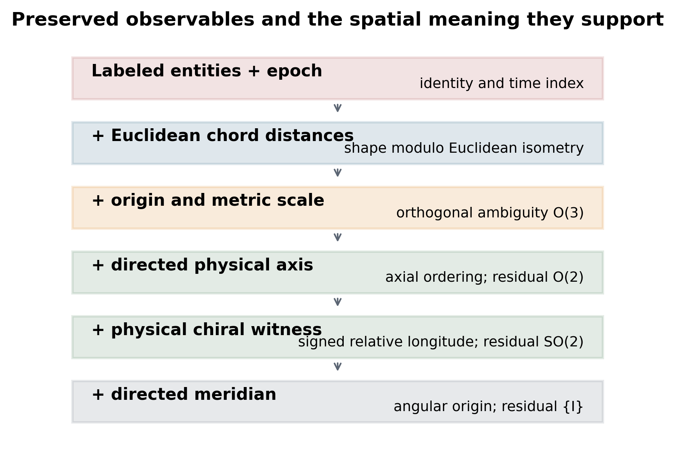
Figure 1
Preserved observables and the spatial meaning they support. Each layer adds information not recoverable from the preceding layer under the stated Euclidean model.

Slide 2
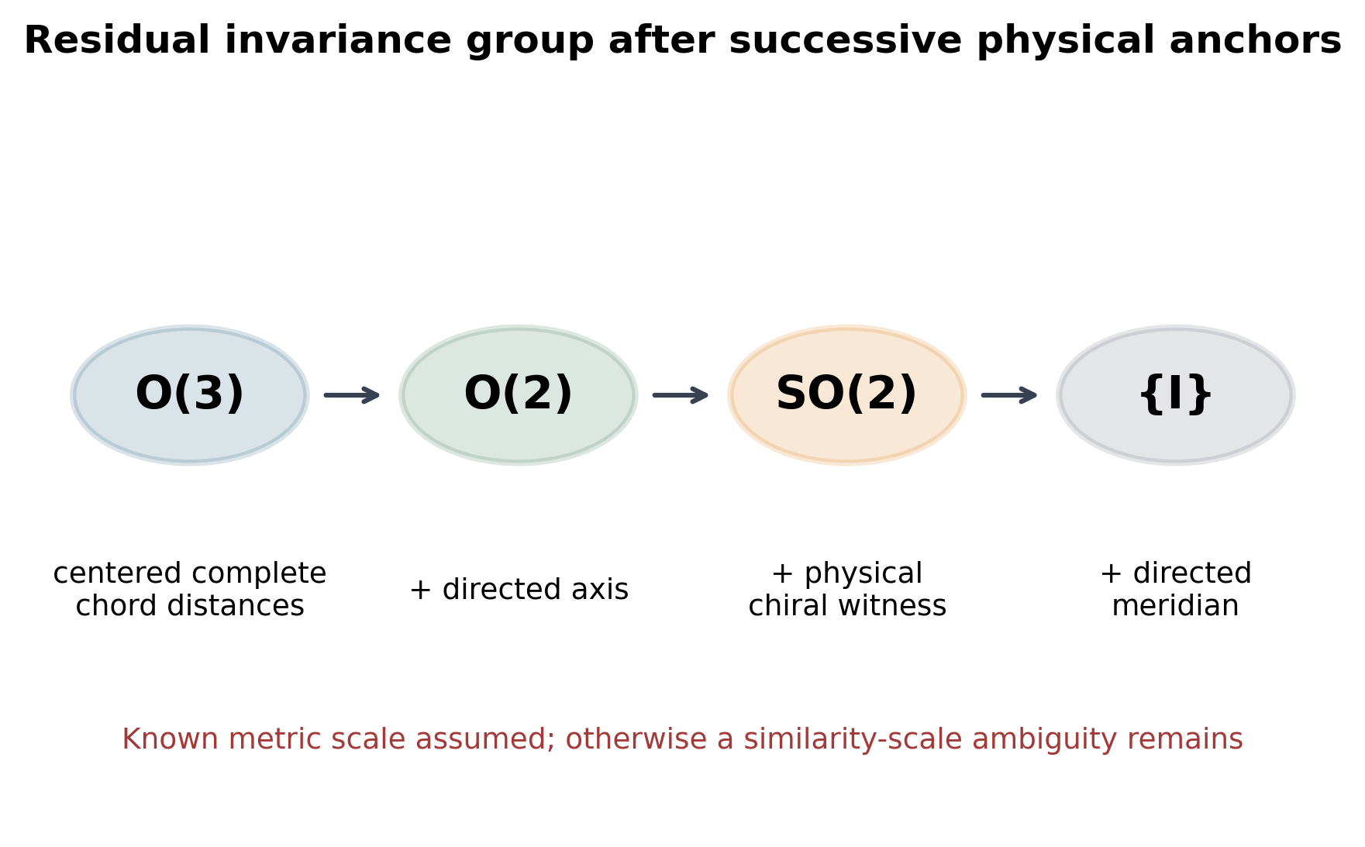
Figure 2
Residual invariance group after successive physical anchors. Complete centered Euclidean chord distances leave O(3); a directed axis leaves O(2); an independently recoverable physical chiral witness leaves SO(2); and a directed meridian removes the final axial rotation.

Slide 3
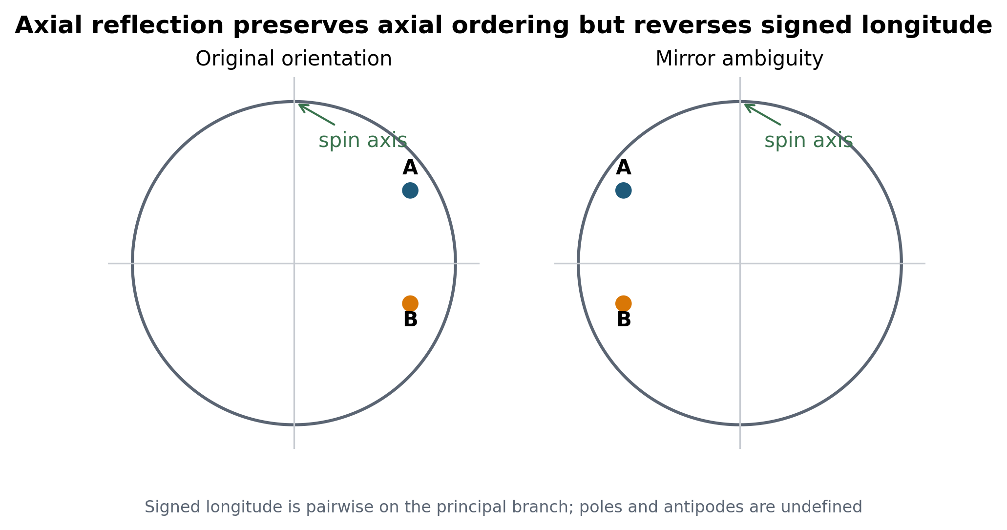
Figure 3
Directional asymmetry under axial reflection. Generic axial-latitude ordering is preserved, whereas signed relative longitude reverses. The longitude relation is pairwise on the principal branch and is undefined at axis and projected-antipode degeneracies.

Slide 4
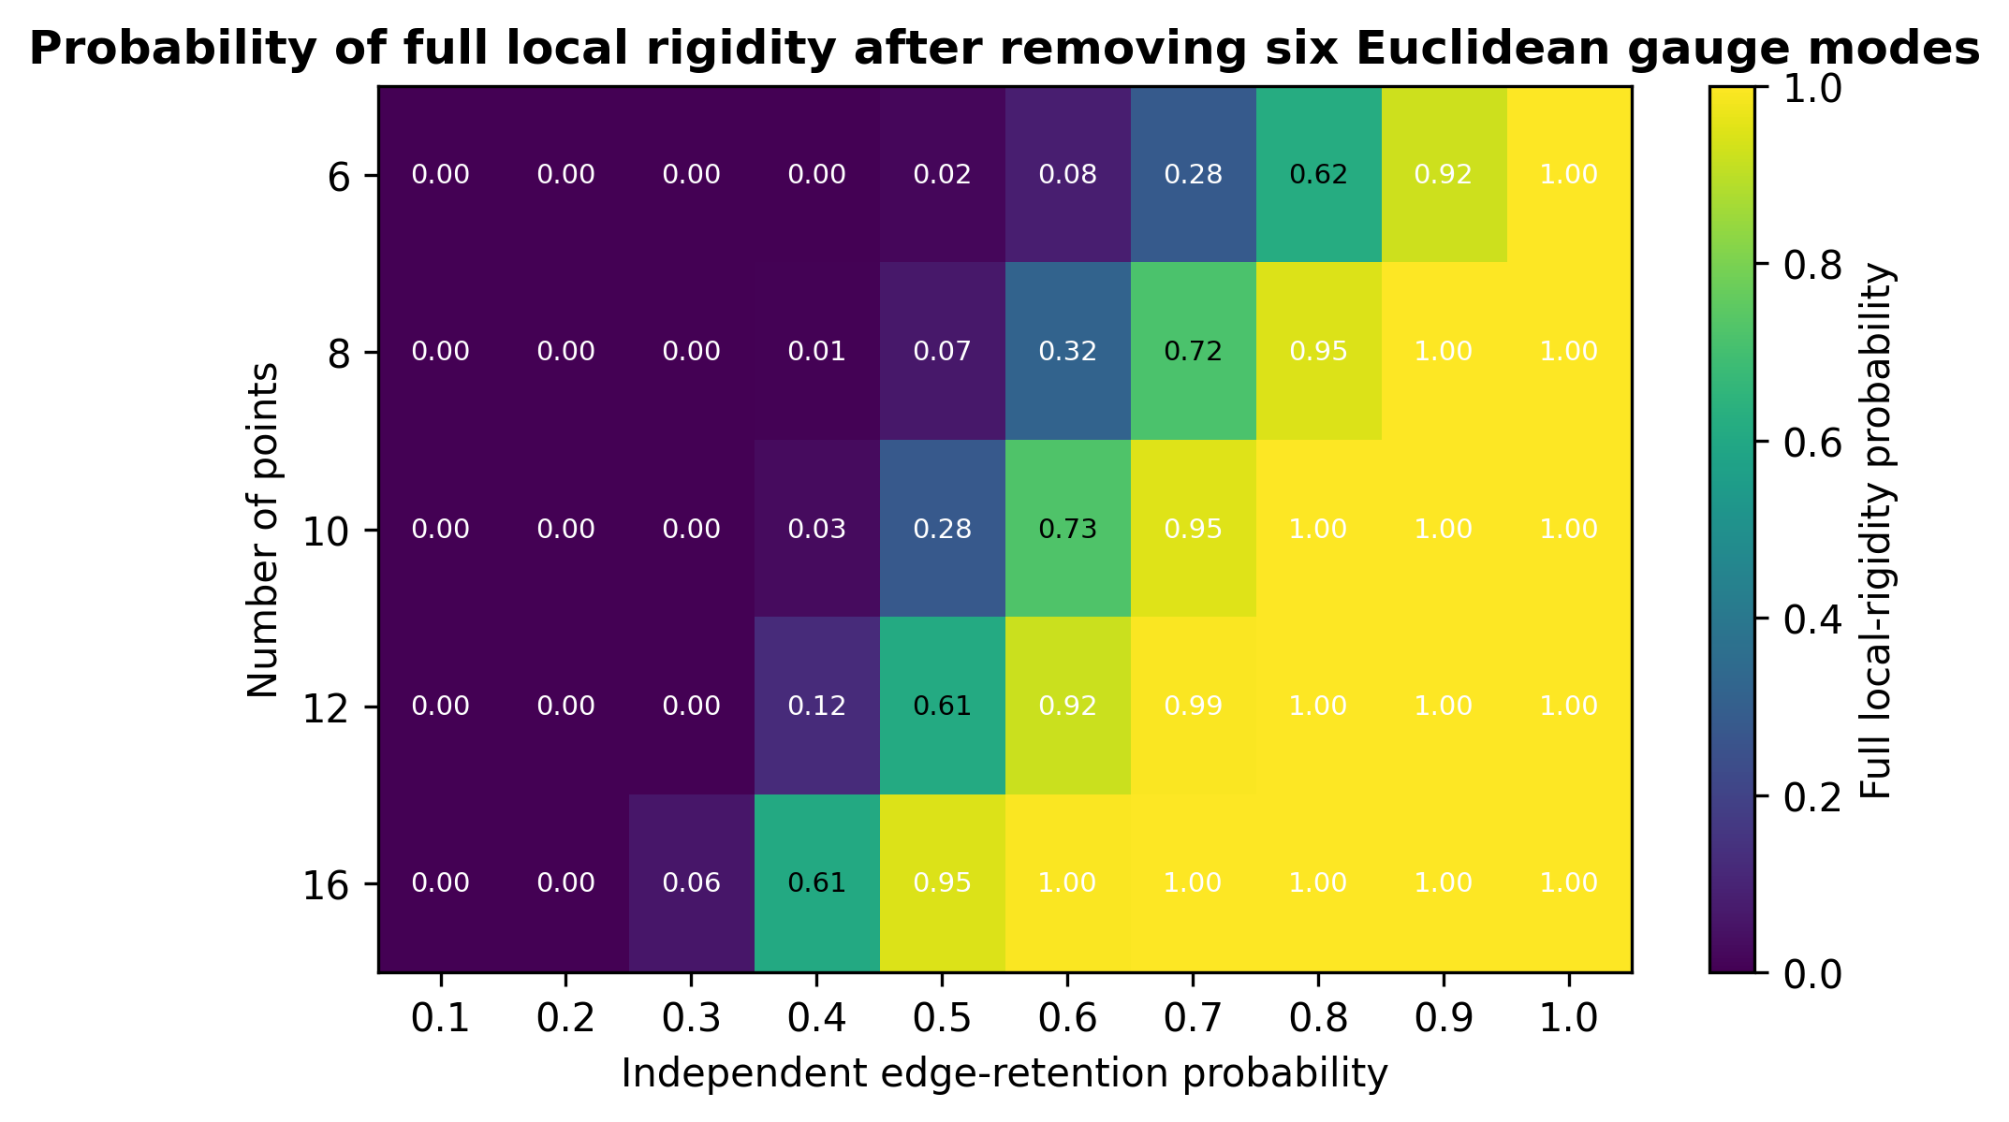
Figure 4
Probability of full local rigidity for generic three-dimensional random frameworks. Each cell summarizes 2000 independently sampled point-and-edge realizations after the six infinitesimal Euclidean gauge modes are removed. The result concerns local rigidity, not global uniqueness.

Slide 5
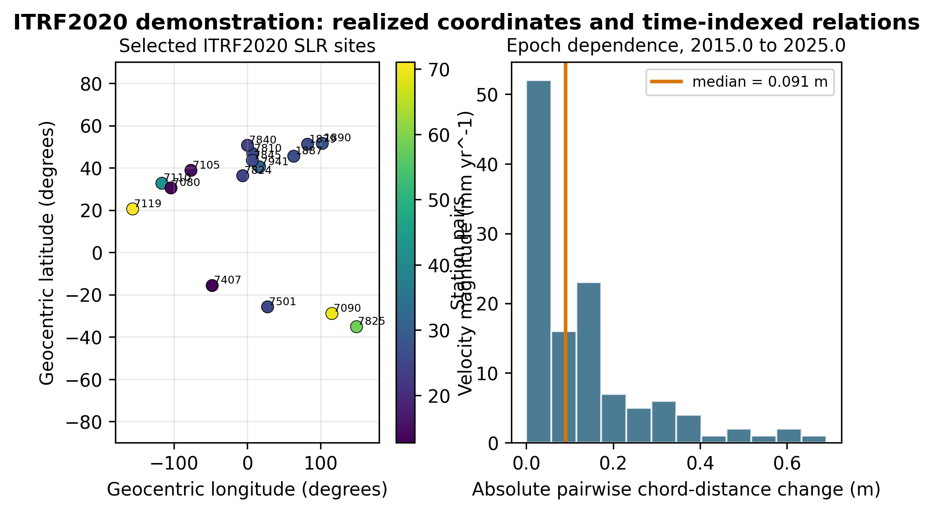
Figure 5
ITRF2020 demonstration. The left panel shows the selected SLR sites and published velocity magnitudes. The right panel shows absolute pairwise Euclidean chord-distance changes after linear propagation from epoch 2015.0 to 2025.0; this is an epoch-sensitivity calculation, not a reflected physical realization.

Slide 6
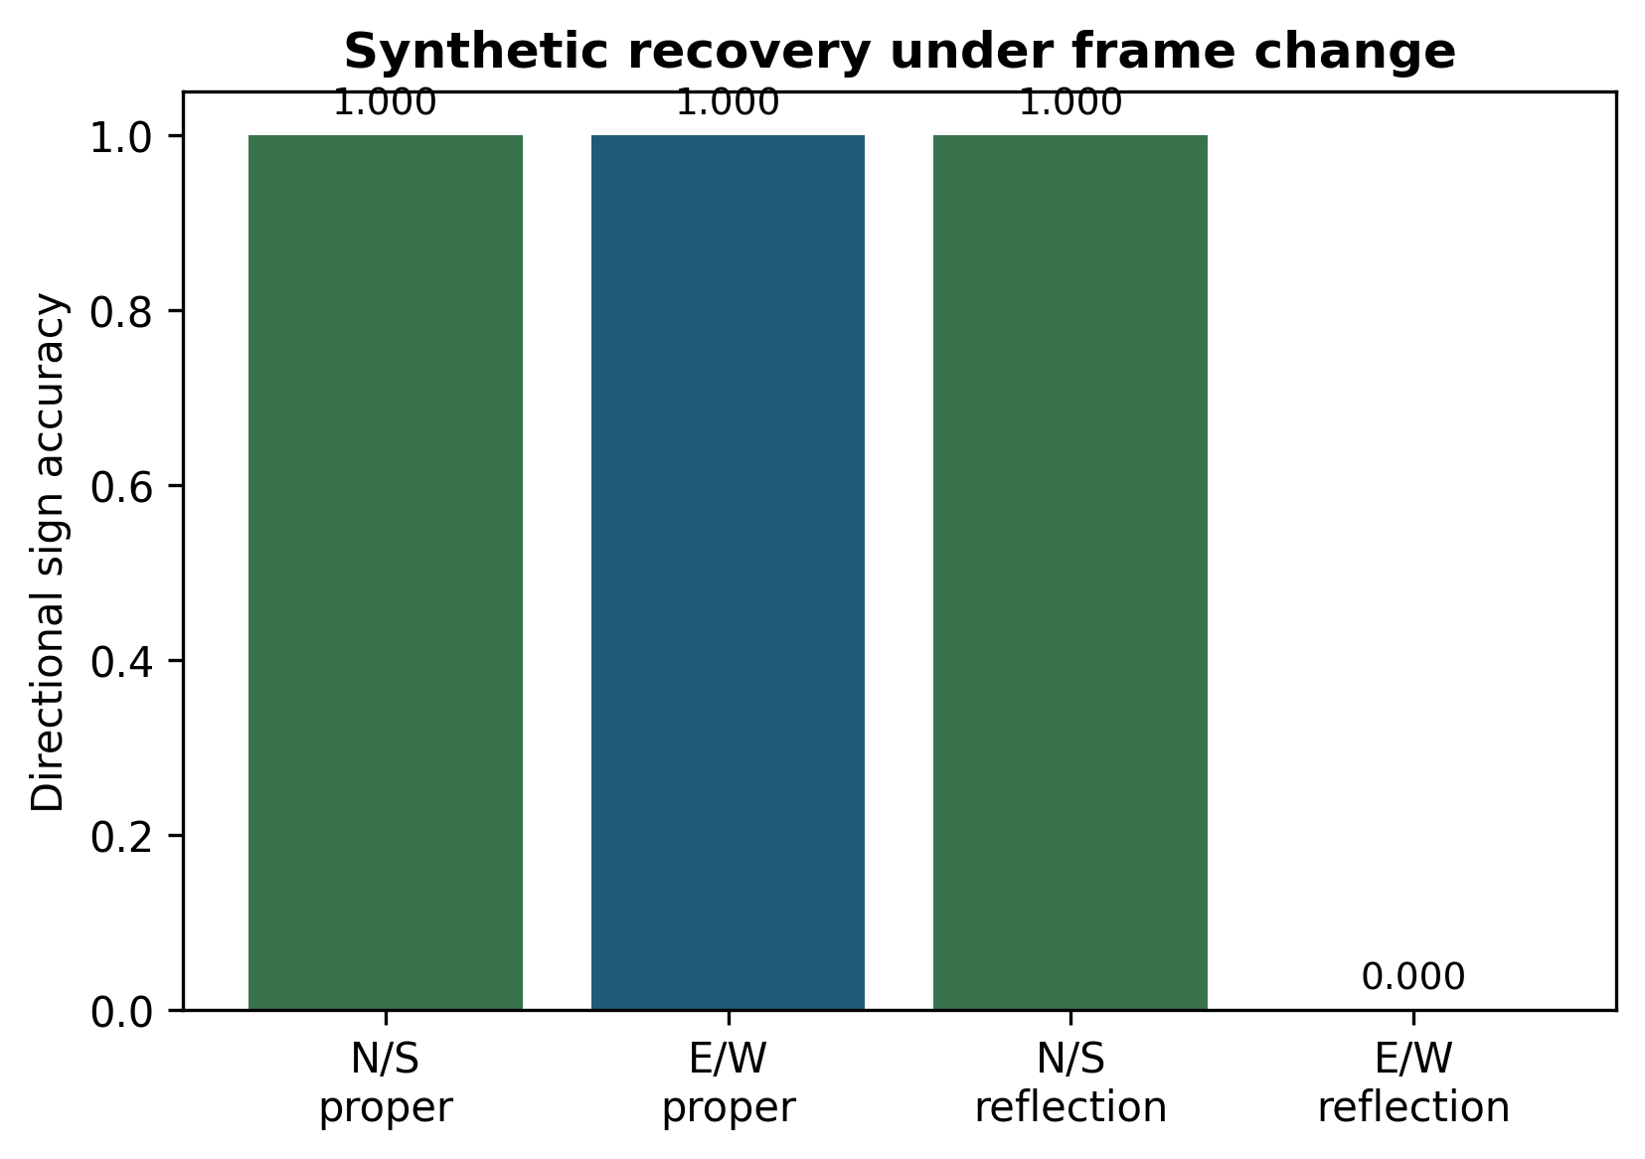
Supplementary Figure S1
Synthetic theorem-validation benchmark under proper rotation and axial reflection.

Slide 7
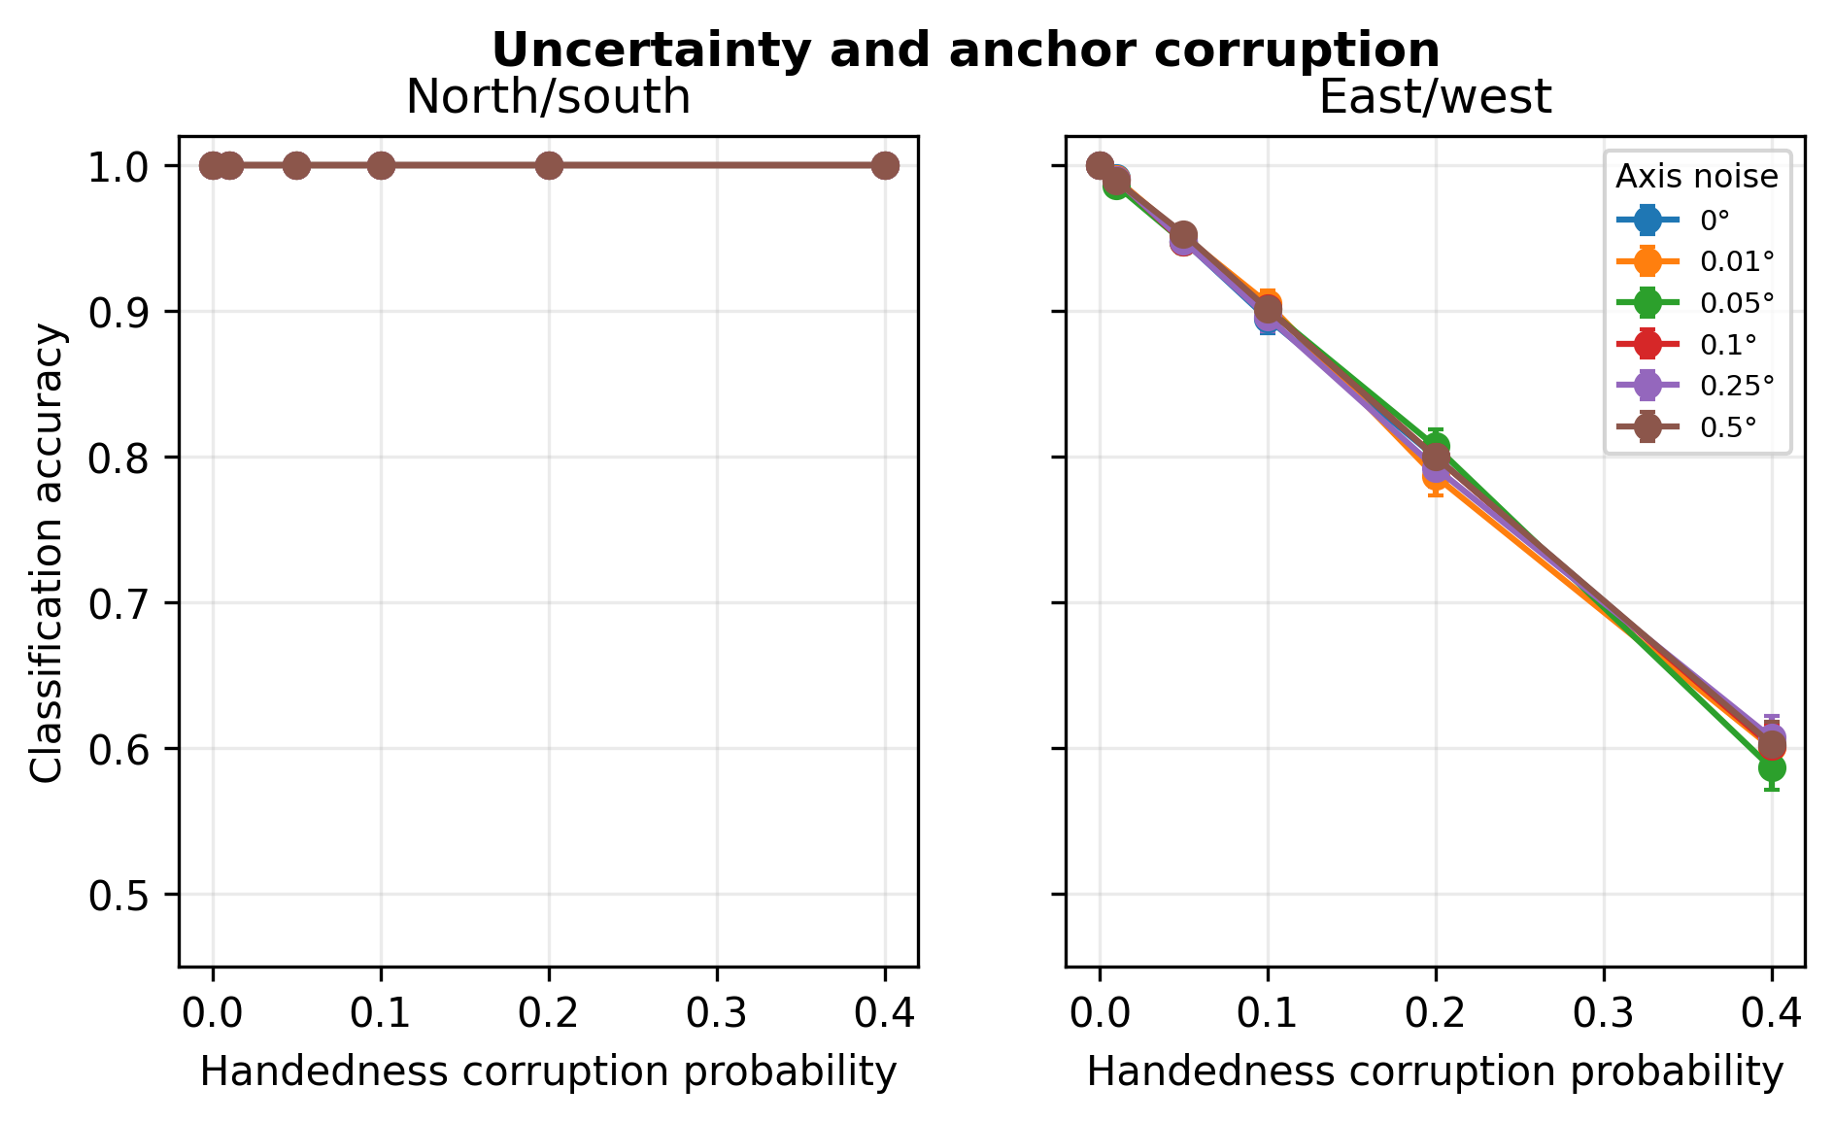
Supplementary Figure S2
Seeded axis-noise and algebraic-orientation-corruption validation experiment.

