Slide 1
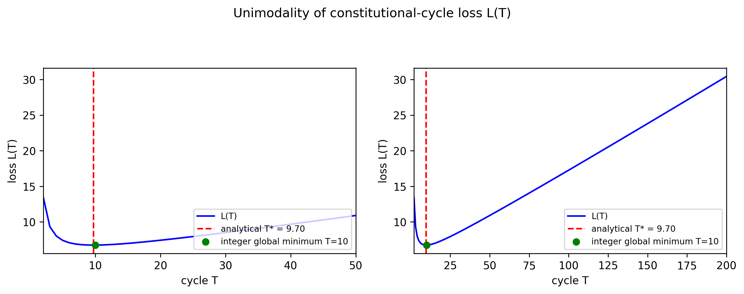
Figure 1 Unimodality of the constitutional-cycle loss function L(T)
Left panel: detail near the optimum for T = 2 to 50. Right panel: the same function over the full range T = 2 to 200. The analytical optimum T* and the integer global minimum are indicated for an illustrative parameter set. L(T) is unimodal over 200 random parameter draws and is steeper to the left of the optimum, so erring on the side of a longer cycle is less costly.

Slide 2
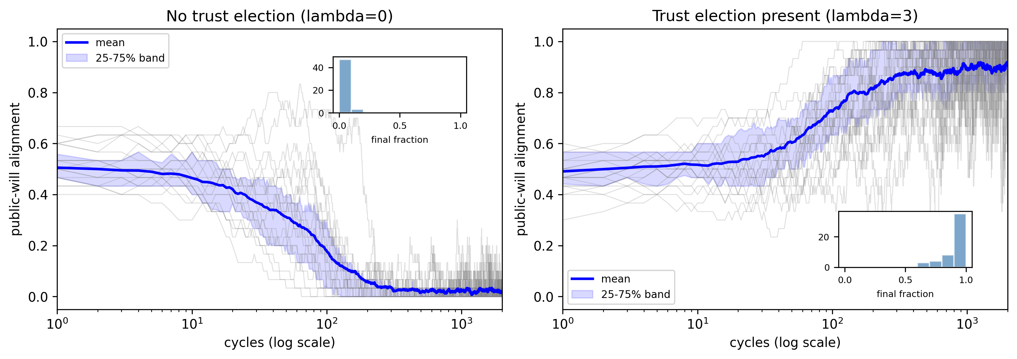
Figure 2 Intertemporal accountability mechanism
Left: without a trust election (lambda = 0) public-will alignment collapses (mean 0.917, P(final>0.8)=0.82). Right: with a periodic high-value trust election (lambda = 3) the population converges distributionally to high public-will alignment (mean 0.917, P(final>0.8)=0.82) (illustrative parameter set; log scale). The parameter lambda is the weight of a future selection event, not a direct reward for the public-will outcome, so the result is a stochastic threshold rather than a mechanical identity.

