Slide 1
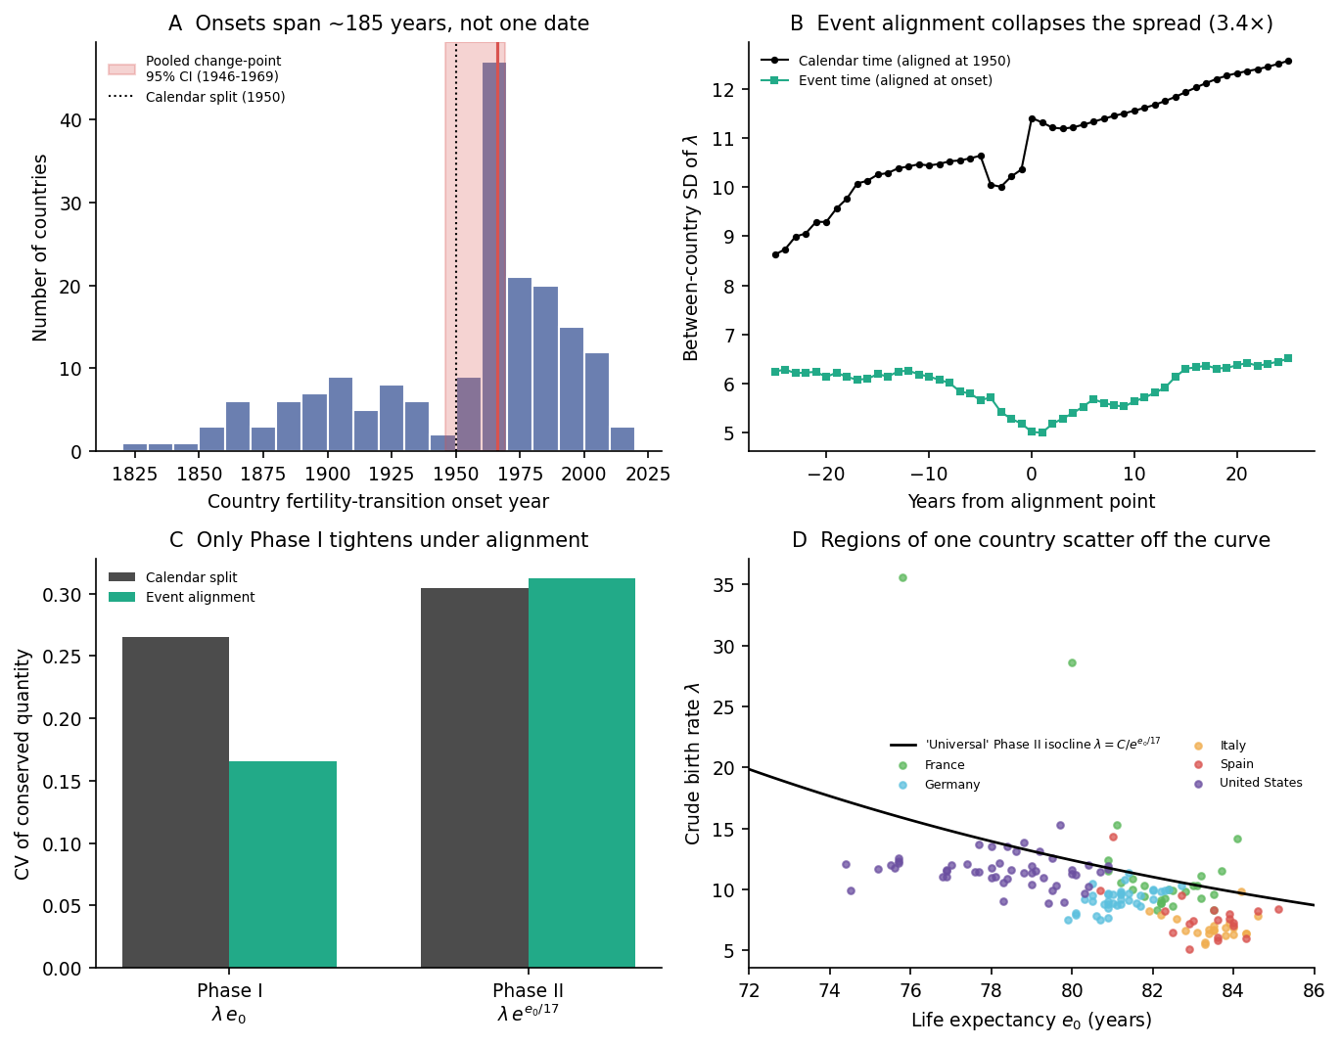
Figure 1. Two universal pathways under scrutiny
(A) Country fertility-transition onsets span ~185 years; the pooled change point (95% CI 1946-1969) is a summary of asynchronous transitions. (B) Aligning each country at its own onset collapses the between-country spread of lambda (3.4x variance reduction). (C) Under event alignment only the Phase I conserved quantity tightens; Phase II does not. (D) Within single countries, regions at nearly identical e0 scatter off the 'universal' curve.

Slide 2
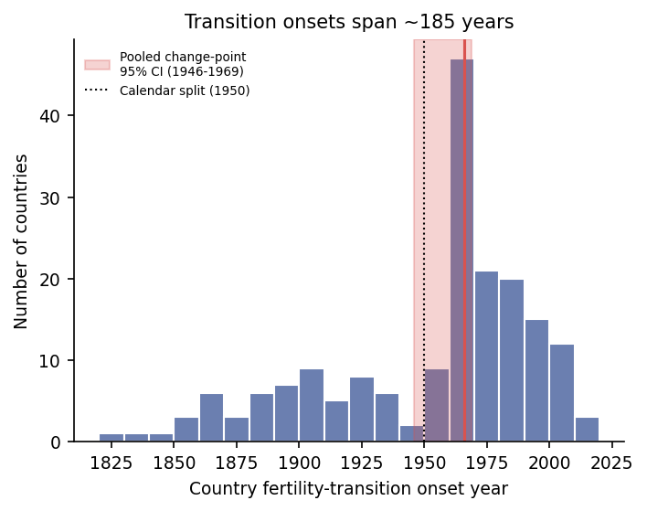
Panel A. Transition onsets span ~185 years
Distribution of country-specific fertility-transition onset years (Gapminder, n=185). Red band: bootstrap 95% CI of the single pooled calendar change point.

Slide 3
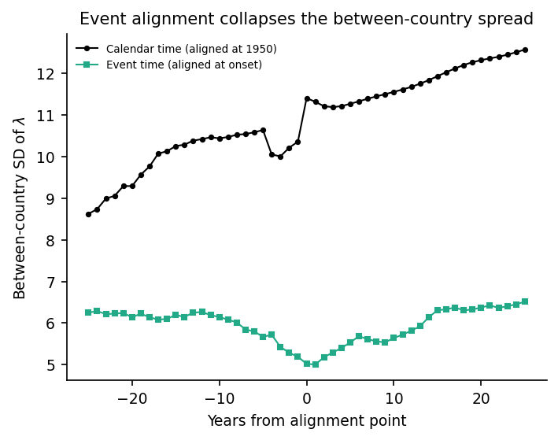
Panel B. Event alignment collapses the spread
Between-country SD of the crude birth rate around the alignment point, in calendar time (1950) versus event time (each country's onset).

Slide 4
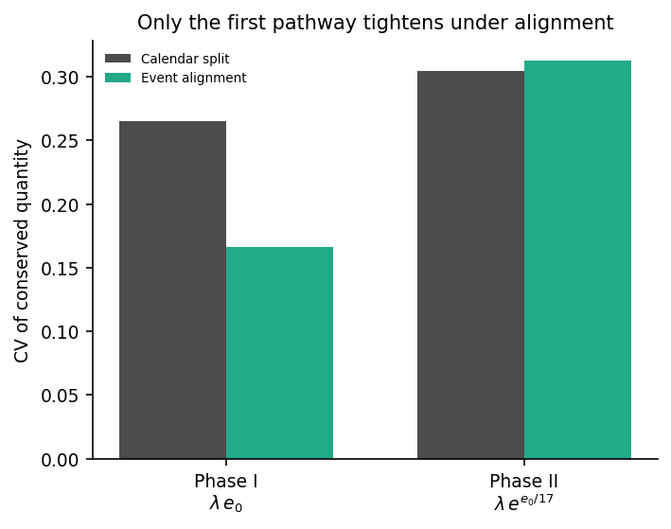
Panel C. Asymmetric universality of the two pathways
Coefficient of variation of the two conserved quantities within the paper's fitting windows, comparing the calendar split with event alignment.

Slide 5
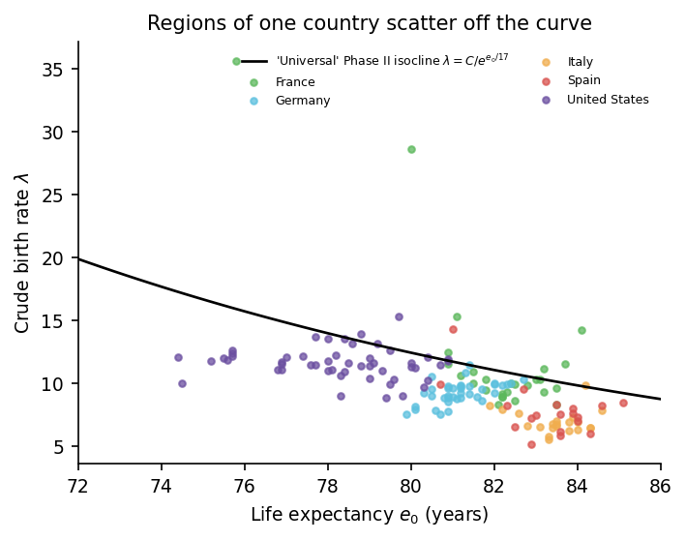
Panel D. Sub-national heterogeneity
Region-level crude birth rate versus life expectancy (2019) for five decentralised states, against the fitted national Phase II isocline.

Slide 6
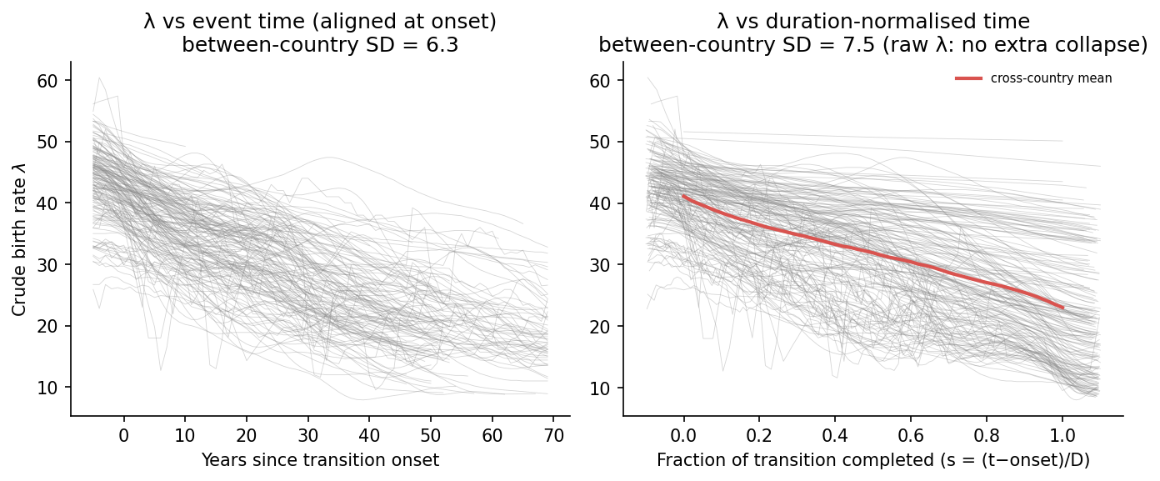
Figure 5. Time-axis rescaling does not create universality
Left: crude birth rate versus years since each country's transition onset. Right: versus duration-normalised time s=(t-onset)/D. Rescaling the time axis does not shrink the raw between-country spread of lambda beyond onset alignment; only the amplitude-normalised shape collapses, and the relationship at matched e0 is invariant to any monotone time warp.

