Slide 1
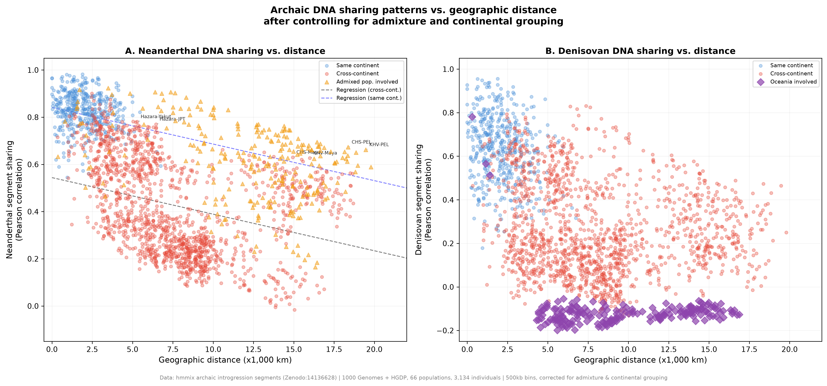
Figure 1. Archaic DNA sharing vs. geographic distance
Scatter plot of pairwise archaic DNA segment sharing correlation vs. geographic distance for 66 populations (2,145 pairs). (A) Neanderthal: blue = same continent, red = cross-continent, orange triangles = admixed populations. Dashed lines show corrected regression. (B) Denisovan: purple diamonds = Oceania-involved pairs. Corrected for admixture and continental grouping (R² = 0.51 / 0.50).

Slide 2
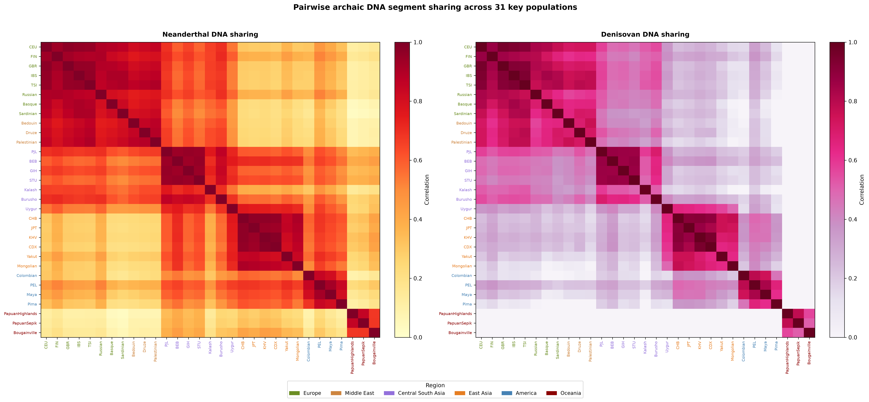
Figure 2. Pairwise archaic DNA sharing heatmap
Heatmap of Neanderthal (left) and Denisovan (right) introgression segment sharing for 31 key populations. Note the isolated Oceanian cluster in the Denisovan panel (bottom-right), reflecting the Wallace Line boundary. Population labels colored by continental region.

Slide 3
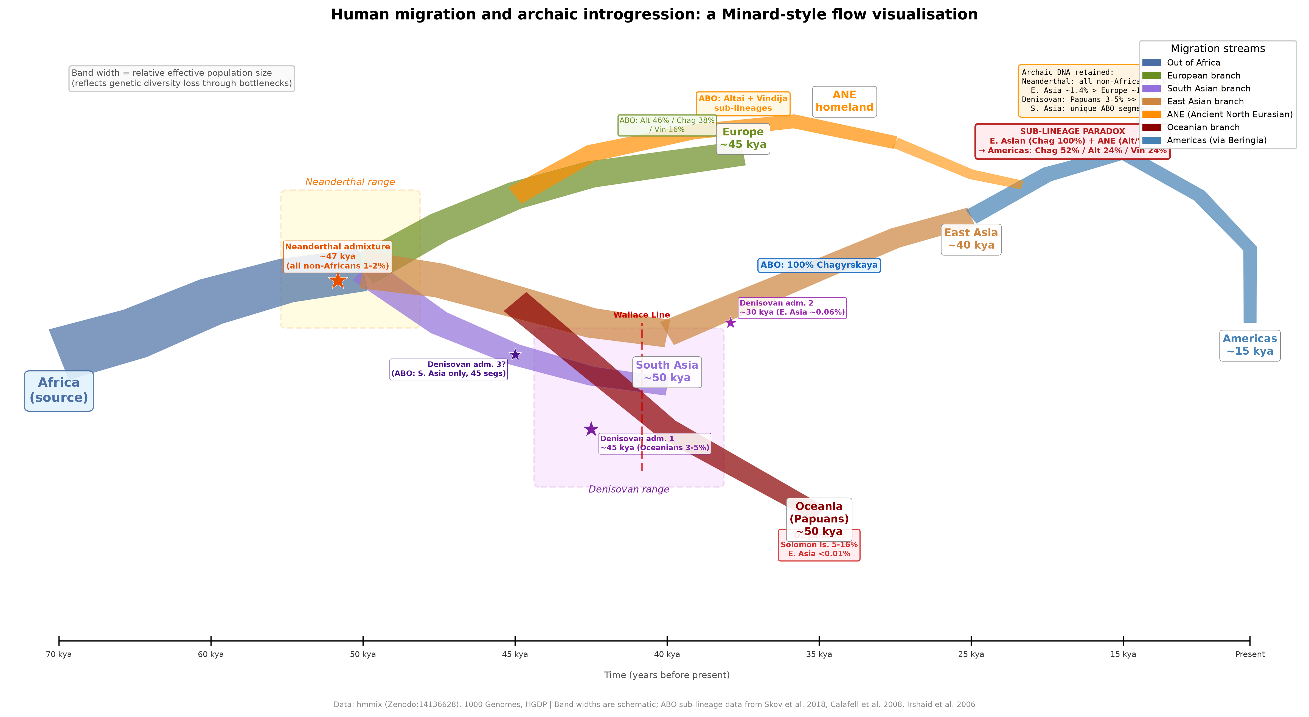
Figure 3. Minard-style Out-of-Africa migration flow
Flow visualization of Homo sapiens Out-of-Africa migration with archaic admixture events. Band width = relative population size. Stars = admixture events (Neanderthal ~47 kya; Denisovan 1 ~45 kya for Oceania 3-5%; Denisovan 2 ~30 kya for East Asia ~0.06%). Timelines approximate.

Slide 4
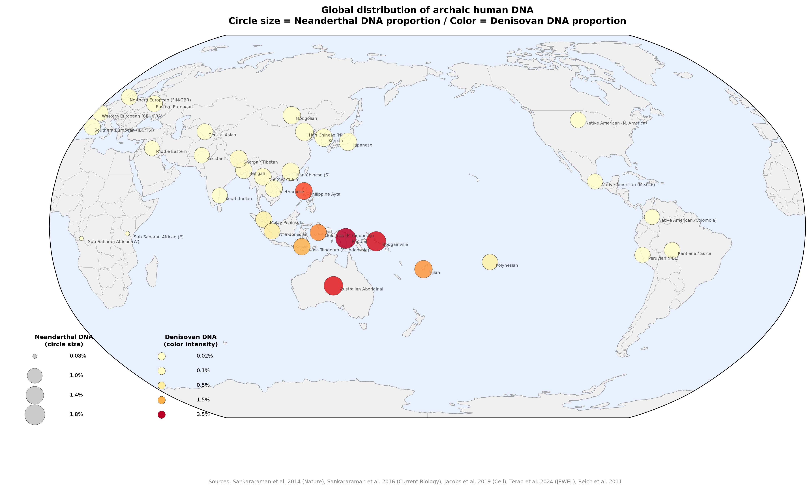
Figure 4. Bivariate world map of archaic DNA
Global distribution of archaic human DNA. Circle size = Neanderthal DNA proportion (0.08-1.8%). Color intensity = Denisovan DNA proportion (0.02-3.5%). Sharp color transition at the Wallace Line visible between mainland SE Asia and island Melanesia.

