Slide 1
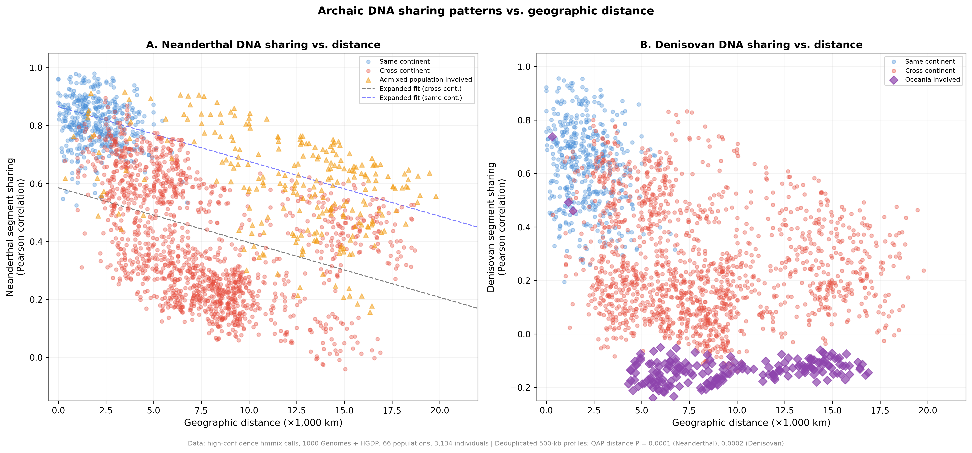
Figure 1
Archaic-segment profile similarity and geographic distance. Each point is a dependent population pair. Lines are descriptive distance-only fits; reported P values use population-label quadratic assignment permutations.

Slide 2
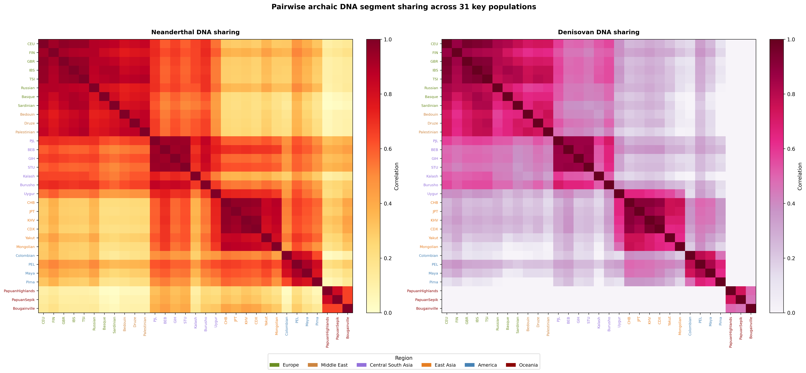
Figure 2
Pairwise archaic-segment profile similarity for 31 prespecified populations. The subset is displayed for legibility; all 66 populations were analyzed.

Slide 3
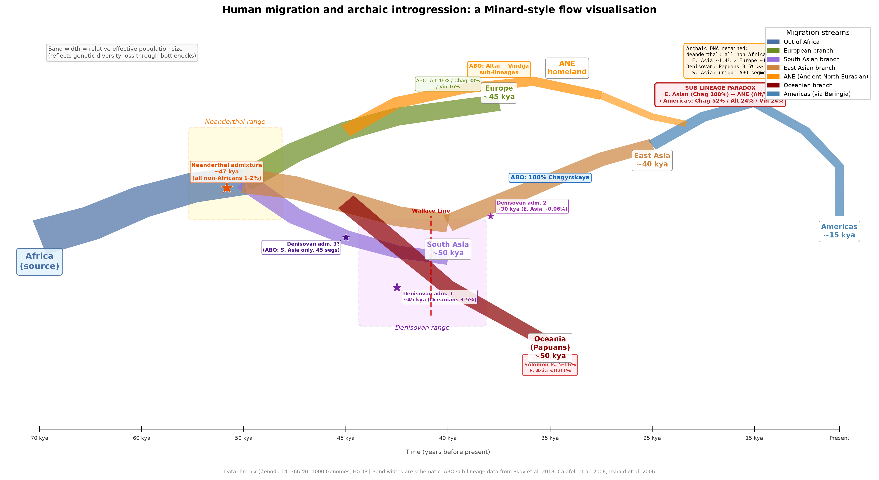
Figure 3
Minard-style schematic of human dispersal and archaic introgression. Band widths, branch positions, and event placement are illustrative and do not estimate migration magnitude, ancestry proportion, or a route supported by the present analysis.

Slide 4
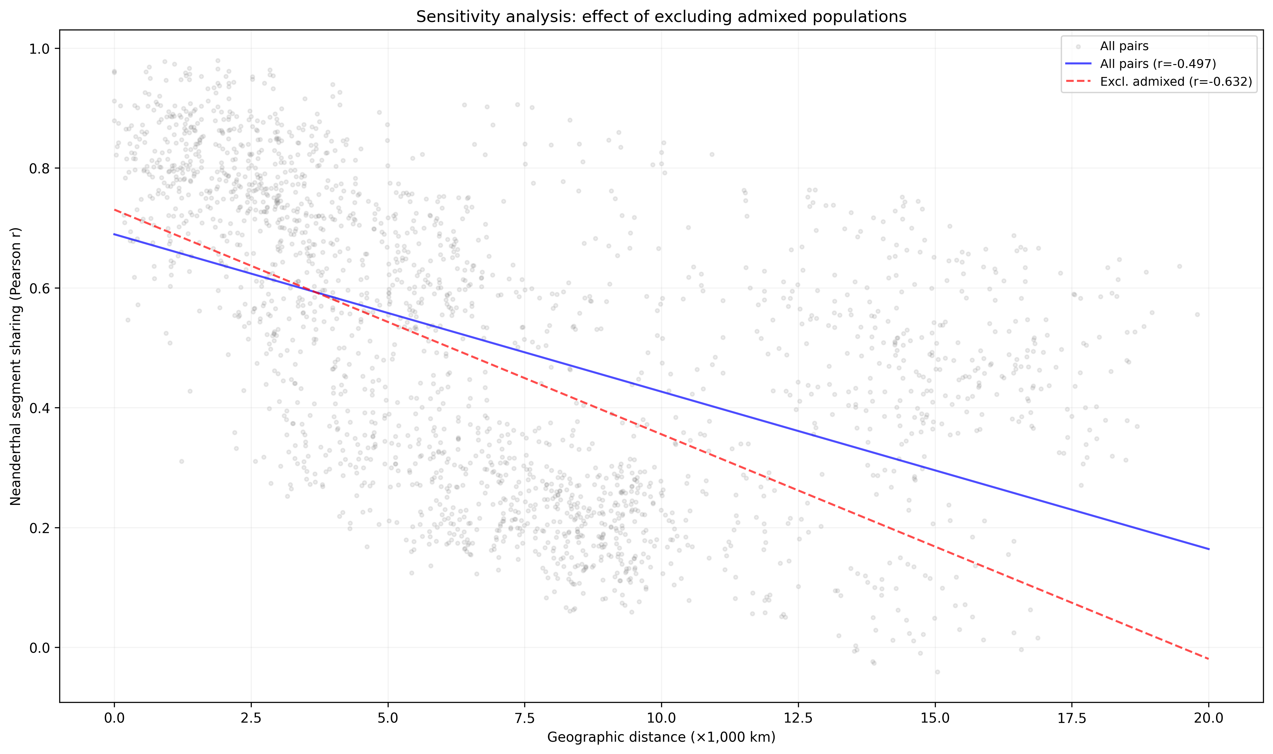
Figure 4
Sensitivity of the descriptive Neanderthal distance correlation to exclusion of designated recently admixed populations.

Slide 5
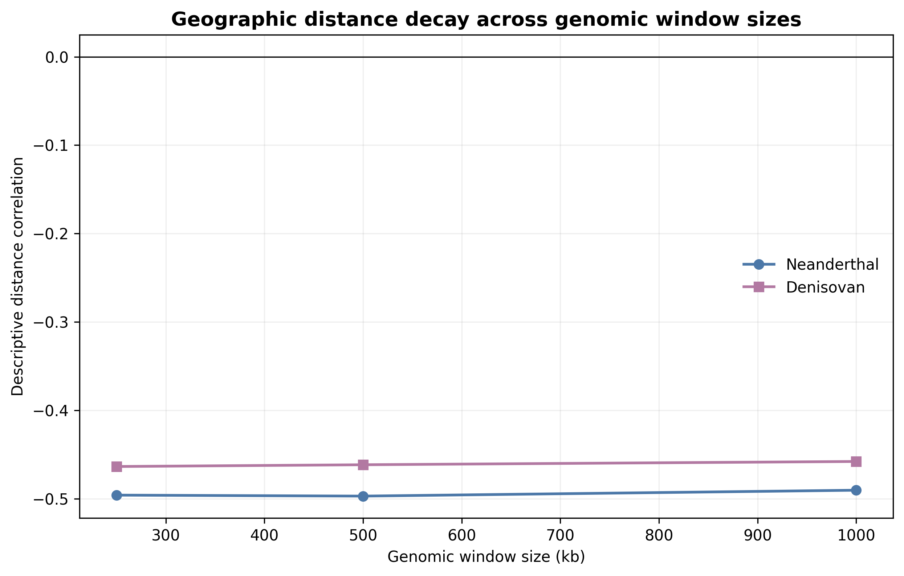
Figure 5
Descriptive geographic distance correlations at 250-kb, 500-kb, and 1-Mb window sizes. Quadratic assignment procedure results are tabulated in Supplementary Data.

Slide 6
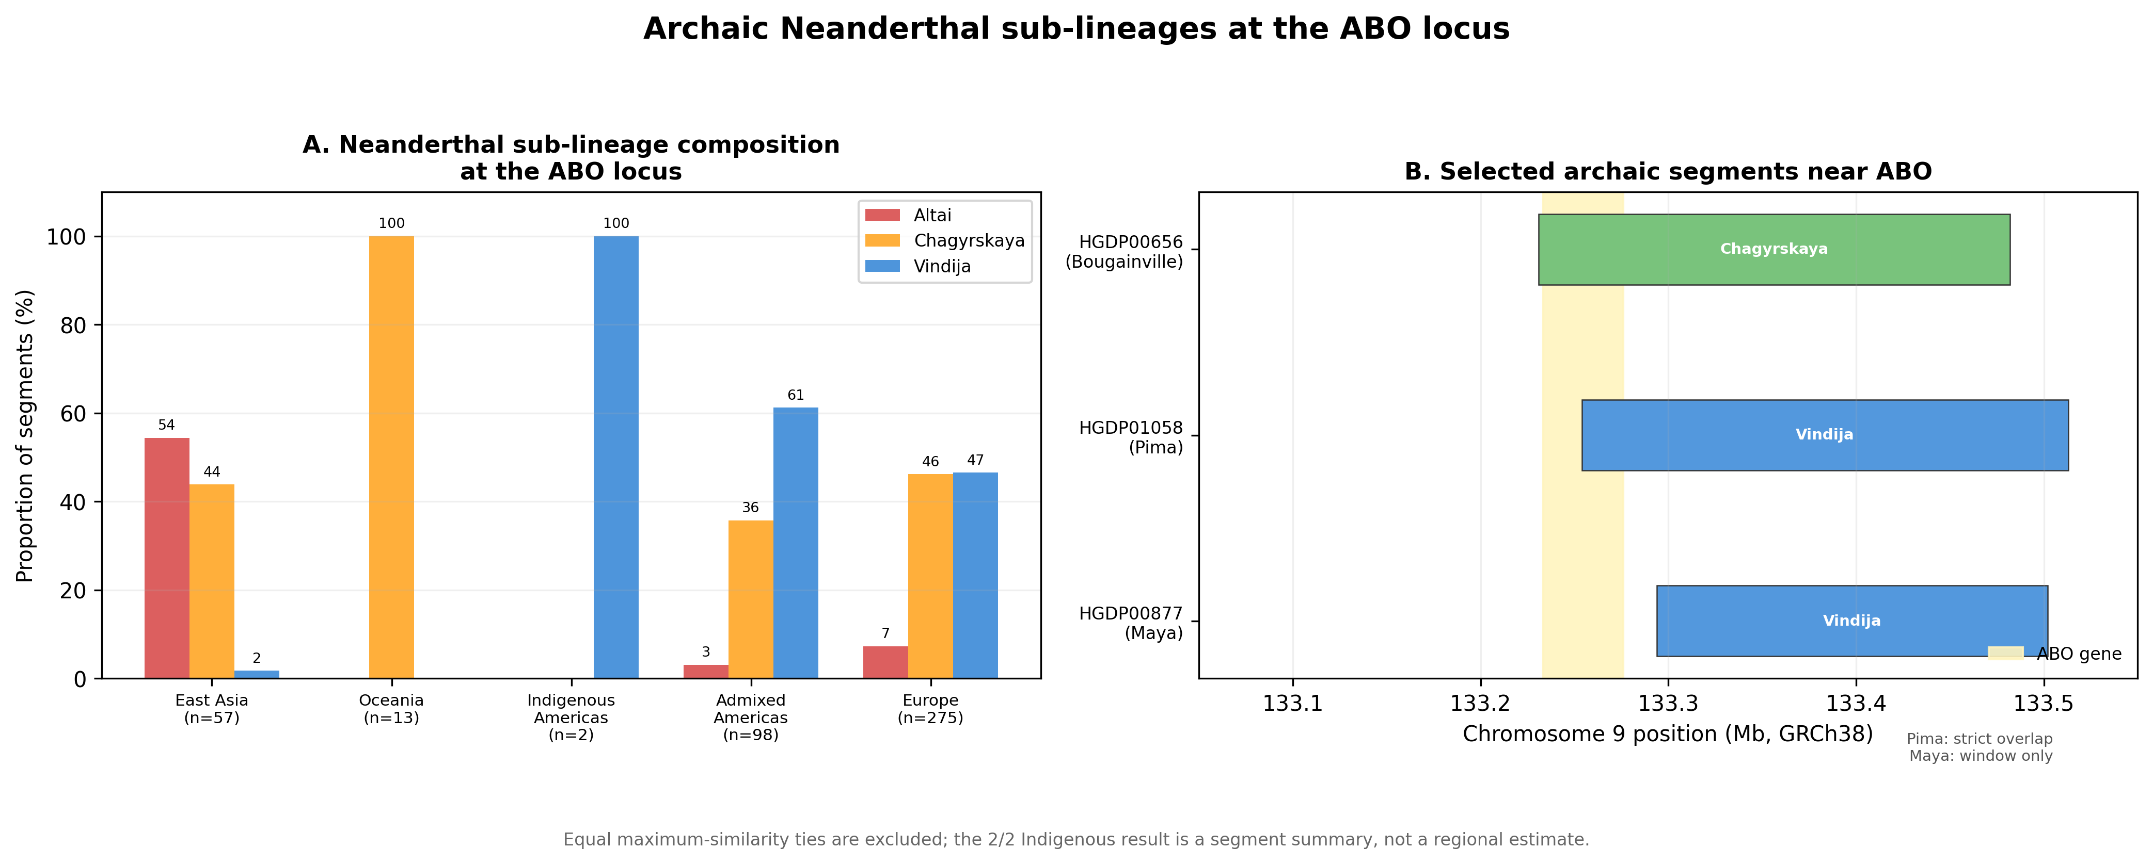
Figure 6
ABO-centered analysis preserving the historical grouped-bar and segment-map layout. Equal maximum-similarity ties are excluded from the displayed three-reference proportions and retained in Supplementary Data. The Pima segment overlaps ABO; the Maya segment is within the wider interval but does not overlap the gene. Counts are segments, not regional frequencies.

Slide 7
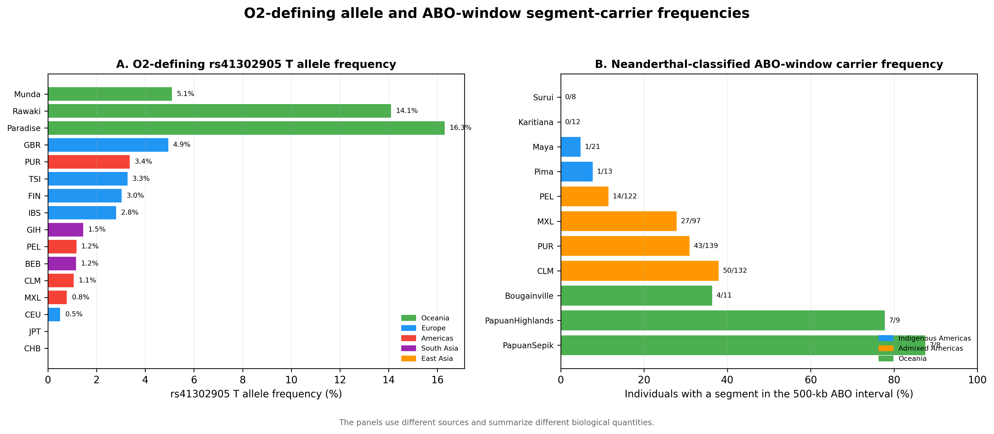
Figure 7
O2 blood-group subtype-defining allele frequencies and ABO-window segment-carrier frequencies. The panels use different sources and are not an association analysis; proximity does not establish that the O2 allele is Neanderthal-derived.

Slide 8
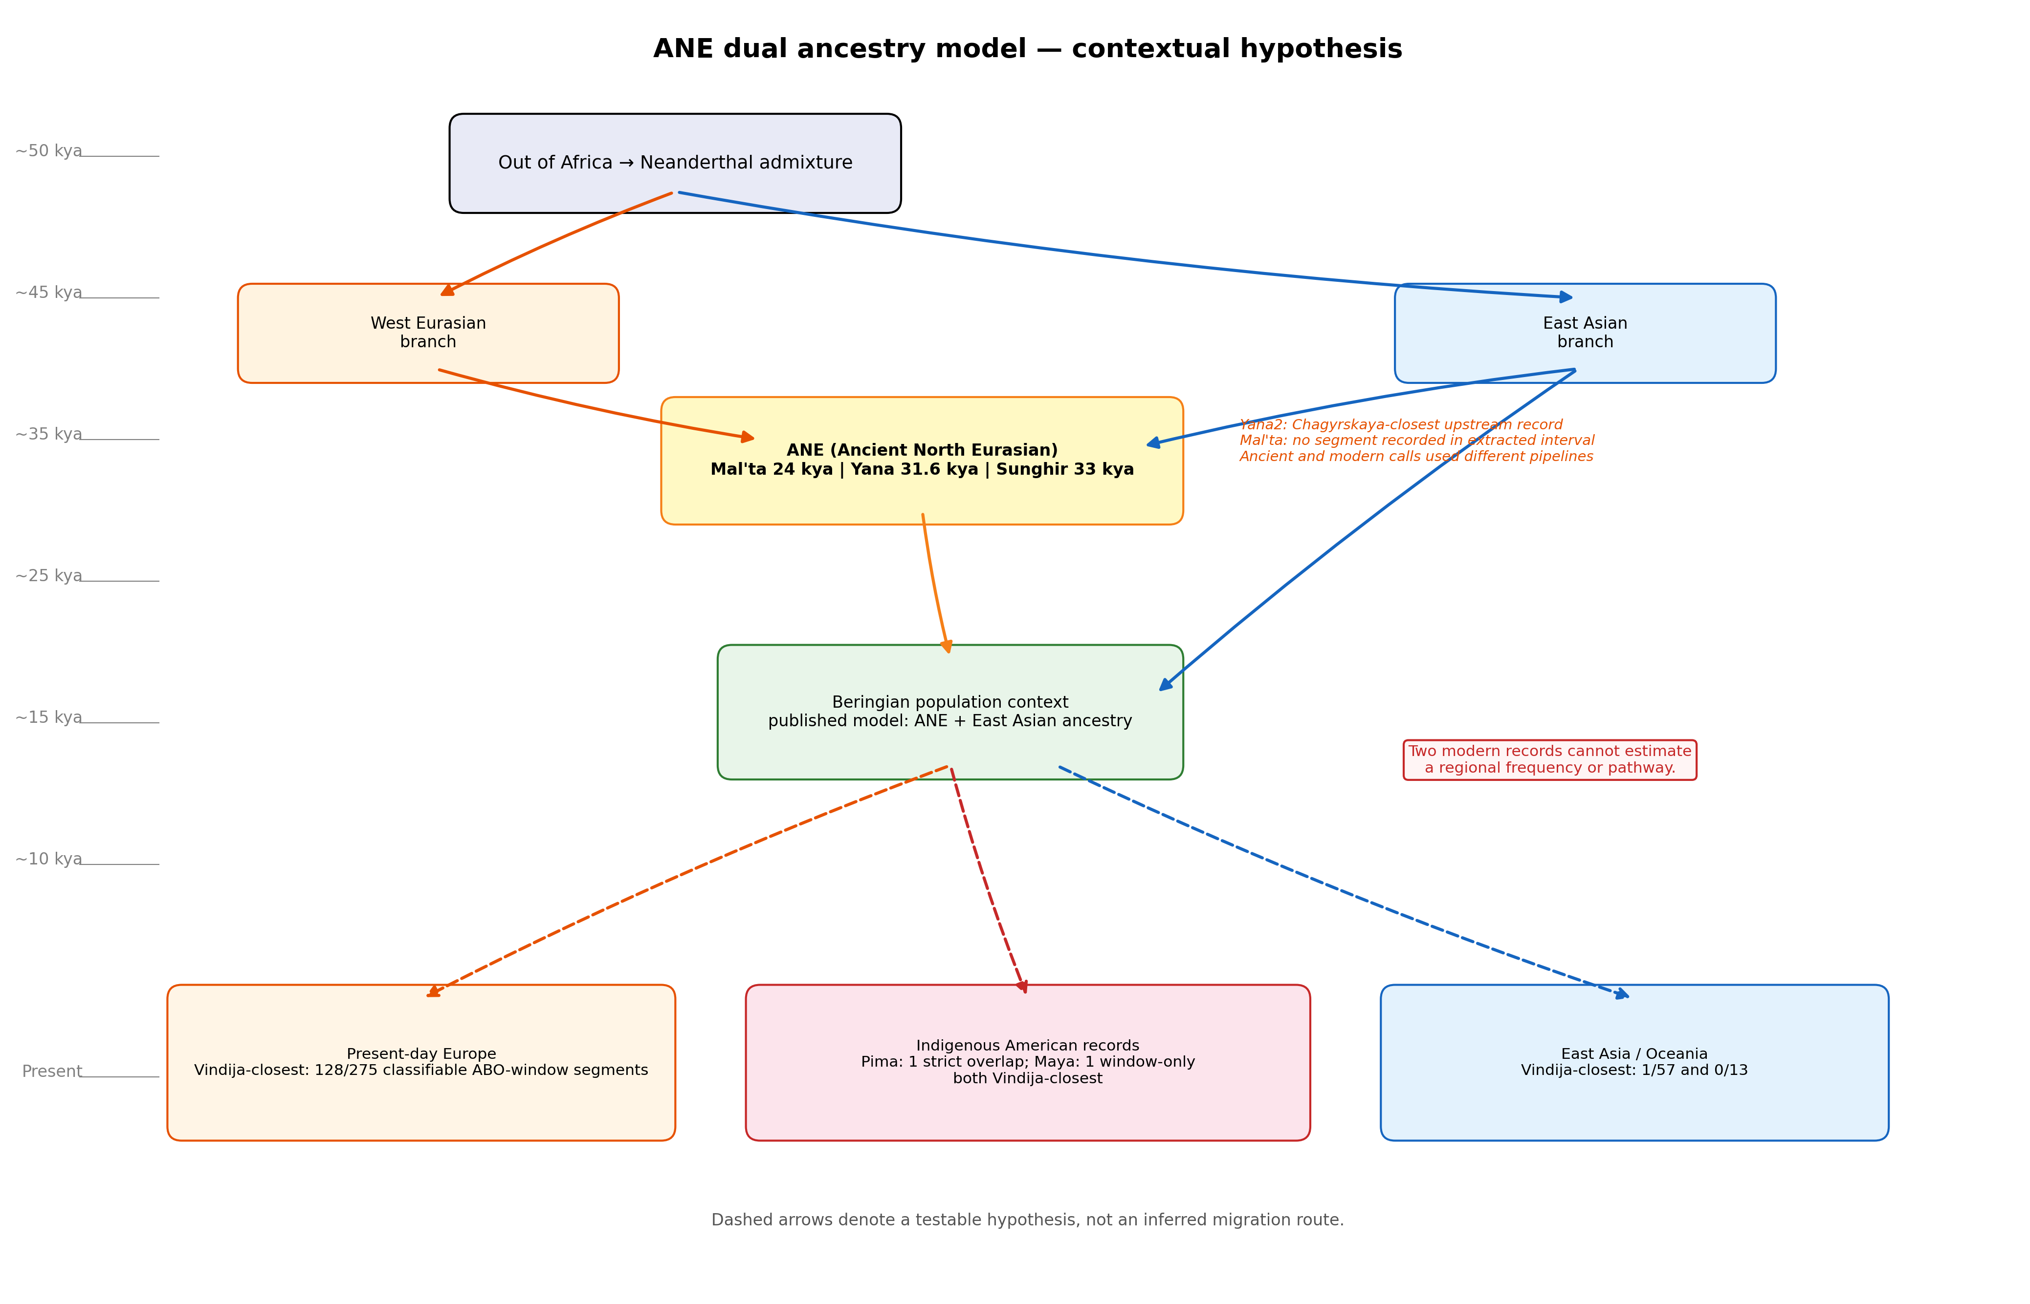
Figure 8
Ancient North Eurasian contextual hypothesis. Dashed arrows represent a testable narrative, not evidence that either observed segment followed the illustrated route.

Slide 9
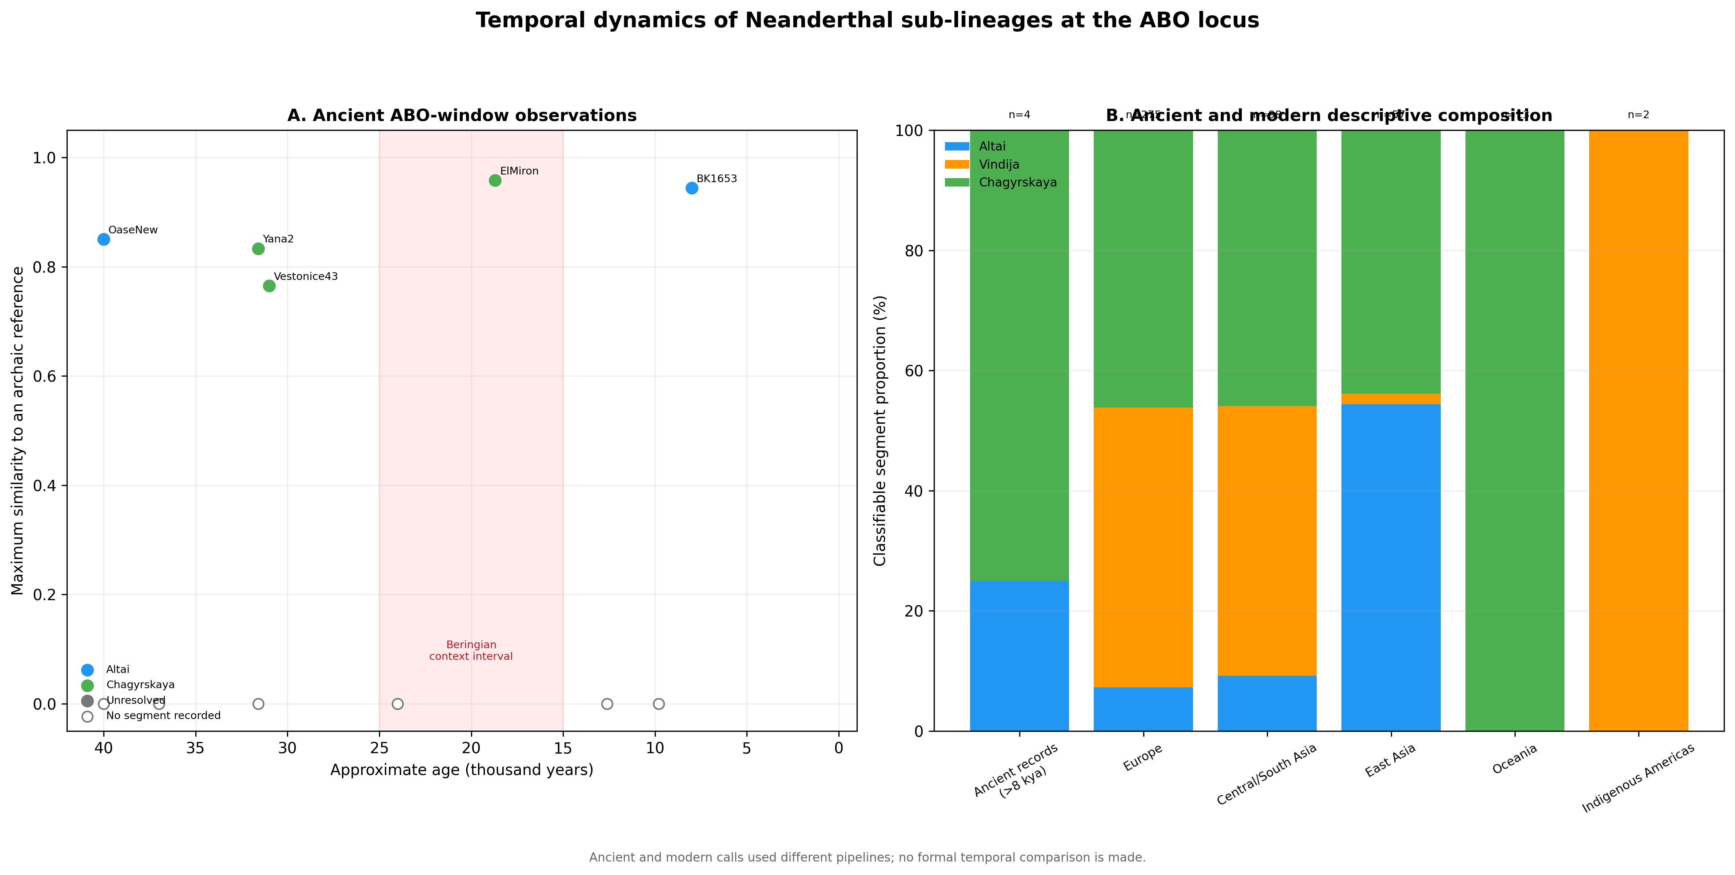
Figure 9
Descriptive ancient and modern ABO-window summaries generated by different pipelines; no formal temporal comparison is made.

Slide 10
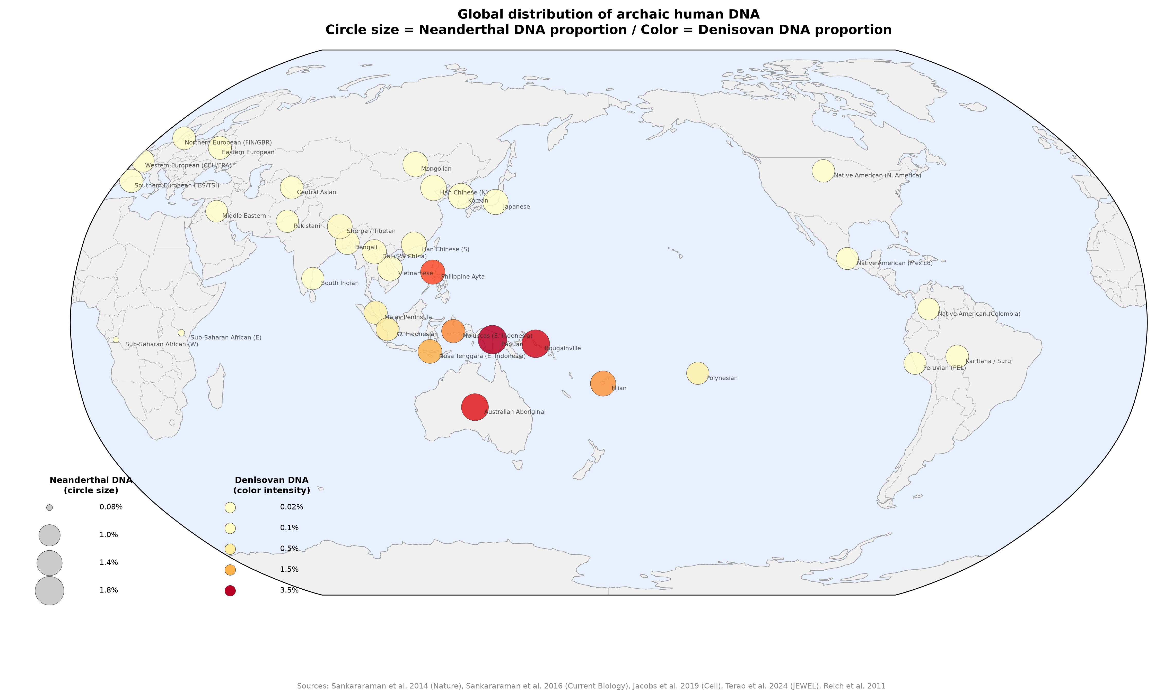
Figure 10
Literature-derived global context. Circle size represents approximate Neanderthal ancestry and color intensity represents approximate Denisovan ancestry. Values were not used in the pairwise statistical models.

Slide 11
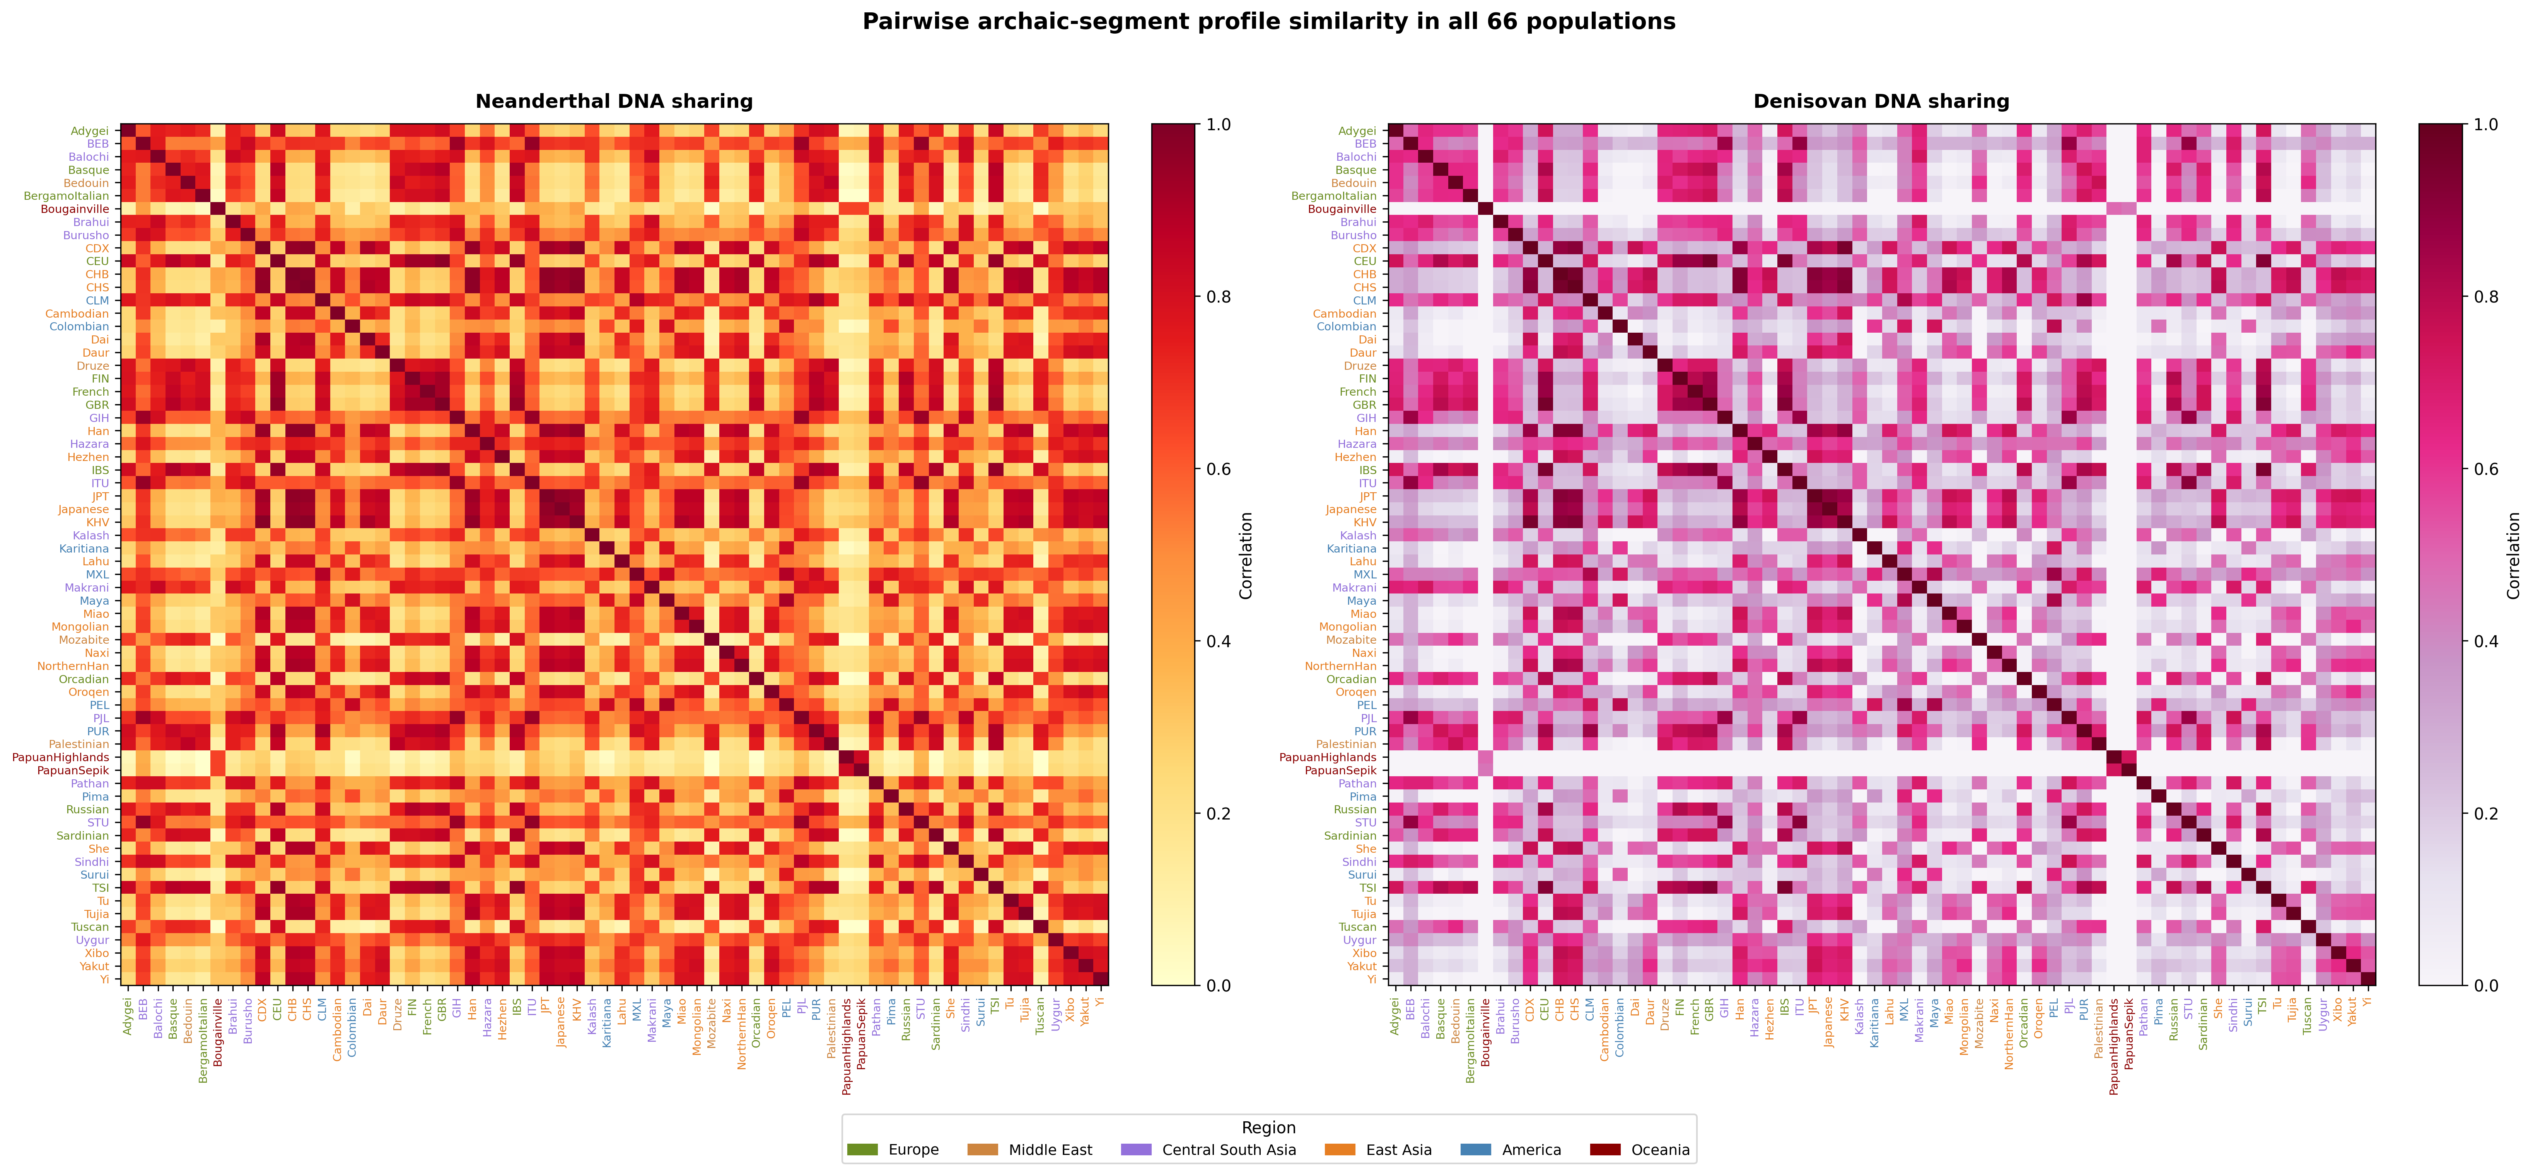
Figure S1
Complete 66-population Neanderthal and Denisovan profile-similarity matrices.

Slide 12
Table 1. Positive-residual Neanderthal pairs after false discovery rate control
Population 1 | Population 2 | Region 1 | Region 2 | Distance (km) | Sharing (r) | z-score
No qualifying pair | — | — | — | — | — | No z>2 and q<0.10 result
Note. The prespecified family contains all non-admixed population pairs. No pair met both z>2 and Benjamini-Hochberg q<0.10; the Denisovan analysis likewise identified no qualifying pair. Complete nominal rankings and dependence-aware model results are provided in Supplementary Data.

Slide 13
Table 2. ABO-window Neanderthal-reference composition
Region | n | Altai % | Vindija % | Chagyrskaya %
East Asia | 57 | 54.4 | 1.8 | 43.9
Europe | 275 | 7.3 | 46.5 | 46.2
Indigenous Americas | 2 | 0.0 | 100.0 | 0.0
Admixed Americas | 98 | 3.1 | 61.2 | 35.7
Central/South Asia | 98 | 9.2 | 44.9 | 45.9
Middle East | 44 | 11.4 | 52.3 | 36.4
Oceania | 13 | 0.0 | 0.0 | 100.0
Note. Counts are classifiable segments, not individuals. Percentages use the three-reference denominator shown by n. Equal maximum-similarity ties are excluded from these percentages but retained in Supplementary Data. The 2/2 Indigenous American value is not a regional frequency estimate; only one segment overlaps ABO.

