Slide 1
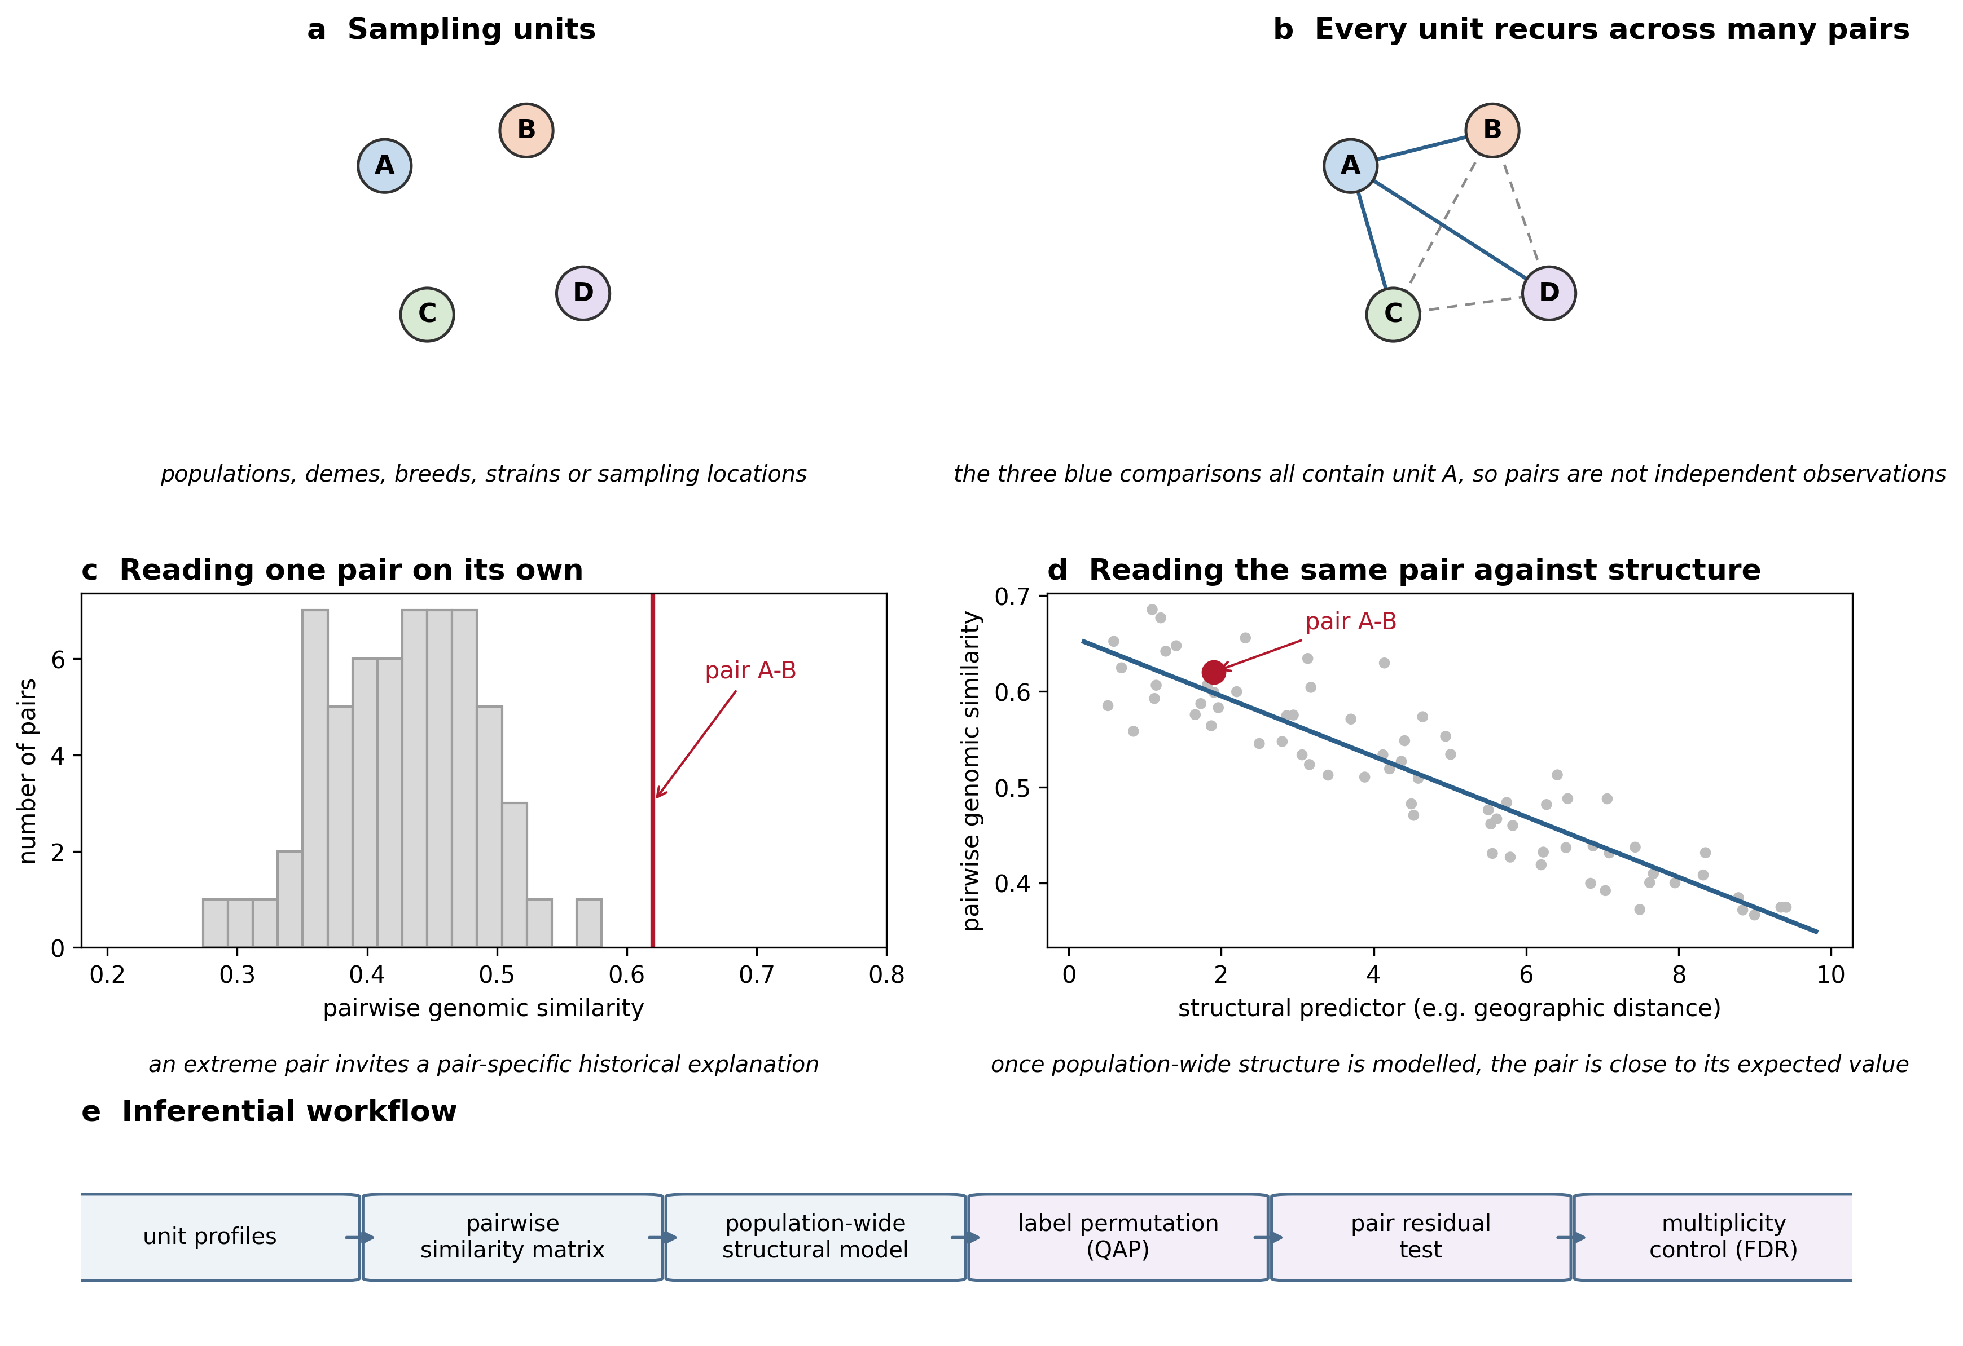
Figure 1
Why pairwise comparisons need a structural null. (a) Four sampling units. (b) Every unit recurs across many pairs, so pairwise measurements are not independent. (c) Reading one pair on its own invites a pair-specific explanation. (d) The same pair read against the expectation generated by the whole set of units. (e) The inferential workflow used here: population profiles, complete pairwise similarity matrix, population-wide structural model, population-label permutation (QAP), residual pair test, and multiplicity control. Panels a-d are schematic illustrations and do not display analysis results.

Slide 2
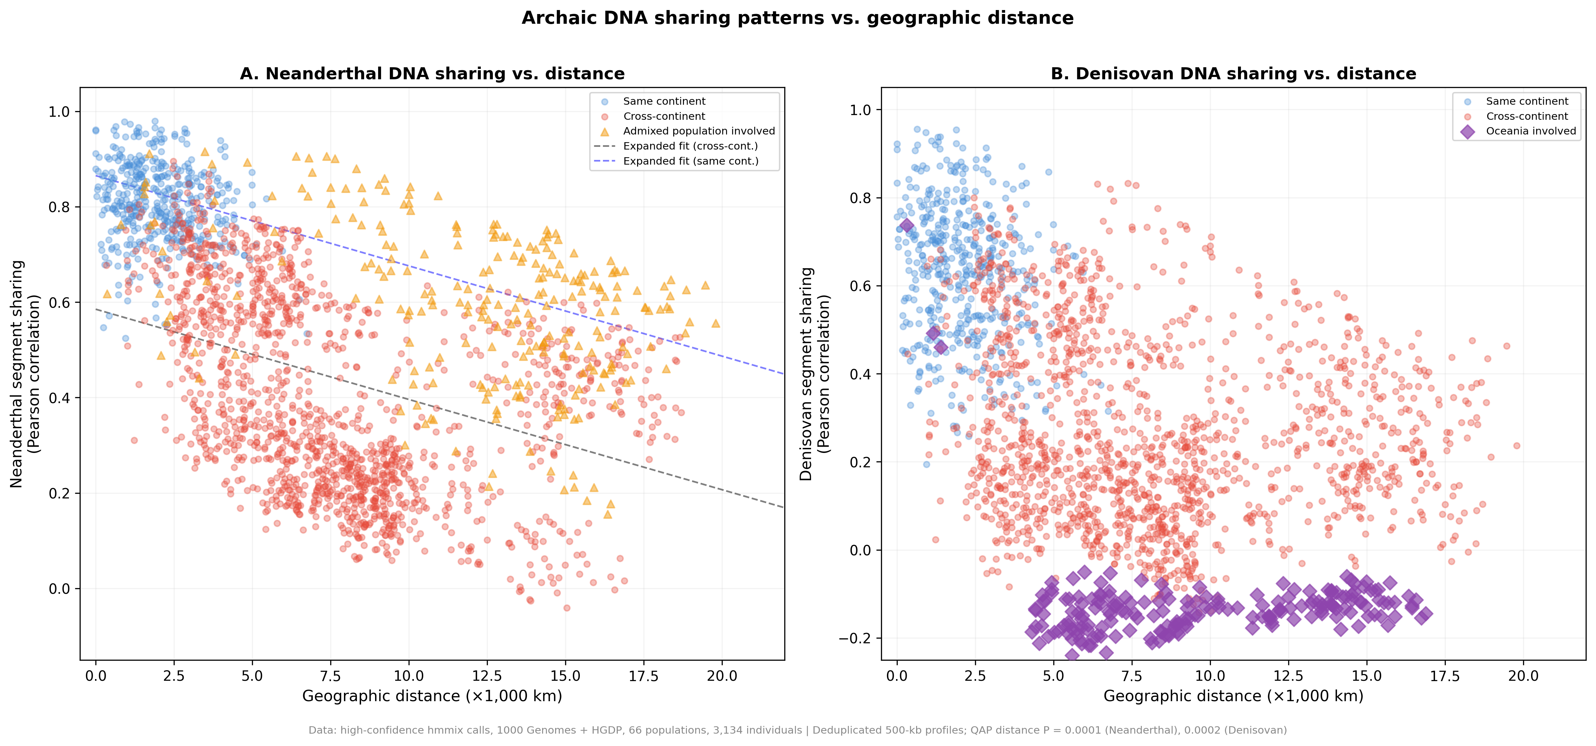
Figure 2
Archaic-segment profile similarity against geographic distance. Each point is one population pair; pairs sharing a population are not independent. Lines are descriptive distance-only fits, and reported P values come from population-label QAP permutations.

Slide 3
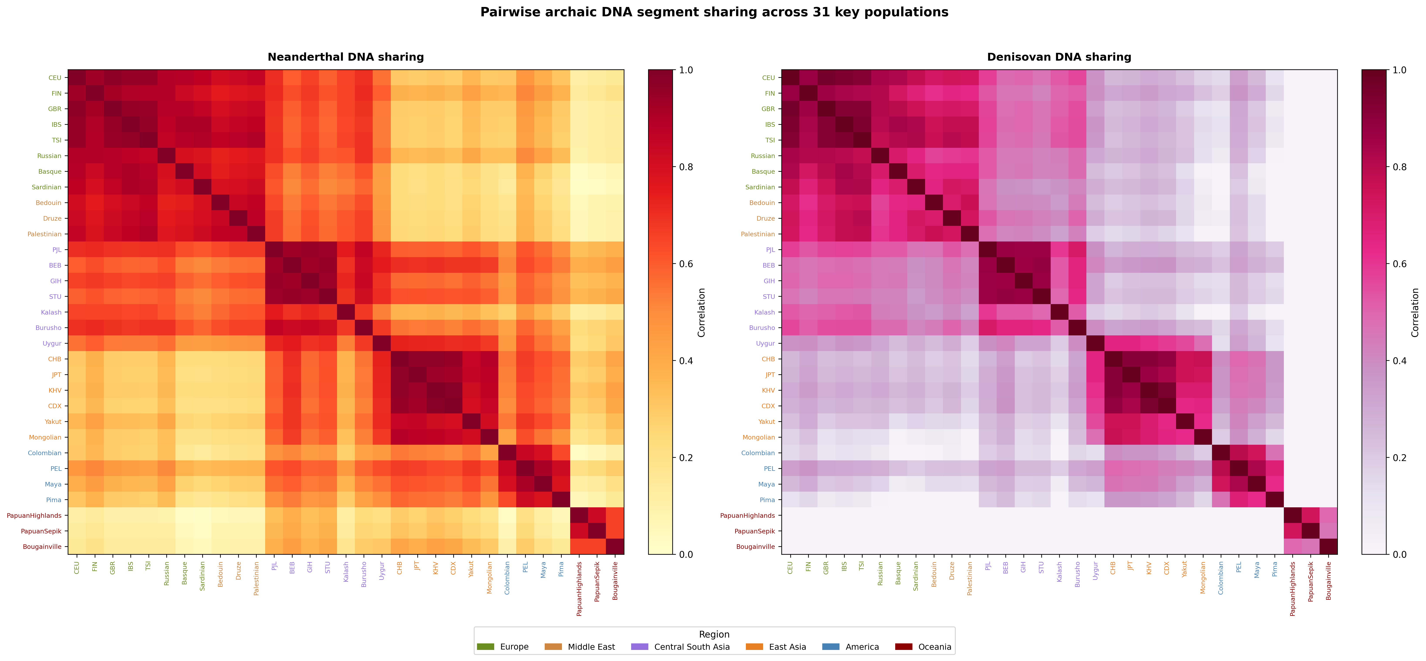
Figure 3
Population-wide similarity structure. Pairwise archaic-segment profile similarity for 31 populations selected for visual legibility and ordered by geographic region; all 66 populations were analysed (Figure S1).

Slide 4
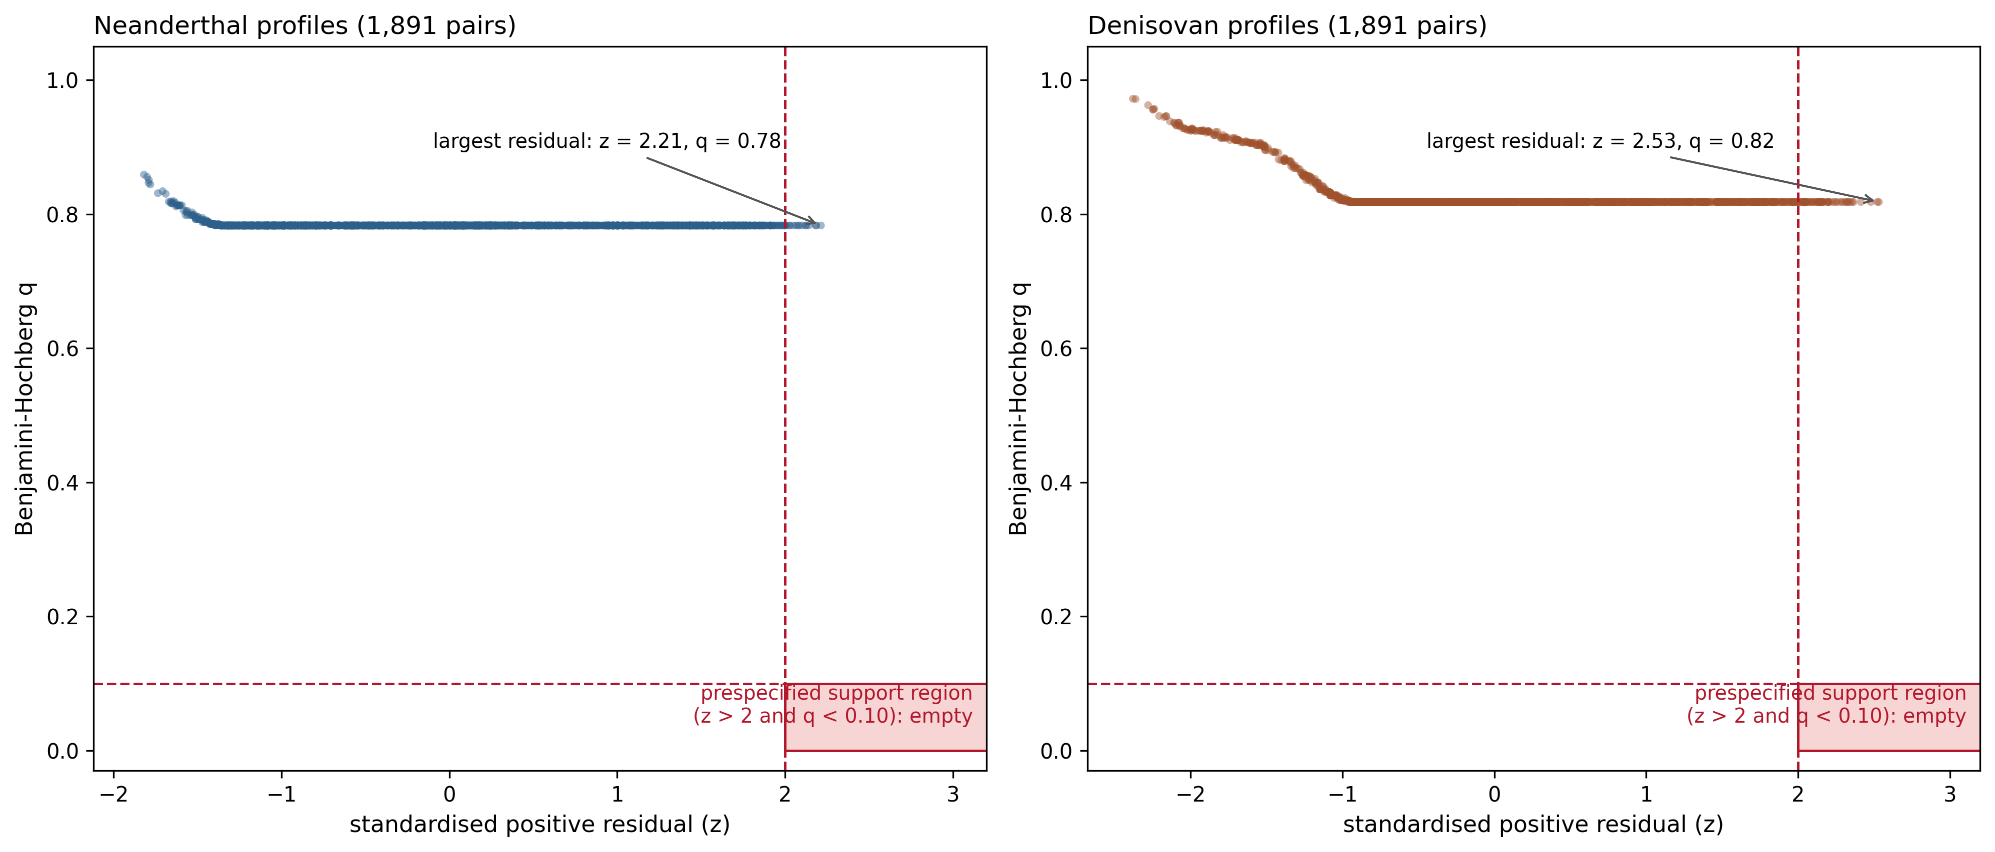
Figure 4
Pair-specific evidence against the structural expectation. For each non-admixed population pair, the standardised positive residual from the population-wide model is plotted against its Benjamini-Hochberg q value. The shaded region marks the prespecified support criterion (z>2 and q<0.10), which contains no pair for either ancestry.

Slide 5
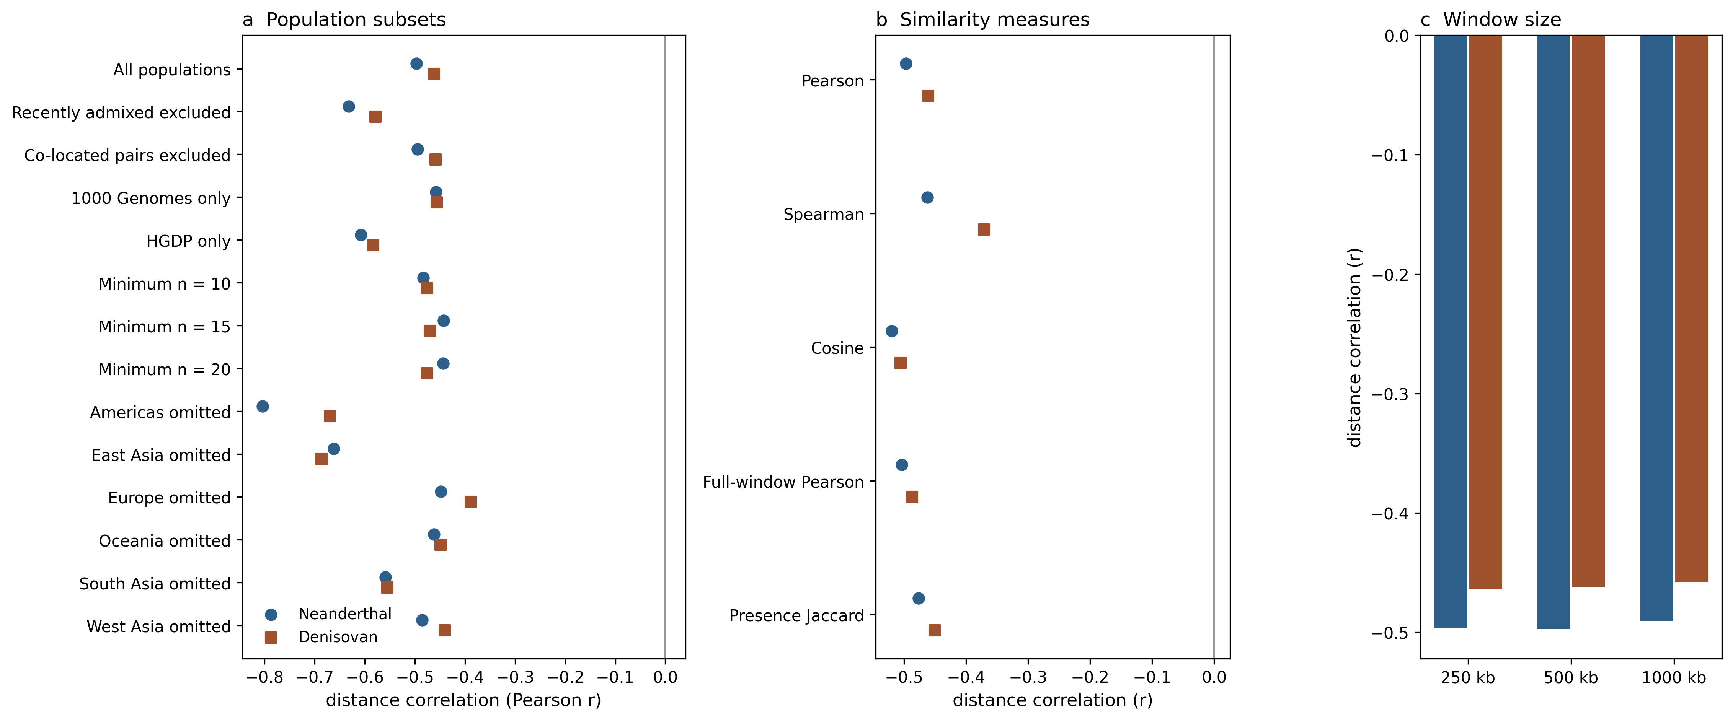
Figure 5
Robustness of the population-wide distance association. (a) Population subsets, including dataset restrictions, minimum sample sizes, exclusion of recently admixed populations and co-located pairs, and omission of each region in turn. (b) Alternative similarity measures. (c) 250-kb, 500-kb, and 1-Mb window sizes. All panels summarise analyses reported in Supplementary Data; no additional hypothesis test is introduced.

Slide 6
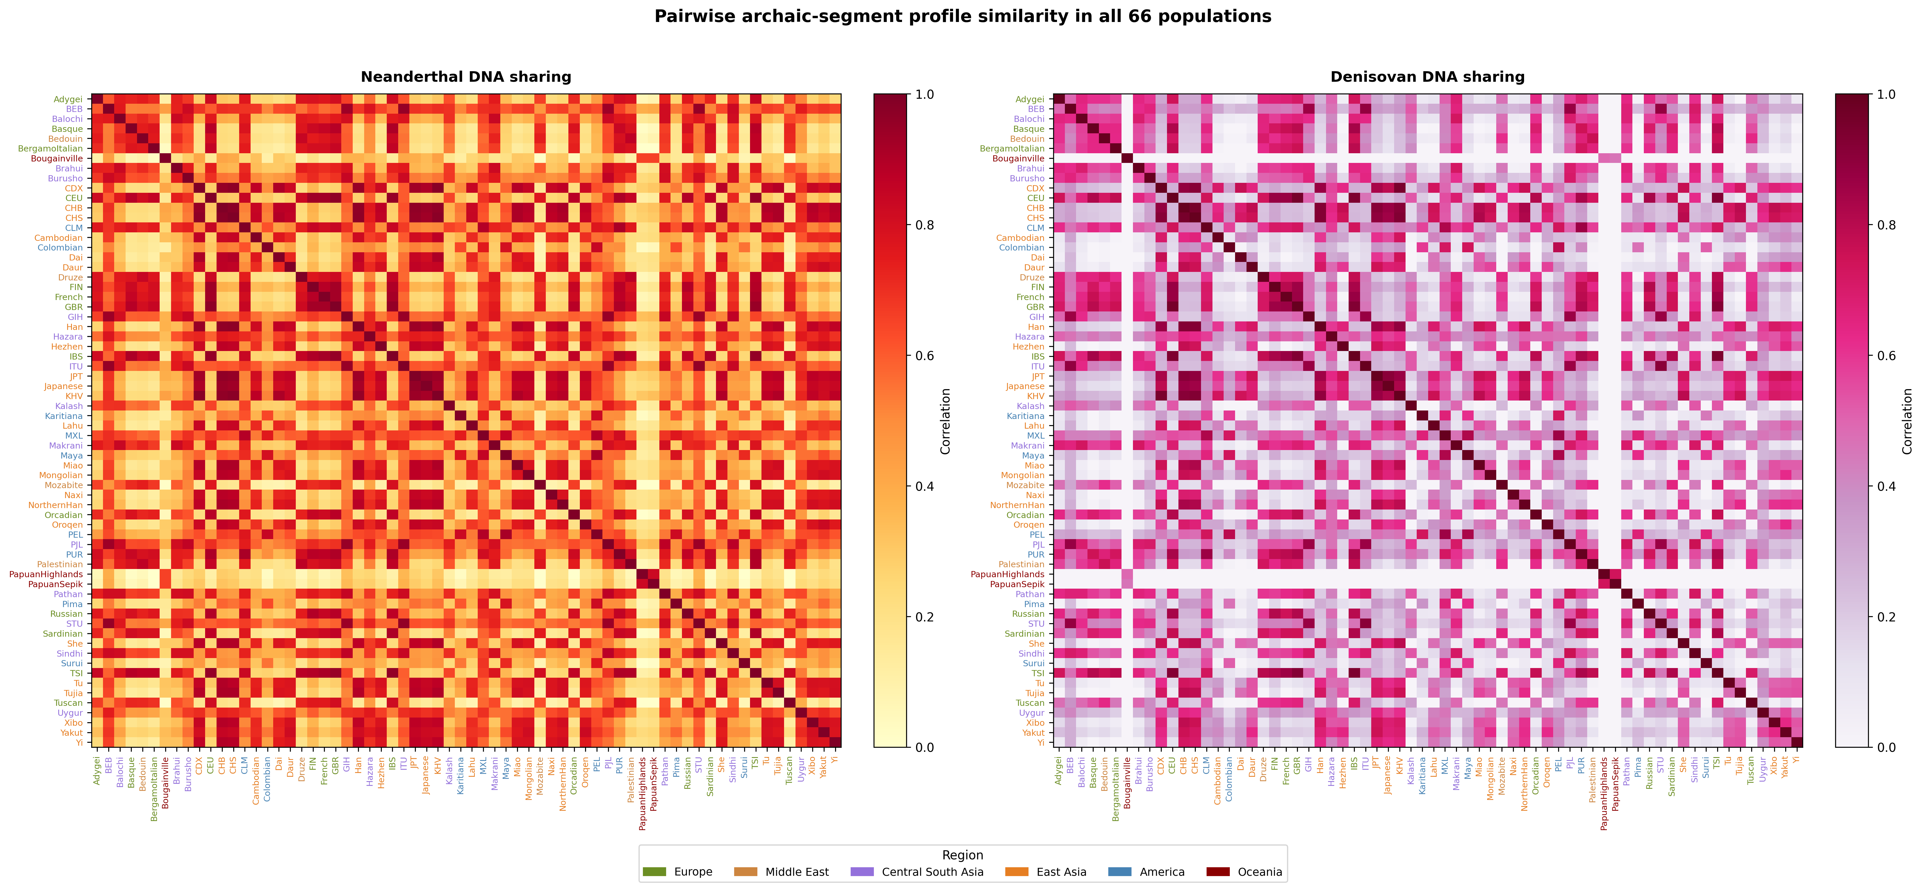
Figure S1
Complete 66-population Neanderthal and Denisovan profile-similarity matrices.

Slide 7
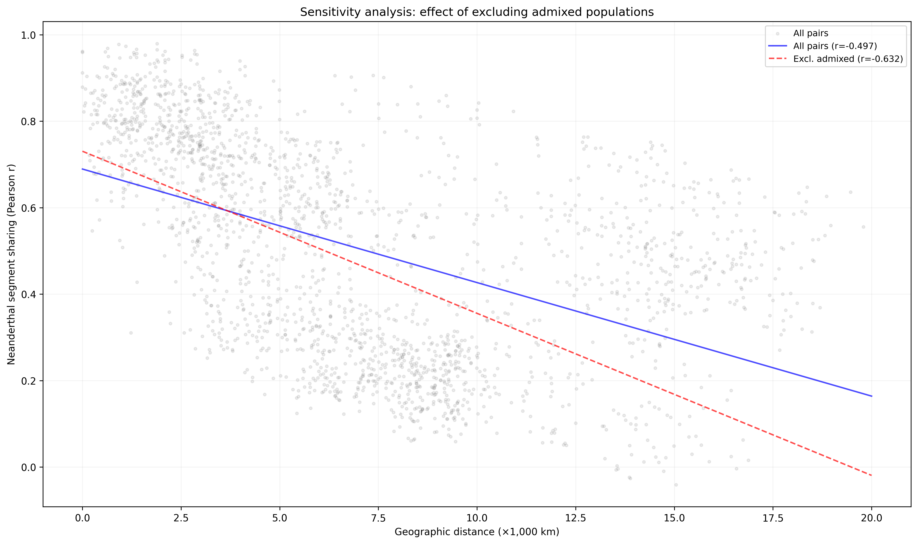
Figure S2
Sensitivity of the descriptive Neanderthal distance correlation to exclusion of designated recently admixed populations.

Slide 8
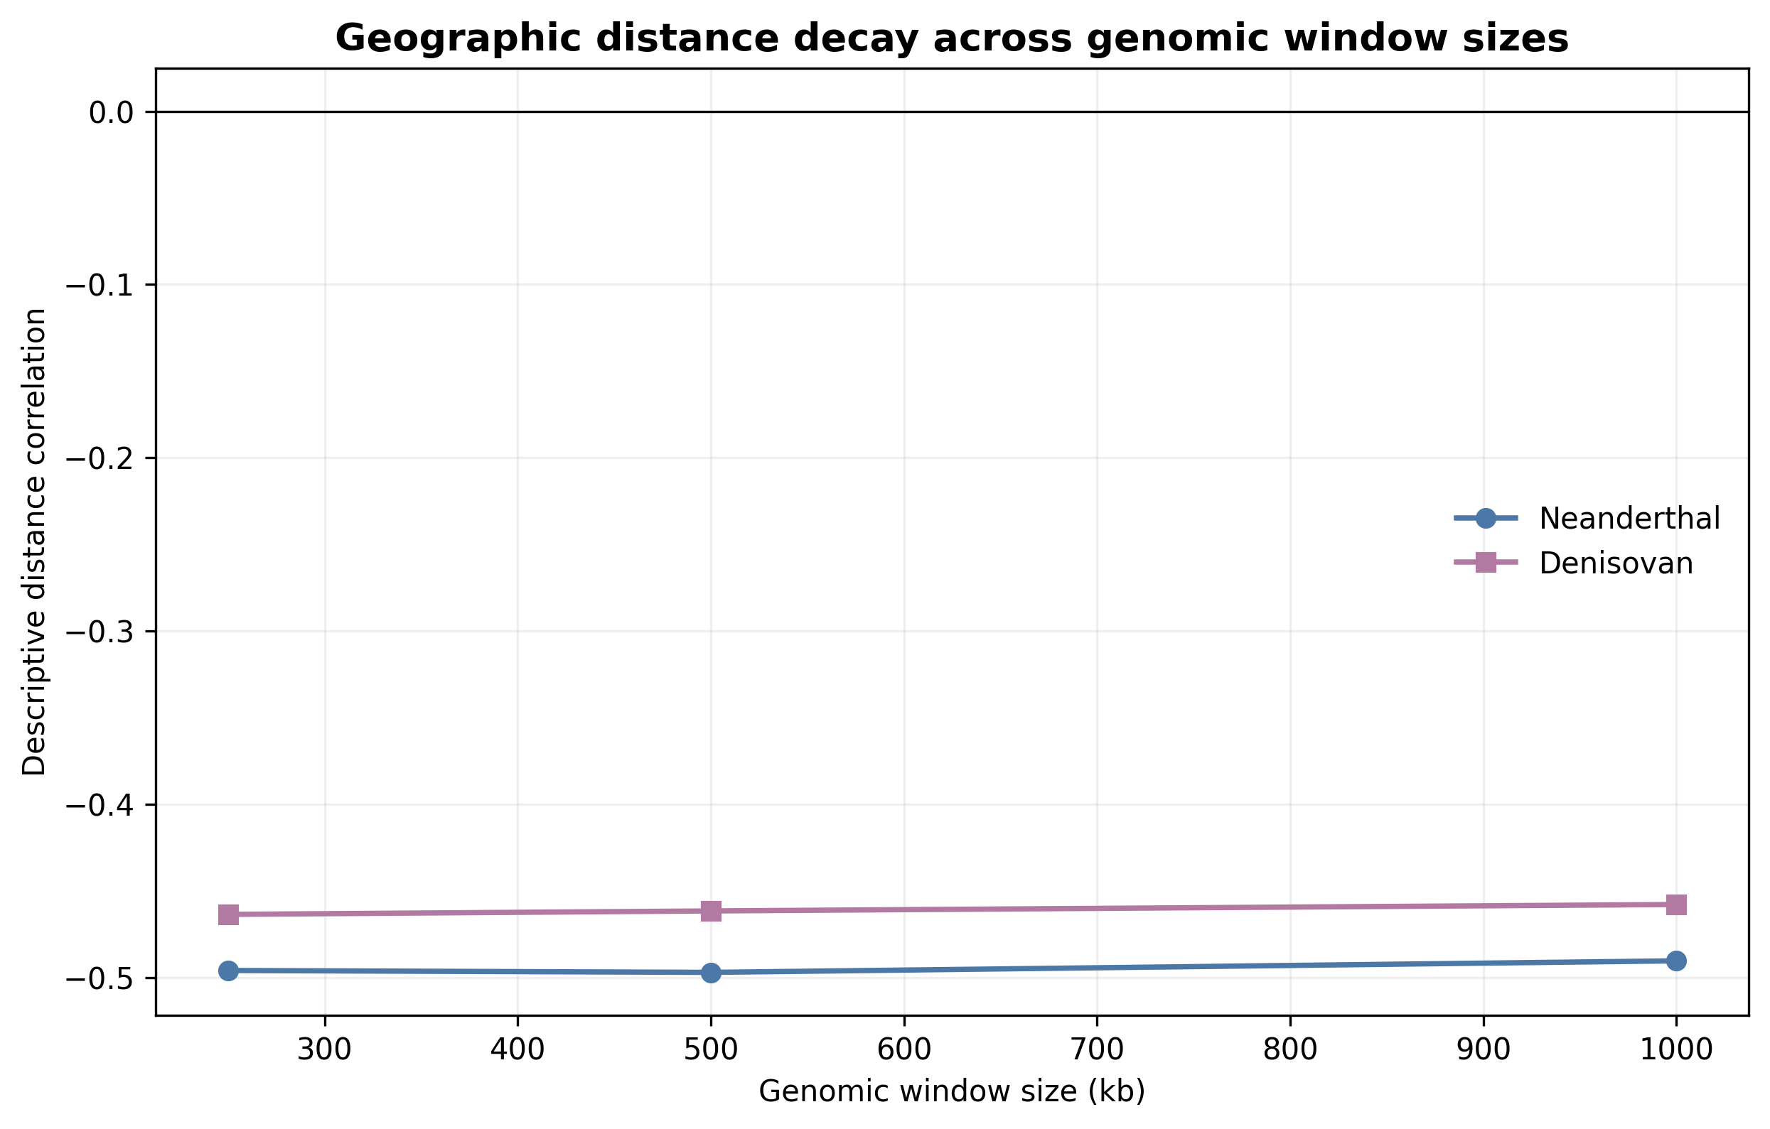
Figure S3
Descriptive geographic distance correlations at 250-kb, 500-kb, and 1-Mb window sizes. QAP results are tabulated in Supplementary Data.

Slide 9
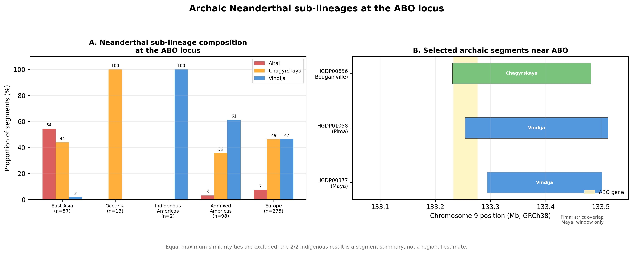
Figure S4
Exploratory ABO-centered analysis preserving the historical grouped-bar and segment-map layout. Equal maximum-similarity ties are excluded from the displayed three-reference proportions and retained in Supplementary Data. The Pima segment overlaps ABO; the Maya segment is within the wider interval but does not overlap the gene. Counts are segments, not regional frequencies, and are not interpreted as a migration route.

Slide 10
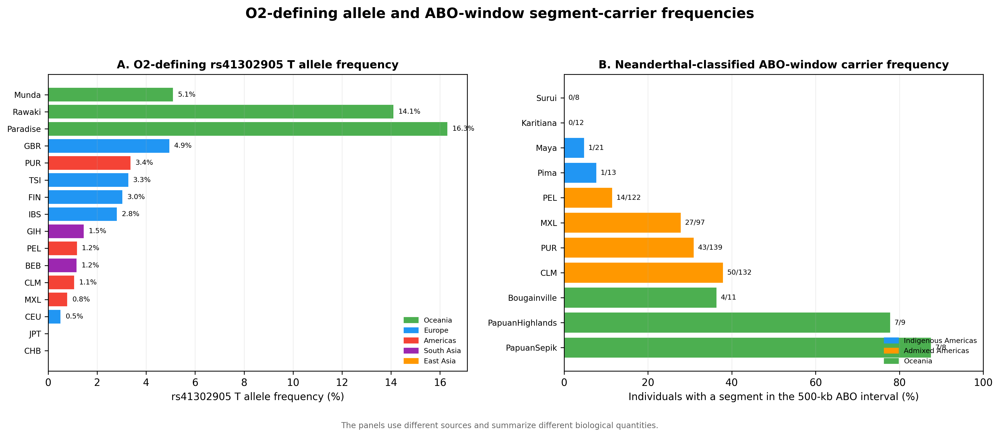
Figure S5
O2 blood-group subtype-defining allele frequencies and ABO-window segment-carrier frequencies. The panels use different sources and are not an association analysis; proximity does not establish that the O2 allele is Neanderthal-derived.

Slide 11
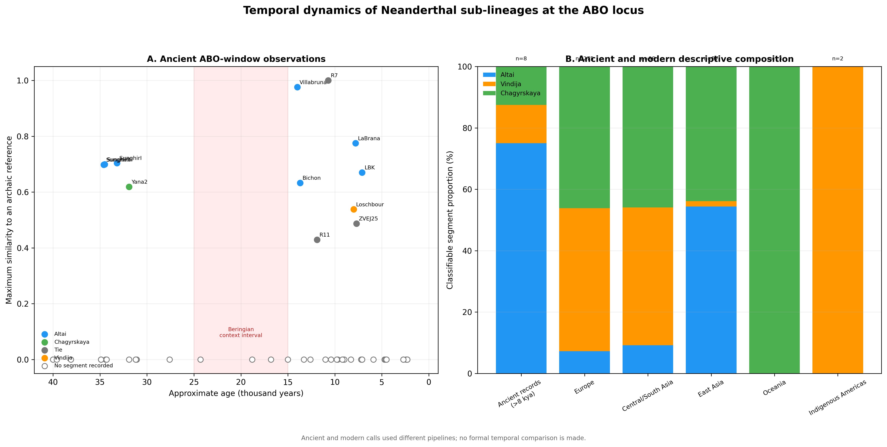
Figure S6
Descriptive ancient and modern ABO-window summaries generated by different pipelines; no formal temporal comparison is made.

Slide 12
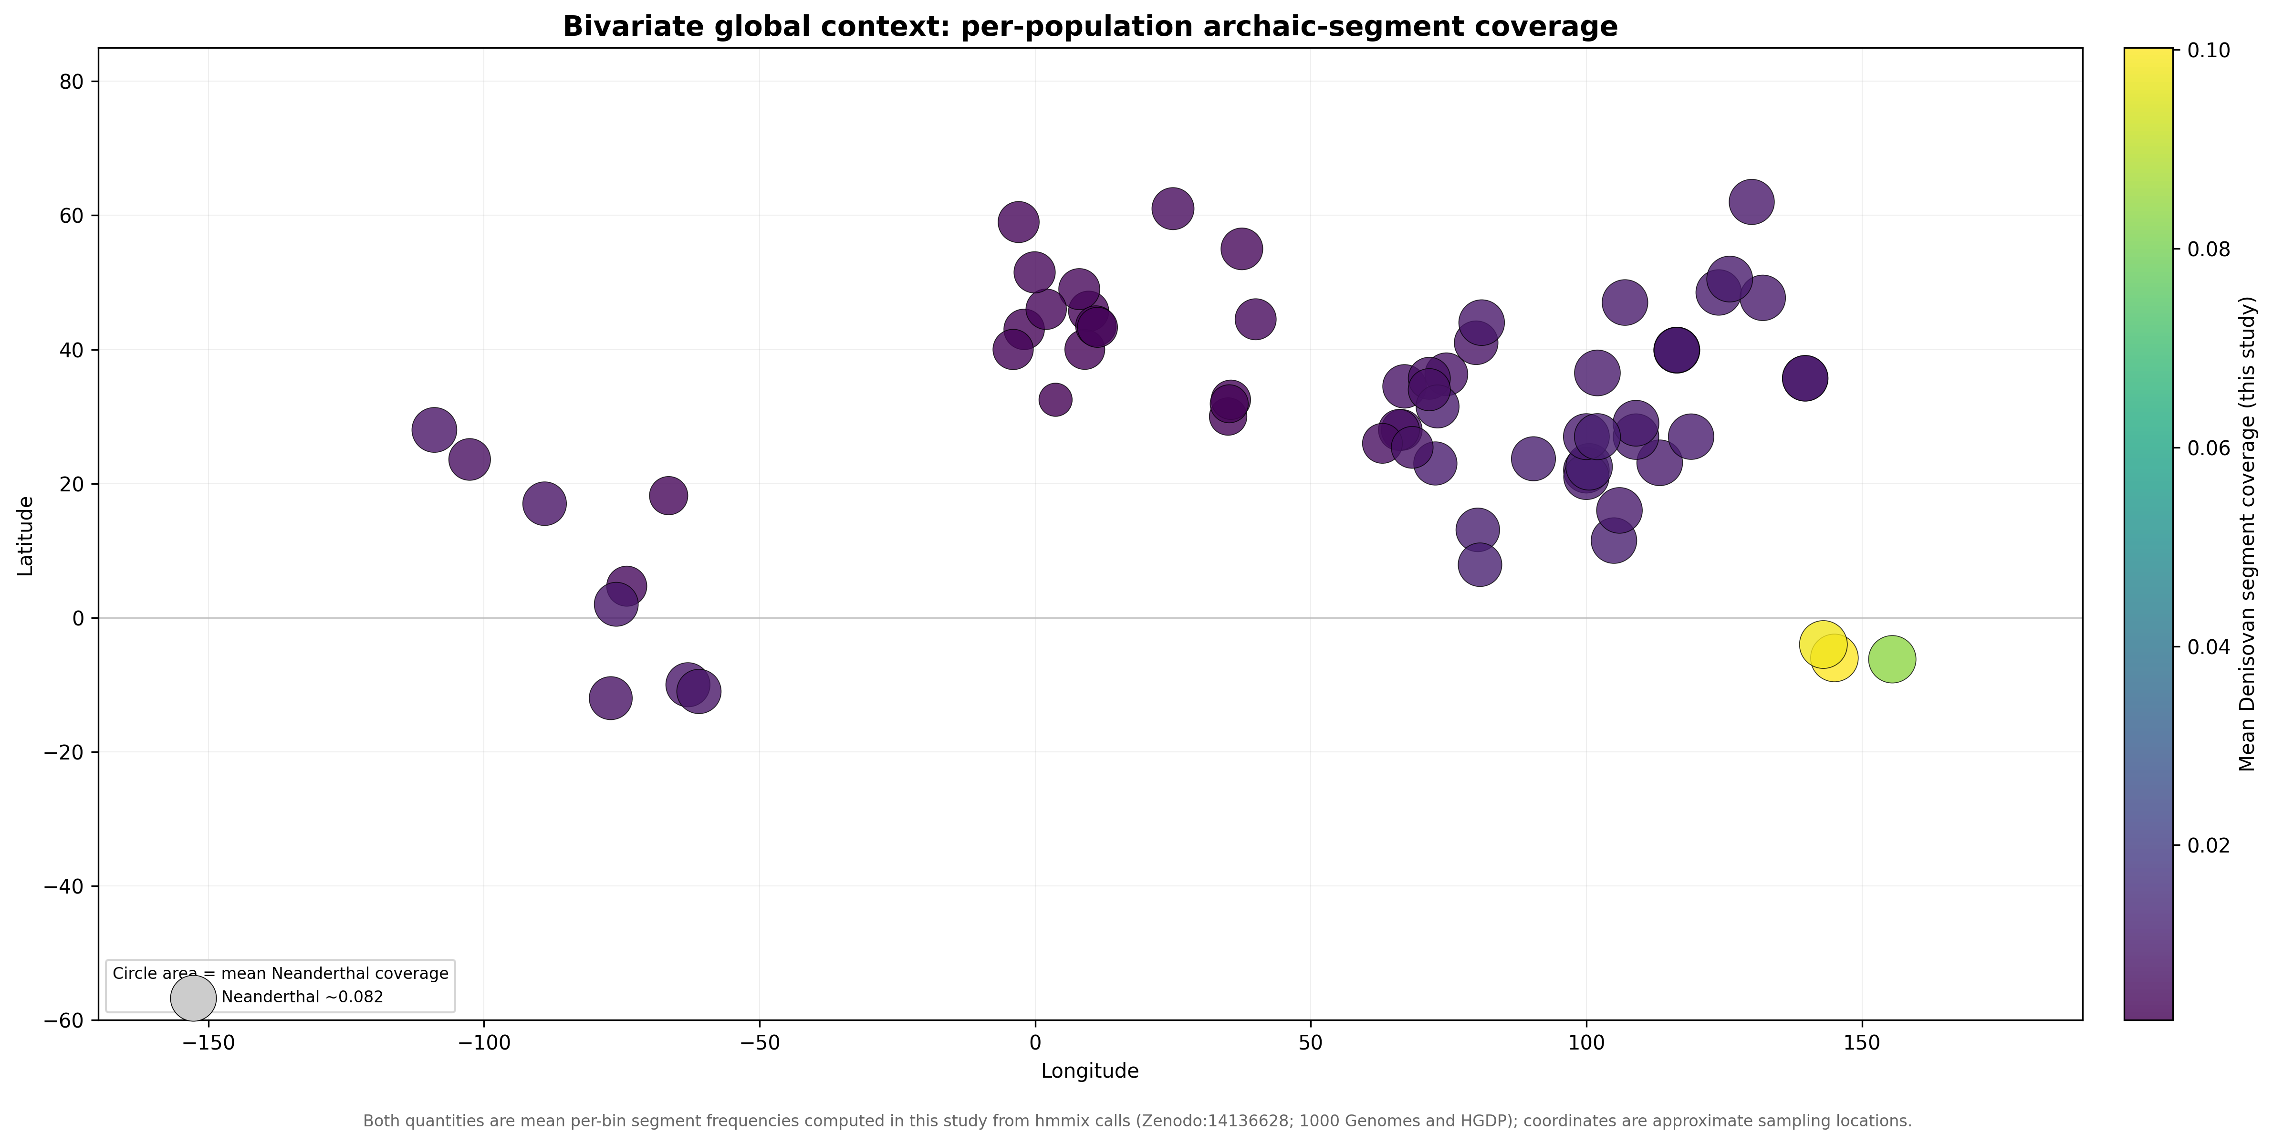
Figure S7
Bivariate global context computed in this study. Circle area encodes the mean per-bin Neanderthal-segment coverage and colour encodes the mean per-bin Denisovan-segment coverage for each population, both from data/population_profiles_500kb.npz; coordinates are approximate sampling locations from data/population_metadata.csv. These descriptive summaries were not used in the pairwise statistical models.

Slide 13
Table 1. Positive-residual archaic pairs after false discovery rate control
Ancestry | Population 1 | Population 2 | Region 1 | Region 2 | Distance (km) | Sharing (r) | z-score
— | No qualifying pair | — | — | — | — | — | No z>2 and q<0.10 result for either ancestry
Note. The prespecified family contains all non-admixed population pairs. A supported positive outlier required z>2 and Benjamini-Hochberg q<0.10 for Neanderthal or Denisovan ancestry; complete nominal rankings and dependence-aware model results are provided in Supplementary Data.

Slide 14
Table S1. Exploratory ABO-window Neanderthal-reference composition
Region | n | Altai % | Vindija % | Chagyrskaya %
East Asia | 57 | 54.4 | 1.8 | 43.9
Europe | 275 | 7.3 | 46.5 | 46.2
Indigenous Americas | 2 | 0.0 | 100.0 | 0.0
Admixed Americas | 98 | 3.1 | 61.2 | 35.7
Central/South Asia | 98 | 9.2 | 44.9 | 45.9
Middle East | 44 | 11.4 | 52.3 | 36.4
Oceania | 13 | 0.0 | 0.0 | 100.0
Note. Counts are classifiable segments, not individuals. Percentages use the three-reference denominator shown by n. Equal maximum-similarity ties are excluded from these percentages but retained in Supplementary Data. The 2/2 Indigenous American value is not a regional frequency estimate; only one segment overlaps ABO, and these counts are not interpreted as a migration route.

