Slide 1
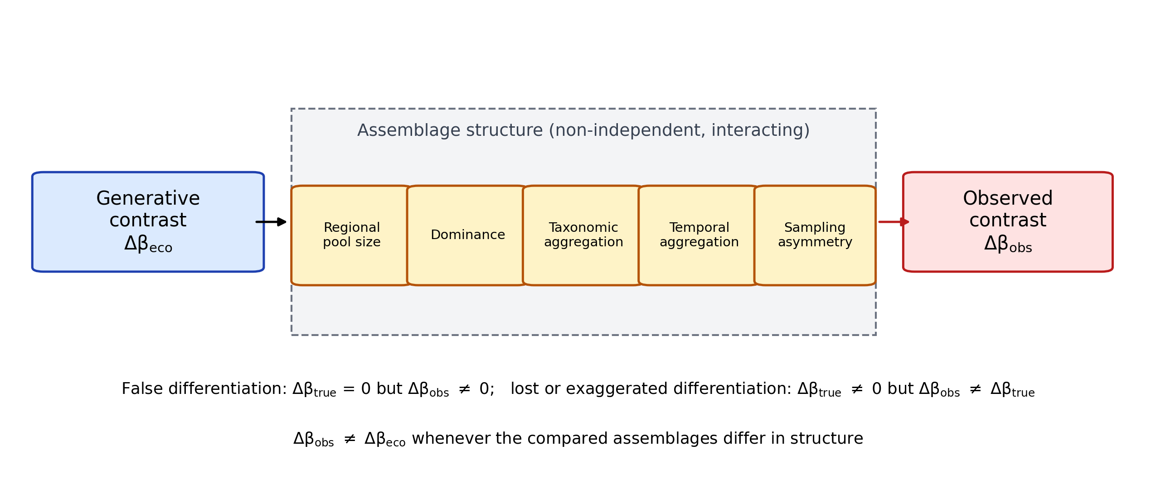
Figure 1
Figure 1. Conceptual framework. A generative (ecological) guild contrast, Δβeco, is filtered through assemblage structure (regional pool size, dominance, taxonomic aggregation, temporal aggregation and sampling asymmetry, which are non-independent and can interact) before the observed contrast, Δβobs, is measured. Structural differences can create a contrast where none exists (false differentiation) or alter the size of an existing contrast, so the observed contrast need not equal the ecological contrast when the compared assemblages differ in structure.

Slide 2
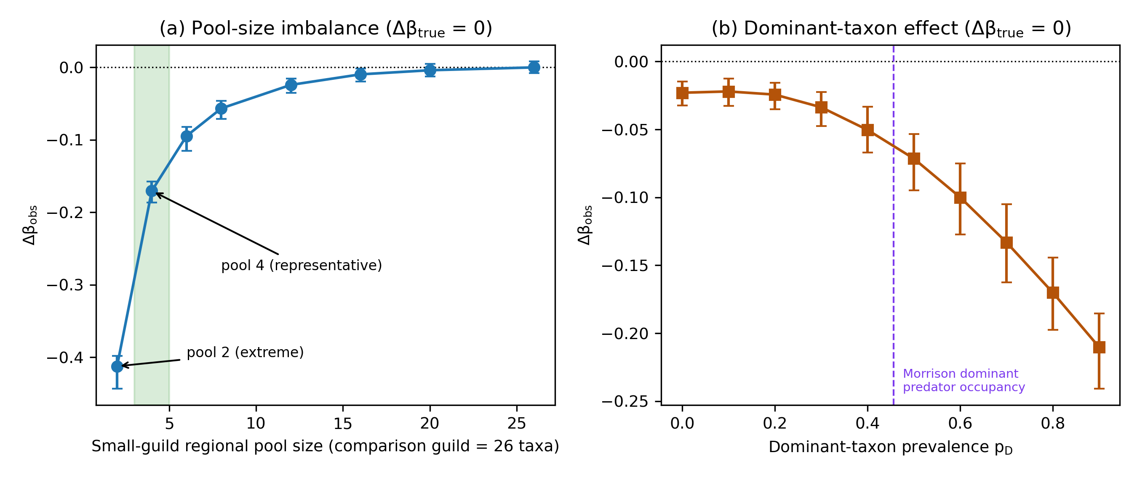
Figure 2
Figure 2. Structural asymmetry creates false differentiation when Δβtrue = 0. (a) Δβobs against the regional pool size of the smaller guild (comparison guild 26 taxa); the four-taxon pool is the representative case (−0.17) and the two-taxon pool the extreme tested condition (−0.41). (b) Δβobs against the prevalence pD of a single dominant taxon; the dashed line marks the occupancy of the dominant Morrison predator (45.6% of collections). Negative Δβ indicates apparent spatial continuity of the smaller or dominance-structured guild. Points are means of 200 replicates with 95% replicate intervals (seed 20260922).

Slide 3
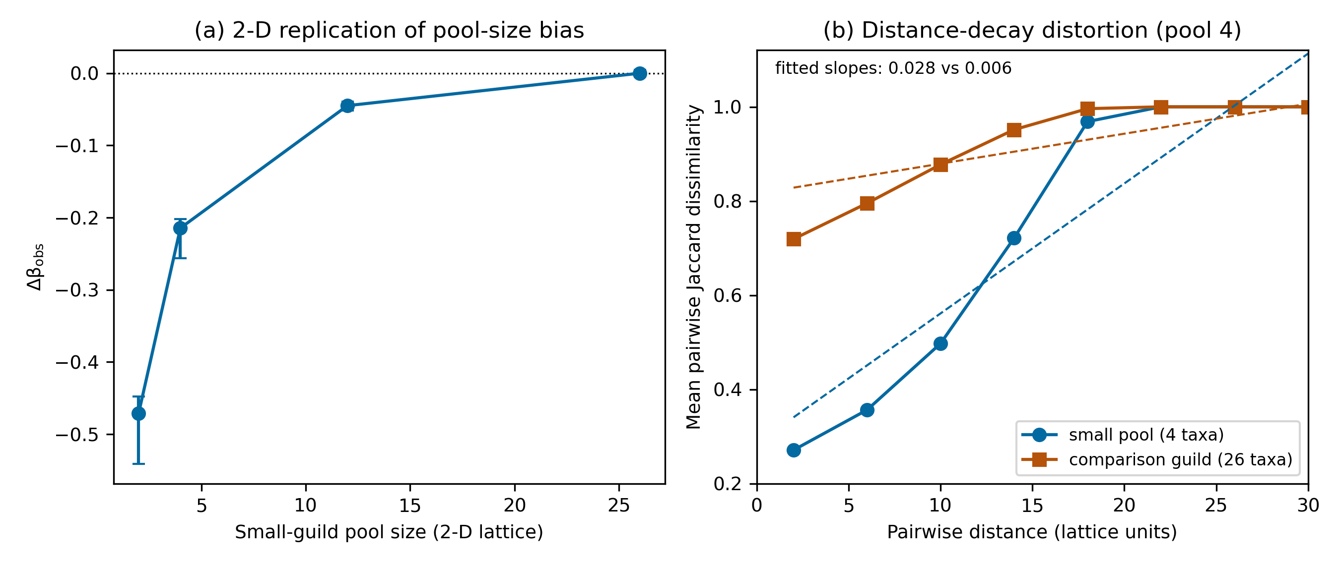
Figure 3
Figure 3. Two-dimensional replication and distance-decay distortion. (a) Δβobs under pool asymmetry on a 40 × 40 lattice with disc-shaped ranges (four-taxon pool −0.21; two-taxon pool −0.47; means and 95% replicate intervals of 100 replicates; seed 20260924). (b) Mean pairwise Jaccard dissimilarity against pairwise distance (lattice units) for the four-taxon and 26-taxon guilds generated by the same spatial process; dashed lines show the fitted linear decay slopes (0.028 versus 0.006 per lattice unit).

Slide 4
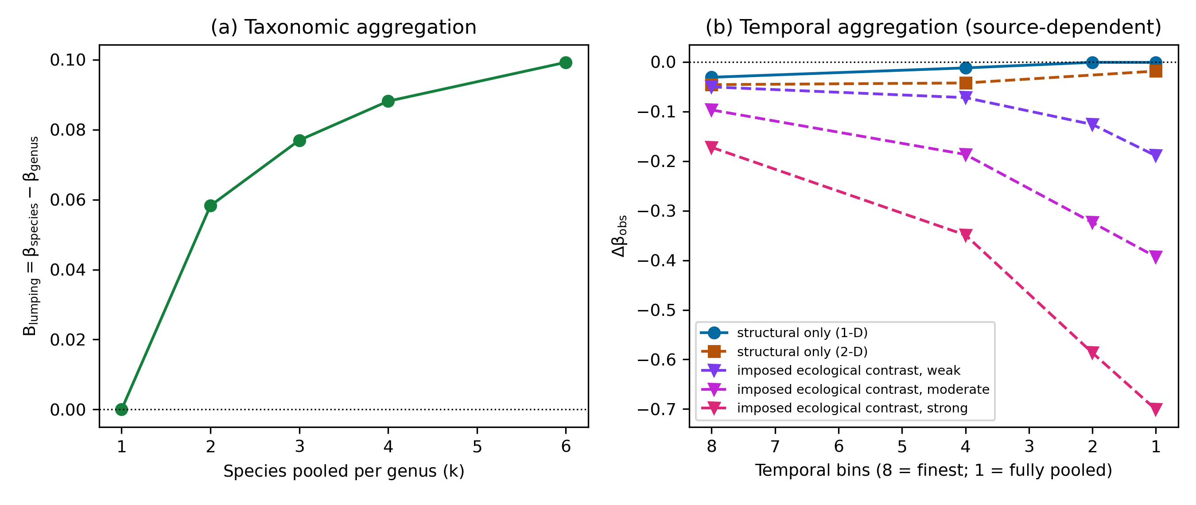
Figure 4
Figure 4. Taxonomic and temporal aggregation. (a) Pooling k geographically partitioned species into one genus column; Blumping = βspecies − βgenus (positive values indicate greater apparent continuity), reaching +0.099 at k = 6. (b) Δβobs against the number of temporal bins under union pooling (8 = finest resolution, 1 = fully pooled). Structural-only contrasts are erased by pooling (one-dimensional −0.031 to −0.001; two-dimensional −0.046 to −0.018), whereas contrasts that include an imposed difference in range breadth are amplified (−0.05, −0.10 and −0.17 become −0.19, −0.39 and −0.70 at full pooling).

Slide 5
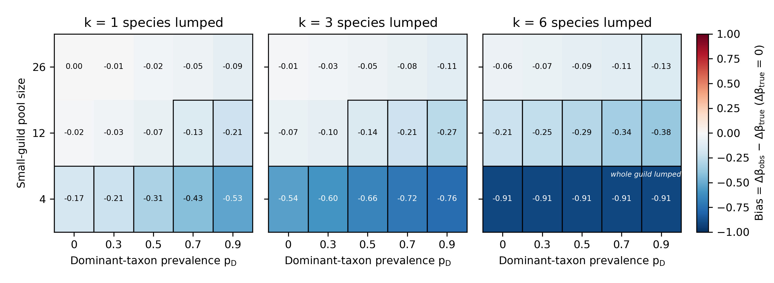
Figure 5
Figure 5. Factorial bias map with Δβtrue = 0. Bias = Δβobs − Δβtrue by small-guild pool size and dominant-taxon prevalence pD, with one panel per lumping level k; cell labels give mean bias over 100 replicates (seed 20260923), and outlined cells have a false-difference rate (absolute Δβobs above 0.1) of at least 0.95. In the cells labelled "whole guild lumped" (pool 4, k = 6) the entire small guild is collapsed into one column, so its turnover is zero by construction and bias equals the negative of the comparison guild's mean dissimilarity (−0.91).

Slide 6
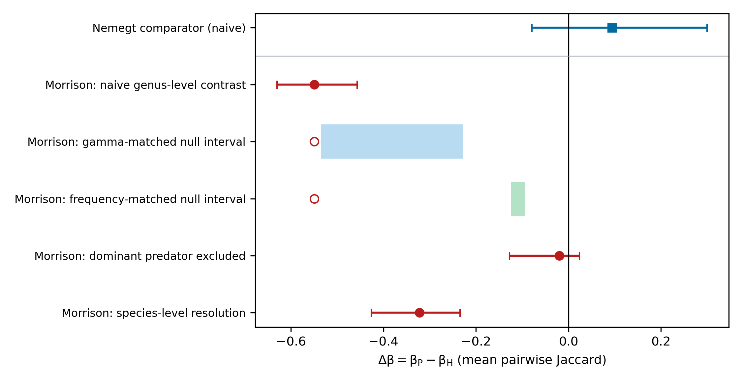
Figure 6
Figure 6. Sequential structural decomposition of the Morrison Formation guild contrast and the Nemegt comparator. Filled symbols show estimates with bootstrap 95% CIs (999 resamples of collections): Morrison naive genus-level contrast (−0.550), contrast after exclusion of the dominant predator (−0.020) and species-level contrast (−0.322); Nemegt naive contrast (+0.094). Shaded bands are null 95% intervals for the gamma-matched (−0.534 to −0.229) and frequency-matched (−0.124 to −0.095) nulls, with the observed naive contrast shown as an open circle; null intervals are distinct from bootstrap CIs.

