Slide 1
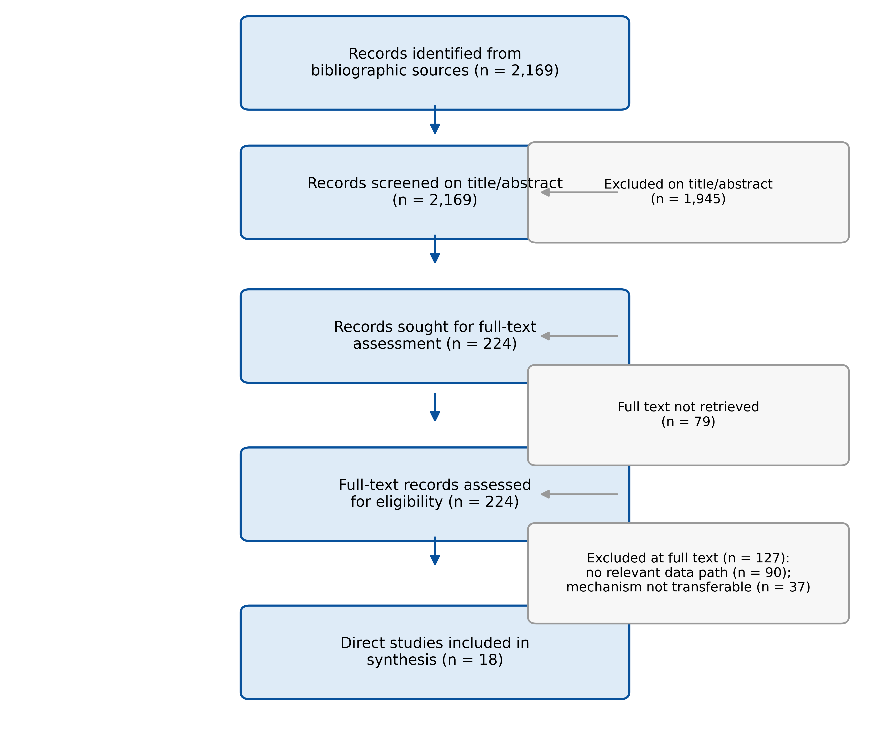
Figure 1
Figure 1. PRISMA-ScR flow of record identification, title/abstract screening, full-text eligibility assessment, and inclusion. Counts are reproduced from the committed screening sheet.

Slide 2
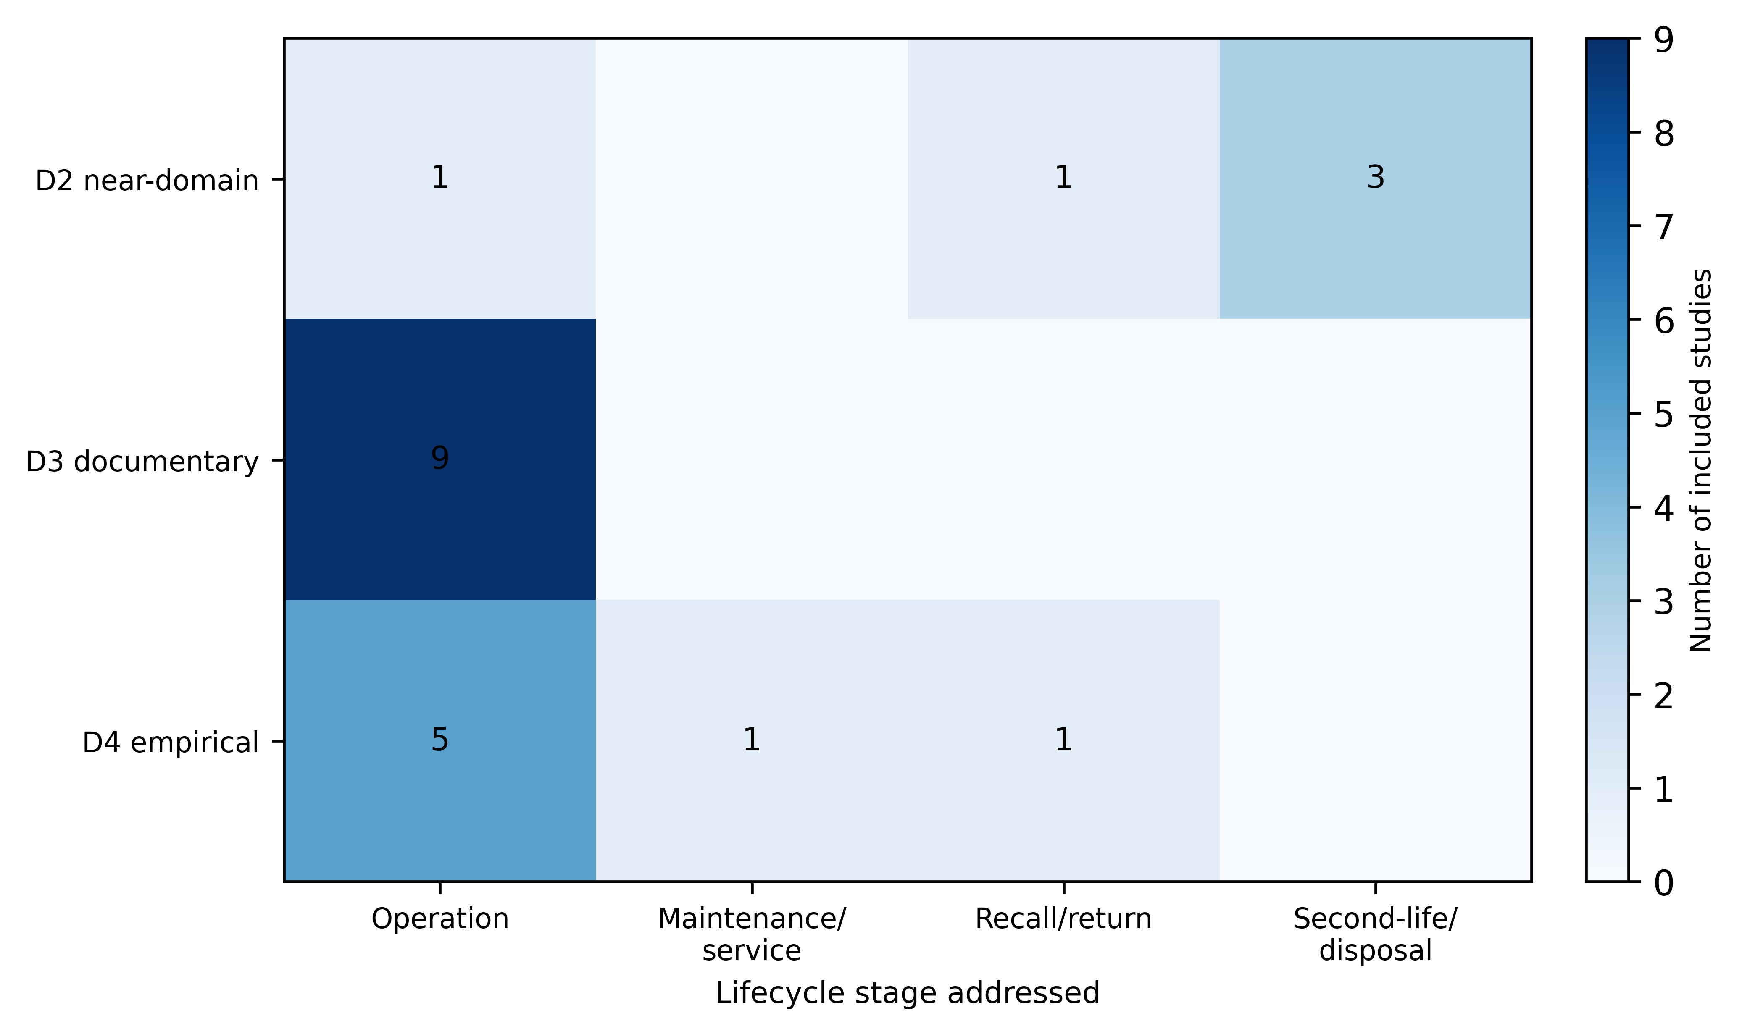
Figure 2
Figure 2. Evidence map of the 18 included direct studies by evidence distance (D4 direct empirical, D3 direct documentary, D2 near-domain empirical) and lifecycle stage addressed. A study that addresses more than one stage is counted in each relevant stage, so row totals may exceed the number of studies at that distance.

Slide 3
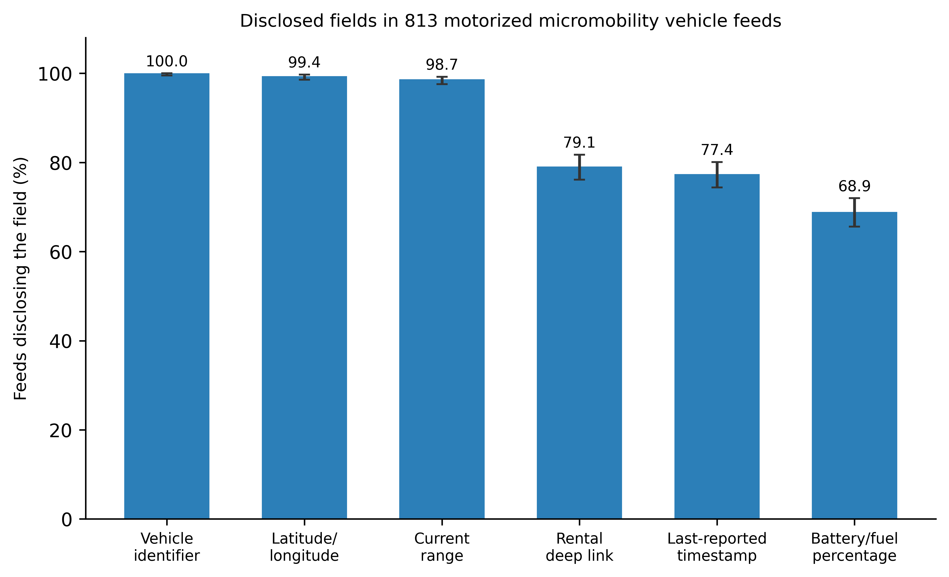
Figure 3
Figure 3. Prevalence of disclosed fields in 813 successfully retrieved, non-empty public vehicle-status feeds that declared motorized micromobility. Bars show the point estimate; whiskers show the 95% Wilson confidence interval. Field presence is a disclosure signal, not evidence of a privacy harm.

Slide 4
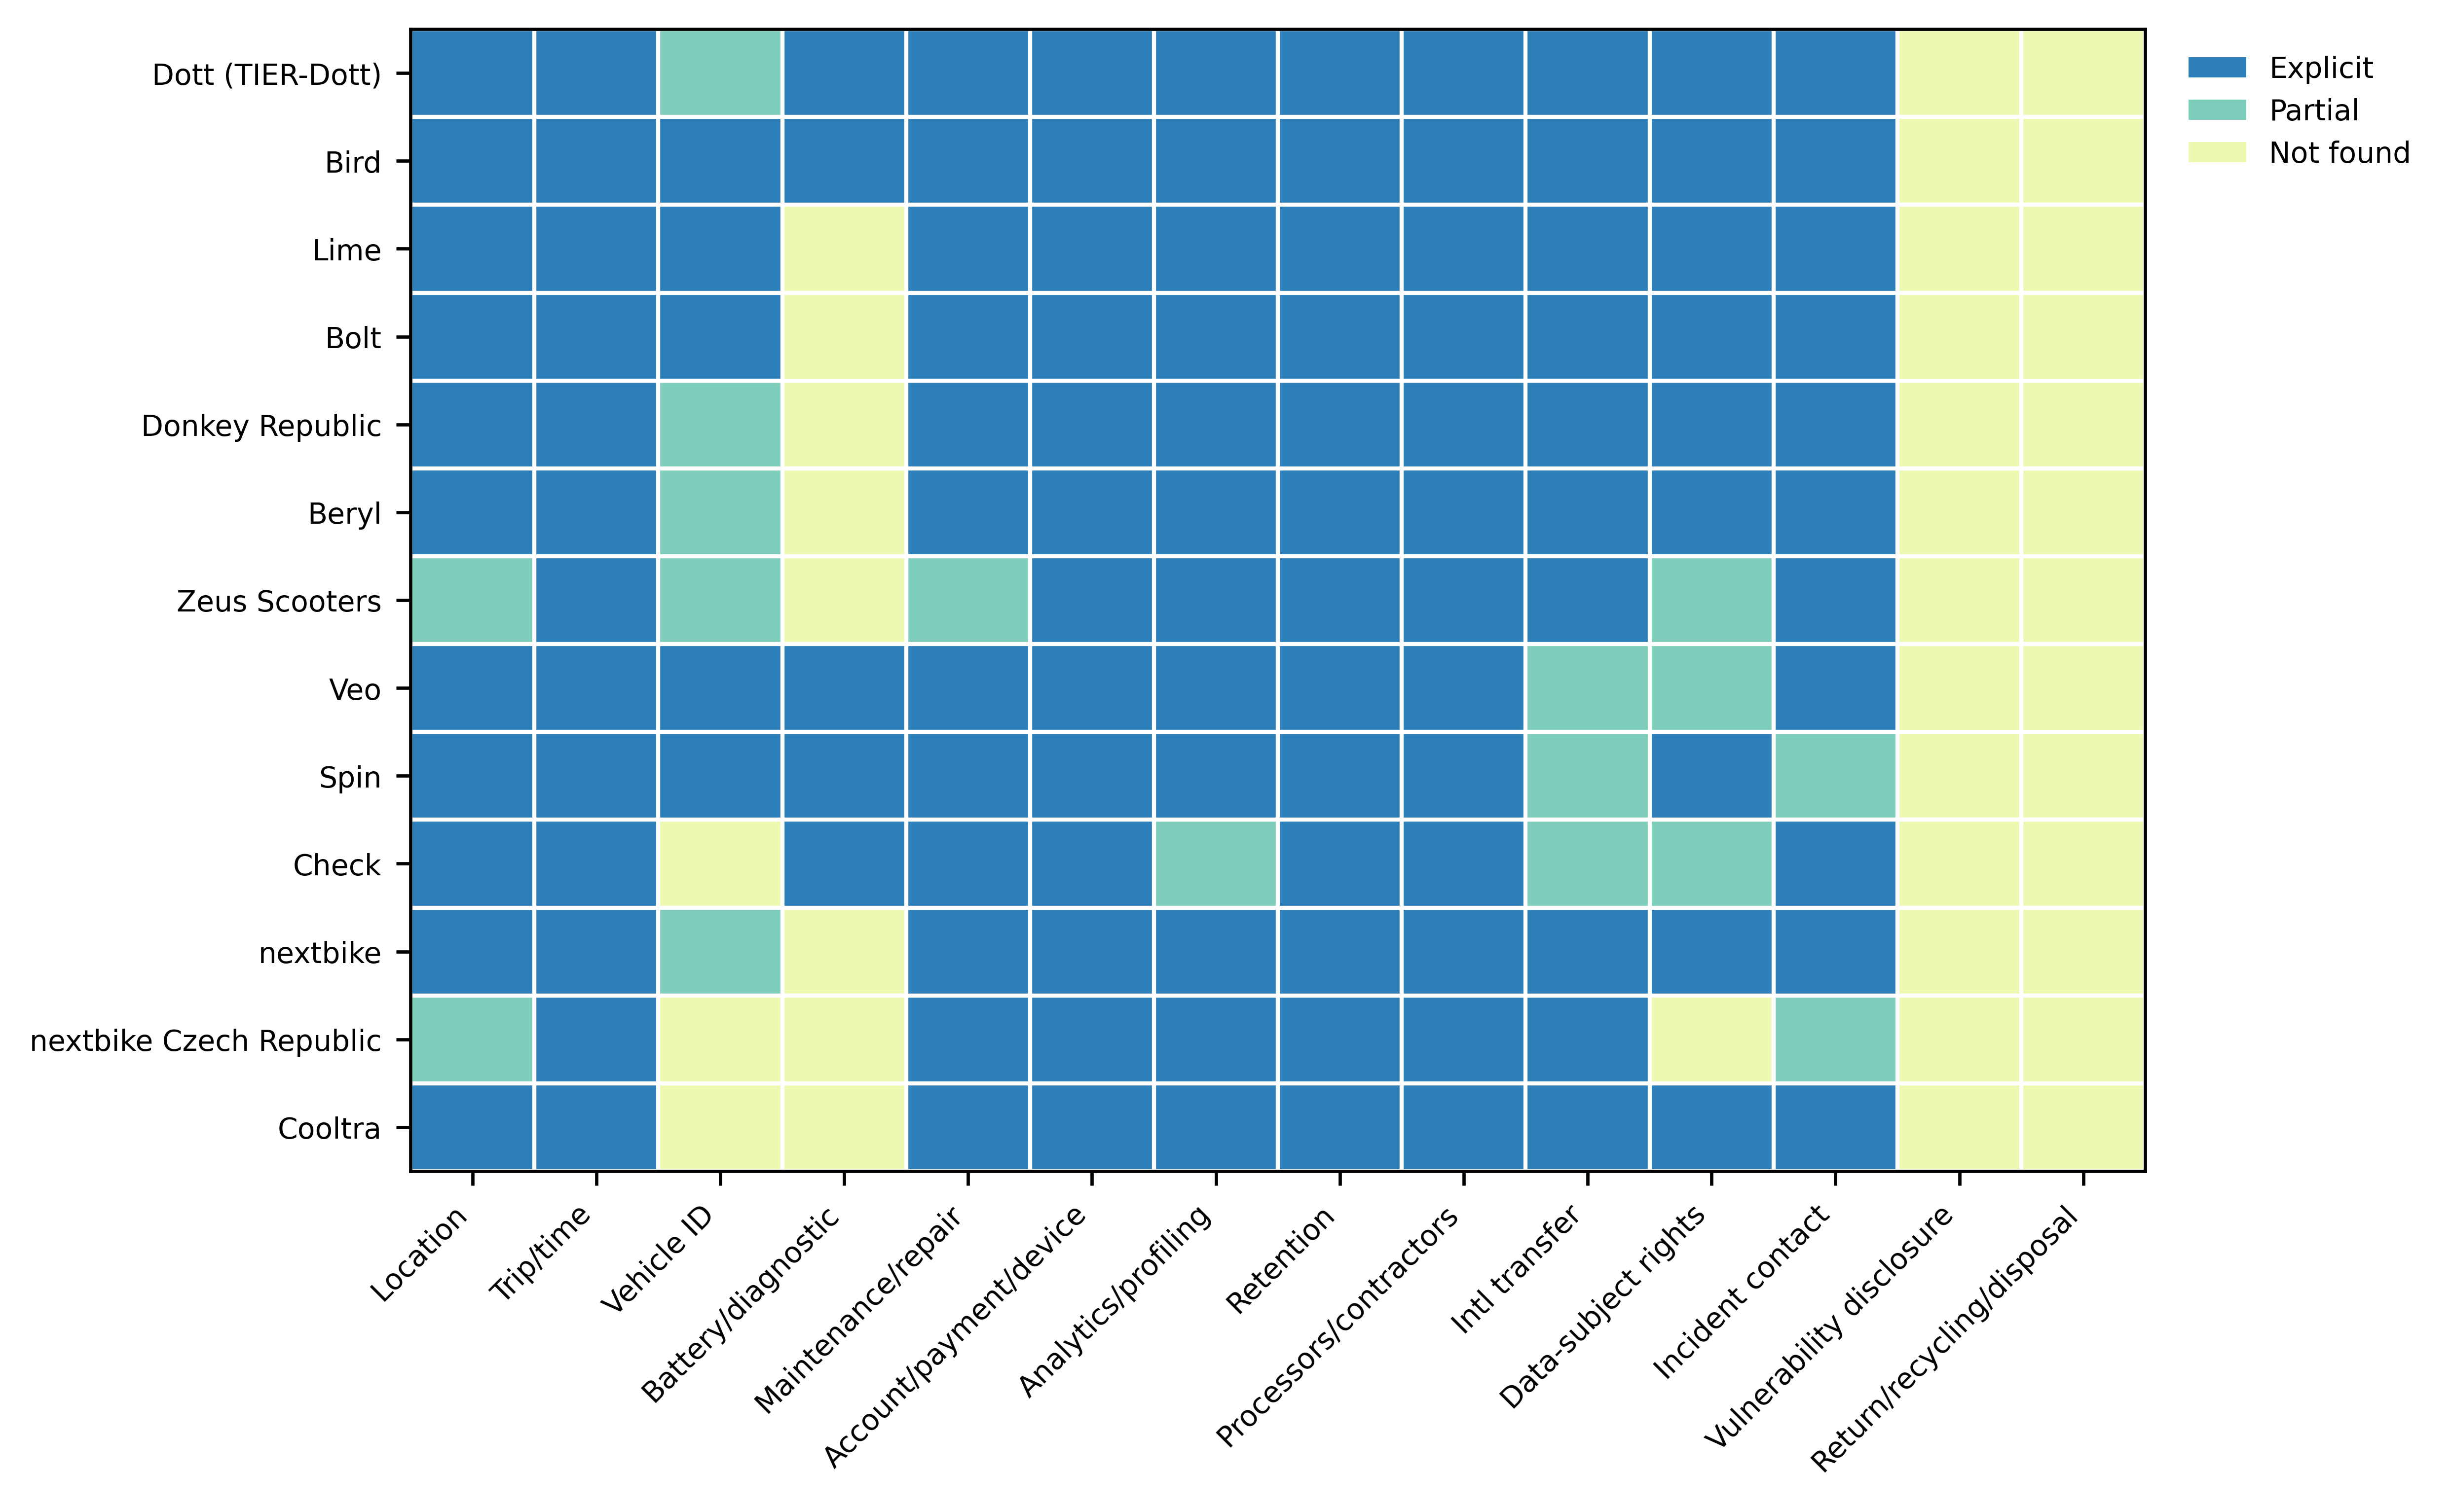
Figure 4
Figure 4. Disclosure-domain coding of public operator privacy notices across 14 domains (n = 13 coded operators; 2 further operators were unavailable for reproducible retrieval). Cells show explicit, partial, or not-found coding; not-found denotes silence in the document, not evidence that a practice is absent.

Slide 5
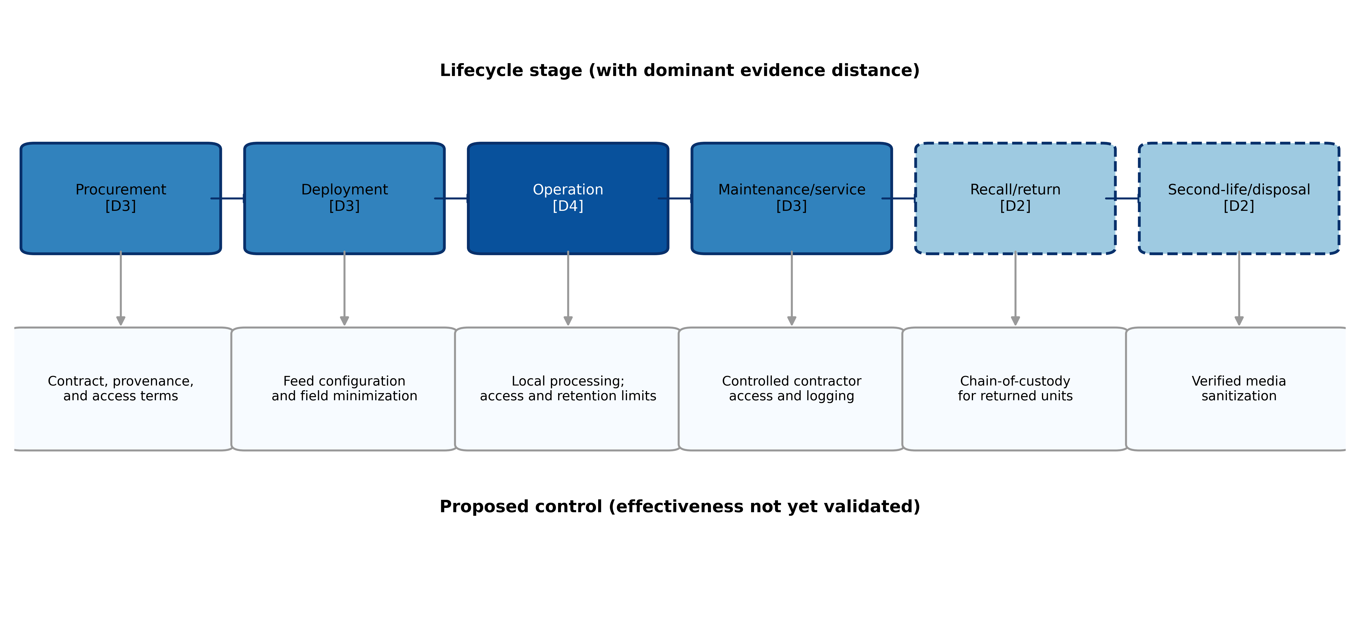
Figure 5
Figure 5. Lifecycle data-exposure model linking each stage to the evidence distance of its supporting sources and to a proposed, as-yet unvalidated control. Solid boxes denote stages with direct (D3-D4) evidence; dashed boxes denote stages supported only by near-domain (D2) evidence.

