Slide 1
Fig. 1 — DVS × Noise Inverse Problem: Four Domains and Five Gaps (G1–G5)
A. DVS Noise Physical Modeling (5 papers)
B. DVS Noise Filtering Methods (7 papers)
G1 Bayesian Inverse Formulation
G2 Auxiliary Channel Noise Prediction
G3 ★ Astronomy-specific Pipeline
C. DVS Astronomy & Space Apps (5 papers)
D. Noise Inverse Problem (non-DVS) (7 papers)
G4 ★ Template-free Object Detection
G5 SciDVS + Large Tel. Integrated Demo
Gap map: four surveyed domains (A–D) and five identified gaps (G1–G5). All shapes are individually editable.

Slide 2
Fig. 2 — PI-DC-DVS Pipeline
DVS Main Channel e(t, x, y, p)
Auxiliary Channels T(t), a(t), I(t)
Physics Model (A5 Pixel Model)
Stage 1: Noise Forward Model Construction
λ_noise(x,y,t) = F(θ, T(t), bias, I_bg)
Stage 2: Bayesian Inverse Problem Solving (G1)
θ = argmin D(e_obs, F(θ)) — MLE / Variational / DeepClean-type NN (G2)
Stage 3: Residual Event Stream Generation
e_residual = e_obs ⊖ F(θ) — Probabilistic Thinning / Rate Subtraction
Stage 4 (G4): Template-free Object Detection
Residual anomaly detection → shift-and-stack → Statistical test → Cataloging
Stage 5: Physical Validation
PSD test / Injection-Recovery / Known Object / Blind test
System architecture of the PI-DC-DVS noise inverse problem pipeline. All boxes and arrows are individually editable.

Slide 3
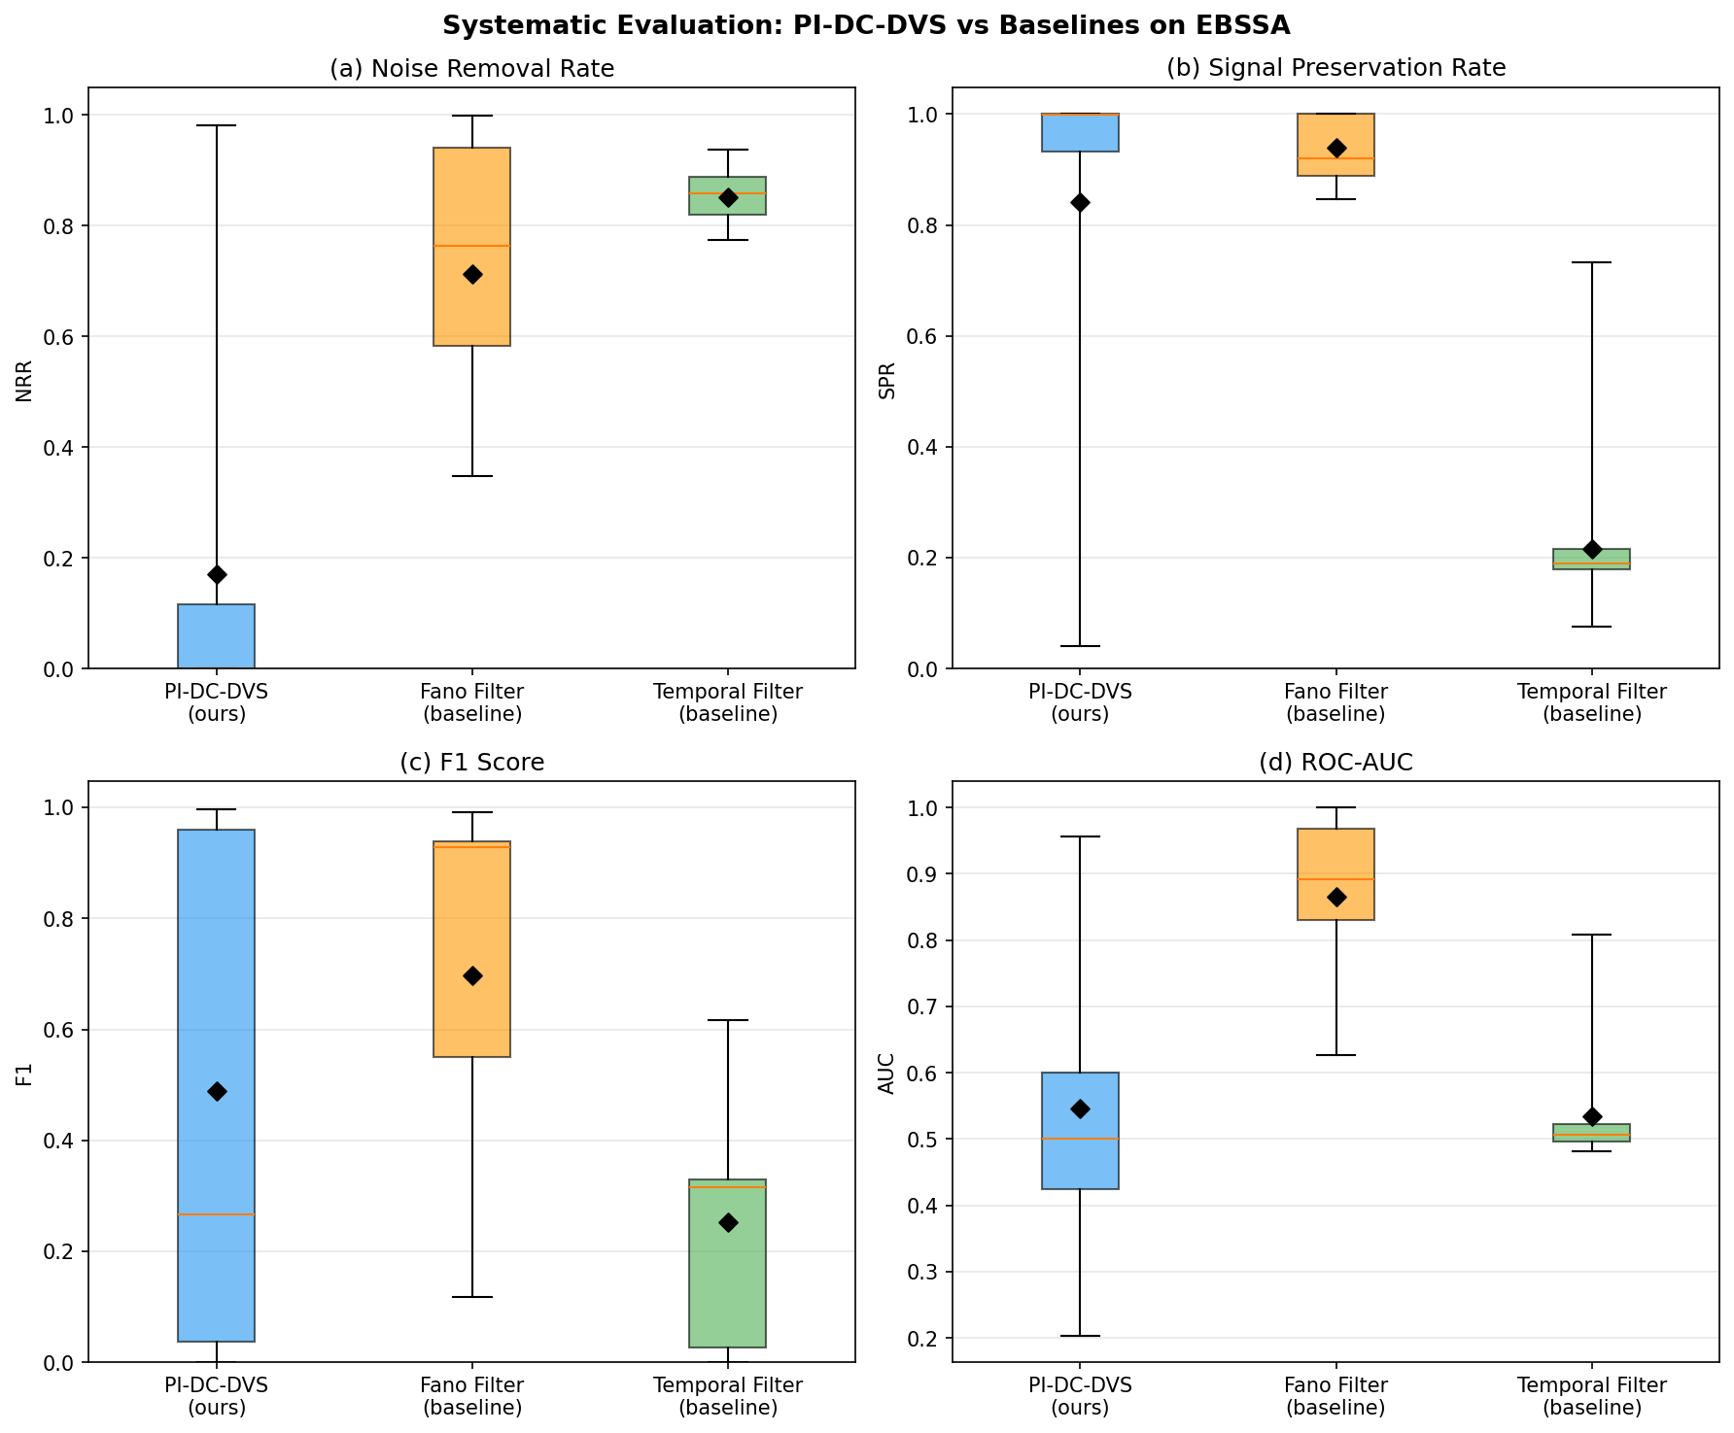
Fig. 3 — Systematic Evaluation
Boxplot comparison (NRR, SPR, F1, AUC) of three methods on 20 EBSSA recordings.

Slide 4
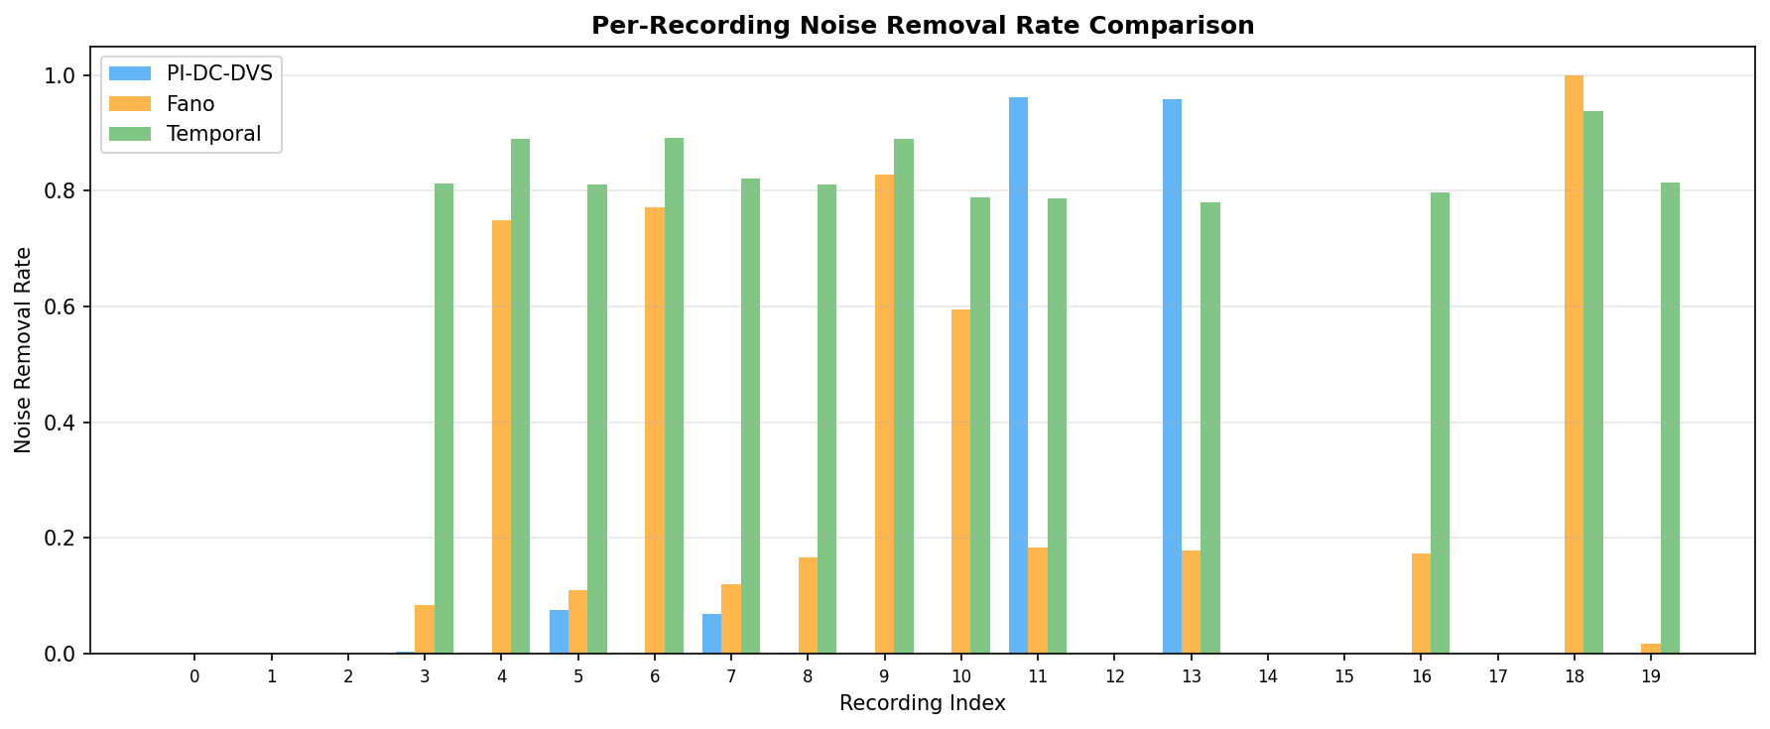
Fig. 4 — Per-Recording Comparison
Per-recording noise removal rate for Fano filter, PI-DC-DVS NN, and temporal filter.

Slide 5
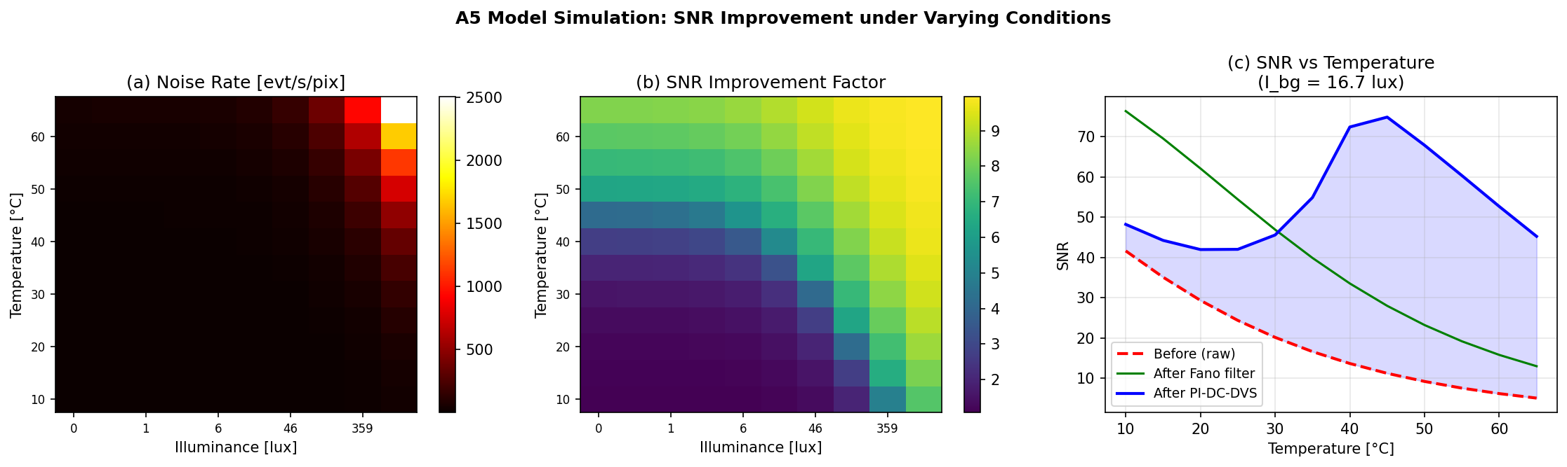
Fig. 5 — A5 Model Simulation
Noise rate and SNR improvement across temperature–illuminance parameter space.

Slide 6
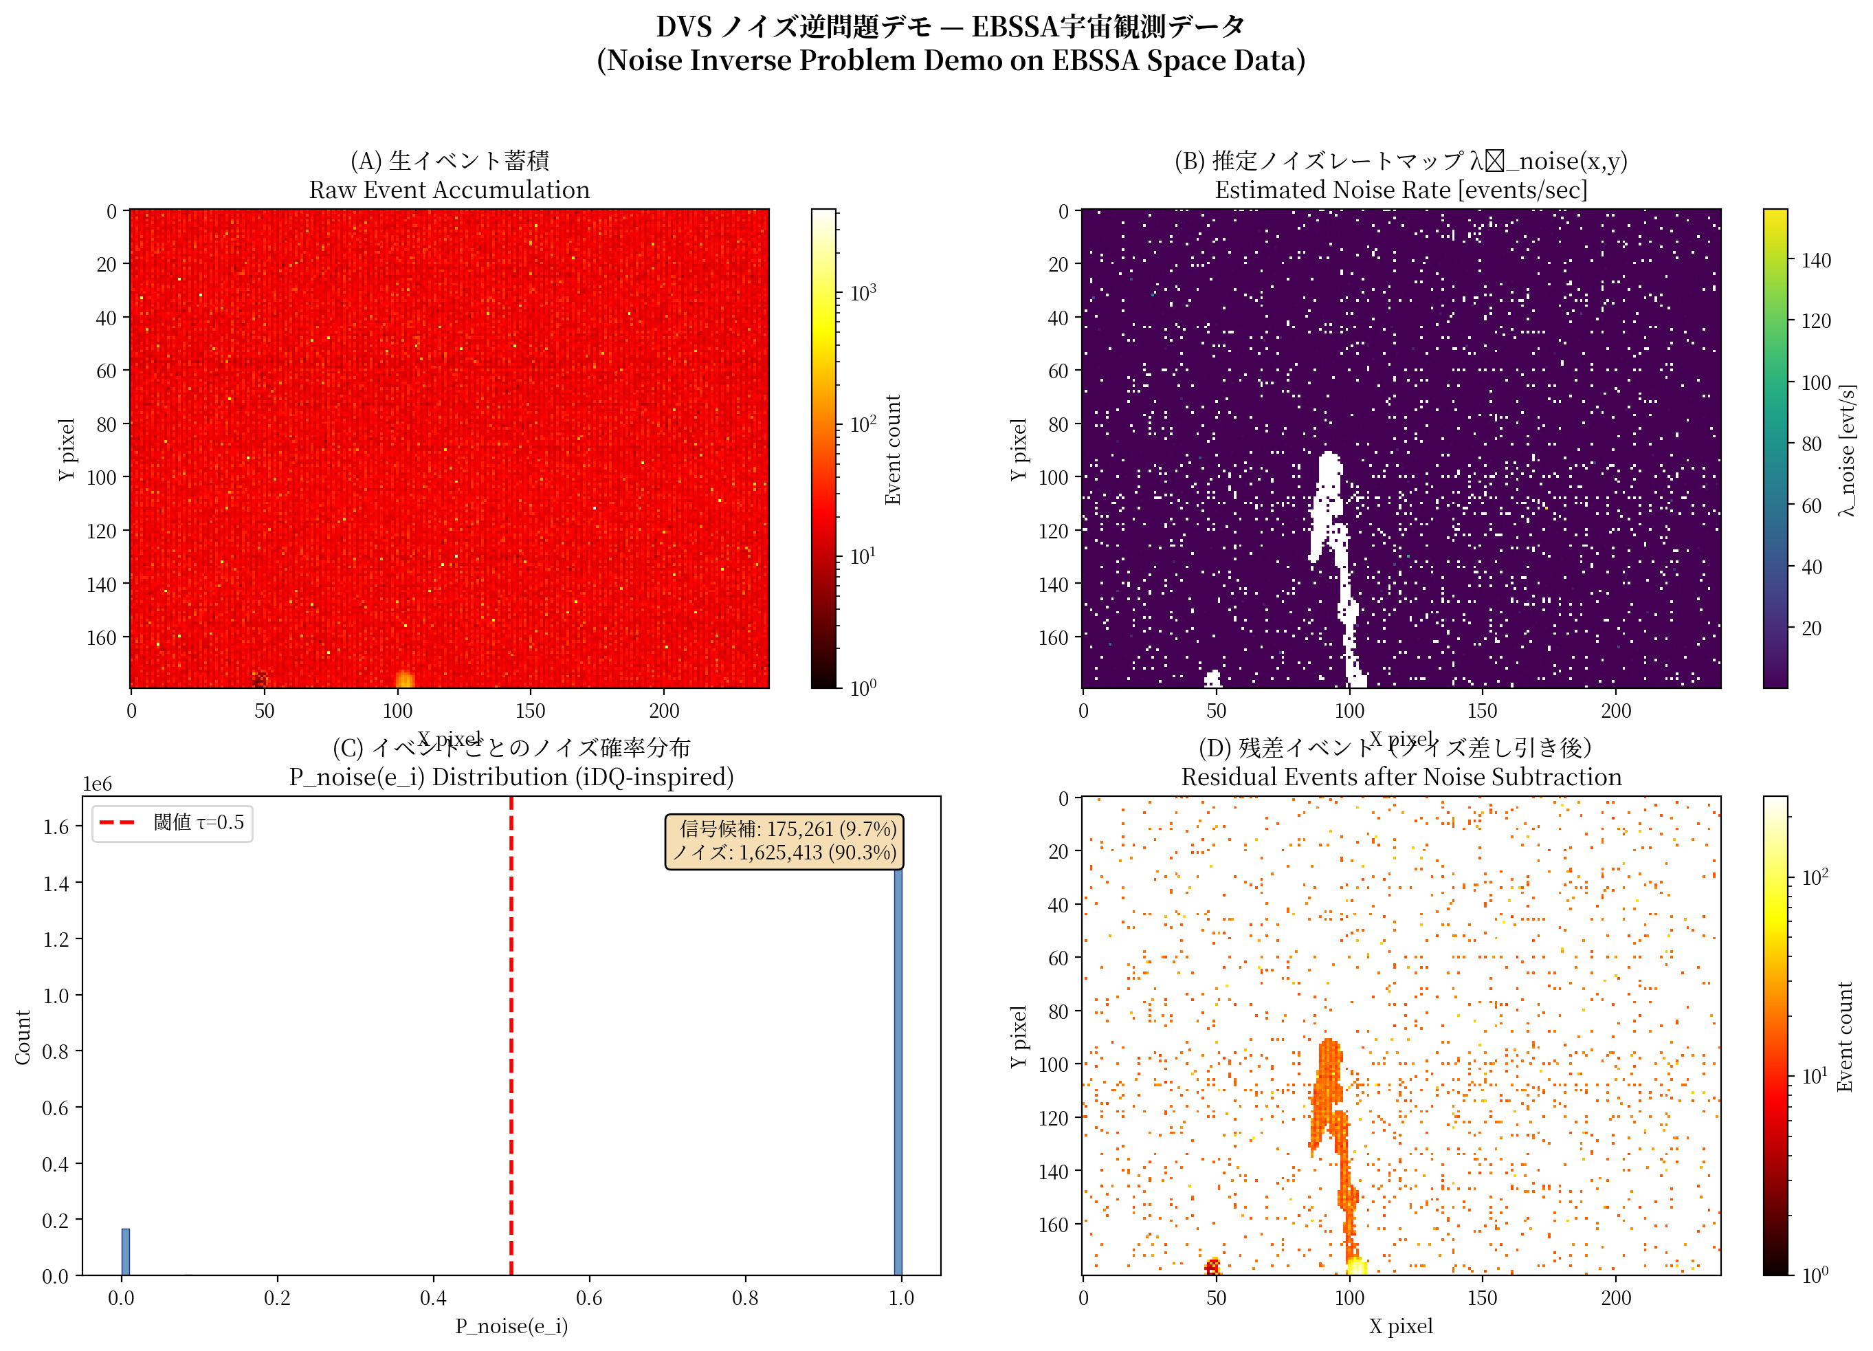
Fig. 6 — Noise Inverse Demo
Raw events → noise map → P_noise distribution → residual with satellite trail.

Slide 7
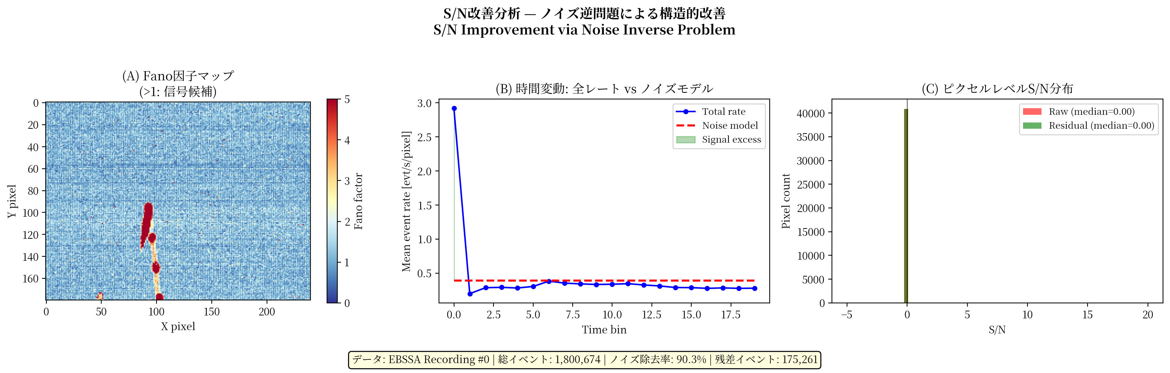
Fig. 7 — S/N Improvement
Fano factor map, temporal dynamics, and per-pixel SNR distribution.

