Slide 1
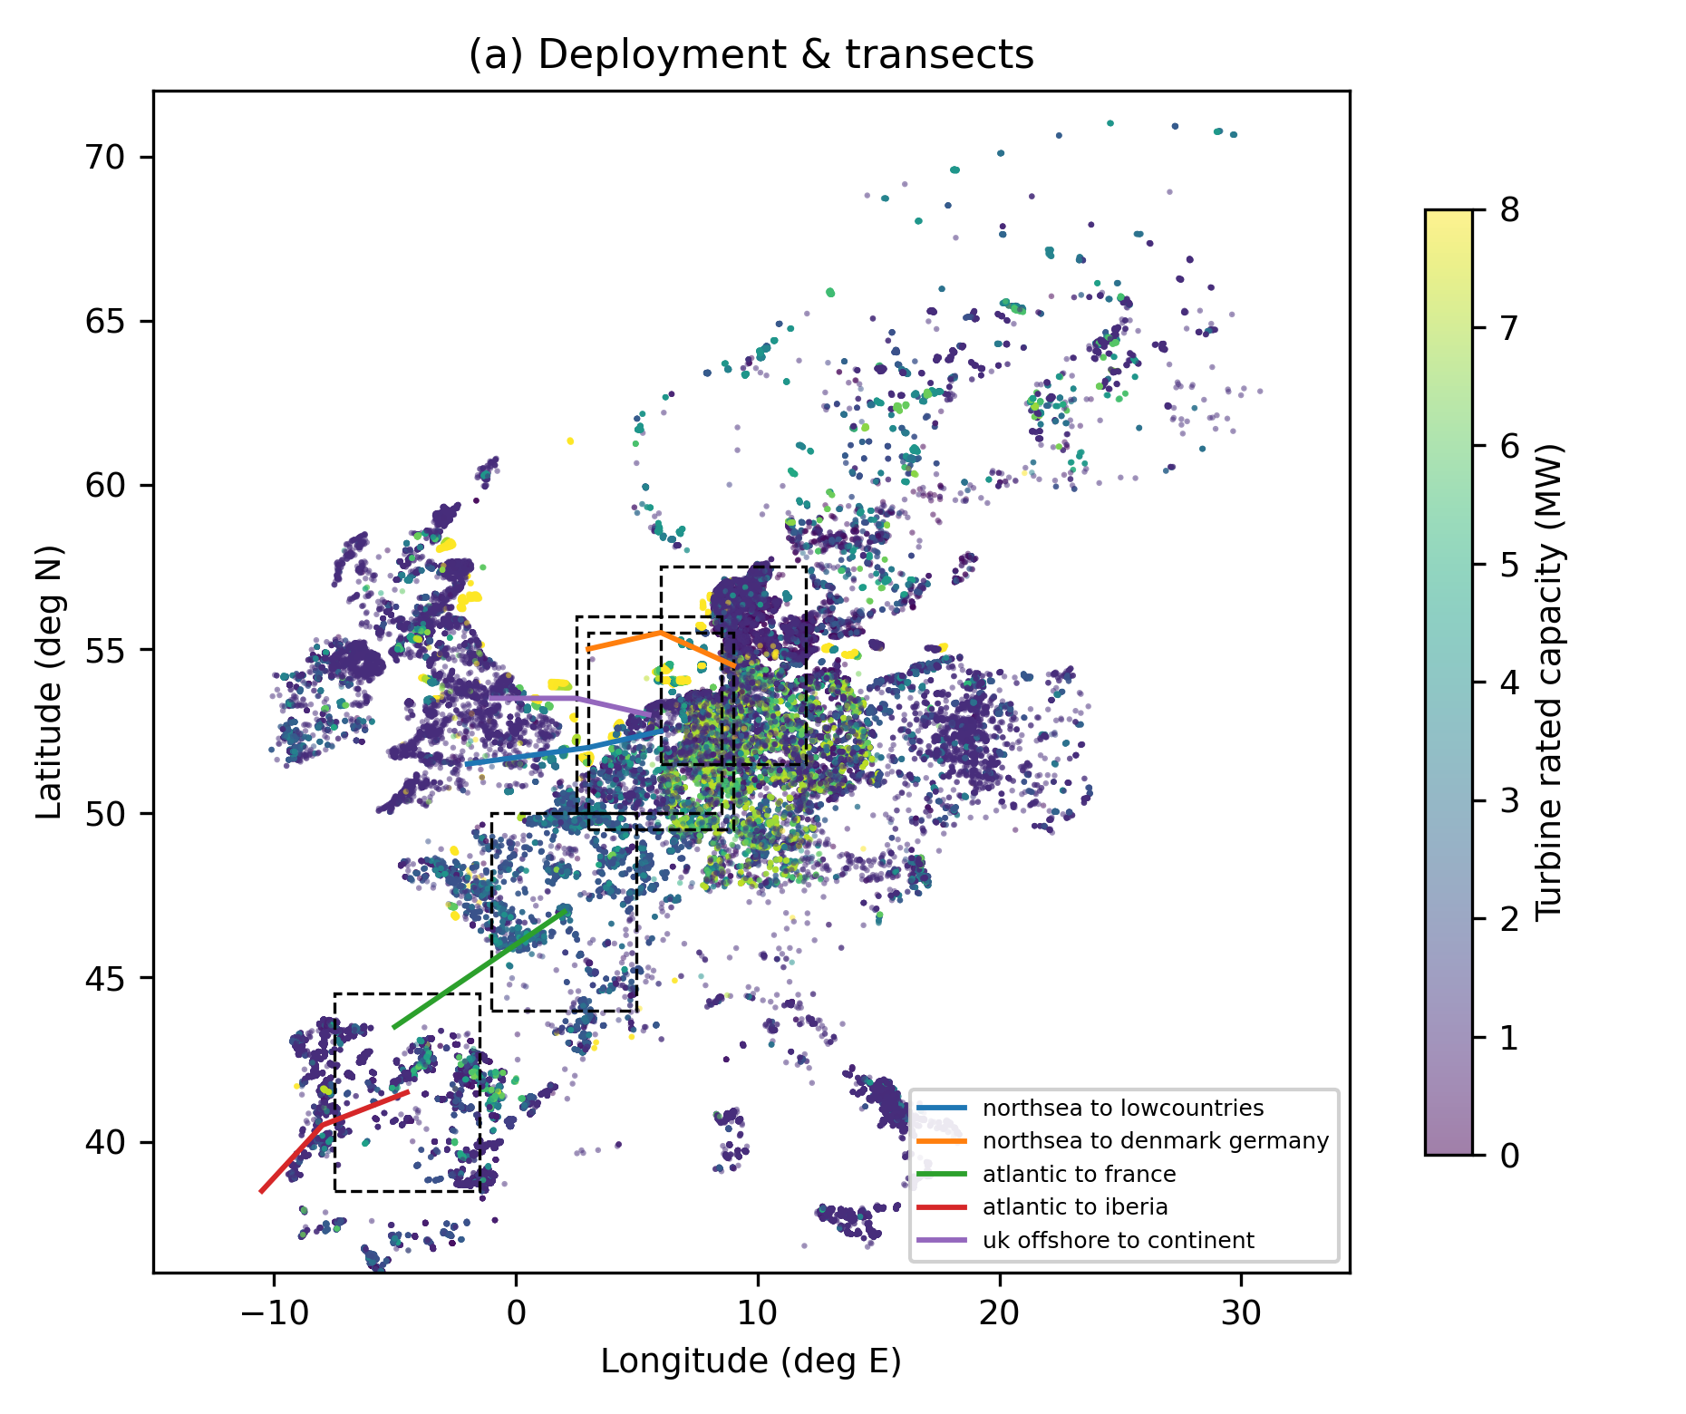
Fig.1 Deployment & transects

Slide 2
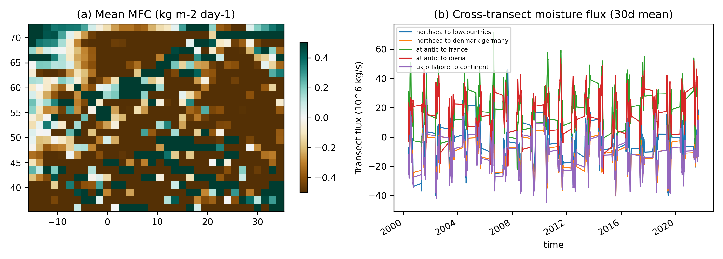
Fig.2 MFC climatology & transect fluxes

Slide 3
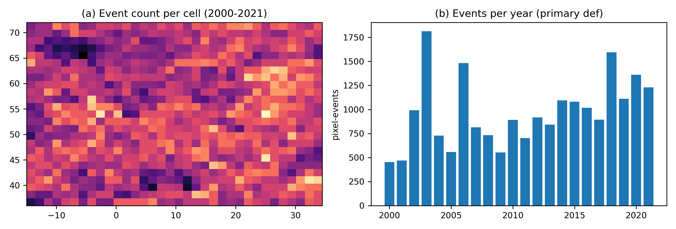
Fig.3 Heatwave climatology

Slide 4
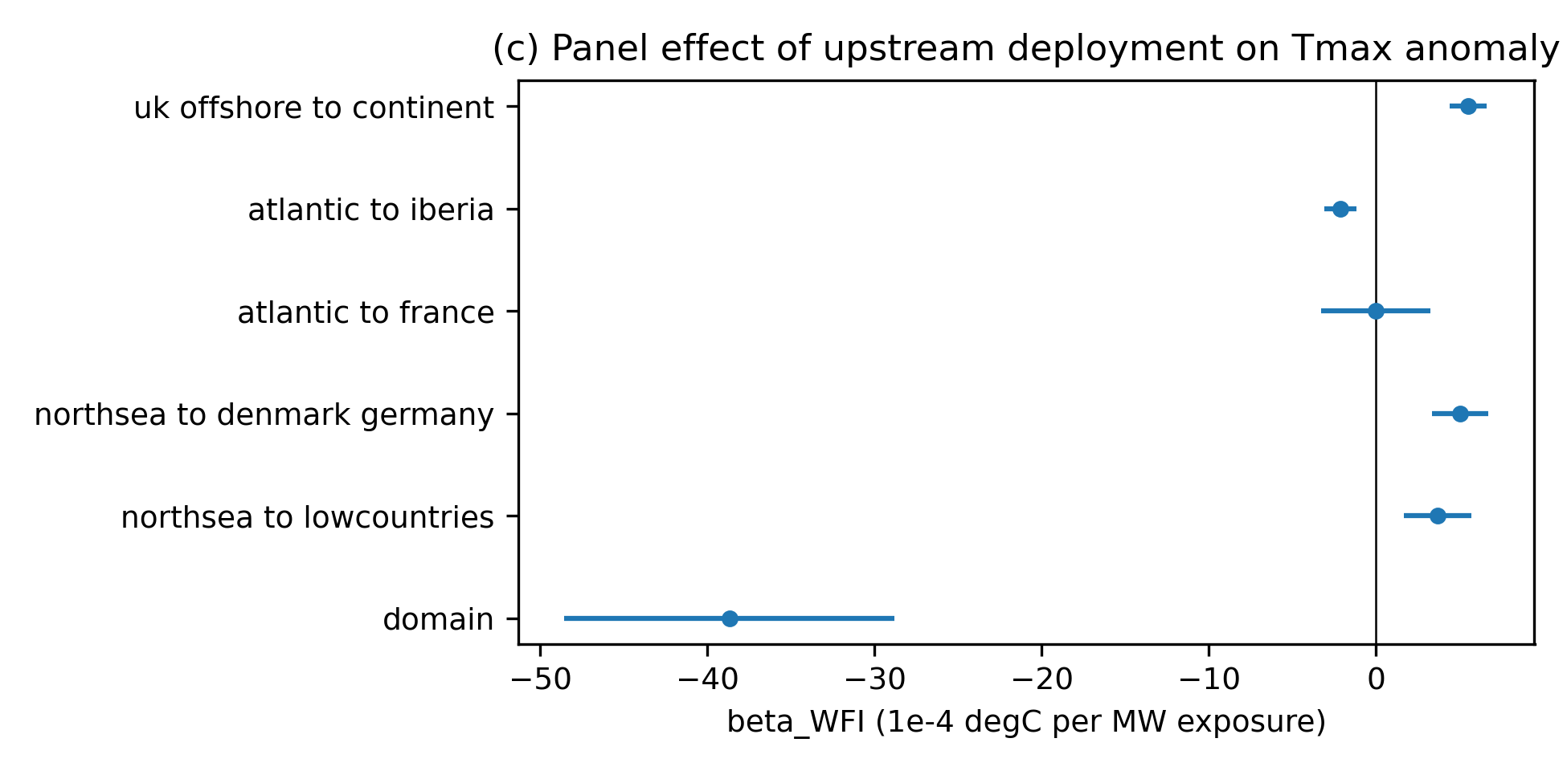
Fig.4 Regional panel coefficients

Slide 5
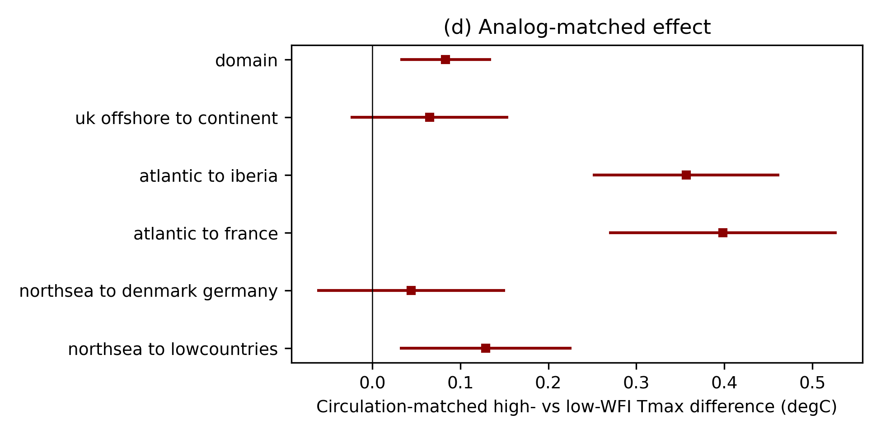
Fig.5 Analog-matched effects

Slide 6
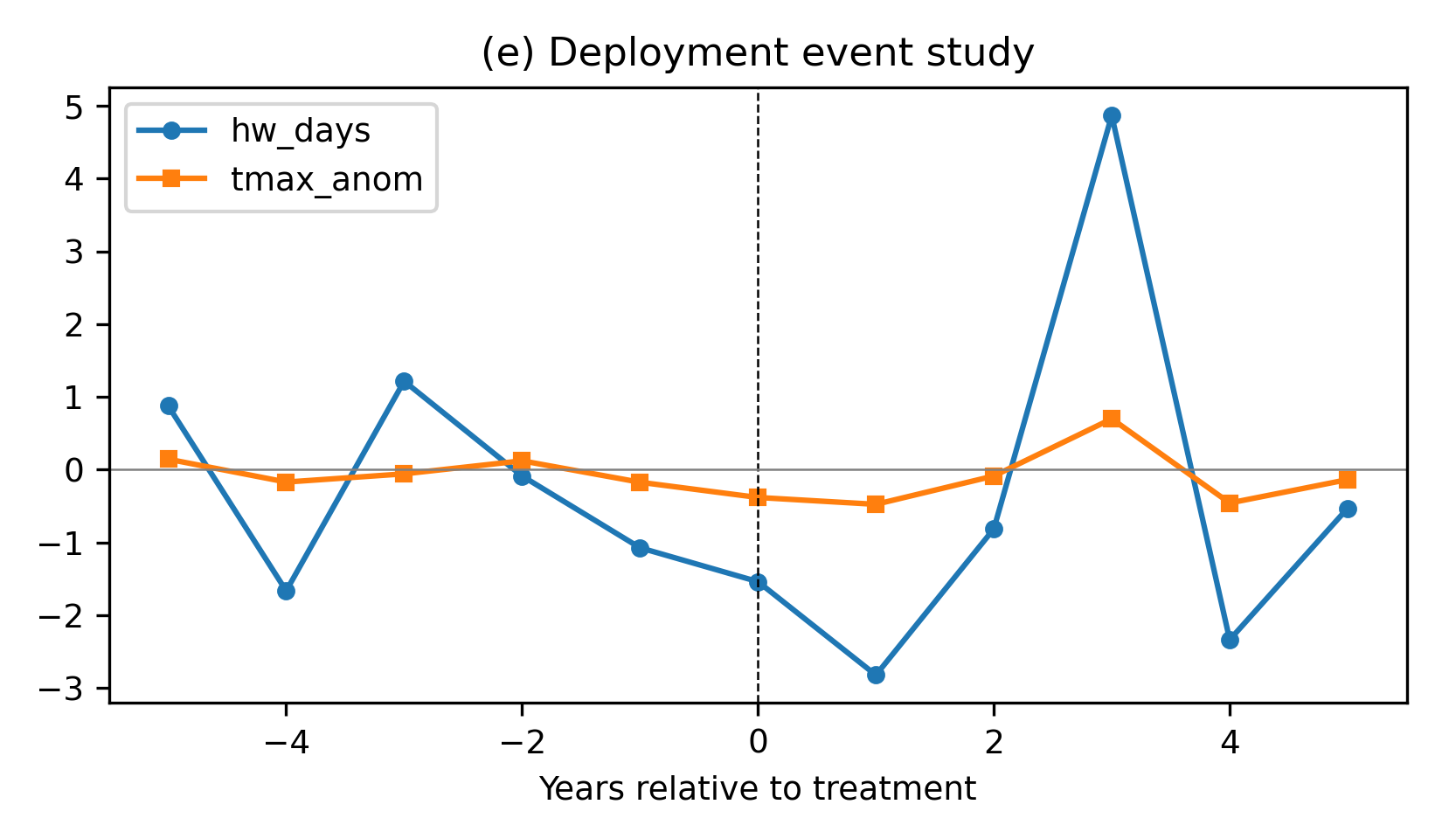
Fig.6 Deployment event study

Slide 7
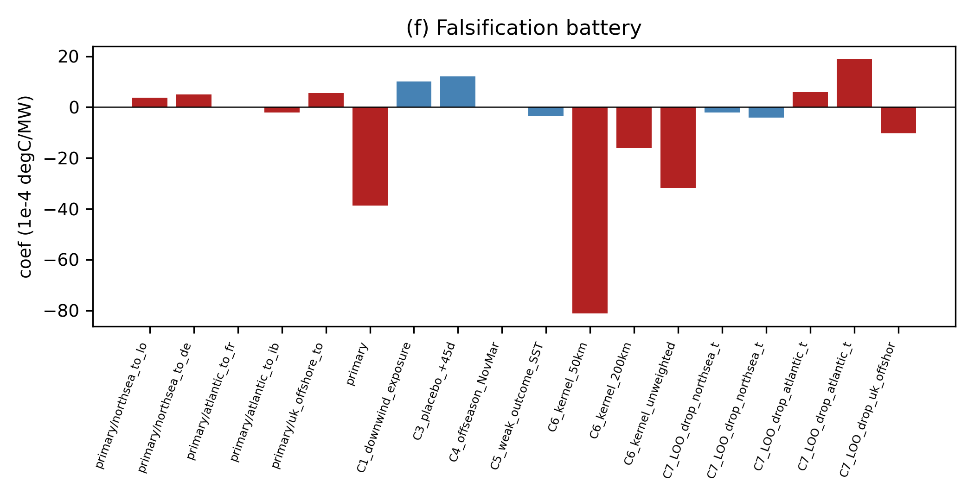
Fig.7 Falsification battery

Slide 8
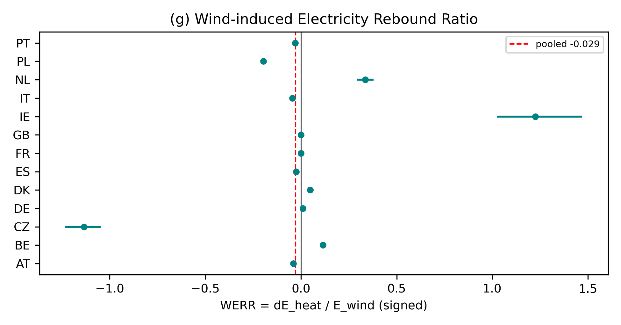
Fig.8 WERR per country

