Slide 1
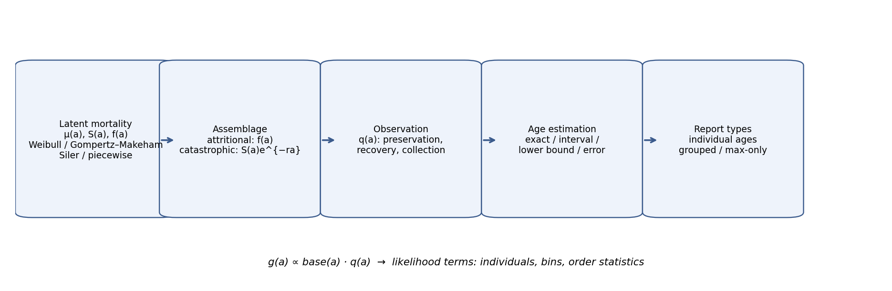
Figure 1. Generative chain: latent mortality → assemblage mechanism → observation q(a) → age estimation → report type.

Slide 2
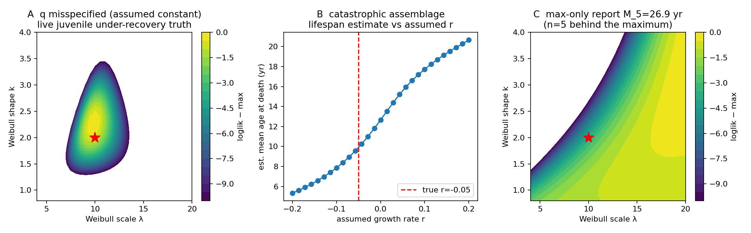
Figure 2. Identifiability exhibits: q misspecification surface; r-dependence of catastrophic estimates; max-only likelihood ridge.

Slide 3
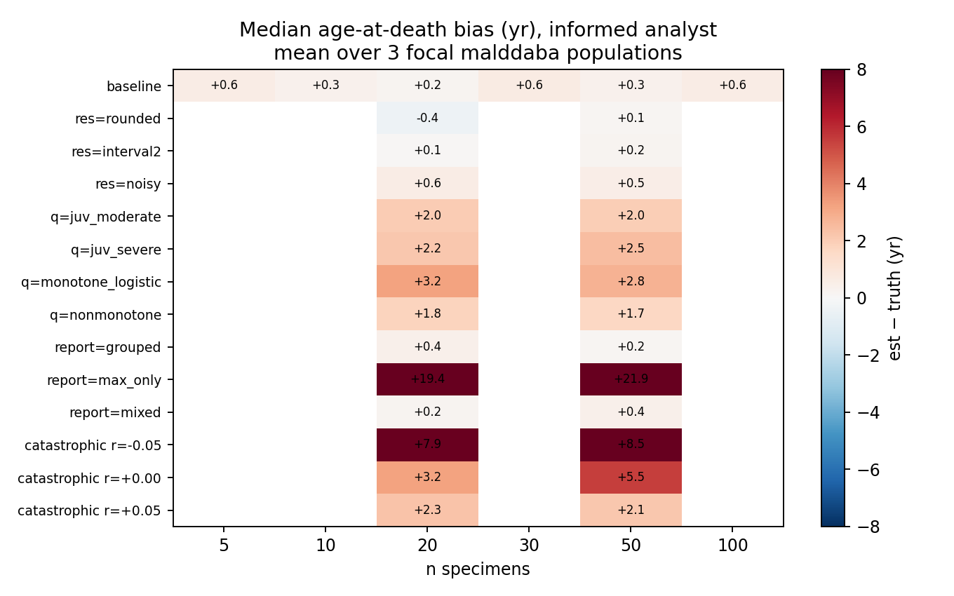
Figure 3. Recoverability map: median age-at-death bias across fossilization scenarios and sample sizes.

Slide 4
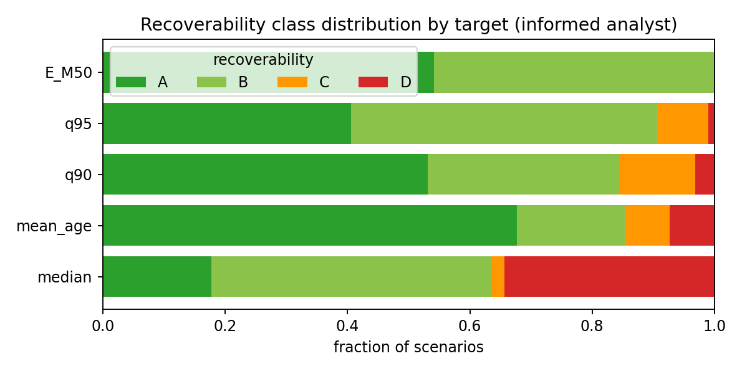
Figure 4. Recoverability class distribution (A–D) by mortality summary quantity.

Slide 5
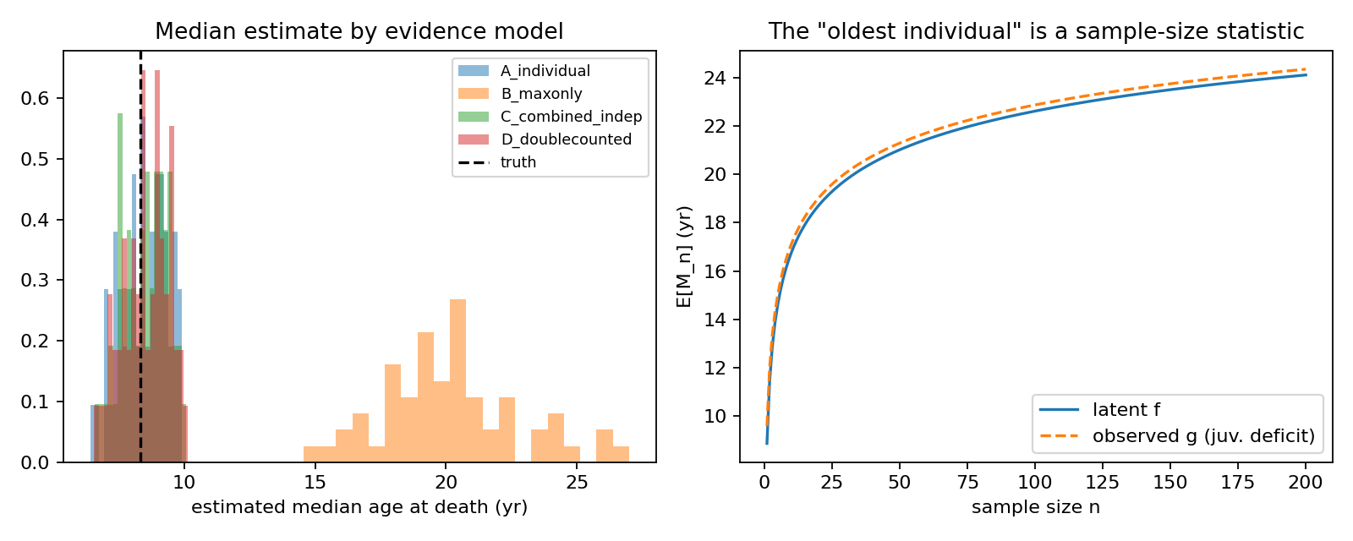
Figure 5. Evidence models for the maximum; E[M_n] under latent f vs observed g.

Slide 6
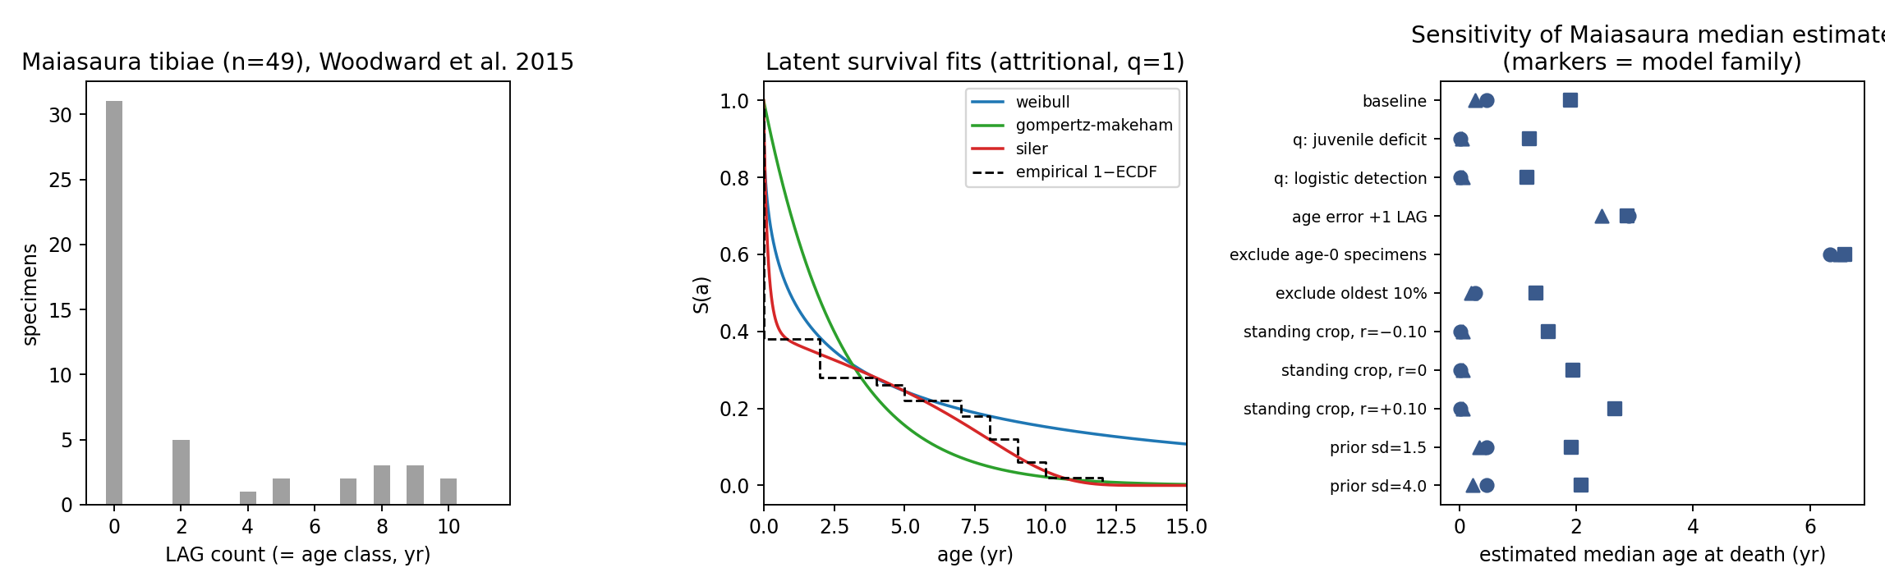
Figure 6. Maiasaura demonstration: data, survival fits, sensitivity of the median estimate.

Slide 7
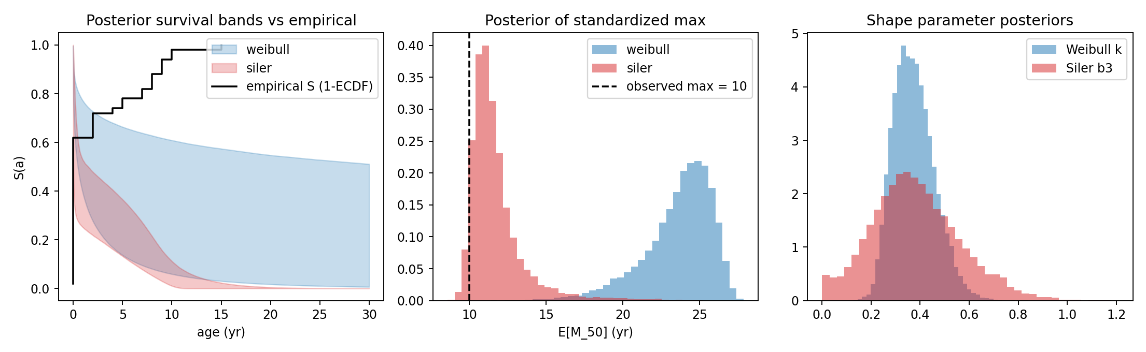
Figure 7. Bayesian posterior for Maiasaura latent mortality and standardized maximum.

